Slide 1


Slide 2


Slide 3
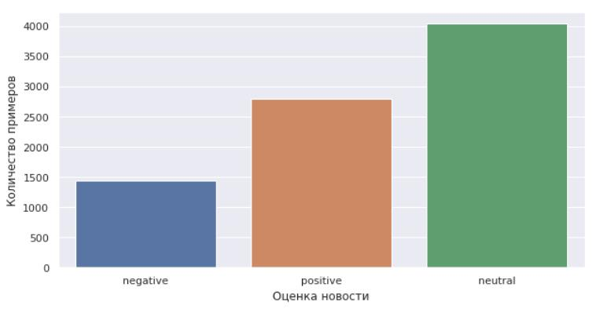

•
•
•
•

Slide 4
^{S}neu
^{S}_{neg} S_{pos}
^{S}neg
S_{pos}
^{W}_{neg} = S_{neg}/S_{pos} W_{pos} = S_{pos}/S_{neg}
F req (x)
y
x
y

Slide 5
sentiment
word
word
words
W_{pos}
word_{freq} F req_{neg}(word)
polarity
word
W_{pos}
word_{freq} F req_{pos}(word)
polarity
word
W_{neu}
neutral_{freq} F req_{neu}(word)
word_{freq}
^{neutral}freq
2
sentiment
neutral_{freq}
sentiment
^{word}_{freq}∗polarity
2
word_{freq}
word_{freq} ∗ polarity
^{W}neg
^{W}pos

Slide 6
t
d
tf(t, d) =
P^{n}
t
n_{k}
k
idf(t, D) = log
|D|
|{ d ∈D|t∈d }|
i
i
tf − idf(t, d, D) = tf(t, d) × idf(t, D)
30000
N =
news_{vector} ∈ R^{N}
news_{vector}

Slide 7
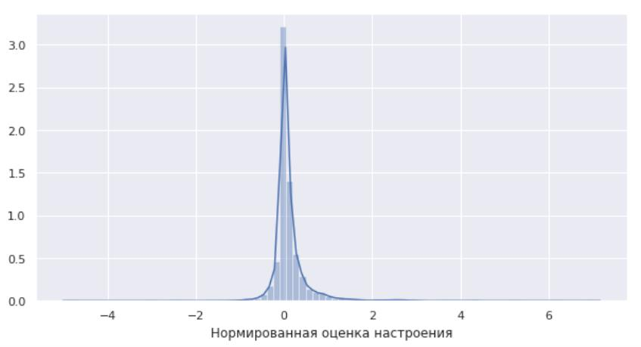
•
•

Slide 8
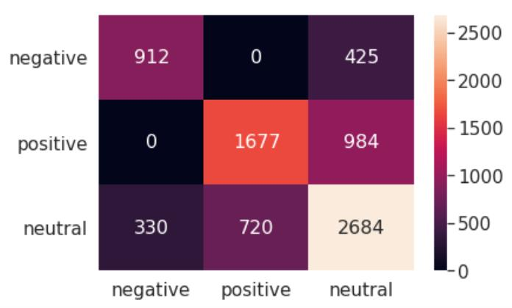

Slide 9
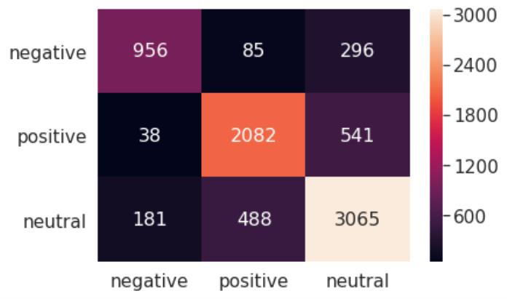

Slide 10
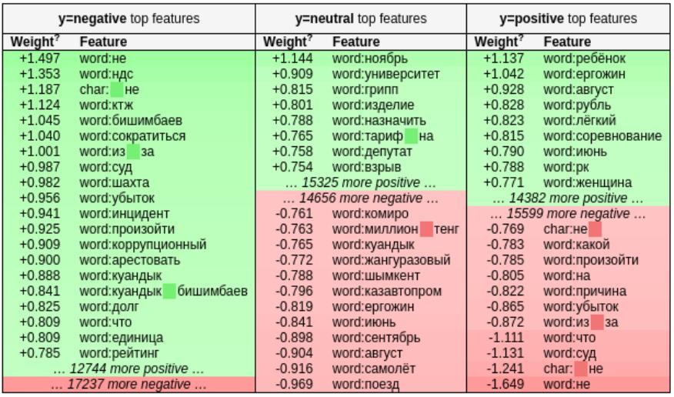

Slide 11
