Slide 1
Project #3: Threads
Operating System (CSE4070-01) Project
Fall 2022
Prof. Sungyong Park
TA: Kihyun Kim
Hamin Hwangbo

Slide 2
Contents
Process Scheduling
Threads
Synchronization
Requirements
Evaluation
Documentation
Submission

Slide 3
Notes
"Project #3: Threads" in the class matches "Project 1: Threads" in Pintos document.
You can find the information of this project in Chapter 2 of Pintos document.

Slide 4
Process Scheduling

Slide 5
Sketch of Pintos
Until project #2, we focused on the things related with user programs.
User stack and argument passing
System call handler and system calls (using file system API)
Protecting inappropriate memory access
Due to your efforts, current Pintos can run most of user programs which resides in src/examples.
However, Pintos uses simple scheduler, round-robin scheduler.
It means Pintos doesn't consider the priority of each process or thread.
Round-Robin
Scheduling
App1
PRI=31
Pintos
User Programs
System Calls
Pintos
Kernel
App2
PRI=63
QEMU
Notes:
2번 프로젝트까지는 , user stack, arg passing, system call 관련 , memory 관리 코드들을 작성하며 user program이 정상적으로 작동할 수 있도록 핀토스를 구현했습니다.
여러분들께서 2번 프로젝트까지 잘 구현을 하셧다면 핀토스는 example 디렉토리 안에 있는 user program을 작동시킬수 있을 것입니다.
그렇지만 2번 프로젝트 까지는 핀토스는 하나의 user program이 정상적으로 작동시키데 포커스를 맞추었고,
현재 핀토스 스케쥴러는 간단한 라운드 로빈 스케쥴러로만 구현이 되어있기 때문에 오른쪽 그림과 같이 서로 다른 우선순위를 갖는 프로그램 2개를 우선순위를 고려하여 처리할 수 없는 상황입니다.

Slide 6
Schedulers
We’ve learned variety of schedulers in the class.
FIFO (First In, First Out)
SJF (Shortest Job First)
STCF (Shortest Time-to-Completion First)
RR (Round-Robin)
Pintos uses round-robin scheduler as default scheduler.
Notes:
수업시간에 배우셨겠지만 ..
앞서 말씀드렸듯이 핀토스는

Slide 7
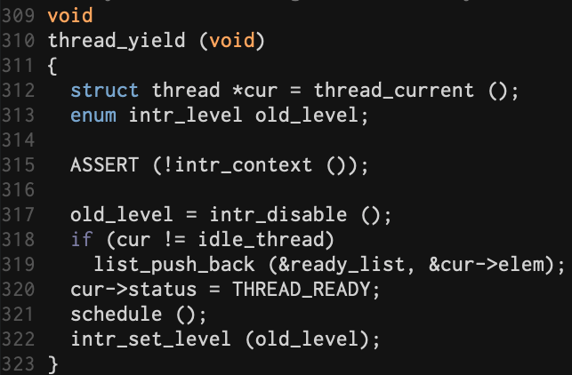
Default Scheduler in Pintos
thread_yield() push current thread at the end of the ready list and calls schedule().
Notes:
다음으로는 핀토스의 스케쥴러 관련 코드를 살펴보겠습니다.
정리하면.

Slide 8
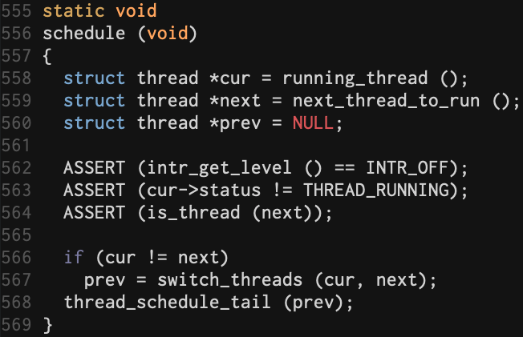
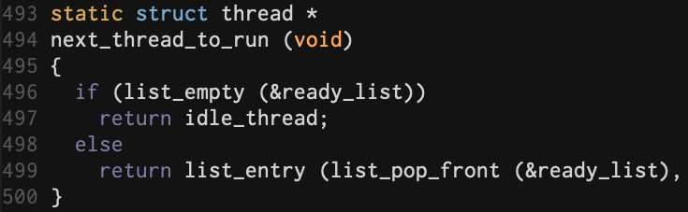
Default Scheduler in Pintos
next_thread_to_run()
pops the first thread in the ready list
schedule() calls next_thread_to_run()
to find next thread to be run &
calls switch_threads() to switch process
Notes:
다음으로는 방금 설명드린 thread yield 함수에서 호출하는 schedule 함수를 살펴보겠습니다.
Schdule 함수에서는 먼저 현재 쓰래드와, 다음에 실행될 쓰래드를 받아옵니다.
먼저 인터럽트가 정상적으로 꺼져 있는지, 현재 쓰래드 status가 running 상태가 아닌지, 다음에 수행될 쓰래드가 유효한지 확인하는 예외처리를 먼저 하게 됩니다.
그 후 switch trehads 함수 호출을 통해 실제 프로세스 스위칭 되게 됩니다.

Slide 9
Schedulers
Implement complex scheduler which considers thread's priority.
Knowledge of threads and synchronization techniques are needed to improve scheduler.
Threads are the objects of scheduling.
Synchronization such as semaphores or locks should be used in the scheduler to organize order of thread execution.
Notes:
지금까지 핀토스 스케쥴러를 간단히 코드레벨로 살펴보았는데요
이번 프로젝트에서는 기존 라운드로빈으로 구현된 핀토스의 스케쥴러를 쓰레드의 우선순위를 고려할 수 있는 조금 더 복잡한 스케쥴러를 구현하는 것입니다.
이것을 구현하기 위해 쓰래드와 sync에 대해 이해할 필요가 있습니다. 다음 슬라이드에서 부터
쓰래드와 sync관련 내용을 설명드리겠습니다.

Slide 10
Threads

Slide 11
Threads
A thread is a basic unit of CPU utilization.
It shares code, data and other resources with other threads belonging to the same process.
If a process only has one thread in it, we can consider this thread as a process.
code
data
files
code
data
files
registers
stack
registers
registers
registers
stack
stack
stack
Single-threaded process
Multithreaded process

Slide 12
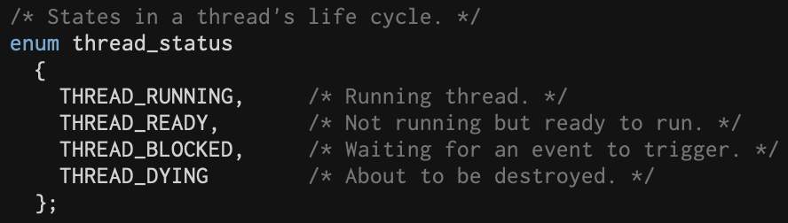
Thread Status
A thread can have one of four status.
Creation
READY
RUNNING
DYING
BLOCKED

Slide 13
Thread Switching
thread_block()
thread_exit()
thread_yield()
THREAD_BLOCKED
THREAD_DYING
THREAD_READY
schedule()
Find the next thread to be run
Change registers and stack pointer between current thread and next thread
switch_threads()
Free pages if the thread which has been switched from is dead
thread_schedule_tail()

Slide 14
Synchronization

Slide 15
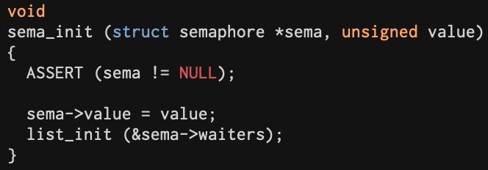
Semaphores
A semaphore is a nonnegative integer with down and up operators.
When sema_down() is called, if the value of semaphore is 0, the thread that calls sema_down() is blocked.
sema_up() wakes up one of blocked threads.
※ threads/synch.c

Slide 16
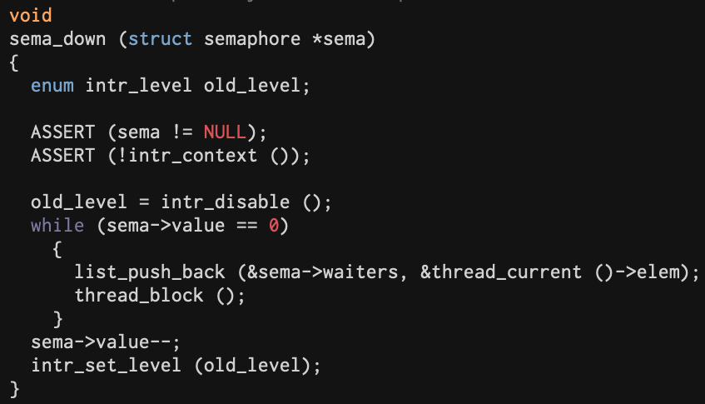
Semaphores
A semaphore is a nonnegative integer with down and up operators.
When sema_down() is called, if the value of semaphore is 0, the thread that calls sema_down() is blocked.
sema_up() wakes up one of blocked threads.
※ threads/synch.c

Slide 17
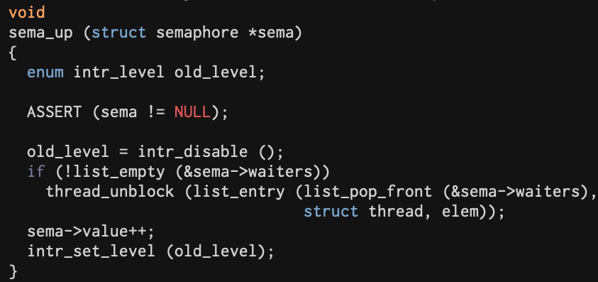
Semaphores
A semaphore is a nonnegative integer with down and up operators.
When sema_down() is called, if the value of semaphore is 0, the thread that calls sema_down() is blocked.
sema_up() wakes up one of blocked threads.
※ threads/synch.c

Slide 18
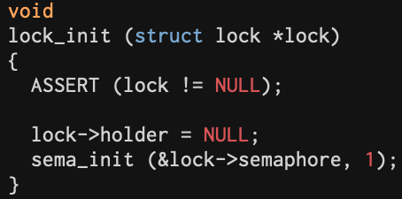
Locks
Lock is a specialization of a semaphore with an initial value of 1.
It also has two operators, acquire (equivalent of down in semaphore) and release (equivalent of up)
※ threads/synch.c

Slide 19
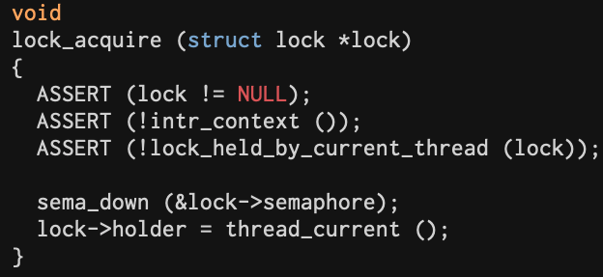
Locks
Lock is a specialization of a semaphore with an initial value of 1.
It also has two operators, acquire (equivalent of down in semaphore) and release (equivalent of up)
※ threads/synch.c

Slide 20
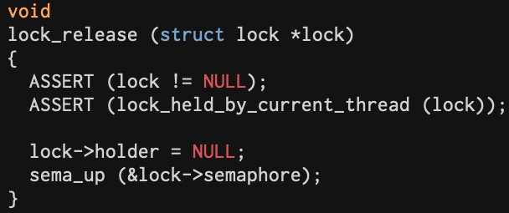
Locks
Lock is a specialization of a semaphore with an initial value of 1.
It also has two operators, acquire (equivalent of down in semaphore) and release (equivalent of up)
※ threads/synch.c

Slide 21
Requirements

Slide 22
Requirements
Alarm Clock
Priority Scheduling
Advanced Scheduler (BSD Scheduler) → Additional

Slide 23
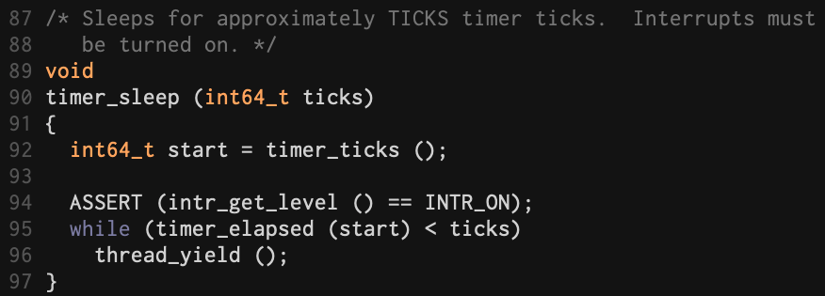
Alarm Clock
timer_sleep() is used to let the thread fall asleep.
Though it calls thread_yield() immediately when the timer is not expired, it's not efficient since the thread iterates between RUNNING state and READY state.
Thus, we will modify this to avoid inefficiency.
Ticks는 언제까지 타이머를 재울것인지
← Get current time
← Yield CPU until the "ticks" has gone by

Slide 24
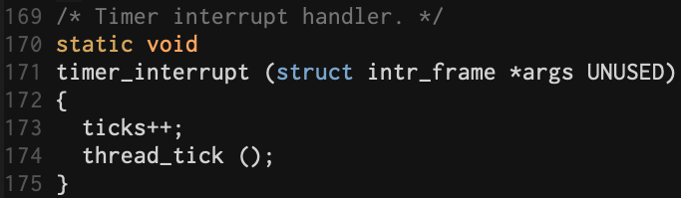
Alarm Clock
How to avoid inefficiency?
After checking that "ticks" has gone by, if not, block the thread (BLOCKED state).
To manage these threads, create a new queue to store it.
When the thread is inserted into the queue, wake up time should be saved as well.
When time is up, wake up the thread and insert it into ready queue (ready_list).
How can you check that the time is up after the thread is blocked?
timer_interrupt() is called every tick.
Find the threads that need to be woken up in this function.
If it is the case, insert it into ready queue.
매 시간마다 timer_interrupt가 실행
즉 시간이 얼마나 지났는지 알 수 있음.

Slide 25
Priority Scheduling
Until now, Pintos performs round-robin scheduling for threads.
When thread_yield() or thread_unblock() is called, the current thread or unblocked thread are inserted at the end of the ready list regardless of its priority.

Slide 26
Priority Scheduling
In this project, we are to implement complex scheduler which considers priority of the threads.
If there comes new thread that has higher priority than the current thread, the current thread should immediately yield the CPU to new thread.
CPU
PRI
63
PRI
31
PRI
61
PRI
31
PRI
31
PRI
23
PRI
13
Ready List
Priority Scheduler

Slide 27
Priority Scheduling
In this project, we are to implement complex scheduler which considers priority of the threads.
If there comes new thread that has higher priority than the current thread, the current thread should immediately yield the CPU to new thread.
CPU
PRI
31
PRI
63
PRI
61
PRI
31
PRI
31
PRI
23
PRI
13
Ready List
Priority Scheduler

Slide 28
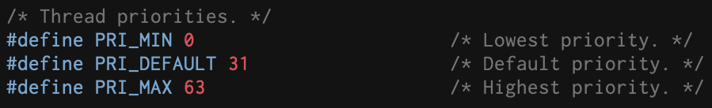
Priority Scheduling
Thread priorities range from PRI_MIN (0) to PRI_MAX (63).
Default priority value is PRI_DEFAULT (31).
Lower numbers correspond to lower priorities, so that priority 0 is the lowest and 63 is the highest.
The initial thread priority is passed as an argument to thread_create ().

Slide 29

Priority Scheduling
Thread priorities range from PRI_MIN (0) to PRI_MAX (63).
Default priority value is PRI_DEFAULT (31).
Lower numbers correspond to lower priorities, so that priority 0 is the lowest and 63 is the highest.
The initial thread priority is passed as an argument to thread_create ().

Slide 30
Priority Scheduling - Aging
Default priority scheduling invokes starvation of processes which have low priority.
Thus, we need aging technique that increases the priority in proportion to the time passed after the process resides in ready list.
Before implementing aging technique, modify the codes as in the next page.
The codes indicate that aging technique is used only when Pintos kernel gets '-aging' option and sets aging flag to TRUE.

Slide 31
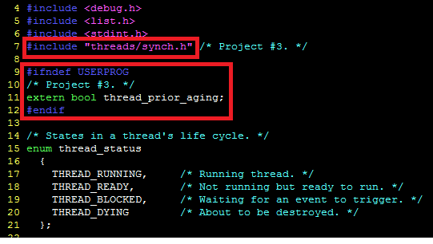
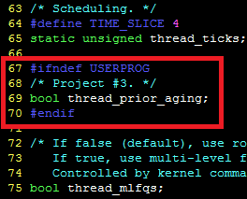
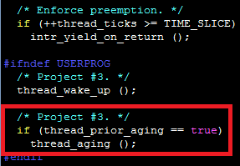
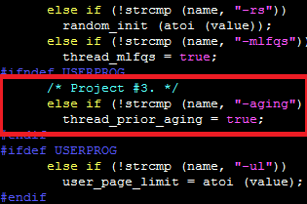
Priority Scheduling - Aging
src/threads/thread.h
src/threads/init.c
src/threads/thread.c

Slide 32
Priority Scheduling - Aging
Replace tests to existing tests directory
Extract threads_tests.tar and overwrite extracted directory to src/tests/threads
How to implement aging
Check that thread_prior_aging is TRUE
If it is TRUE, increase the priority proportional to the time spent as the tick is increased.

Slide 33
Advanced Scheduler - BSD Scheduler
This is additional implementation of this project.
You can find the information about this in Appendix B. 4.4 BSD Scheduler.

Slide 34
Advanced Scheduler - BSD Scheduler
BSD scheduler is general purpose scheduler.
Multi-Level Feedback Queue (MLFQ) or Multi-Level Ready Queue (MLRQ) is generally used in general purpose scheduler.
Each priority has its own ready queue.
When schedule() is invoked, thread is selected from the highest priority queue.
Ready queue of each priority follows round robin policy.
In this project, you can use MLFQs of 64 queues or MLFQ of 1 queue.
MLFQs of 64 queues will be covered in this slide.

Slide 35
Advanced Scheduler - BSD Scheduler
Select the thread in the highest ready queue
PRI
63
PRI
63
PRI
62
...
CPU
MLFQ
PRI
31
PRI
31
PRI
31
...
PRI
0
Round Robin

Slide 36
Advanced Scheduler - Niceness
Each thread in Pintos has nice value in the range from -20 to 20.
Positive nice value lower the priority so that other threads can occupy CPU.
nice value 0 doesn't affect the priority.
Initial nice value of the thread
If the thread is created initially, set nice value to 0.
If not, the thread starts with a nice value inherited from their parent thread.
Functions to implement
int thread_get_nice (void)
Returns the current thread’s nice value
void thread_set_nice (int new_nice)
Set the current thread’s nice value to new_nice
Recalculates the thread’s priority based on the new value
If the running thread no longer has the highest priority, yields

Slide 37
Advanced Scheduler - Calculating Priority
Scheduler has priorities of 64 level.
Maximum priority: 63 (PRI_MAX)
Minimum priority: 0 (PRI_MIN)
64 ready queues are generally used, but you can use only 1 ready queue.
Calculating Priority
Initial priority is decided in thread_create()
Every 4 tick, priorities of all thread in the system are recalculated.
Formula for calculating priority
priority = PRI_MAX – (recent_cpu / 4) - (nice * 2)
recent_cpu : Estimate of the CPU time the thread has used recently
nice: nice value of the thread
Based on the formula of BSD scheduler, the thread that had much CPU time will get lower priority in the next scheduling.

Slide 38
Advanced Scheduler - Calculating recent_cpu
recent_cpu
It estimates CPU time of the thread.
More recent CPU time should be weighted more heavily than less recent CPU time.
Initial recent_cpu value of the thread:
If it is created first, the value is 0.
If not, inherits value of the parent thread.
Whenever time interrupt is invoked, recent_cpu value of the thread in RUNNING state is increased by 1. (Except for idle thread)
recent_cpu value of all thread (RUNNING, READY and BLOCKED) is recalculated every second.
recent_cpu = (2 * load_avg) / (2 * load_avg + 1 ) * recent_cpu + nice
load_avg : average of the number of thread in READY state
Functions to Implement
Int thread_get_recent_cpu (void)
Returns 100 times the current thread’s recent_cpu value
Rounded up to the nearest integer.

Slide 39
Advanced Scheduler - Calculating load_avg
load_avg
System-wide value
Initialized to 0 when system is booted.
load_avg value is updated every second.
load_avg = (59/60) * load_avg + (1/60) * ready_threads
ready_threads : number of thread in READY or RUNNING state (Except for idle thread)
Functions to Implement
thread_get_load_avg (void)
Returns 100 times the current system load average,
Rounded to the nearest integer.

Slide 40
Advanced Scheduler - Summary
Thread can manage nice value in range from -20 to 20.
Range of priority: 0 (PRI_MIN) - 63 (PRI_MAX)
Priority
Recalculate priority in every 4 ticks (same as TIME_SLICE)
priority = PRI_MAX – (recent_cpu / 4) - (nice * 2)
recent_cpu
recent_cpu indicates recent CPU time of the thread.
recent_cpu value of the thread in RUNNING state is increased by 1 in every tick.
recent_cpu value of all thread is updated in every second (1sec = TIMER_FREQ)
recent_cpu = (2 * load_avg) / (2 * load_avg + 1 ) * recent_cpu + nice
load_avg
Estimate the average of number of thread in READY state.
Initialized to 0 when it is booted.
load_avg value is updated in every second.
load_avg = (59/60) * load_avg + (1/60) * ready_threads

Slide 41
Advanced Scheduler - Fixed-Point Real Arithmetic
Pintos kernel doesn't support floating-point arithmetic.
But in BSD scheduler, real numbers such as recent_cpu and load_avg are used.
Fixed-point format is used instead of floating-point arithmetic.
p.q format: p is integer and q is fraction
For 32-bit, 1 bit for sign, 17 bits for integer (p) and 14 bits for fraction (q)
Example of fixed-point number
12.50 -> 1*2^3 + 1*2^2 + 1*2^(-1)
32 bit (4 Byte)
0 0 0 0 0 0 0 0 0 0 0 0 0 0 1 1 0 0 . 1 0 0 0 0 0 0 0 0 0 0 0 0 0
1bit(sign)
17 (p)bit
14 (q)bit

Slide 42
Evaluation
13 tests will be graded. (Refer to the test case list in the next slide)
Total score is 100 which consists of 80 for test cases and 20 for documentation.
Refer to src/tests/threads/Grading src/tests/threads/Rubric.alarm src/tests/threads/Rubric.priority to check the points of each test.

Slide 43
Evaluation
Alarm
No. | Test Case | Point
1 | alarm-single | 4
2 | alarm-multiple | 4
3 | alarm-simultaneous | 4
4 | alarm-priority | 4
5 | alarm-zero | 1
6 | alarm-negative | 1
Total |  | 18
Priority
No. | Test Case | Point
1 | priority-change | 3
2 | priority-change2 | 3
3 | priority-fifo | 3
4 | priority-preempt | 3
5 | priority-sema | 3
6 | priority-aging | 3
7 | priority-lifo | 3
Total |  | 21

Slide 44
Evaluation
priority-lifo can't be checked by 'make check'
Run the following command:
pintos -v -- -q run priority-lifo
Analyze the code and the result of priority-lifo test in the document.

Slide 45
Evaluation
Additional Requirement
5% additional point for BSD Scheduler implementation
Describe where and how you implemented the BSD scheduler in the documentation.
Tests related with mlfqs will pass when implementing BSD Scheduler.
No. | Test Case | Point
1 | mlfqs-load-1 | 5
2 | mlfqs-load-60 | 5
3 | mlfqs-load-avg | 3
4 | mlfqs-recent-1 | 5
5 | mlfqs-fair-2 | 5
6 | mlfqs-fair-20 | 3
7 | mlfqs-nice-2 | 4
8 | mlfqs-nice-10 | 2
9 | mlfqs-block | 5
Total |  | 37

Slide 46
Documentation
Use the document file uploaded on e-class
Documentation accounts for 20% of total score. (Development 80%, Documentation 20%)

Slide 47
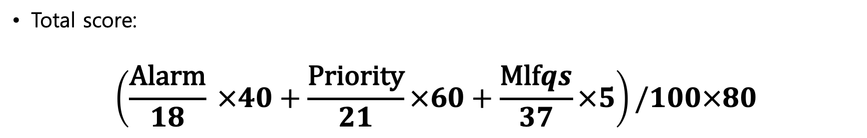
Evaluation
Total score:
$$\left(\frac{\text{Alarm}}{18} ×40+\frac{\text{Priority}}{21}×60+\frac{\text{Mlf}qs}{37}×5\right)/100×80$$

Slide 48
Submission
Make 'ID' directory and copy 'src' directory in the pintos directory and the document file ([ID].docx).
Compress 'ID' directory to 'os_prj3_[ID].tar.gz'.
We provide the script 'submit.sh' to make tar.gz file which contains 'src' directory and document file. 학생들의 편의를 위해 pintos 디렉토리 내 submit.sh 스크립트를 제공합니다. 이 스크립트는 src 디렉토리와 document file을 포함한 tar.gz 파일을 생성합니다.
Disclaimer
Any result produced from the 'submit.sh' script is at your own risk.
You must check the contents of the tar.gz file before submission.
'submit.sh' 스크립트로 생성된 결과의 모든 책임은 사용자에게 귀속됩니다.
제출하기 전, tar.gz 파일의 내용물을 반드시 다시 한 번 체크하기 바랍니다.

Slide 49
Submission
Notice – ‘submit.sh’
The ‘submit.sh’ script should be executed on a directory where ‘src’ folder is located.
submit.sh 스크립트는 src 폴더가 위치한 디렉토리에서 실행되어야 합니다.
‘ID’ folder should not be in the directory.
해당 디렉토리에 ‘학번’ 폴더가 없어야 합니다.
‘ID.docx’ file should be located in the directory.
Also, report file with extensions other than ‘docx’ will not be compressed.
해당 디렉토리에 ‘학번.docx’ 파일이 있어야 함께 압축됩니다.
또한 ‘docx’ 이외의 확장자를 가진 보고서 파일은 압축되지 않습니다.
Be sure to backup your code in case of an unexpected situation.
만일의 경우를 대비해 반드시 코드를 백업하여 주세요.

Slide 50
Submission
It is a personal project.
Due date : 2022. 11. 12 23:59
Submission
The form of submission file is as follows:
No hardcopy.
Copy will get a penalty (1st time: 0 Point and downgrading, 2nd time: F grade)
Name of compressed file | Example (ID: 20189999)
os_prj3_[ID].tar.gz | os_prj3_20189999.tar.gz

Slide 51
Submission
Contents
Pintos source codes (Only 'src' directory in pintos directory) 최소한의 용량을 위해 src 디렉토리만 압축파일에 포함합니다.
Document: [ID].docx (e.g. 20189999.docx; Other format is not allowed such as .hwp)
How to submit
Make tar.gz file.
Copy the document file ([ID].docx) to pintos directory.
Execute submit.sh script in the pintos directory and follow the instructions of the script. pintos 디렉토리 내의 submit.sh 스크립트를 실행하고 스크립트의 지시를 따르십시오.
Check that os_prj3_[ID].tar.gz is created.
Decompress os_prj3_[ID].tar.gz and check the contents in it. ($ tar -zxf os_prj3_[ID].tar.gz) (Only [ID].docx and src directory should be contained in the tar.gz file.)
For example, if your ID is 20189999, os_prj3_20189999.tar.gz should be created. To decompress the tar.gz file, execute tar -zxf os_prj3_20189999.tar.gz
Please check the contents of tar.gz file after creating it.
Upload the os_prj3_[ID].tar.gz file to e-class.

