Slide 1
Embedded Operating
System

Slide 2
Agenda
File Management
Directory
Links
File System Architecture
File IO syscalls
Disk allocation & Free space management
Linux Ext2/3 FileSystems
Journaling
Disk scheduling algorithms
Reading
Galvin slides (File System & IO subsystem)
Professional Linux Kernel Architecture (Virtual File System, Extended File System)
Beginning Linux Programming (File SysCalls Programming)

Slide 3
File Management
File = Data + Metadata
Data --> Data blocks
Metadata --> Inode (FCB)
File System = Boot block + Super block + Inode list + Data blocks
Types of Files
User perspective
Text files
Archive files
Media files
Document files
Executable files
etc.

Slide 4
Kernel perspective
Regular files (-) (All user perspective file are regular file)
Special files
Directory files (d)
Link files (l)
Pipe files (p)
Socket files (s)
Device files
Char device files (c)
Block device files (b)

Slide 5
Directory
From end user perspective, directory is a container which contains sub-directories and files.
However, OS treats directory as a special file.
The directory file contains one entry for each subdirectory or file in it.
Each directory entry contains i-node number and name of sub-dir / file.
terminal> ls -a -i -1 /home/sunbeam.
Directory Listing
terminal> ls dirpath
Directory access library functions (man section 3)
opendir()
readdir()
closedir()

Slide 6
opendir()
Open the directory file for reading.
DIR *dp = opendir("dir-path");
arg1: dir path to be opened
returns: DIR pointer if dir opened successfully, otherwise NULL
closedir()
Close the directory file.
closedir(dp);
arg1: DIR pointer.

Slide 7
readdir()
Read the next dirent from the directory file.
struct dirent *ent = readdir(dp);
arg1: DIR pointer.
returns: Pointer to struct dirent, if next entry is available.
Returns NULL if end of dir file is reached.
struct dirent
d_name --> name of file or sub-directory.
d_ino --> inode number of file or sub-directory

Slide 8
Symbolic Link
A symbolic link, also known as a symlink or soft link, is a special type of file that points to another file or directory.
terminal> ln -s /path/of/target/file linkpath
Internally use
symlink() syscall.
man symlink
int symlink(const char *target_path, const char *link_path)
symlink()
syscall A new link file is created (new inode and new data block is allocated), which contains info about the target file (absolute or relative path).
Link count is not incremented.
If target file is deleted, the link becomes useless.
Can create symlinks for directories also

Slide 9
Hard Link
A hard link to a file points to the inode of the file instead of pointing to the file itself.
This way the hard link gets all the attributes of the original file and points to the same data block as the original file.
terminal> ln targetfilepath
Internally use link() syscall.
man link
int link(const char *target_path, const char *link_path);
link() syscall
A new directory entry is created, which has a new name and same inode number.
No new file (inode and data blocks) is created.
Link count in the inode of the file is incremented.
If directory entry of target file is deleted (rm command), file can be still accessed by link directory entry.
Cannot create hard link for directories, because it may lead to infinite recursion (while traversing directories recursively e.g. ls -R)

Slide 10
rm command
The 'rm' means remove.
This command is used to remove a file.
The rm command in Linux, internally calls unlink() system call.
int unlink(const char *filepath);
unlink() syscall
It deletes directory entry of the file.
It decrements link count in the inode by 1.
If link count = 0, the inode is considered to be deleted/free (updated into super-block).
It can be reused for any new file.
When inode is marked free, data blocks are also made free, so that they can also be reused for some new file

Slide 11
Directory
Directory permissions/mode
r -- can read from dir data block -- list directory contents.
w -- can write into dir data block -- create new files & sub-directories, remove file/sub-directory, rename file.
x -- enable browsing the directory -- "cd" command

Slide 12
File System Architecture
Virtual File System:
This layer redirect file system request to the appropriate file system manager.
File system manager:
File system manager enables access to repective file system on the disk.
OS can see all partitions whose file system managers are installed in that OS.
IO subsystem:
Implement buffer cache and other mechanisms to speed up disk IO.

Slide 13
Windows vs Linux
Linux have FS mgrs for ext3/4, reiserfs, xfs, fat, ntfs, cdfs, etc.
Hence Linux support many FS.
Windows have FS mgrs for FAT, NTFS, CDFS.
Hence Windows do not support Linux FS.
However, third-party FS managers can be added into Windows to support Linux FS e.g. ext2fsd.

Slide 14
VFS Structures
struct inode unsigned long i_ino; // inode number
loff_t i_size; // file size unsigned
int i_nlink; // number of hard links
umode_t i_mode; // file mode (permissions)
atomic_t i_count; // reference count
struct list_head i_list; // inode cache
Device driver related
struct list_head i_devices;
dev_t i_rdev;
union {
struct pipe_inode_info *i_pipe;
struct block_device *i_bdev;
struct cdev *i_cdev;
};
struct file_operations *i_fop;

Slide 15
Buffer Cache
Buffer cache is used to speed up disk IO. Each buffer is a memory area and have a buffer header associated with it.
This buffer header maintains metadata about the buffer i.e. disk block number, dirty flag, pointer to buffer, etc.
Buffer cache is a doubly circular linked list of buffer headers.
Whenever a disk block is read into a buffer, its dirty flag is set to false.
It indicates that data in the buffer is same as data on disk. When write operation is done on the buffer its dirty flag is set to true.
Then the buffer is scheduled for the write operation (in disk request queue -- which in turn scheduled as per disk scheduling algorithm).
For read operation from the disk, an empty buffer is allocated in the buffer cache (for intended disk block).
Then read request is scheduled (in disk request queue -- which in turn scheduled as per disk scheduling algorithm).
If requested buffer (for read) is already present in buffer cache (non-dirty), then disk read operation is skipped -- to speed-up disk IO

Slide 16
File IO syscalls
open() syscall
fd = open("/home/kiran/abc.txt", O_RDONLY);
step 1. Convert given file path into its inode number. This is called as path name translation and is done by a kernel ine file from the disk into inode table in memory.
step 2.Inodes of all recently accessed files are kept in inode table.
step 3. A file position is initialized to 0 and is stored in the open file table. It also stores mode in which file is opened and pointer to the in-memory inode. Infomation of all files opened in the system, is maintained in this table.
step 4. Each process is associated with a open file descriptor table. It keeps info of all files opened by that process. This entry stores pointer to the Open FileTable entry.
step 5. Finally index to file desc table entry is returned, which is called as "file descriptor". All further read(), write(), lseek(), close() operations will be using this file desc.

Slide 17
struct file
unsigned int f_flags; // open() arg2
loff_t f_pos; // current file position
struct path f_path; // pointer to dentry
#define f_dentry f_path.dentry
struct list_head fu_list; // open file table
atomic_t f_count; // reference count
Device driver related
struct file_operations *f_op;

Slide 18
struct dentry
struct qstr d_name; // name of file/sub-directory
struct inode *d_inode; // pointer to the inode
struct list_head d_lru; // dentry cache
atomic_t d_count; // reference count
struct fs_struct
struct dentry * root; // stores "root directory" of the process --> used for absolute path
struct dentry * pwd; // stores "current directory" of the process --> used for relative path
int umask; // user file mode mask -- while creating new file this mask is used.

Slide 19
struct files_struct
struct file * fd_array[NR_OPEN_DEFAULT];
struct task_struct
struct fs_struct *fs; // current & root directory
struct files_struct *files; // open file desc tables

Slide 20
Linux open() system call
dentry cache
Directory entries are in data blocks of directory file (on hard disk).
Accessing same dentry repeatedly from disk is slower process.
If dentry is already loaded then it can be accessed quickly using dentry cache.
rename() library functions
rename() internally use link() call to create new hard link and call unlink() to delete the old name.

Slide 21
Reference counting
Used to manage life-time of any object (in complex systems e.g. Linux kernel, ...).
Object has a member called as "refernce count".
The count is incremented everytime new pointer points to the same object and decremented everytime the pointer to the object is no more used/required.
At any moment, reference count is number of pointers referring to the object.
When reference count become zero, it means no pointer it referring to the object and the object can be deleted safely

Slide 22
read() system call
read() syscall
count = read(fd, buf, length); -- syscall api
sys_read(fd, buffer, length) -- syscall implementation
vfs_read(file, buffer, length, inode) -- Virtual file system
Logical FS considers file as sequential set of bytes and set of blocks.
Example: block size = 4096 and file size = 20000 bytes, then number of blocks = 5 (0 to 4).
If current file position = 10000, then reading file block = 2
ext3_read(file, inode, file_block) -- File system manager
Refers inode and file disk block corresponding to the file block.
check buffer cache
if disk block found.
if found, return it; otherwise call disk driver to read that disk block from disk
disk_read(disk_device, disk_block)
device driver Read appropriate sectors and made it available into buffer cache.
The current process is blocked/sleep while disk read operation is in progress.

Slide 23
Write() system call

Slide 24
lseek() syscall
lseek() syscall
Change the file position in open file table entry (struct file --> f_pos).
And returns new file position (from the beginning of the file)
Examples:
lseek(fd, 0, SEEK_SET);
filp->f_pos = 0;
lseek(fd, offset, SEEK_SET);
filp->f_pos = offset;
lseek(fd, 0, SEEK_END);
filp->f_pos = size; // file size (from the inode)
lseek(fd, offset, SEEK_END);
filp->f_pos = size + offset; // note that offset will be negative
lseek(fd, offset, SEEK_CUR);
filp->f_pos = filp->f_pos + offset

Slide 25
close() syscall
close() syscall
Decrement ref count in open file table entry (struct file). If ref count drops to zero, OFT entry is deleted (from OFT).

Slide 26
Operating Systems Concepts
Disk space allocation methods:
When a file is requesting for free data blocks, then in which manner free data blocks gets allocated for that file and how its information can be kept inside inode of that file is referred as disk space allocation method.
The file data blocks are allocated on the file system (data blocks region) on the disk.
The data blocks can be allocated in various ways (depending on file system)
Three disk space allocation methods are there:
Contiguous Allocation
Linked Allocation
Indexed Allocation

Slide 27
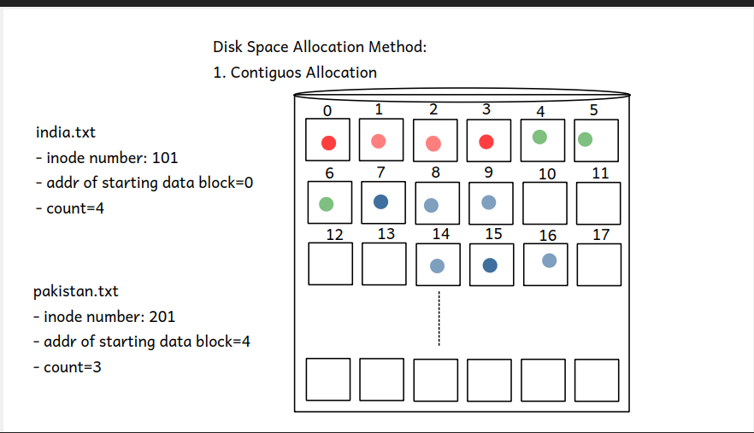
Operating Systems Concepts
Contiguous Allocation : free data blocks gets allocated for a file in a contiguous manner.
Advantages :
Sequential access.
Random access .
Simple to implement.
Disadvantages :
File may not grow(Limitations).
External fragmentation
-Number of blocks required are available but not contiguous.
Defragmentation :
-Moves files on disk so that maximum contiguous free space is available.

Slide 28
Contiguous Allocation
Number of blocks required for the file are allocated contiguously.
inode of the file contains starting block address and number of data blocks.
Faster sequential and random access. Number of blocks required for the file may not be available contiguously.
This is called as "External Fragmentation". To solve this problem, data blocks of the files can be shifted/moved so that max contiguous free space will be available.
This is called as "defragmentation".

Slide 29
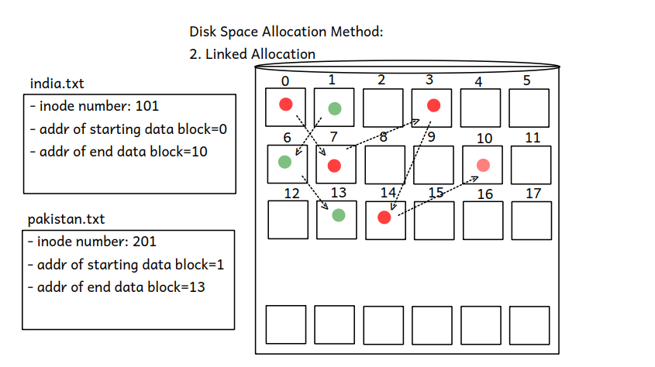
Operating Systems Concepts
Linked Allocation: any free data blocks gets allocated for a file in a linked list manner.
Advantages :
Sequential access.
No file grow limit.
No external fragmentation.
Disadvantages :
Slow random access.
Example : FAT

Slide 30
Linked Allocation
Each data block of the file contains data/contents and address of next data block of that file.
inode contains address of starting and ending data block.
No external fragmentation, faster sequential access.
Slower random access.
e.g. FAT

Slide 31
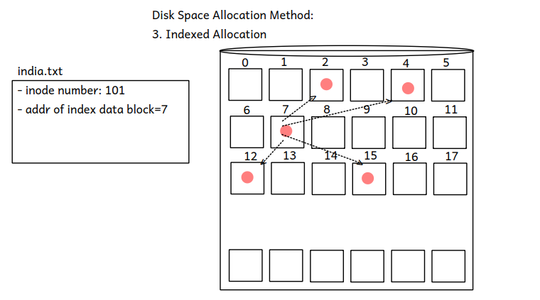
Operating Systems Concepts
Indexed Allocation : any free data blocks gets allocated for a file, as by maintaining an index data block information about allocated data blocks can be kept inside it.
Advantages :
Sequential Access.
Random Access.
No External Fragmentation
Disadvantages :
File cant grow up to some limit.
Example : UFS , EXT 2 , EXT 3

Slide 32
Indexed Allocation
A special data block contain addresses of data blocks of the file.
This block is called as "index block".
The address of index block is stored in the inode of the file.
No external fragmentation, faster random and sequential access.
File cannot grow beyond certain limit

Slide 33
Free Space Management
The free data blocks information is maintained in the super-block.
Super block use some data structures to maintain this information.
Bit Vector
Super block maintains an array of bits to keep track of used and free data blocks.
Number of bits = Number of data blocks. If nth block is used, nth bit in array should be 1.
If nth block is free, nth bit in array should be 0.
When allocating a data block for a file, find first free (0) bit in the bitmap.
Corresponding free block is allocated to the file and then the bit is updated as used (1).
Linked List
Super block keep address of first free data block.
Each free data block keeps address of next free data block.

Slide 34
Grouping
Super block keep address of an free data block.
That free block acts like index block i.e. keeps addresses of other free data blocks
Counting
Super block keep address of an free data block.
That free block acts like index block i.e. keeps addresses of free data block and number of free data blocks after it

Slide 35
File Systems
File System is way of organizing files (data and metadata) on the disk.
File systems differ in metadata (attributes), supported data block sizes, file system layout (boot block + super block + inode list + data blocks).
disk allocation mechanisms, free space management mechanisms, etc.
File system layout is managed by File system driver/manager.

Slide 36
UFS
UNIX File System
Modified indexed allocation
Maximum file size = 16 GB (with 4 KB data block size)
Inode has array of 13 members
10 --> Direct data blocks
11 --> Single indirect data blocks
12 --> Double indirect data blocks
13 --> Triple indirect data blocks

Slide 37
FAT File System
Maximum file size = 4 GB.
FAT -- File Allocation Table
A special data structure in the file system on the disk.
Array implementation of a linked list.
Each element in the FAT table, keep address of next block.
This table is used for disk allocation as well as for free space mgmt.
Data blocks stores only data. Size of data block can be fixed while formatting
e.g. 2 kb, 4 kb (default), 8 kb, 16 kb.
FAT directory entries stores all info about file (no separate inode struct).
file name
size attributes (read-only, hidden, )
start block
Boot record (1 sector = 512 bytes) -- information about file system
label
FAT table information
FS block size
etc. Does
Not support Journaling.

Slide 38
NTFS
NTFS Windows platform
Much sophisticated than FAT
Use B-tree for disk allocation
Max file size > 100 GB
Also implements Journaling mechanism
Refer: wiki

Slide 39
Operating Systems Concepts
Disk Scheduling Algorithms:
When system want to access data from a disk, request can sent to disk controller and disk controller accepts one request at a time and complete it.
There are chances that at a time more than one requests for accessing data from the disk can be made by the processes running in a system, in that case all the requests can be kept in a waiting queue of the disk maintained by an OS, and there is need to schedule/select only one request at a time and sent it to the disk controller, to do this there are certain algorithms referred as disk scheduling algorithms.

Slide 40
Computer Fundamentals and Operating Systems
Memory Technologies
There are four methods by which data can be accessed from the computer memory:
Sequential Access: e.g. Magnetic Tape
Direct Access: e.g. Magnetic Disk
Random Access: e.g. RAM Memory
Associative Access: e.g. Cache Memory
Magnetic Disk : Hard Disk Drive Structure
HDD is made up of one or more circular platters arranged like CD rack.
A Circular platter is a made up of non-magnetic substance like aluminum or aluminum alloy, which is coated with a magnetic substance.

Slide 41
Computer Fundamentals and Operating Systems
Magnetic Disk : Hard Disk Drive Structure
HDD is made up of one or more circular platters arranged like CD rack.
A Circular platter is a made up of non-magnetic substance like aluminum or aluminum alloy, which is coated with a magnetic substance.
Coating of magnetic substance is either from one side to the platter or from both the sides (for increasing its capacity) and hence platter in a magnetic disk may be either single sided platter or double sided platter.
Circular platter is divided into the hundred’s of concentric rings called as tracks whereas each track is divided into thousands of same size of blocks called as sectors.
Usually the size of each sector is 512 bytes
There is one conducting coil referred as head which is used to access data from the sector i.e. head can read and write data from and into a sector at a time.
Head writes and read data sector by sector i.e. block by block, and magnetic disk is also called as block device.

Slide 42
Computer Fundamentals and Operating Systems
All the operations like read, write, control etc... in a HDD are controlled by disk controller, and hence movement of the head also controlled by it.
Seek Time: time required for the disk controller to move head from its current position to the desired track.
Rotational Latency: after reaching head at desired track, circular platter gets rotated till the head does not comes aligned with the desired sector, and time required for this rotation is referred as rotational latency.
Access Time = Seek Time + Rotational Latency.

Slide 43
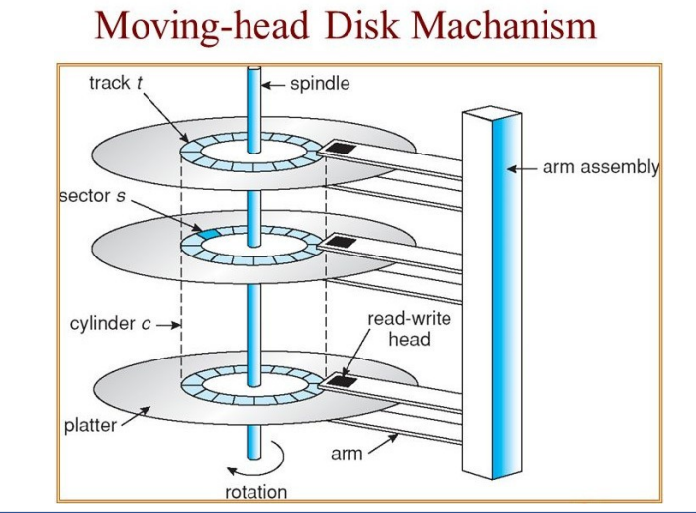
Computer Fundamentals and Operating Systems

Slide 44
Operating Systems Concepts
FCFS (First Come First Served):
request which is arrived first gets accepted and completed.
SSTF (Shortest Seek Time First):
request which is closed to the current position of the head gets accepted and completed.
SCAN:
head keeps scanning the disk from starting cylinder to end cylinder and whichever request came across gets accepted and completed.

Slide 45
C-SCAN (Circular SCAN):
head scans the disk only in a one direction
LOOK:
this policy can be used either with SCAN/C-SCAN, in this, if there is no request in a waiting queue then movement of the head gets stopped

Slide 46

Thank you!
Kiran Jaybhave
email – kiran.jaybhave@sunbeaminfo.com

