Slide 1
Data Structures
Chapter 1 Basic Concepts

Slide 2
Textbook:
Fundamentals of Data Structures in C
  Horowitz Sahni
  Anderson Freed

Slide 3
  小考+手寫作業 10%
  程式作業 20%
  出席 5%
  期中考二次，各15%，共30%
  期末考 20%
  上機考: 15%
  額外: cpe

Slide 4
Chapter 1 Basic Concepts
Overview: System Life Cycle
Algorithm Specification
Data Abstraction
Performance Analysis
Performance Measurement

Slide 5
System life cycle
Good programmers regard large-scale computer programs as systems that contain many complex interacting parts.
As systems, these programs undergo a development process called the system life cycle.

Slide 6
System life cycle
We consider this cycle as consisting of
five phases.
  Requirements
  Analysis: bottom-up vs. top-down
  Design: data objects and operations
  Refinement and Coding
  Verification
    Program Proving
    Testing
    Debugging

Slide 7
Algorithm Specification
1.2.1 Introduction
  An algorithm is a finite set of instructions that accomplishes a particular task.
  Criteria
    input: zero or more quantities that are externally supplied
    output: at least one quantity is produced
    definiteness: clear and unambiguous
    finiteness: terminate after a finite number of steps
    effectiveness: instruction is basic enough to be carried out
  A program does not have to satisfy the finiteness criteria.

Slide 8
Algorithm Specification
Representation
  A natural language, like English or Chinese.
  A graphic, like flowcharts.
  A computer language, like C.
Algorithms + Data structures = Programs [Niklus Wirth]
Sequential search vs. Binary search

Slide 9
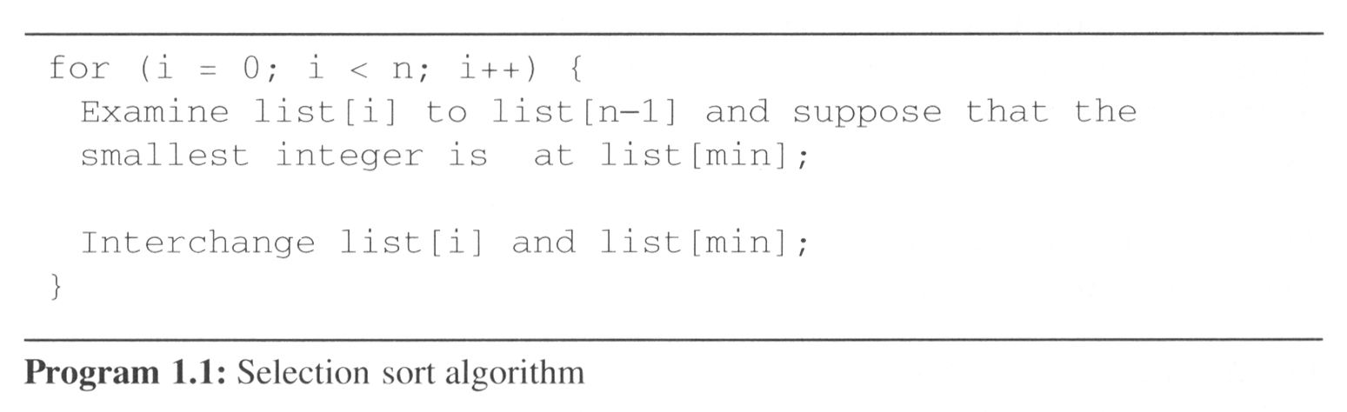
Algorithm Specification
Example 1.1 [Selection sort]:
  From those integers that are currently unsorted, find the smallest and place it next in the sorted list.
i [0] [1] [2] [3] [4]
  - 30 10 50 40 20
  0 10 30 50 40 20
  1 10 20 50 40 30
  2 10 20 30 40 50
  3 10 20 30 40 50

Slide 10
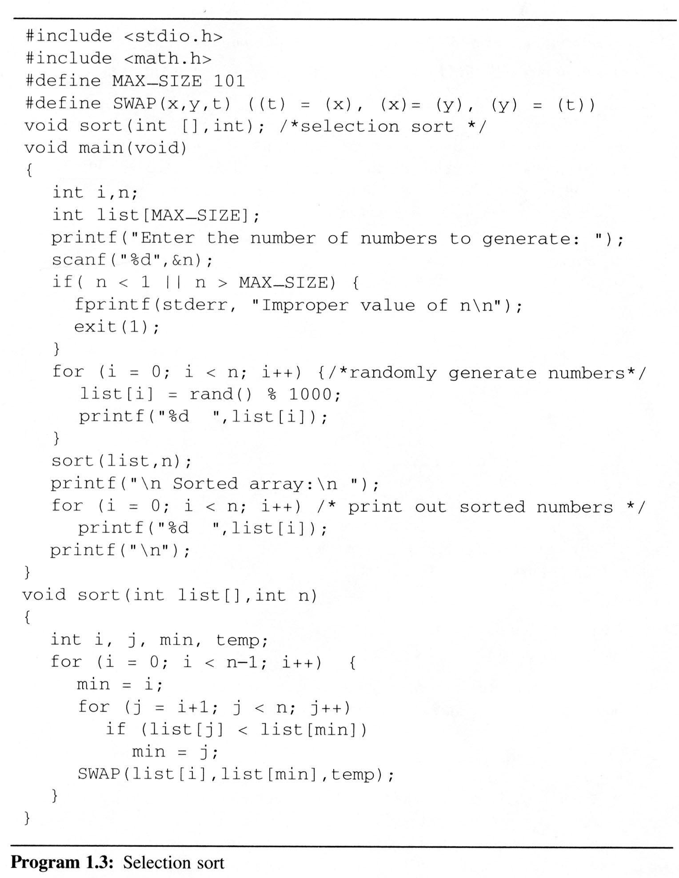
Program 1.3 contains a complete program which you may run on your computer

Slide 11
Algorithm Specification
Example 1.2 [Binary search]:
    [0] [1] [2] [3] [4] [5] [6]
    8 14 26 30 43 50 52
    left right middle list[middle] : searchnum
    0 6 3 30 < 43
    4 6 5 50 > 43
    4 4 4 43 == 43

Slide 12
Algorithm Specification
Example 1.2 [Binary search]:
    [0] [1] [2] [3] [4] [5] [6]
    8 14 26 30 43 50 52
    left right middle list[middle] : searchnum
    0 6 3 30 < 43
    4 6 5 50 > 43
    4 4 4 43 == 43
    0 6 3 30 > 18
    0 2 1 14 < 18
    2 2 2 26 > 18
    2 1 -

Slide 13
Algorithm Specification
Example 1.2 [Binary search]:
    [0] [1] [2] [3] [4] [5] [6]
    8 14 26 30 43 50 52
    left right middle list[middle] : searchnum
    0 6 3 30 < 43
    4 6 5 50 > 43
    4 4 4 43 == 43
    0 6 3 30 > 18
    0 2 1 14 < 18
    2 2 2 26 > 18
    2 1 -
Searching a sorted list
    while (there are more integers to check) {
    middle = (left + right) / 2;
    if (searchnum < list[middle])
    right = middle - 1;
    else if (searchnum == list[middle])
    return middle;
    else left = middle + 1;
    }

Slide 14
int binsearch (int list[], int searchnum, int left, int right){
/* search list[0] <= list[1] <= … <= list[n-1] for searchnum.
Return its position if found. Otherwise return -1 */
int middle;
while (left <= right) {
middle = (left + right)/2;
switch ( COMPARE (list[middle], searchnum)){
    case -1: left = middle + 1;
    break;
    case 0 : return middle;
    case 1 : right = middle – 1;
}
}
return -1;
}
*Program 1.6: Searching an ordered list

Slide 15
Algorithm Specification
1.2.2 Recursive algorithms
  Beginning programmer view a function as something that is invoked (called) by another function
    It executes its code and then returns control to the calling function.

Slide 16
Algorithm Specification
  This perspective ignores the fact that functions can call themselves (direct recursion) A call A.
  They may call other functions that invoke the calling function again (indirect recursion) A call B and B call A.

Slide 17
Algorithm Specification
  This perspective ignores the fact that functions can call themselves (direct recursion) A call A.
  They may call other functions that invoke the calling function again (indirect recursion) A call B and B call A.
    extremely powerful
    frequently allow us to express an otherwise complex process in very clear term
  We should express a recursive algorithm when the problem itself is defined recursively.

Slide 18
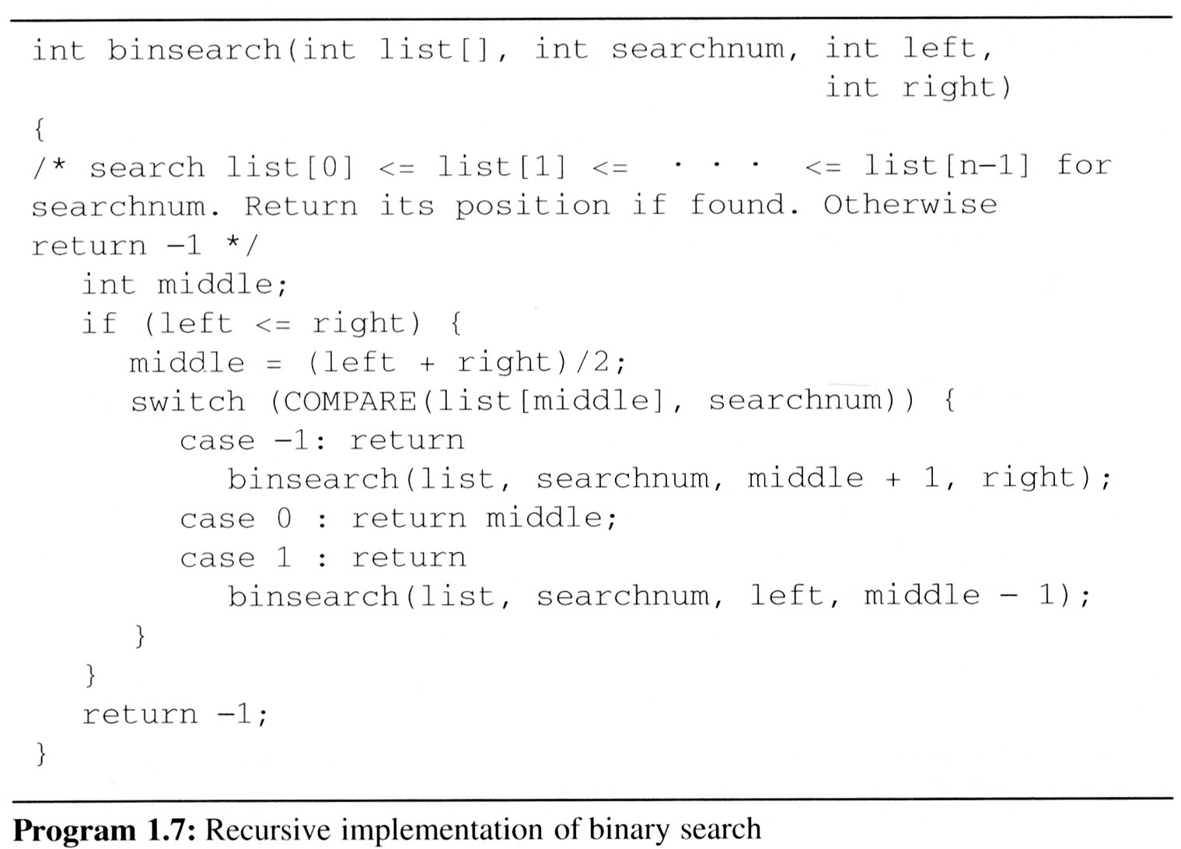

Example 1.3 [Binary search]:

Slide 19
Example 1.3 [Binary search]:

Slide 20
Example 1.3 [Binary search]:

Slide 21
Example 1.4 [Permutations]:
Given the set A= {a, b, c}.
Then the set of permutations of A is
{ (a, b, c),
(a, c, b),
(b, a, c),
(b, c, a),
(c, b, a),
(c, a, b) }

Slide 22
Example 1.4 [Permutations]:
Given the set A= {a, b, c}.
Then the set of permutations of A is
{ (a, b, c),
(a, c, b),
(b, a, c),
(b, c, a),
(c, b, a),
(c, a, b) }

Slide 23
Example 1.4 [Permutations]:
Given the set A= {a, b, c}.
Then the set of permutations of A is
{ (a, b, c),
(a, c, b),
(b, a, c),
(b, c, a),
(c, b, a),
(c, a, b) }

Slide 24
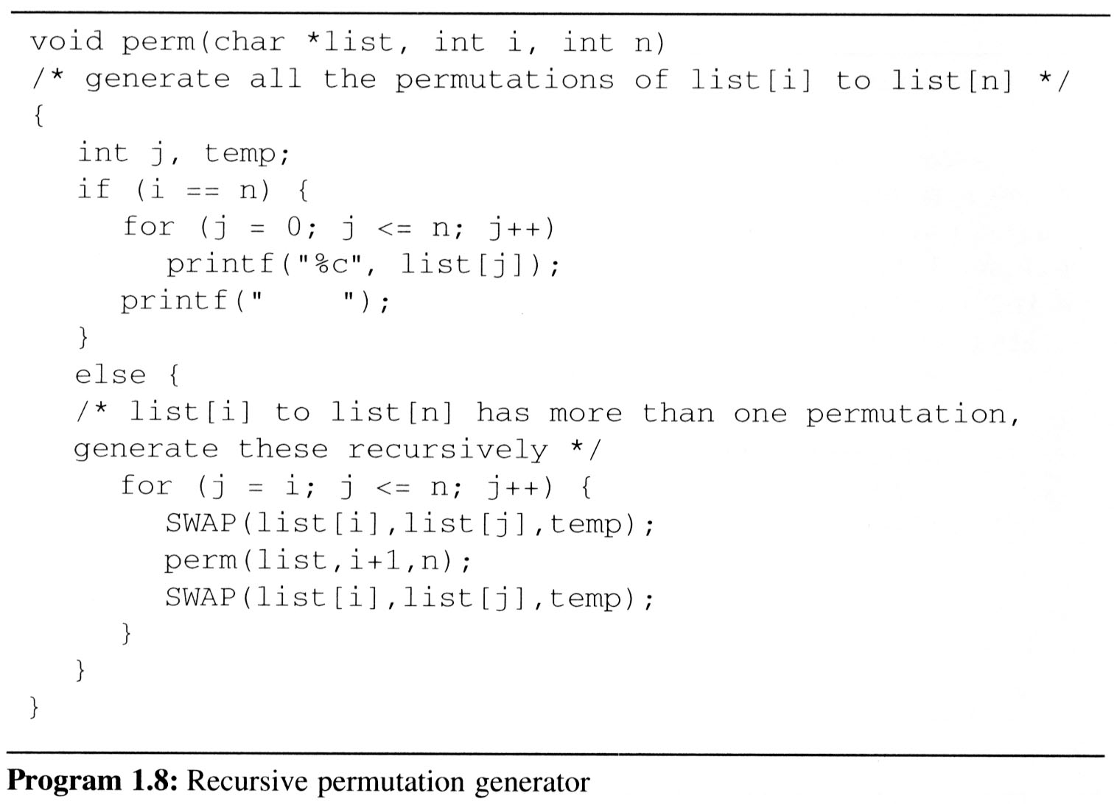

Example 1.4 [Permutations]:

Slide 25
Example 1.4 [Permutations]:

Slide 26
Example 1.4 [Permutations]:

Slide 27
Perm(string, 0, 2), 此時string 有abc
決定位置0放a, 再call perm(string, 1, 2)
決定位置0放b, 再call perm(string, 1, 2)
決定位置0放c, 再call perm(string, 1, 2)

Slide 28
Perm(string, 0, 2), 此時string 有abc
決定位置0放a, 再call perm(string, 1, 2)
決定位置0放b, 再call perm(string, 1, 2)
決定位置0放c, 再call perm(string, 1, 2)

Slide 29
Perm(string, 0, 2)
決定位置0放a, 再call perm(string, 1, 2)
  Perm(string 1, 2), 此時string 只有b,c
    決定位置1放b, 再call perm(string, 2, 2)
    決定位置1放c, 再call perm(string, 2, 2)
決定位置0放b, 再call perm(string, 1, 2)
決定位置0放c, 再call perm(string, 1, 2)

Slide 30
Perm(string, 0, 2)
決定位置0放a, 再call perm(string, 1, 2)
  Perm(string 1, 2), 此時string 只有b,c
    決定位置1放b, 再call perm(string, 2, 2)
    決定位置1放c, 再call perm(string, 2, 2)
決定位置0放b, 再call perm(string, 1, 2)
決定位置0放c, 再call perm(string, 1, 2)

Slide 31
Perm(string, 0, 2)
決定位置0放a, 再call perm(string, 1, 2)
  Perm(string, 1, 2), 此時string 只有b,c
    決定位置1放b, 再call perm(string, 2, 2)
      perm(string, 2, 2), 此時string 只有c
      決定位置2放 c, 然後印出來string，也就是 abc
    決定位置1放c, 再call perm(string, 2, 2)
決定位置0放b, 再call perm(string, 1, 2)
決定位置0放c, 再call perm(string, 1, 2)

Slide 32
Perm(string, 0, 2)
決定位置0放a, 再call perm(string, 1, 2)
  Perm(string, 1, 2), 此時string 只有b,c
    決定位置1放b, 再call perm(string, 2, 2)
      perm(string, 2, 2), 此時string 只有c
      決定位置2放 c, 然後印出來string，也就是 abc
    決定位置1放c, 再call perm(string, 2, 2)
決定位置0放b, 再call perm(string, 1, 2)
決定位置0放c, 再call perm(string, 1, 2)

Slide 33
Perm(string, 0, 2)
決定位置0放a, 再call perm(string, 1, 2)
  Perm(string, 1, 2), 此時string 只有b,c
    決定位置1放b, 再call perm(string, 2, 2)
      perm(string, 2, 2), 此時string 只有c
      決定位置2放 c, 然後印出來string，也就是 abc
    決定位置1放c, 再call perm(string, 2, 2)
      perm(string, 2, 2), 此時string 只有b
      決定位置2放 b, 然後印出來string，也就是 acb
決定位置0放b, 再call perm(string, 1, 2)
決定位置0放c, 再call perm(string, 1, 2)

Slide 34
Perm(string, 0, 2)
決定位置0放a, 再call perm(string, 1, 2)
  Perm(string, 1, 2), 此時string 只有b,c
    決定位置1放b, 再call perm(string, 2, 2)
      perm(string, 2, 2), 此時string 只有c
      決定位置2放 c, 然後印出來string，也就是 abc
    決定位置1放c, 再call perm(string, 2, 2)
      perm(string, 2, 2), 此時string 只有b
      決定位置2放 b, 然後印出來string，也就是 acb
決定位置0放b, 再call perm(string, 1, 2)
決定位置0放c, 再call perm(string, 1, 2)

Slide 35
Perm(string, 0, 2)
決定位置0放a, 再call perm(string, 1, 2)
  Perm(string, 1, 2), 此時string 只有b,c
    決定位置1放b, 再call perm(string, 2, 2)
      perm(string, 2, 2), 此時string 只有c
      決定位置2放 c, 然後印出來string，也就是 abc
    決定位置1放c, 再call perm(string, 2, 2)
      perm(string, 2, 2), 此時string 只有b
      決定位置2放 b, 然後印出來string，也就是 acb
決定位置0放b, 再call perm(string, 1, 2)
決定位置0放c, 再call perm(string, 1, 2)

Slide 36
List[0] | List[1] | List[2]
a | b | c
Call Stack:
i
main
Perm ( string , 0 , 2 )
Perm ( string , 1 , 2 )
Print The String
“abc”
Print The String
“acb”
Print The String
“bac”
Print The String
“bca”
Perm ( string , 2 , 2 )
SWAP ( list[1],list[1], temp)
SWAP ‘b’ ⬄ ‘b’
SWAP ( list[1],list[1], temp)
SWAP ‘b’ ⬄ ‘b’
SWAP ( list[1],list[2], temp)
SWAP ‘b’ ⬄ ‘c’
SWAP ( list[1],list[2], temp)
SWAP ‘b’ ⬄ ‘c’
SWAP ( list[0],list[0], temp)
SWAP ‘a’ ⬄ ‘a’
SWAP ( list[0],list[1], temp)
SWAP ‘a’ ⬄ ‘b’
SWAP ( list[1],list[1], temp)
SWAP ‘b’ ⬄ ‘b’
SWAP ( list[1],list[1], temp)
SWAP ‘b’ ⬄ ‘b’
SWAP ( list[1],list[2], temp)
SWAP ‘a’ ⬄ ‘c’
SWAP ( list[1],list[2], temp)
SWAP ‘a’ ⬄ ‘c’
SWAP ( list[0],list[0], temp)
SWAP ‘a’ ⬄ ‘a’
I=0 J=0 N=2
I=1 J=1 N=2
I=1 J=1 N=2
I=1 J=2 N=2
I=1 J=2 N=2
I=0 J=0 N=2
I=0 J=1 N=2
I=1 J=3 N=2
I=1 J=1 N=2
I=1 J=1 N=2
I=1 J=2 N=2
I=1 J=2 N=2
I=1 J=3 N=2
Call : perm ( list,1, 2)
Call : perm ( list,2, 2)
Call : perm ( list,2, 2)
Call : perm ( list,2, 2)
Call : perm ( list,2, 2)
Call : perm ( list,1, 2)

Slide 37
lv0 perm: i=0, n=2 abc
lv0 SWAP: i=0, j=0 abc
lv1 perm: i=1, n=2 abc
lv1 SWAP: i=1, j=1 abc
lv2 perm: i=2, n=2 abc
print: abc
lv1 SWAP: i=1, j=1 abc
lv1 SWAP: i=1, j=2 abc
lv2 perm: i=2, n=2 acb
print: acb
lv1 SWAP: i=1, j=2 acb
lv0 SWAP: i=0, j=0 abc
lv0 SWAP: i=0, j=1 abc
lv1 perm: i=1, n=2 bac
lv1 SWAP: i=1, j=1 bac
lv2 perm: i=2, n=2 bac
print: bac
lv1 SWAP: i=1, j=1 bac
lv1 SWAP: i=1, j=2 bac
lv2 perm: i=2, n=2 bca
print: bca
lv1 SWAP: i=1, j=2 bca
lv0 SWAP: i=0, j=1 bac
lv0 SWAP: i=0, j=2 abc
lv1 perm: i=1, n=2 cba
lv1 SWAP: i=1, j=1 cba
lv2 perm: i=2, n=2 cba
print: cba
lv1 SWAP: i=1, j=1 cba
lv1 SWAP: i=1, j=2 cba
lv2 perm: i=2, n=2 cab
print: cab
lv1 SWAP: i=1, j=2 cab
lv0 SWAP: i=0, j=2 cba
Example 1.4 [Permutations]:

Slide 38
Data Abstraction
A data type includes
  a collection of objects and
  a set of operations that act on those objects.
    For example, the data type int consists of the objects {0, +1, -1, +2, -2, …, INT_MAX, INT_MIN} and the operations +, -, *, /, and %.

Slide 39
Data Abstraction
The data types of C
  The basic data types: char, int, float and double
  The group data types: array and struct
  The pointer data type
  The user-defined types

Slide 40
Data Abstraction
Abstract Data Type
  An abstract data type(ADT) is a data type
  that is organized in such a way that
  the specification of the objects and
  the operations on the objects is separated from
  the representation of the objects and
  the implementation of the operations.
  We know what is does, but not necessarily how it will do it.

Slide 41
Data Abstraction
Specification vs. Implementation
  An ADT is implementation independent
  Operation specification
    function name
    the types of arguments
    the type of the results
  The functions of a data type can be classify into several categories:
    creator / constructor
    transformers
    observers / reporters

Slide 42
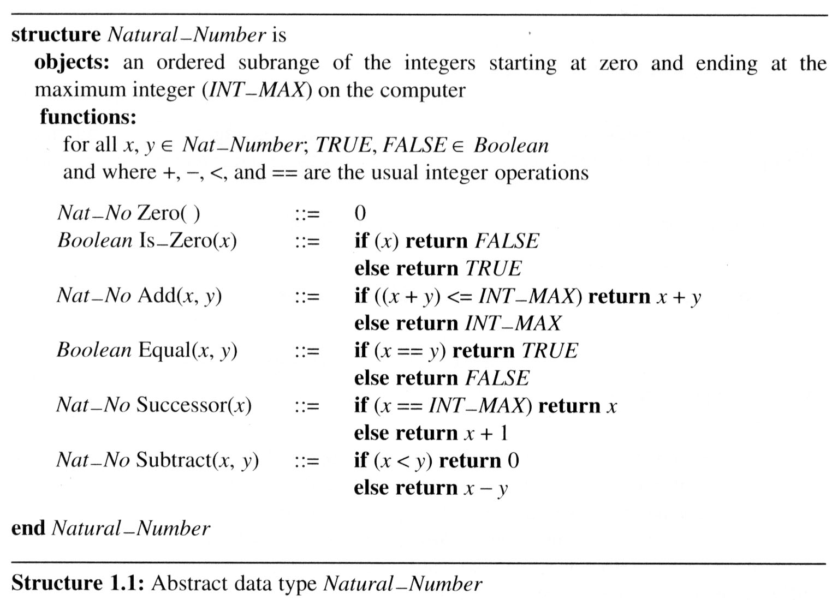
Data Abstraction
Example 1.5 [Abstract data type Natural_Number]
::= is defined as

Slide 43
Performance Analysis
Criteria
  Is it correct?
  Is it readable?
  …
Performance Analysis (machine independent)
  space complexity: storage requirement
  time complexity: computing time
Performance Measurement (machine dependent)

Slide 44
Performance Analysis
1.4.1 Space Complexity:
S(P)=C+S_{P}(I)
  Fixed Space Requirements (C)
  Independent of the characteristics
  of the inputs and outputs
    instruction space
    space for simple variables, fixed-size structured variable, constants

Slide 45
Performance Analysis
1.4.1 Space Complexity:
S(P)=C+S_{P}(I)
  Fixed Space Requirements (C)
  Independent of the characteristics
  of the inputs and outputs
    instruction space
    space for simple variables, fixed-size structured variable, constants
  Variable Space Requirements (S_{P}(I))
  depend on the instance characteristic I
    number, size, values of inputs and outputs associated with I
    recursive stack space, formal parameters, local variables, return address

Slide 46
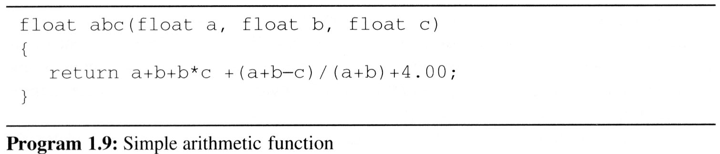
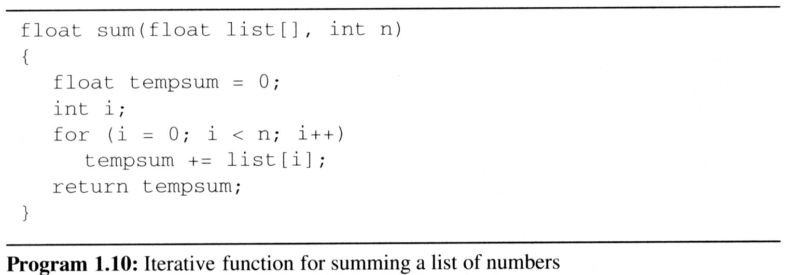
Performance Analysis
Examples:
  S_{abc}(I)=0.
  S_{sum}(I)=S_{sum}(n)=0.
Recall: pass the address of the
first element of the array &
pass by value

Slide 47
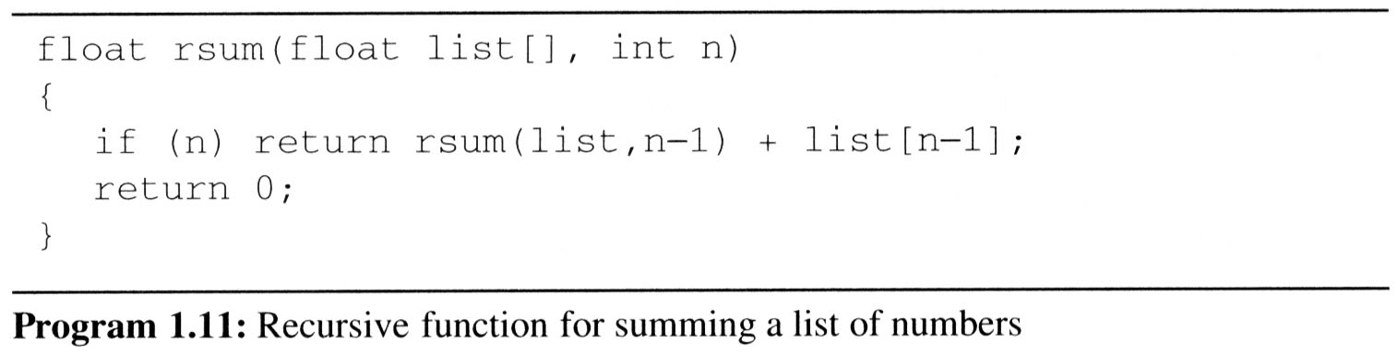
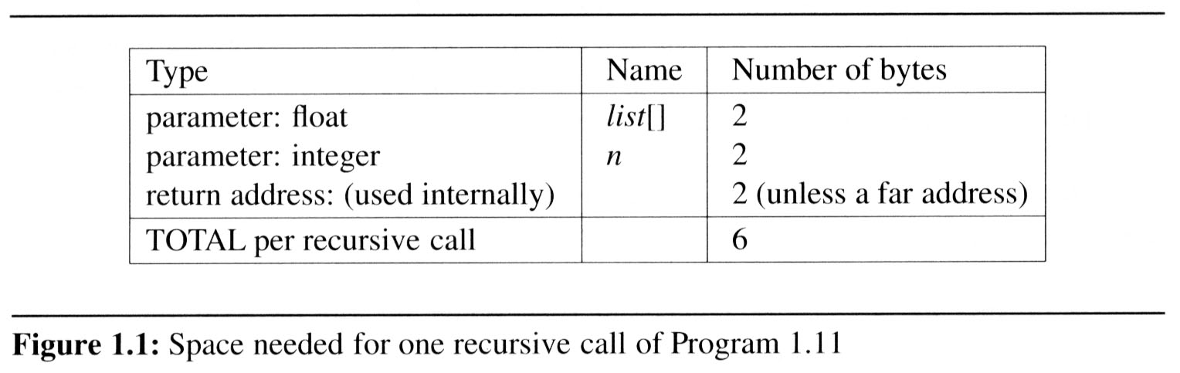
Performance Analysis
  Example 1.8: Program 1.11 is a recursive function for addition. Figure 1.1 shows the number of bytes required for one recursive call.
S_{sum}(I)=S_{sum}(n)=6n

Slide 48
Performance Analysis
1.4.2 Time Complexity:
T(P)=C+T_{P}(I)
  T(P): The time taken by a program, P,
  C: compile time
  T_{P}(I) : run (or execution) time

Slide 49
Performance Analysis
1.4.2 Time Complexity:
T(P)=C+T_{P}(I)
  T(P): The time taken by a program, P,
  C: compile time
  T_{P}(I) : run (or execution) time
  Fixed time requirements
    Compile time (C), independent of instance characteristics
  Variable time requirements
    Run (execution) time T_{P}
    T_{P}(n)=c_{a}ADD(n)+c_{s}SUB(n)+c_{l}LDA(n)+c_{st}STA(n)

Slide 50
Performance Analysis
A program step is a syntactically or semantically meaningful program segment whose execution time is independent of the instance characteristics.
  Example
  (Regard as the same unit machine independent)
    abc = a + b + b * c + (a + b - c) / (a + b) + 4.0
    abc = a + b + c

Slide 51
Performance Analysis
Methods to compute the step count
  Introduce variable count into programs
  Tabular method
    Determine the total number of steps contributed by each statement step per execution × frequency
    add up the contribution of all statements

Slide 52
Performance Analysis
Iterative summing of a list of numbers
*Program 1.12: Program 1.10 with count statements (p.23)
float sum (float list[ ], int n)
{
float tempsum = 0; count++; /* for assignment */
int i;
for (i = 0; i < n; i++) {
count++; /*for the for loop */
tempsum += list[i]; count++; /* for assignment */
}
count++; /* last execution of for */
return tempsum;
count++; /* for return */
}
2n + 3 steps

Slide 53
Performance Analysis
Tabular Method
*Figure 1.2: Step count table for Program 1.10 (p.26)

Slide 54
Performance Analysis
Recursive summing of a list of numbers
*Program 1.14: Program 1.11 with count statements added (p.24)
float rsum (float list[ ], int n)
{
count++; /*for if conditional */
if (n) {
count++; /* for return and rsum invocation*/
return rsum (list, n-1) + list[n-1];
}
count++;
return list[0];
}
2n+2 steps

Slide 55

Performance Analysis
*Figure 1.3: Step count table for recursive summing function (p.27)

Slide 56
Performance Analysis
1.4.3 Asymptotic notation (O, Ω, Θ)
  Complexity of c₁n²+c₂n and c₃n
    for sufficiently large of value, c₃n is faster than c₁n²+c₂n
    for small values of n, either could be faster
      c₁=1, c₂=2, c₃=100 --> c₁n²+c₂n ≤ c₃n for n ≤ 98
      c₁=1, c₂=2, c₃=1000 --> c₁n²+c₂n ≤ c₃n for n ≤ 998
    break even point
      no matter what the values of c1, c2, and c3, the n beyond which c₃n is always faster than c₁n²+c₂n

Slide 57
Performance Analysis
Definition: [Big “oh’’]
  f(n) = O(g(n)) iff there exist positive constants c and n₀ such that f(n) ≤ cg(n) for all n, n ≥ n₀.
Definition: [Omega]
  f(n) = Ω(g(n)) (read as “f of n is omega of g of n”) iff there exist positive constants c and n₀ such that f(n) ≥ cg(n) for all n, n ≥ n₀.
Definition: [Theta]
  f(n) = Θ(g(n)) (read as “f of n is theta of g of n”) iff there exist positive constants c₁, c₂, and n₀ such that c₁g(n) ≤ f(n) ≤ c₂g(n) for all n, n ≥ n₀.

Slide 58
Performance Analysis
Theorem 1.2:
  If f(n) = a_{m}n^{m}+…+a₁n+a₀, then f(n) = O(n^{m}).
Theorem 1.3:
  If f(n) = a_{m}n^{m}+…+a₁n+a₀ and a_{m} > 0, then f(n) = Ω(n^{m}).
Theorem 1.4:
  If f(n) = a_{m}n^{m}+…+a₁n+a₀ and a_{m} > 0, then f(n) = Θ(n^{m}).

Slide 59
Performance Analysis
Examples
  f(n) = 3n+2
    3n + 2 <= 4n, for all n >= 2, ∴3n + 2 = Ο (n)
    3n + 2 >= 3n, for all n >= 1, ∴3n + 2 = Ω (n)
    3n <= 3n + 2 <= 4n, for all n >= 2, ∴ 3n + 2 = Θ (n)

Slide 60
Performance Analysis
Examples
  f(n) = 10n²+4n+2
    10n²+4n+2 <= 11n², for all n >= 5, ∴ 10n²+4n+2 = Ο (n²)
    10n²+4n+2 >= n², for all n >= 1, ∴ 10n²+4n+2 = Ω (n²)
    n² <= 10n²+4n+2 <= 11n², for all n >= 5, ∴ 10n²+4n+2 = Θ (n²)
  100n+6=O(n) /* 100n+6≤101n for n≥10 */
  10n²+4n+2=O(n²) /* 10n²+4n+2≤11n² for n≥5 */
  6*2^{n}+n²=O(2^{n}) /* 6*2^{n}+n² ≤7*2^{n} for n≥4 */

Slide 61
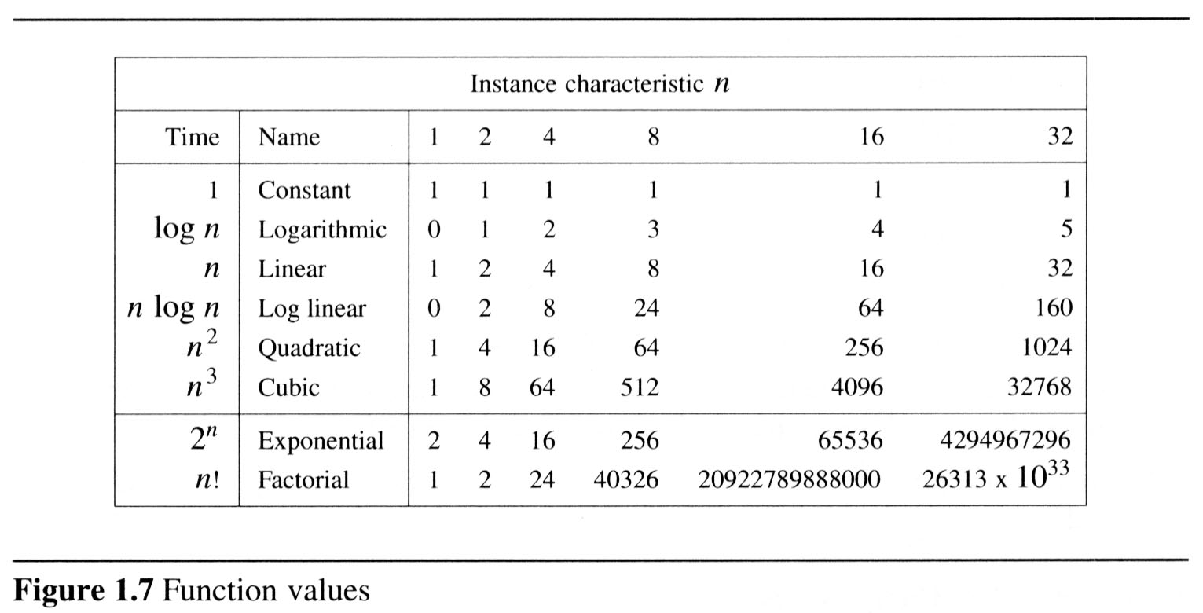
Performance Analysis
1.4.4 Practical complexity
  To get a feel for how the various functions grow with n, you are advised to study Figures 1.7 and 1.8 very closely.

Slide 62
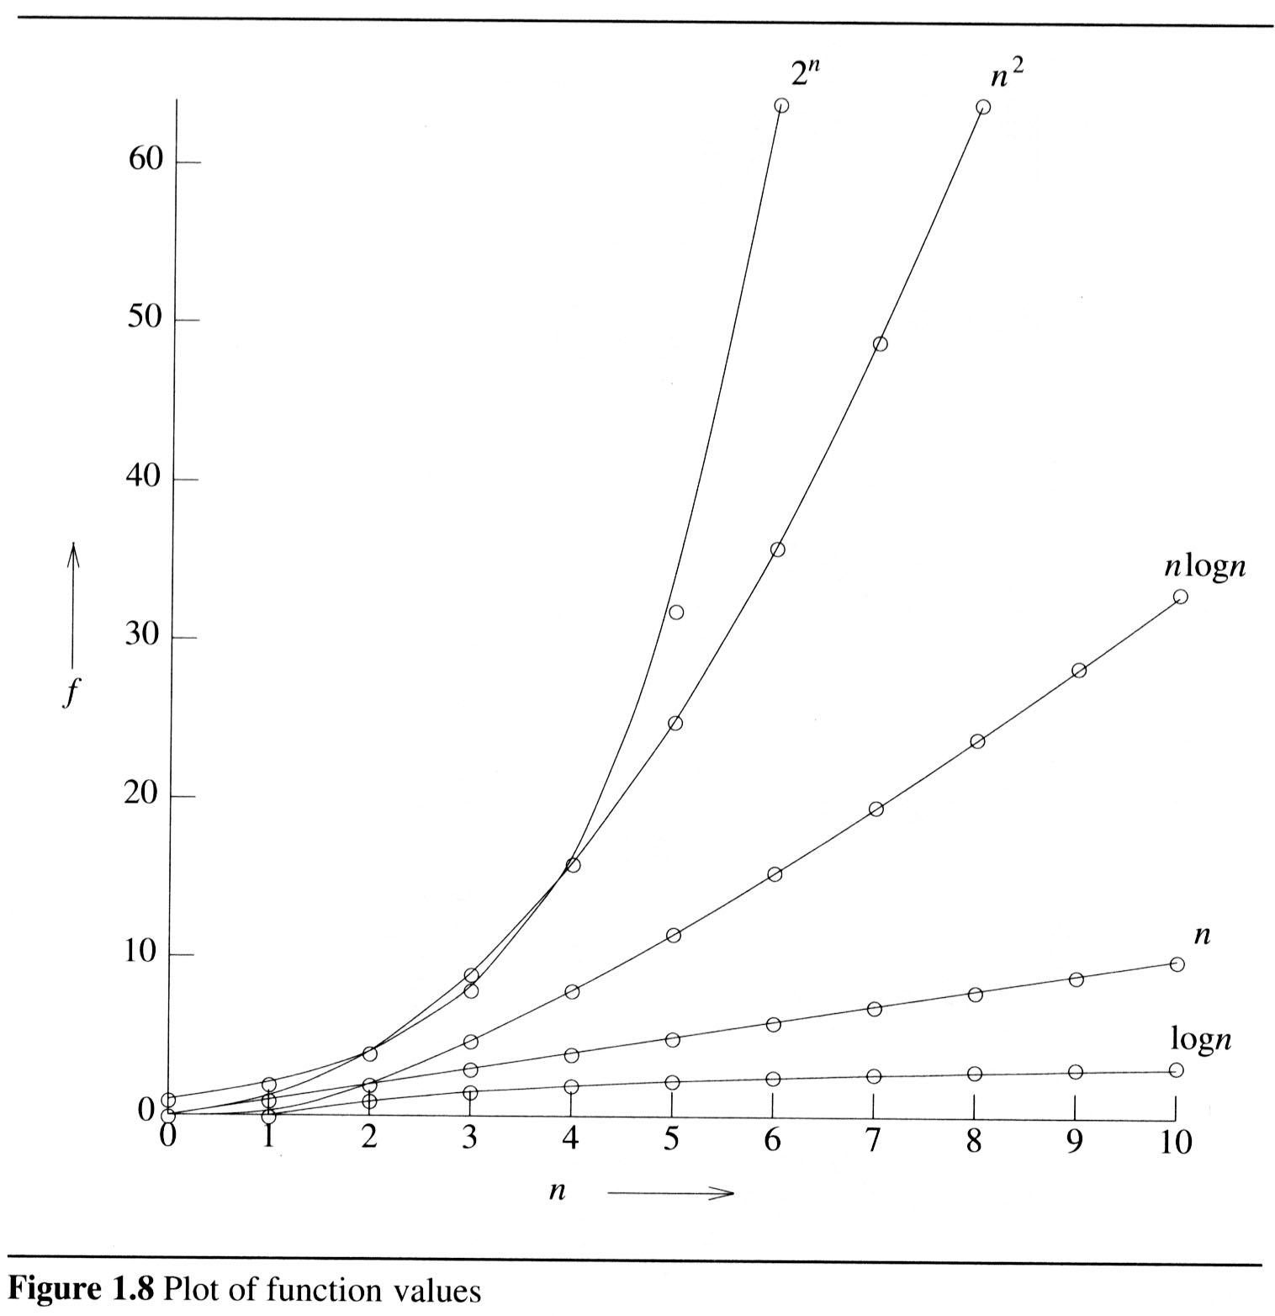
Performance Analysis

Slide 63
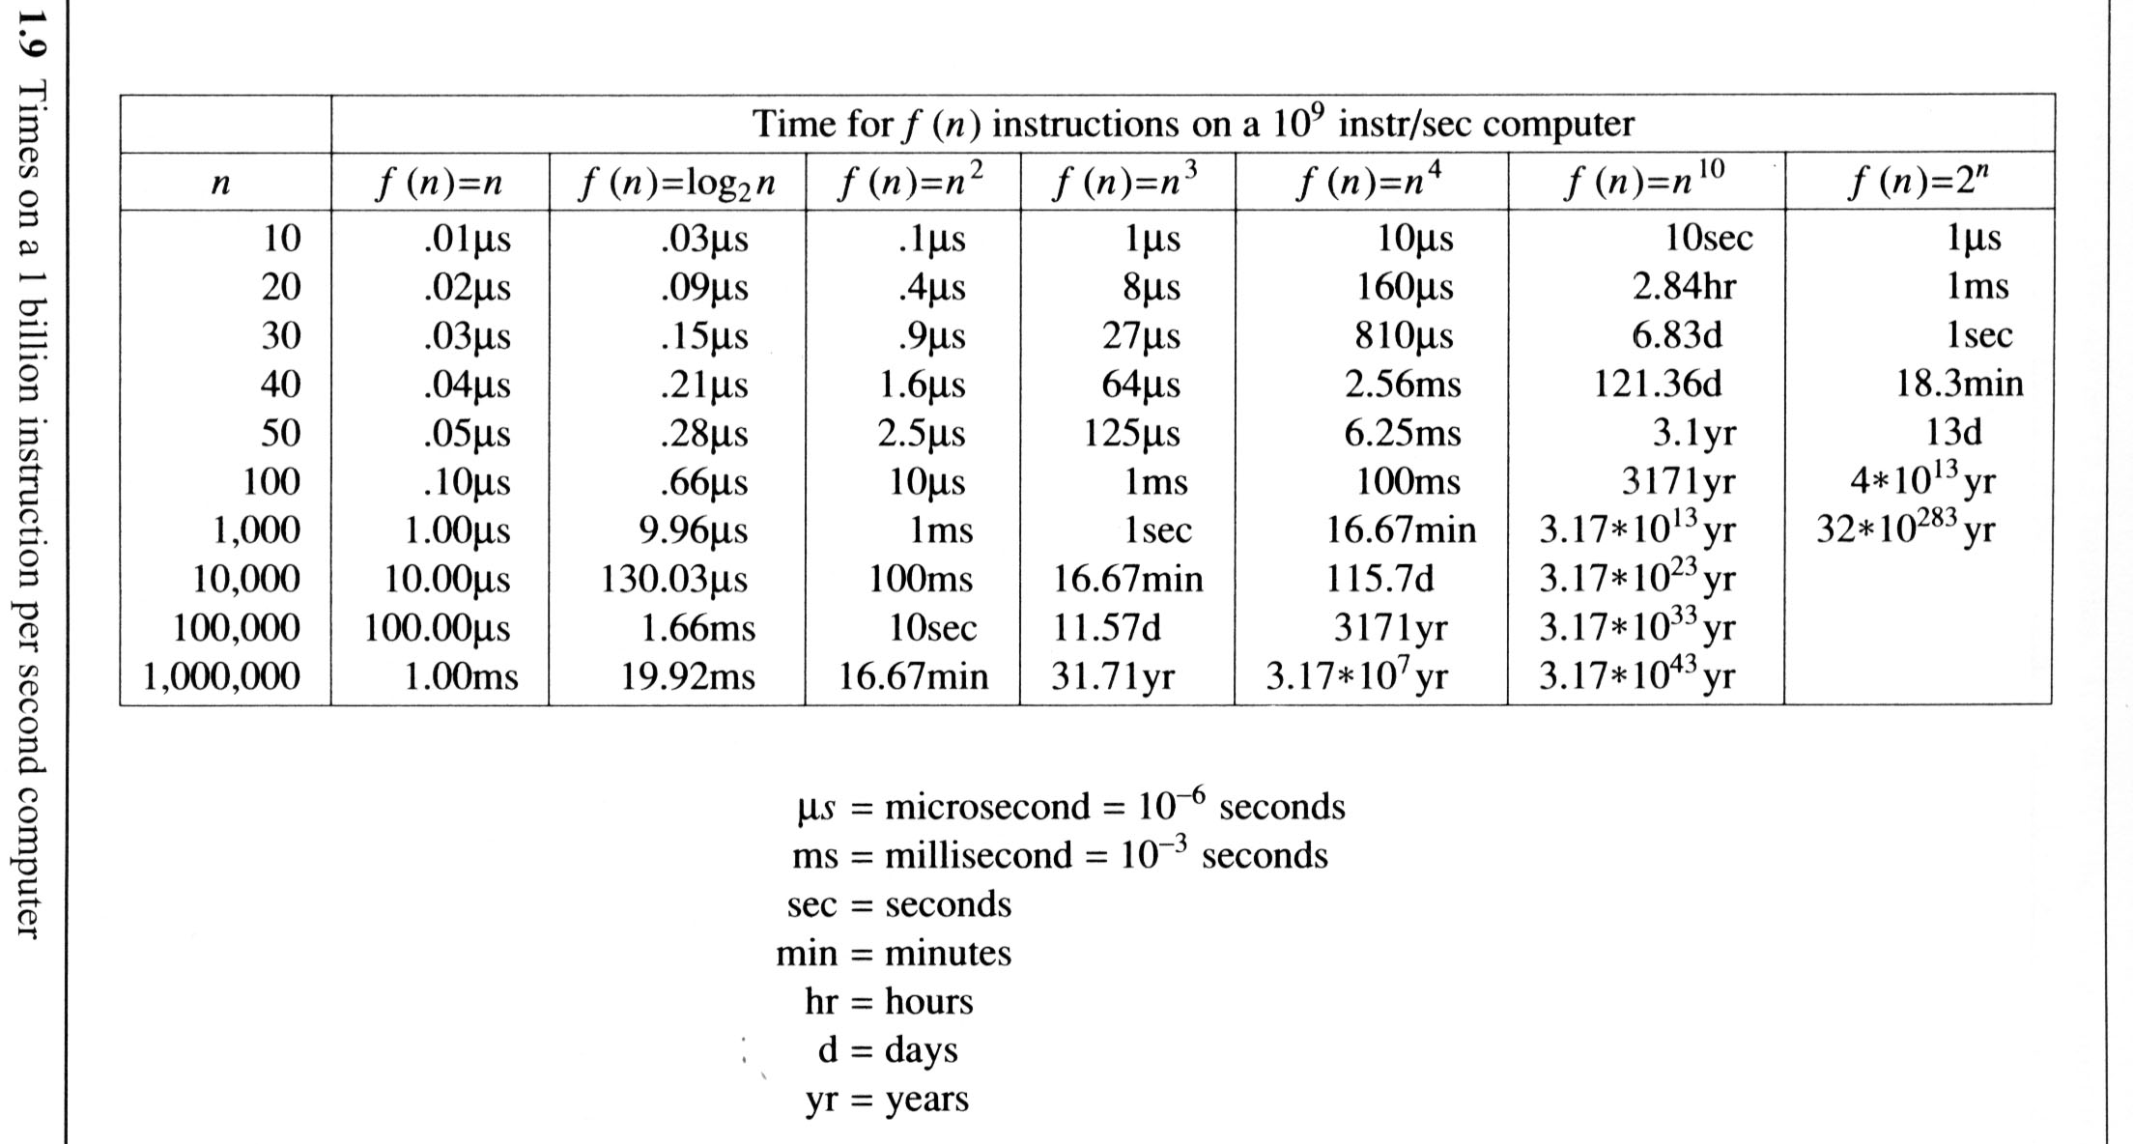
Performance Analysis
Figure 1.9 gives the time needed by a 1 billion instructions per second computer to execute a program of complexity f(n) instructions.

Slide 64
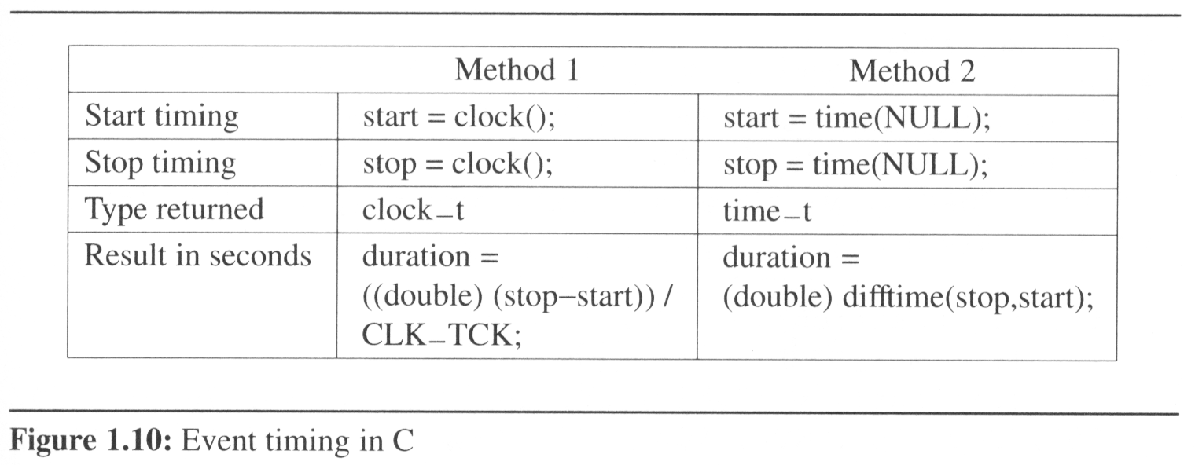
Performance Measurement
Although performance analysis gives us a powerful tool for assessing an algorithm’s space and time complexity, at some point we also must consider how the algorithm executes on our machine.
  This consideration moves us from the realm of analysis to that of measurement.

Slide 66

What Went Wrong?
start = clock();
counter = 0;
do {
counter++;
insertionSort(a,n);
} while (clock() - start < 1000)
elapsedTime = (double)(clock() – start)/
CLOCKS_PER_SEC;
timeToSort = elapsedTime/counter;
Notes:
Suppose we are measuring worst-case run time. The array a initially is in descending order. After the first iteration, the data is sorted. Subsequent iterations no longer start with worst-case data. So the measured time is for one worst-case sort plus counter-1 best-case sorts!

Slide 67
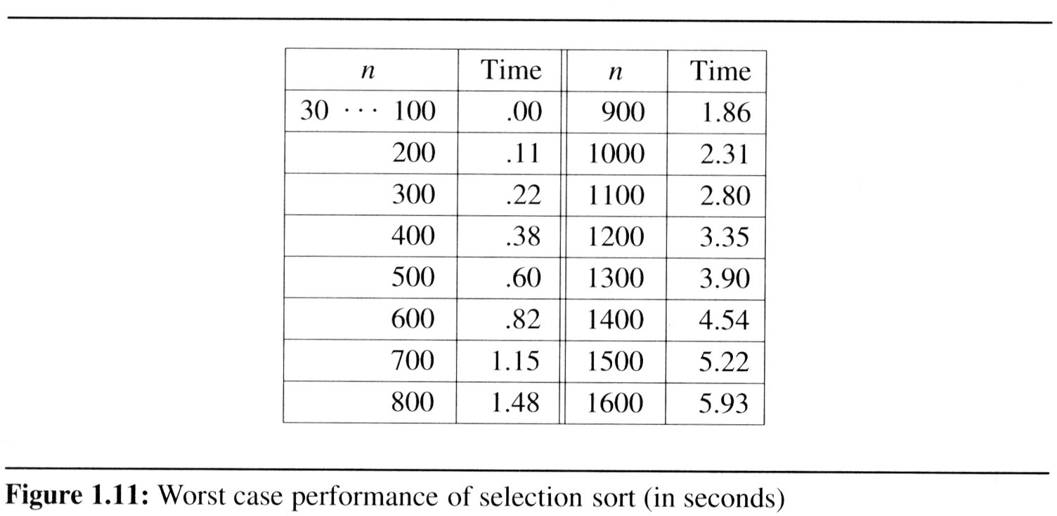
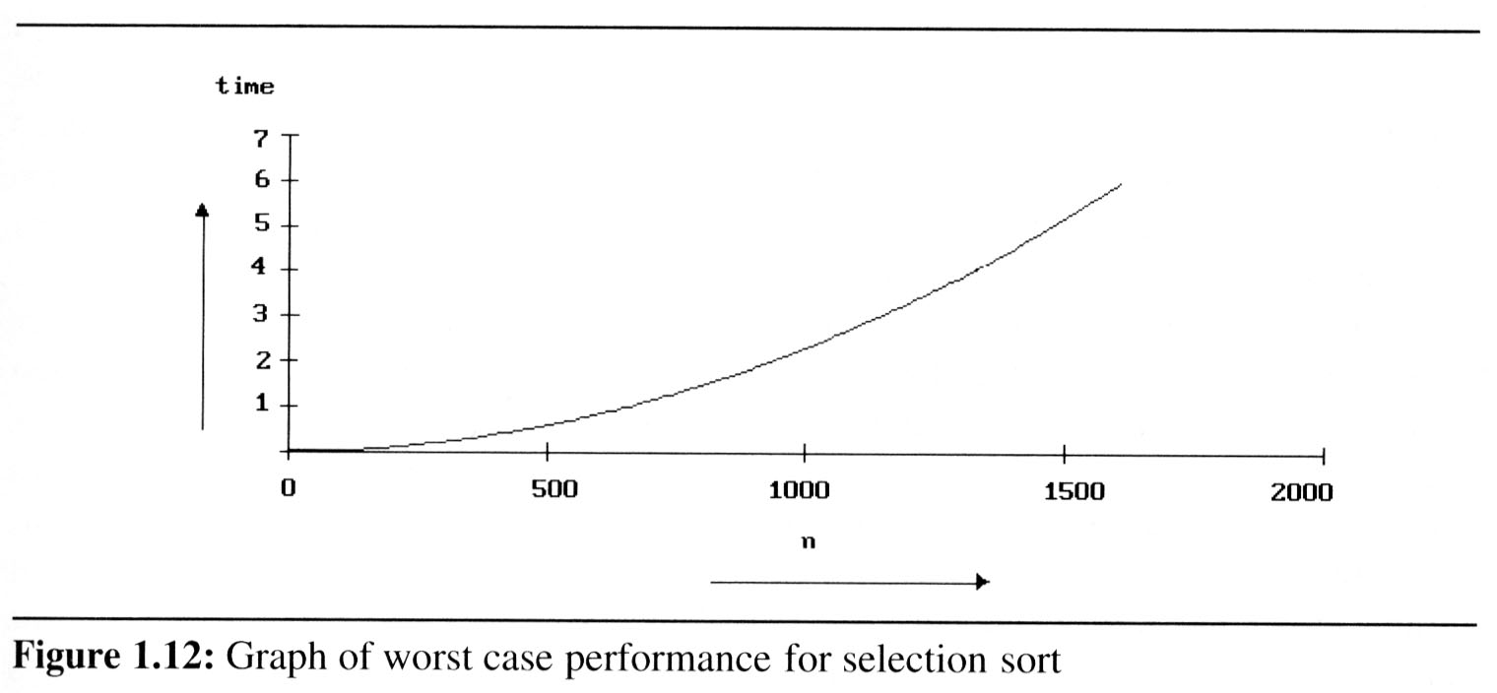
Performance Measurement
Example 1.22
[Worst case performance of the selection sort]:
  The tests were conducted on an IBM compatible PC with an 80386 cpu, an 80387 numeric coprocessor, and a turbo accelerator. We use Broland’s Turbo C compiler.

Slide 68
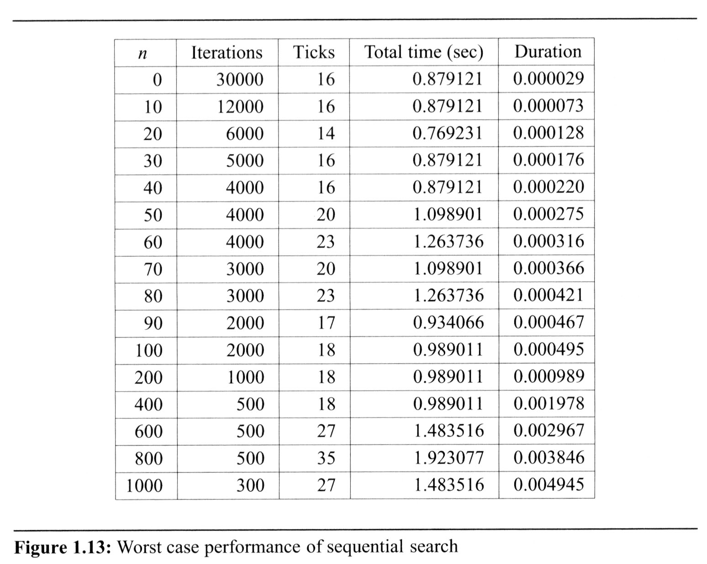
Performance Measurement

