Slide 1
CS235102
Data Structures
Chapter 4 Lists

Slide 2
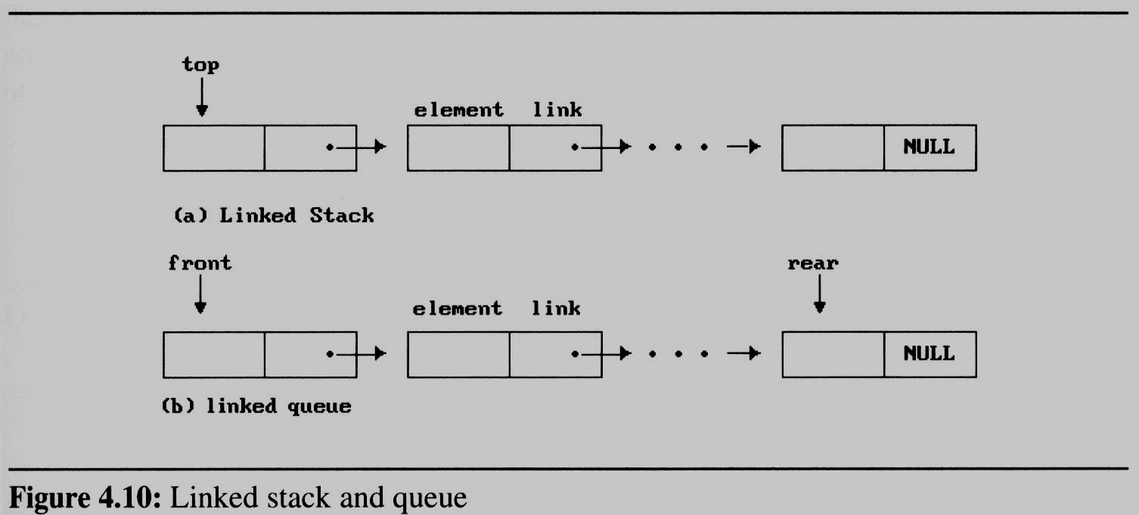
Dynamically Linked
Stacks and Queues (1/8)
When several stacks and queues coexisted, there was no efficient way to represent them sequentially.
  Notice that direction of links for both stack and the queue facilitate easy insertion and deletion of nodes.
    Easily add or delete a node form the top of the stack.
    Easily add a node to the rear of the queue and add or delete a node at the front of a queue.

Slide 3
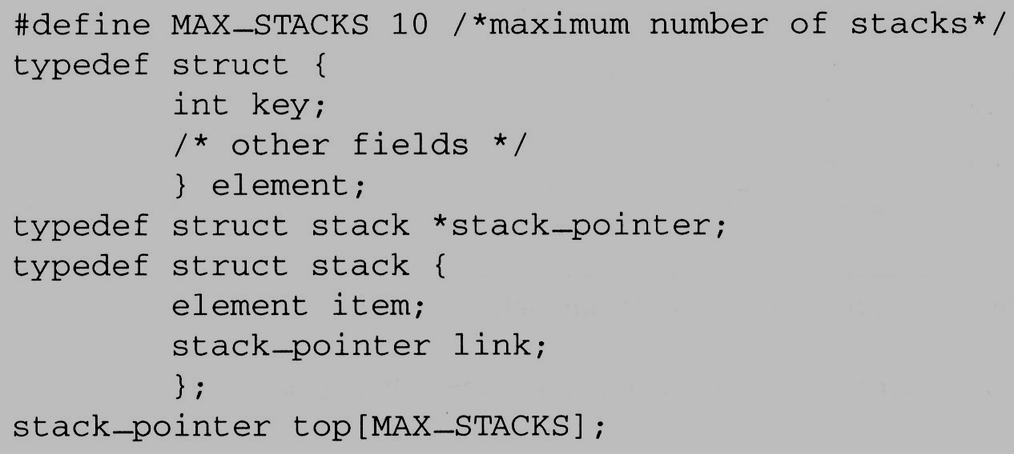
Dynamically Linked
Stacks and Queues (2/8)
Represent n stacks
Stack
top
item
link
link
...
NULL

Slide 4
Dynamically Linked
Stacks and Queues (3/8)
Push in the linked stack
  void add(stack_pointer *top, element item){
  /* add an element to the top of the stack */
  stack_pointer temp = (stack_pointer) malloc (sizeof (stack));
  if (IS_FULL(temp)) {
  fprintf(stderr, “ The memory is full\n”);
  exit(1);
  }
  temp->item = item;
  temp->link = *top;
  *top= temp;
  }
temp
item
link
top
link
link
...
NULL

Slide 5
Dynamically Linked
Stacks and Queues (4/8)
Pop from the linked stack
  element delete(stack_pointer *top) {
  /* delete an element from the stack */ Pop
  stack_pointer temp = *top;
  element item;
  if (IS_EMPTY(temp)) {
  fprintf(stderr, “The stack is empty\n”);
  exit(1);
  }
  item = temp->item;
  *top = temp->link;
  free(temp);
  return item;
  }
temp
top
item
link
link
link
...
NULL

Slide 6
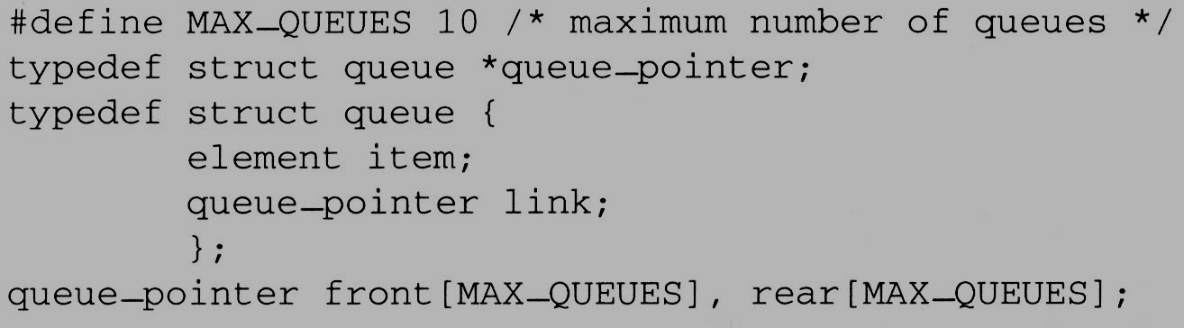
Dynamically Linked
Stacks and Queues (5/8)
Represent n queues

Slide 7
Dynamically Linked
Stacks and Queues (5/8)
Represent n queues
Queue
front
item
link
Delete from
link
...
Add to
rear
NULL

Slide 8
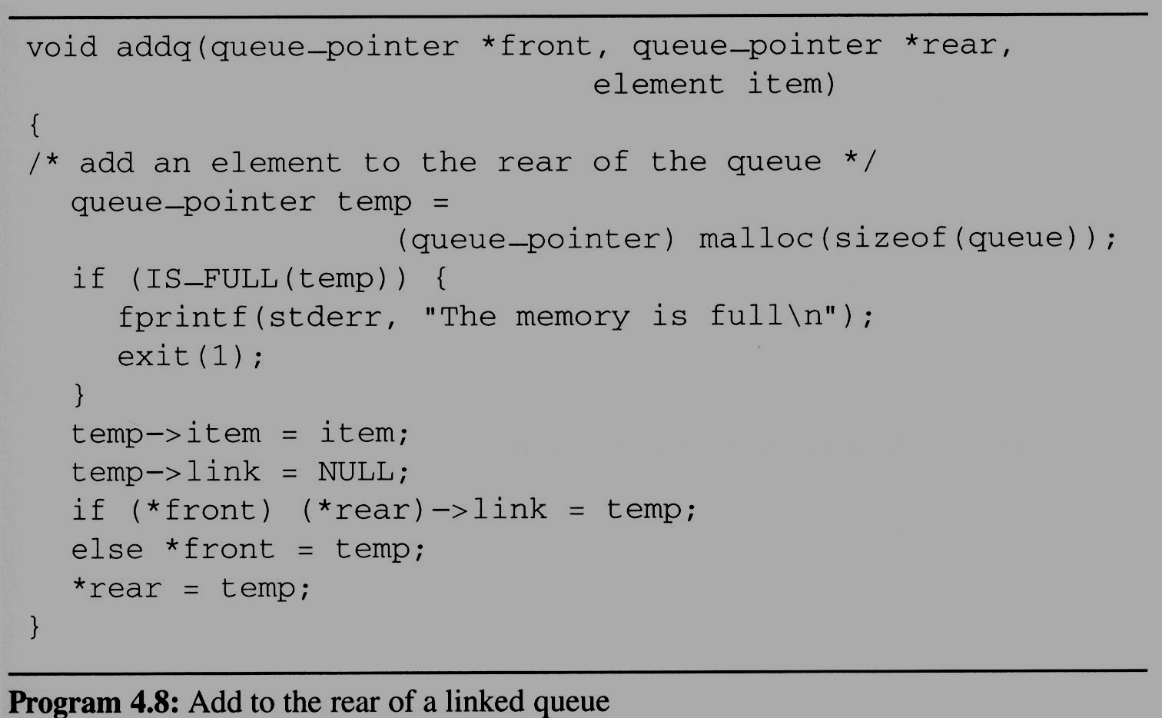
Dynamically Linked
Stacks and Queues (6/8)
enqueue in the linked queue
...

Slide 9
Dynamically Linked
Stacks and Queues (6/8)
enqueue in the linked queue
如果本來queue是空的，Front是指向null的，當有東西進來時，它也要變動

Slide 10
Dynamically Linked
Stacks and Queues (8/8)
The solution presented above to the n-stack, m-queue problem is both computationally and conceptually simple.
  We no longer need to shift stacks or queues to make space.
  Computation can proceed as long as there is memory available.

Slide 11
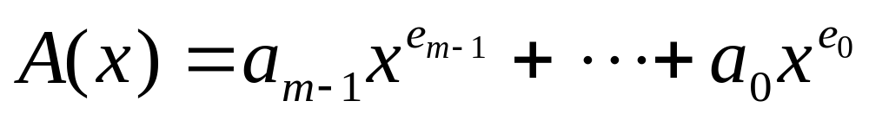
Polynomials (1/9)
Representing Polynomials As Singly Linked Lists
  The manipulation of symbolic polynomials, has a classic example of list processing.
  In general, we want to represent the polynomial:
    Where the a_{i} are nonzero coefficients and the e_{i} are nonnegative integer exponents such that
    e_{m-1} ＞ e_{m-2} ＞ … ＞ e₁ ＞ e₀ ≧ 0 .
  We will represent each term as a node containing coefficient and exponent fields, as well as a pointer to the next term.

Slide 12
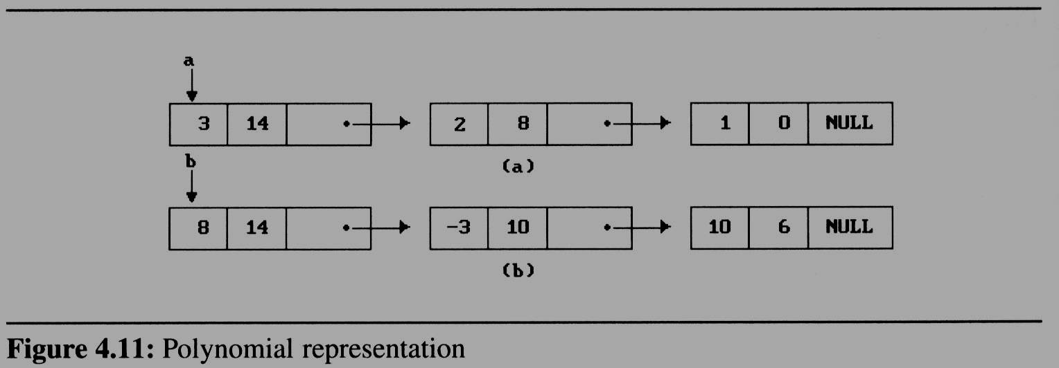


Polynomials (2/9)
coef | expon | link

Slide 13
Polynomials (2/9)
Assuming that the coefficients are integers, the type declarations are:
  typedef struct poly_node *poly_pointer;
  typedef struct poly_node {
  int coef;
  int expon;
  poly_pointer link;
  };
  poly_pointer a,b,d;
Draw poly_nodes as:
coef | expon | link

Slide 14
Polynomials (3/9)
Adding Polynomials
  To add two polynomials,we examine their terms starting at the nodes pointed to by a and b.
    If the exponents of the two terms are equal
      add the two coefficients
      create a new term for the result.
    If the exponent of the current term in a is less than b
      create a duplicate term of b
      attach this term to the result, called d
      advance the pointer to the next term in b.
    We take a similar action on a if a->expon > b->expon.
  Figure 4.12 generating the first three term of
  d = a+b (next page)

Slide 15
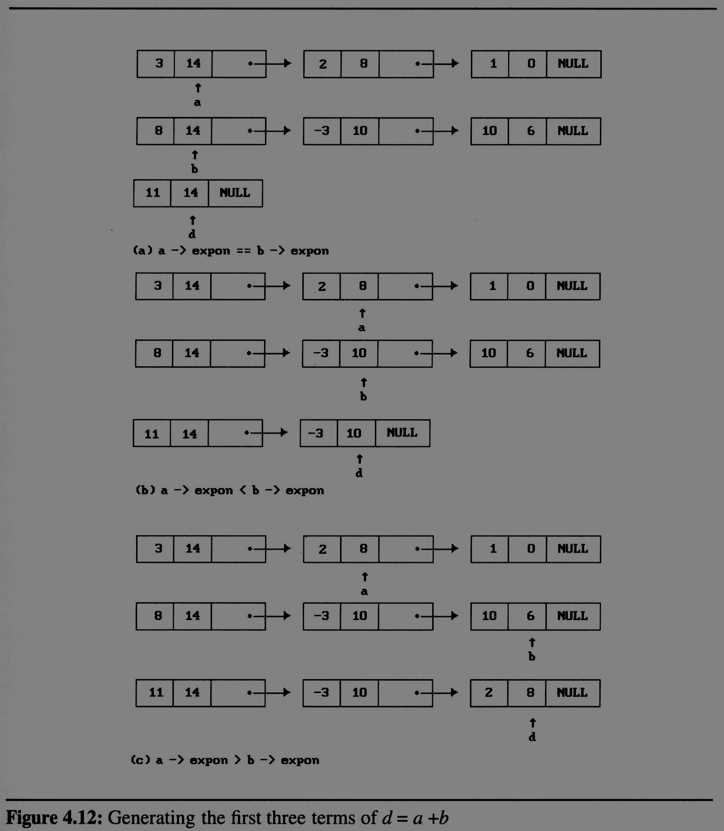
Polynomials
(4/9)

Slide 16
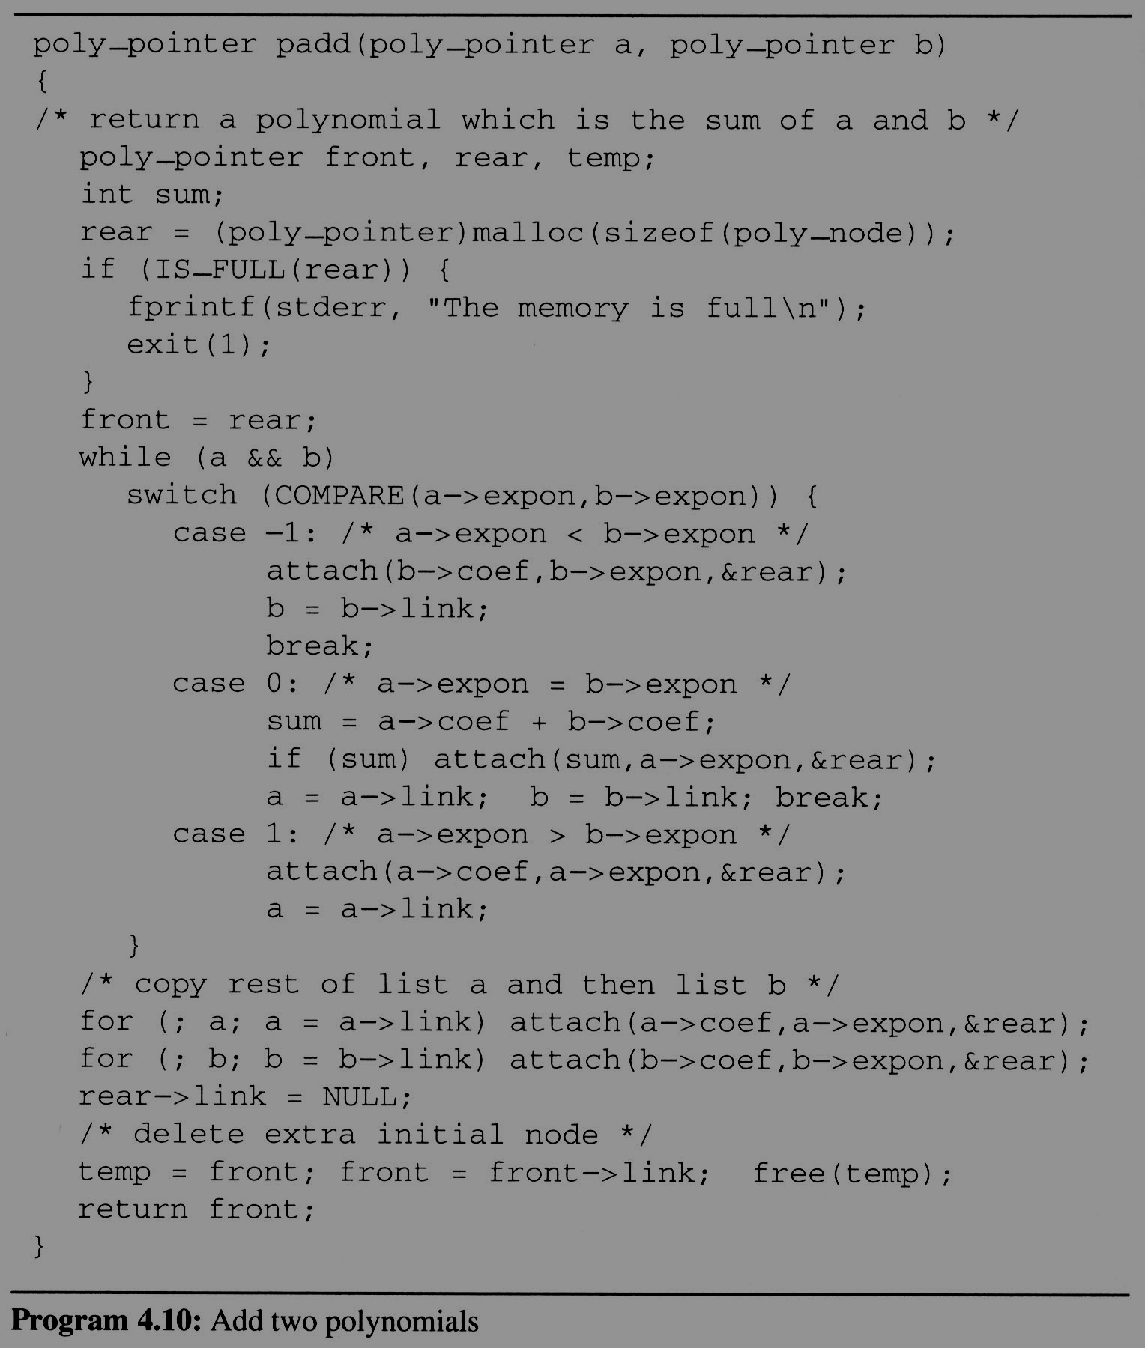
Polynomials
(5/9)
Add two
polynomials

Slide 17
Polynomials (6/9)
Attach a node to the end of a list
  void attach(float coefficient, int exponent, poly_pointer *ptr){
  /* create a new node with coef = coefficient and expon = exponent, attach it to the node pointed to by ptr. Ptr is updated to point to this new node */
  poly_pointer temp;
  temp = (poly_pointer) malloc(sizeof(poly_node));
  /* create new node */
  if (IS_FULL(temp)) {
  fprintf(stderr, “The memory is full\n”);
  exit(1);
  }
  temp->coef = coefficient; /* copy item to the new node */
  temp->expon = exponent;
  (*ptr)->link = temp; /* attach */
  *ptr = temp; /* move ptr to the end of the list */
  }

Slide 18
Polynomials (7/9)
Analysis of padd
  coefficient additions
  0 ≤ additions ≤ min(m, n)
  where m (n) denotes the number of terms in A (B).
  exponent comparisons
  extreme case:
  e_{m-1} > f_{m-1} > e_{m-2} > f_{m-2} > … > e₁ > f₁ > e₀ > f₀
  m+n-1 comparisons
  creation of new nodes
  extreme case: maximum number of terms in d is m + n new nodes
  summary: O(m+n)

Slide 19
Polynomials (8/9)
A Suite for Polynomials
  e(x) = a(x) * b(x) + d(x)
  poly_pointer a, b, d, e;
  ...
  a = read_poly();
  b = read_poly();
  d = read_poly();
  temp = pmult(a, b);
  e = padd(temp, d);
  print_poly(e);
read_poly()
print_poly()
padd()
psub()
pmult()
temp is used to hold a partial result.
By returning the nodes of temp, we
may use it to hold other polynomials

Slide 20
Polynomials (9/9)
Erase Polynomials
  erase frees the nodes in temp
  void erase (poly_pointer *ptr){
  /* erase the polynomial pointed to by ptr */
  poly_pointer temp;
  while ( *ptr){
  temp = *ptr;
  *ptr = (*ptr) -> link;
  free(temp);
  }
  }

