Slide 1
Project 4: Metalloproteins
Current Project Progress
Seun Ogedengbe
Carl Butt

Slide 2
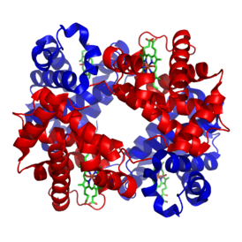
Definition
Metalloproteins are proteins that contain a metal ion cofactor
Hemoglobin
http://upload.wikimedia.org/wikipedia/commons/thumb/3/3d/1GZX_Haemoglobin.png/274px-1GZX_Haemoglobin.png

Slide 3
Functions
There are four primary functions for metalloproteins:
1) Transporting metal ions from one place to another.
2) Using metal ions as a catalyst for some action (as enzymes).
3) Signal transduction
4) Storage of metal ions for later use as one of 1-3

Slide 4
Expectations
The metal ions are, as you would expect, ionic.
They would not be able to fulfill their purposes if allowed to interact with (polar) water.
So we expect any metal ions to be well- wrapped.

Slide 5
Current Results
Standard ratio of #(Metal ions) : #(Desolvation shells with metal ions) is > 1 , so well-wrapped.
One exception (Ribonecleoside-diphosphate reductase) which had two magnesium ions, each unwrapped.

Slide 6
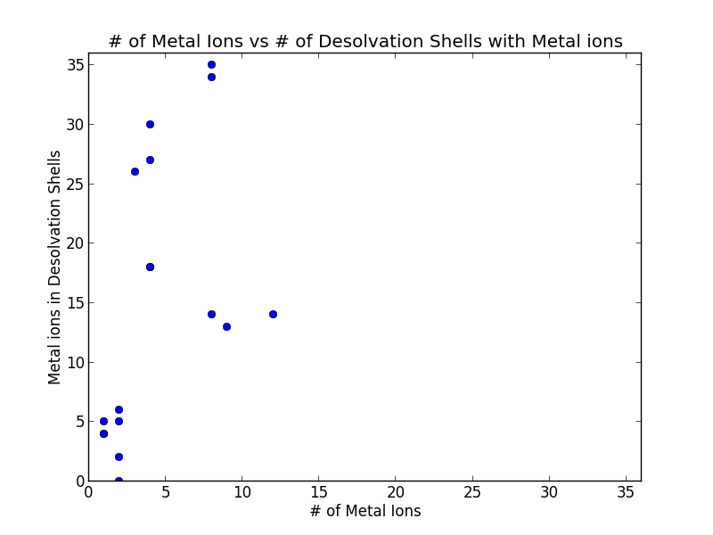

Slide 7
Specific Metals
Iron and magnesium tend to be the least well-wrapped, perhaps because they appear in large groups (like the heme group, for iron)
Copper and zinc tend to be be best-wrapped
Cadherins tend toward the middle of metalloproteins

Slide 8
To be worked on
Organize the breakdown by metal more thoroughly
Get more precise data on distances from dehydrons
Analyze position within desolvation shells

Slide 9
Sources
http://www.ncbi.nlm.nih.gov/pubmed/2377604
http://pac.iupac.org/publications/pac/pdf/1983/pdf/5501x0035.pdf (p36 seems useful).
http://symposium.cshlp.org/content/52/579.full.pdf
http://www.ks.uiuc.edu/Research/cadherin/
Word, et. Al. <1999> J. Mol. Biol. 285, 1735-1747

