Slide 1
Project 4: Metalloproteins
Current Project Progress
Seun Ogedengbe
Carl Butt

Slide 2
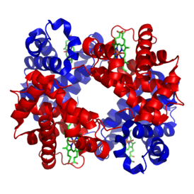
Definition
Metalloproteins are proteins that contain a metal ion cofactor
Hemoglobin
http://upload.wikimedia.org/wikipedia/commons/thumb/3/3d/1GZX_Haemoglobin.png/274px-1GZX_Haemoglobin.png

Slide 3
Functions
There are four primary functions for metalloproteins:
1) Transporting metal ions from one place to another.
2) Using metal ions as a catalyst for some action (as enzymes).
3) Signal transduction
4) Storage of metal ions for later use as one of 1-3

Slide 4
Current Results
The selected proteins have as many as 4 well wrapped metal ions.
This means that these metal ions are crucial to the performance of the protein.

Slide 5
Sources
http://www.ncbi.nlm.nih.gov/pubmed/2377604
http://pac.iupac.org/publications/pac/pdf/1983/pdf/5501x0035.pdf (p36 seems useful).
http://symposium.cshlp.org/content/52/579.full.pdf
http://www.ks.uiuc.edu/Research/cadherin/
Word, et. Al. <1999> J. Mol. Biol. 285, 1735-1747

