Slide 1
COMP0190 · 3D Organ Shape Completion
Part 1 Progress Report
Inference and Preliminary Analysis of Skull Completion
Using the Existing MSN Pre-trained Weights
Student: Qi Jinyu Supervisor: Petru Manescu
2026-07-28

Slide 2
Method: Inference Pipeline
MSN pre-trained model (PCT encoder-decoder + BERT text condition), used as-is — no retraining
1. Data prep
2. Sampling
3. Inference
4. Output
Load .ply skull cloud,
normalize
FPS to 4096 (input)
/ 6144 (GT) points
PCT + BERT features
→ cross-attn decoder
Completed skull,
6144 points
Key points
▪ Weights reused as-is from MSN_weights3.h5 — no architecture change, no retraining at this stage
▪ Inference on skull point clouds converted through our own pipeline (paired SkullFix incomplete/complete data)
▪ Batch evaluation run on CPU: this machine's 24GB GPU memory is nearly filled by BERT+PCT, so CPU guarantees stable completion
COMP0190 · 3D Organ Shape Completion — Part 1 Progress
2

Slide 3
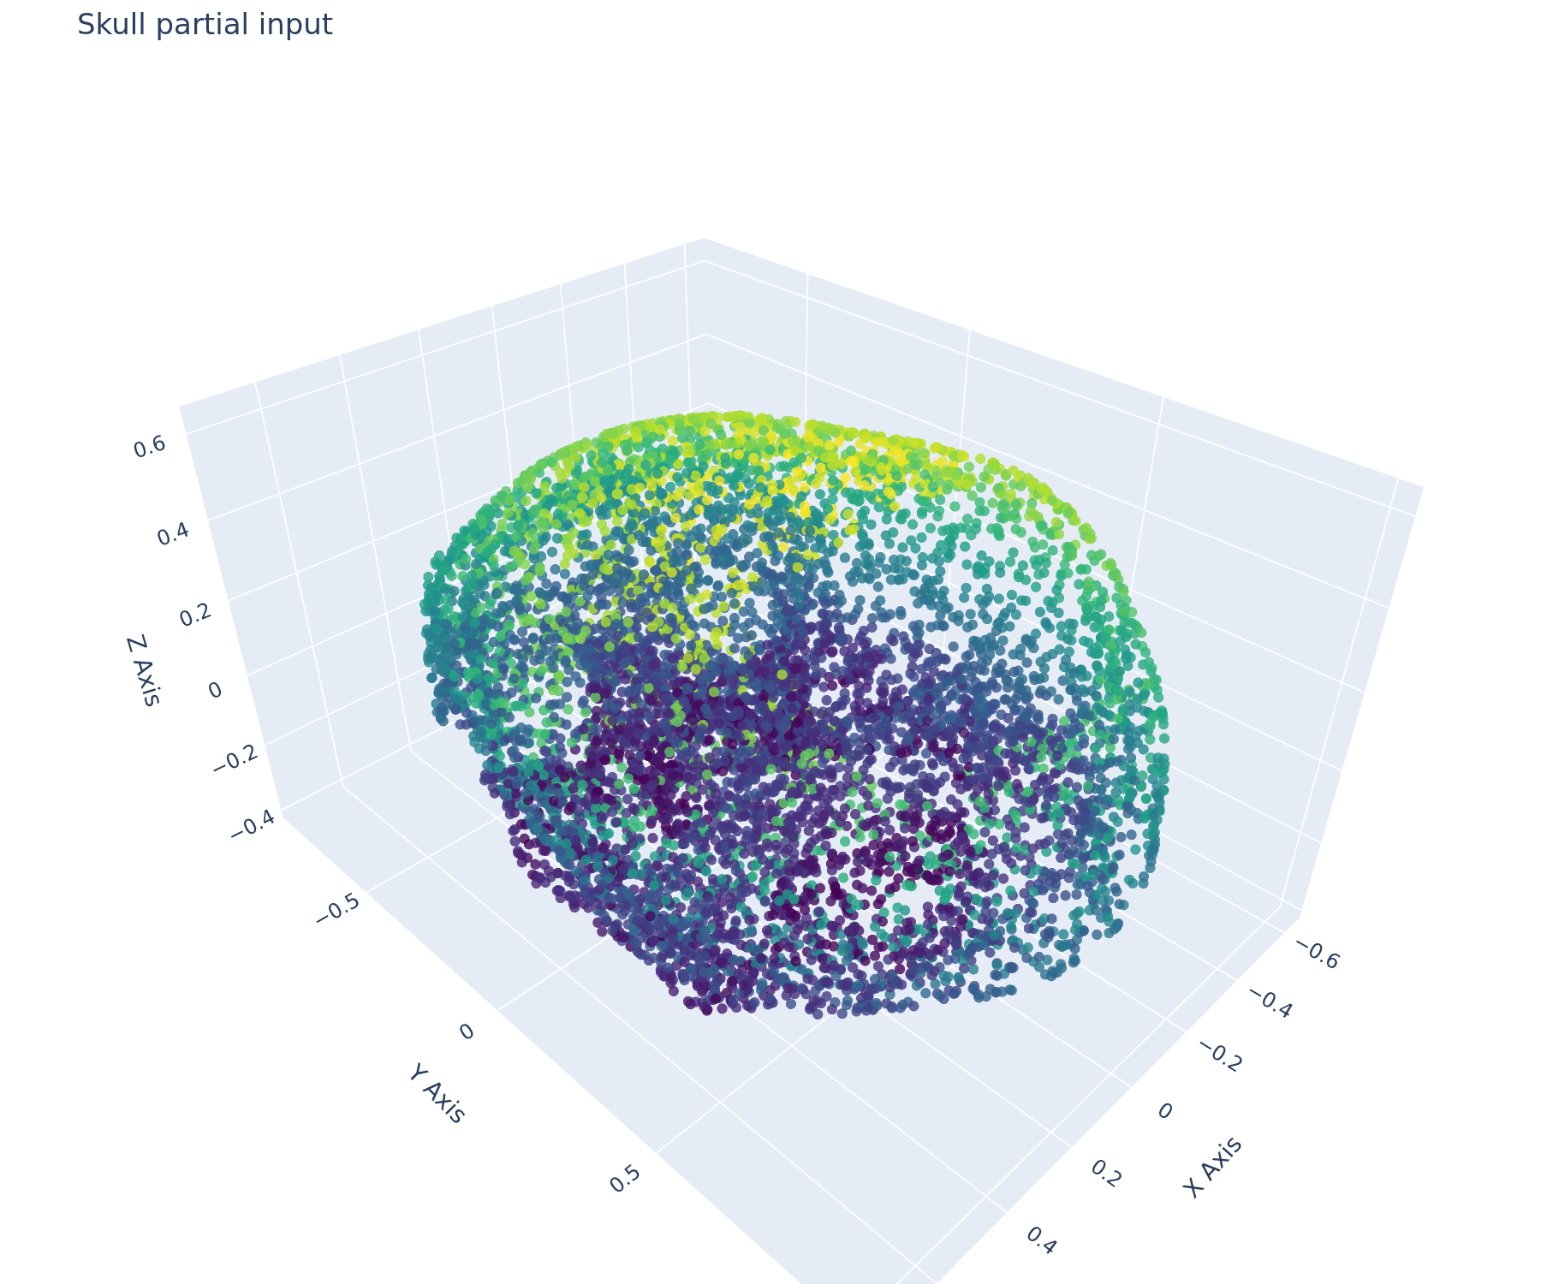
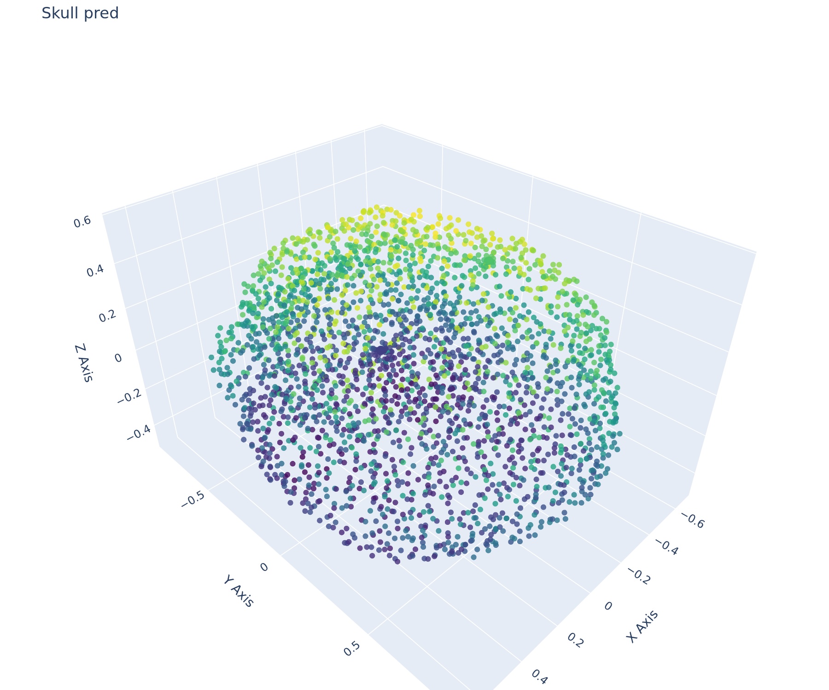
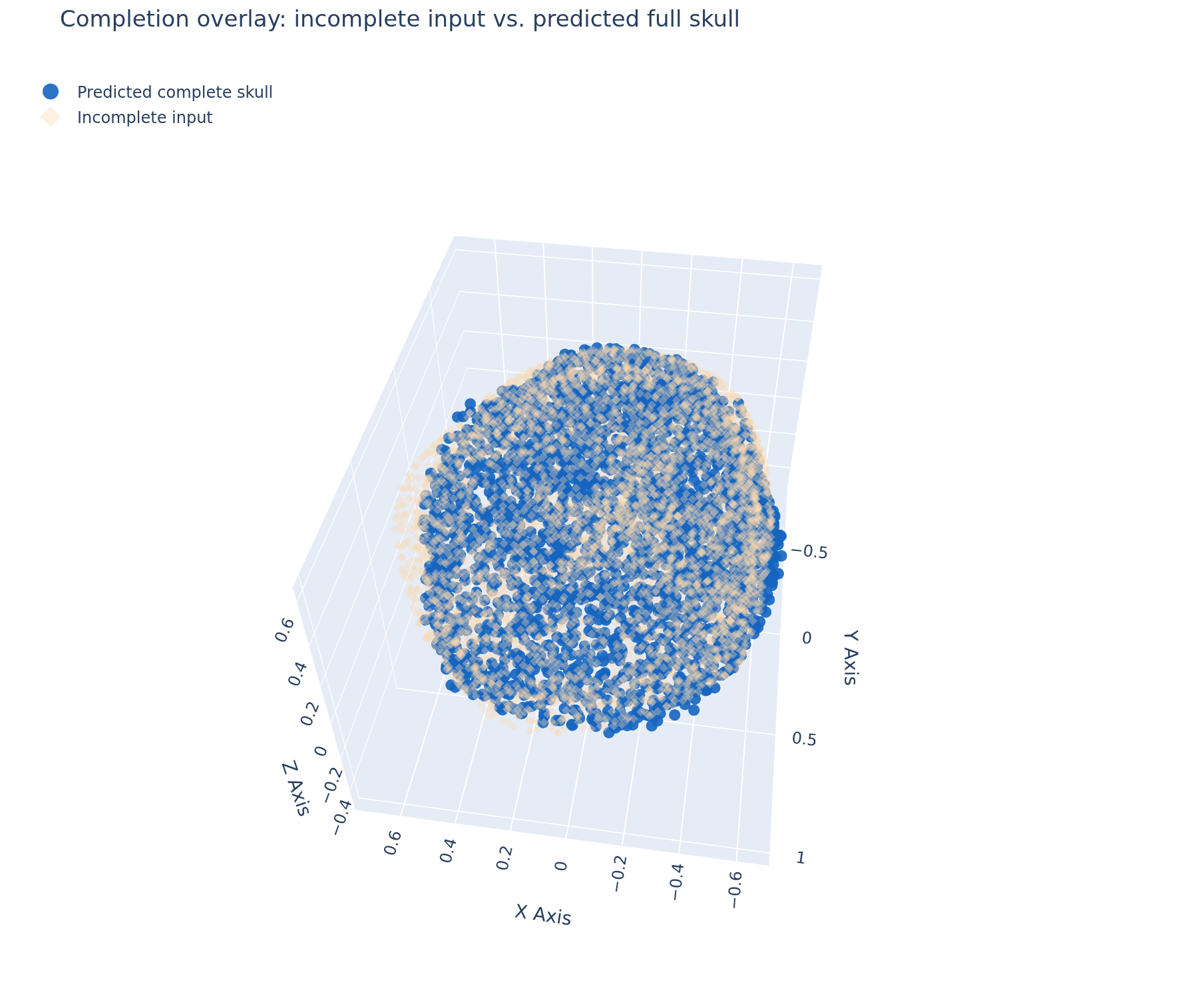
Qualitative Check: skull_000
Direct exports from the inference notebook
Incomplete input
Model prediction (6144 pts)
Overlay: prediction (vivid) + input (pale)
▪ Overall skull outline is recovered; the input already covers most of the surface, with a small, localized region filled in by the model
COMP0190 · 3D Organ Shape Completion — Part 1 Progress
3

Slide 4
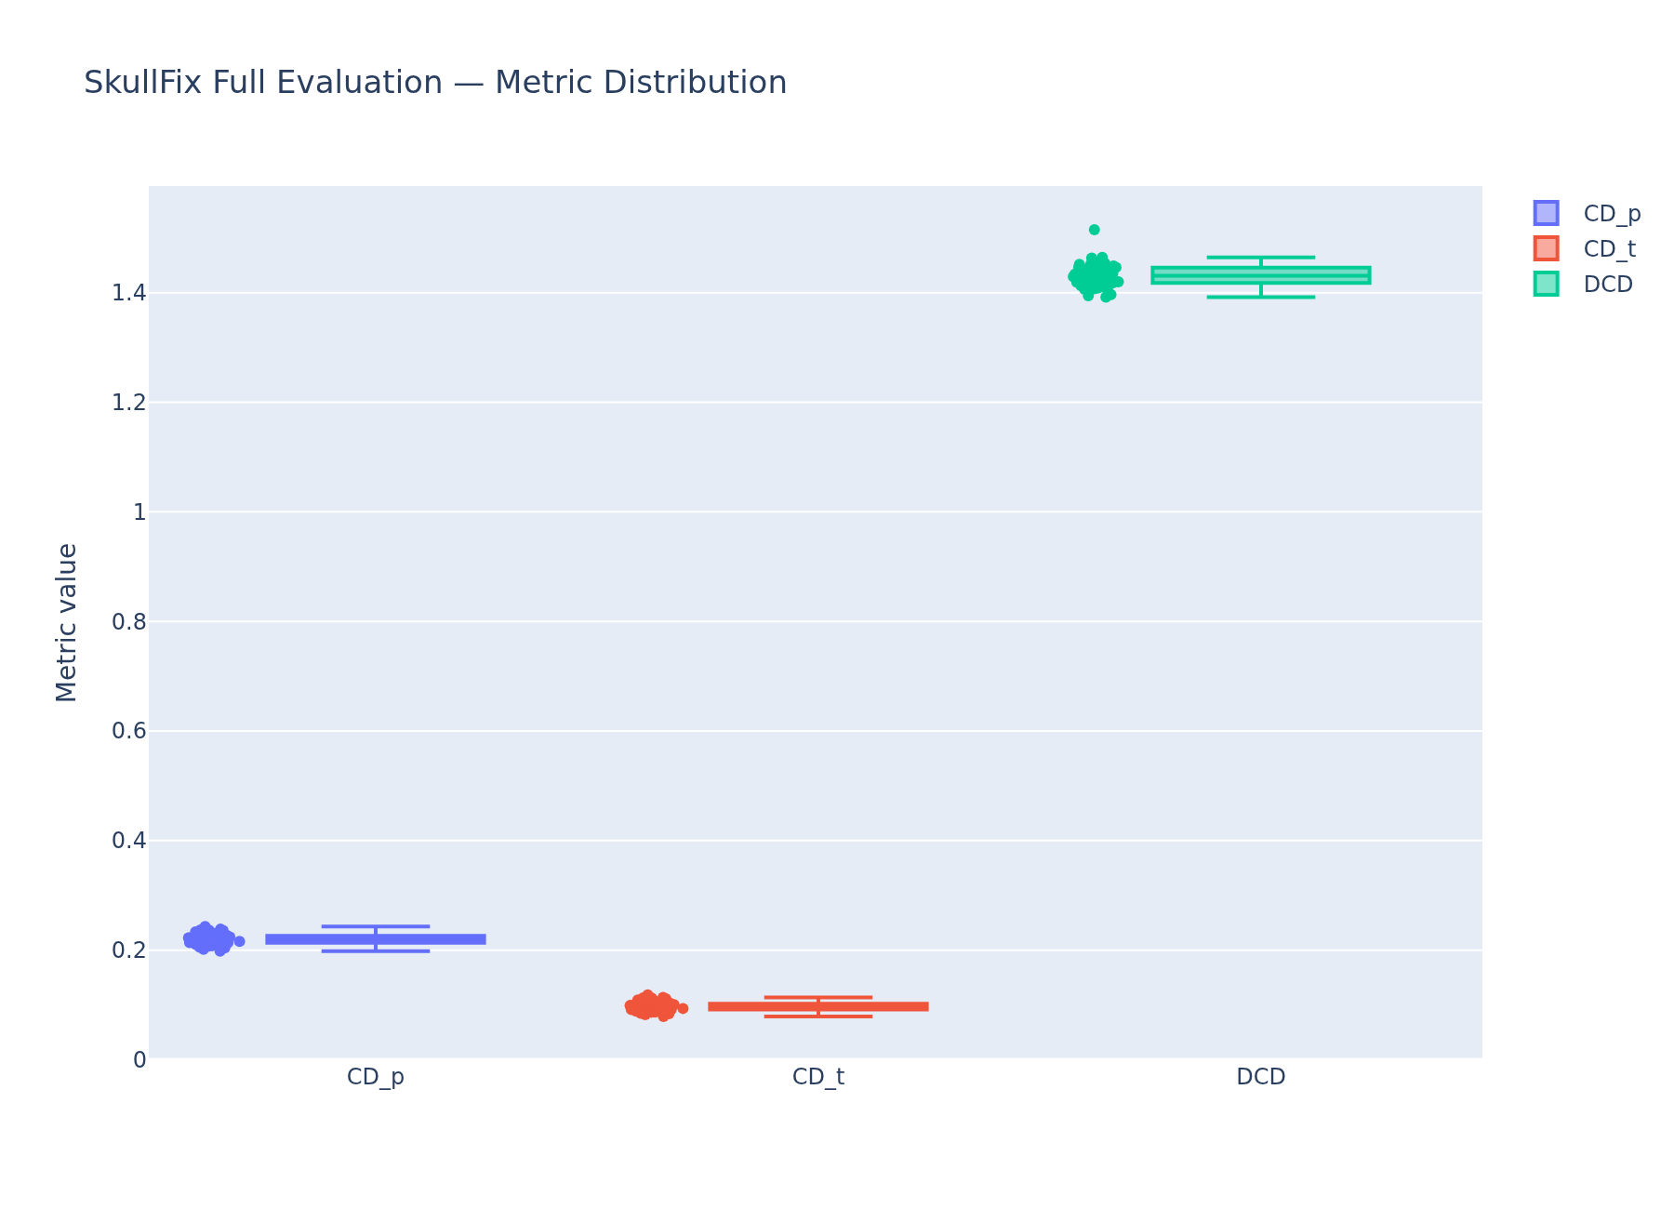
Quantitative Results & What They Mean (50 samples)
Same Chamfer / Density-aware Chamfer metrics used as the training loss
Metric | Mean | Std Dev | Min | Max
CD_p | 0.2203 | 0.0101 | 0.1980 | 0.2431
CD_t | 0.0976 | 0.0088 | 0.0790 | 0.1186
DCD | 1.4317 | 0.0212 | 1.3918 | 1.5149
Reading the numbers
▪ Consistent but weak — small std devs mean uniformly mediocre, not unstable
▪ CD_p ≈ 0.22 is ~22% of the unit-normalized shape radius; DCD ≈ 1.43 sits ~71% up its 0–2 range
▪ CD–DCD gap points at uneven point density (clustered points), not just geometric error
▪ Pipeline reproduces end-to-end, but these weights are not yet a usable skull-completion baseline
Main cause (verified in code): training synthesizes defects by removing a kNN patch from the complete shape, never reading the real incomplete files — a domain gap, not a broken pipeline.
COMP0190 · 3D Organ Shape Completion — Part 1 Progress
4

Slide 5
What Was Changed in the Training Code
Rewrite of the released MSN training demo so the published architecture trains from scratch on a single GPU
Data pipeline
Model and training
▪ Paired normalisation: a single transform derived from the defective skull is applied to both clouds. Previously each was normalised independently, which placed a matched pair in two different coordinate frames.
▪ Voxel spacing from the nrrd header is now applied, so geometry is in millimetres rather than voxel indices.
▪ 50 SkullFix pairs regenerated from the source nrrd into a cached .npz, split by skull id.
▪ Distance kernels rewritten — verified bit-identical to the original.
▪ Loss changed from DCD alone to Chamfer + DCD.
▪ Learning rate 1e-7 → 3e-4 with warm-up; batch size 8 → 4.
▪ Frozen BERT branch precomputed (single class gives a constant output).
▪ Centroid sampling without replacement, and deterministic at inference so evaluation is reproducible.
▪ Checkpoints saved weights-only (2.25 GB → 750 MB per file).
Architecture unchanged. The model trained here is the published one — 187.5 M parameters, 4096 input points → 6144 output points — trained from scratch, not a reduced stand-in.
COMP0190 · 3D Organ Shape Completion — Part 2 Progress
5

Slide 6
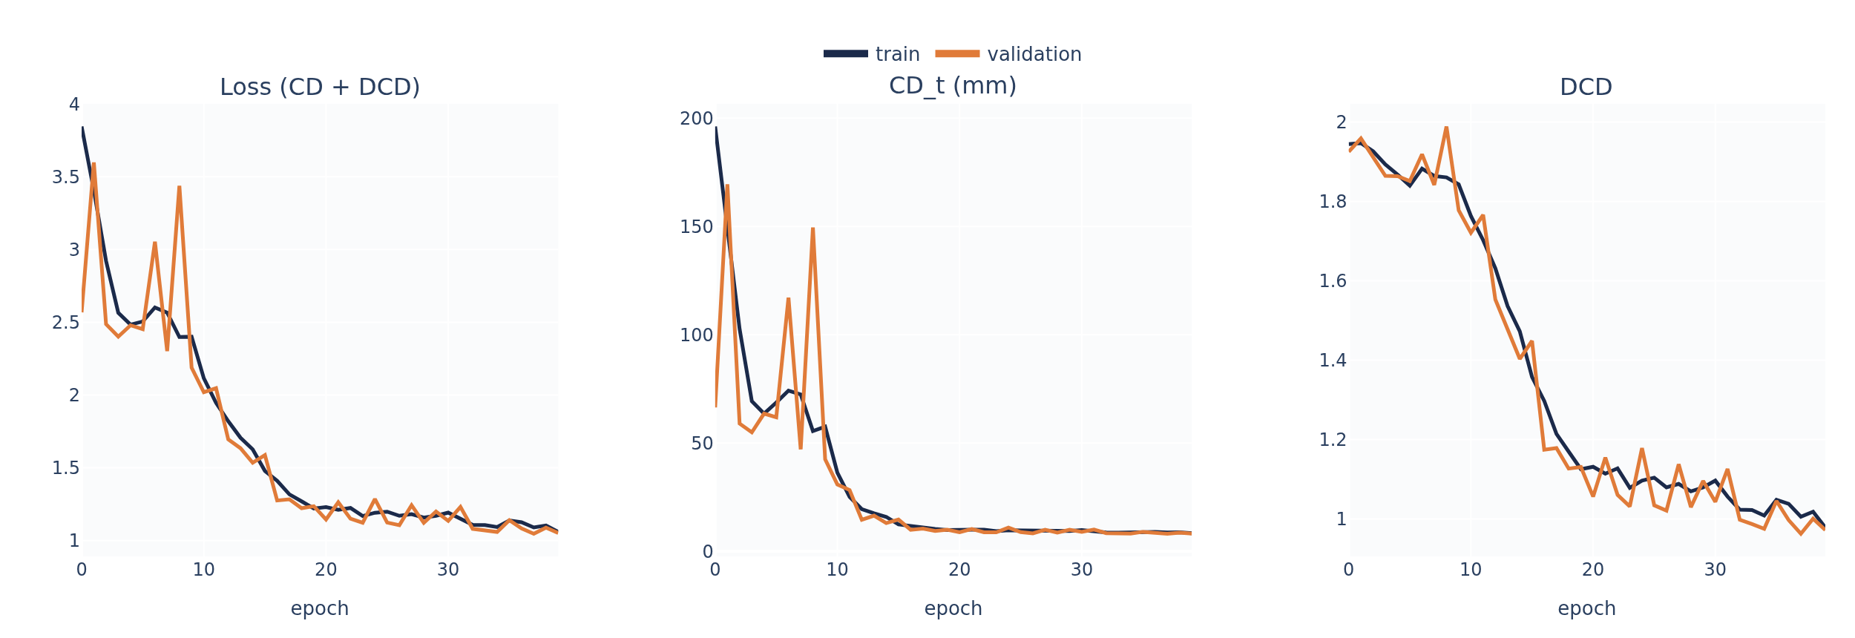
From-Scratch Training: Setup and Quantitative Result
SkullFix, 40 training / 10 validation skulls, single RTX 4090
Setup
▪ Published MSN architecture, 187.5 M parameters
▪ Adam 3e-4 (100-step warm-up), batch 4, loss = CD + DCD
▪ 40 epochs in 3 minutes on one RTX 4090
Validation set (10 skulls)
Metric | Mean | Std | Min | Max
CD_p | 0.1984 | 0.0102 | 0.1865 | 0.2190
CD_t | 0.0790 | 0.0083 | 0.0696 | 0.0960
CD_t (mm) | 8.15 | 0.86 | 7.18 | 9.90
DCD | 0.9660 | 0.0705 | 0.8826 | 1.0943
Training curves — validation CD_t falls from 66 mm to 8.2 mm; most of the
descent occurs within the first 20 epochs.
Wall-clock cost fell from the published 6 × A6000 / 6 weeks to 3 minutes on one GPU. The comparison is not like-for-like — this run uses 40 skulls, not the full MedShapeNet corpus.
COMP0190 · 3D Organ Shape Completion — Part 2 Progress
6

Slide 7
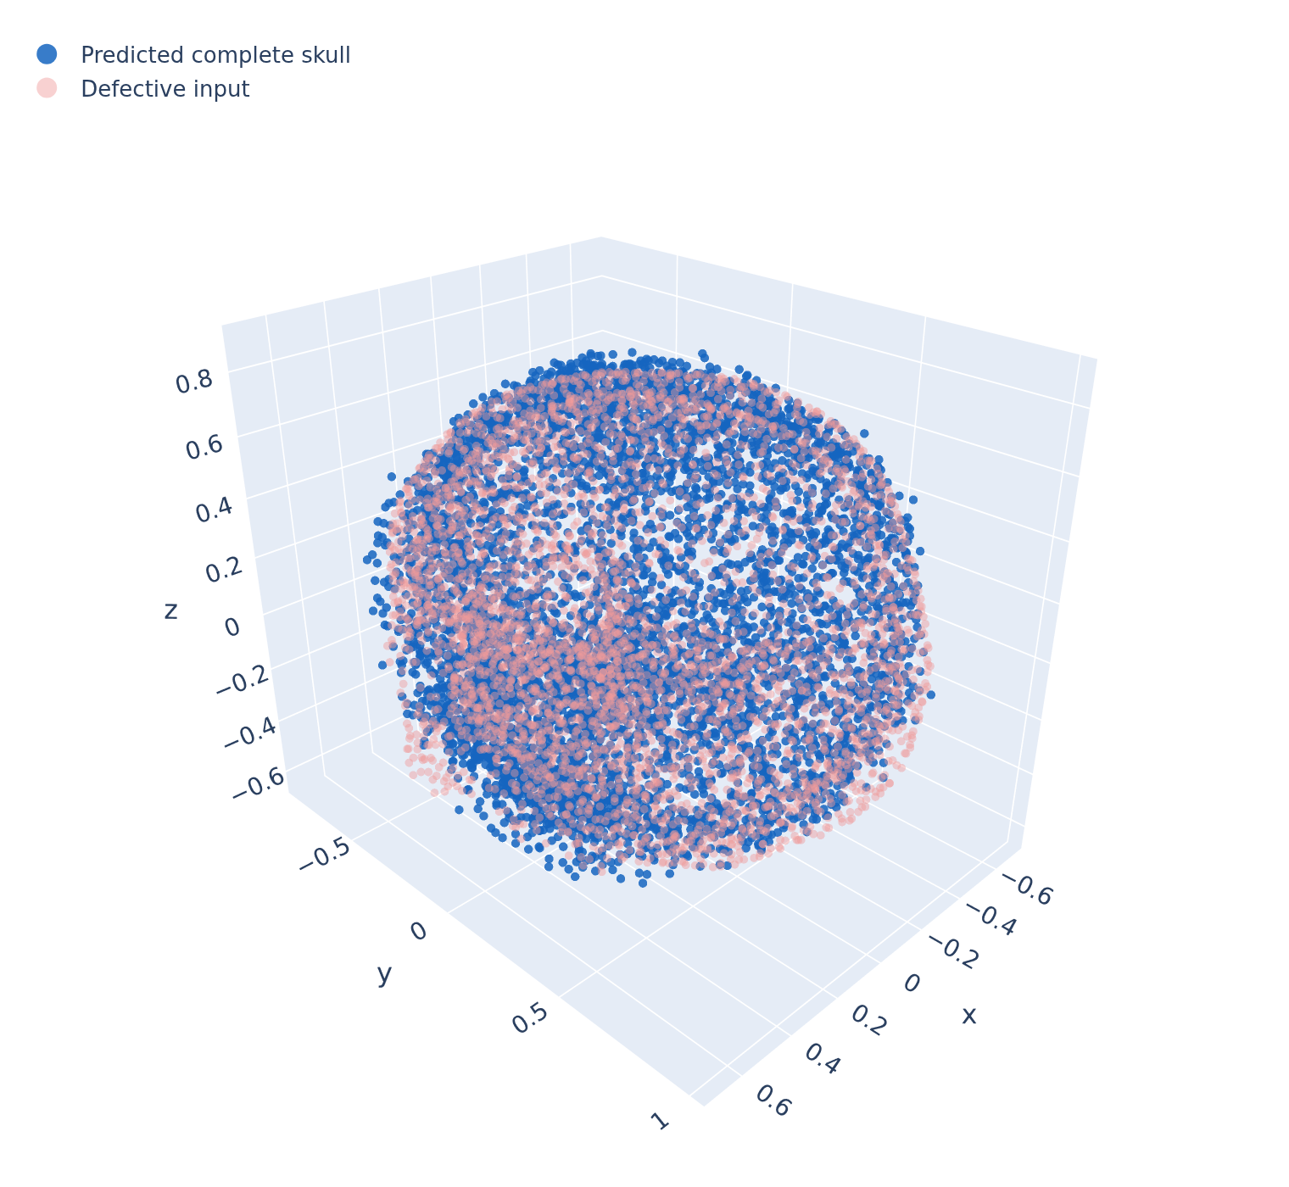
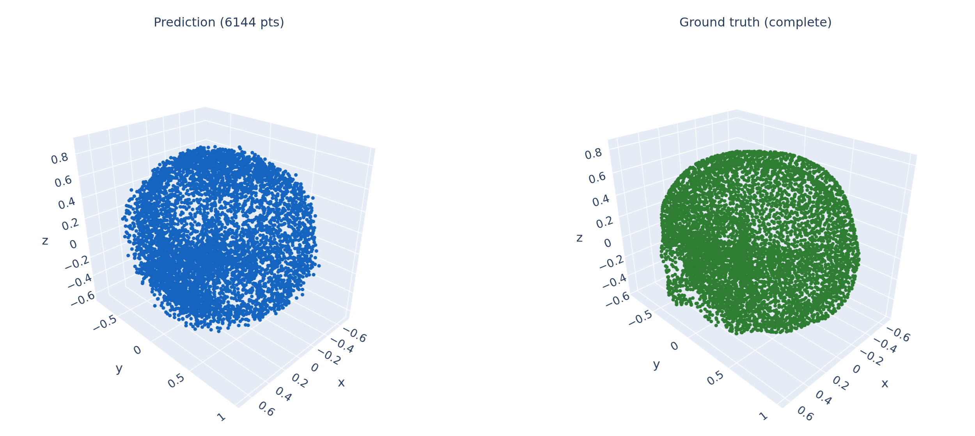
Qualitative Check: skull_032 (best validation sample)
Rendered directly from the trained checkpoint — CD_t = 7.18 mm
Prediction (blue) over defective input (pale red)
Prediction vs ground truth, same viewpoint
Reading: the predicted cloud matches the overall size, position and envelope of the skull, but it is diffuse — the ground truth forms a clean shell, the prediction does not yet resolve onto a surface. Chamfer distance is tolerant of this failure mode.
COMP0190 · 3D Organ Shape Completion — Part 2 Progress
7

Slide 8
Limitations and Next Steps
What this run does and does not establish
Limitations
Next steps
▪ Shape not yet learned. The output reproduces the envelope, not an
anatomical surface, so the 8.15 mm figure overstates the visual quality.
▪ Under-trained. 40 epochs / 3 minutes; all three curves are still falling.
▪ Sample size. 40 training skulls carries no statistical weight, and
SkullFix contains a single regular craniotomy defect pattern.
▪ Train ≈ validation here does not show absence of over-fitting: training
metrics are measured under stochastic centroid sampling (augmentation),
validation under the deterministic path, so the two are not comparable.
▪ Metrics incomplete. CD and DCD are mean-distance measures only; no
Hausdorff, Dice, or boundary conformity — and for a cranial implant the
fit at the defect boundary matters more than the mean.
▪ Output is a 6144-point cloud, not a surface mesh, so it is still one
reconstruction step away from anything implantable.
▪ Train to convergence rather
than to a time budget.
▪ Scale to all 100 pairs, then
on to SkullBreak.
▪ Add Hausdorff, Dice and
boundary-conformity metrics,
shared by both routes.
▪ Implement the voxel baseline.
The project's core question — voxel versus geometry-aware completion — is not yet answered. This stage established the geometry-aware route only.
COMP0190 · 3D Organ Shape Completion — Part 2 Progress
8

