Slide 1
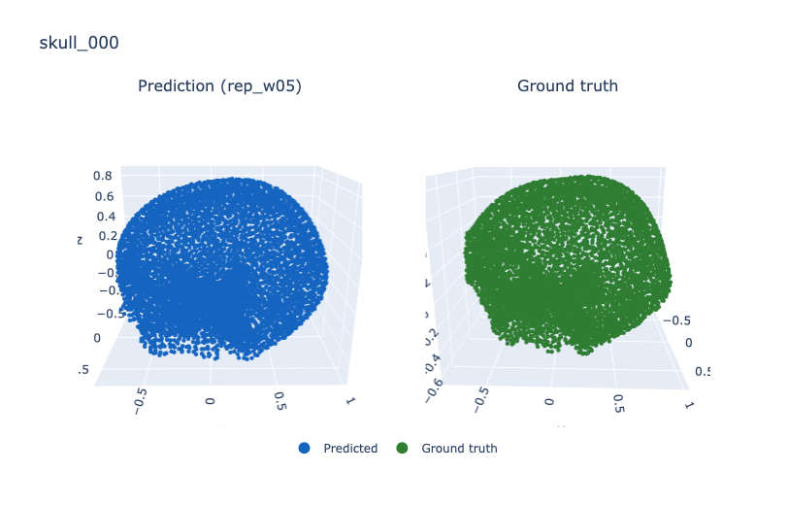
Task and baseline
Skull completion: 4,096 points of a defective skull in, 6,144 points of a complete skull out.
SkullFix, 100 skulls, 80 train / 20 validation — the same split for every run reported here.
For a reference point I ran the authors' released weights on my own data: same validation skulls, same metrics, same aligned point clouds.
 | CD_t (mm) | DCD
Pretrained weights | 10.71 | 1.428
This work | 6.41 | 0.676
Sanity check.
The source paper reports DCD = 1.41269 on its own validation set. The same weights measure 1.42772 on my data — a 1% match, which confirms the metric implementation and the weight loading.
It also frames the comparison honestly: their model has not failed on skulls. It performs here almost exactly as it does on its own data, so the gain comes from specialisation.

Slide 2
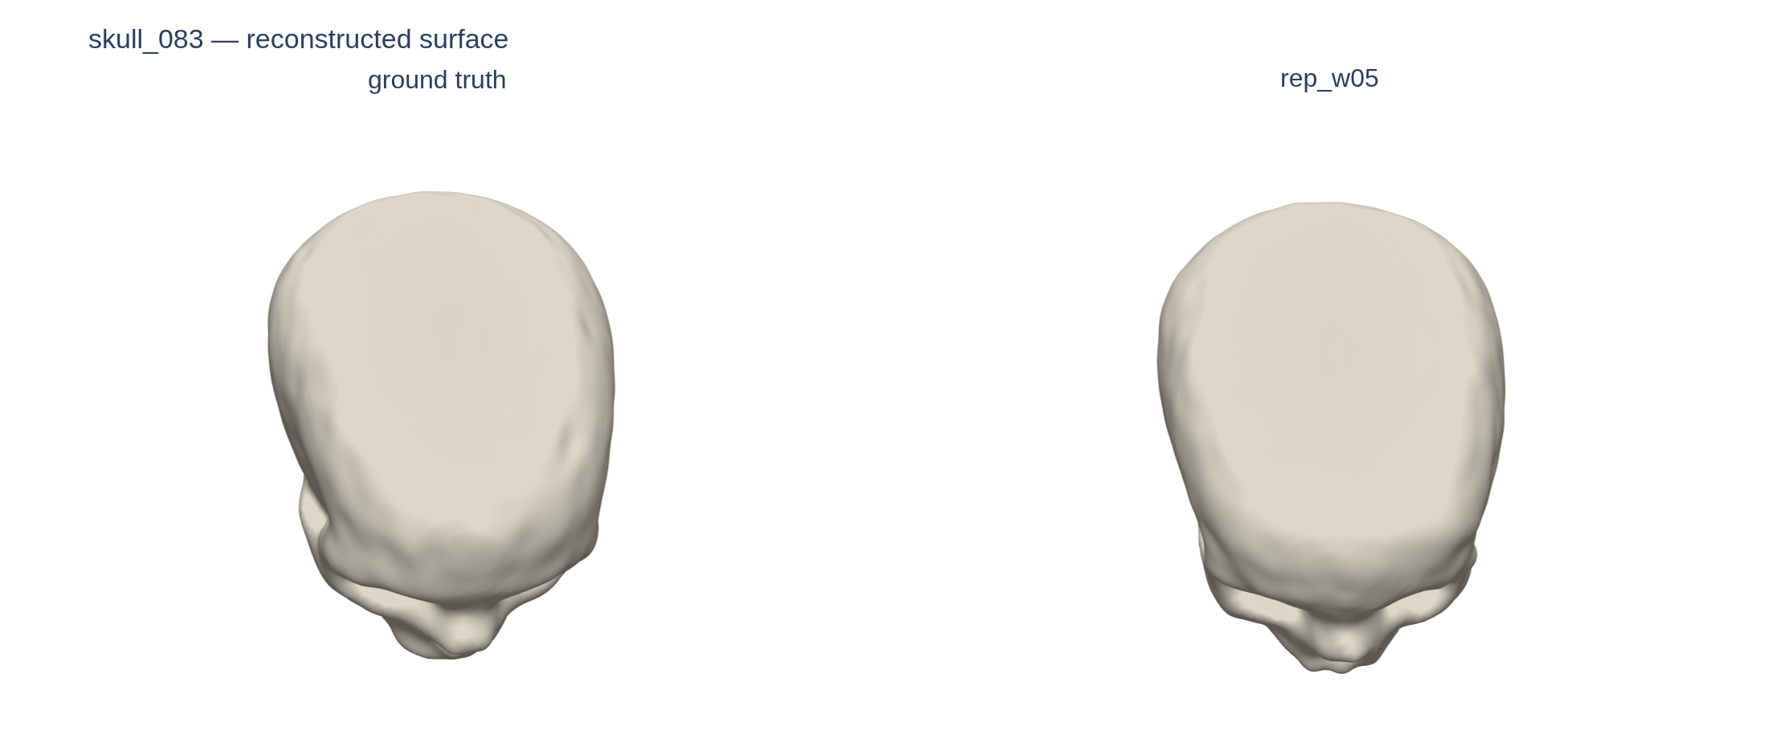
Evaluation tooling
Scatter plots cannot show whether a predicted surface is any good, so I built a reconstruction path: point cloud → distance field → marching cubes → Taubin smoothing. The original repository has none of this.
Poisson reconstruction, the usual choice, was deliberately avoided. It needs per-point normals, which are unreliable on a thin bone shell, and it tends to close holes — the one feature being inspected.
Two rules that came out of it:
Meshes are for looking, never for metrics. Reconstruction pushes the surface outward by a median of 5.3 mm, the same order as the model's own error.
Reconstruction parameters are locked. Every knob changes how smooth a surface looks, so per-figure tuning would disguise itself as model improvement.
What a mesh cannot show
These two surfaces look alike, and the measurements agree. The real difference between my models is in how the points are distributed — which a shaded surface hides completely.
That is why the diagnostics from here on are point clouds, not meshes.

Slide 3
Change of direction
The original plan
Add a smoothness penalty — the predicted surface looked bumpy in the renders. I measured it first, and three things argued against it.
What the data pointed at instead
Point spacing. 12.8% of predicted points sit within 2 mm of a neighbour; ground truth, being farthest-point sampled, has none at all.
1. No measurable difference to exploit
Local roughness came out at 0.736 for ground truth against 0.760 for the prediction.
2. The measurement itself is unreliable
A skull is a thin shell, inner and outer surfaces 5–7 mm apart, and a local surface fit cannot tell that apart from real roughness. Without a trustworthy measure I could not have judged whether the change helped.
3. Overdoing it would cost accuracy
Pushing past the ground truth's own smoothness makes the prediction smoother than the target, which the distance metrics count as error.
 | prediction | ground truth
points closer than 2 mm | 12.8% | 0.0%
spacing CV | 0.389 | 0.145
Those clumped points are wasted — they cover no surface a neighbour does not already cover. Unlike roughness this is unambiguous, and it is what the rest of this work goes after.
Worth noting in advance: fixing the density also improved the surface. Deviation p95 fell from 6.56 to 5.59 mm without any smoothness term at all.

Slide 4
Loss experiments
What I tried
Why it could never work
The obvious response is to lean harder on DCD — the density-aware loss the original project trains with. It has two knobs, and I swept both.
DCD = 1 − exp(−α·d) · 1 / count^λ
The density part of DCD works by counting how many ground-truth points end up assigned to the same prediction. A count is a whole number: nudge a point slightly and it usually does not change at all. So it tells the optimiser nothing about which direction to move — the gradient is not small, it is absent. I checked, and TensorFlow returns nothing for it.
DCD can therefore make Chamfer care more about some points than others, but it can never push two predictions apart.
It is also blind to the most common case: two predictions sitting on top of each other, each claimed by a different ground-truth point. Both counts are 1, so nothing is charged.
Repulsion = max(0, r₀ − d)²
If two predicted points are closer than r₀, push them apart; once they are r₀ apart, do nothing. That is the force DCD structurally lacks — so the two are not redundant.
 | CD_t | clumped | CV
baseline | 7.22 | 12.8% | 0.389
weight 1→3 | 7.59 | 10.0% | 0.370
lambda 1→2 | 7.03 | 12.5% | 0.386
Raising the weight buys density at a poor rate — 2.8 points of clumping for 0.37 mm of accuracy, and 10% is still far from 0%. Raising lambda, which targets density specifically, moves it almost not at all.
Both were dead ends. The question is whether I swept them badly, or whether the loss simply cannot do this.

Slide 5
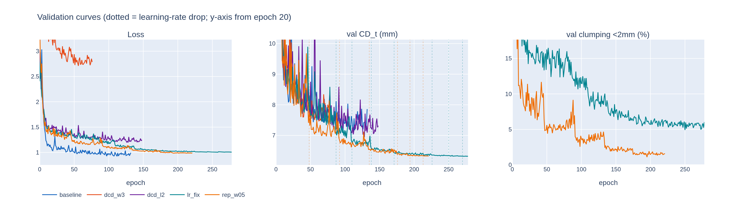
What worked
A configuration bug, not loss design
The learning-rate scheduler and early stopping both watch validation loss, but the scheduler's patience was 40 against early stopping's 20 — so training always ended first and the learning rate had never once been reduced, in any experiment.
Fixing it: CD_t 7.22 → 6.40 mm, training runs to 279 epochs instead of 133. The dotted lines mark each drop.
Repulsion loss
Points closer than 2 mm to each other get pushed apart, and the penalty switches off entirely once they are far enough — so it stops competing with Chamfer rather than pushing indefinitely. The 2 mm threshold was read off the ground truth's own spacing.
Attribution: a third run with the learning-rate fix but no repulsion separates the two. All of the CD_t gain is the learning rate — 6.40 against 6.41. Repulsion contributes density only.

Slide 6
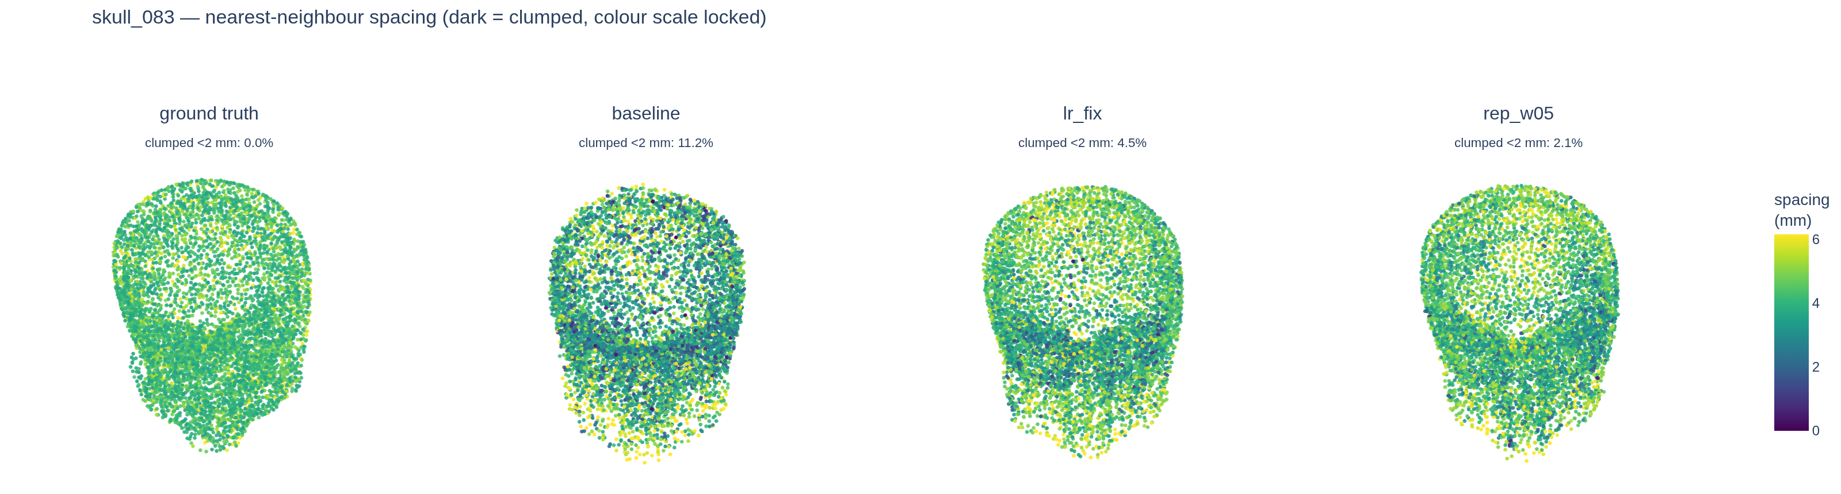
Density
Colour is nearest-neighbour spacing, dark meaning points on top of each other. One colour scale across all four panels — auto-scaling each panel to its own data would render a 12.8% clump rate and a 1.4% one identically.
 | clumped <2 mm | spacing CV | CD_t (mm)
baseline | 12.8% | 0.389 | 7.22
+ learning-rate fix | 5.6% | 0.297 | 6.40
+ repulsion | 1.4% | 0.238 | 6.41
ground truth | 0.0% | 0.145 | —
Clumping falls to 1.4% against ground truth's 0.0%, at no accuracy cost — CD_t is unchanged within run-to-run variance. Repulsion is a density component, and I will describe it as one rather than as a general improvement.

Slide 7
Results
20 validation skulls; millimetres converted with each skull's own scale. HD95 is the 95th-percentile error — Chamfer is a mean and averages away a single bad region, which for implant design is exactly what matters.
run | CD_t (mm) | HD95 (mm) | F1@0.05 | F1@0.03 | DCD | clumped<2mm | spacing CV
baseline | 7.220 | 7.244 | 0.862 | 0.462 | 0.856 | 12.85% | 0.389
dcd_w3 | 7.595 | 8.122 | 0.835 | 0.435 | 0.879 | 10.04% | 0.370
dcd_l2 | 7.031 | 7.155 | 0.876 | 0.476 | 0.847 | 12.47% | 0.386
lr_fix | 6.400 | 6.205 | 0.927 | 0.556 | 0.693 | 5.60% | 0.297
rep_w05 | 6.409 | 6.205 | 0.928 | 0.556 | 0.676 | 1.36% | 0.238
ground truth | — | — | — | — | — | 0.00% | 0.145
F-score against the source paper — same metric definition, different datasets
 | training data | F1@0.05 | F1@0.03
Source paper, Table 1 | 200,000 clouds / 240 classes | 0.937 | 0.741
This work | 80 skulls / 1 class | 0.928 | 0.556
Source paper, Table 2 | 4,800 shapes | 0.892 | 0.623
At the loose threshold this sits between their full model and their small-data run, with three orders of magnitude less training data; at the strict threshold it is behind both, which is where the remaining work is.
DCD and F-score are comparable across projects because definitions and normalisation match. Chamfer is not — under this codebase's definition the paper's CD would fall 35× below the point spacing, so they are almost certainly using a squared-distance variant. I do not put those side by side.

Slide 8
Next steps
Planned
Under consideration
1. Ablate DCD away
Density is handled by repulsion, the hyper-parameter experiments produced nothing, and the mechanism explains why. If removing it changes nothing, three losses collapse to two — a cleaner result than stacking terms.
2. k-fold cross-validation
Every number here is a single 20-skull split. The code is in place and has never been run; this has to happen before anything is written up.
3. Defect-region-restricted metrics
Most of the skull is already in the input, so current metrics are diluted by how well the model reproduces what it was handed. Evaluation-side change only — no retraining.
Focus the model on the defect
The dataset ships implant labels I have never used. Training on them directly puts all capacity on the hard part and matches the AutoImplant protocol — but it is a large change and breaks comparability with everything so far.
Point-to-plane attraction
Another route to the smoothness goal. Chamfer pulls each prediction toward a discrete sample, which lets points scatter either side of the true surface; pulling toward a fitted local plane removes that. Orthogonal to repulsion, verifiable with existing tools.
Poisson reconstruction control
The current visualisation is deliberately robust to uneven density, so it cannot show why density matters clinically. Poisson is not — running it would connect the metric to usability.

