Slide 1
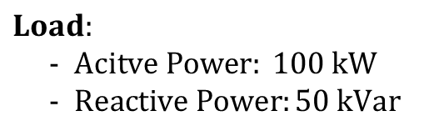

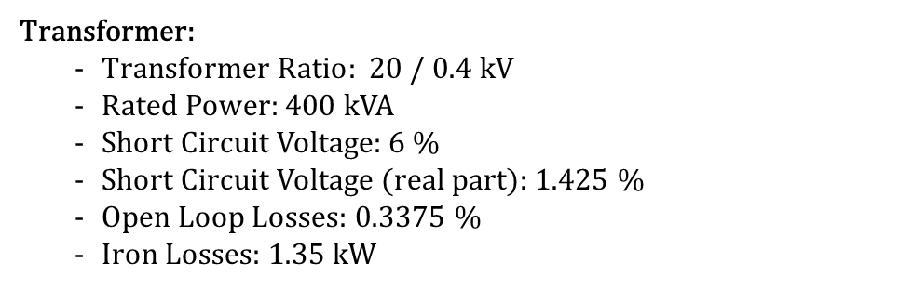
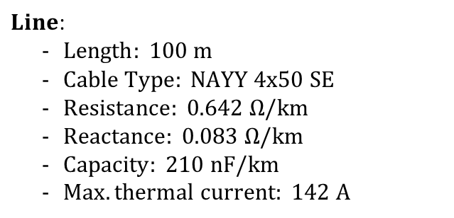

$$Grid Connection:$$
- $Voltage: 1.02 pu$
$$Voltage Level:20kV$$
$$Voltage Level:400V$$
$$Voltage Level:400V$$
Transformer:
$Transformer Ratio: 20 / 0.4 kV$
Rated Power: 400 kVA
Short Circuit Voltage: 6 %
Short Circuit Voltage (real part): 1.425 %
Open Loop Losses: 0.3375 %
Iron Losses: 1.35 kW
$Line$:
$Length: 100 m$
$Cable Type: NAYY 4x50 SE$
$Resistance: 0.642 Ω/km$
$Reactance: 0.083 Ω/km$
$Capacity: 210 nF/km$
$Max. thermal current: 142 A$
$$Load:$$
$Acitve Power: 100 kW$
$Reactive Power:50 kVar$

