Slide 1


PCRA PROCEDURE
PCRA Technical Working Group TRAINING

Slide 2
STEP. 1 MAPPING PROCESS
Box 1. Suggested questions for structured sessions in community engagement fora.
A plenary/ Q/A template provided
Perspectives and experiences of past and current local weather and climate e.g.
-What have been the main threats/hazards facing the community in the last 20-30 years?
-Have you noticed changes in the climate over the last 20-30 years? Explain.
NB: Use the resource map and historical profile to blend with plenary to maximize on data collection

Slide 3
STEP 2 HAZARDS AND SOCIAL, POLITICAL AND ECONOMIC CHALLENGES Identifying current and historical climate hazards and trends
The aim of this section is to identify the challenges and risks that the community believes to be a problem for their livelihoods and well-being (climate and non-climate).
2.1 Ask ‘What do you think are the main risks that your community is currently facing or has faced recently? These might include any of: climate related issues, conflict, insecurity, covid, pests, livestock and crop disease, pollution, political risks, economic risks etc. A plenary/ Q/A template provided
NB: Use both map and historical profile
STEP 3: VULNERABLE GROUP IDENTIFICATION
Identifying the most vulnerable groups in the community The objective of this activity is to identify the people in the community most vulnerable to climate risk (and other risks). These are usually the most economically, socially and politically marginalised and disadvantaged individuals, households and groups in the community.
PCRA Session Three: Current Climate Context - (Phase One Step Five)

Slide 4
Climate Hazards
Facilitator Prior Preparation
NB: Use hazard vulnerability assessment tool to blend – previously done
Step 4: IDENTIFYING CURRENT AND HISTORICAL CLIMATE HAZARDS AND TRENDS–
Current Climate Context Explores current and historical climate hazards and impacts as experienced by the main interest groups and stakeholders in the ward/county. Through an exploration of lived experience of recent climate hazards, the session will focus on identifying the factors that build the resilience of different local production systems and factors that undermine them.
NB: use the historical timeline for reference

Slide 5
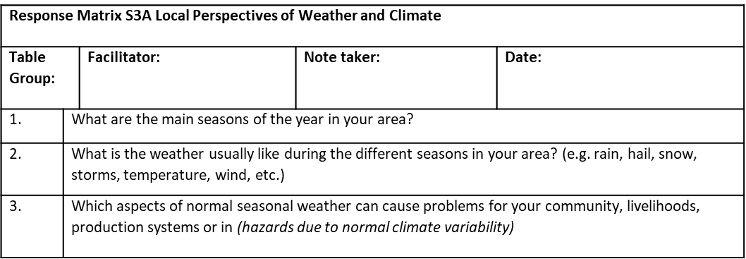

Slide 6
STEP 5: METHODOLOGIES USED IN EXPLORING THE IMPACTS OF HAZARDS
Exploring the Impacts of Hazards (90 min)
The facilitator works with the stakeholders to systematically assess the direct impacts and indirect impacts of the top three climate hazards that are have a critical impact on their livelihoods or productive systems/sector etc.
Direct and Indirect Impacts
NB: use hazard ranking tool
Note-takers should use a separate response matrix S3B for each hazard. During this activity, new sites of interest may be identified on the map, these should be marked and labelled and entered into the map matrix S1A from the session 2. The vulnerable groups response matrices could also be useful at this point (S1C).

Slide 7
STEP 6 : ADAPTIVE CAPACITY AND EXISTING POLICY RESPONSE
Exploring adaptive capacity and existing policy responses
Take the table group through each of the top three climate hazards (and its associated impacts) in turn, asking the stakeholders about existing strategies or practices they use to avoid the negative consequences of the hazard or to take advantage of the opportunities it brings.
Note-takers should use a separate response matrix (see S3C).
NB: Use access & control and wealth ranking

Slide 8
Response Matrix: S3C – Current Adaptation Strategies (Traditional Practices and Policy & Programming Initiatives) Hazard: Drought
Table Group: Facilitator: Notetaker: Date:
Impact or Impact Chain | Resilience Strategy (Describe and rate Effectiveness/ Sustainability; specify location if appropriate) | Vulnerable groups | Factors that can/do support this strategy | Factors that undermine/weaken this strategy
Lack of pasture for livestock | Livestock mobility through seasonal land use system High Effectiveness Sustainable | Mobile Pastoralists | Strong traditional institutions (e.g. Deda in Isiolo) Effective water governance Policies supportive of mobility | Insecurity Privatisation of seasonal grazing areas Obstructions to mobility Unregulated water points

Slide 9
7. FUTURE SCENARIO EXPLORATION
Future Climate Projections Information Sheet
National Projections then county projections.
-Temperature
-Rainfall
-Likely Impacts of the key trends

Slide 10
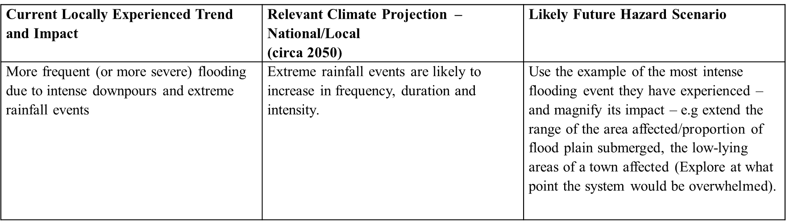
8. ADDITIONAL SCENARIO IMPACTS
Future Climate Context
Review the climate and weather hazard trends which the participants have identified, together with their associated impacts, then generate a number of future hazard scenarios based around these trends by placing them with the context of national climate projections
Template provided

Slide 11
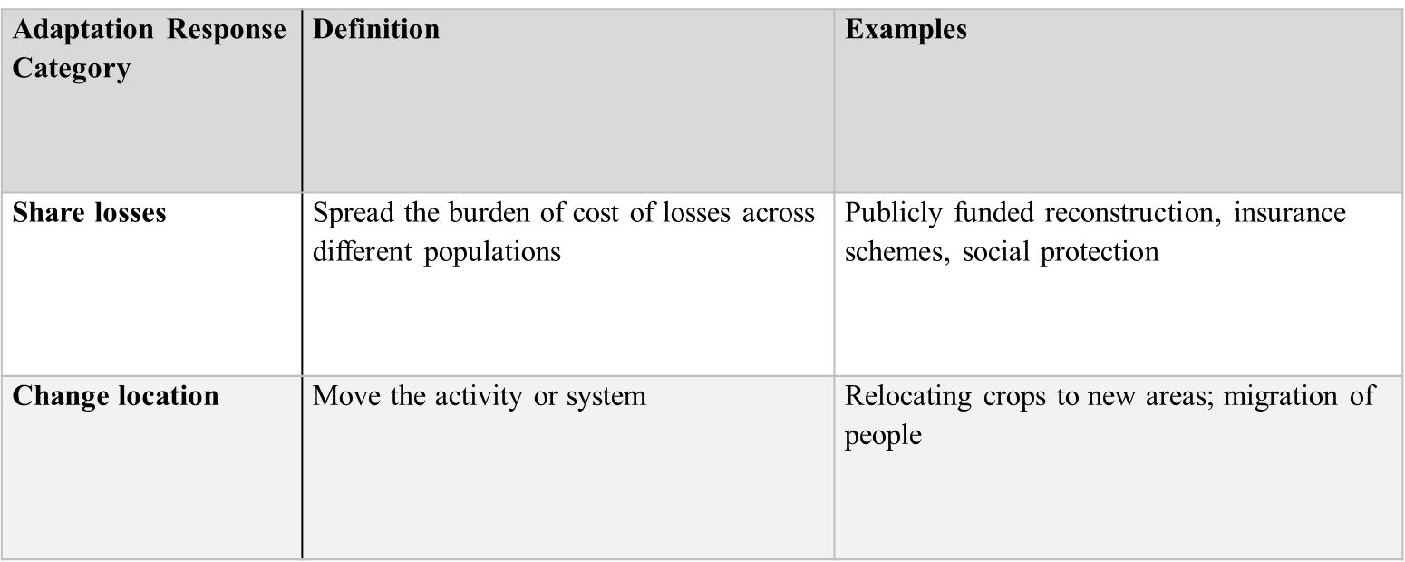
9. EFFECTIVENESS EXISTING ADAPTATION OPTIONS
Table 1 Adaptation Options Response Categories

Slide 12
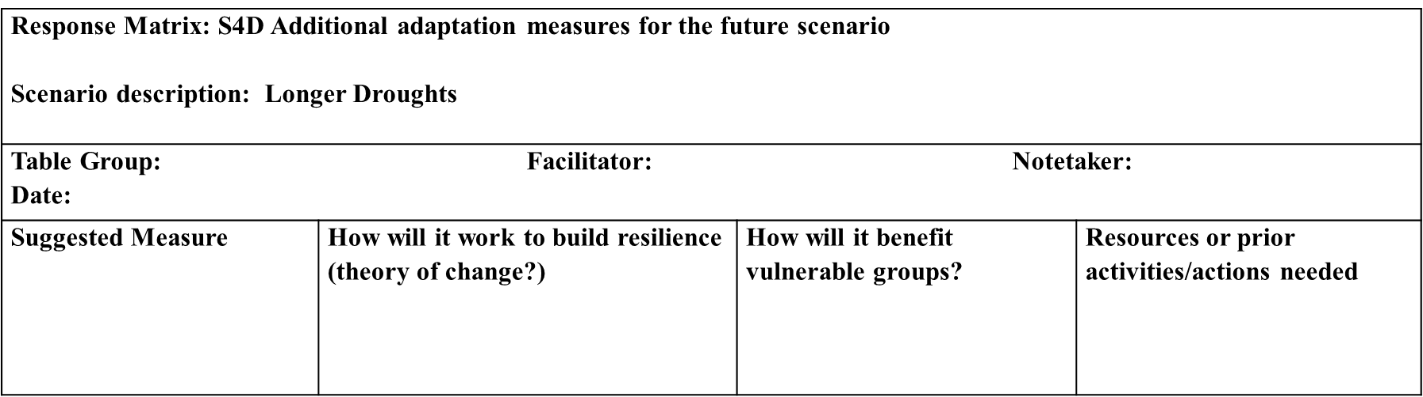
10. ADDITIONAL ADAPTATION OPTIONS

Slide 13
11:WARD CLIMATE CHANGE ACTION PLANS
PCRA Session Five Adaptation Priority Objectives Session Objective Stakeholders in the different table groups review adaptation options and identify broad thematic adaptation priorities covering both current and future climate risks. The session encourages the integration of priorities between stakeholder and sectors, and distinguished priorities at different scales.
Review and rank adaptation options to produce an adaptation pathway.

Slide 14
Table Groups review other groups’ priorities and reconsider their own
Now that the table groups have had an opportunity to view each other’s priorities , Ask the participants to consider whether there are any synergies or commonalities between their priorities and those proposed by other groups. What opportunities are there for complimentary or cohesion? (10 min)
Refine into ward CCAP for upscaling to County CCAP (report writing process to be shared later.)

Slide 15


