Slide 1
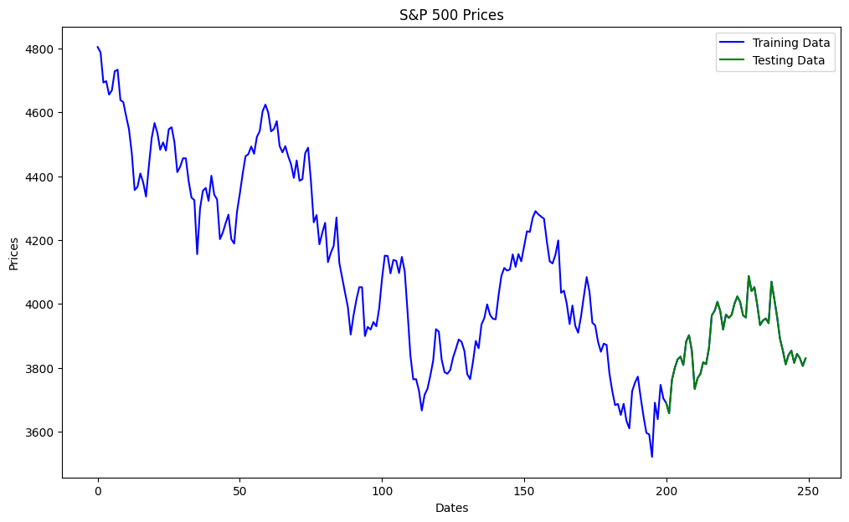

Slide 2
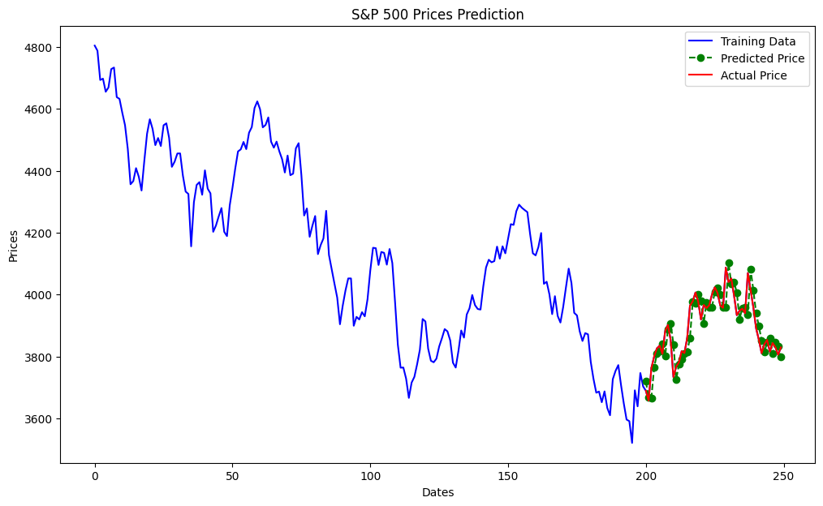

Slide 3
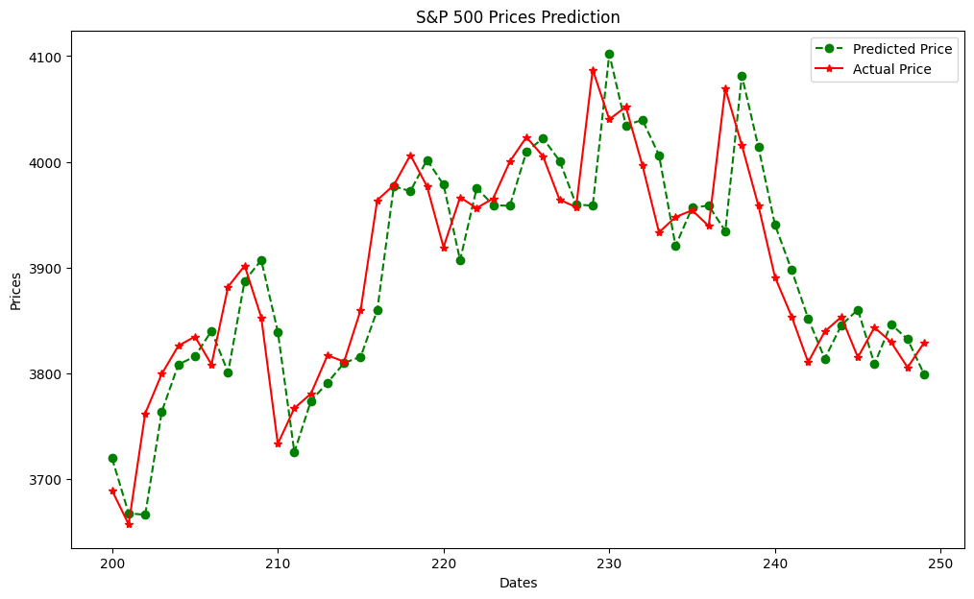
test_data predictions
0 3689.050049 3719.528289
1 3657.100098 3667.515583
2 3762.010010 3666.176012
3 3799.439941 3763.808710
4 3825.969971 3808.218183
5 3834.689941 3815.967268
6 3808.260010 3840.102112
7 3881.850098 3800.760063
8 3901.790039 3887.432397
9 3852.899902 3907.019233
10 3733.250000 3839.331237
11 3766.979980 3725.310979
12 3780.709961 3773.893798
13 3817.020020 3791.127105
14 3810.939941 3809.712608
15 3859.889893 3815.627497
16 3963.719971 3859.613997
17 3977.969971 3976.805352
18 4006.409912 3972.288823
19 3976.820068 4001.846040
20 3919.260010 3978.348313
21 3966.389893 3906.974737
22 3956.229980 3975.265045
23 3965.510010 3959.000504
24 4000.300049 3958.389282
25 4023.340088 4009.436466
26 4005.360107 4022.373581
27 3964.189941 4000.973273
28 3957.179932 3959.597961
29 4087.139893 3958.567493
30 4040.169922 4102.022112
31 4052.020020 4034.559465
32 3996.629883 4039.649222
33 3933.280029 4006.371549
34 3947.790039 3920.375723
35 3954.169922 3956.729559
36 3939.290039 3958.620027
37 4069.379883 3934.506623
38 4015.540039 4081.526844
39 3958.370117 4013.820351
40 3890.909912 3940.297839
41 3853.790039 3897.711369
42 3810.469971 3851.887976
43 3839.489990 3813.839292
44 3853.260010 3845.391987
45 3815.110107 3860.233026
46 3843.340088 3808.675674
47 3829.560059 3846.455626
48 3805.449951 3832.103087
49 3829.060059 3798.967982

Slide 4
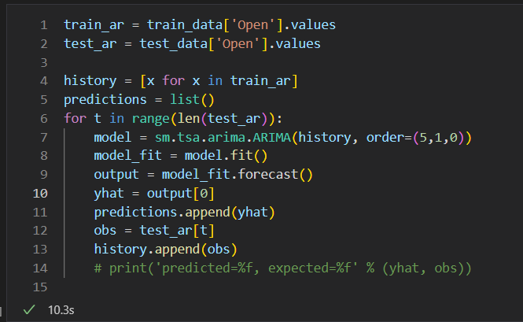

Slide 5
