Slide 1
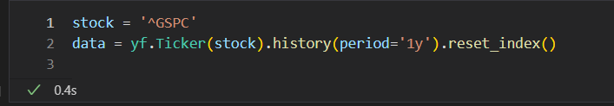
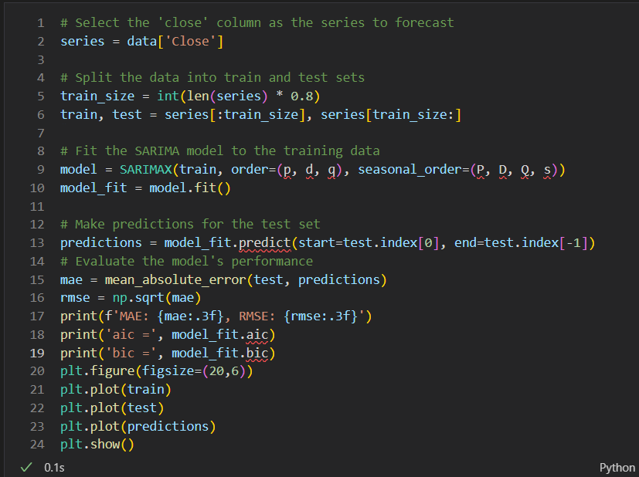

order是三個整數的元組，表示模型的自回歸 (AR, p)、差分 (I, d) 和移動平均 (MA, q) 分量的順序。
seasonal_order是一個包含四個整數的元組，表示模型的季節性分量的順序。前三個整數與order元組相同，表示季節性(AR, P)、季節性差分(I, D)和季節性(MA, Q)項的順序。第四個整數是季節週期(s)，代表一個季節的時間步數。
Akaike Information Criterion (AIC)
Bayesian Information Criterion (BIC)

Slide 2

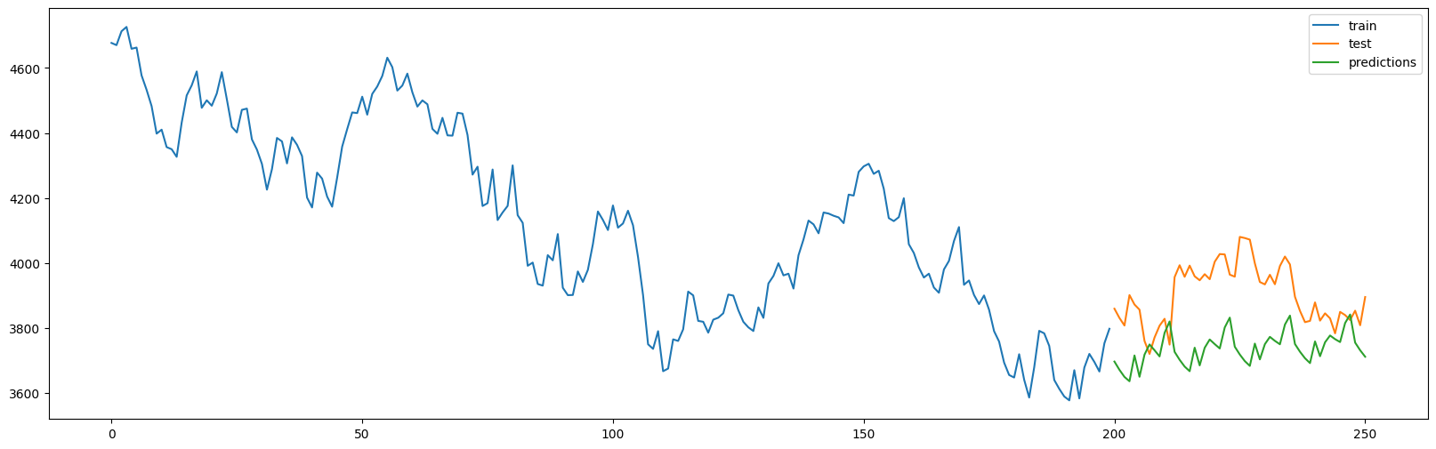
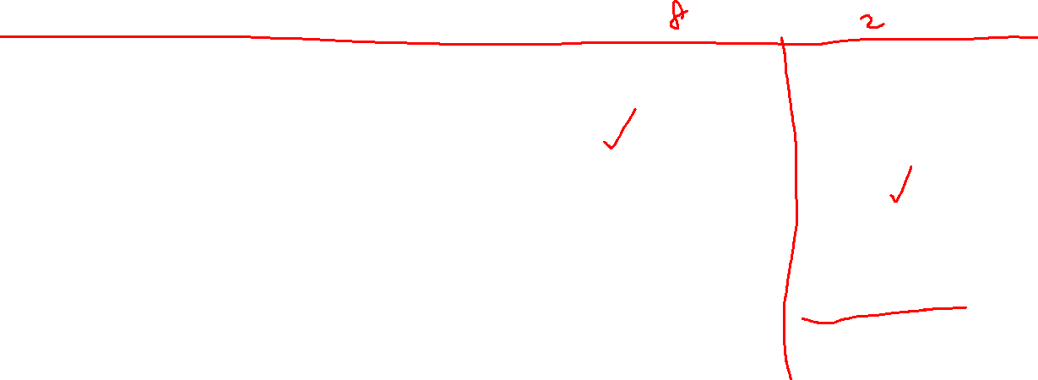
aic = 2542.562720086409
bic = 2552.272045974899
MAE: 171.130, RMSE: 13.082

Slide 3

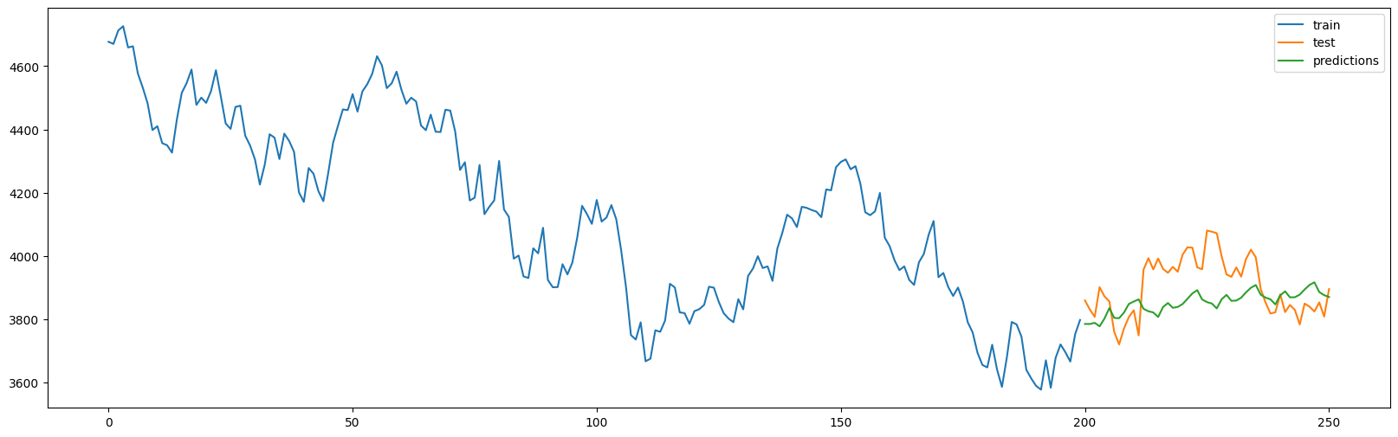
aic = 2160.29671125426
bic = 2173.24247910558
MAE: 88.835, RMSE: 9.425

Slide 4

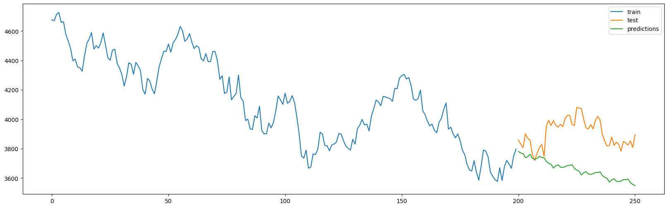
aic = 2126.2044716646124
bic = 2135.897797515176
MAE: 244.172, RMSE: 15.626

Slide 5

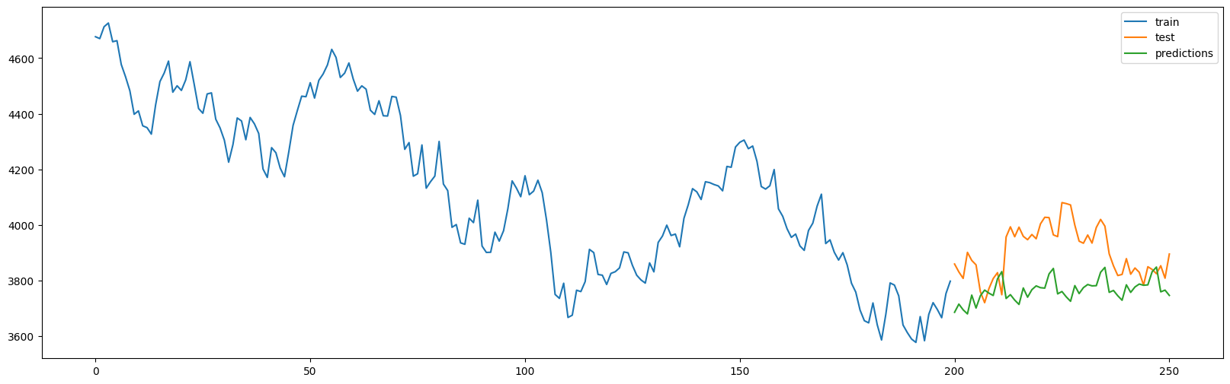
aic = 2382.3463277922574
bic = 2395.2920956435773
MAE: 144.890, RMSE: 12.037

Slide 6

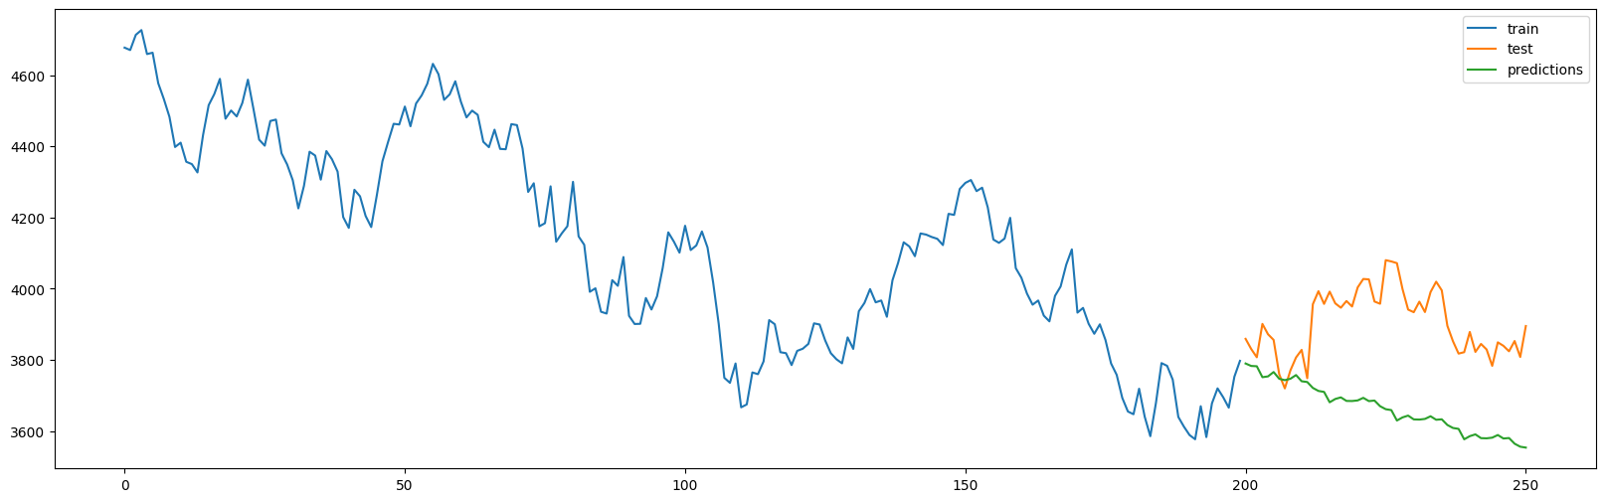
aic = 2128.3103719535884
bic = 2141.234806421007
MAE: 240.006, RMSE: 15.492

Slide 7


aic = 2162.183445343221
bic = 2178.365655157371
MAE: 88.171, RMSE: 9.390

Slide 8


aic = 2129.6176483809886
bic = 2145.7731914652613
MAE: 243.881, RMSE: 15.617

Slide 9


aic = 2132.825255379963
bic = 2158.6312287696687
MAE: 88.201, RMSE: 9.392

Slide 10
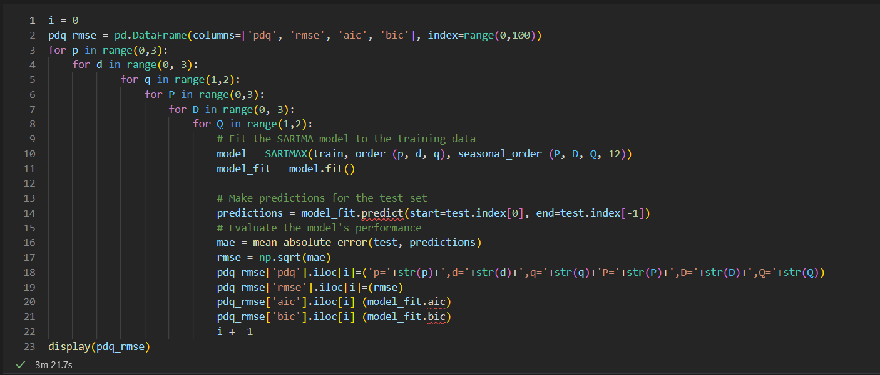

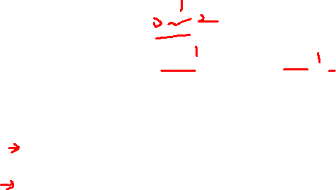
hyperparameter tuning

Slide 11


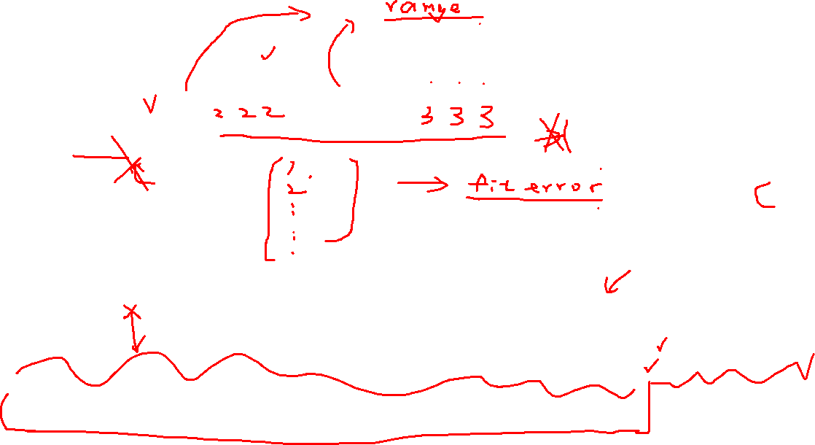
Best RMSE
aic = 2163.19463580171
bic = 2176.14040365303
MAE: 81.320, RMSE: 9.018

Slide 12
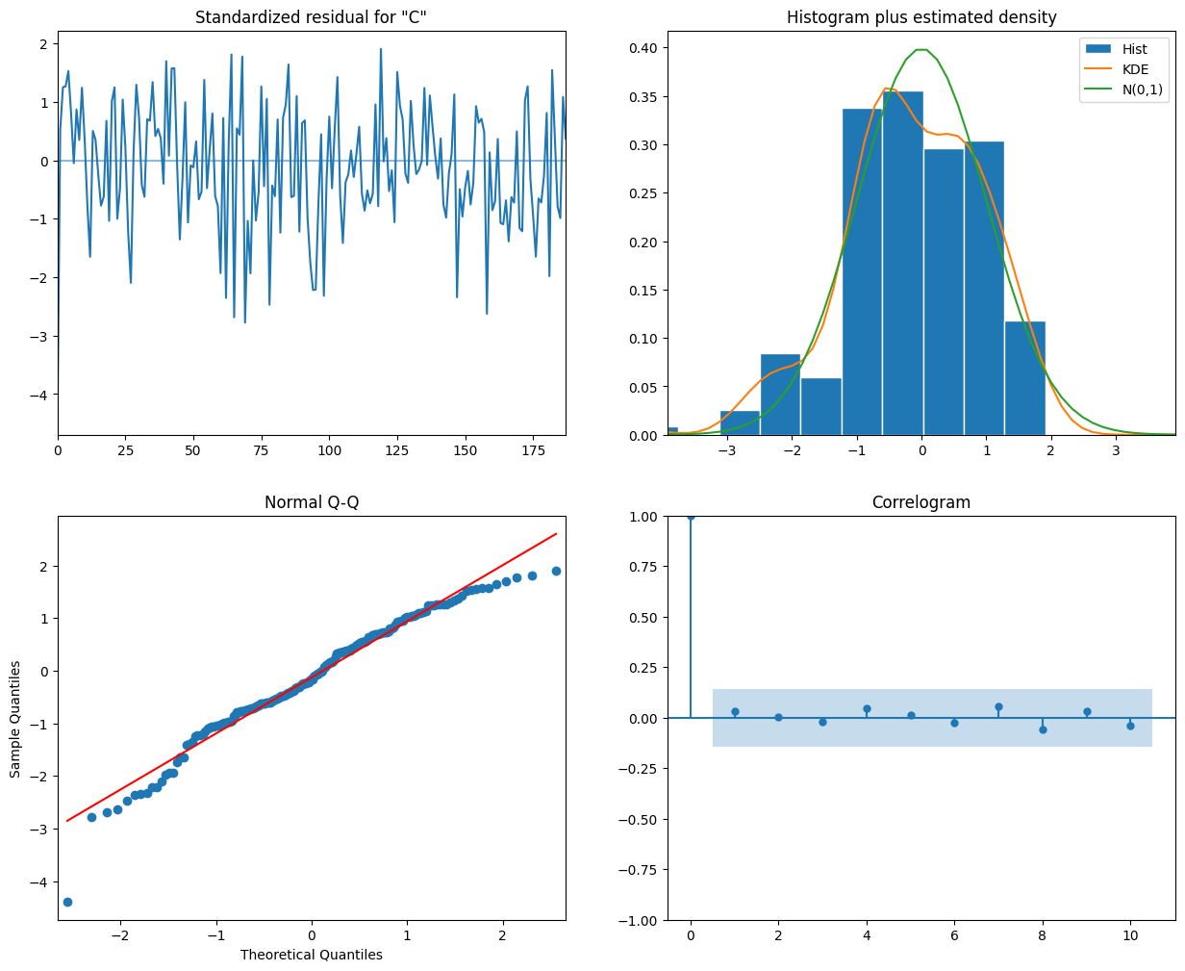

Slide 13

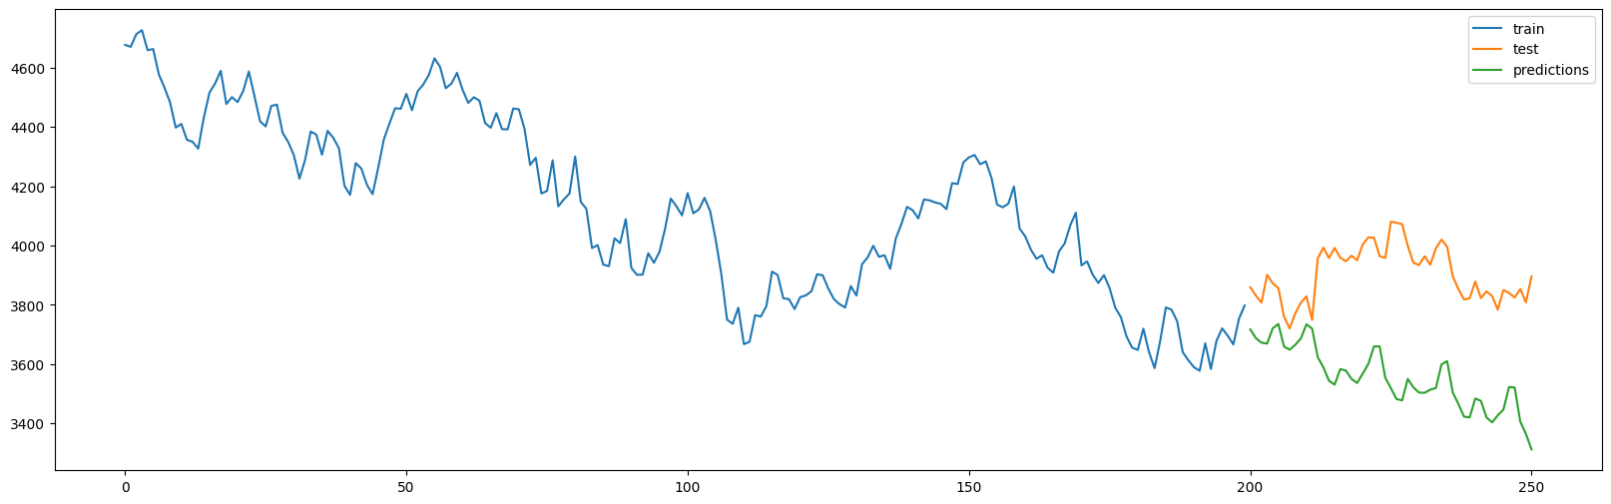
Best AIC, BIC
AIC = 2075.0200370404723
BIC = 2090.815313536545
MAE: 349.319, RMSE: 18.690

Slide 14
