Slide 1
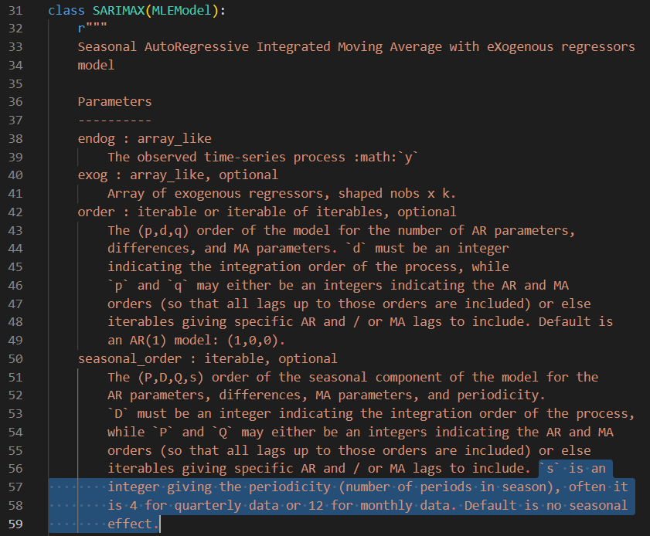

https://www.kaggle.com/code/liweidai/sarimax#%E9%A0%90%E6%B8%AC%E6%A8%A1%E5%9E%8B-Predictive-modelling

Slide 2
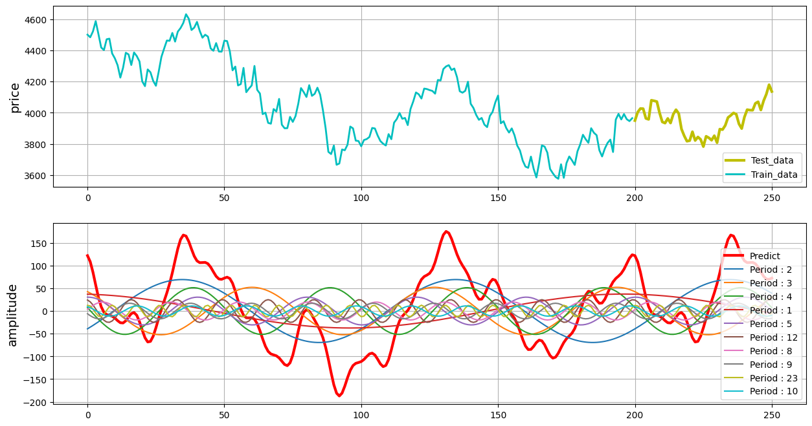
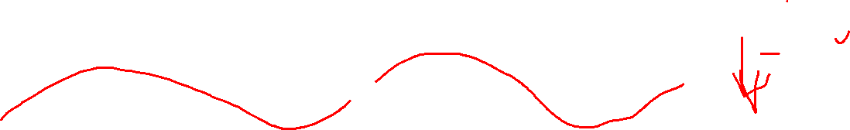

Slide 3
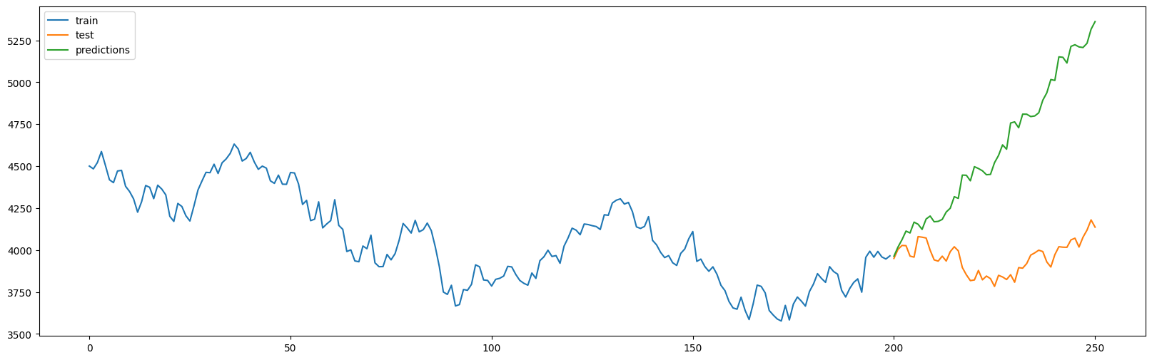
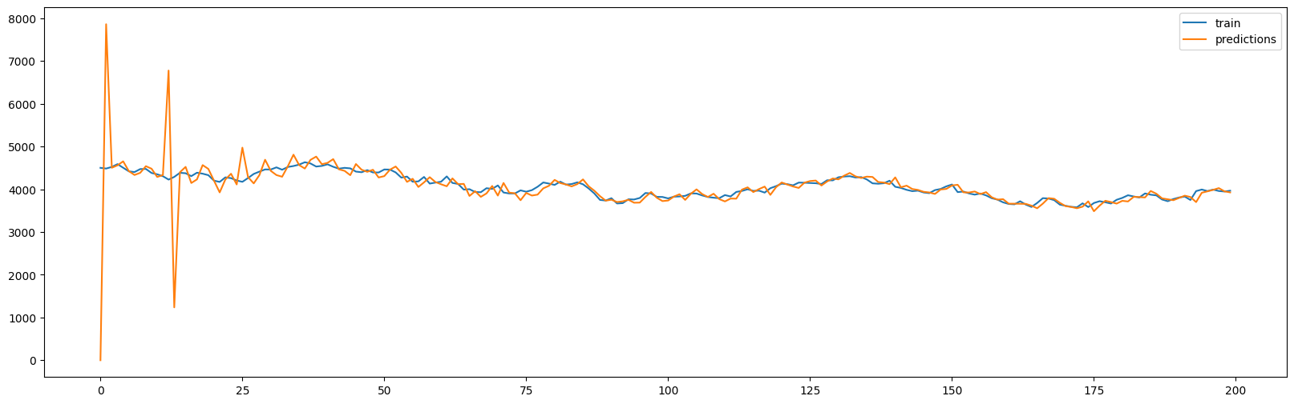
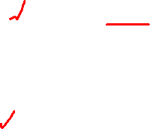
p = 0 , d = 2 , q = 1 , P = 2 , D = 2 , Q = 1 , s = 12
aic = 2077.492382912033

Slide 4
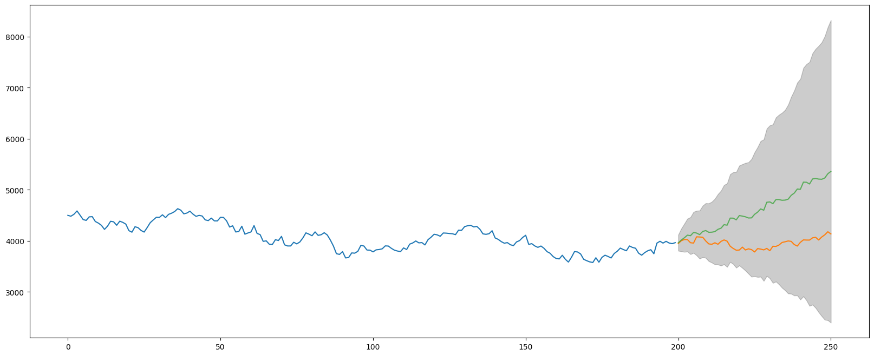
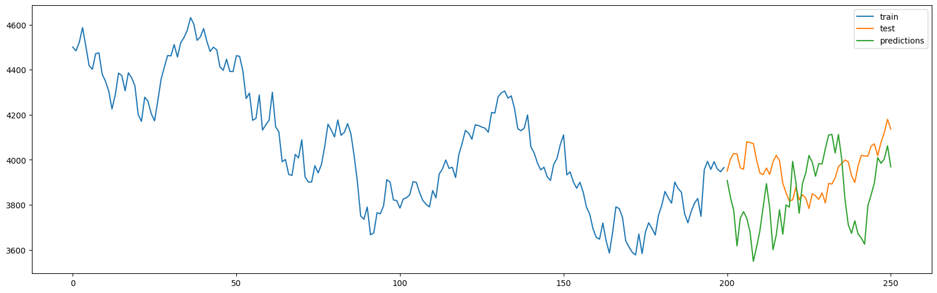

Slide 5
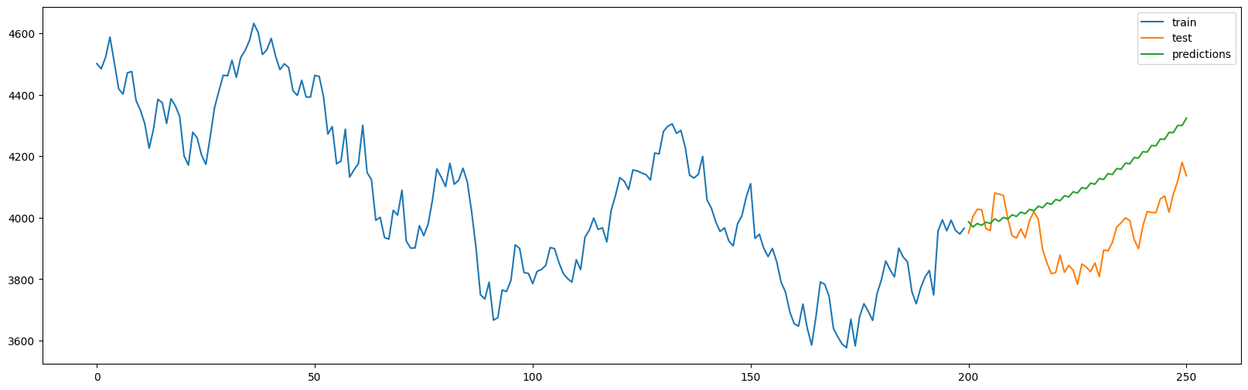
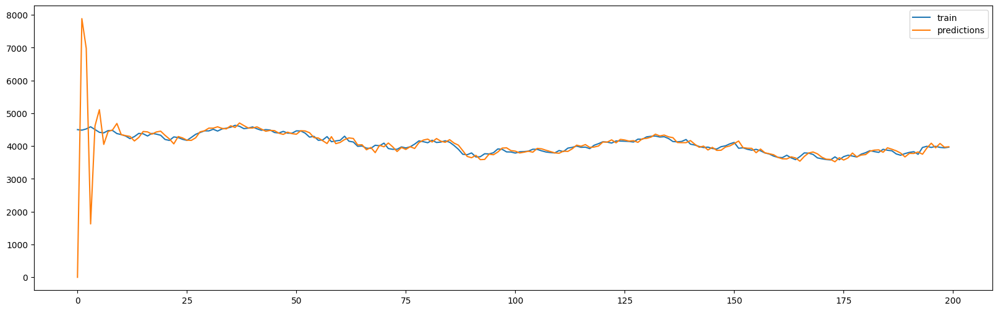

p = 0 , d = 2 , q = 1 , P = 2 , D = 2 , Q = 1 , s = 2
aic = 2265.0063862399356

Slide 6
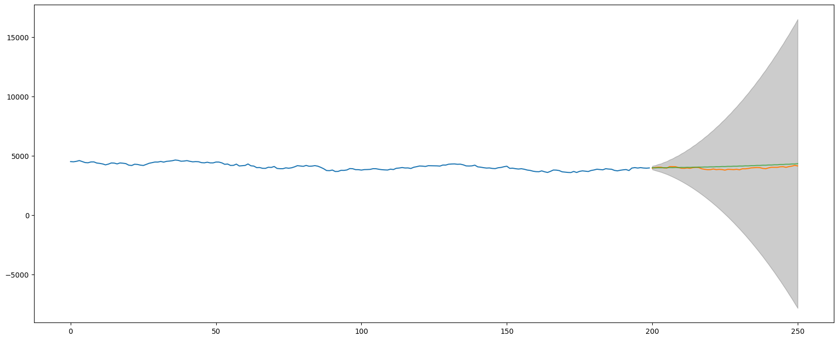

Slide 7
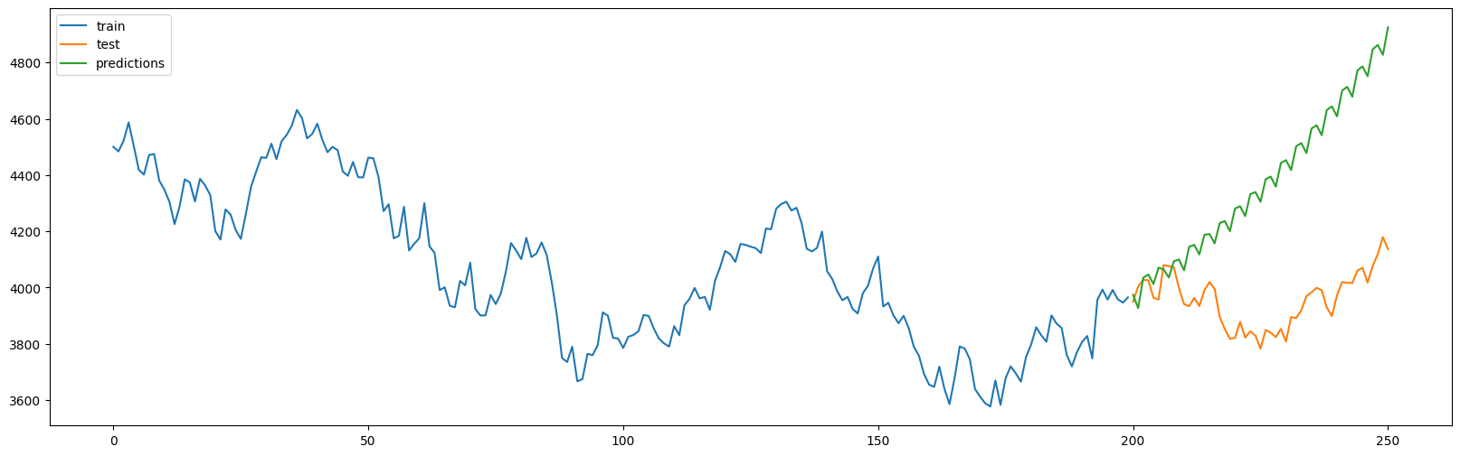
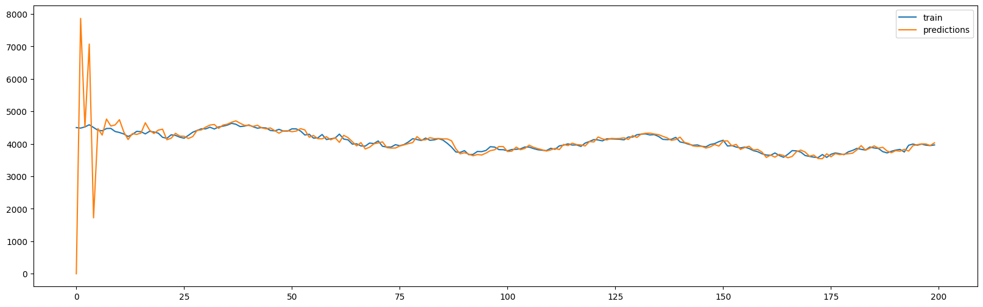
p = 0 , d = 2 , q = 1 , P = 2 , D = 2 , Q = 1 , s = 3
aic = 2239.305309128429

Slide 8
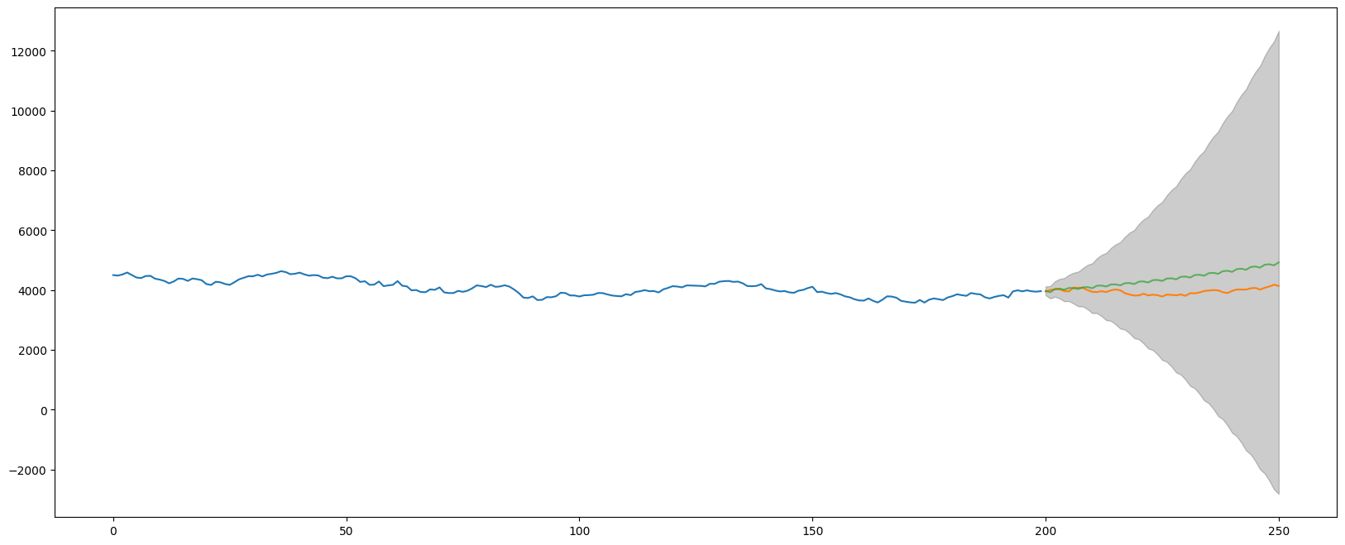

Slide 9
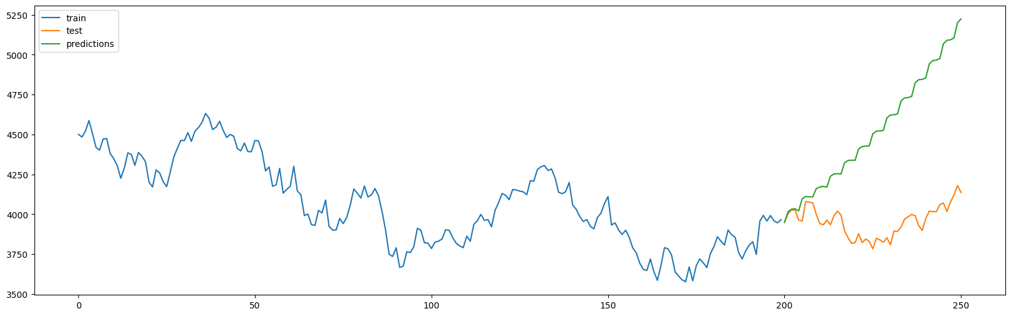

p = 0 , d = 2 , q = 1 , P = 2 , D = 2 , Q = 1 , s = 4
aic = 2235.330505987952

Slide 10
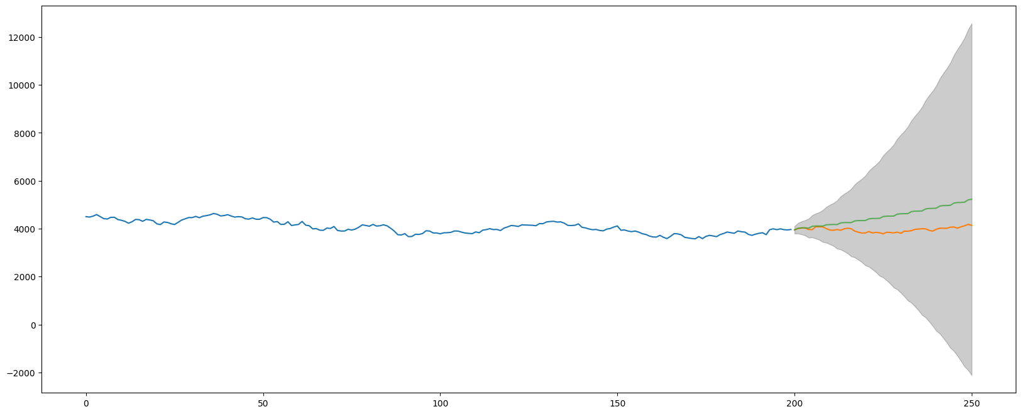

Slide 11
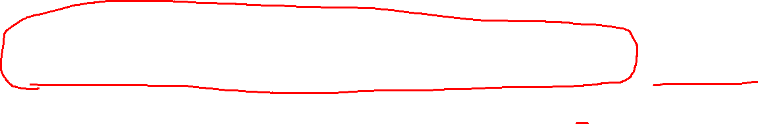
p = 0 , d = 2 , q = 1 , P = 2 , D = 2 , Q = 1 , s = 12
aic = 2077.492382912033

Slide 13
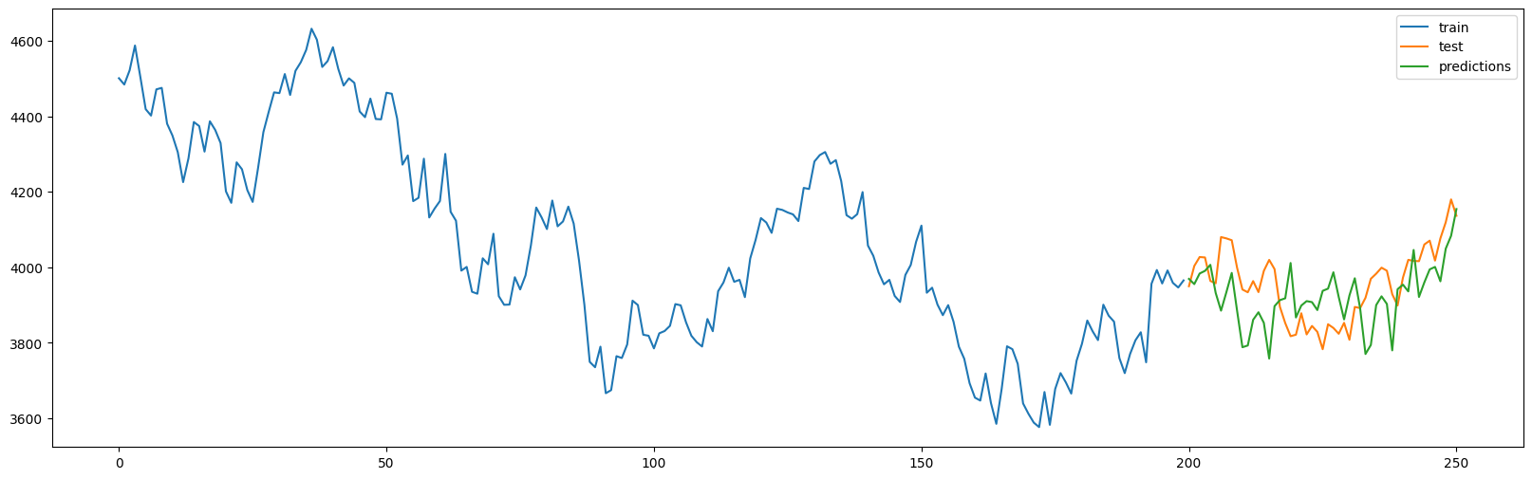
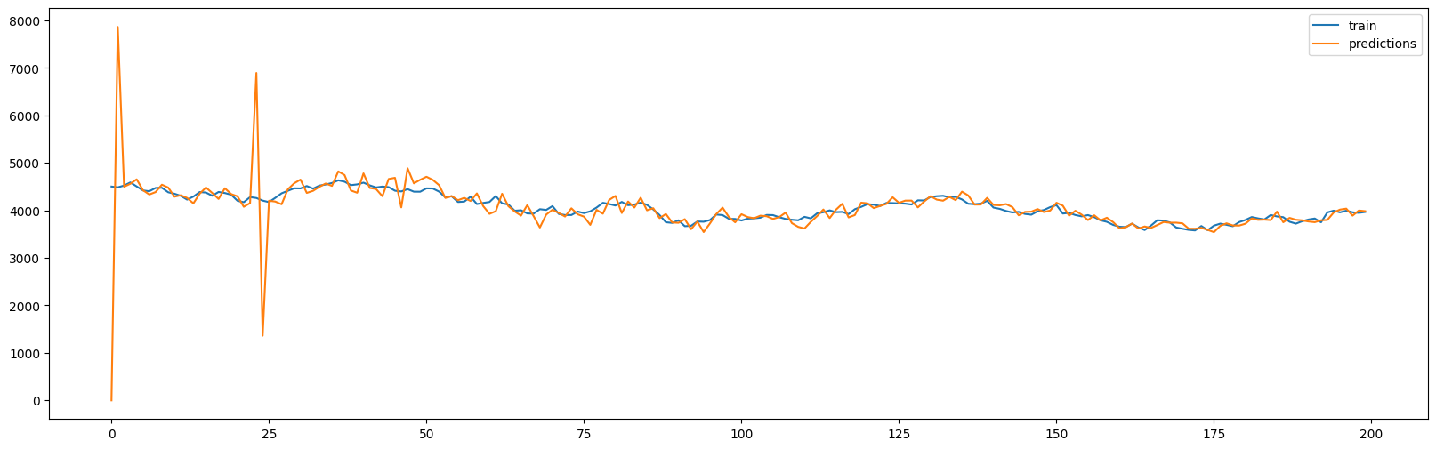

p = 0 , d = 2 , q = 1 , P = 2 , D = 2 , Q = 1 , s = 23
aic = 1836.9720998005573

Slide 14
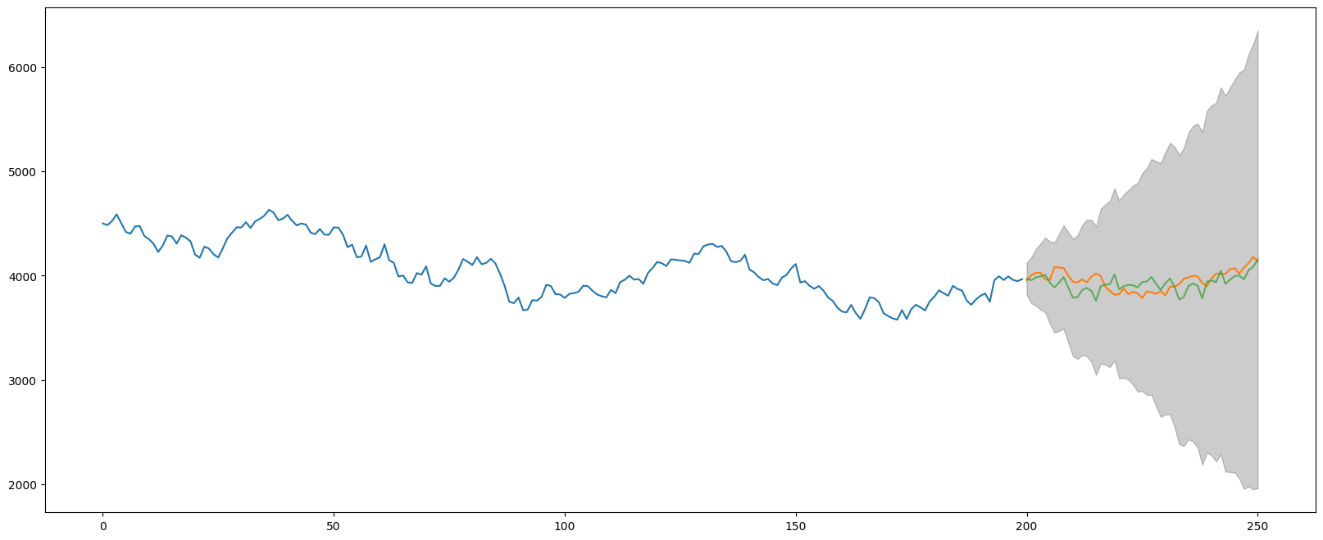

Slide 15
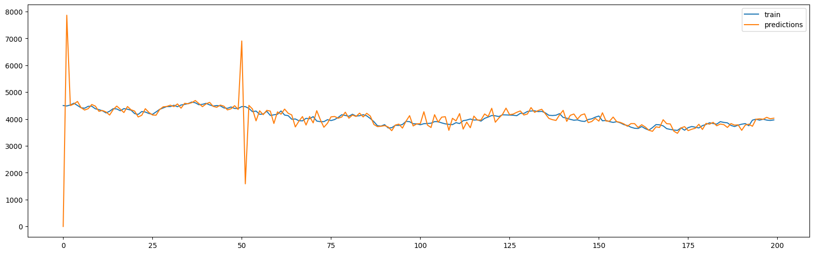
p = 0 , d = 2 , q = 1 , P = 2 , D = 2 , Q = 1 , s = 50
aic = 1255.6312828361552

Slide 16
