Slide 1
1. date_predict_start = '2020-01-01'
FFT stock_name = "^GSPC"
date_predict_start = '2020-01-01'
data_range = 250
slide_range = 10
n_slide = 10
pv_range = 2
fit_method = 'rmse'
pv_method = 'CL’
n_harm_lower_limit = 1
n_harm_upper_limit = 50
Sarima stock_name = "^GSPC"
date_predict_start = '2020-01-01'
data_range = 250
slide_range = 10
n_slide = 10
pv_range = 2
fit_method = 'rmse'
pv_method = 'CL'
Lstm stock_name = "^GSPC“
date_predict_start = '2020-01-01’
data_range = 250
prediction_day = 30
slide_range = 10
n_slide = 10
pv_range = 2
train_data : 2000-01~2019-12
共476筆資料

Slide 2
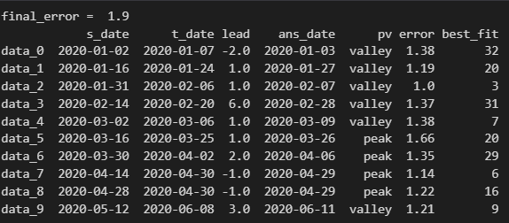
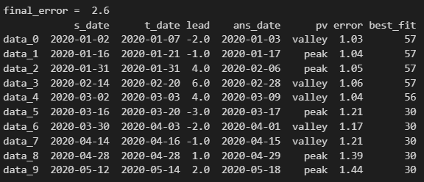

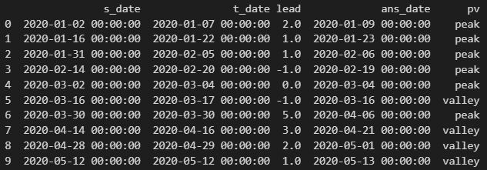
FFT
Sarima
Lstm

Slide 3
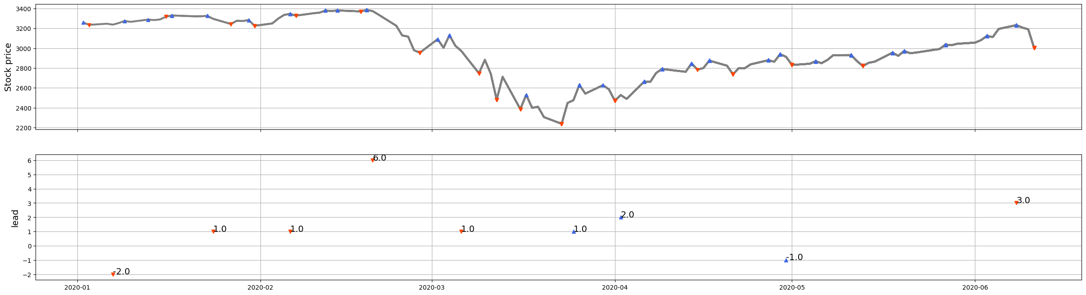
FFT

Slide 4
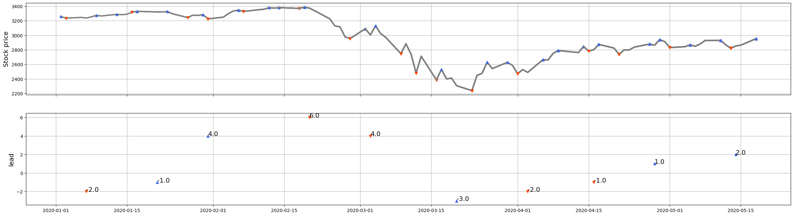
Sarima

Slide 5
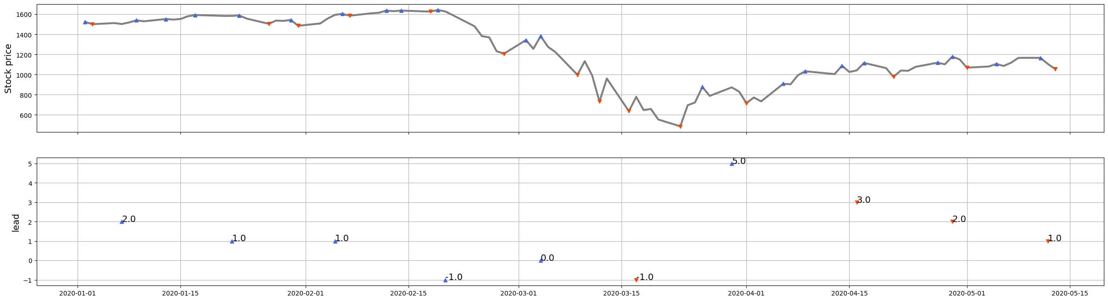
Lstm

Slide 6
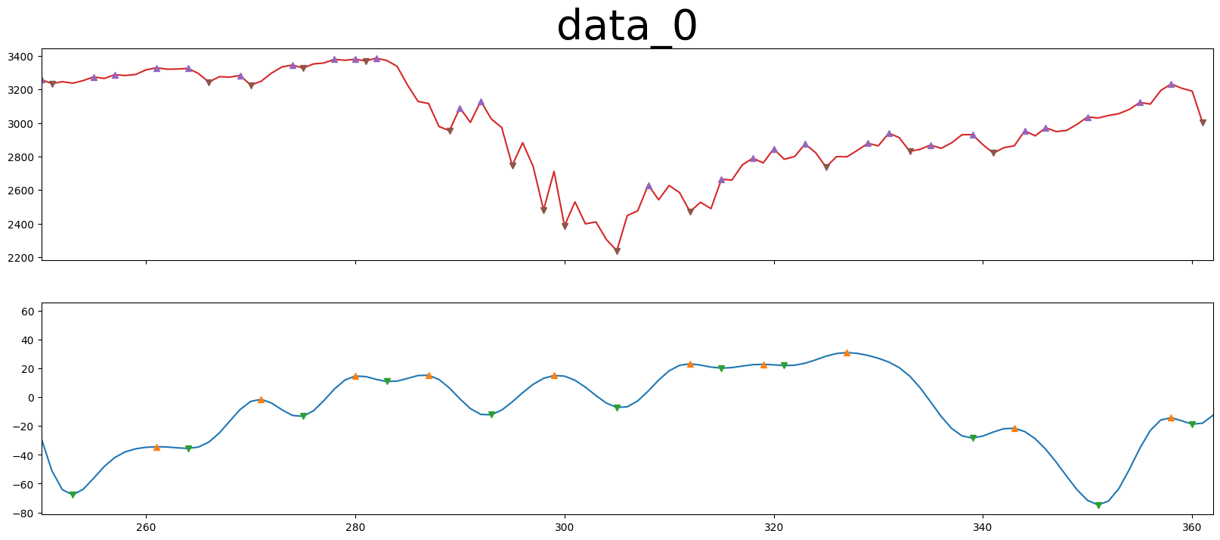
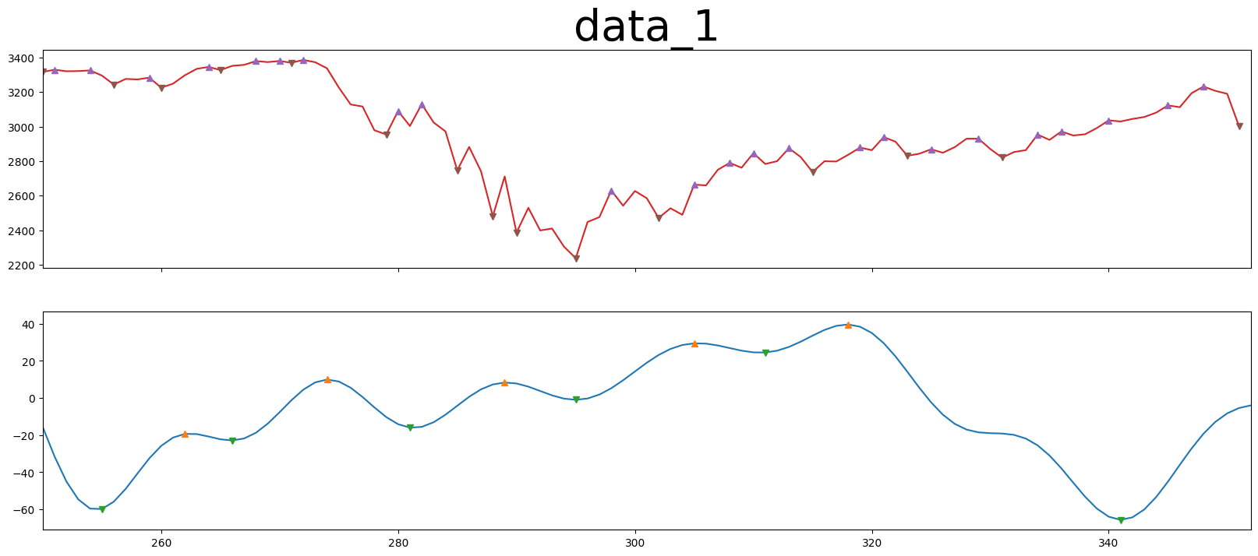
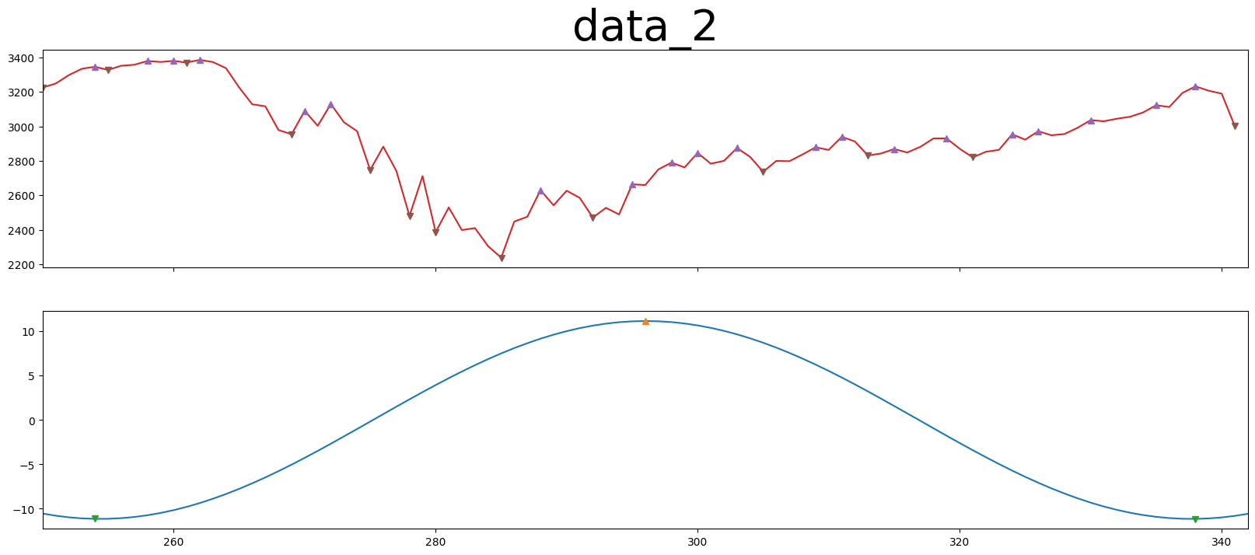
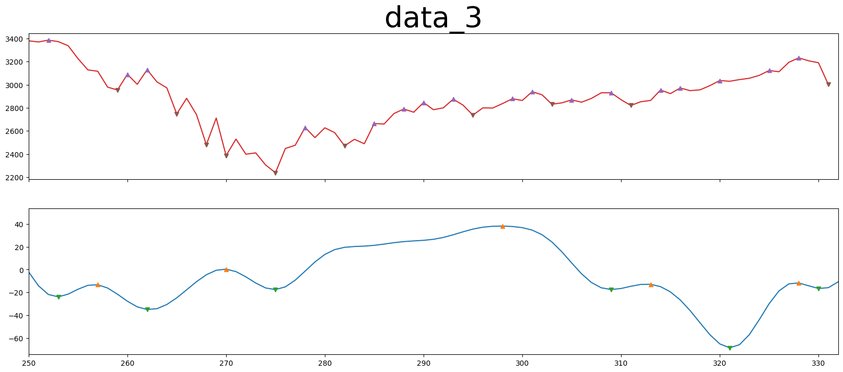
FFT

Slide 7
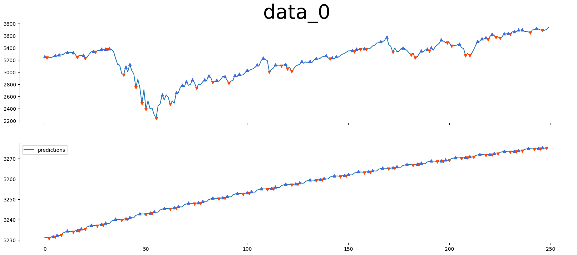
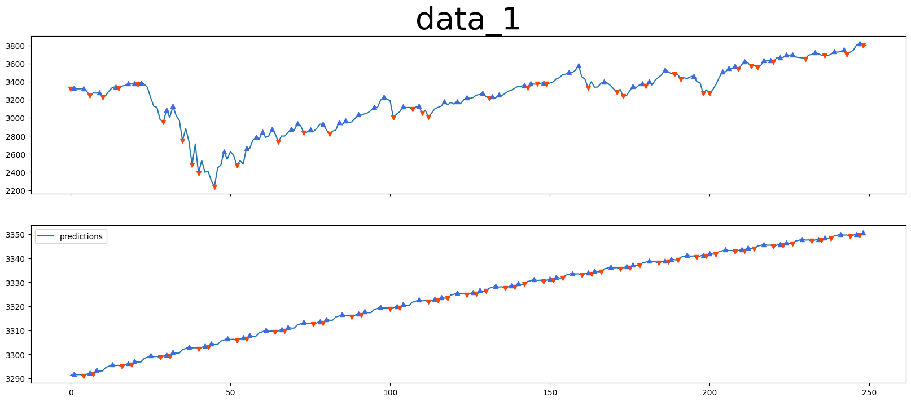
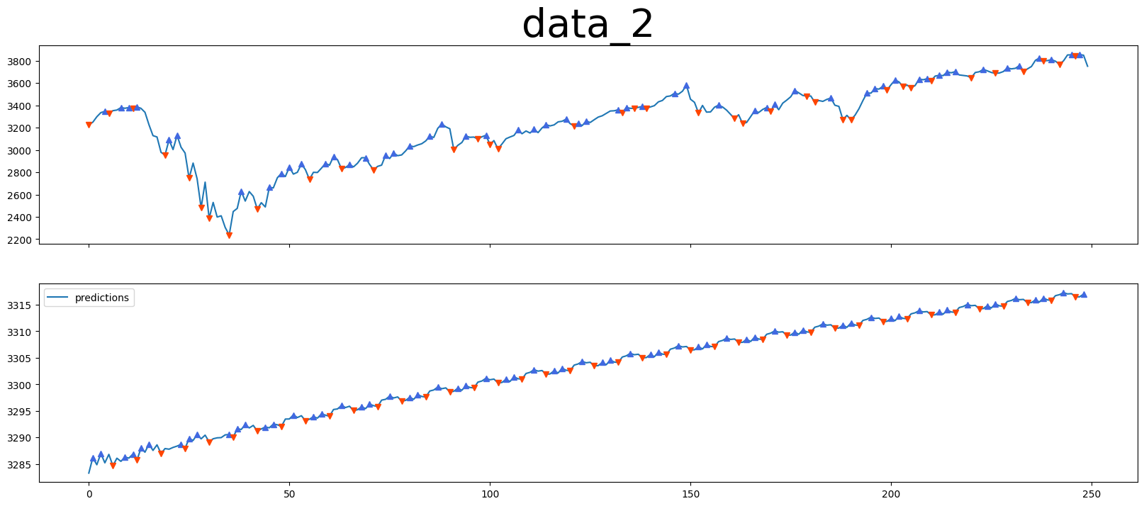
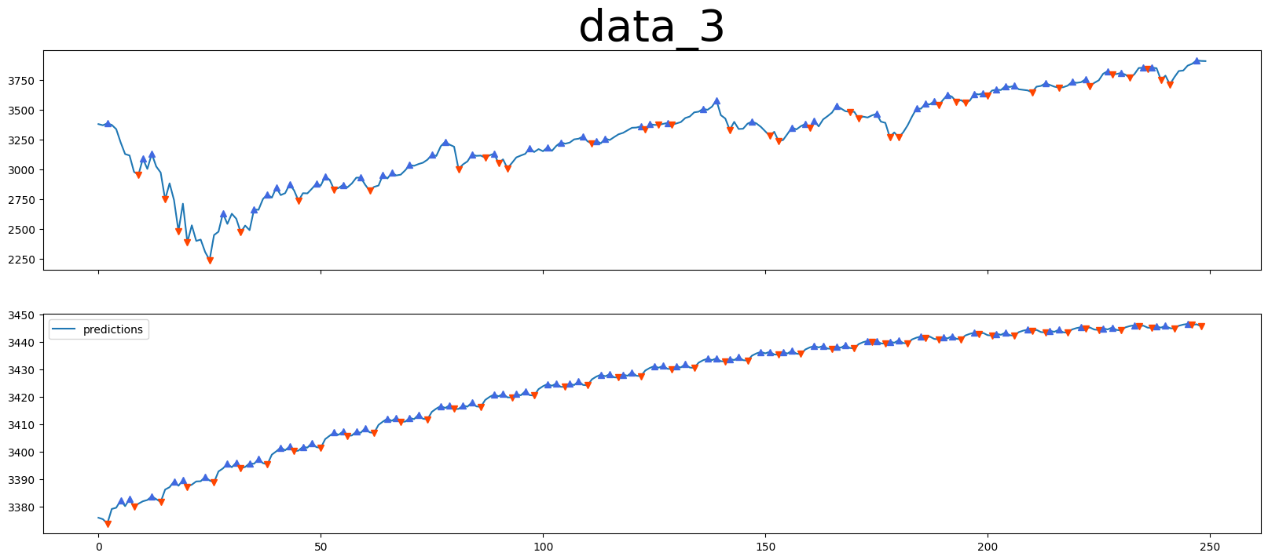
Sarima

Slide 8
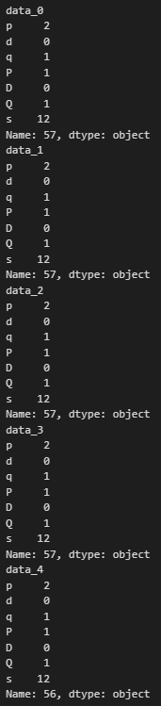
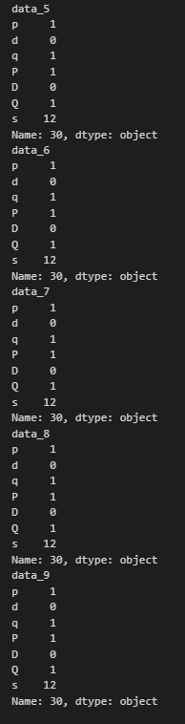

Slide 9
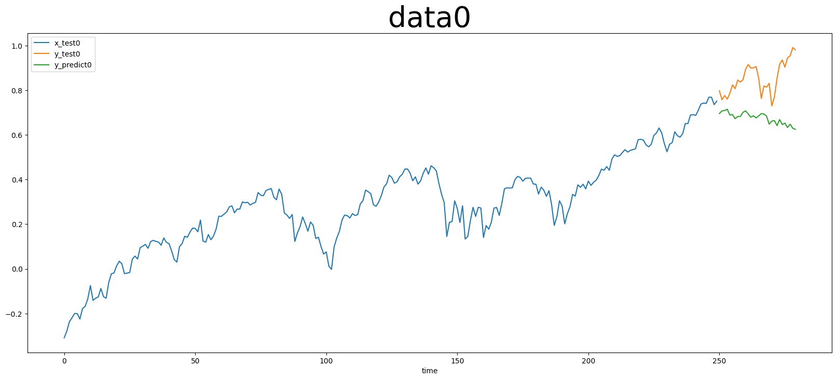
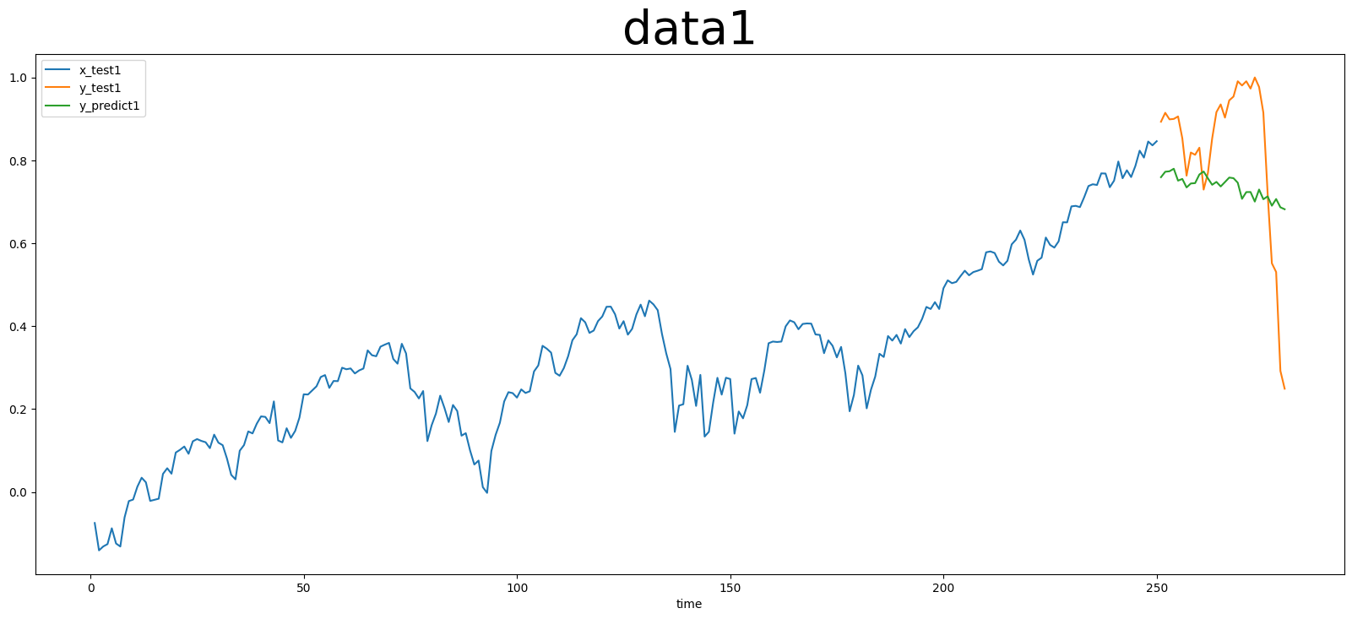
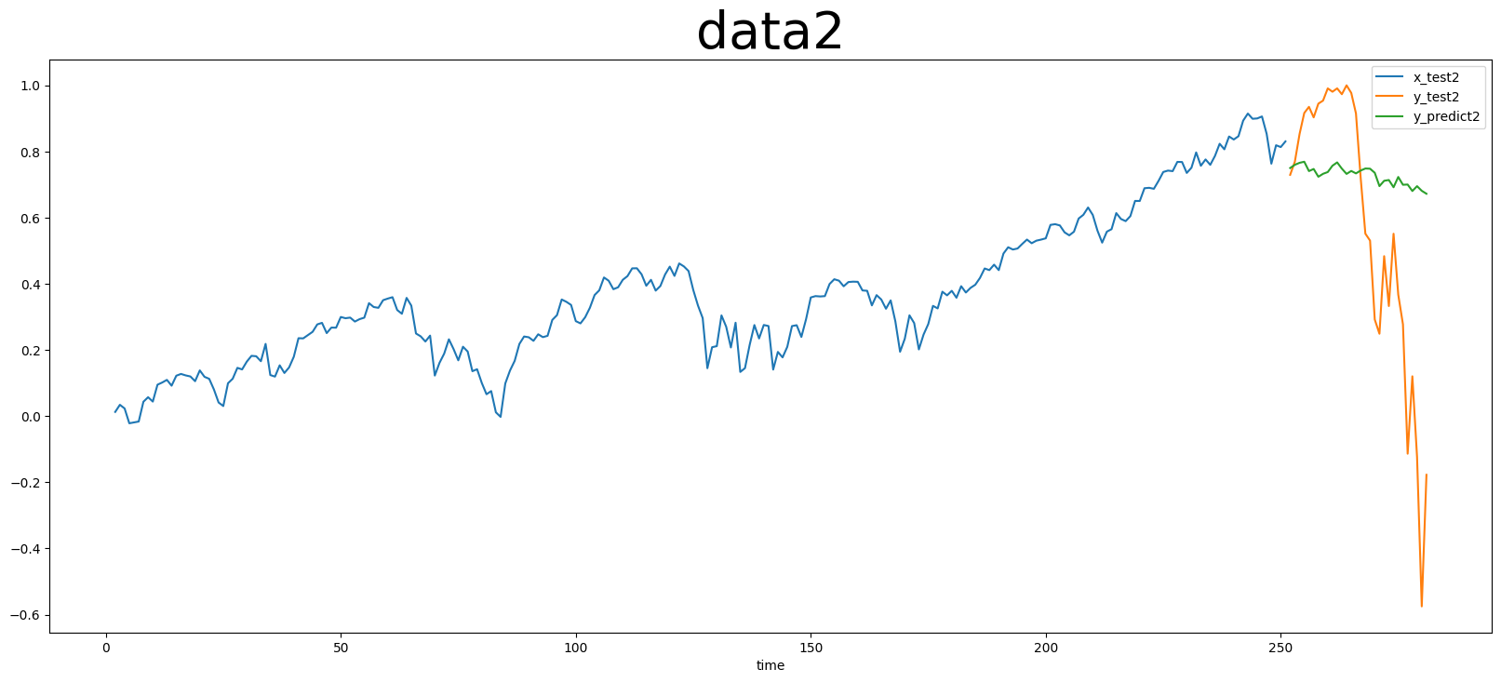
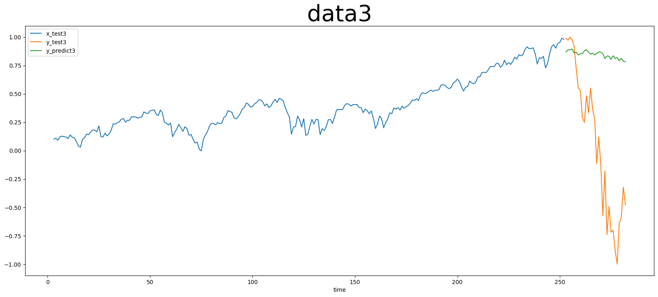
Lstm

Slide 10
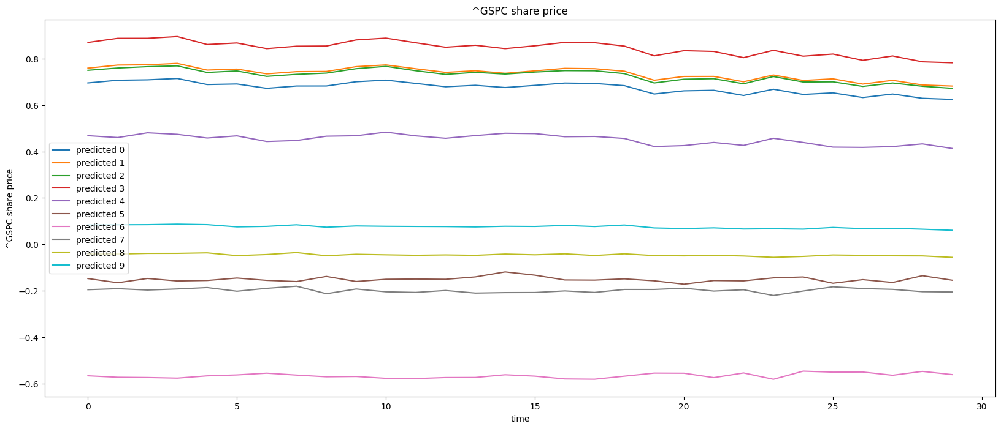
Lstm

Slide 11
1. date_predict_start = ‘2019-01-01'
FFT stock_name = "^GSPC"
date_predict_start = ‘2019-01-01'
data_range = 250
slide_range = 10
n_slide = 10
pv_range = 2
fit_method = 'rmse'
pv_method = 'CL’
n_harm_lower_limit = 1
n_harm_upper_limit = 50
Sarima stock_name = "^GSPC"
date_predict_start = ‘2019-01-01'
data_range = 250
slide_range = 10
n_slide = 10
pv_range = 2
fit_method = 'rmse'
pv_method = 'CL'
Lstm stock_name = "^GSPC“
date_predict_start = ‘2019-01-01’
data_range = 250
prediction_day = 30
slide_range = 10
n_slide = 10
pv_range = 2
train_data : 1999-01~2018-12
共476筆資料

Slide 12
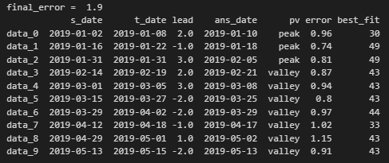
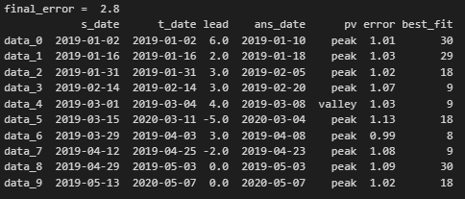
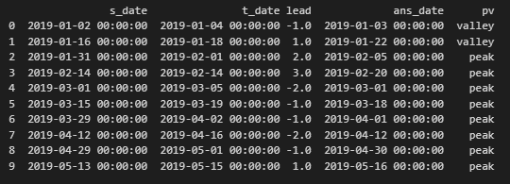
FFT
Sarima
Lstm

Slide 13
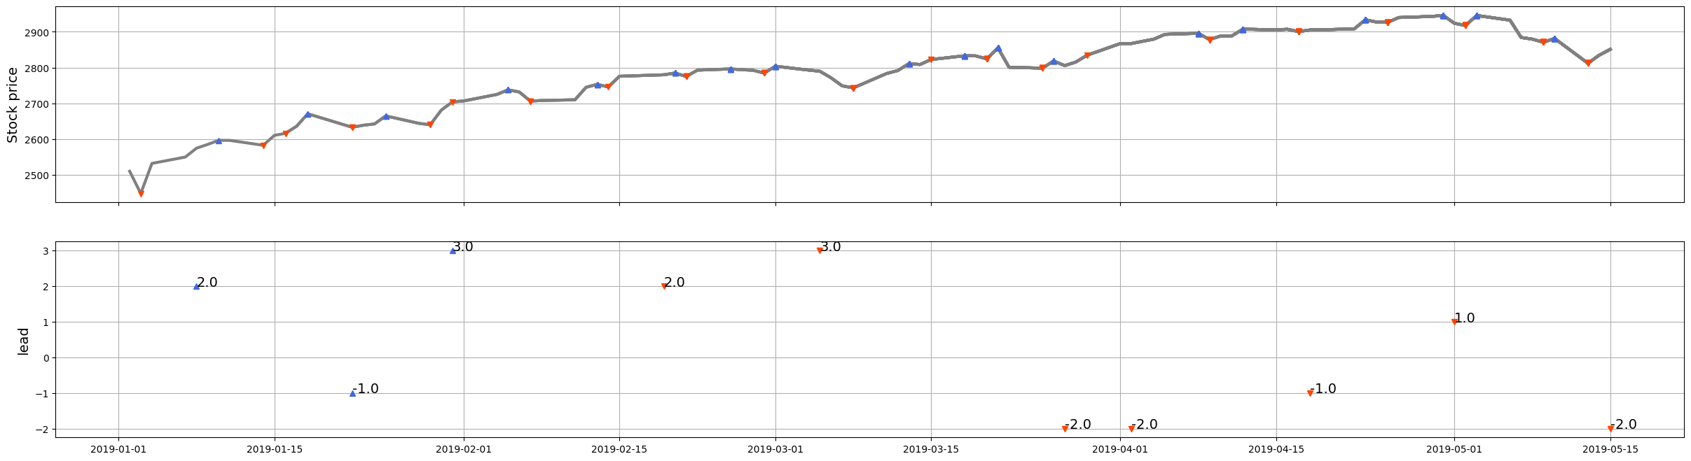
FFT

Slide 14
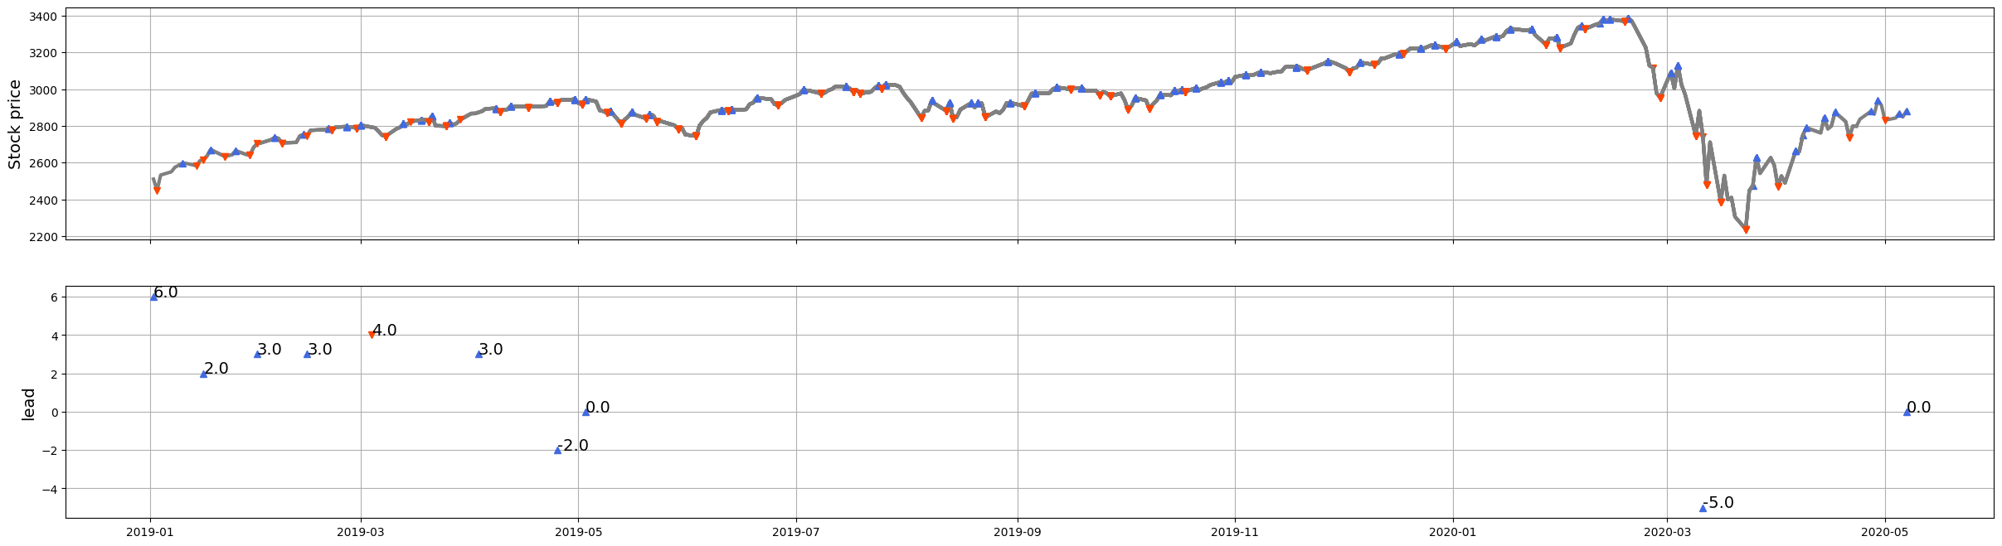
Sarima

Slide 15
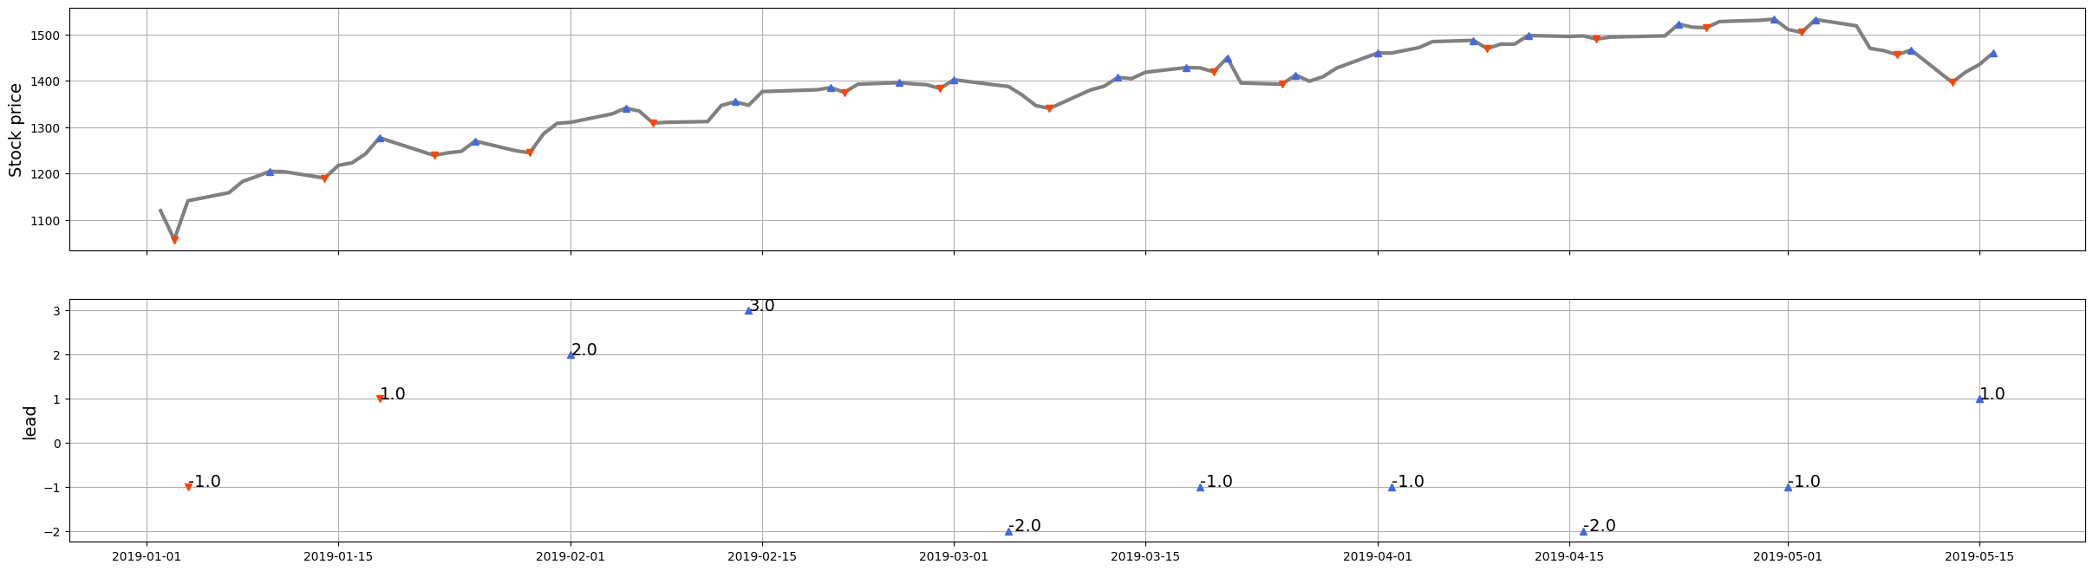
Lstm

Slide 16
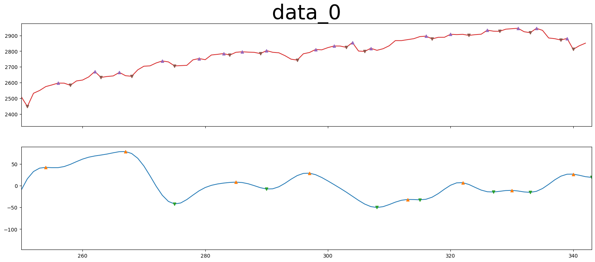
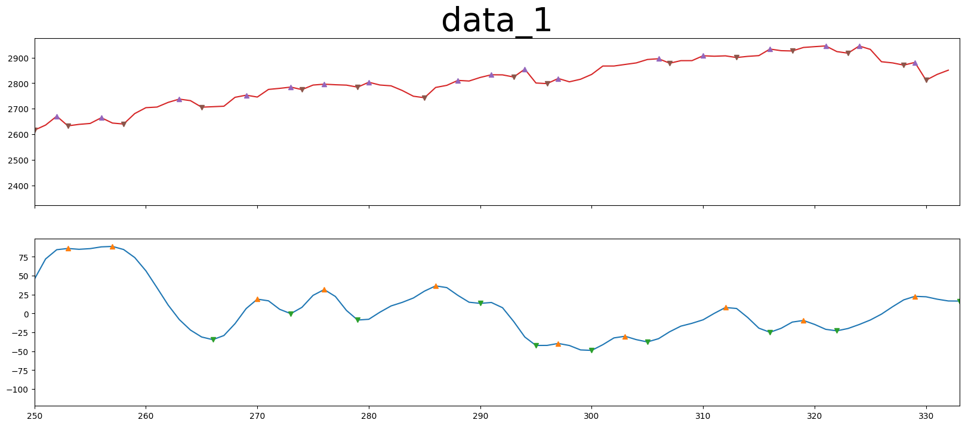
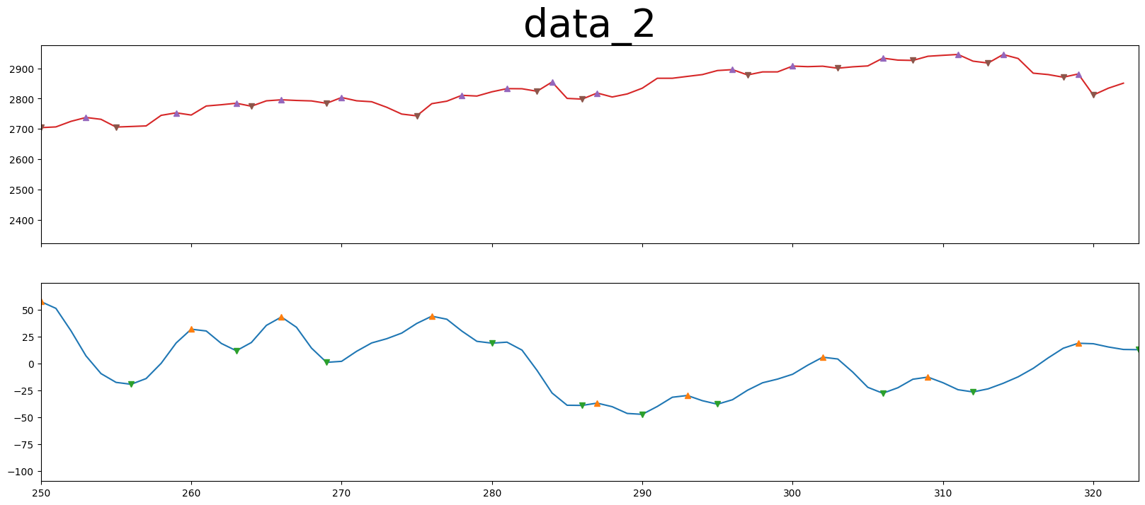
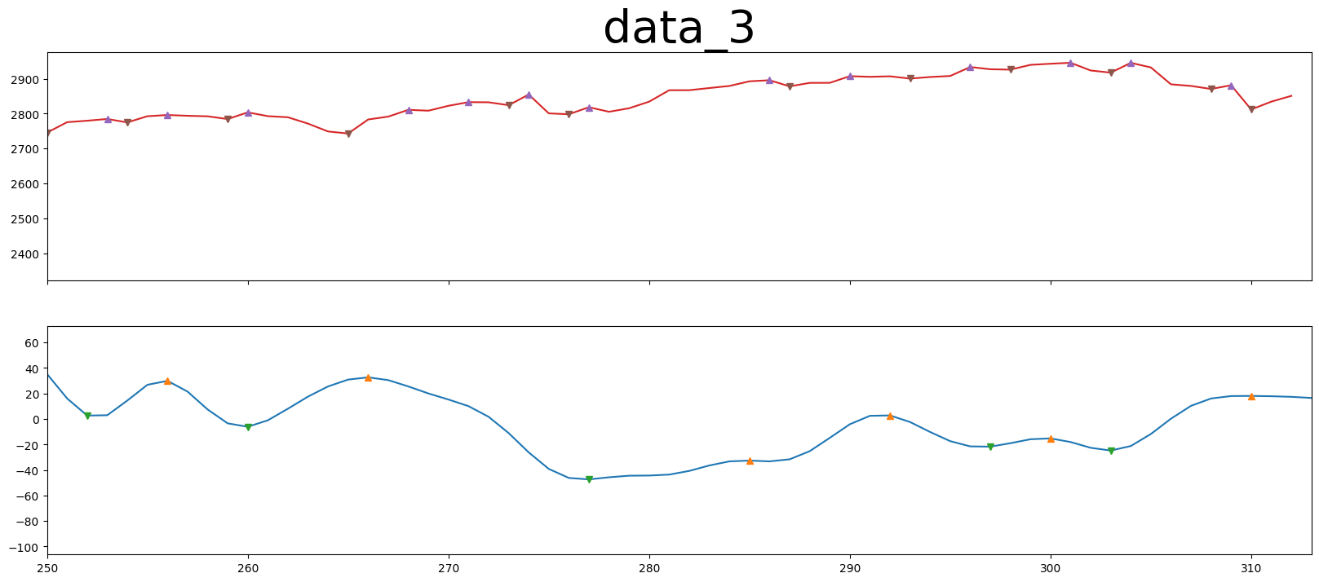
FFT

Slide 17
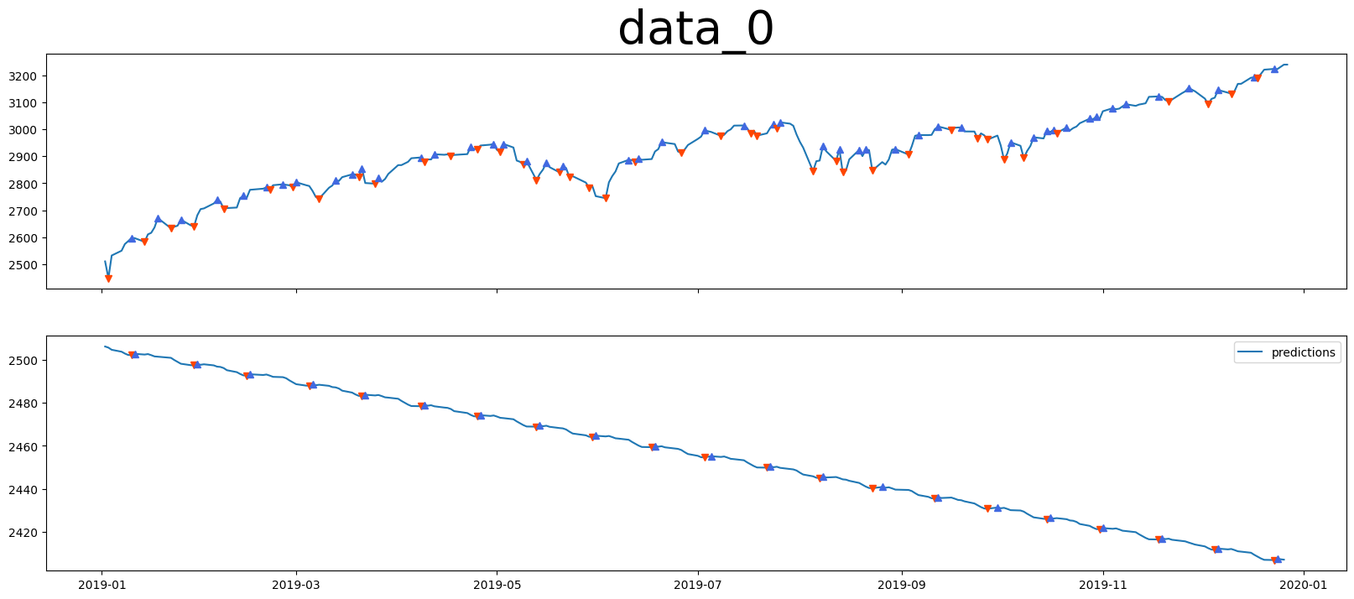
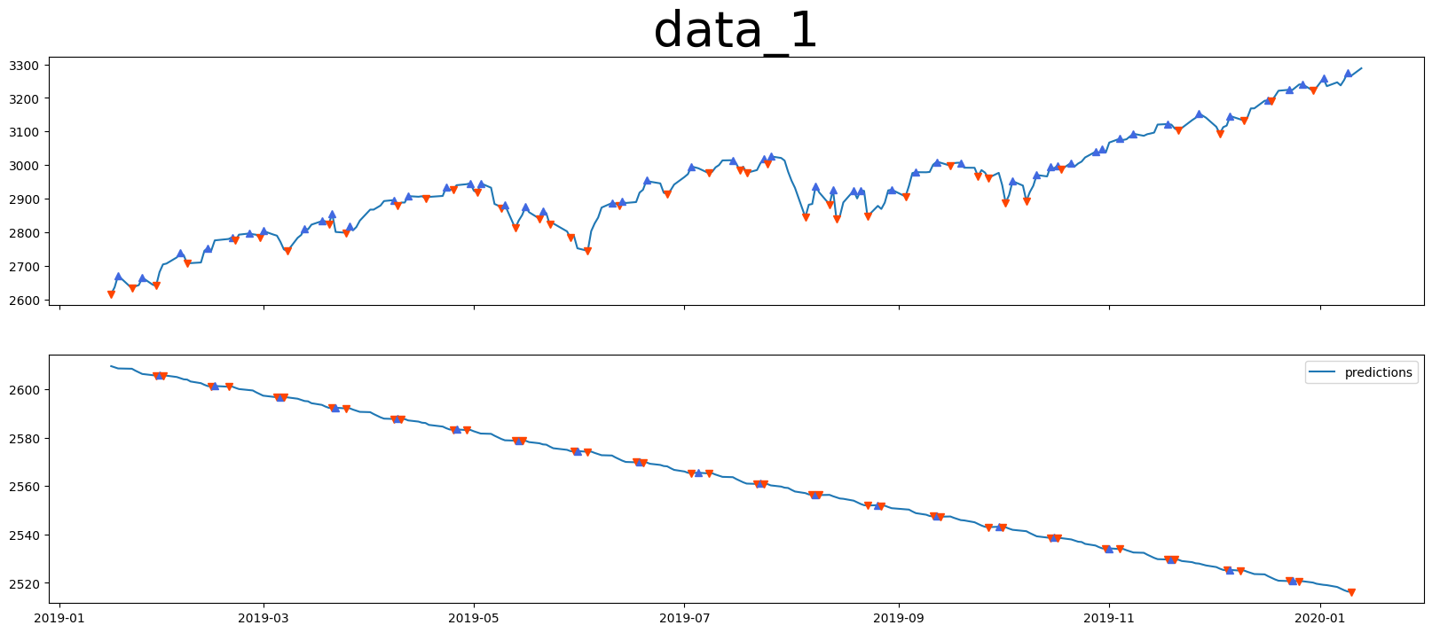
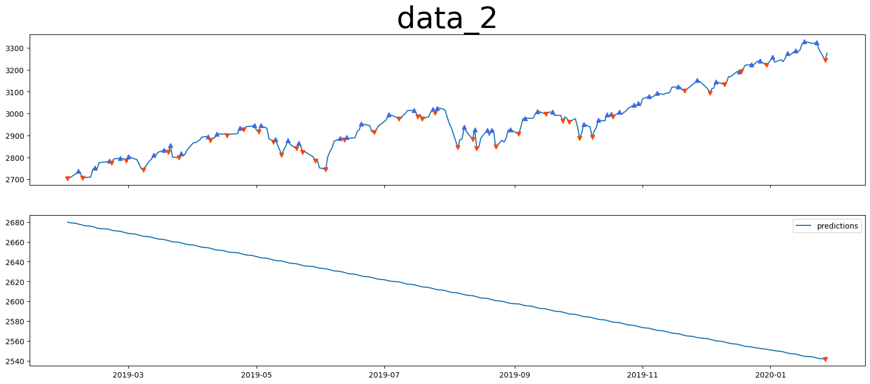
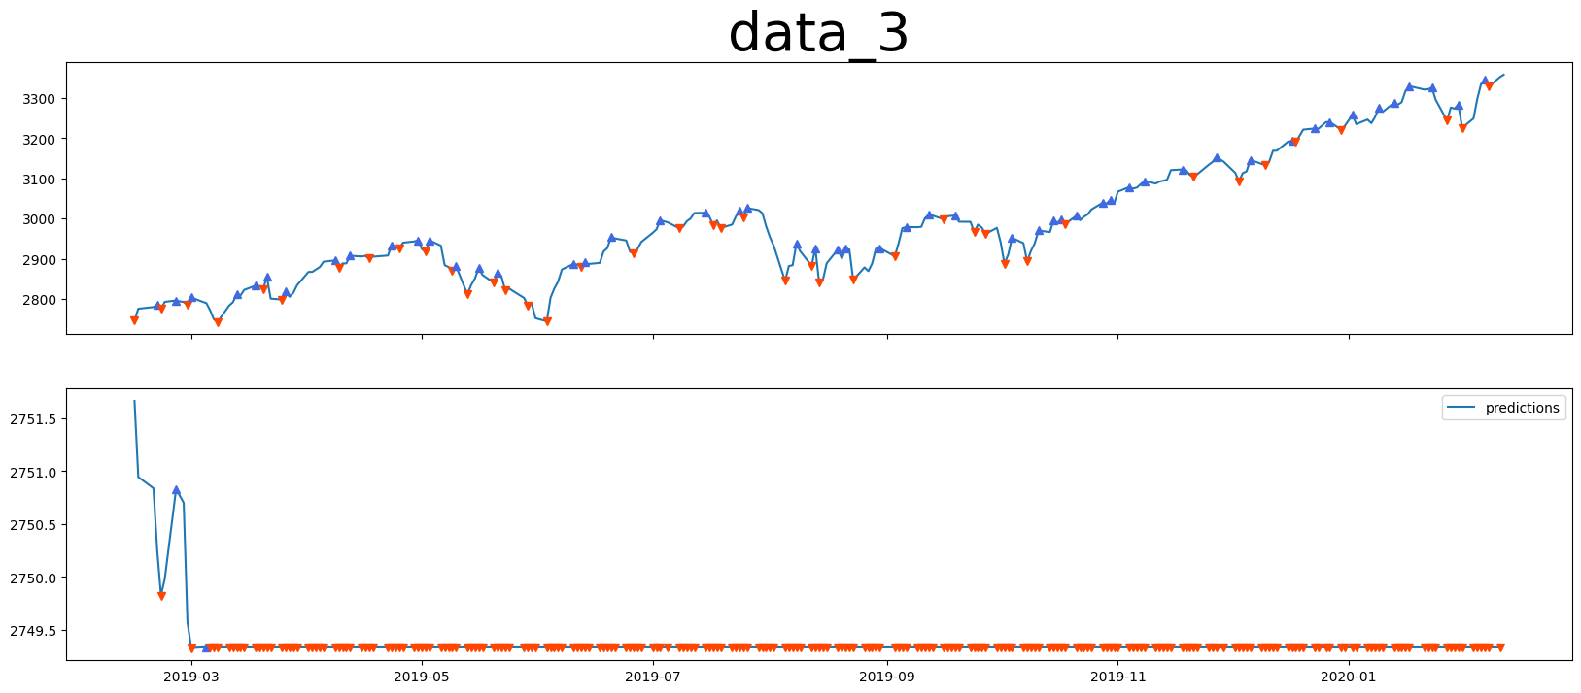
Sarima

Slide 18
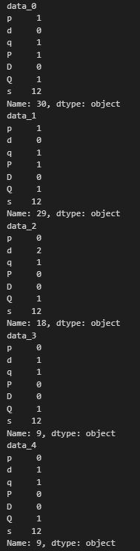
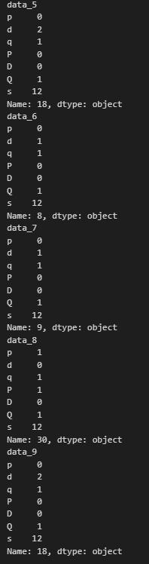

Slide 19
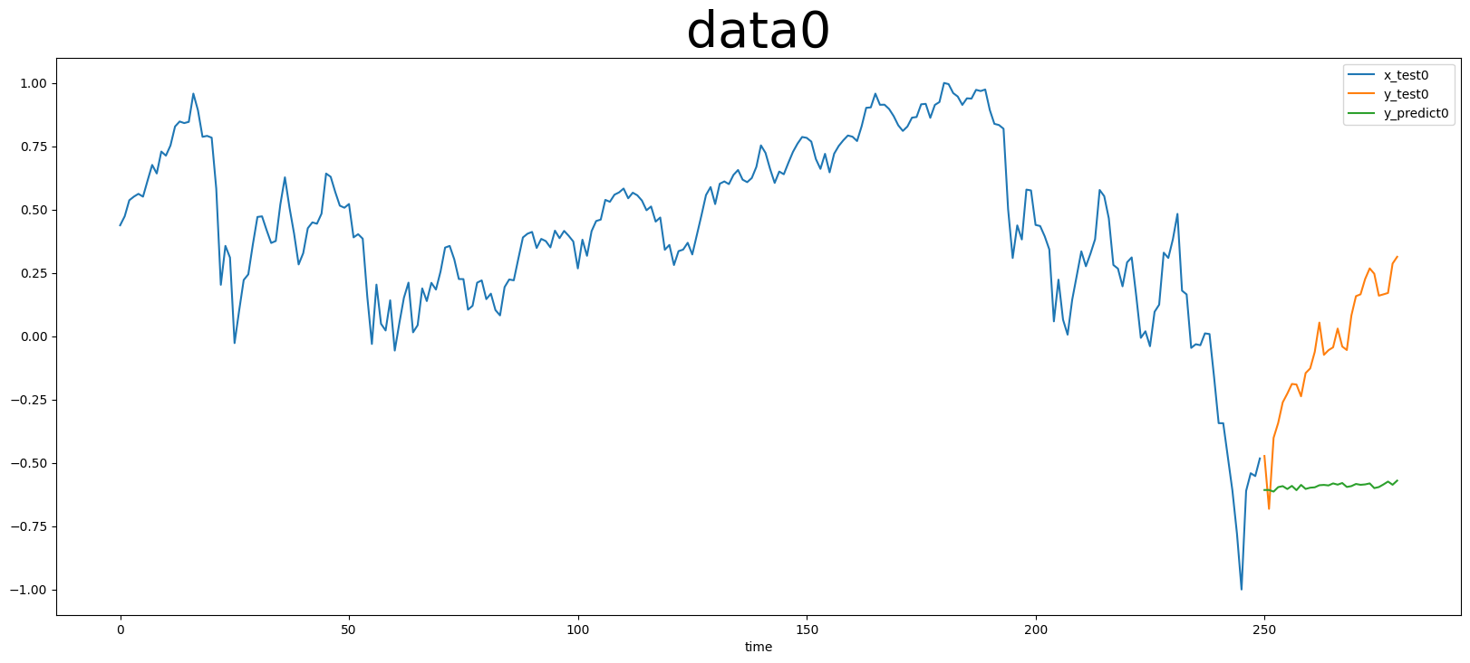
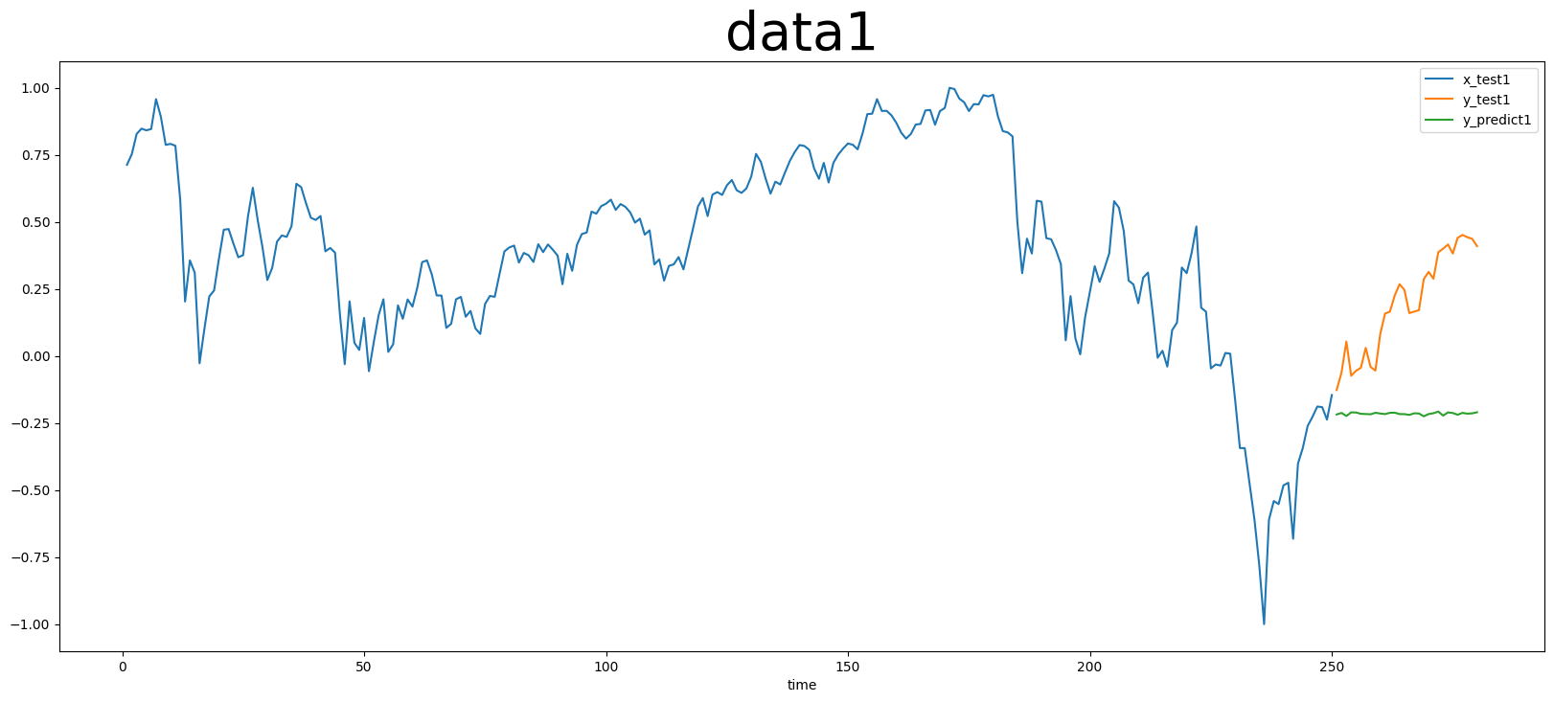
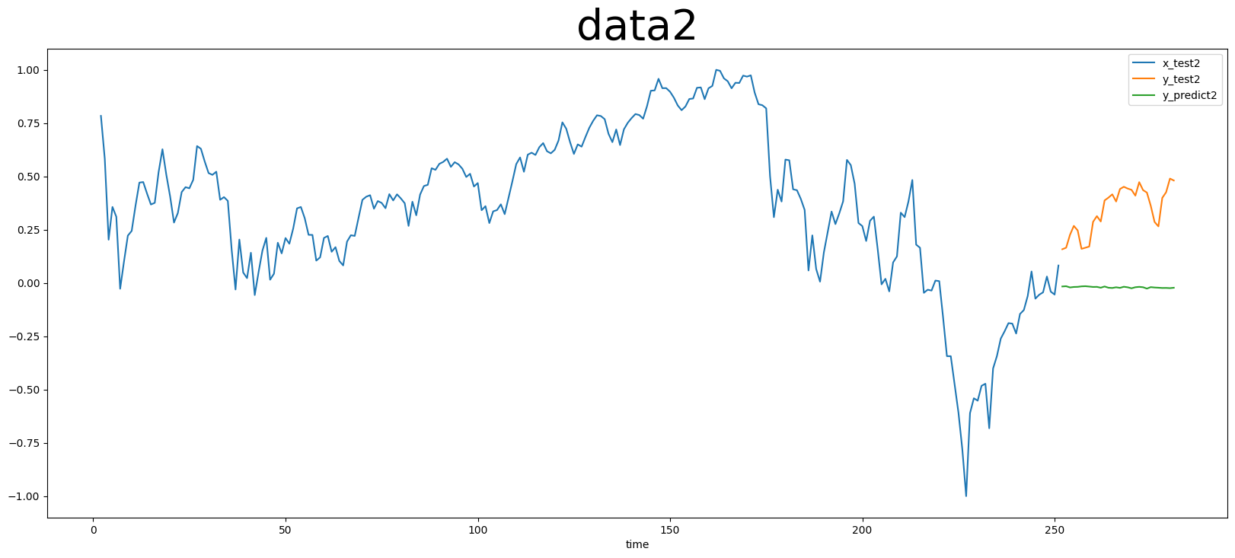
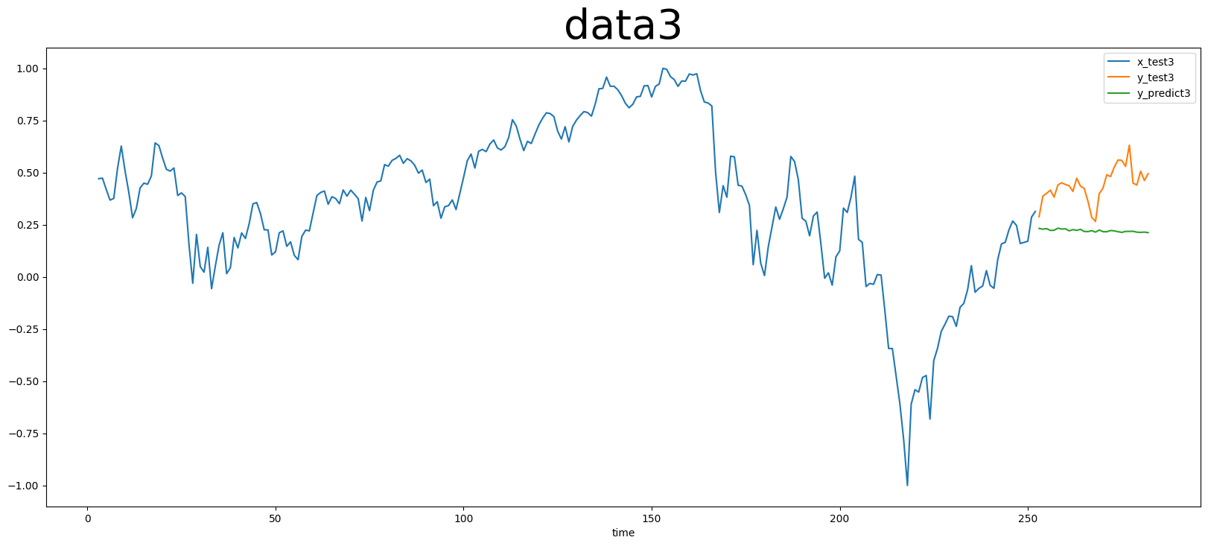
Lstm

Slide 20
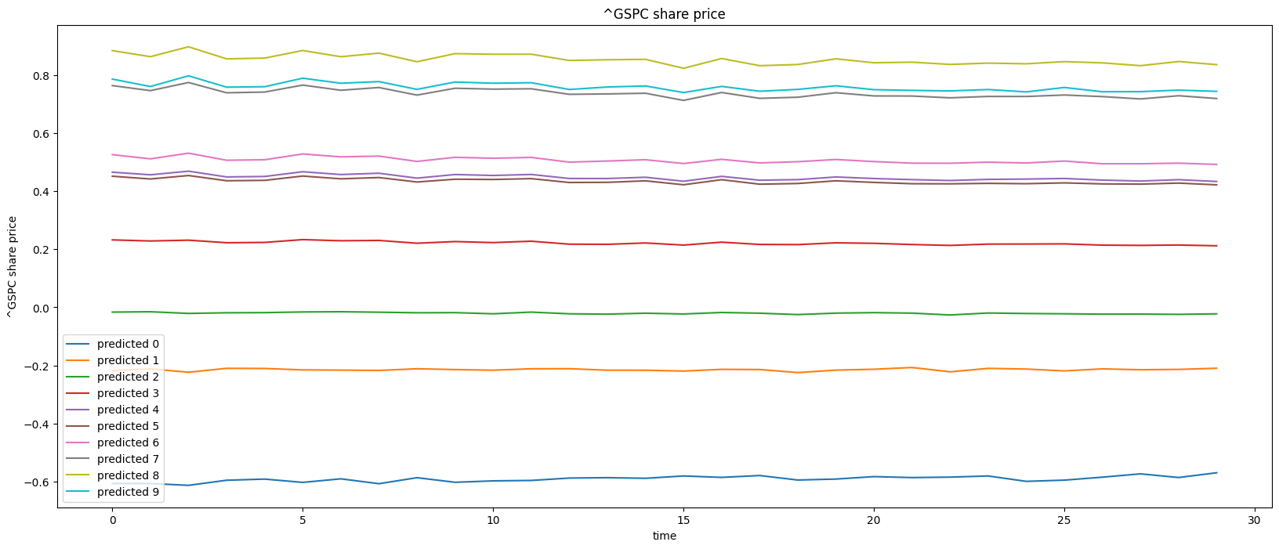
Lstm

Slide 21
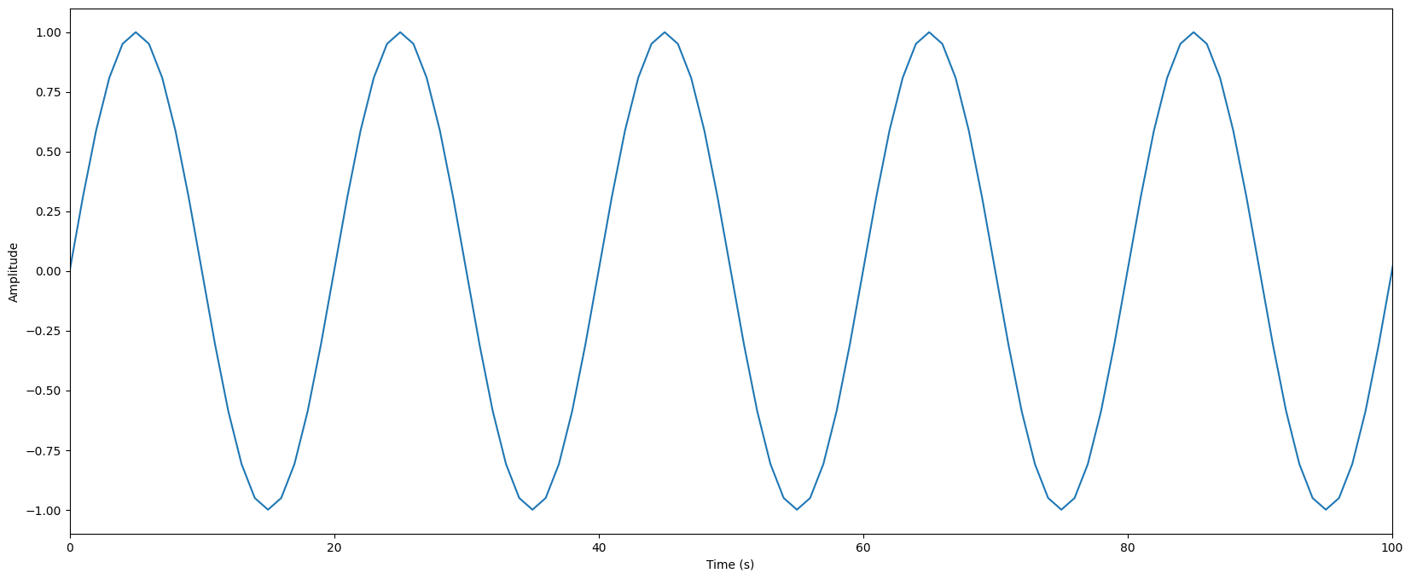
test
FFT
Sarima
Lstm

Slide 22
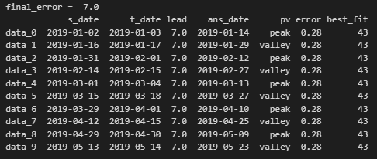
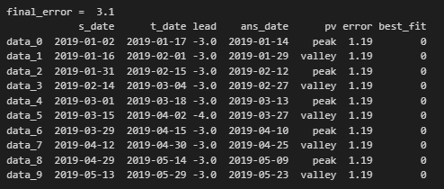
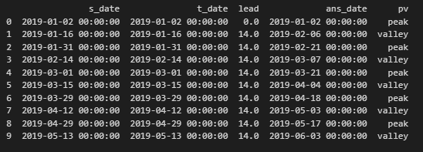
FFT
Sarima
Lstm

Slide 23
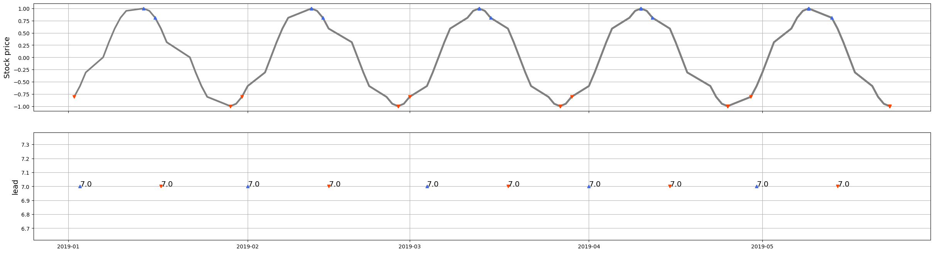
FFT

Slide 24
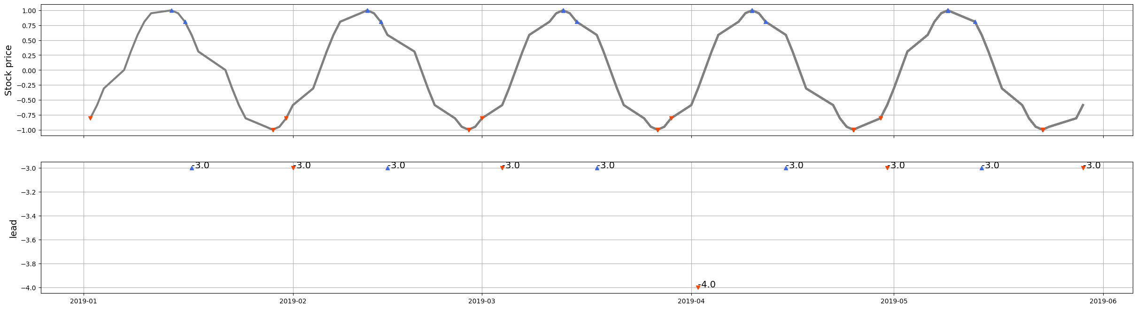
Sarima

Slide 25
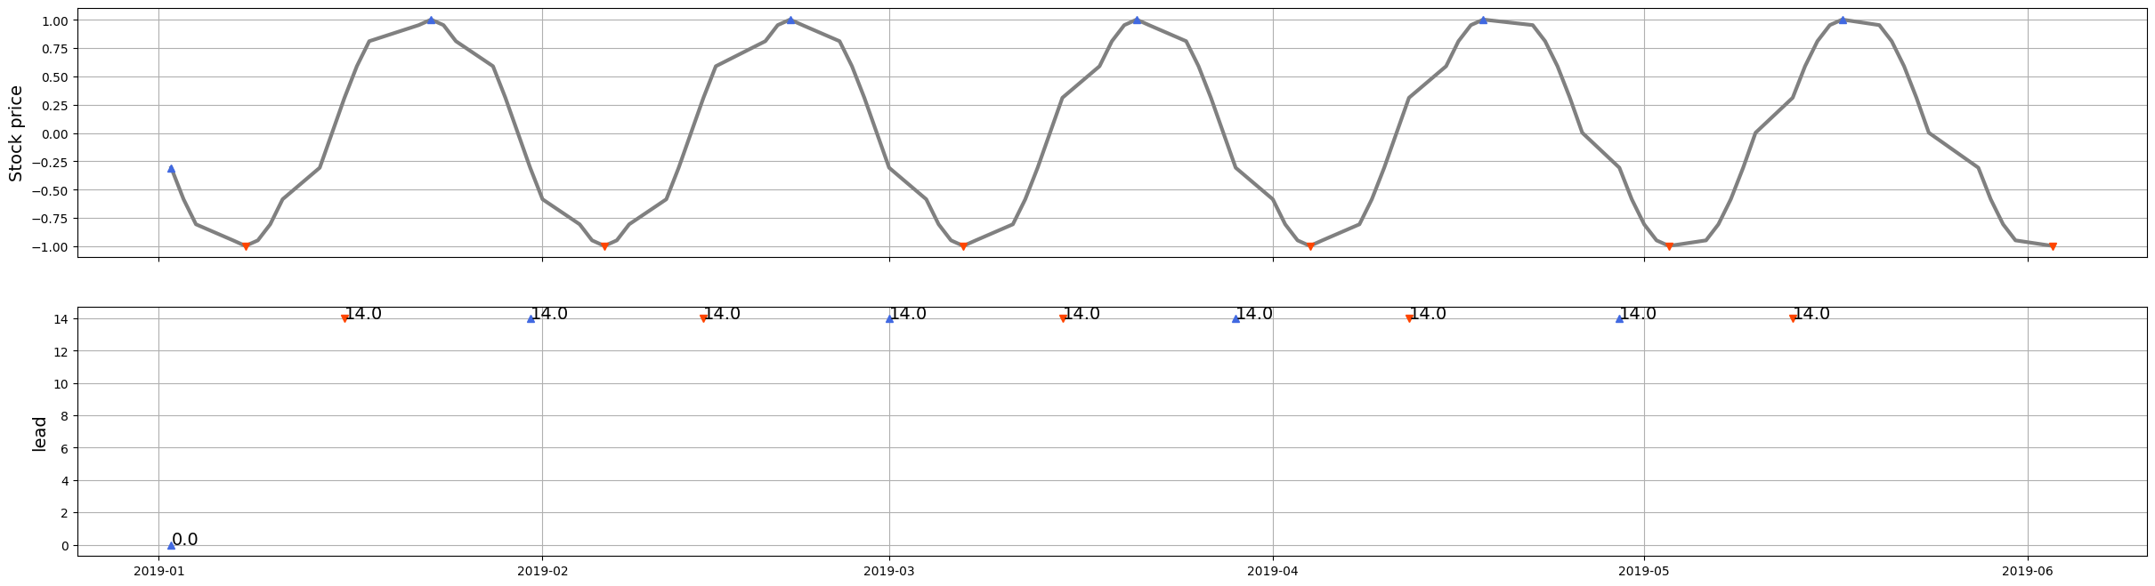
Lstm

Slide 26
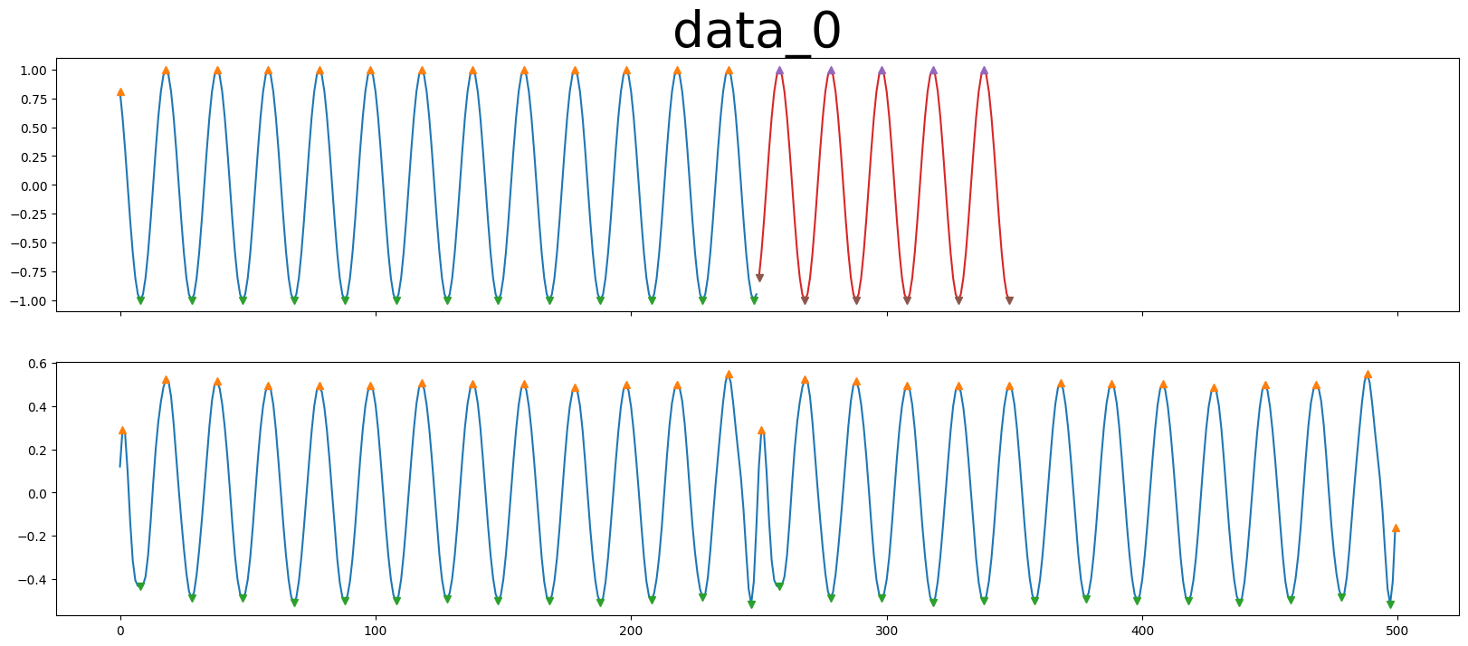



FFT

Slide 27
FFT

Slide 28




Sarima

Slide 29



Slide 30




Lstm

Slide 31

Lstm

