Slide 1
pv_range | Layer_1 | Layer_2 | Layer_3 | Final_error | Final_error in FFT
2 (5days) | 256 | 128 | 64 | 1.8 | 1.8
 | 128 | 64 | 32 | 1.8
 | 64 | 32 | 16 | 2.1
5 (11days) | 256 | 128 | 64 | 3.7 | 4.2
 | 128 | 64 | 32 | 4.2
 | 64 | 32 | 16 | 3.6
7 (15days) | 256 | 128 | 64 | 5.1 | 8.8
 | 128 | 64 | 32 | 6.0
 | 64 | 32 | 16 | 6.2

Slide 2
1. date_predict_start = '2020-01-01'
FFT stock_name = "^GSPC"
date_predict_start = '2020-01-01'
data_range = 250
slide_range = 10
n_slide = 10
pv_range = 2
fit_method = 'rmse'
pv_method = 'CL’
n_harm_lower_limit = 1
n_harm_upper_limit = 50
Sarima stock_name = "^GSPC"
date_predict_start = '2020-01-01'
data_range = 250
slide_range = 10
n_slide = 10
pv_range = 2
fit_method = 'rmse'
pv_method = 'CL'
Lstm stock_name = "^GSPC“
date_predict_start = '2020-01-01’
data_range = 250
prediction_day = 30
slide_range = 10
n_slide = 10
pv_range = 2
train_data : 2000-01~2019-12
共476筆資料

Slide 3
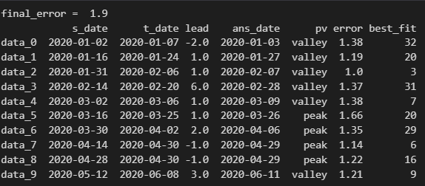
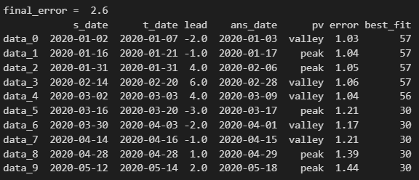

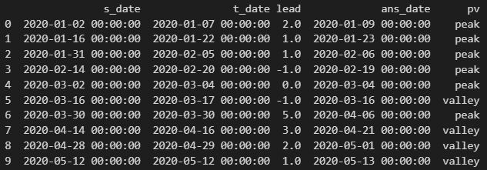
FFT
Sarima
Lstm

Slide 4
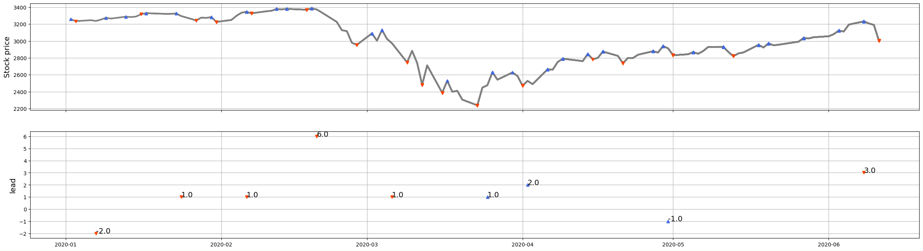
FFT

Slide 5
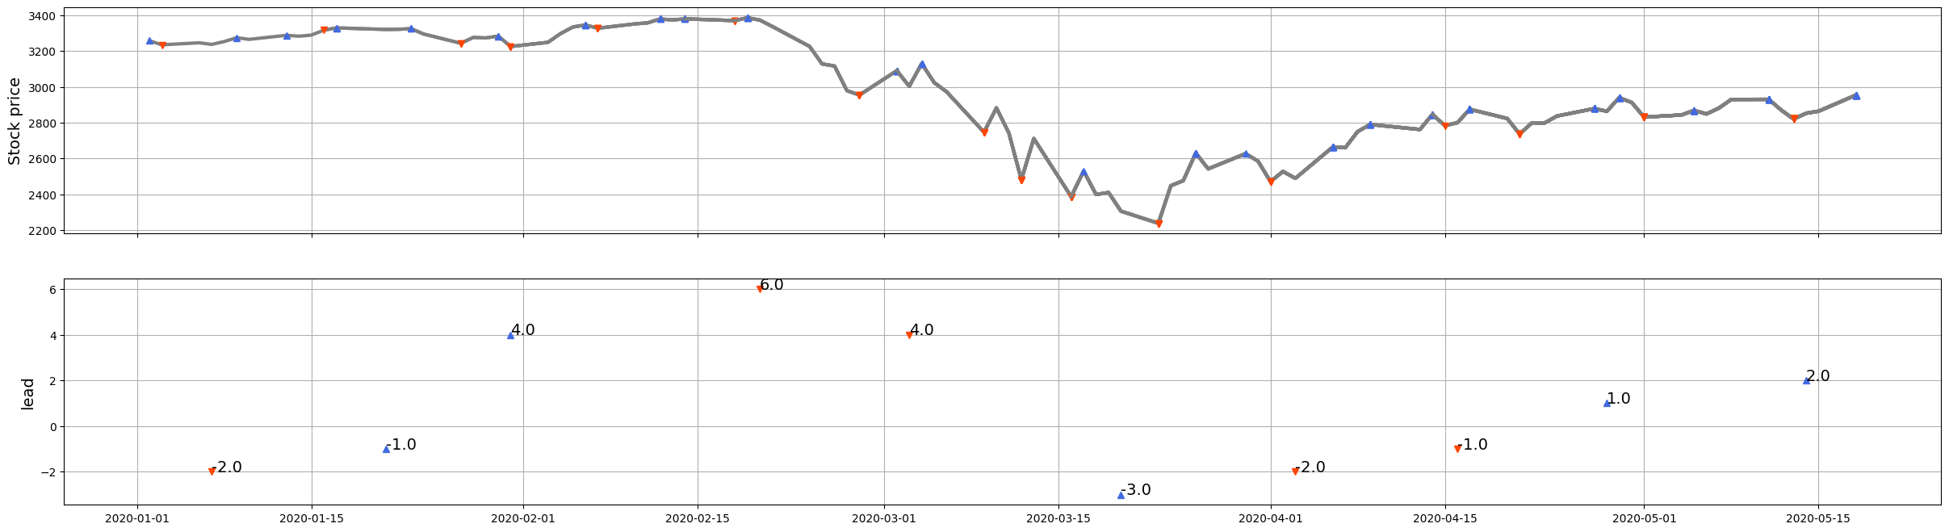
Sarima

Slide 6
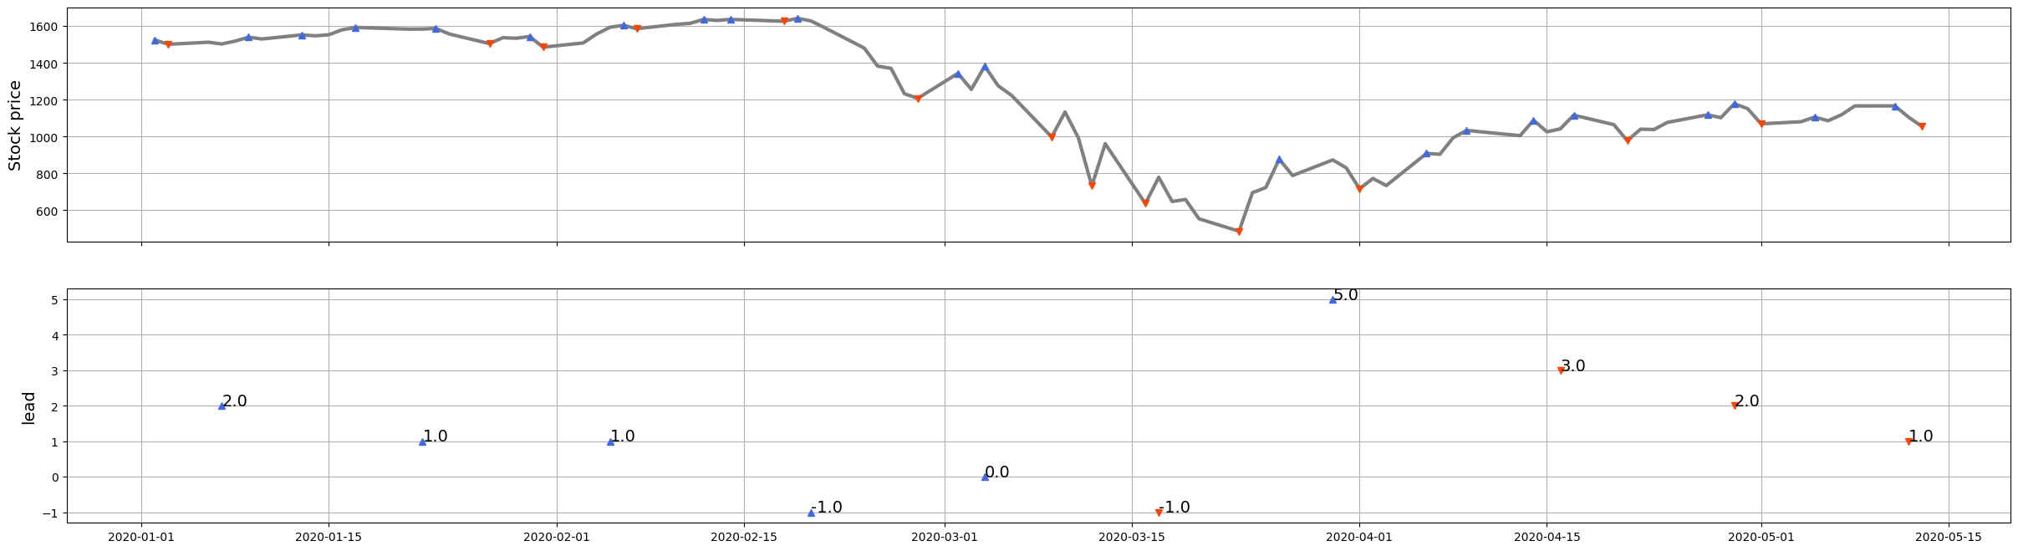
Lstm

Slide 7
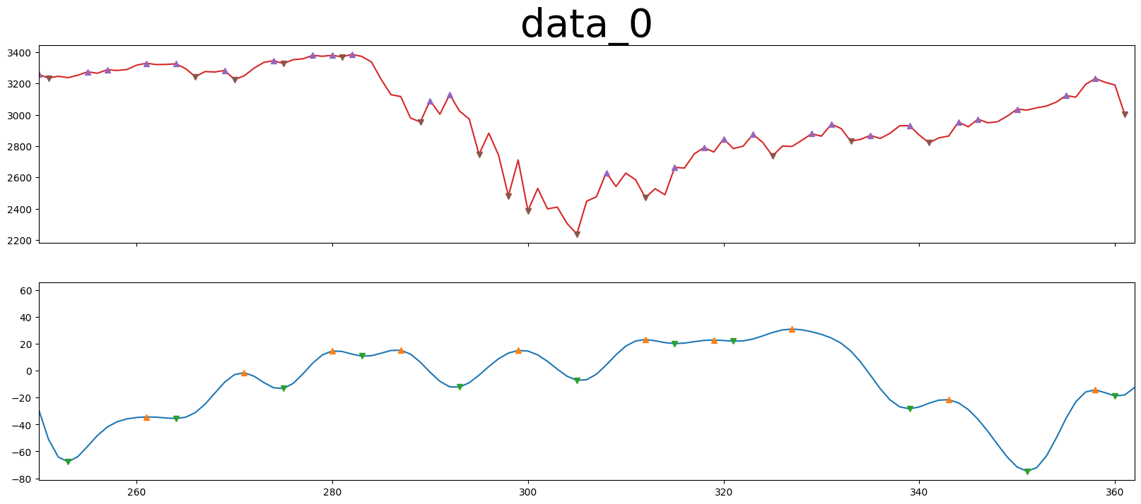
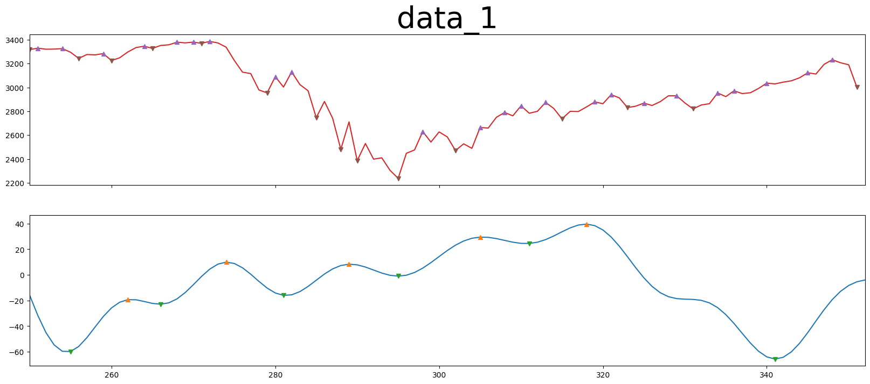
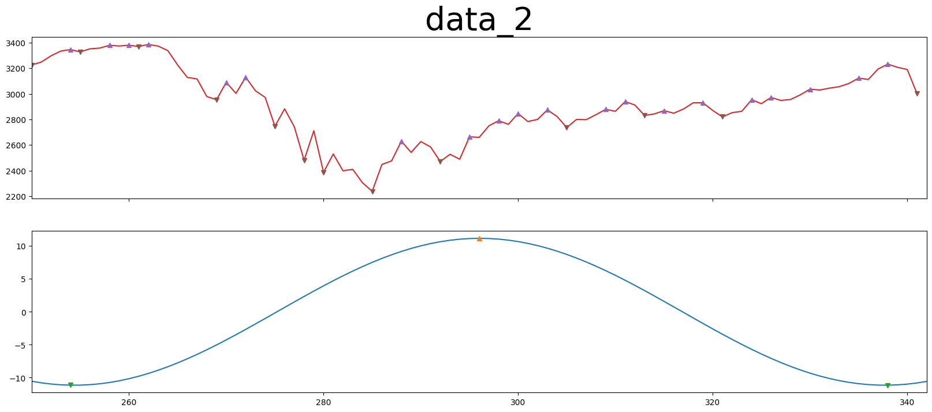
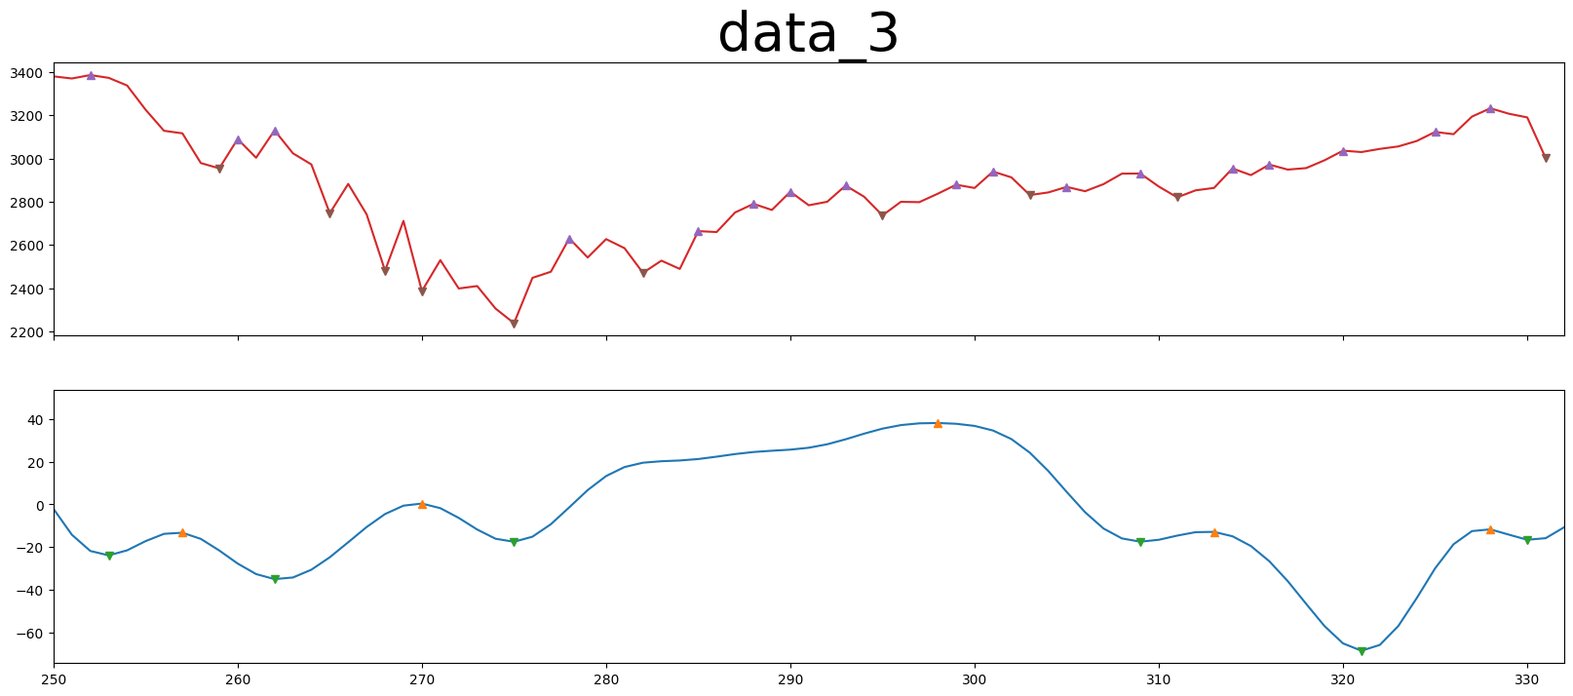
FFT

Slide 8
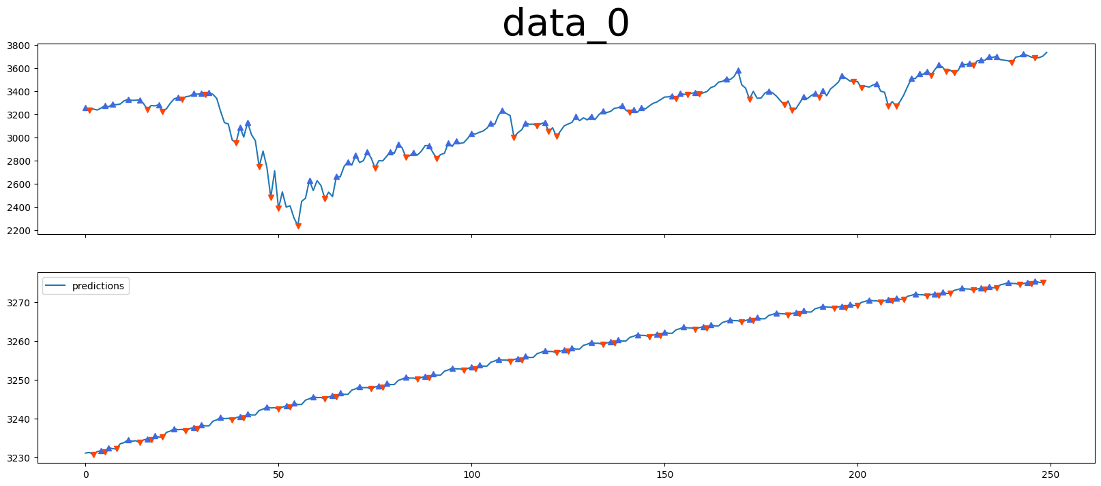
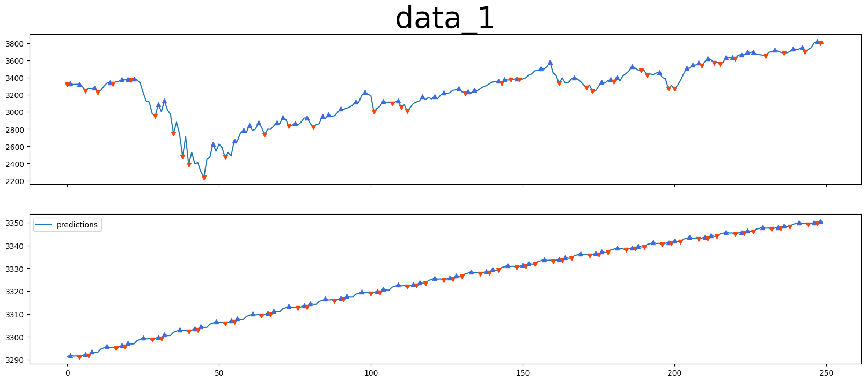
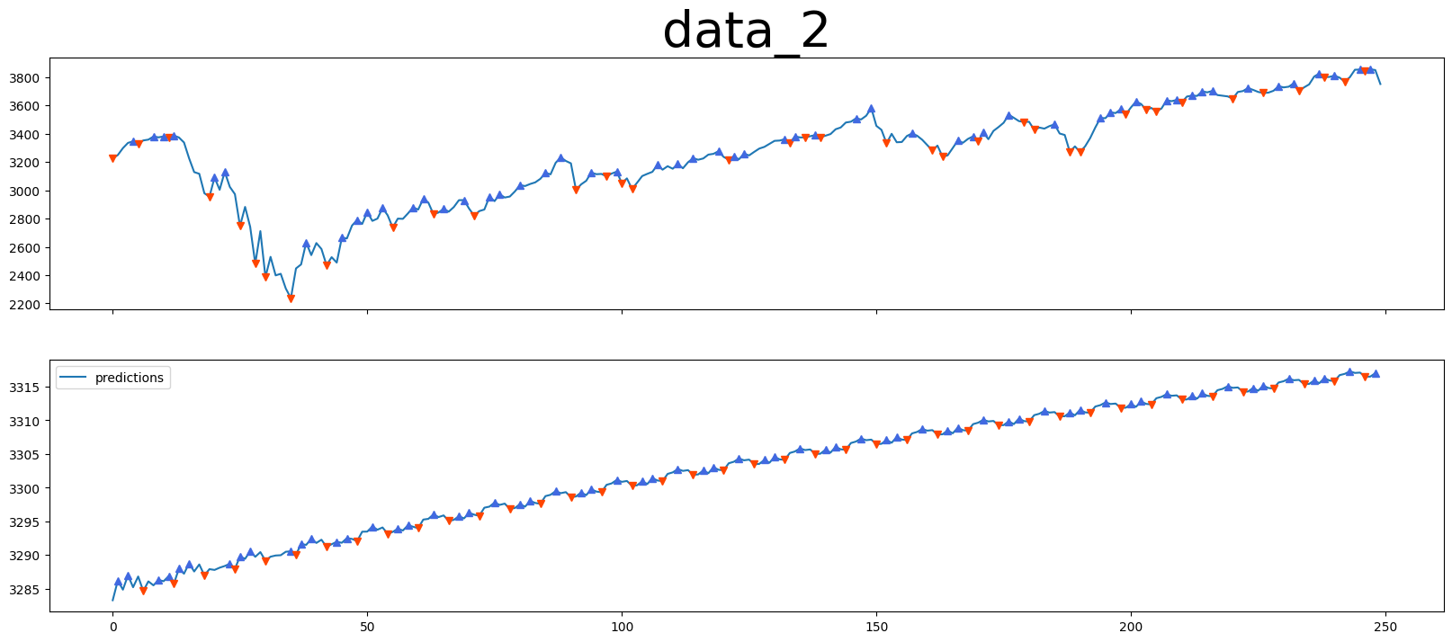
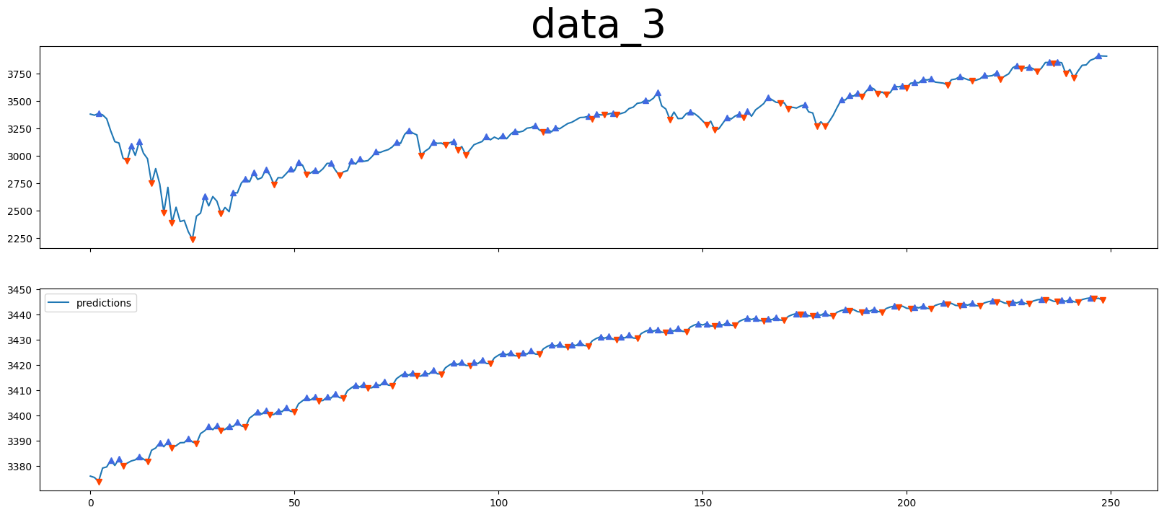
Sarima

Slide 9
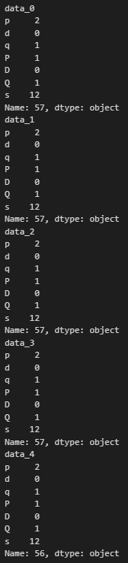
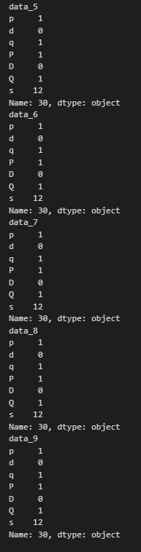

Slide 10
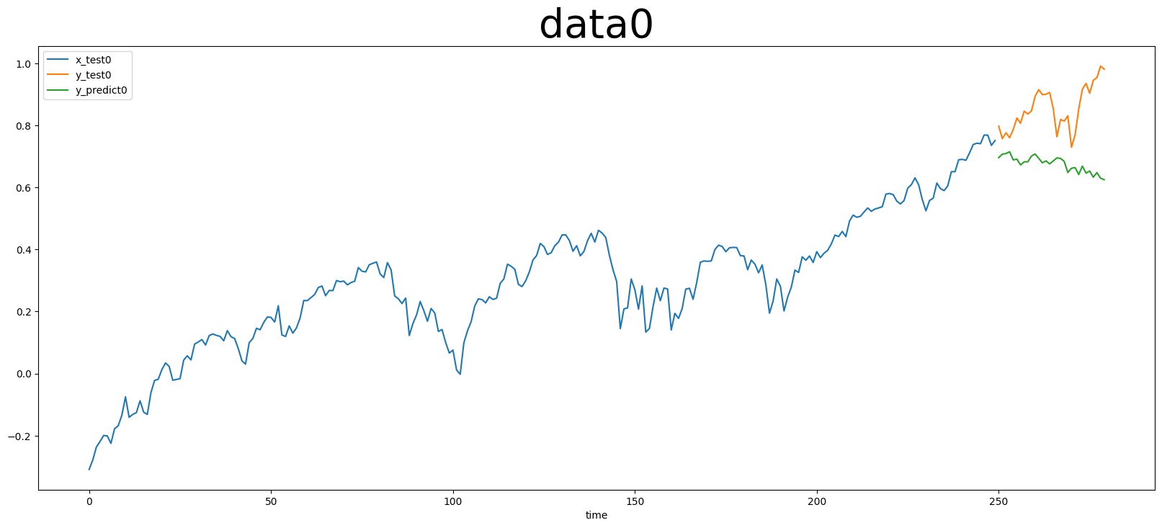
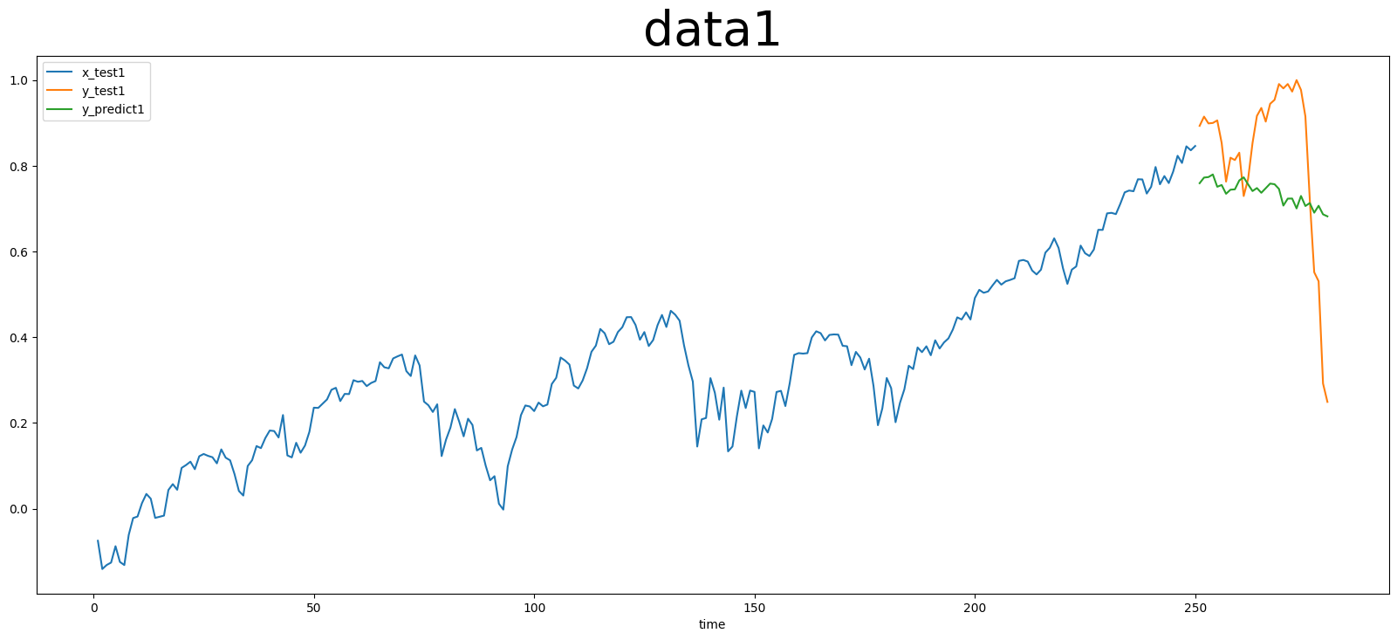
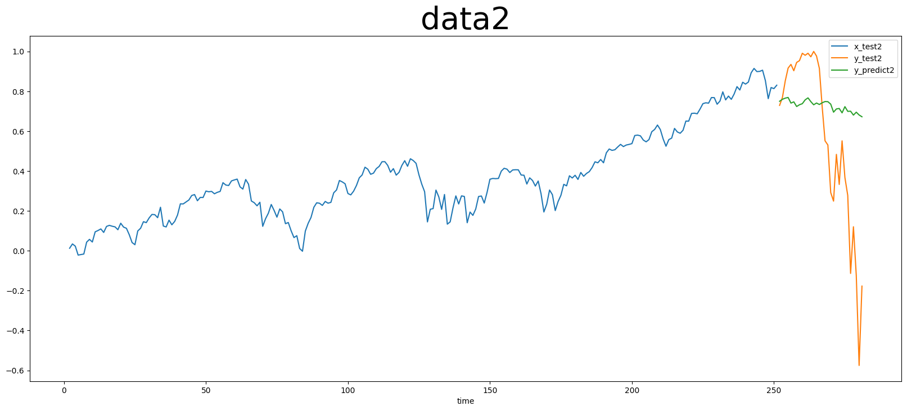
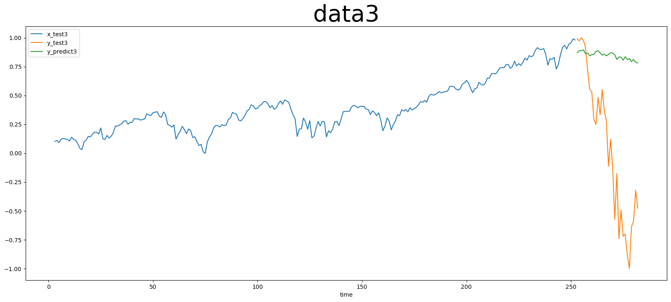
Lstm

Slide 11
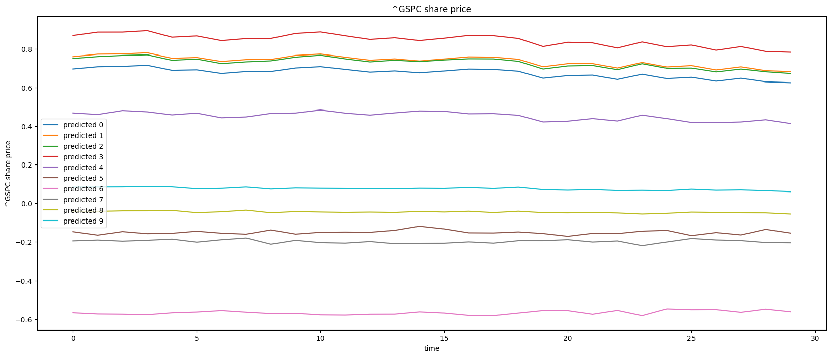
Lstm

Slide 12
1. date_predict_start = ‘2019-01-01'
FFT stock_name = "^GSPC"
date_predict_start = ‘2019-01-01'
data_range = 250
slide_range = 10
n_slide = 10
pv_range = 2
fit_method = 'rmse'
pv_method = 'CL’
n_harm_lower_limit = 1
n_harm_upper_limit = 50
Sarima stock_name = "^GSPC"
date_predict_start = ‘2019-01-01'
data_range = 250
slide_range = 10
n_slide = 10
pv_range = 2
fit_method = 'rmse'
pv_method = 'CL'
Lstm stock_name = "^GSPC“
date_predict_start = ‘2019-01-01’
data_range = 250
prediction_day = 30
slide_range = 10
n_slide = 10
pv_range = 2
train_data : 1999-01~2018-12
共476筆資料

Slide 13
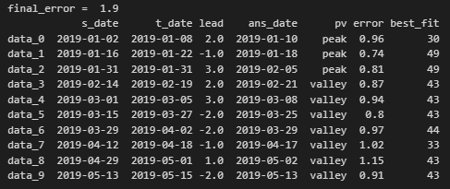
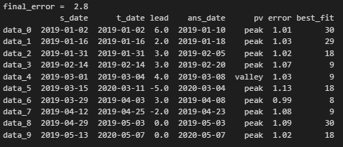
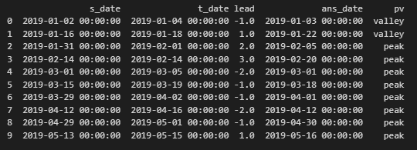
FFT
Sarima
Lstm

Slide 14
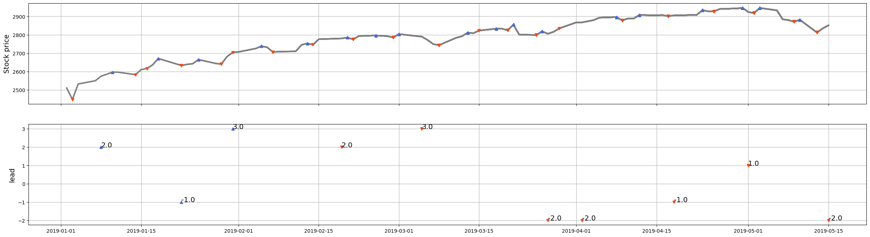
FFT

Slide 15
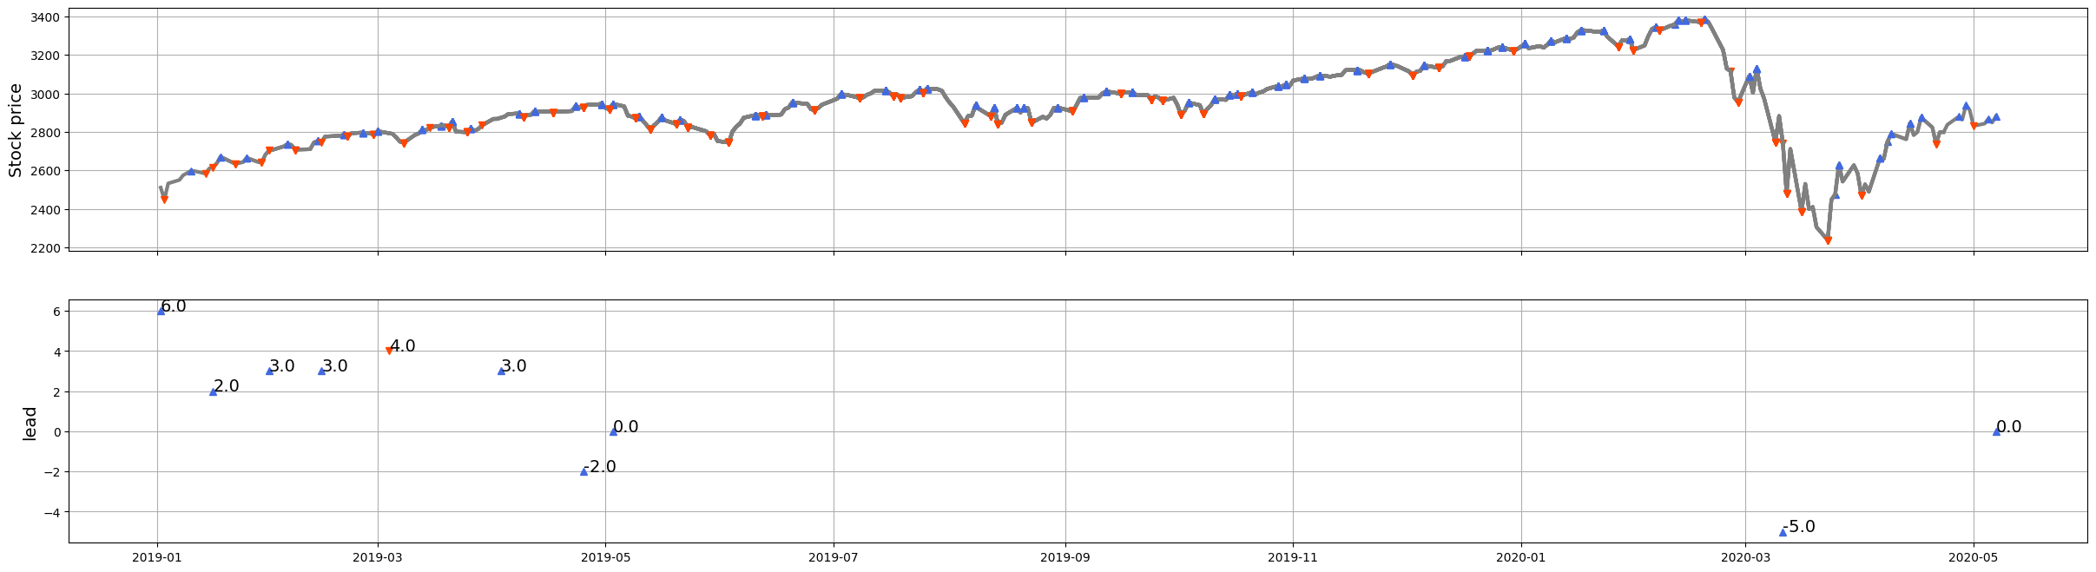
Sarima

Slide 16
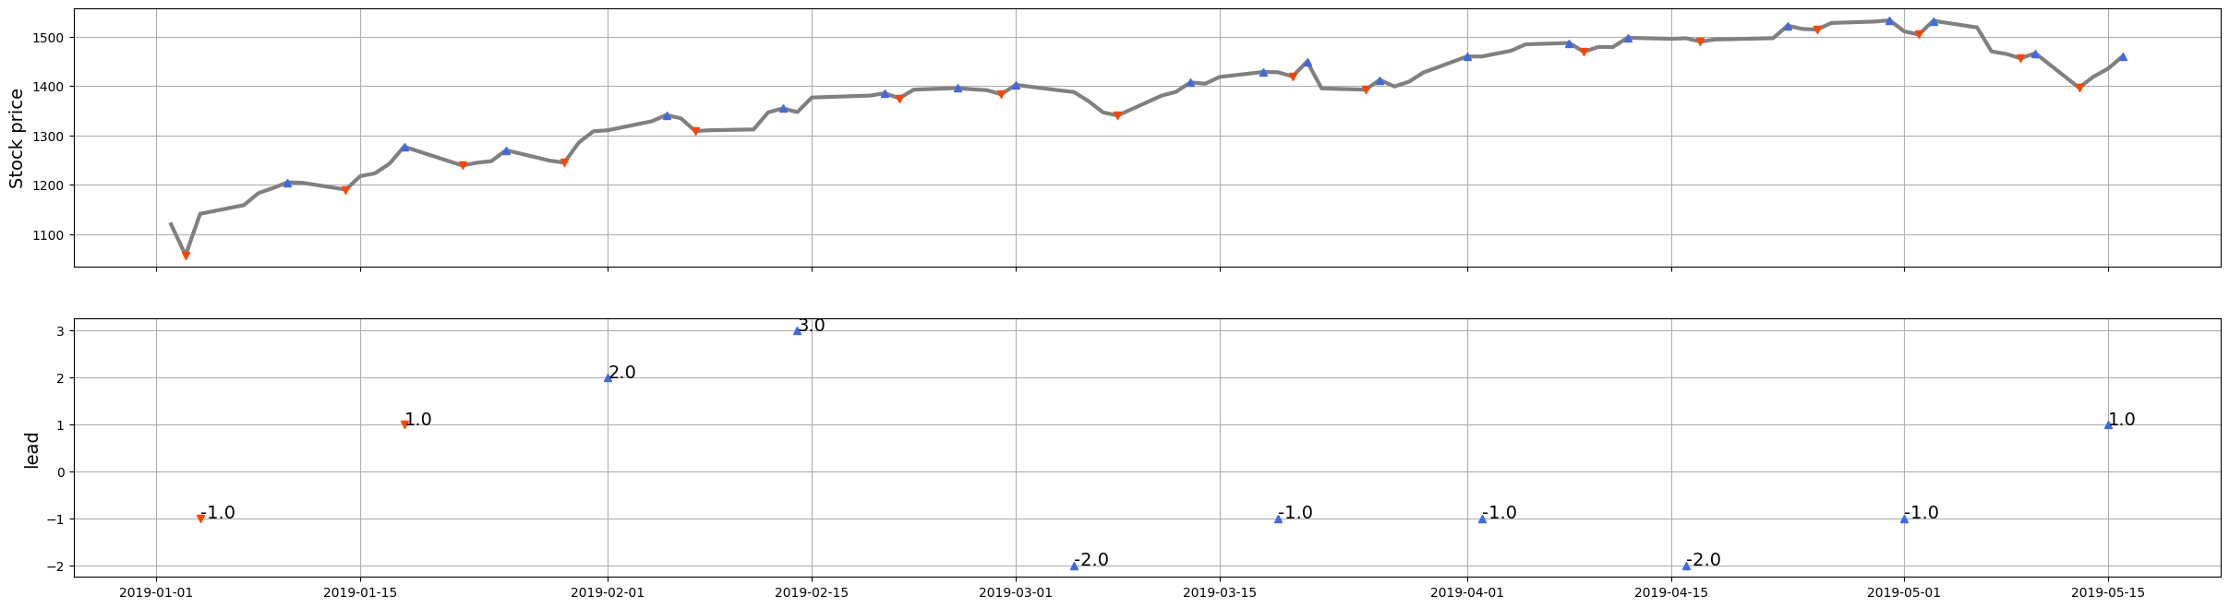
Lstm

Slide 17
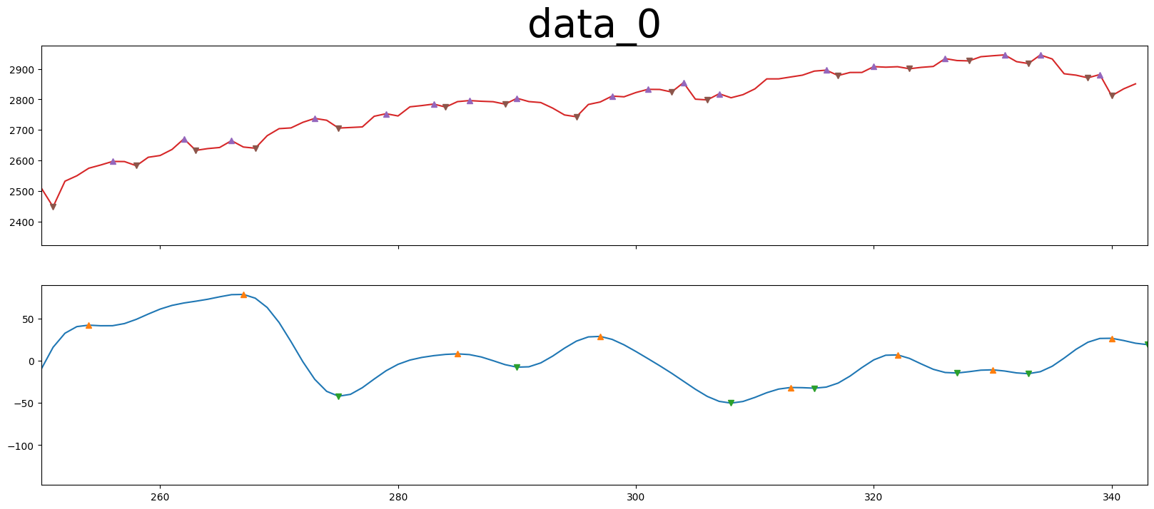
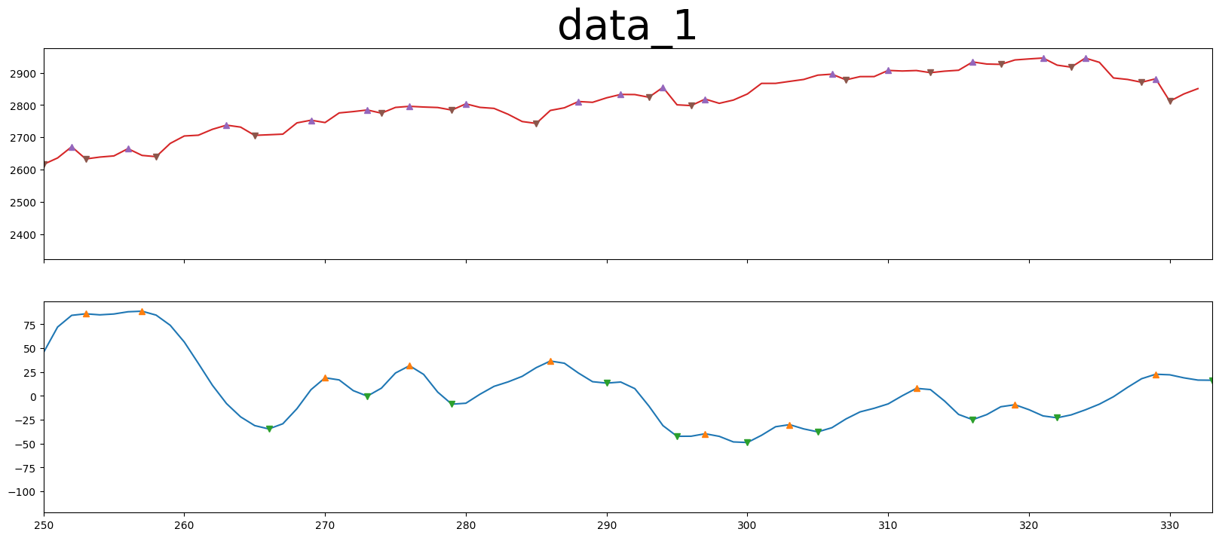
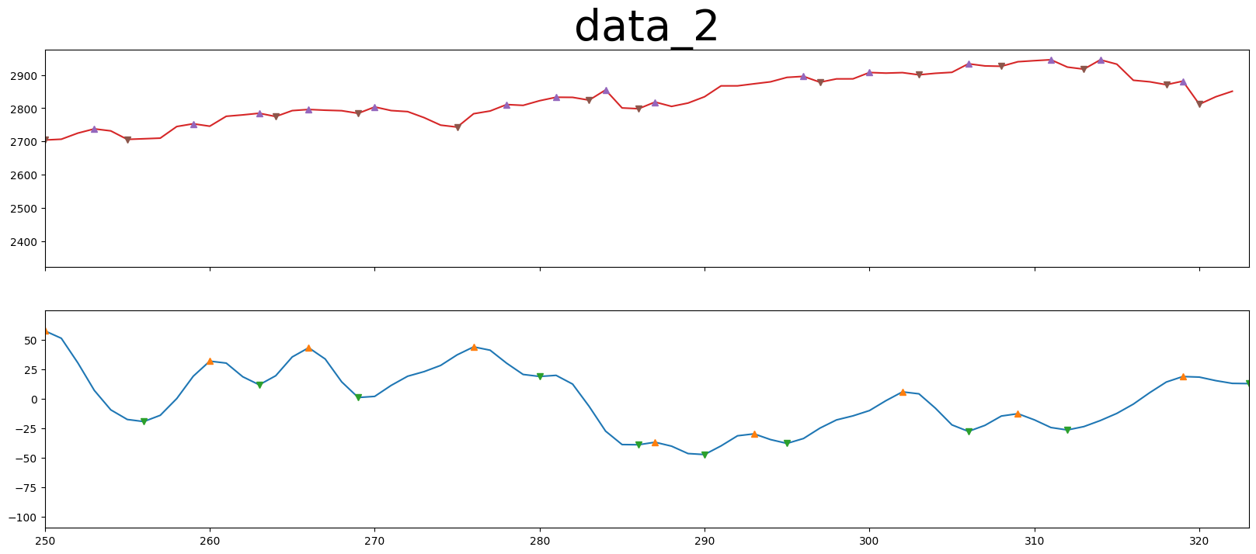
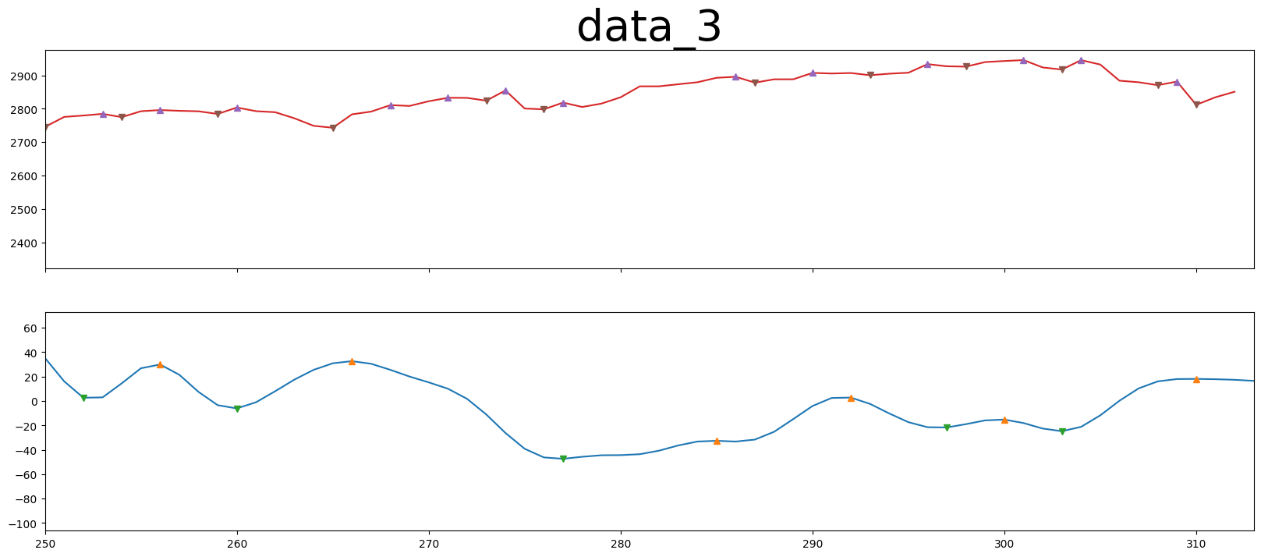
FFT

Slide 18
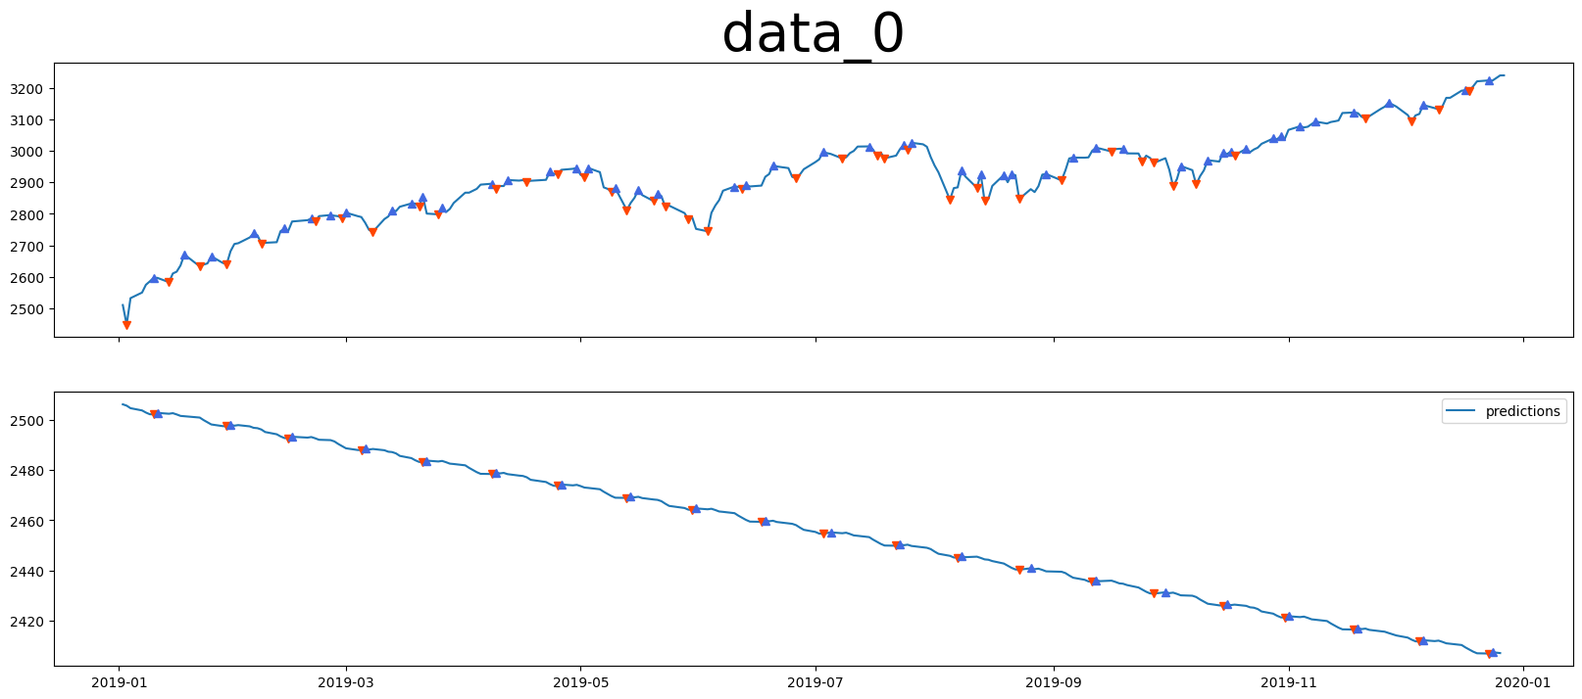
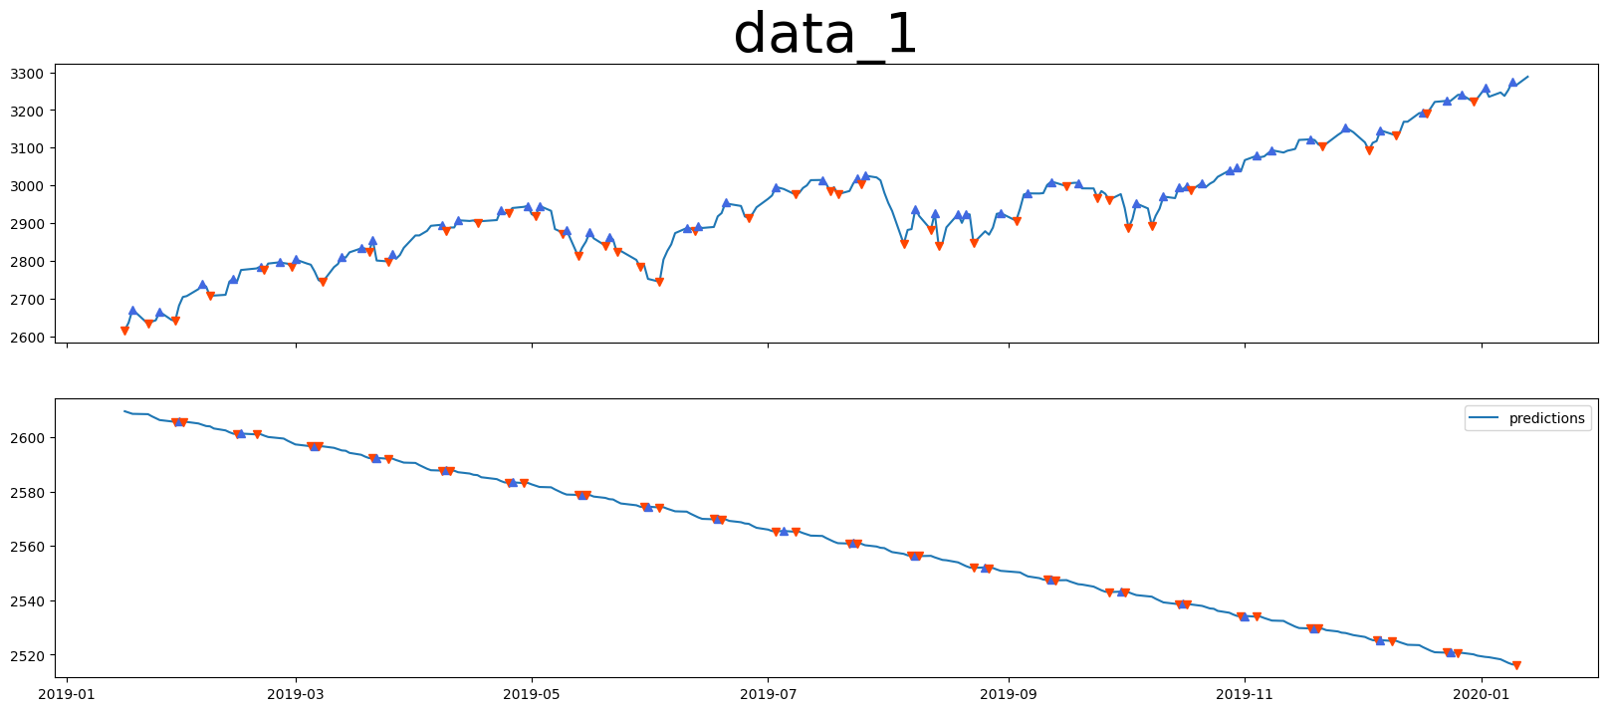
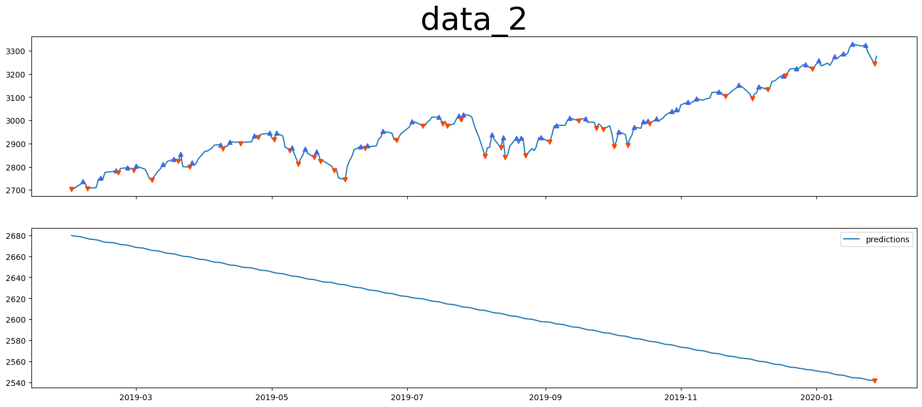
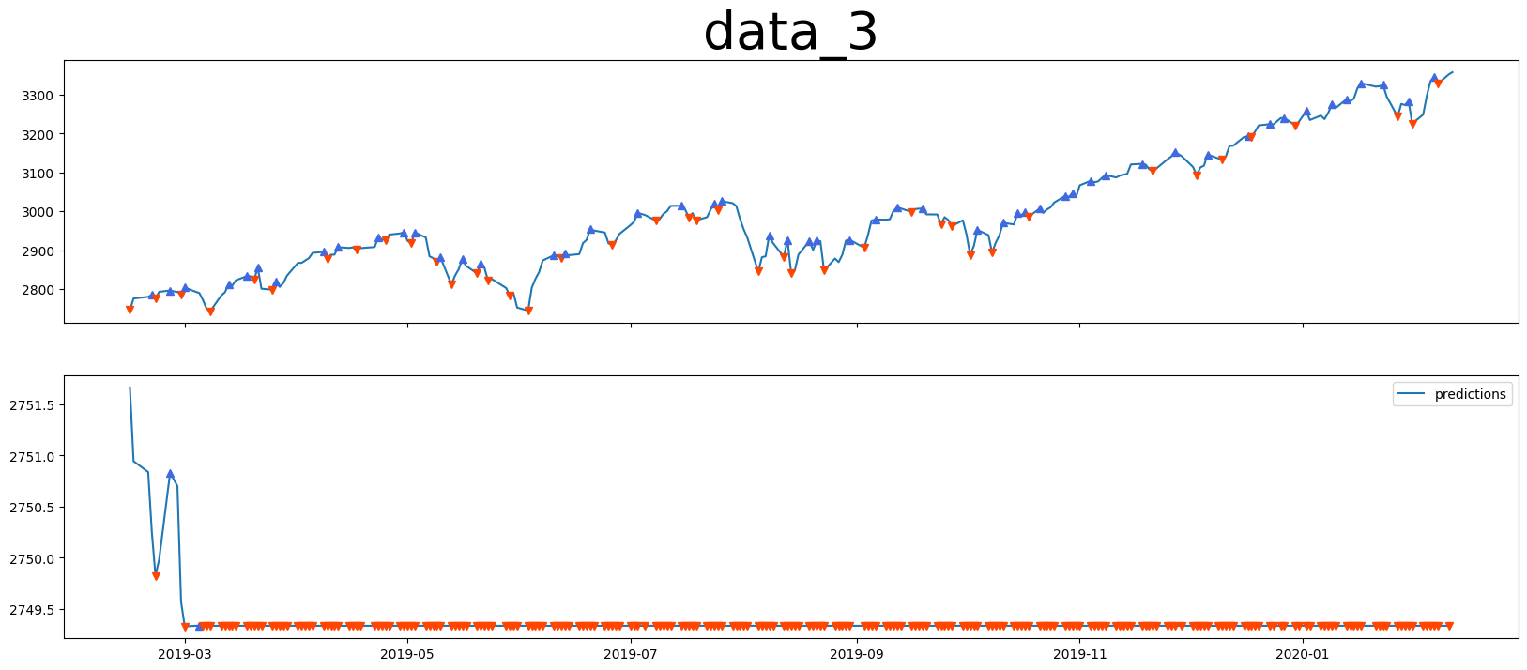
Sarima

Slide 19
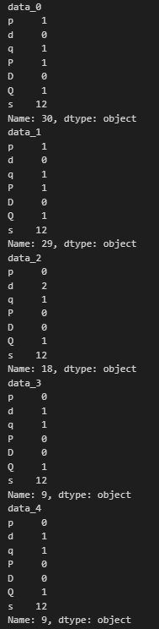
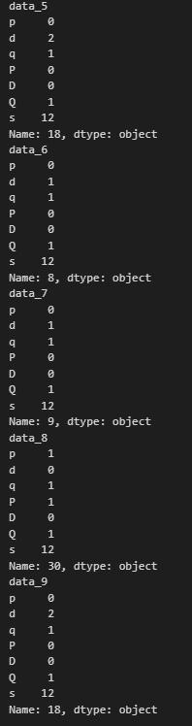

Slide 20
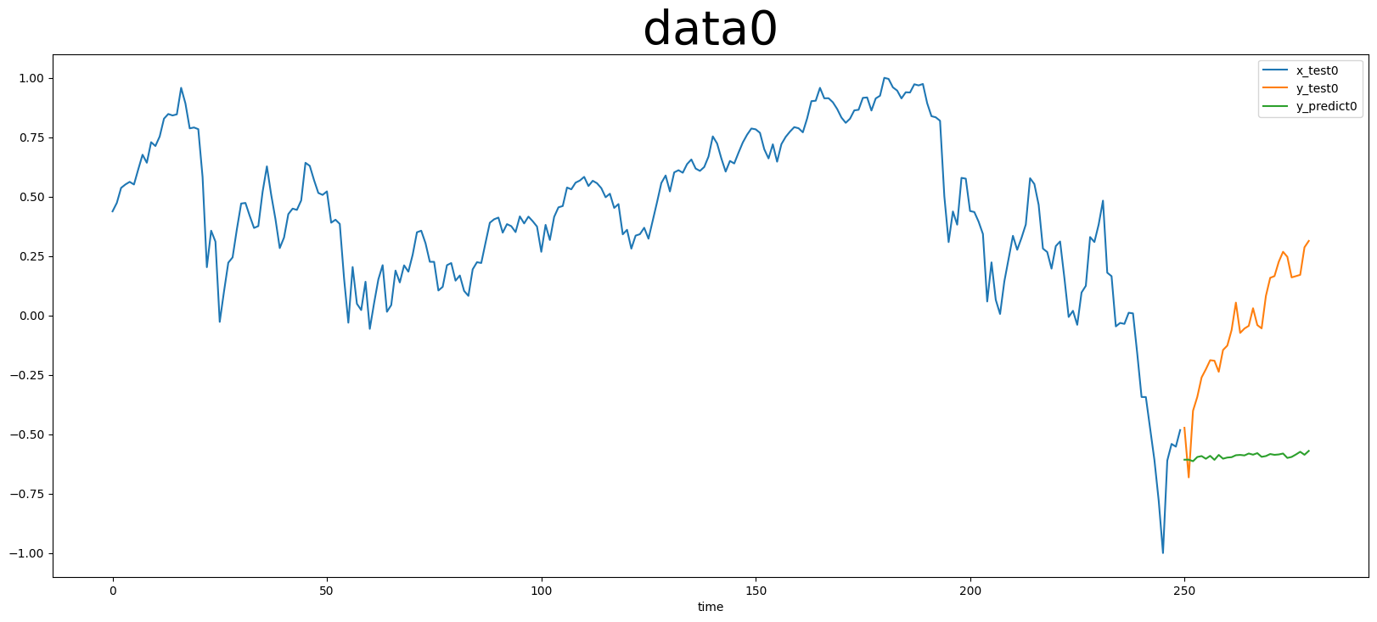
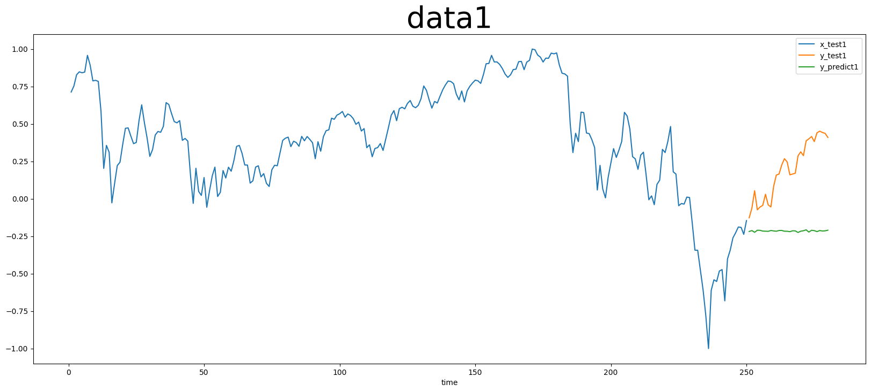
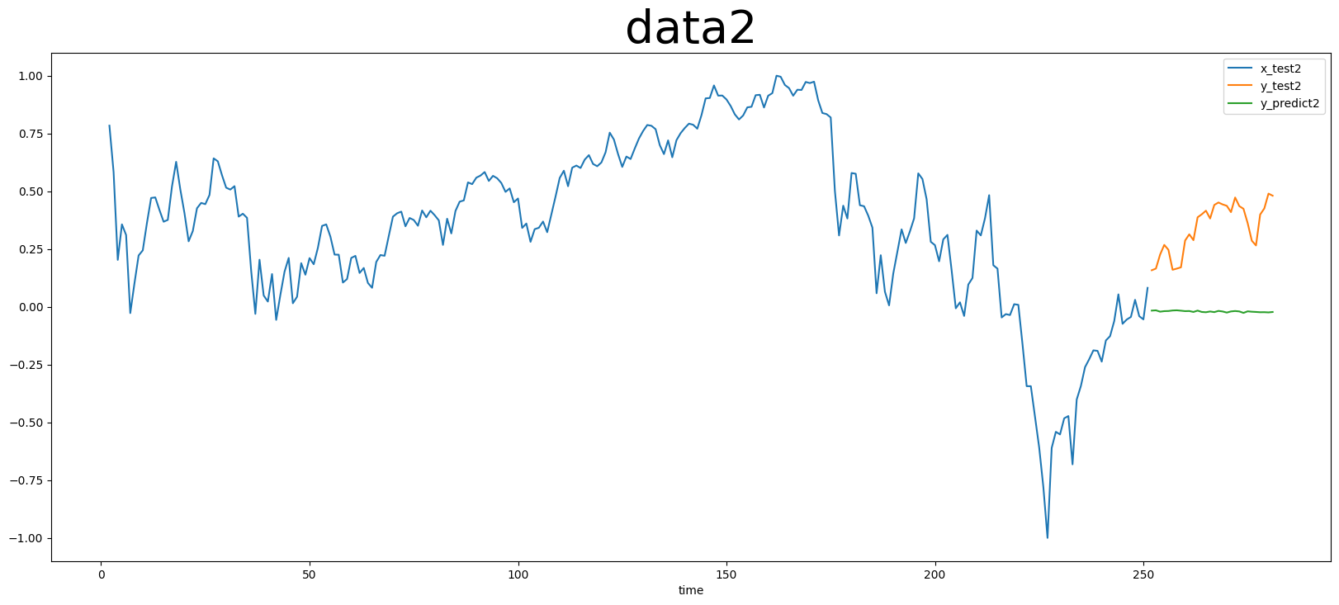
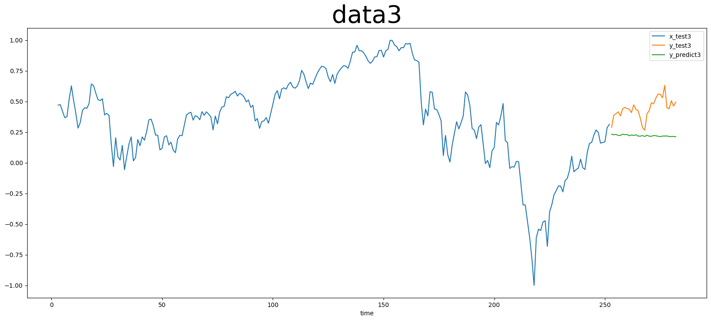
Lstm

Slide 21
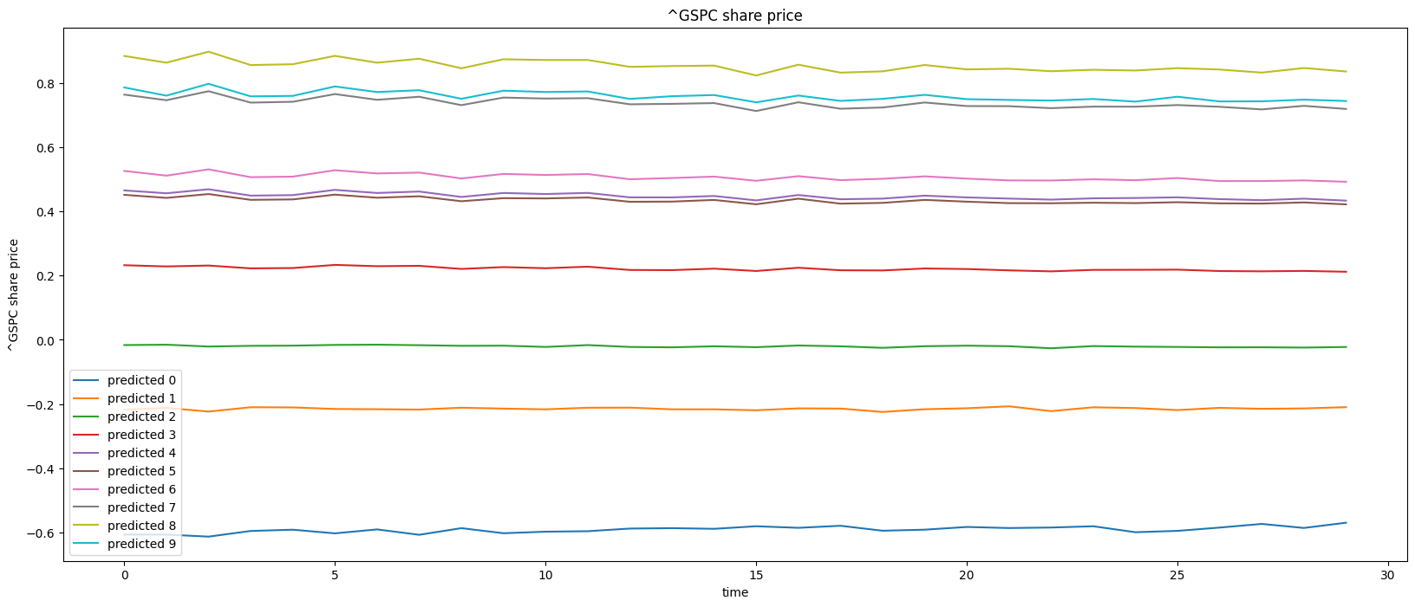
Lstm

Slide 22
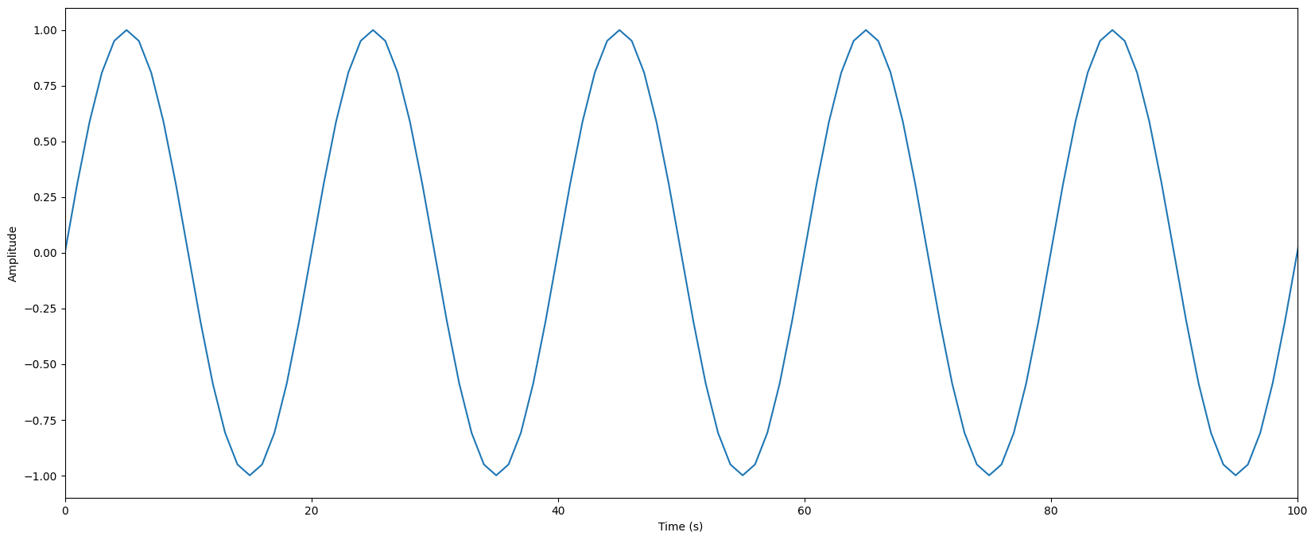
test
FFT
Sarima
Lstm

Slide 23
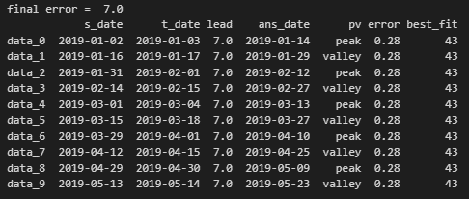
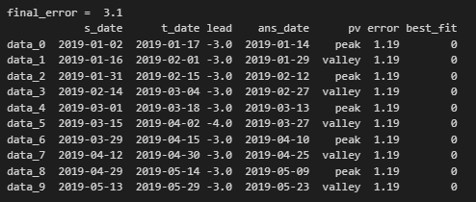
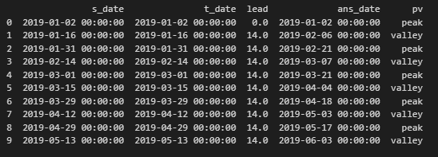
FFT
Sarima
Lstm

Slide 24
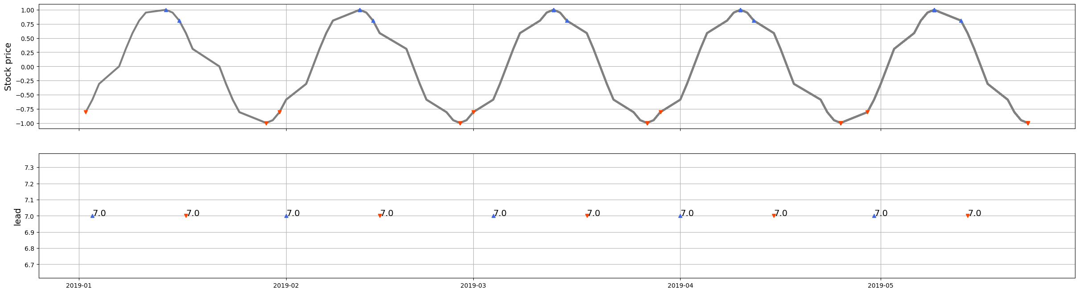
FFT

Slide 25
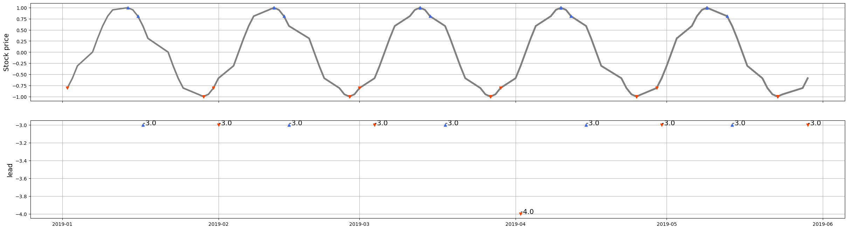
Sarima

Slide 26
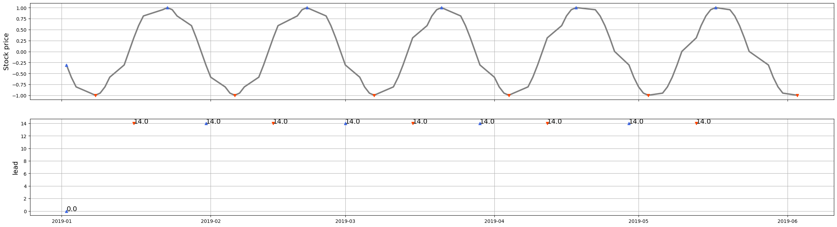
Lstm

Slide 27
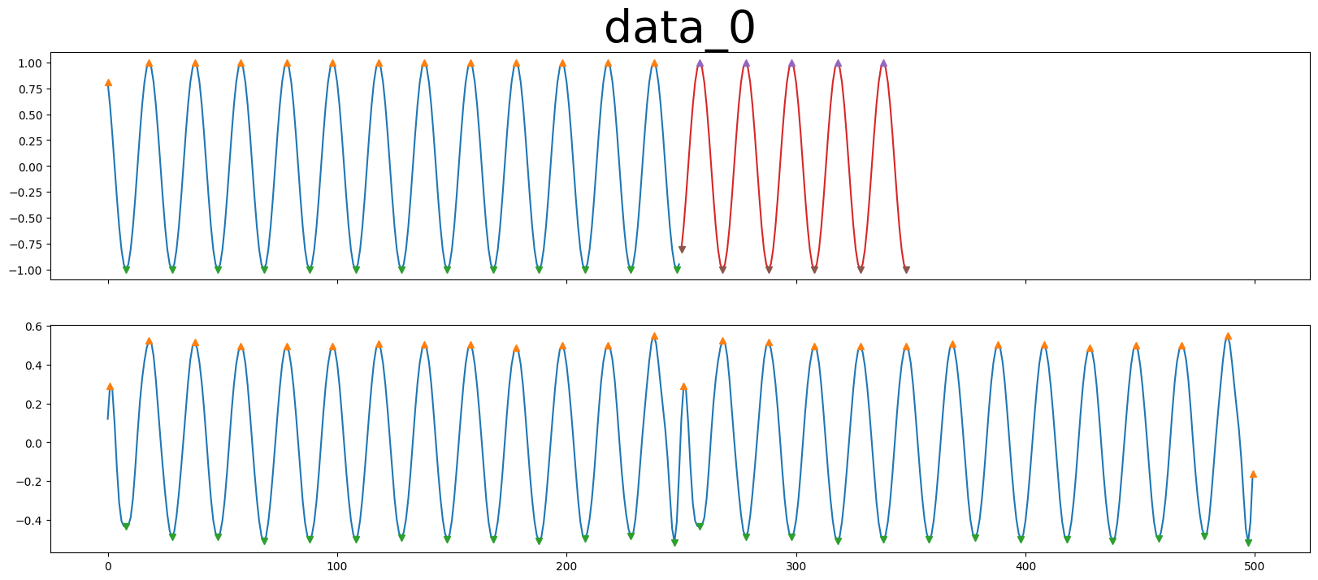



FFT

Slide 28
FFT

Slide 29




Sarima

Slide 30



Slide 31




Lstm

Slide 32

Lstm

