Slide 1
1. date_predict_start = '2020-01-01'
FFT stock_name = "^GSPC"
date_predict_start = '2020-01-01'
data_range = 250
slide_range = 10
n_slide = 10
pv_range = 2
fit_method = 'rmse'
pv_method = 'CL’
n_harm_lower_limit = 1
n_harm_upper_limit = 50
Sarima stock_name = "^GSPC"
date_predict_start = '2020-01-01'
data_range = 250
slide_range = 10
n_slide = 10
pv_range = 2
fit_method = 'rmse'
pv_method = 'CL'
Lstm stock_name = "^GSPC“
date_predict_start = '2020-01-01’
data_range = 250
slide_range = 10
n_slide = 10
pv_range = 2
base_day = 10
prediction_day = 10
slide = 10

Slide 2
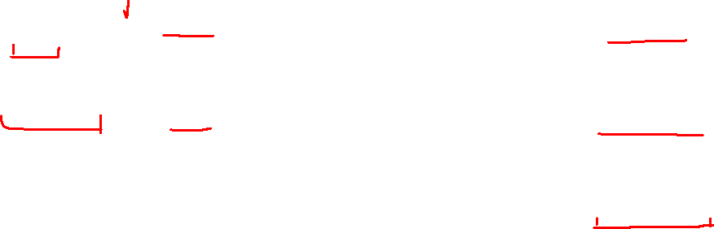
pv_range | Layer_1 | Layer_2 | Layer_3 | Final_error in Lstm | Final_error in FFT | Final_error in Sarima
2 (5days) | 256 | 128 | 64 | 1.8 | 1.8 | 2.6
 | 128 | 64 | 32 | 1.8
 | 64 | 32 | 16 | 2.1
5 (11days) | 256 | 128 | 64 | 3.7 | 4.2 | 5.4
 | 128 | 64 | 32 | 4.2
 | 64 | 32 | 16 | 3.6
7 (15days) | 256 | 128 | 64 | 5.1 | 8.8 | 10.0
 | 128 | 64 | 32 | 6.0
 | 64 | 32 | 16 | 6.2

Slide 3
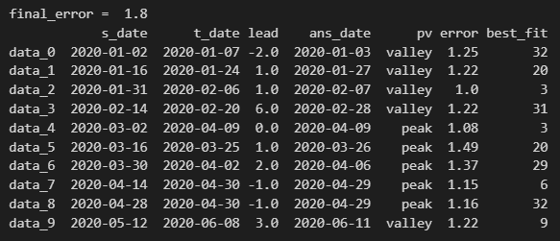
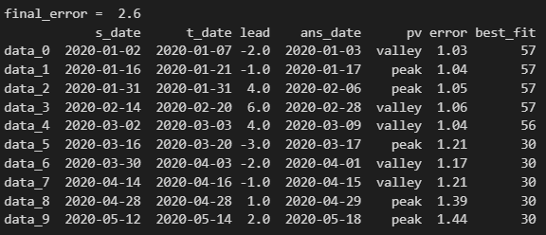
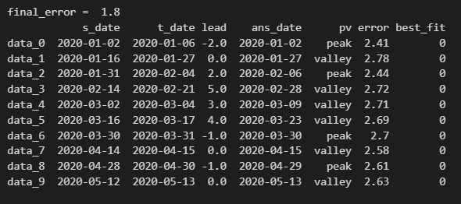
FFT
Sarima
Lstm

Slide 4
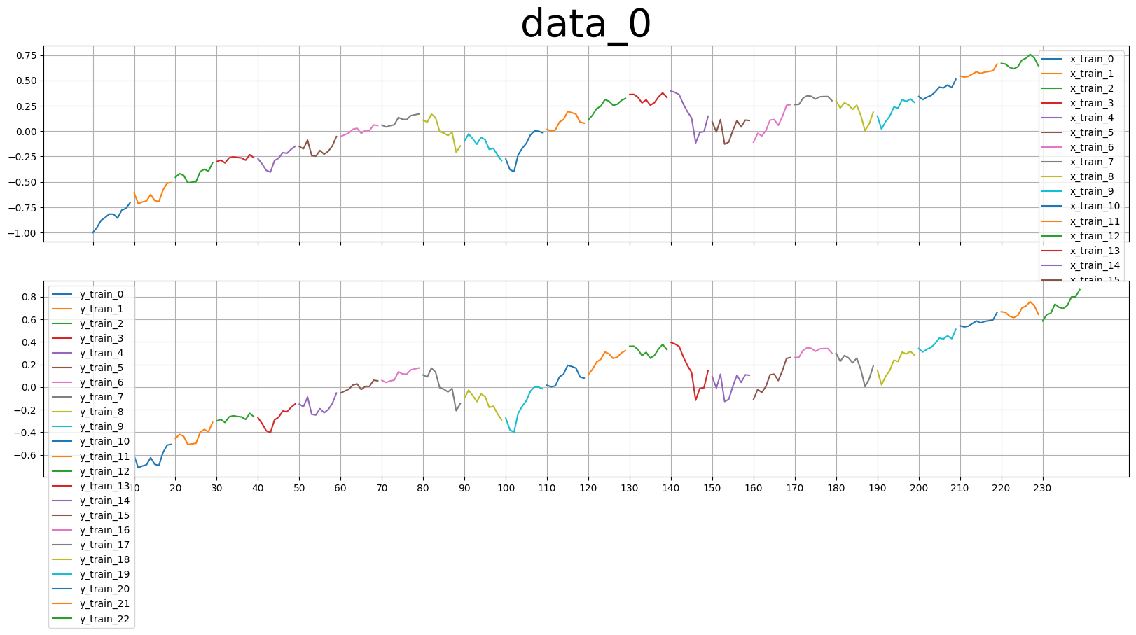
base_day = 10
prediction_day = base_day
slide = base_day
Length of x_train
Length of y_train
base_day = 10
slide = 10
prediction_day = 10

Slide 5
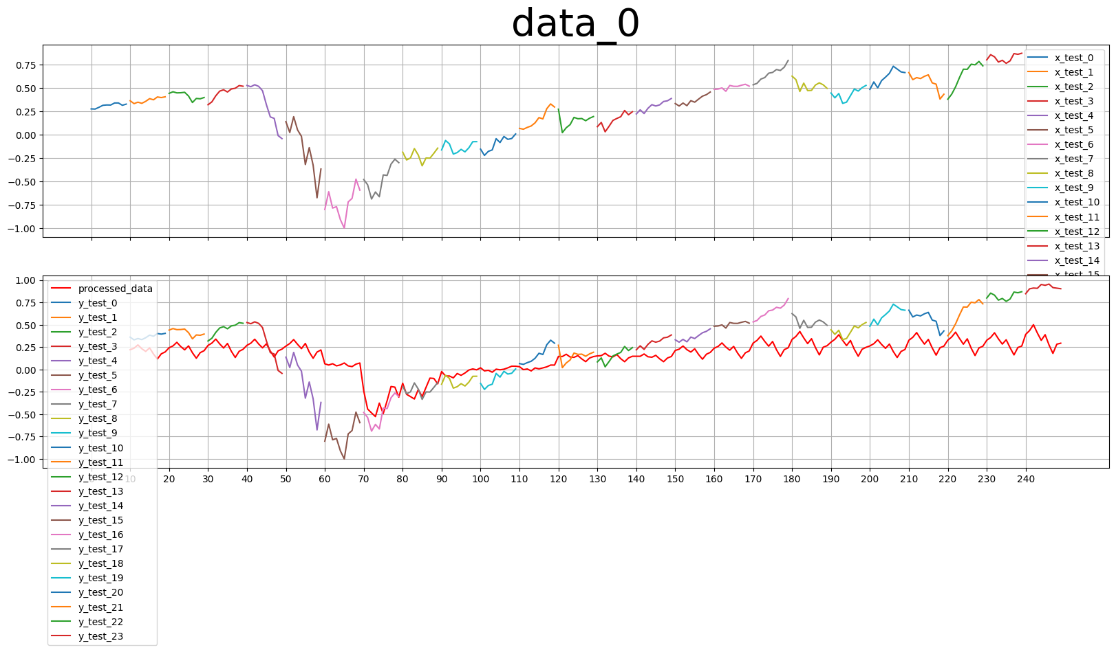
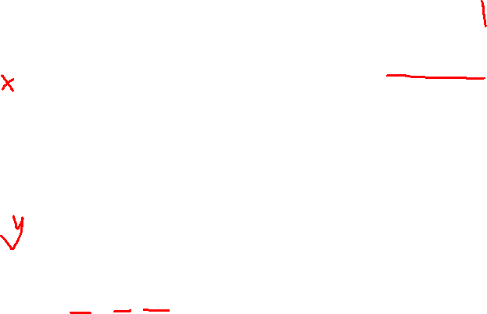
x_test, y_test, processed_data

Slide 6
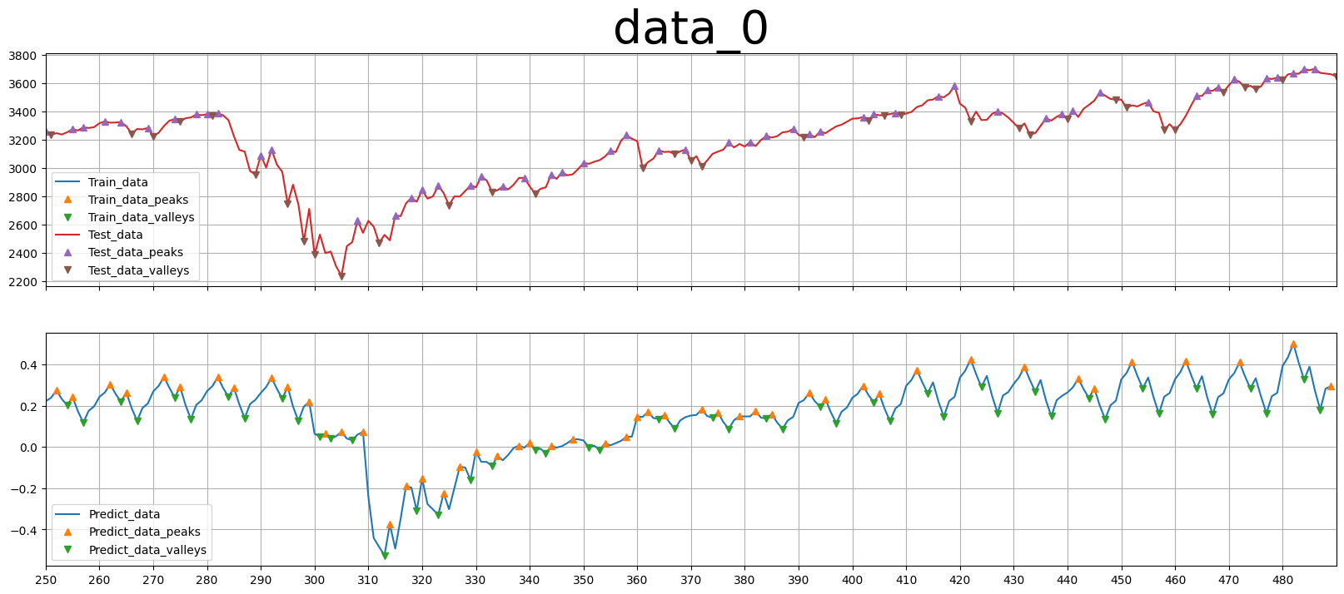
pv_range = 2
(5days)
Layer_1 = 256, Layer_2 = 128, Layer_3 = 64

Slide 7
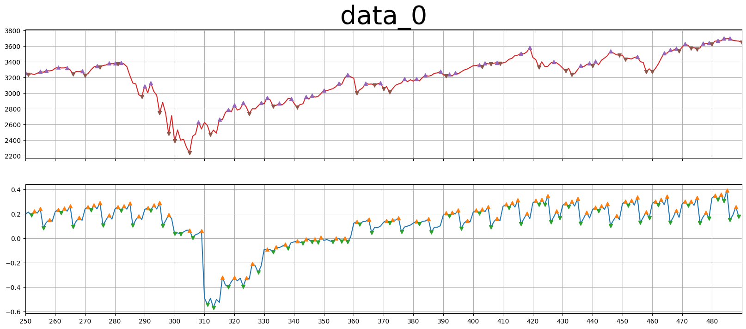
pv_range = 2
(5days)
Layer_1 = 128, Layer_2 = 64, Layer_3 = 32

Slide 8
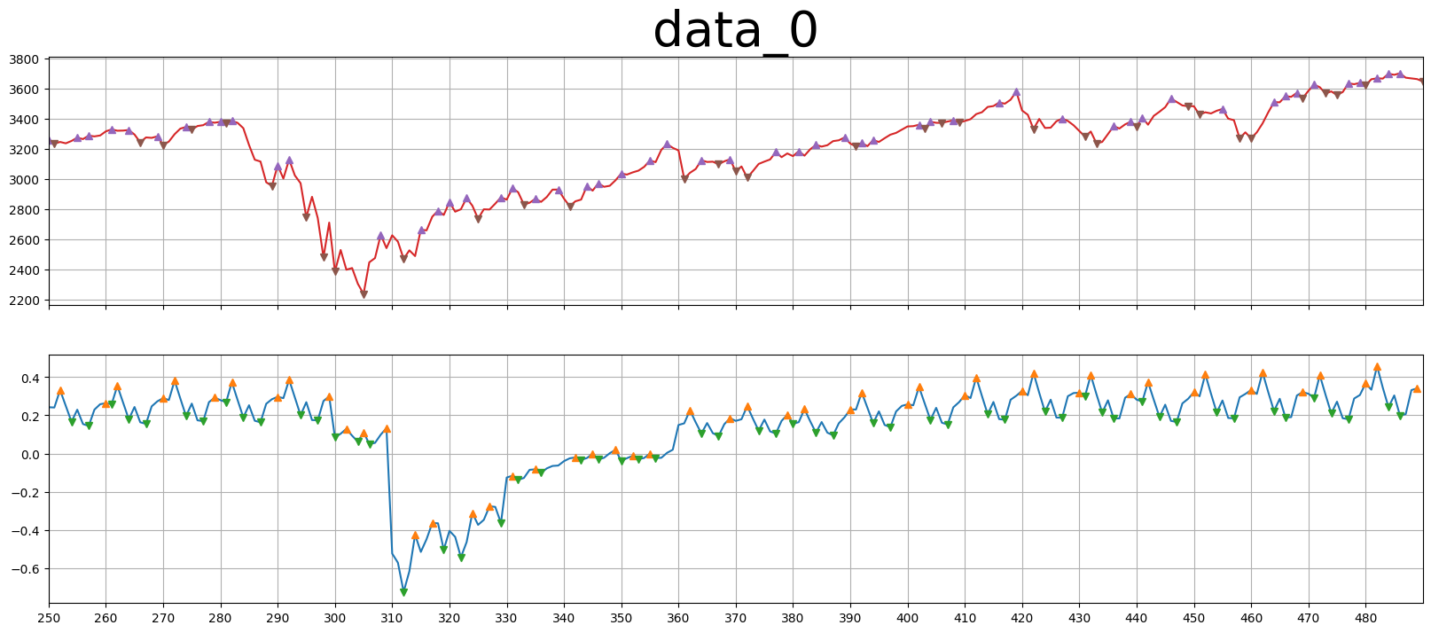
pv_range = 2
(5days)
Layer_1 = 64, Layer_2 = 32, Layer_3 = 16

Slide 9
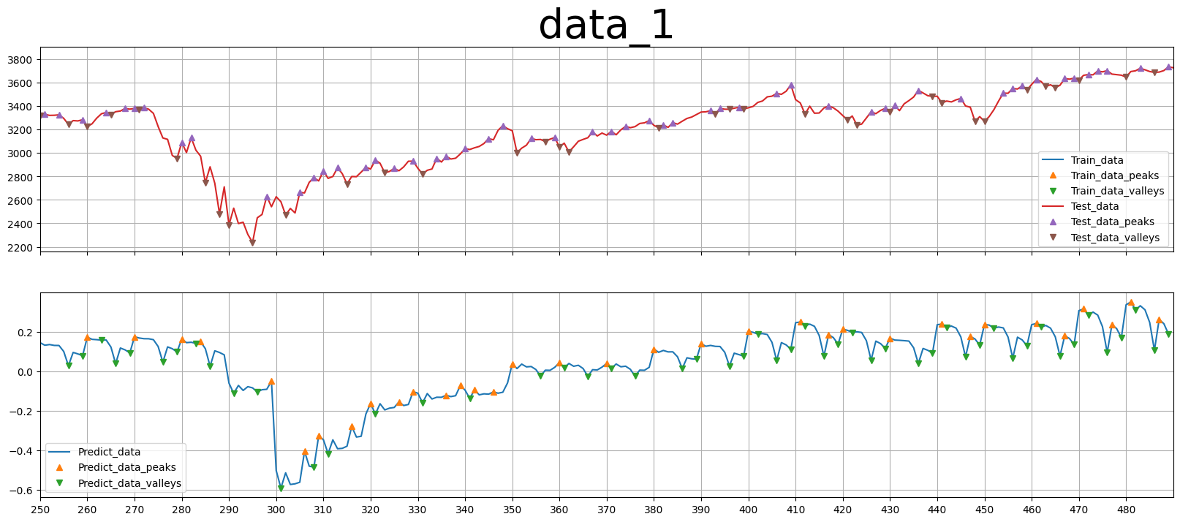

Slide 10
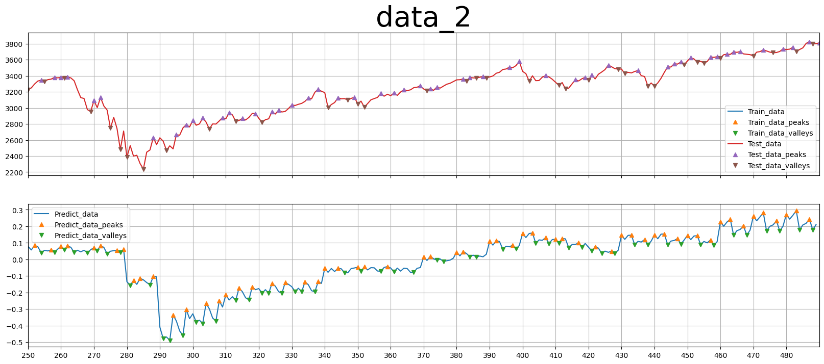

Slide 11
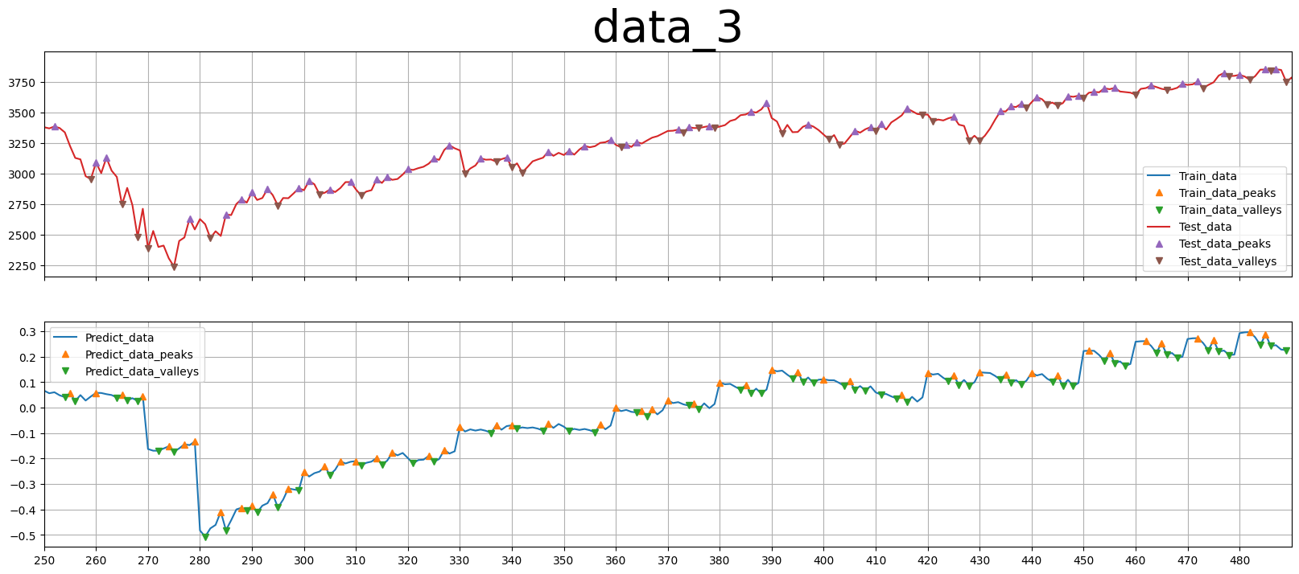

Slide 12
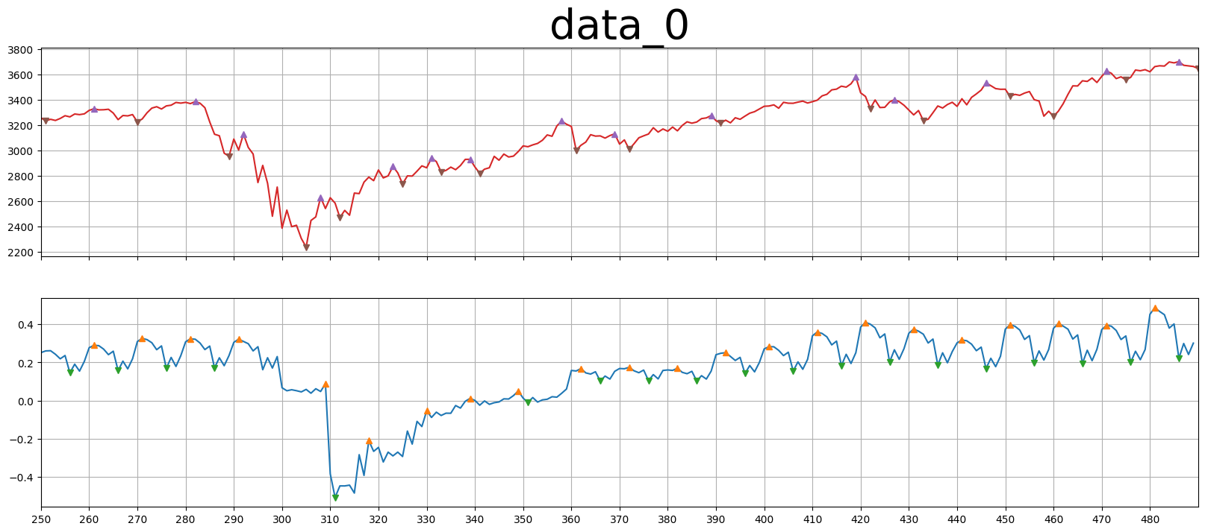
pv_range = 5
(5days)
Layer_1 = 256, Layer_2 = 128, Layer_3 = 64

Slide 13
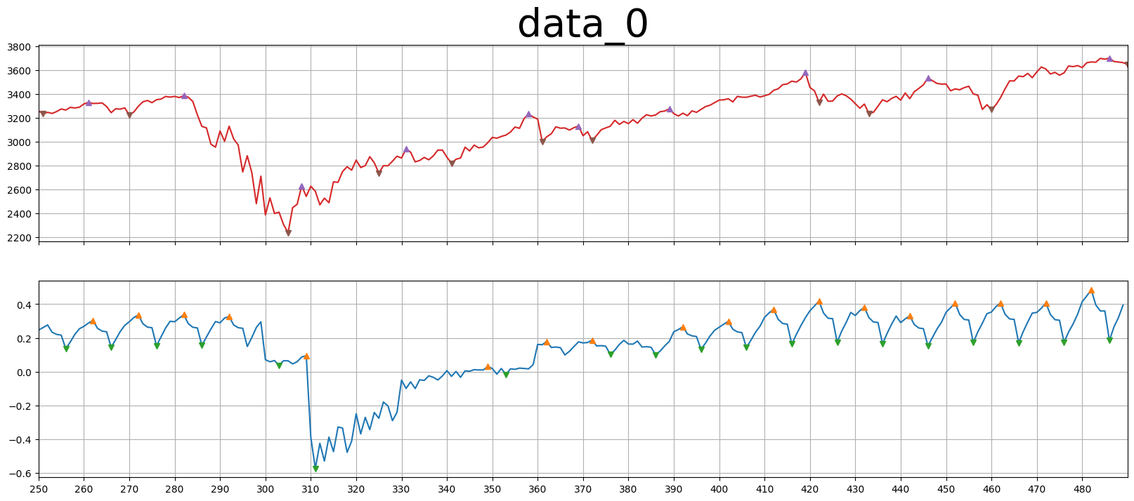
pv_range = 7
(5days)
Layer_1 = 256, Layer_2 = 128, Layer_3 = 64

