Slide 1
1. date_predict_start = '2020-01-01'
FFT stock_name = "^GSPC"
date_predict_start = '2020-01-01'
data_range = 250
slide_range = 10
n_slide = 10
pv_range = 2
fit_method = 'rmse'
pv_method = 'CL’
n_harm_lower_limit = 1
n_harm_upper_limit = 50
Sarima stock_name = "^GSPC"
date_predict_start = '2020-01-01'
data_range = 250
slide_range = 10
n_slide = 10
pv_range = 2
fit_method = 'rmse'
pv_method = 'CL'
Lstm stock_name = "^GSPC“
date_predict_start = '2020-01-01’
data_range = 250
slide_range = 10
n_slide = 10
pv_range = 2
base_day = 10
prediction_day = 10
slide = 10

Slide 2
pv_range | Final_error | Profit | Final_error | Profit | Final_error | Profit | Final_error | Profit
 | Lstm base_day = 10 |  | Lstm base_day = 20 |  | Lstm base_day = 30 |  | FFT
2 (5days), data_range=250 | 2.5 | -32.75 | 2.5 | -269.92 | 1.5 | -90.79 | 1.8 | -284.54
 | 1.7 | -272.29 | 1.3 | -217.23 | 0.9 | 656.59
 | 2.2 | -395.18 | 0.9 | 272.31 | 2.3 | 27.02
5 (11days), data_range=250 | 5.1 | 390.91 | 6.8 | -144.64 | 5.6 | 116.72 | 4.2 | -102.06
 | 3.6 | 1163.43 | 5.3 | -300.35 | 5.7 | 12.09
 | 4.1 | 1029.87 | 4.1 | 541.43 | 7.5 | -1015.19
7 (15days), data_range=250 | 4.1 | 652.95 | 6.6 | 236.53 | 11.1 | -1393.46 | 8.8 | -961.23
 | 4.0 | 648.32 | 7.9 | 184.16 | 8.3 | -762.26
 | 5.7 | 612.10 | 9.0 | -265.46 | 10.0 | 378.45

Slide 3
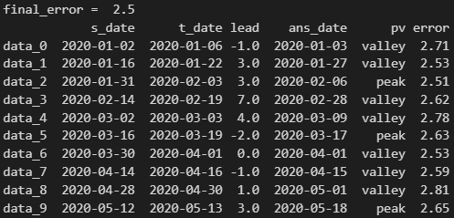
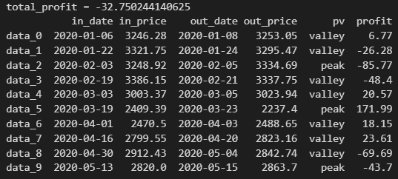
valley
peak
Pv_range
Pv_range
t_date
s_date
s_date
t_date
Pv_range
Pv_range
Sell
out_price
in_date
in_price
Sell
out_date
Profit = out_price-in_price
Profit = in_price – out_price
out_date
Buy
Buy
in_price
out_price
in_date

Slide 4
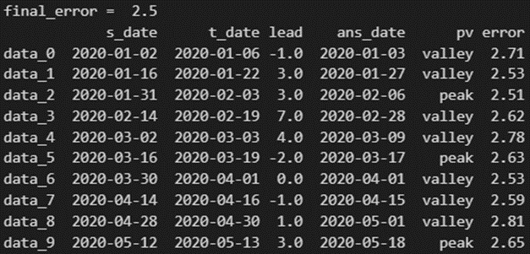
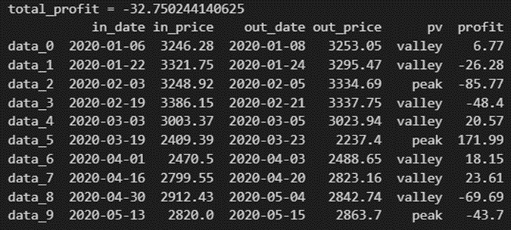
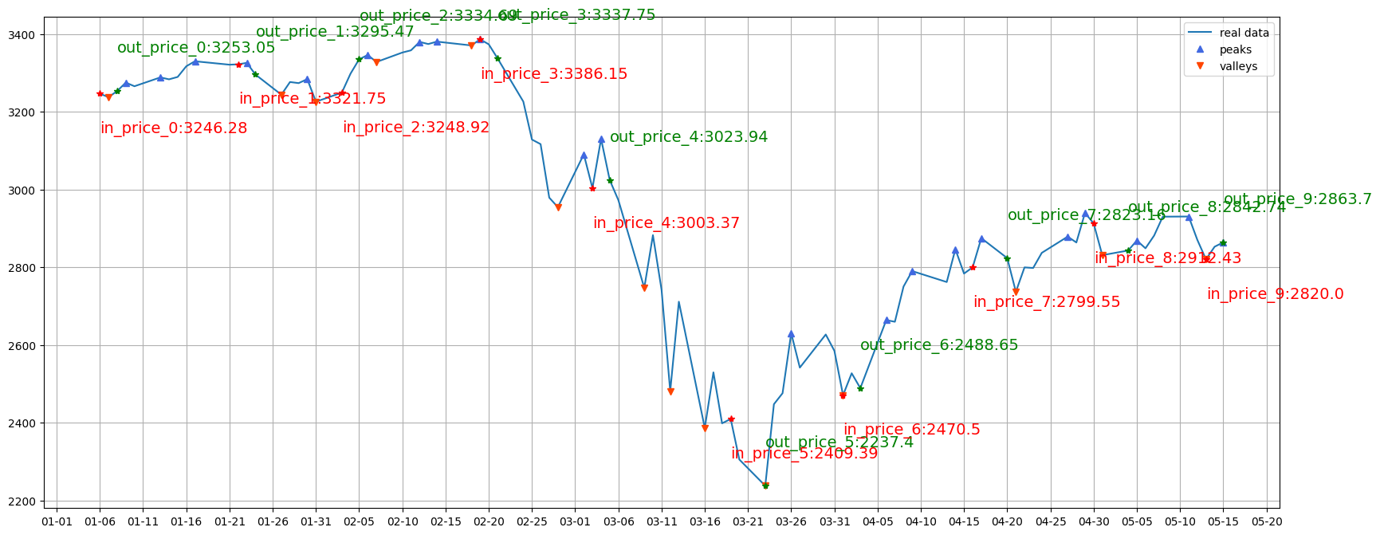

pv_range=2, base_day=10, try_1

Slide 5
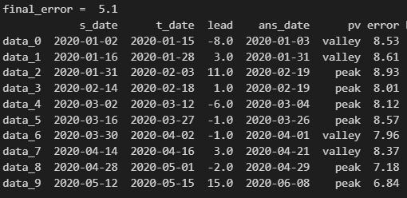
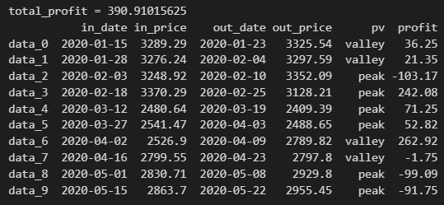
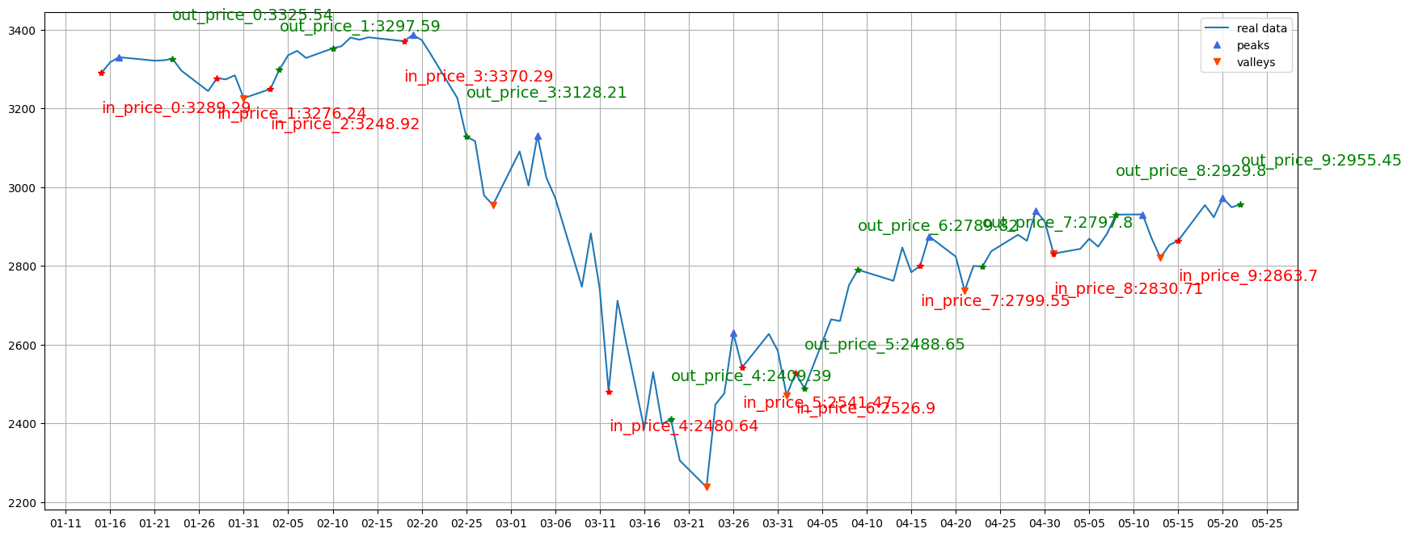
pv_range=5, base_day=10, try_1

Slide 6
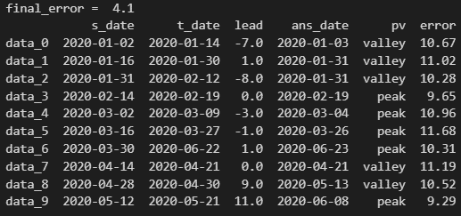
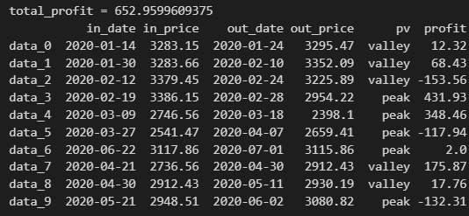
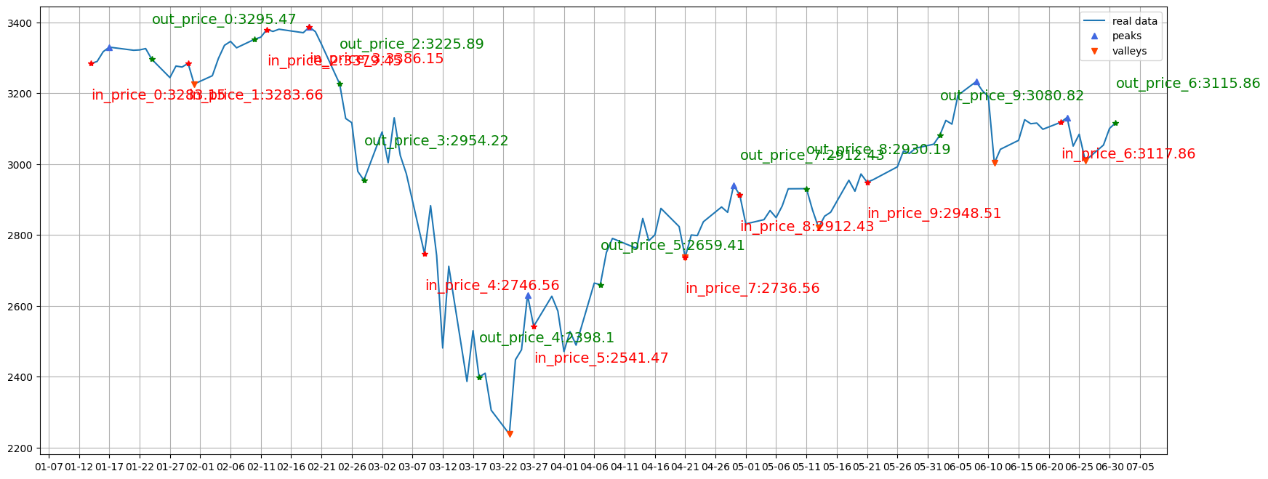
pv_range=7, base_day=10, try_1

Slide 7
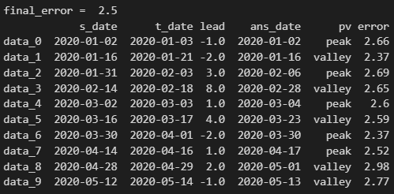
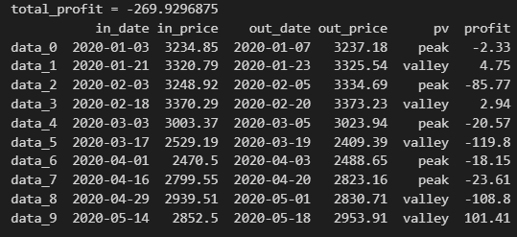
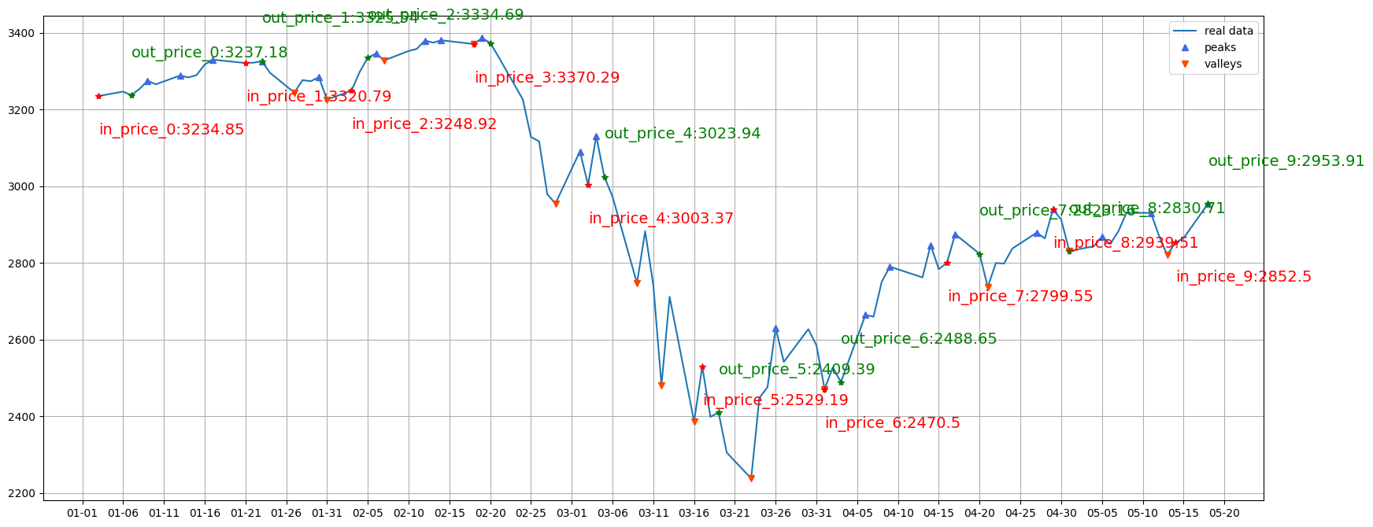
pv_range=2, base_day=20, try_1

Slide 8
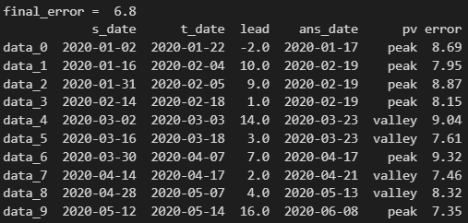
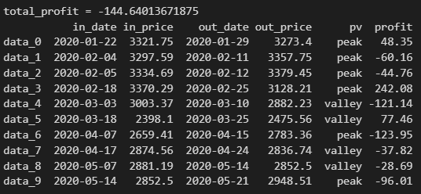
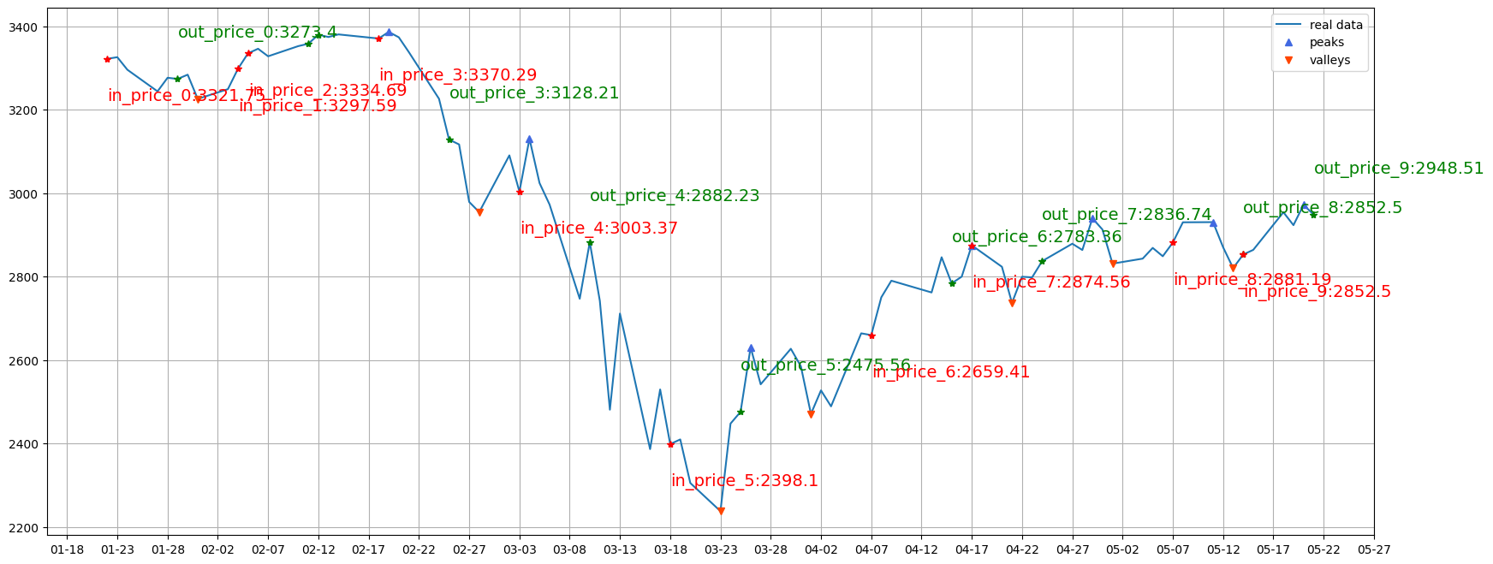
pv_range=5, base_day=20, try_1

Slide 9
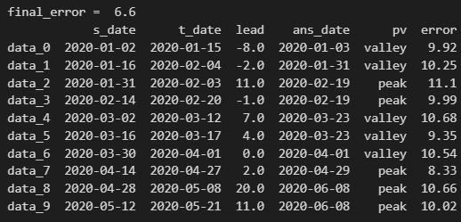
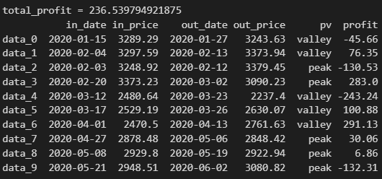
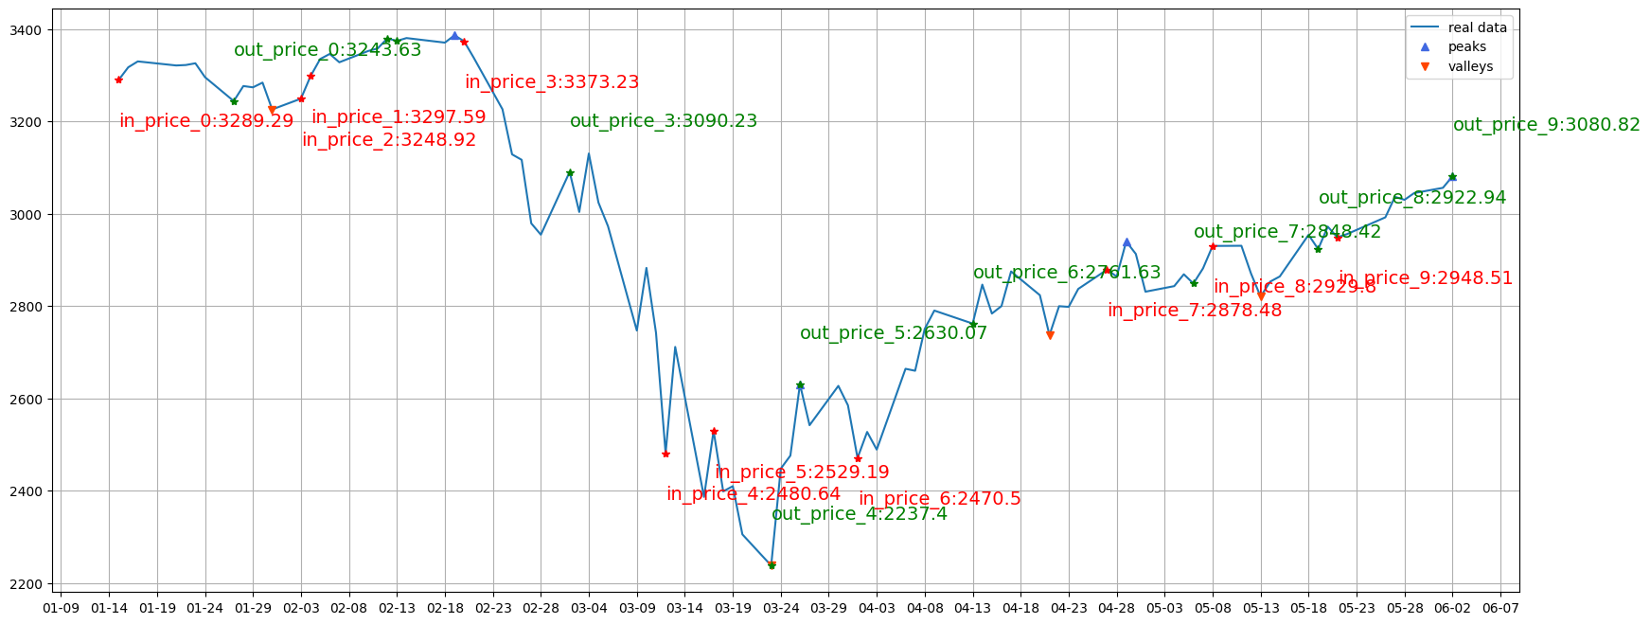
pv_range=7, base_day=20, try_1

Slide 10
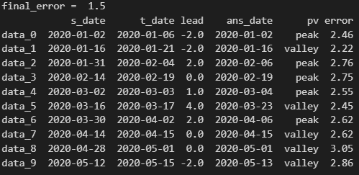
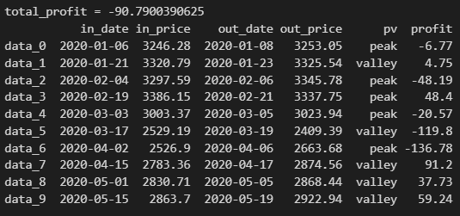
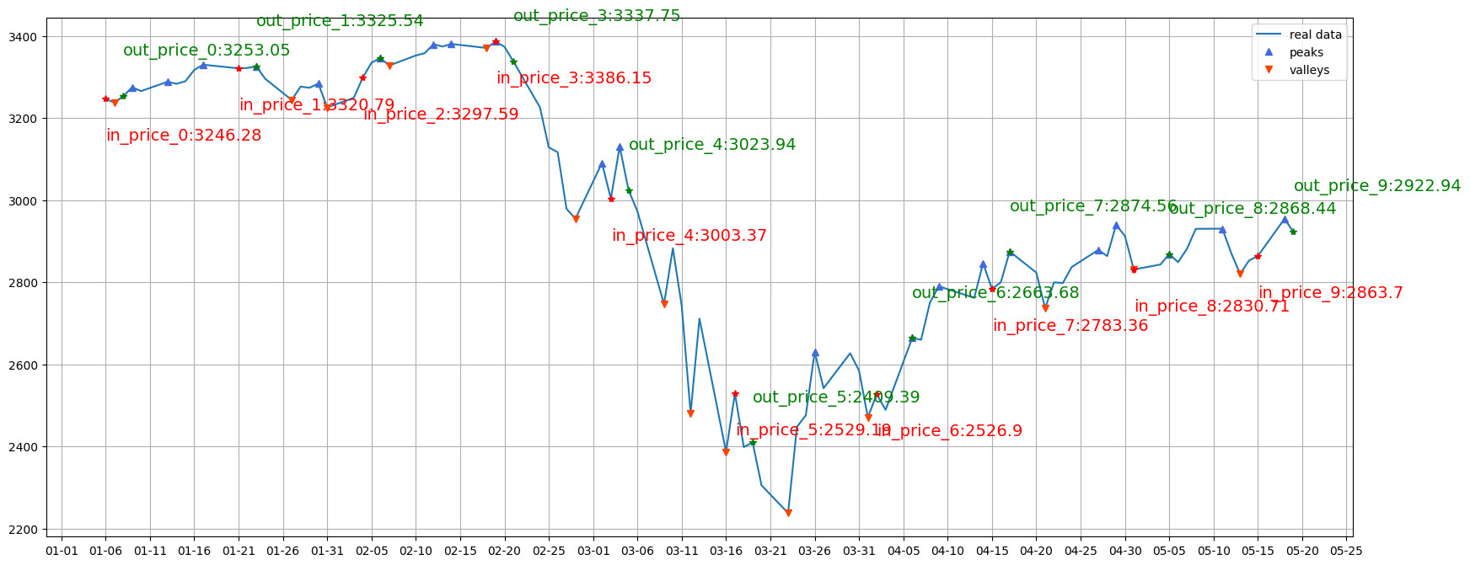
pv_range=2, base_day=30, try_1

Slide 11
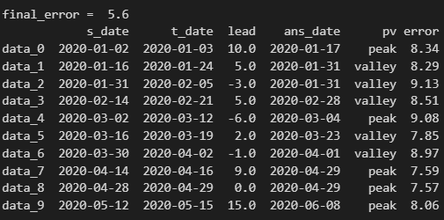
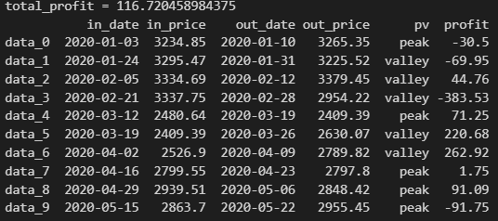
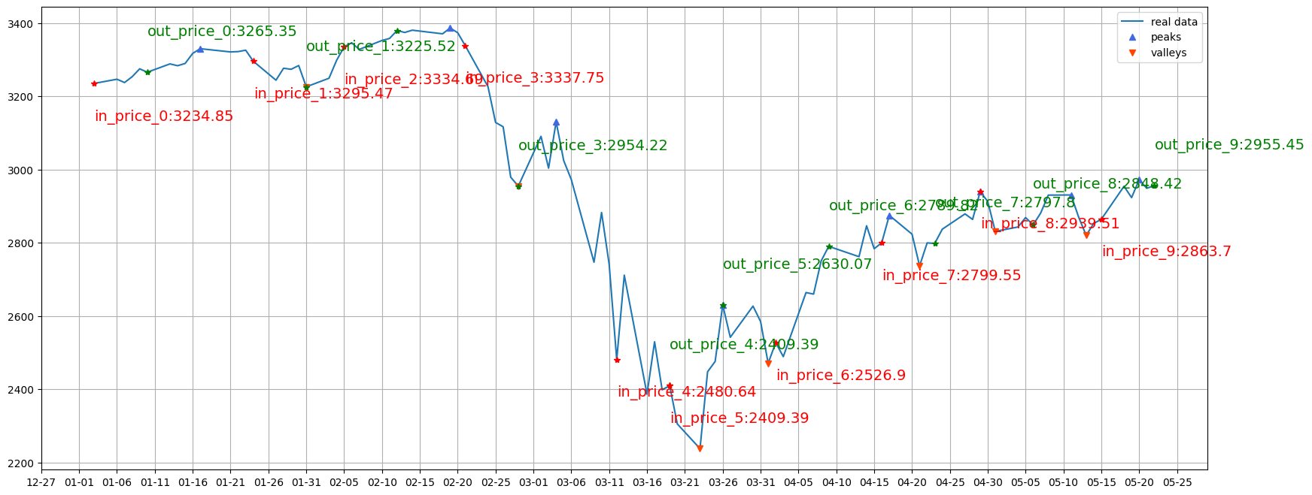
pv_range=5, base_day=30, try_1

Slide 12
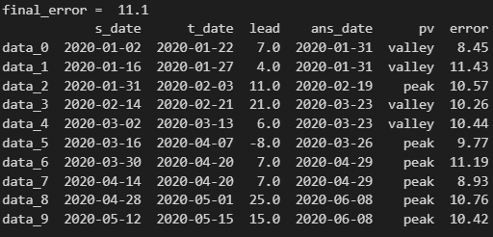
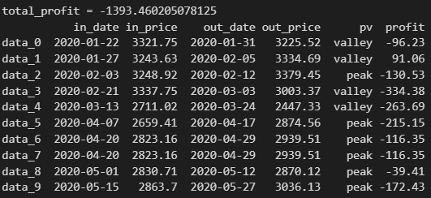
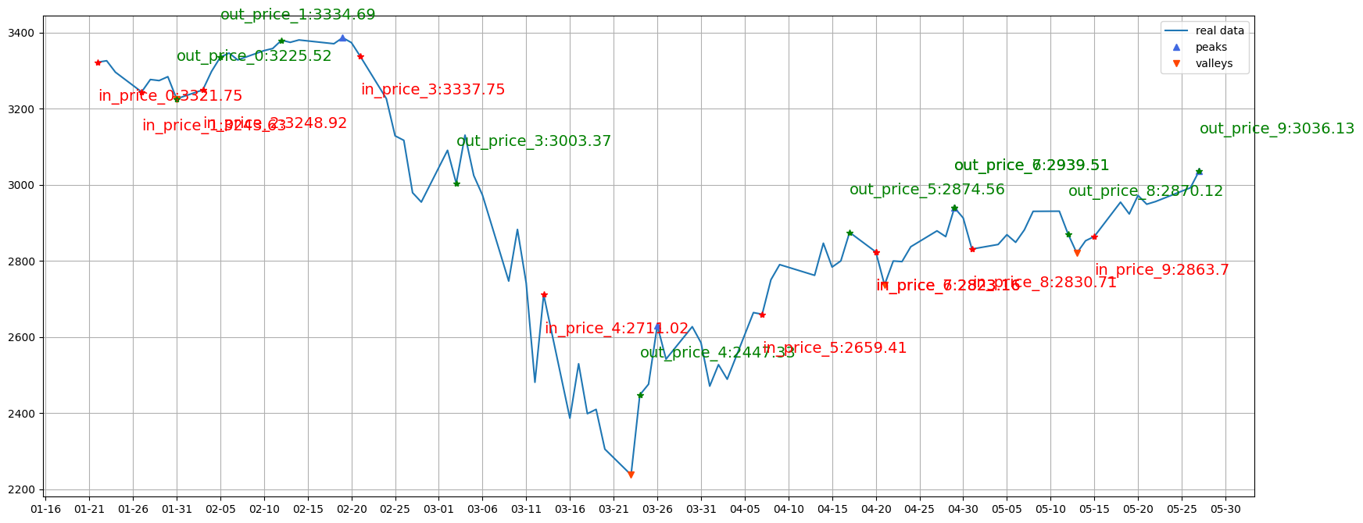
pv_range=7, base_day=30, try_1

Slide 13
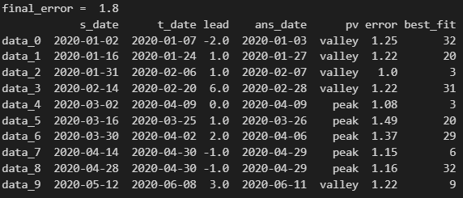
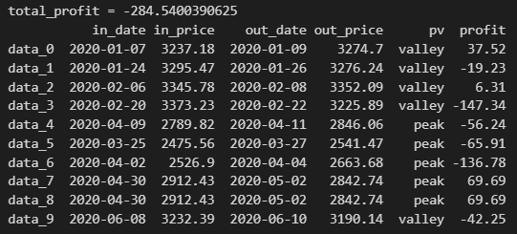
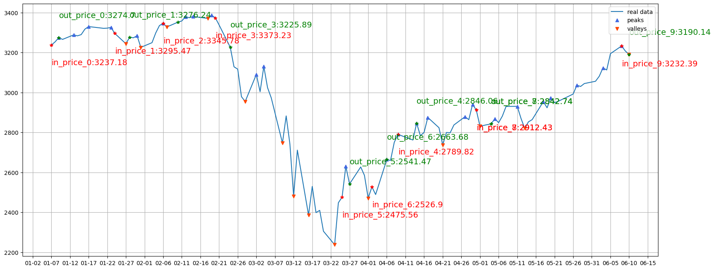
FFT, pv_range=2, try_1

Slide 14
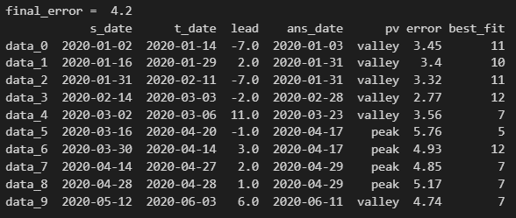
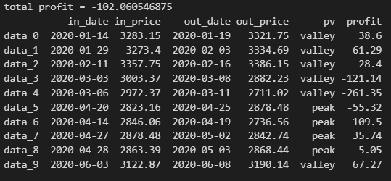
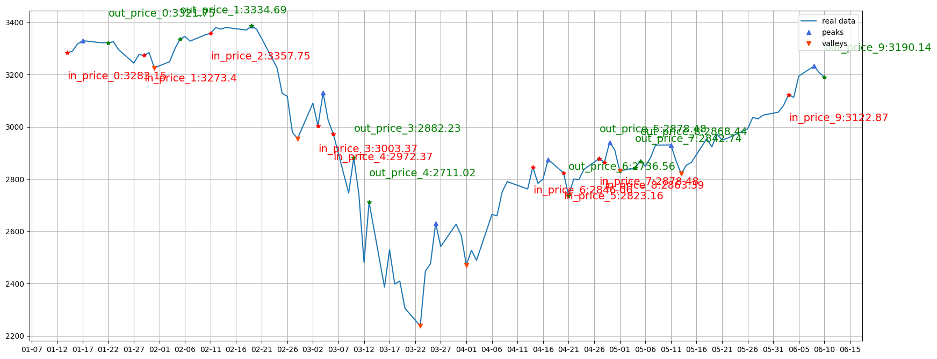
FFT, pv_range=5, try_1

Slide 15
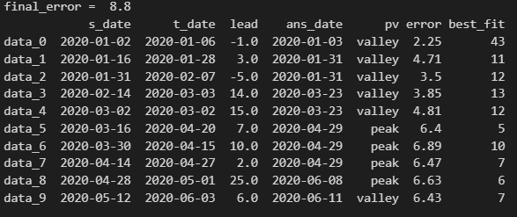
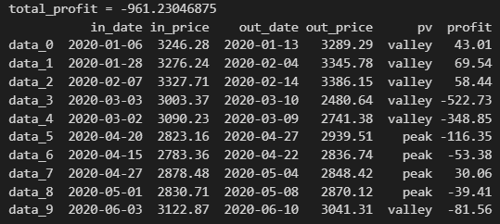
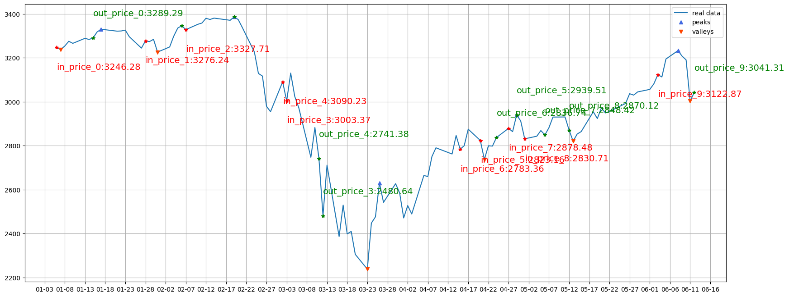
FFT, pv_range=7, try_1

