Slide 1
date_predict_start = '2020-01-01'
FFT stock_name = "^GSPC"
date_predict_start = '2020-01-01'
data_range = 250
slide_range = 10
n_slide = 10
pv_range = 2
fit_method = 'rmse'
pv_method = 'CL’
n_harm_lower_limit = 1
n_harm_upper_limit = 50
Lstm stock_name = "^GSPC“
date_predict_start = '2020-01-01’
data_range = 250
slide_range = 10
n_slide = 10
pv_range = 2
base_day = 10
prediction_day = 10
slide = 10
profit_percentage = 0.1
loss_percentage = 0.1

Slide 2
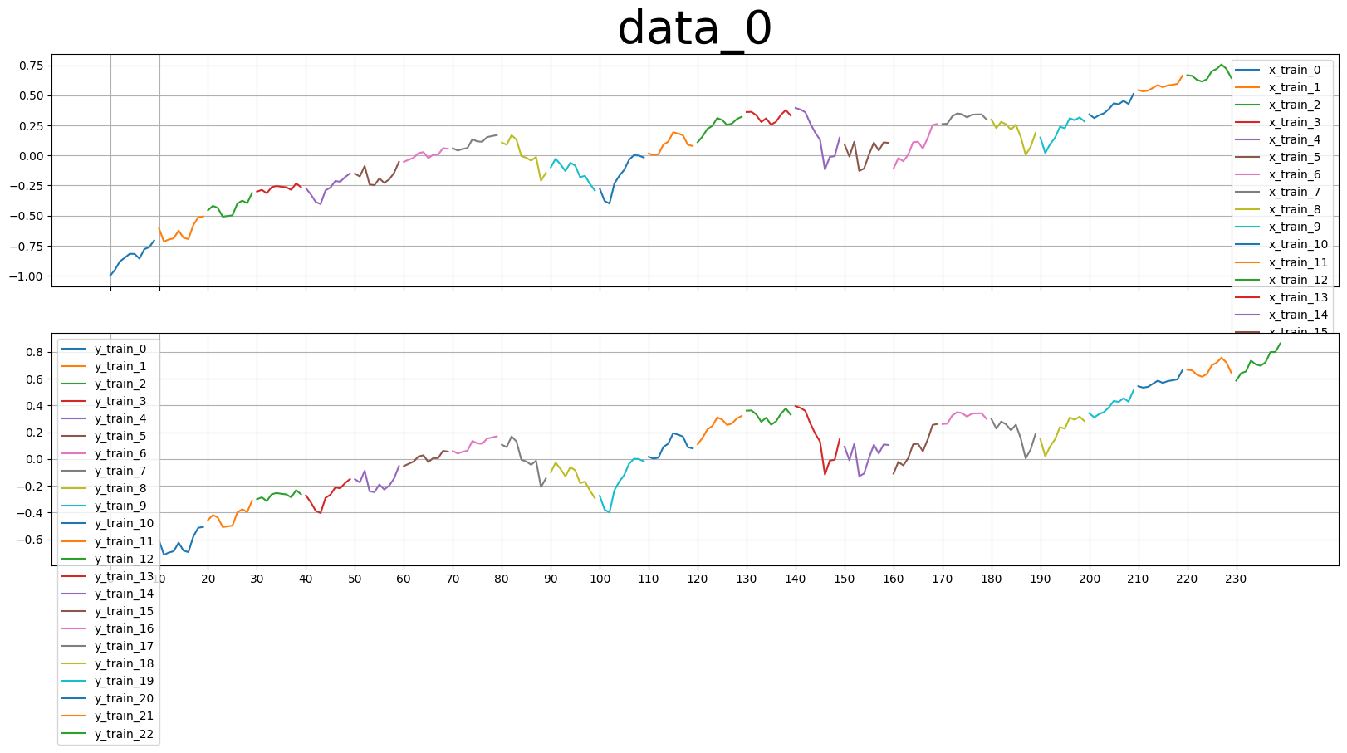
base_day = 10
prediction_day = base_day
slide = base_day
Length of x_train
Length of y_train
base_day = 10
slide = 10
prediction_day = 10

Slide 3
pv_range |  | Final_error | Profit | Final_error | Profit | Final_error | Profit | Final_error | Profit
Parameters 7 (15days), data_range=250 | profit_ percentage = 0.1 loss_ percentage = 0.1 | Lstm base_day = 10 |  | Lstm base_day = 20 |  | Lstm base_day = 30 |  | FFT
Try_1 | Strategy A | 4.2 | 459.34 | 6.2 | 290.60 | 5.0 | 283.85 | 8.8 | -823.32
 | Strategy B |  | 328.96 |  | 336.80 |  | 418.18 |  | -517.14
 | Strategy C |  | 256.82 |  | 298.01 |  | 291.26 |  | -823.32
Try_2 | Strategy A | 7.0 | 1286.12 | 8.7 | -330.79 | 9.1 | 55.09
 | Strategy B |  | 904.12 |  | -193.17 |  | 257.06
 | Strategy C |  | 1286.12 |  | -330.79 |  | 190.08
Try_3 | Strategy A | 11.5 | -793.28 | 8.9 | -1140.18 | 11.8 | -613.67
 | Strategy B |  | -1154.91 |  | -898.78 |  | -1144.46
 | Strategy C |  | -793.28 |  | -1140.18 |  | -621.09

Slide 4
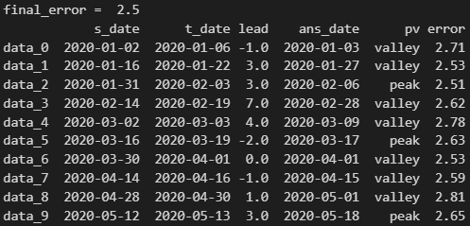
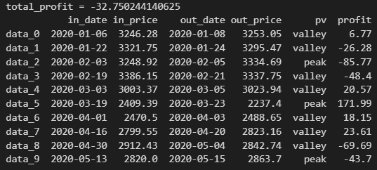
Strategy A
valley
peak
Pv_range
Pv_range
t_date
s_date
s_date
t_date
Pv_range
Pv_range
Sell
out_price
in_date
in_price
Sell
out_date
Profit = out_price-in_price
Profit = in_price – out_price
out_date
Buy
Buy
in_price
out_price
in_date

Slide 5
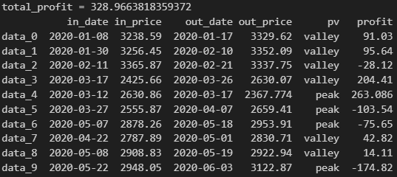
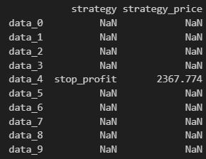
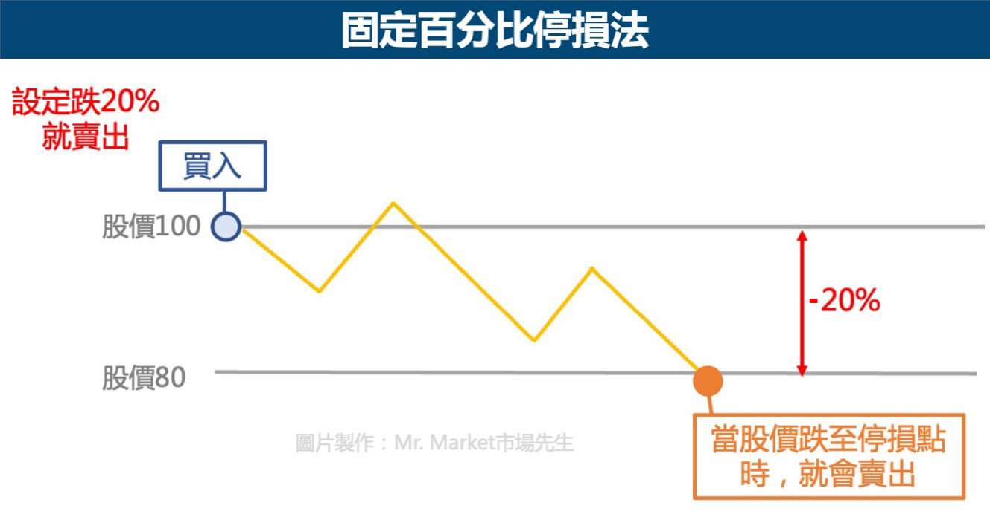
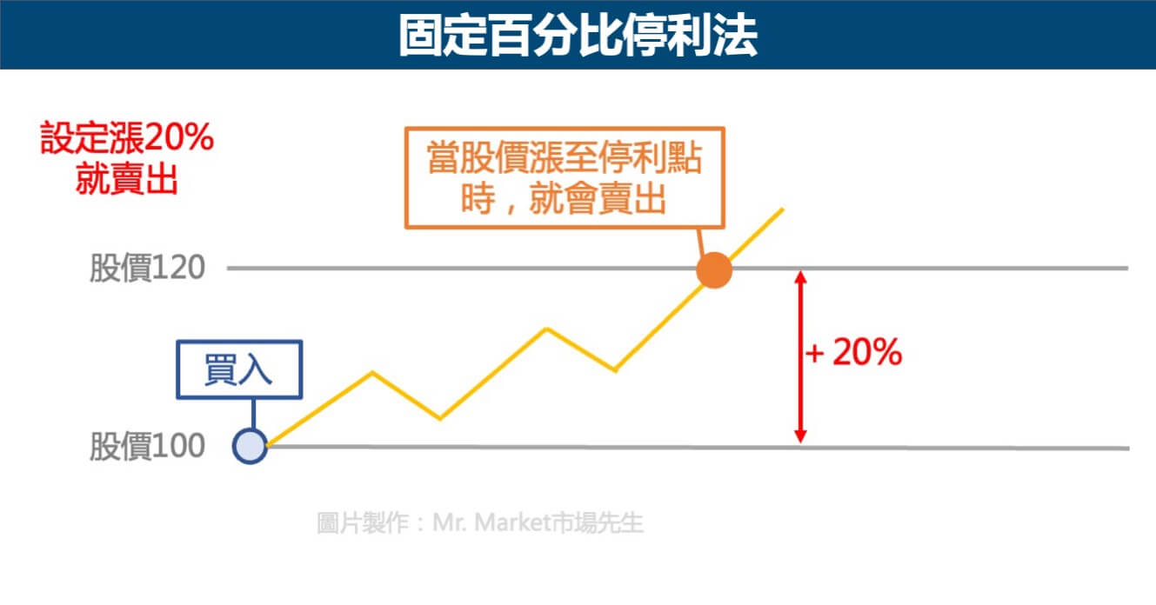
Strategy B

Slide 6
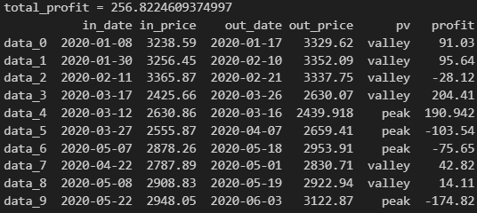
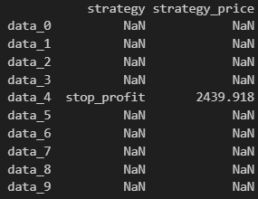
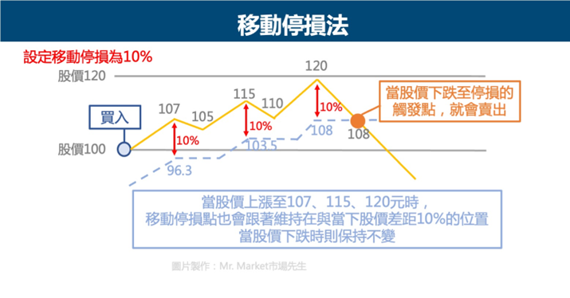
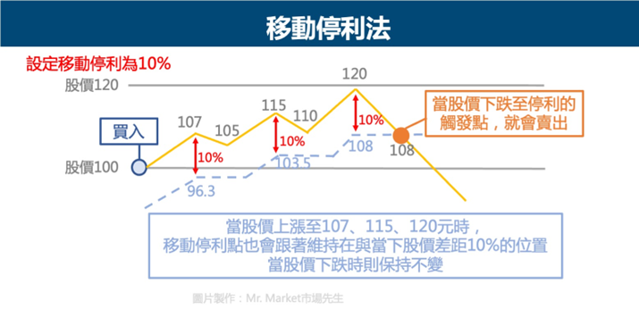
Strategy C

Slide 7
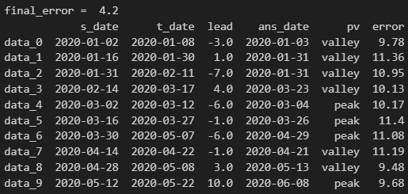
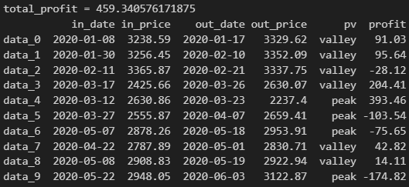
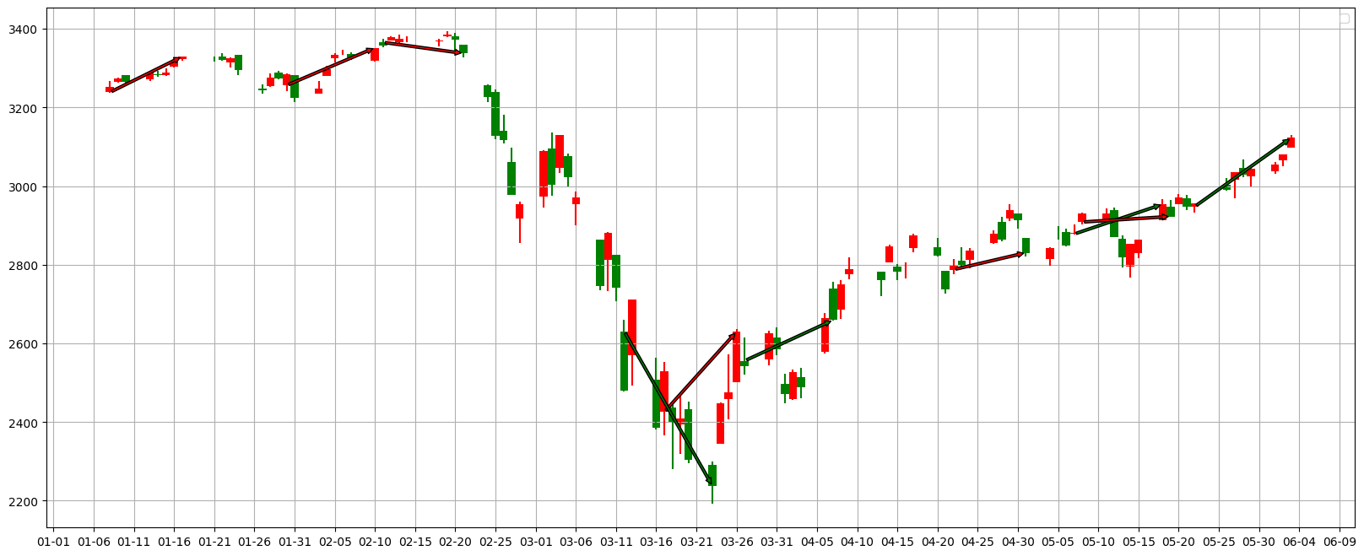
pv_range=7, base_day=10, try_1, Strategy A
Valley:
buy--sell
Peak:
sell--buy
Stop profit line
Stop loss line

Slide 8

pv_range=7, base_day=10, try_1, Strategy B
Valley:
buy--sell
Peak:
sell--buy
Stop profit line
Stop loss line

Slide 9
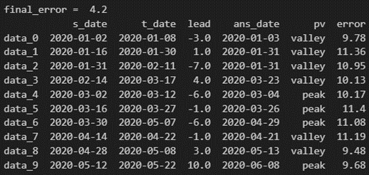
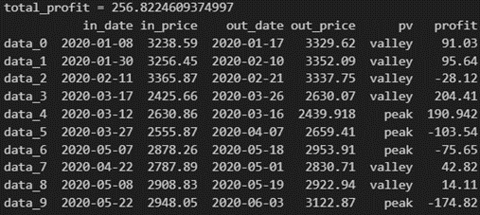
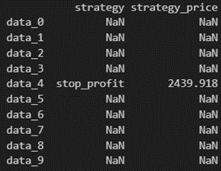

pv_range=7, base_day=10, try_1, Strategy C
Valley:
buy--sell
Peak:
sell--buy
Stop profit line
Stop loss line

Slide 10
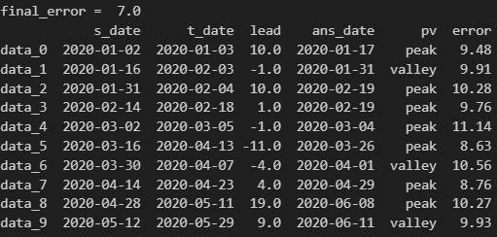
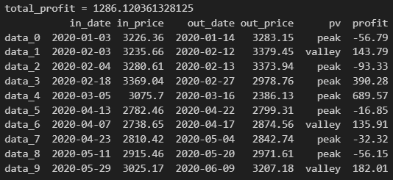
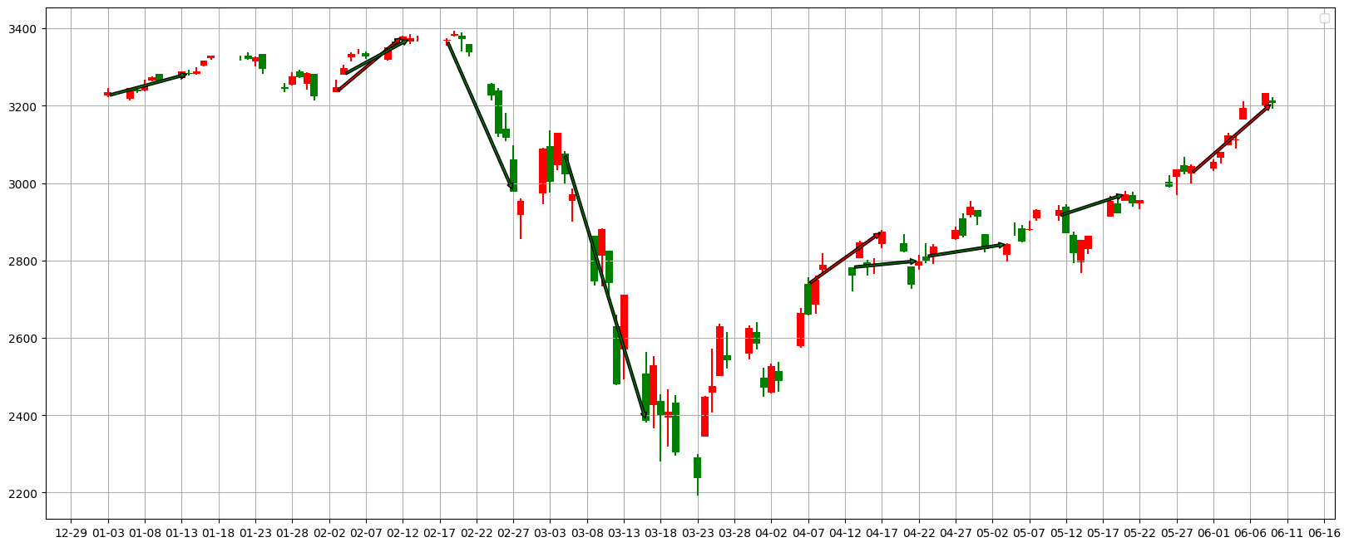
pv_range=7, base_day=20, try_1, Strategy A
Valley:
buy--sell
Peak:
sell--buy
Stop profit line
Stop loss line

Slide 11
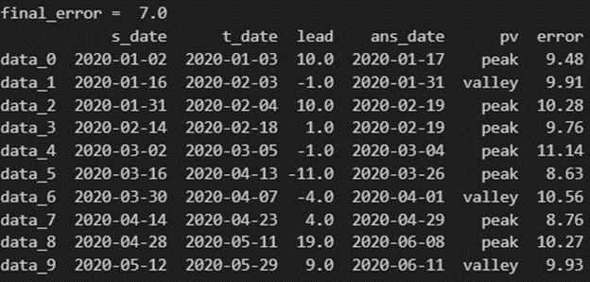
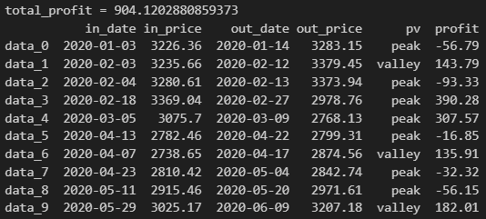
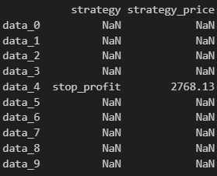
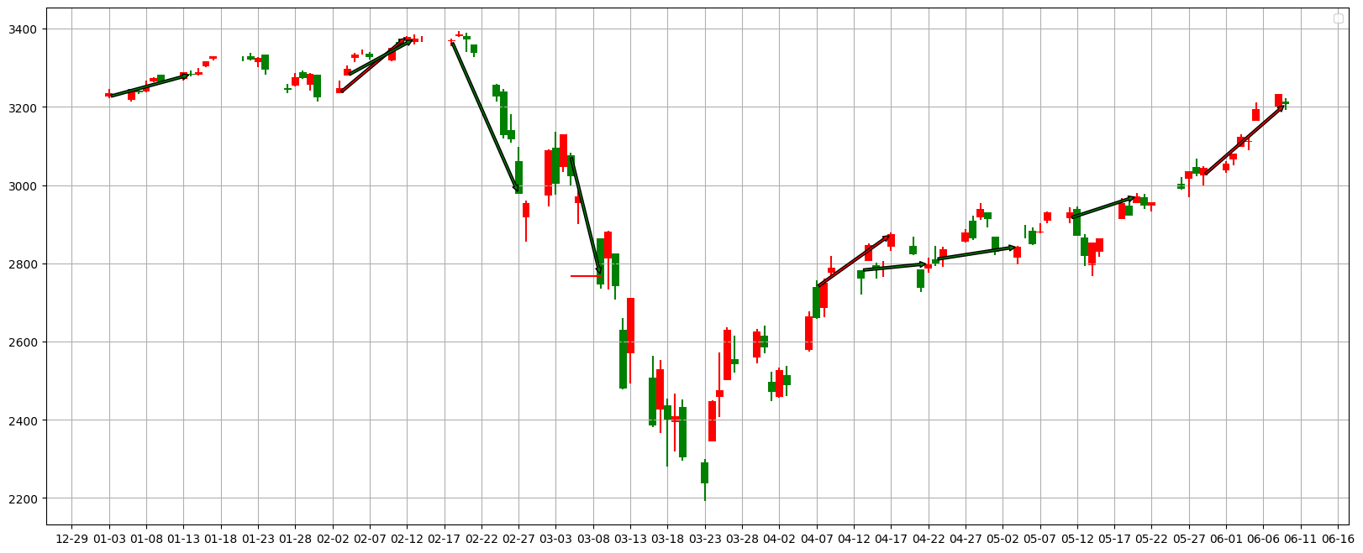
pv_range=7, base_day=20, try_1, Strategy B
Valley:
buy--sell
Peak:
sell--buy
Stop profit line
Stop loss line

Slide 12
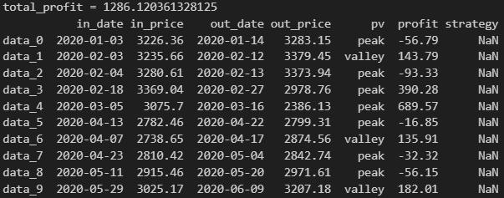
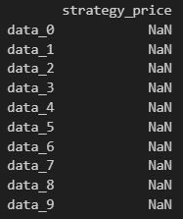
pv_range=7, base_day=20, try_1, Strategy C
Valley:
buy--sell
Peak:
sell--buy
Stop profit line
Stop loss line

Slide 13
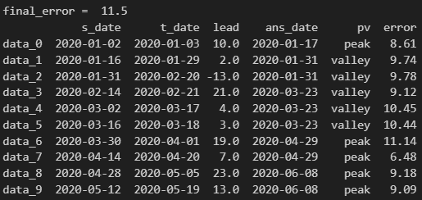
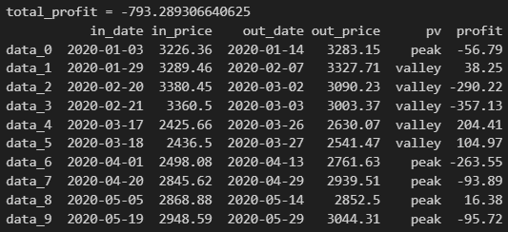
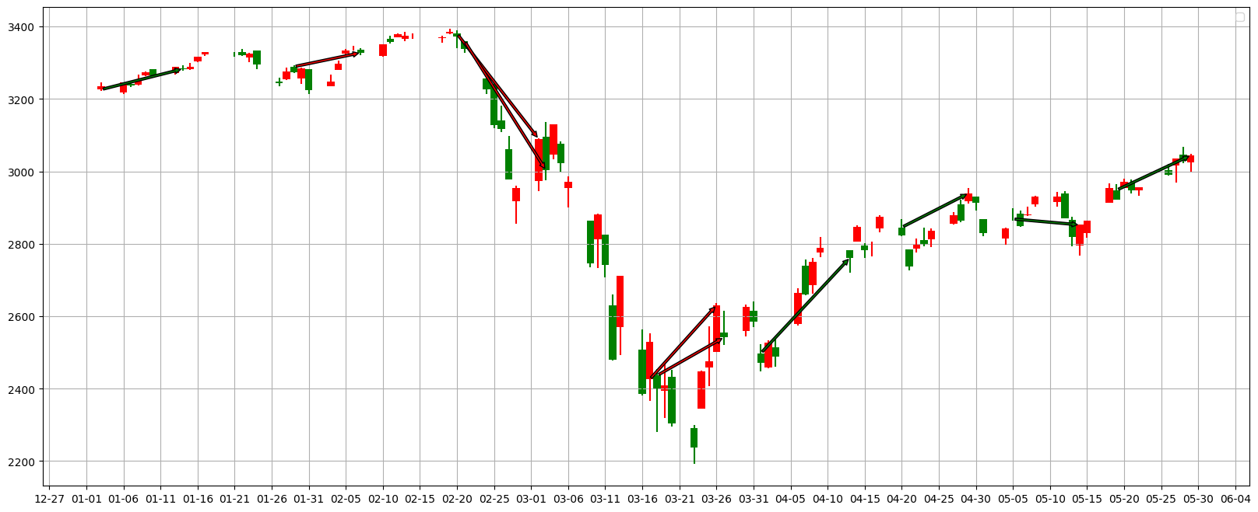
pv_range=7, base_day=30, try_1, Strategy A
Valley:
buy--sell
Peak:
sell--buy
Stop profit line
Stop loss line

Slide 14
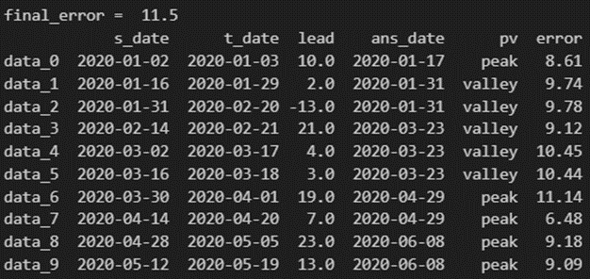
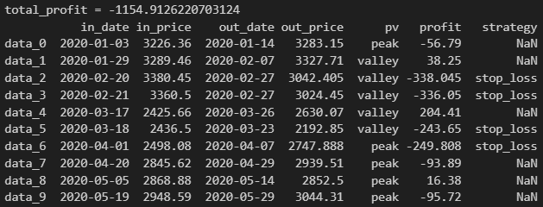
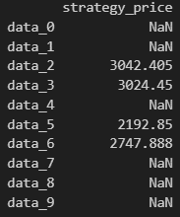
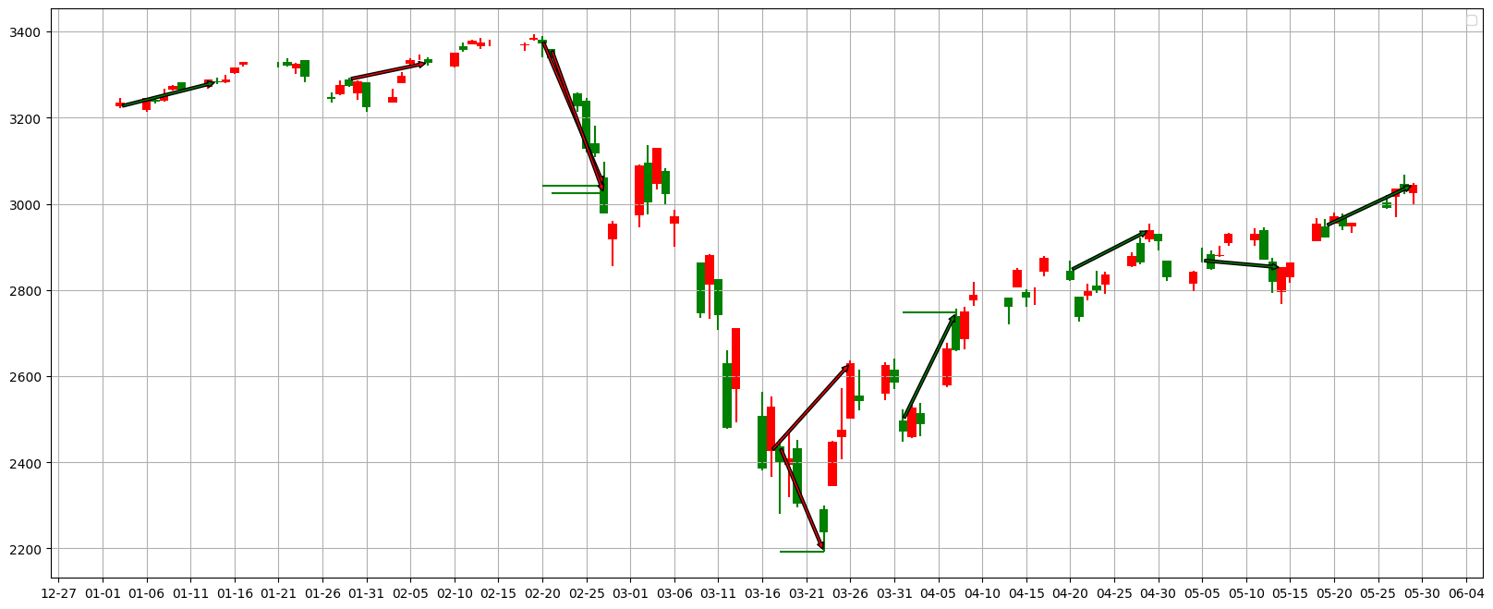
pv_range=7, base_day=30, try_1, Strategy B
Valley:
buy--sell
Peak:
sell--buy
Stop profit line
Stop loss line

Slide 15
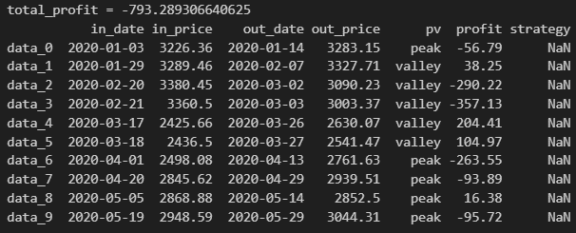
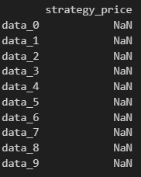
pv_range=7, base_day=30, try_1, Strategy C
Valley:
buy--sell
Peak:
sell--buy
Stop profit line
Stop loss line

Slide 16
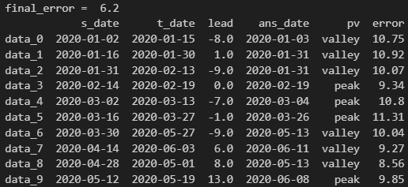
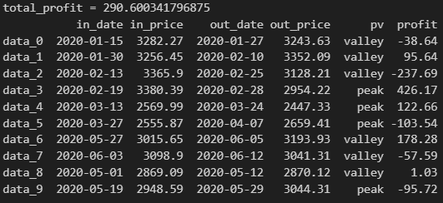
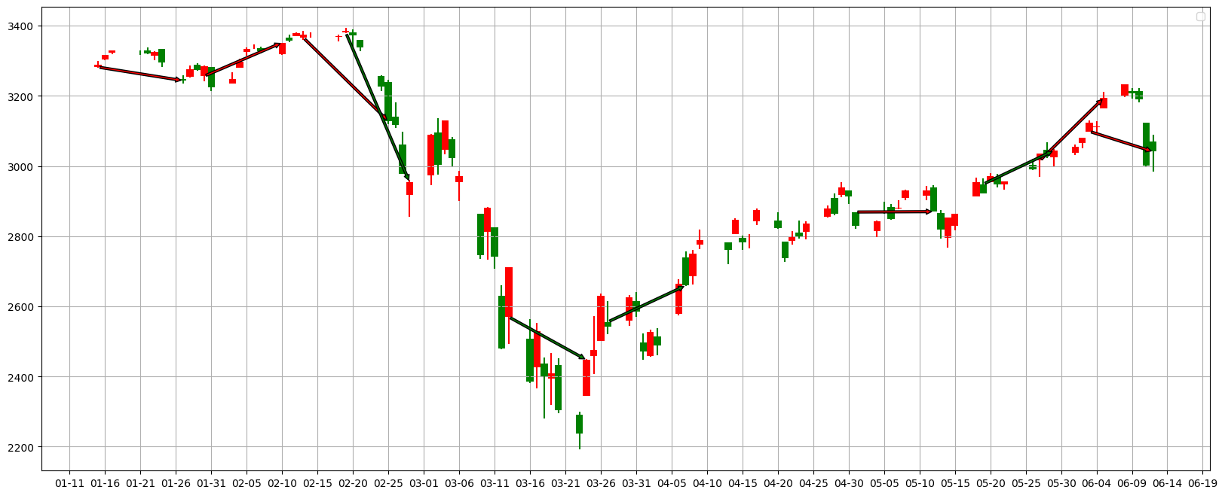
pv_range=7, base_day=10, try_2, Strategy A
Valley:
buy--sell
Peak:
sell--buy
Stop profit line
Stop loss line

Slide 17
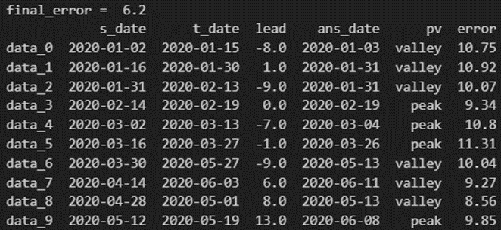
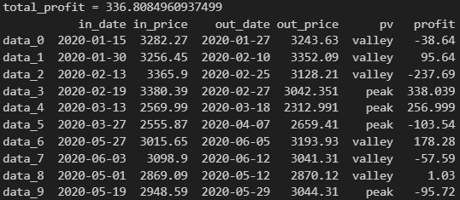
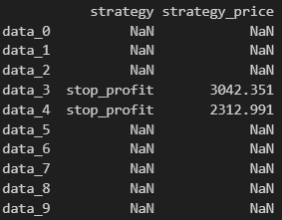

pv_range=7, base_day=10, try_2, Strategy B
Valley:
buy--sell
Peak:
sell--buy
Stop profit line
Stop loss line

Slide 18
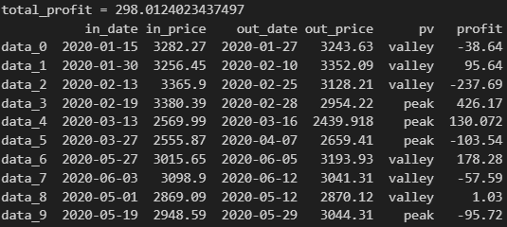
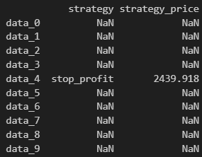

pv_range=7, base_day=10, try_2, Strategy C
Valley:
buy--sell
Peak:
sell--buy
Stop profit line
Stop loss line

Slide 19
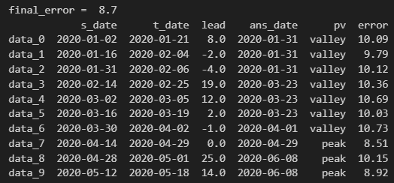
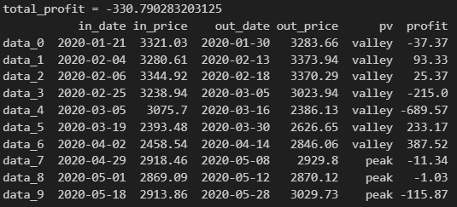
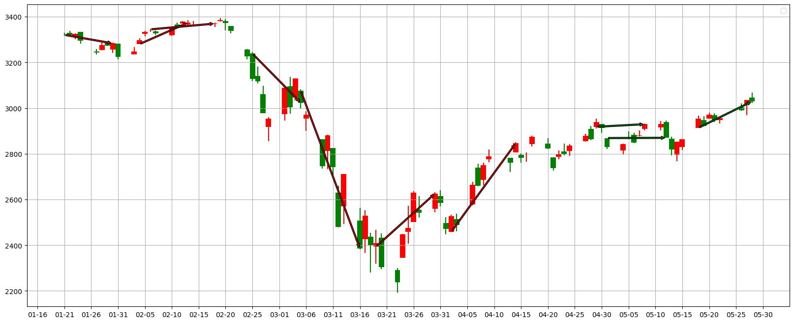
pv_range=7, base_day=20, try_2, Strategy A
Valley:
buy--sell
Peak:
sell--buy
Stop profit line
Stop loss line

Slide 20
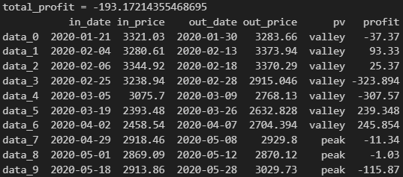
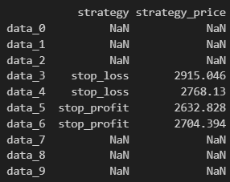
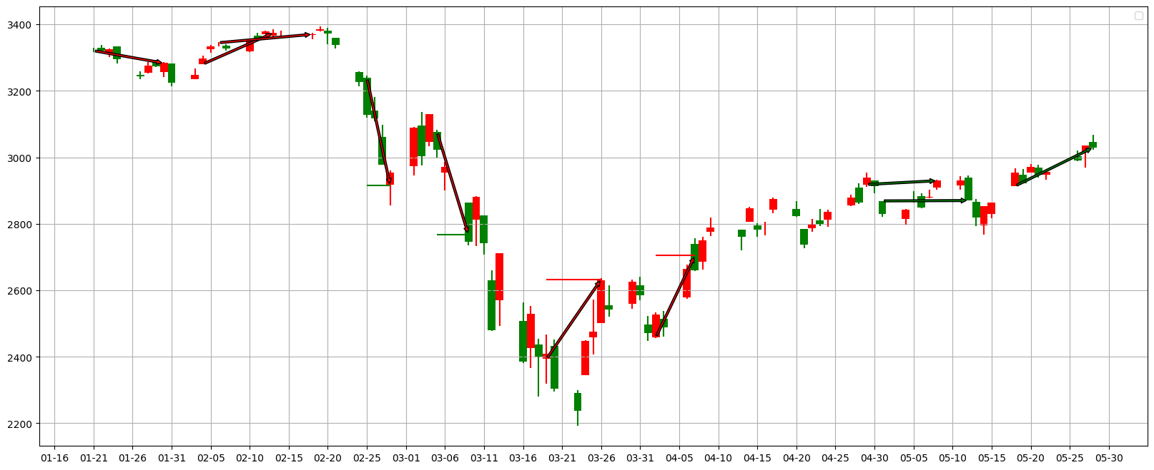
pv_range=7, base_day=20, try_2, Strategy B
Valley:
buy--sell
Peak:
sell--buy
Stop profit line
Stop loss line

Slide 21
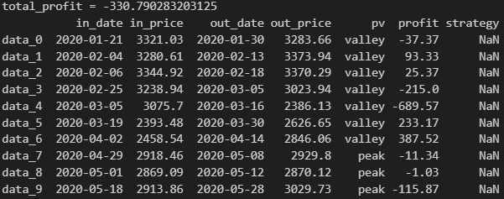

pv_range=7, base_day=20, try_2, Strategy C
Valley:
buy--sell
Peak:
sell--buy
Stop profit line
Stop loss line

Slide 22



pv_range=7, base_day=30, try_2, Strategy A
Valley:
buy--sell
Peak:
sell--buy
Stop profit line
Stop loss line

Slide 23




pv_range=7, base_day=30, try_2, Strategy B
Valley:
buy--sell
Peak:
sell--buy
Stop profit line
Stop loss line

Slide 24


pv_range=7, base_day=30, try_2, Strategy C
Valley:
buy--sell
Peak:
sell--buy
Stop profit line
Stop loss line

Slide 25



pv_range=7, base_day=10, try_3, Strategy A
Valley:
buy--sell
Peak:
sell--buy
Stop profit line
Stop loss line

Slide 26



pv_range=7, base_day=10, try_3, Strategy B
Valley:
buy--sell
Peak:
sell--buy
Stop profit line
Stop loss line

Slide 27



pv_range=7, base_day=10, try_3, Strategy C
Valley:
buy--sell
Peak:
sell--buy
Stop profit line
Stop loss line

Slide 28



pv_range=7, base_day=20, try_3, Strategy A
Valley:
buy--sell
Peak:
sell--buy
Stop profit line
Stop loss line

Slide 29




pv_range=7, base_day=20, try_3, Strategy B
Valley:
buy--sell
Peak:
sell--buy
Stop profit line
Stop loss line

Slide 30



pv_range=7, base_day=20, try_3, Strategy C
Valley:
buy--sell
Peak:
sell--buy
Stop profit line
Stop loss line

Slide 31



pv_range=7, base_day=30, try_3, Strategy A
Valley:
buy--sell
Peak:
sell--buy
Stop profit line
Stop loss line

Slide 32



pv_range=7, base_day=30, try_3, Strategy B
Valley:
buy--sell
Peak:
sell--buy
Stop profit line
Stop loss line

Slide 33



pv_range=7, base_day=30, try_3, Strategy C
Valley:
buy--sell
Peak:
sell--buy
Stop profit line
Stop loss line

Slide 34



FFT, pv_range=7, try_1, Strategy A
Valley:
buy--sell
Peak:
sell--buy
Stop profit line
Stop loss line

Slide 35




FFT, pv_range=7, try_1, Strategy B
Valley:
buy--sell
Peak:
sell--buy
Stop profit line
Stop loss line

Slide 36


FFT, pv_range=7, try_1, Strategy C
Valley:
buy--sell
Peak:
sell--buy
Stop profit line
Stop loss line

