Slide 1
date_predict_start = '2020-01-01'
FFT stock_name = "^GSPC"
date_predict_start = '2020-01-01'
data_range = 250
slide_range = 10
n_slide = 10
pv_range = 2
fit_method = 'rmse'
pv_method = 'CL’
n_harm_lower_limit = 1
n_harm_upper_limit = 50
profit_percentage = 0.1
loss_percentage = 0.1
Sarima
stock_name = "^GSPC"
date_predict_start = '2020-01-01'
data_range = 250
slide_range = 10
n_slide = 10
pv_range = 2
fit_method = 'rmse'
pv_method = 'CL'
p_range = range(0, 3)
d_range = range(0, 3)
q_range = range(1, 3)
P_range = range(0, 3)
D_range = range(0, 3)
Q_range = range(1, 3)
s = 12
profit_percentage = 0.1
loss_percentage = 0.1
Lstm stock_name = "^GSPC“
date_predict_start = '2020-01-01’
data_range = 250
slide_range = 10
n_slide = 10
pv_range = 2
x_length = 10
prediction_day = 10
slide = 10
profit_percentage = 0.1
loss_percentage = 0.1

Slide 2
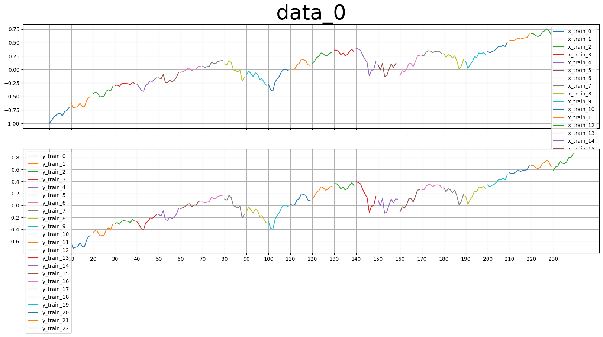
x_length = 10
y_length= x_length
slide = y_length
Length of x
Length of y
x_length = 10
slide = 10
y_length = 10

Slide 3
pv_range |  | Final_error | Profit | Final_error | Profit | Final_error | Profit | Final_error | Profit
Parameters 7 (15days), data_range=250 | profit_ percentage = 0.1 loss_ percentage = 0.1 | Lstm x_length = 10 |  | Lstm x_length = 20 |  | Lstm x_length = 30 |  | FFT
Try_1 | Strategy A | 5.1 | 339.03 | 5.9 | 216.86 | 8.7 | -157.08 | 8.8 | -823.32
 | Strategy B |  | 671.64 |  | 347.23 |  | -287.46 |  | -517.14
 | Strategy C |  | 346.44 |  | 419.37 |  | -359.60 |  | -823.32
Try_2 | Strategy A | 5.2 | 630.27 | 7.6 | 197.52 | 12.1 | -955.95
 | Strategy B |  | 659.52 |  | 98.10 |  | -1070.08
 | Strategy C |  | 637.68 |  | 400.04 |  | -1090.95
Try_3 | Strategy A | 4.0 | 636.39 | 6.4 | 480.25 | 9.9 | -1223.59
 | Strategy B |  | 855.11 |  | 624.52 |  | -1094.00
 | Strategy C |  | 643.80 |  | 615.24 |  | -1312.87

Slide 4
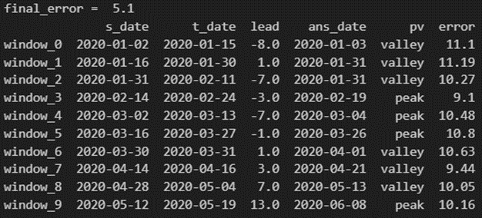
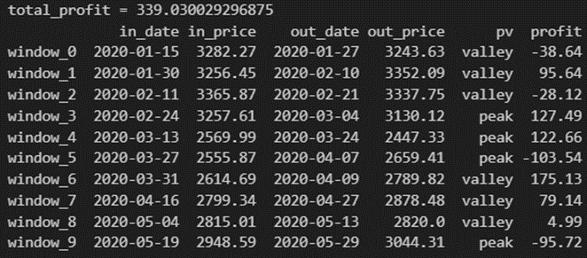

Strategy A
valley
peak
Pv_range
Pv_range
t_date
s_date
s_date
t_date
Pv_range
Pv_range
Sell
out_price
in_date
in_price
Sell
out_date
Profit = out_price-in_price
Profit = in_price – out_price
out_date
Buy
Buy
in_price
out_price
in_date

Slide 5
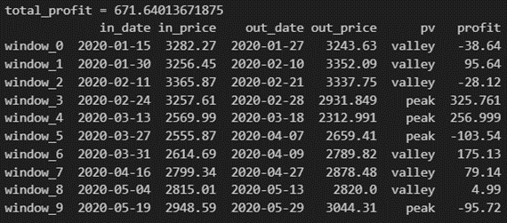
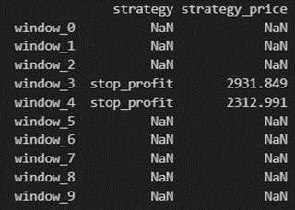
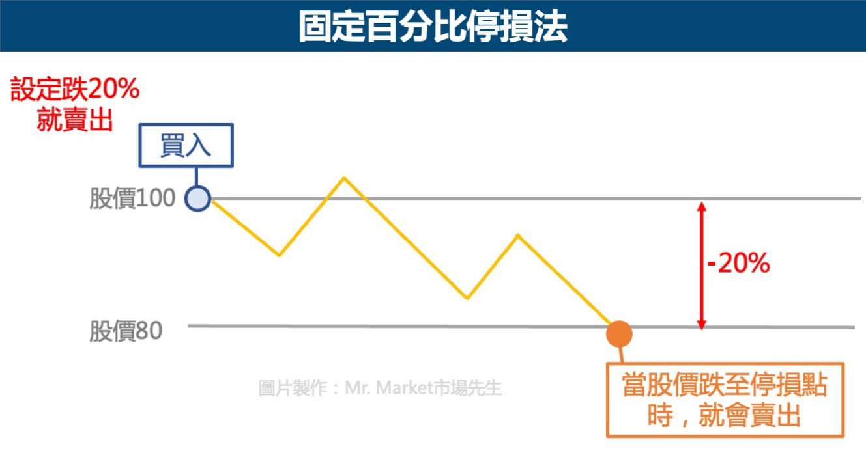
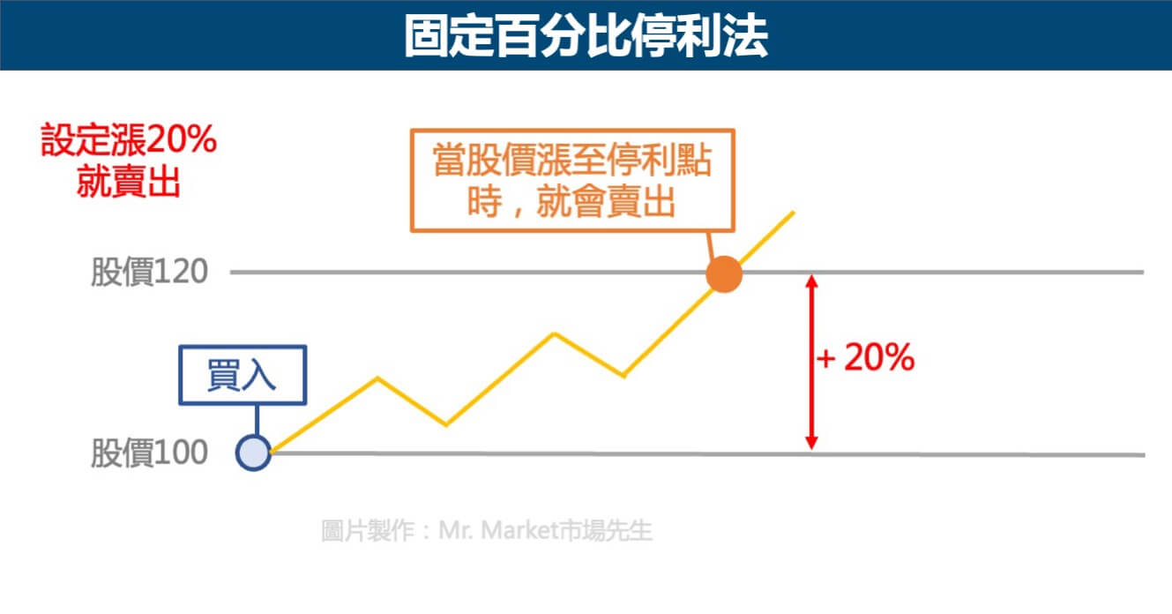
Strategy B

Slide 6
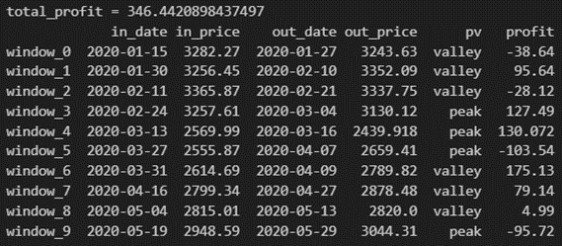
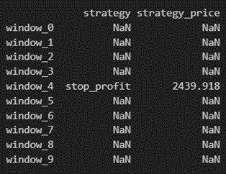
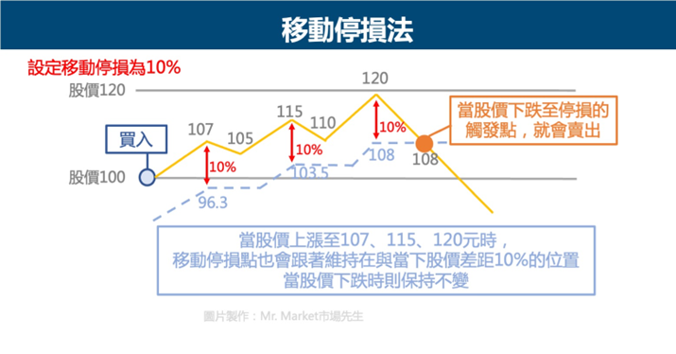
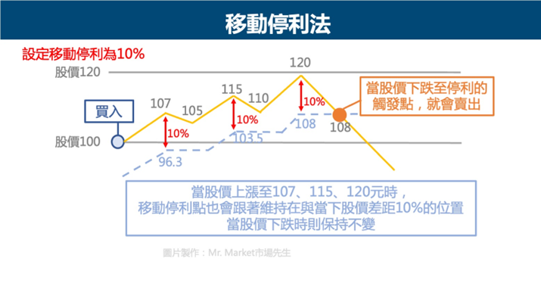
Strategy C

Slide 7
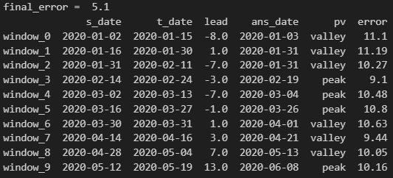
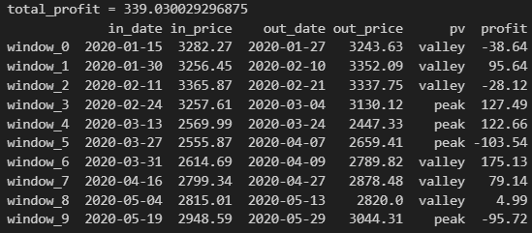
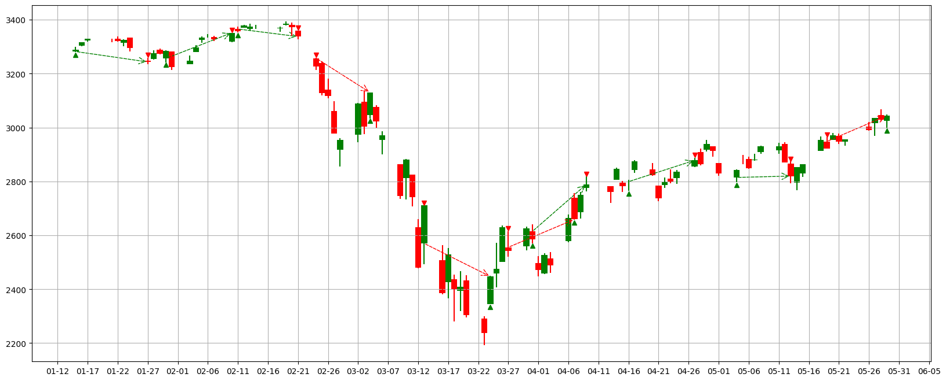
pv_range=7, x_length=10, try_1, Strategy A
Valley:
buy→sell
Peak:
sell→buy
Stop profit line
Stop loss line
buy
sell
increasing
decreasing

Slide 8
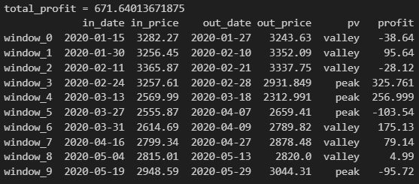
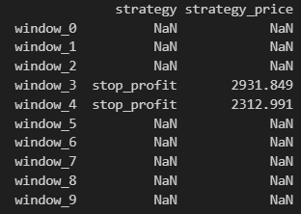

pv_range=7, x_length=10, try_1, Strategy B
Valley:
buy→sell
Peak:
sell→buy
Stop profit line
Stop loss line
buy
sell
increasing
decreasing

Slide 9
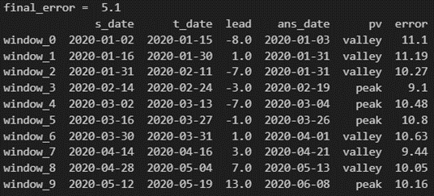
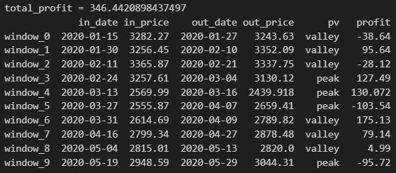
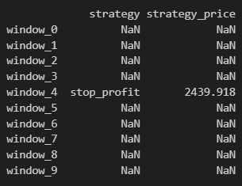

pv_range=7, x_length=10, try_1, Strategy C
Valley:
buy→sell
Peak:
sell→buy
Stop profit line
Stop loss line
buy
sell
increasing
decreasing

Slide 10
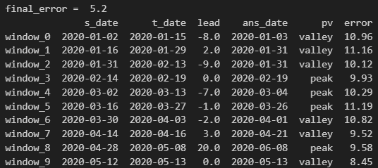
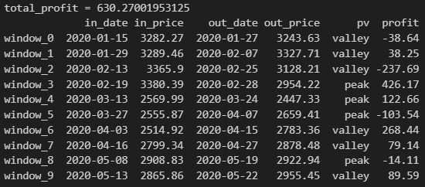
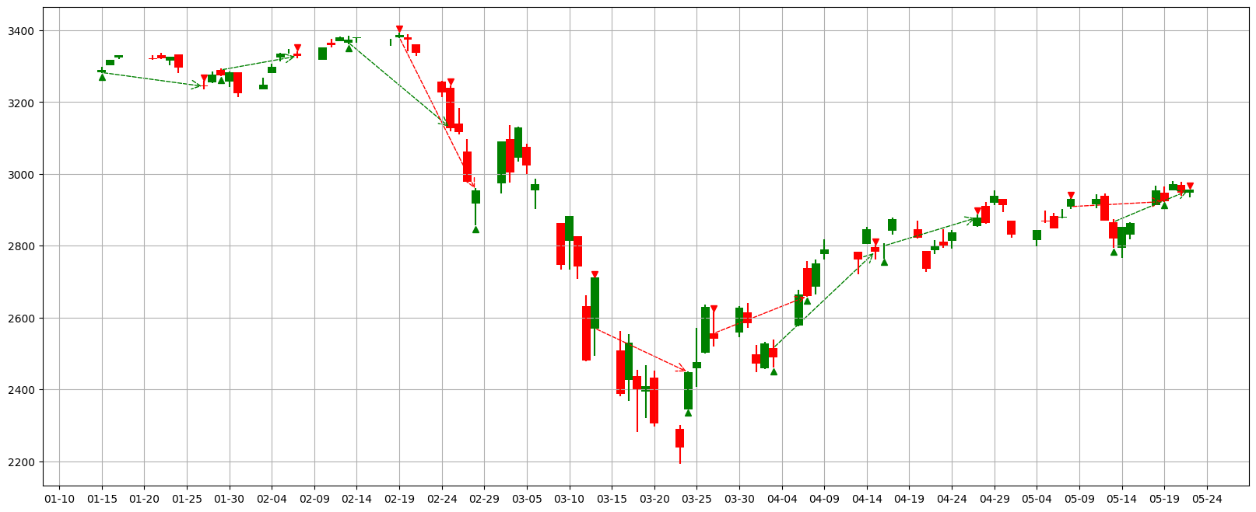
pv_range=7, x_length=10, try_2, Strategy A
Valley:
buy→sell
Peak:
sell→buy
Stop profit line
Stop loss line
buy
sell
increasing
decreasing

Slide 11
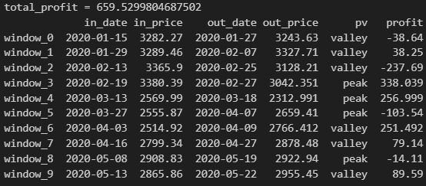
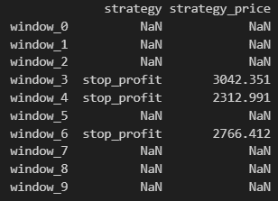

pv_range=7, x_length=10, try_2, Strategy B
Valley:
buy→sell
Peak:
sell→buy
Stop profit line
Stop loss line
buy
sell
increasing
decreasing

Slide 12
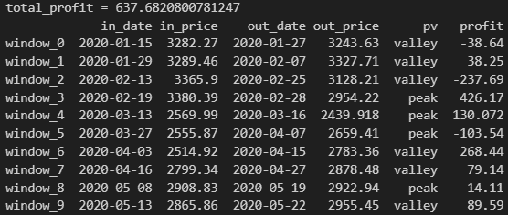
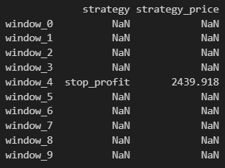

pv_range=7, x_length=10, try_2, Strategy C
Valley:
buy→sell
Peak:
sell→buy
Stop profit line
Stop loss line
buy
sell
increasing
decreasing

Slide 13
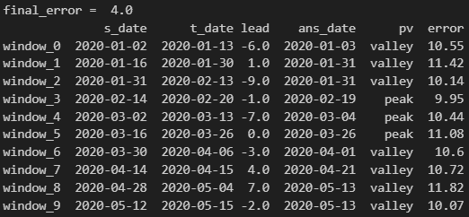
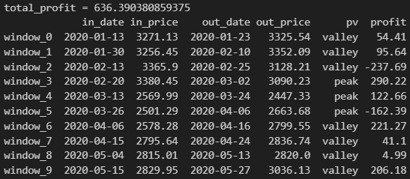
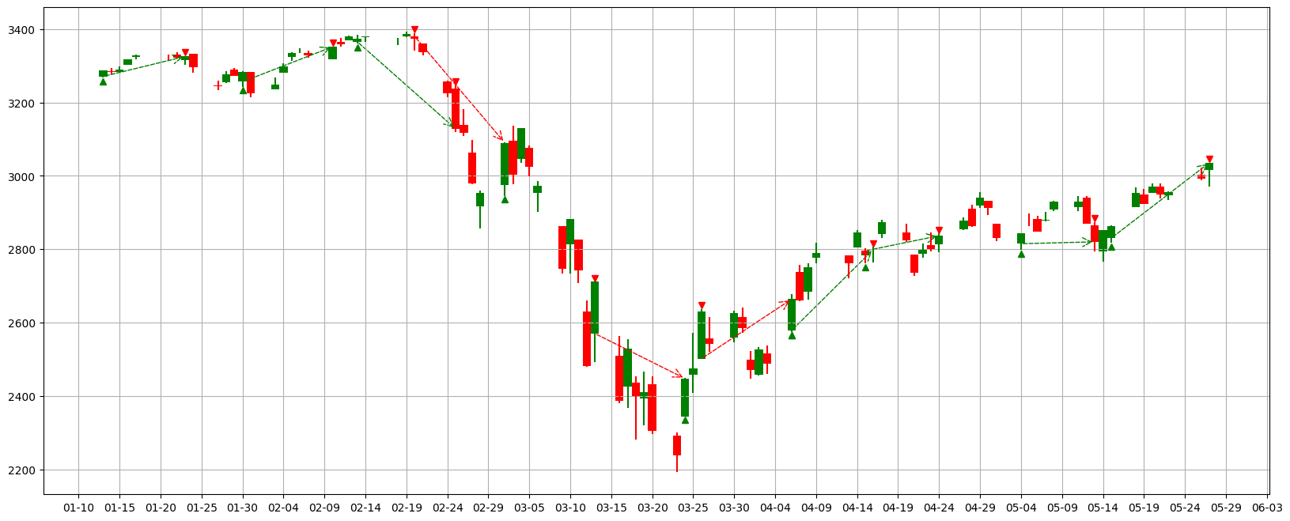
pv_range=7, x_length=10, try_3, Strategy A
Valley:
buy→sell
Peak:
sell→buy
Stop profit line
Stop loss line
buy
sell
increasing
decreasing

Slide 14

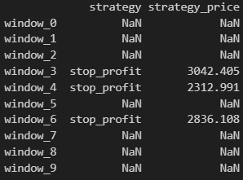
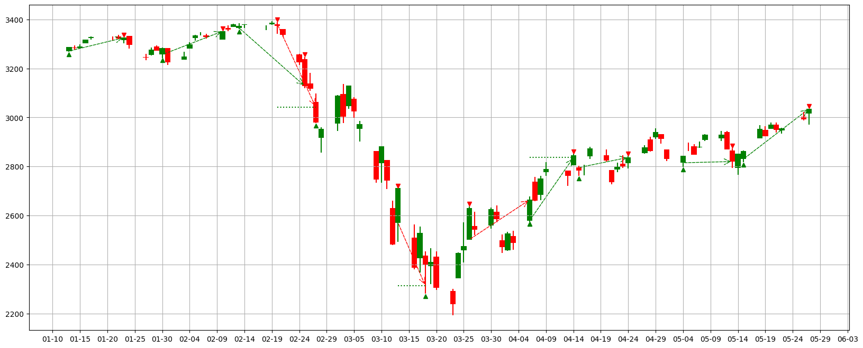
pv_range=7, x_length=10, try_3, Strategy B
Valley:
buy→sell
Peak:
sell→buy
Stop profit line
Stop loss line
buy
sell
increasing
decreasing

Slide 15
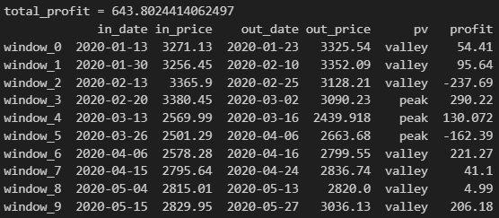
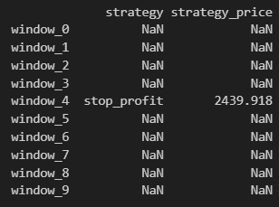

pv_range=7, x_length=10, try_3, Strategy C
Valley:
buy→sell
Peak:
sell→buy
Stop profit line
Stop loss line
buy
sell
increasing
decreasing

Slide 16
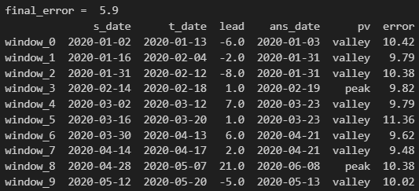
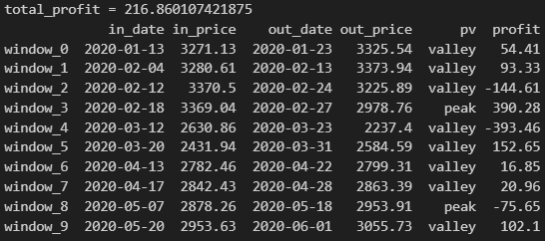
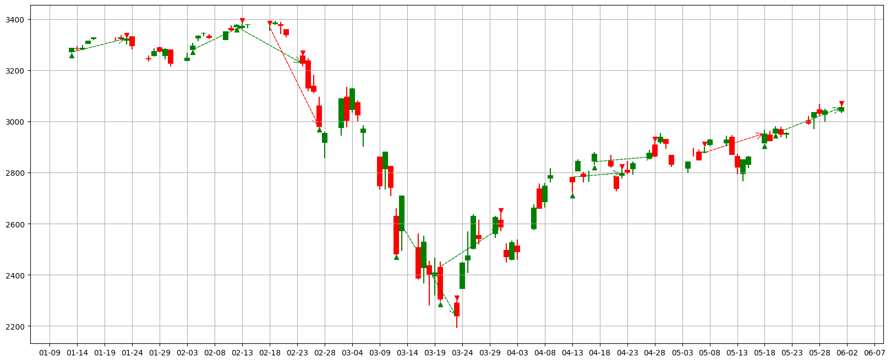
pv_range=7, x_length=20, try_1, Strategy A
Valley:
buy→sell
Peak:
sell→buy
Stop profit line
Stop loss line
buy
sell
increasing
decreasing

Slide 17
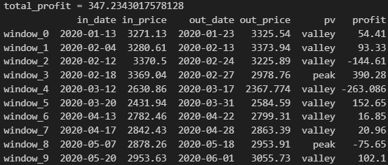
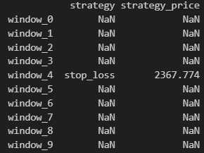

pv_range=7, x_length=20, try_1, Strategy B
Valley:
buy→sell
Peak:
sell→buy
Stop profit line
Stop loss line
buy
sell
increasing
decreasing

Slide 18
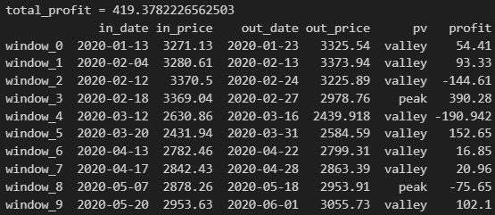
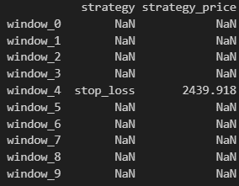

pv_range=7, x_length=20, try_1, Strategy C
Valley:
buy→sell
Peak:
sell→buy
Stop profit line
Stop loss line
buy
sell
increasing
decreasing

Slide 19
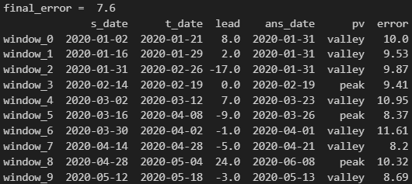
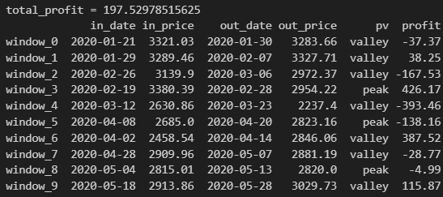
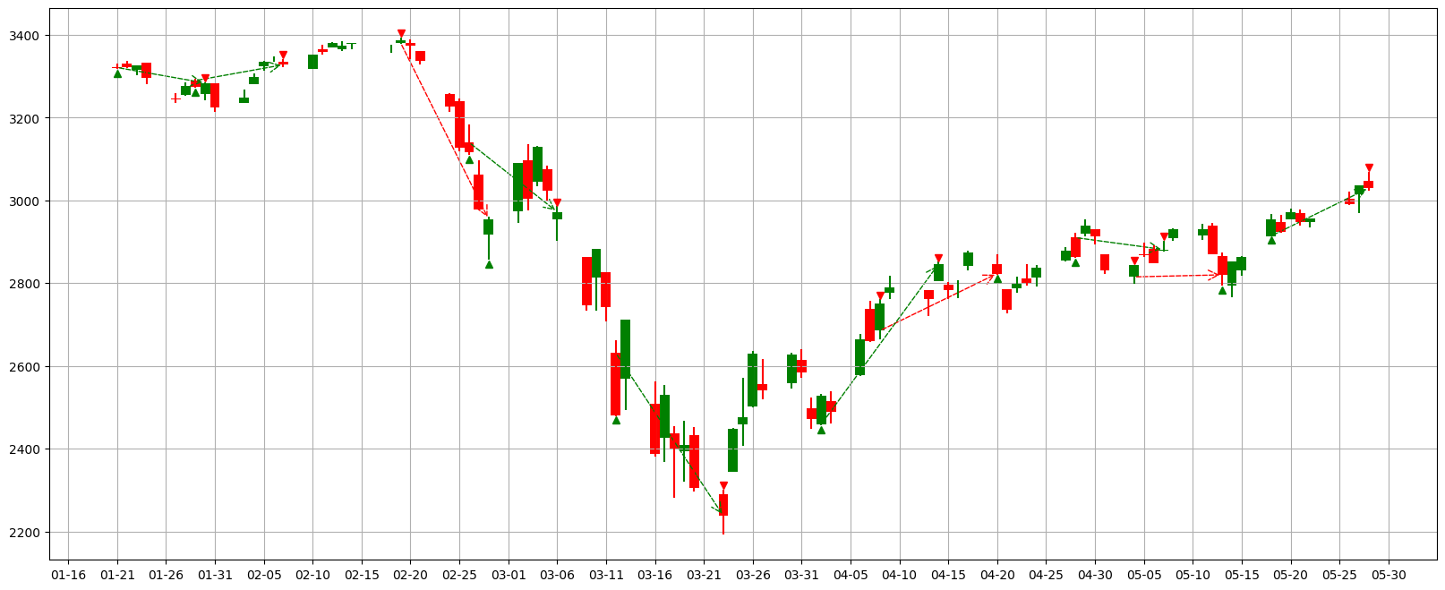
pv_range=7, x_length=20, try_2, Strategy A
Valley:
buy→sell
Peak:
sell→buy
Stop profit line
Stop loss line
buy
sell
increasing
decreasing

Slide 20
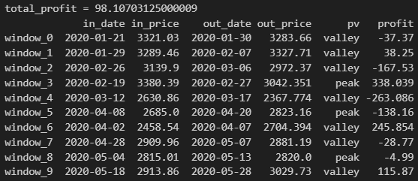
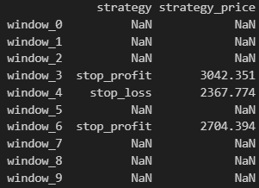

pv_range=7, x_length=20, try_2, Strategy B
Valley:
buy→sell
Peak:
sell→buy
Stop profit line
Stop loss line
buy
sell
increasing
decreasing

Slide 21
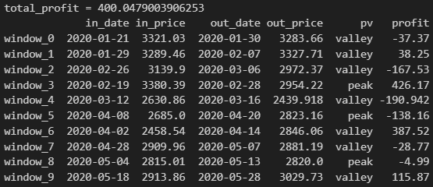
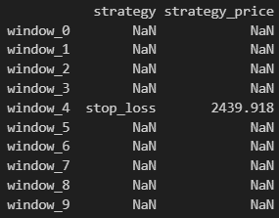

pv_range=7, x_length=20, try_2, Strategy C
Valley:
buy→sell
Peak:
sell→buy
Stop profit line
Stop loss line
buy
sell
increasing
decreasing

Slide 22
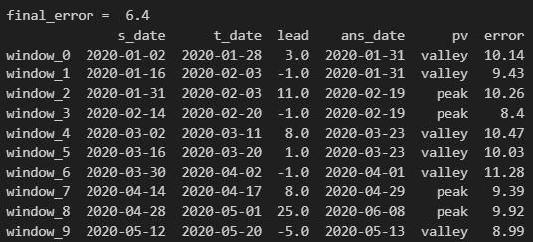
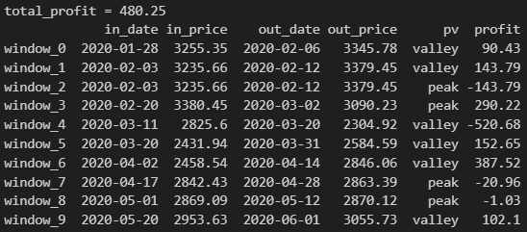
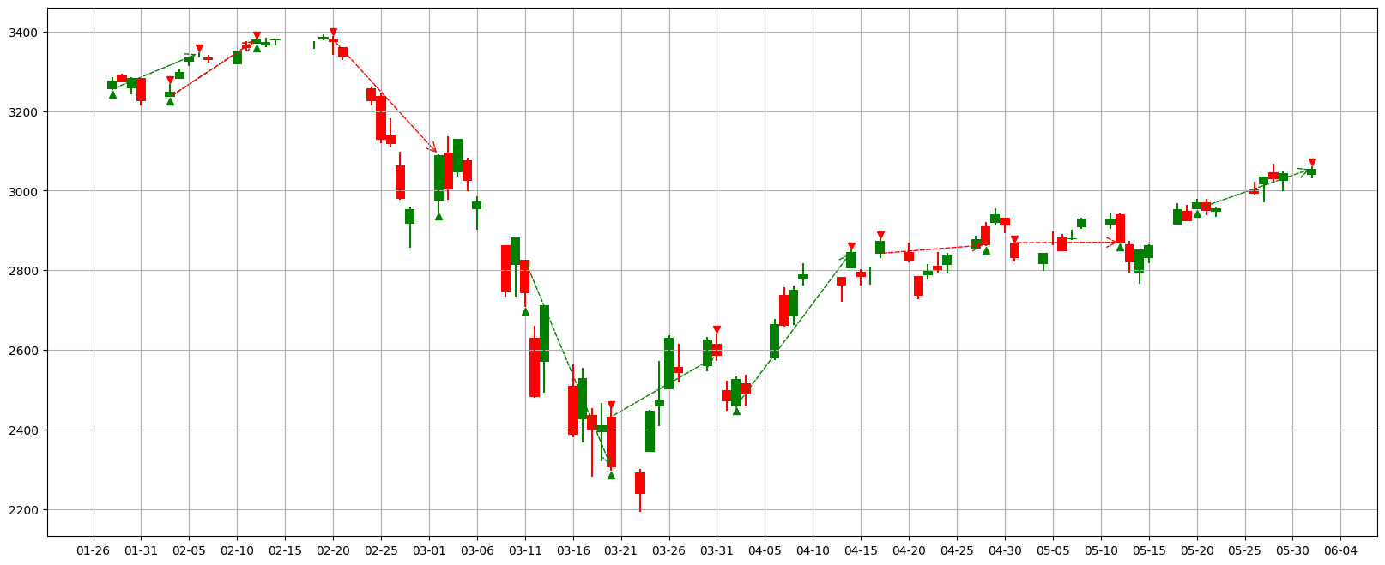
pv_range=7, x_length=20, try_3, Strategy A
Valley:
buy→sell
Peak:
sell→buy
Stop profit line
Stop loss line
buy
sell
increasing
decreasing

Slide 23



pv_range=7, x_length=20, try_3, Strategy B
Valley:
buy→sell
Peak:
sell→buy
Stop profit line
Stop loss line
buy
sell
increasing
decreasing

Slide 24



pv_range=7, x_length=20, try_3, Strategy C
Valley:
buy→sell
Peak:
sell→buy
Stop profit line
Stop loss line
buy
sell
increasing
decreasing

Slide 25



pv_range=7, x_length=30, try_1, Strategy A
Valley:
buy→sell
Peak:
sell→buy
Stop profit line
Stop loss line
buy
sell
increasing
decreasing

Slide 26



pv_range=7, x_length=30, try_1, Strategy B
Valley:
buy→sell
Peak:
sell→buy
Stop profit line
Stop loss line
buy
sell
increasing
decreasing

Slide 27



pv_range=7, x_length=30, try_1, Strategy C
Valley:
buy→sell
Peak:
sell→buy
Stop profit line
Stop loss line
buy
sell
increasing
decreasing

Slide 28



pv_range=7, x_length=30, try_2, Strategy A
Valley:
buy→sell
Peak:
sell→buy
Stop profit line
Stop loss line
buy
sell
increasing
decreasing

Slide 29



pv_range=7, x_length=30, try_2, Strategy B
Valley:
buy→sell
Peak:
sell→buy
Stop profit line
Stop loss line
buy
sell
increasing
decreasing

Slide 30



pv_range=7, x_length=30, try_2, Strategy C
Valley:
buy→sell
Peak:
sell→buy
Stop profit line
Stop loss line
buy
sell
increasing
decreasing

Slide 31



pv_range=7, x_length=30, try_3, Strategy A
Valley:
buy→sell
Peak:
sell→buy
Stop profit line
Stop loss line
buy
sell
increasing
decreasing

Slide 32



pv_range=7, x_length=30, try_3, Strategy B
Valley:
buy→sell
Peak:
sell→buy
Stop profit line
Stop loss line
buy
sell
increasing
decreasing

Slide 33



pv_range=7, x_length=30, try_3, Strategy C
Valley:
buy→sell
Peak:
sell→buy
Stop profit line
Stop loss line
buy
sell
increasing
decreasing

Slide 34



FFT, pv_range=7, try_1, Strategy A
Valley:
buy→sell
Peak:
sell→buy
Stop profit line
Stop loss line
buy
sell
increasing
decreasing

Slide 35



FFT, pv_range=7, try_1, Strategy B
Valley:
buy→sell
Peak:
sell→buy
Stop profit line
Stop loss line
buy
sell
increasing
decreasing

Slide 36


FFT, pv_range=7, try_1, Strategy C
Valley:
buy→sell
Peak:
sell→buy
Stop profit line
Stop loss line
buy
sell
increasing
decreasing

Slide 37
Flow chart
LoadData
Preprocessing
Model
Postprocessing
Evaluate

Slide 38
Organizational Chart
Data
LoadData
Preprocessing
postprocessing
Model
FFTModel
LstmModel
SarimaModel
Evaluate
EvaluateModel
EvaluatePorfit

