Slide 1
Flow chart
LoadData
Preprocess
Model
Postprocess
Evaluate

Slide 2
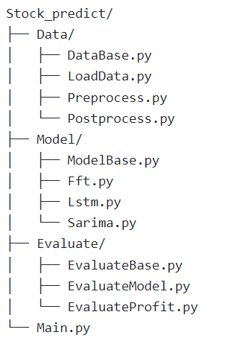
Organizational Chart
DataBase
LoadData
Preprocess
postprocess
ModelBase
FFTModel
LstmModel
SarimaModel
EvaluateBase
EvaluateModel
EvaluatePorfit

Slide 3
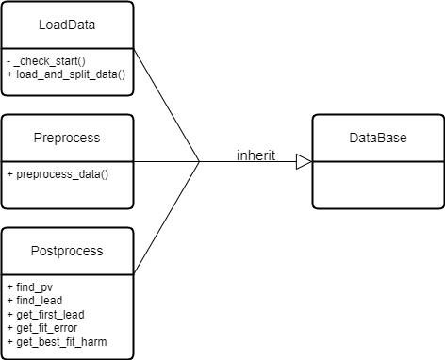
Class Diagram

Slide 4
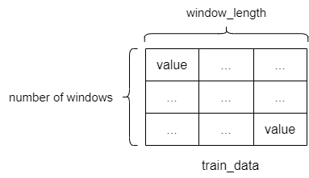
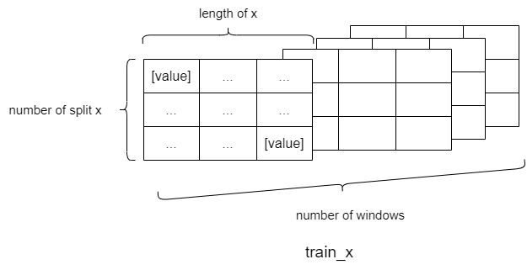
Array Diagram
train_x, train_y
test_x, test_y
train_data, test_data
LoadData
Preprocess
Model
load_and_split_data()
preprocess_data()
shape: (number of windows, window_length)
shape: (number of windows, number of split x, length of x, 1)

Slide 5


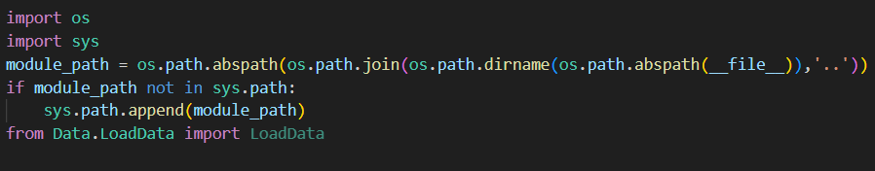
1. From Stock_predict
2. From Data

Slide 6
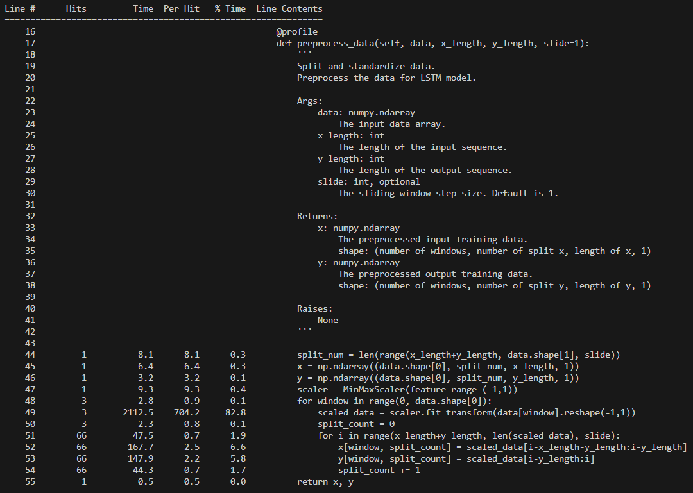
line_profiler
Line（程式行號）
Hits （次數）
Time（總時間）
Per Hit（平均時間）
%Time（佔用執行總時間的比例）

