Slide 1
main.py Flow chart
LoadData
Preprocess
Model
Postprocess
Evaluate
fit_error
best_harmonics
peaks, valleys
lead, first lead

Slide 2
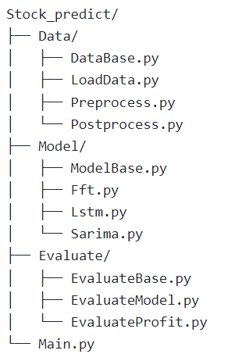
All Organizational Chart
DataBase
LoadData
Preprocess
postprocess
ModelBase
FFTModel
LstmModel
SarimaModel
EvaluateBase
EvaluateModel
EvaluatePorfit

Slide 3
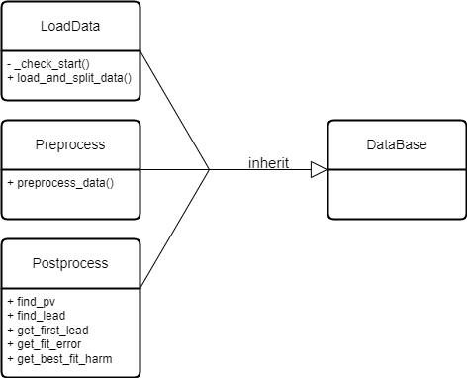
Data Class Diagram

Slide 4
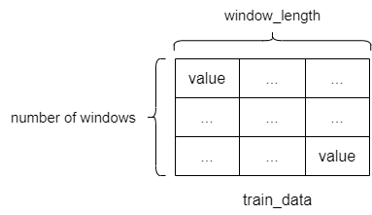
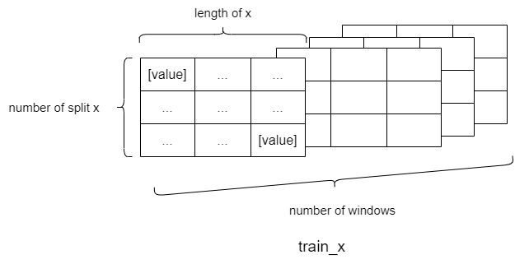
Data Array Diagram
train_x, train_y
test_x, test_y
train_data, test_data
LoadData
Preprocess
Model
load_and_split_data()
preprocess_data()
shape: (number of windows, window_length)
x, y: numpy.ndarray
shape: (number of windows, number of split, length, 1)

Slide 5
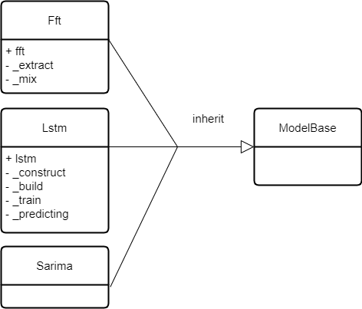
Model Class Diagram

Slide 6
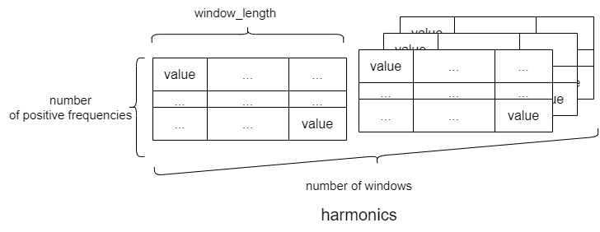
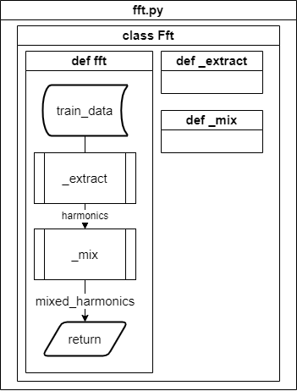
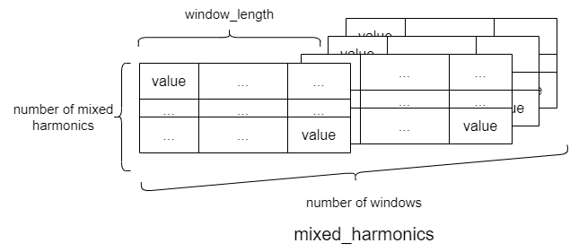
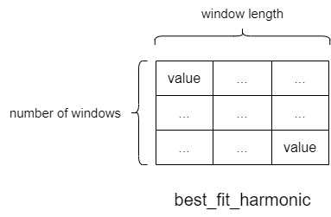
Fft
harmonics: numpy.ndarray
shape: (number of windows, number of positive frequencies, window_length)
n_harm_lower_limit = 1
n_harm_upper_limit = 5
number of positive frequence
= [0, 1, 2, 3, 4, ….]
number of mixed harmonics
= [0, 1, 2, 3, 4]
Compute error
Get best harmonic
mixed_harmonics: numpy.ndarray
shape: (number of windows, number of mixed harmonics, window_length)

Slide 7
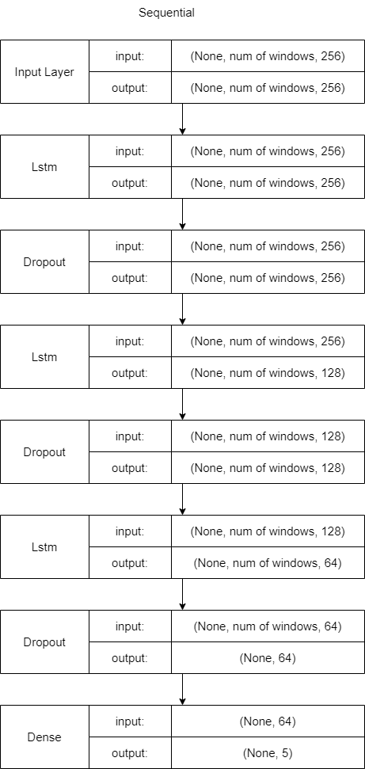
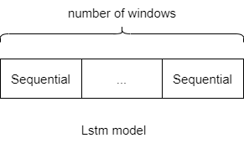
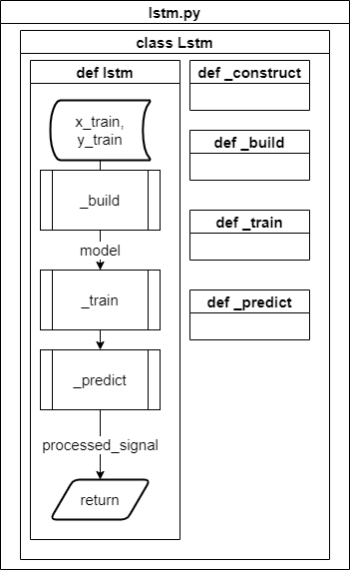
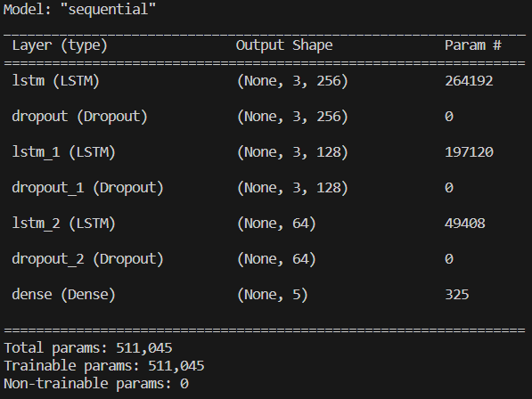
Lstm

Slide 8

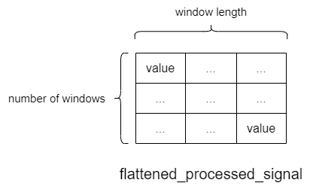
Lstm
processed_signal: numpy.ndarray
shape =
(number of windows, number of split y, length of y)
flatten_processed_signal: numpy.ndarray
shape =
(number of windows, window length)

Slide 9
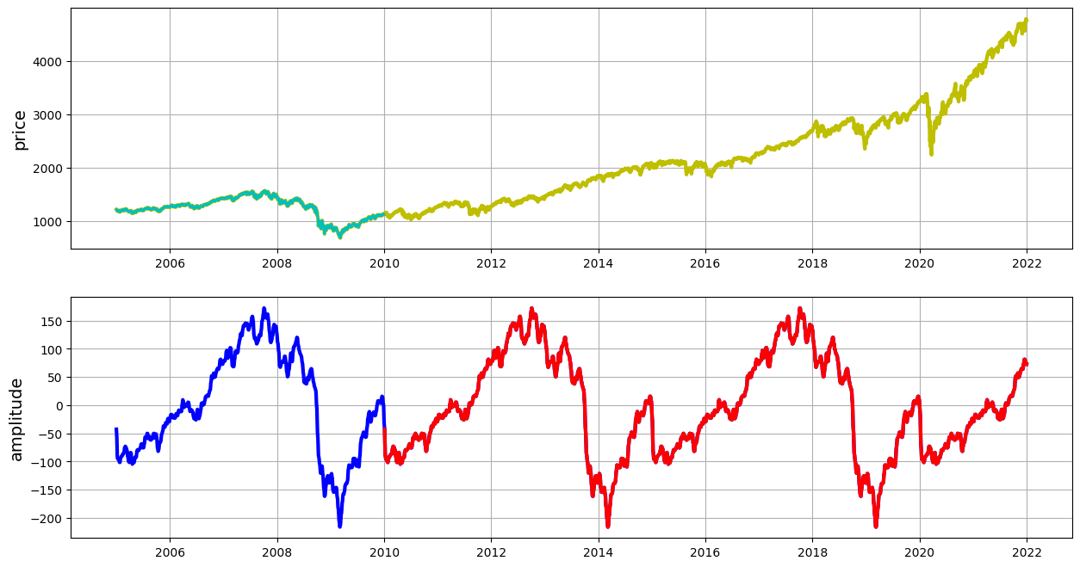
train_data
test_data
mixed_train_harm
mixed_test_harm

Slide 10
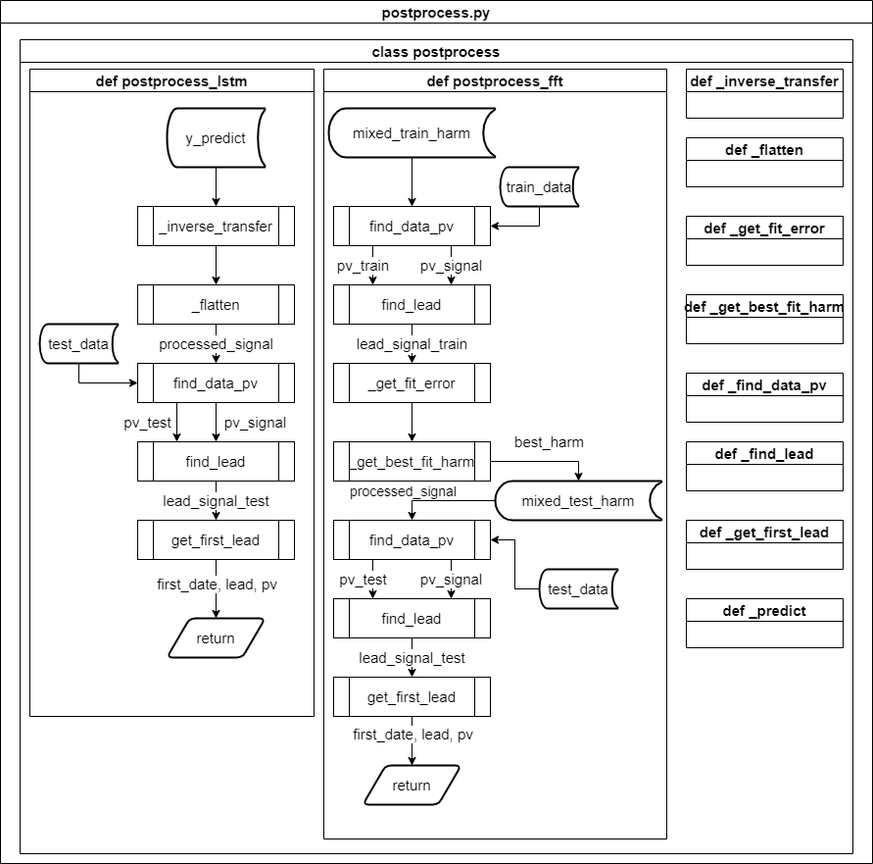
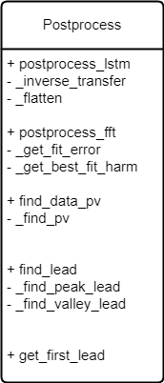
Postprocess

Slide 11
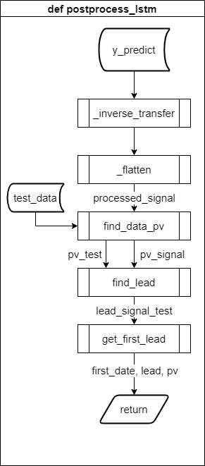
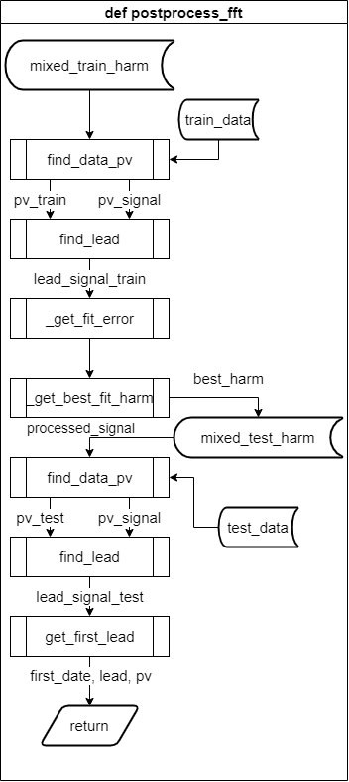

Slide 12
 | 0 | 1 | 2 | 3 | 4 | 5 | 6 | 7 | 8 | 9 | 0 | 1 | 2 | 3 | 4 | 5 | 6 | 7 | 8 | 9
0 | Train_data |  |  |  |  |  |  |  |  |  | Test_data
1 | X_train |  | Y_train
2 |  | X_train |  | Y_train
3 |  |  | X_train |  | Y_train
4 |  |  |  | X_train |  | Y_train
5 |  |  |  |  | X_train |  | Y_train
6 |  |  |  |  |  | X_train |  | Y_train
7 |  |  |  |  |  |  | X_train |  | Y_train
1 |  |  |  |  |  |  |  |  | X_test |  | Y_test
2 |  |  |  |  |  |  |  |  |  |  | X_test |  | Y_test
3 |  |  |  |  |  |  |  |  |  |  |  |  | X_test |  | Y_test
4 |  |  |  |  |  |  |  |  |  |  |  |  |  |  | X_test |  | Y_test
5 |  |  |  |  |  |  |  |  |  |  |  |  |  |  |  |  | X_test |  | Y_test
1 |  |  |  |  |  |  |  |  | X_test |  | y_predict
2 |  |  |  |  |  |  |  |  |  |  | X_test |  | y_predict
3 |  |  |  |  |  |  |  |  |  |  |  |  | X_test |  | y_predict
4 |  |  |  |  |  |  |  |  |  |  |  |  |  |  | X_test |  | y_predict
5 |  |  |  |  |  |  |  |  |  |  |  |  |  |  |  |  | X_test |  | y_predict
 |  |  |  |  |  |  |  |  |  |  | prediction
Step 1.
Split the row_data into train_data and test_data according to the window_length.
window_length = 10
x_length = y_length = slide = 2
Step 2.
Split train_data and test_data into x and y based on x_length and y_length.
Step 3.
Use x_test to predict y_predict.
Step 4.
Flatten multiple y_predict into prediction.

Slide 13
first_date, pv, lead
Peak = 1
Valley = -1
np.ndarray
index |  | 0 | 1 | 2 | 3 | 4 | 5 | 6 | 7 | 8 | 9
test_data | [ | 0 | 0 | 1(Peak) | 0 | 0 | 0 | 0 | -1(Valley) | 0 | 1(Peak) | ]
prediction | [ | 0 | 1(Peak) | 0 | 0 | 1(Peak) | 0 | 0 | -1(Valley) | 0 | -1(Valley) | ]
lead_signal_test | { | - | 1 | - | - | -2 | - | - | 0 | - | -2 | }
lead_signal_test | [ | 0 | 1 | 0 | 0 | -2 | 0 | 0 | 0 | 0 | -2 | ]
first_date | [1] | [1]
pv | [1(Peak)] | [Peak]
lead | [1] | [1]
np.ndarray
dict
np.ndarray
np.ndarray
np.ndarray

