Slide 1
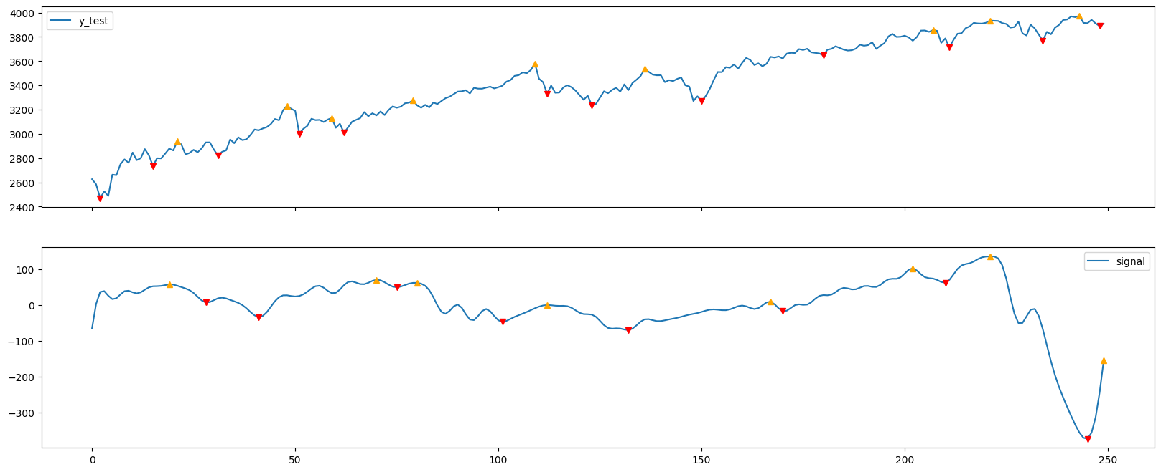
FFT

Slide 2
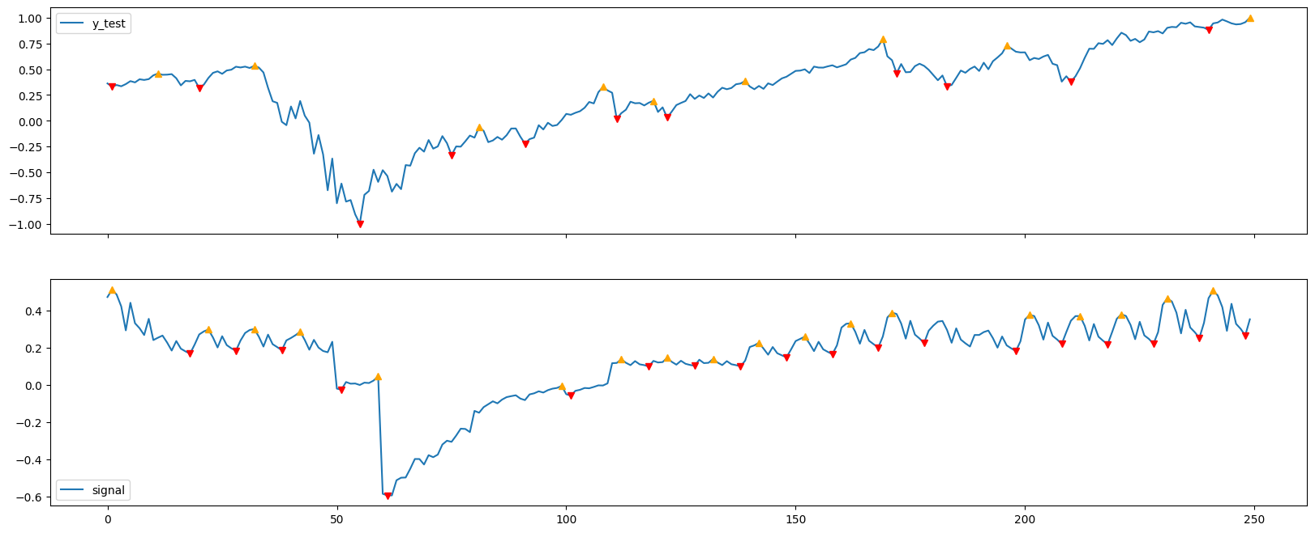
Lstm

Slide 3
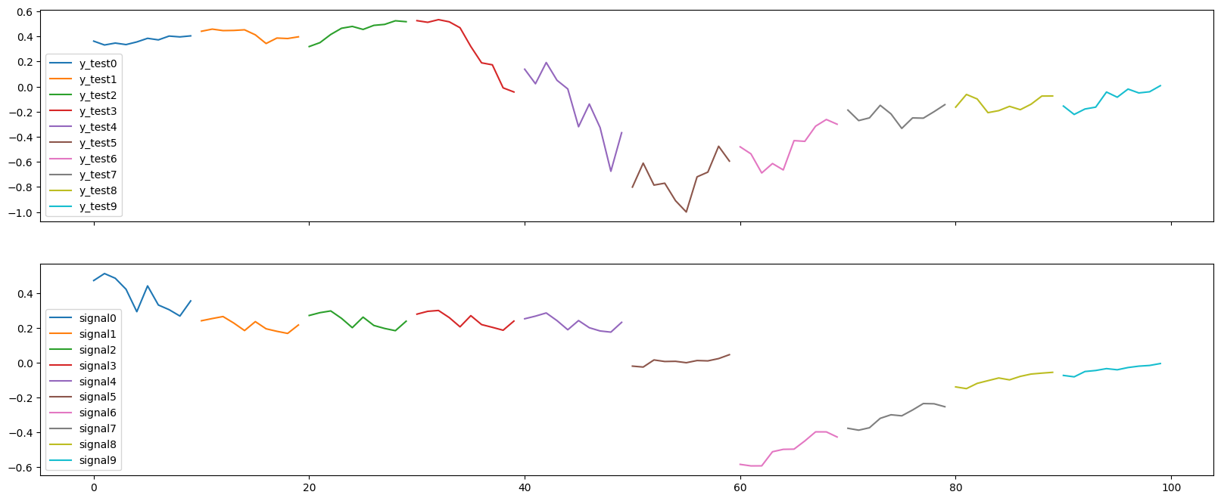
Lstm

Slide 4
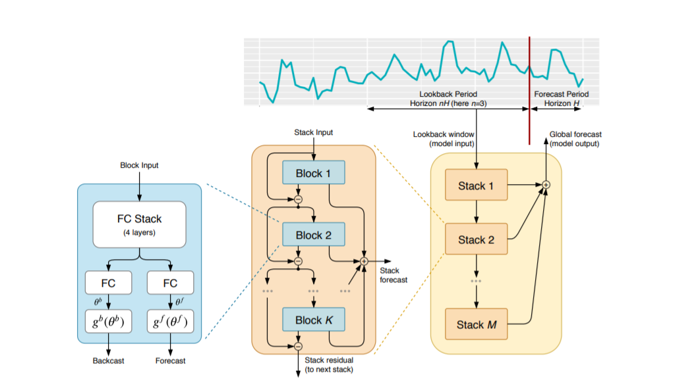
Nbeats

Slide 5
Nbeats parameter
horizon: how far out into the future you want to predict. A horizon value of 1 means you are predicting one step ahead. A value of two means you are predicting two steps ahead, and so on
lookback: what multiple of the horizon you want to use for training data. So if horizon is 1 and lookback is 5, your training window will be the previous 5 values. If horizon is 2 and lookback is 5, then your training window will be the previous 10 values.

Slide 6
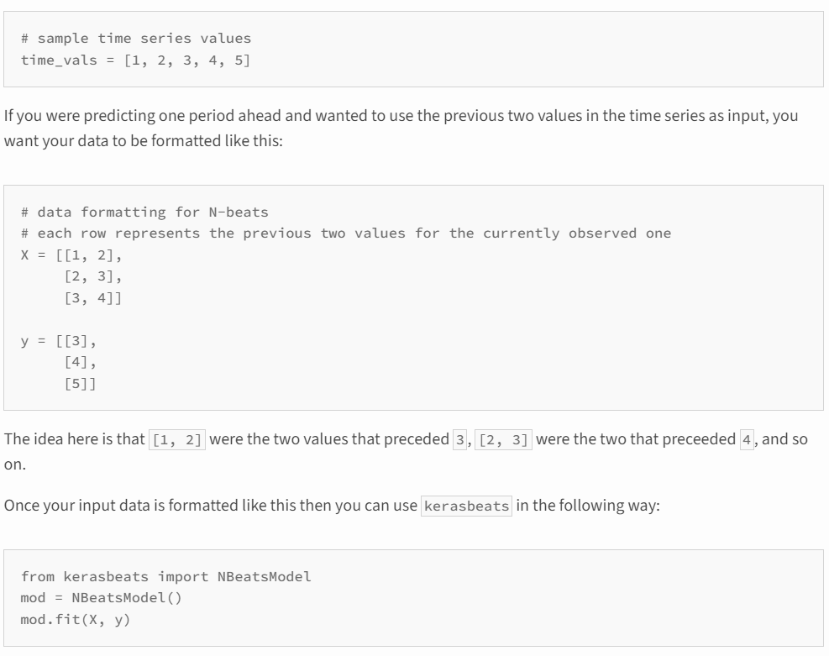
Nbeats parameter

Slide 7
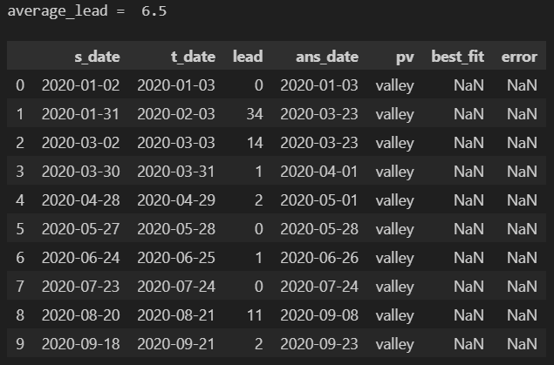
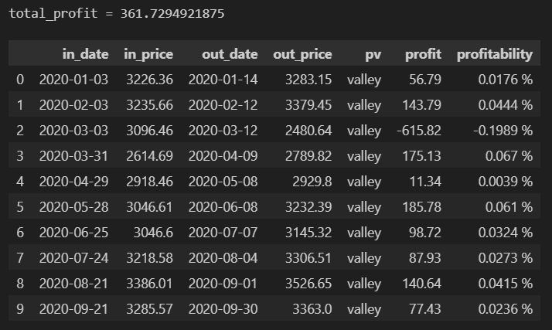

Slide 8
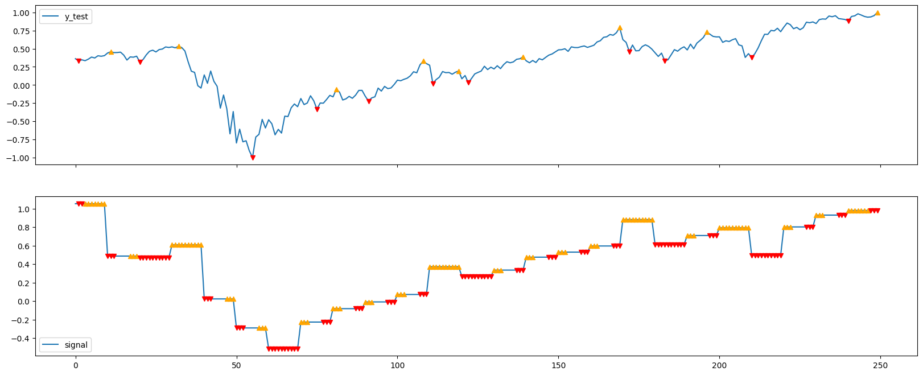
lookback = y_length, horizon = 1

Slide 9
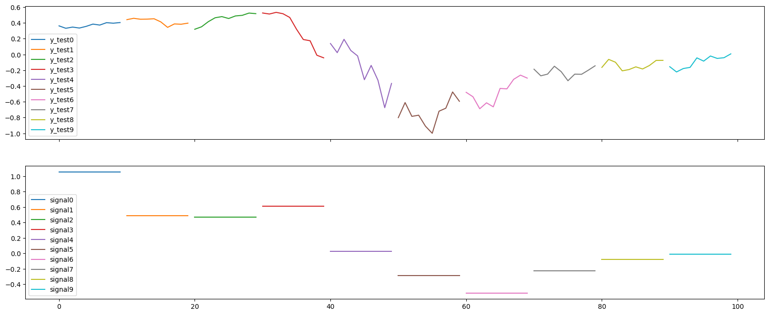
lookback = y_length, horizon = 1

Slide 10
pv_range | Average_lead | Total_profit in stratage 1 | Total_profit in stratage 2 | Total_profit in stratage 3
7 (15days), data_range=250 | 7.9 | -523.35 | -155.24 | -269.40
 | 5.2 | 992.34 | 739.97 | 786.95
 | 8.2 | -245.90 | -428.90 | -530.57
7 (15days), data_range=500 | 4.3 | 1229.07 | 860.97 | 975.13
 | 9.5 | -255.93 | 112.16 | -1.99
 | 8.2 | 557.96 | 403.19 | 534.40

Slide 11
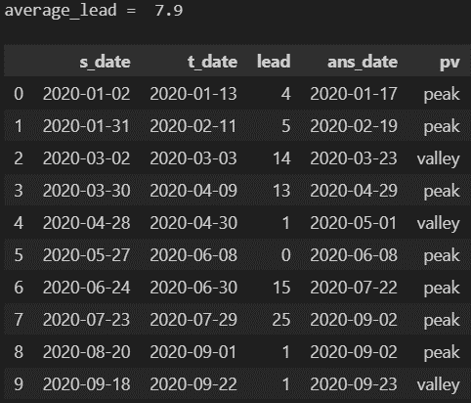
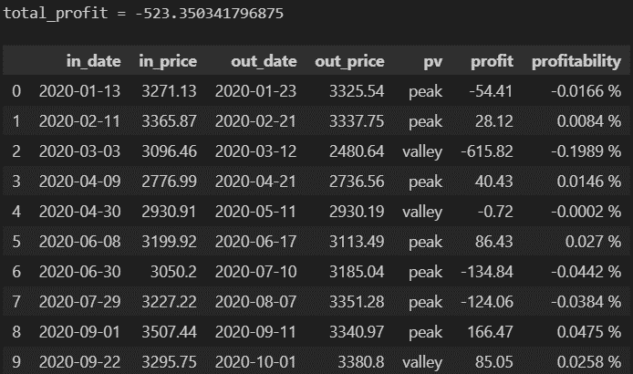
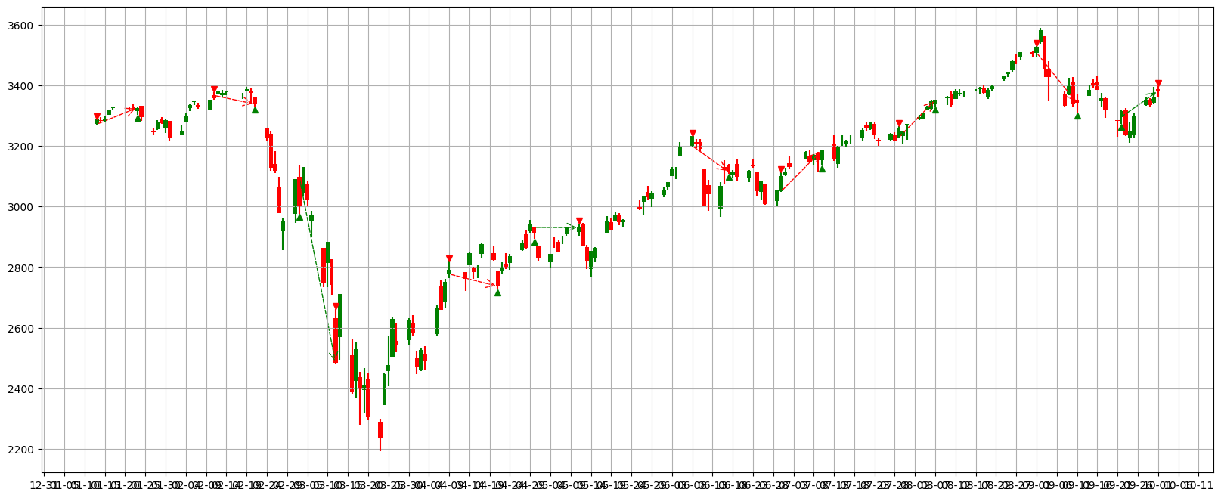
pv_range=7, data_range=250, Strategy 1
Valley:
buy→sell
Peak:
sell→buy
Stop profit line
Stop loss line
buy
sell
increasing
decreasing

Slide 12
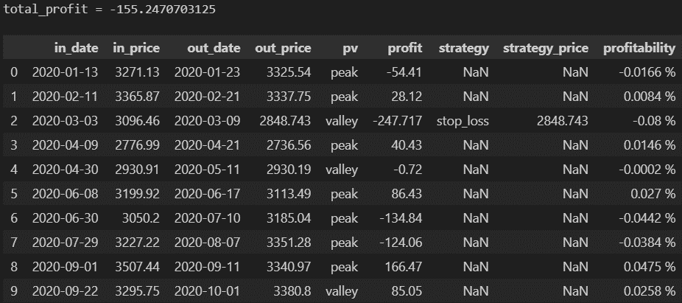

pv_range=7, data_range=250, Strategy 2
Valley:
buy→sell
Peak:
sell→buy
Stop profit line
Stop loss line
buy
sell
increasing
decreasing

Slide 13
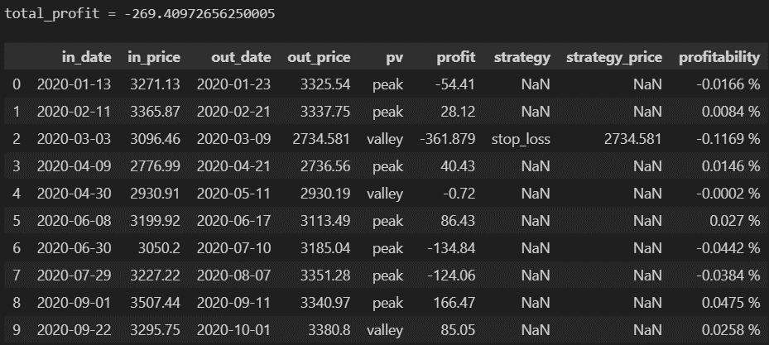

pv_range=7, data_range=250, Strategy 3
Valley:
buy→sell
Peak:
sell→buy
Stop profit line
Stop loss line
buy
sell
increasing
decreasing

Slide 14
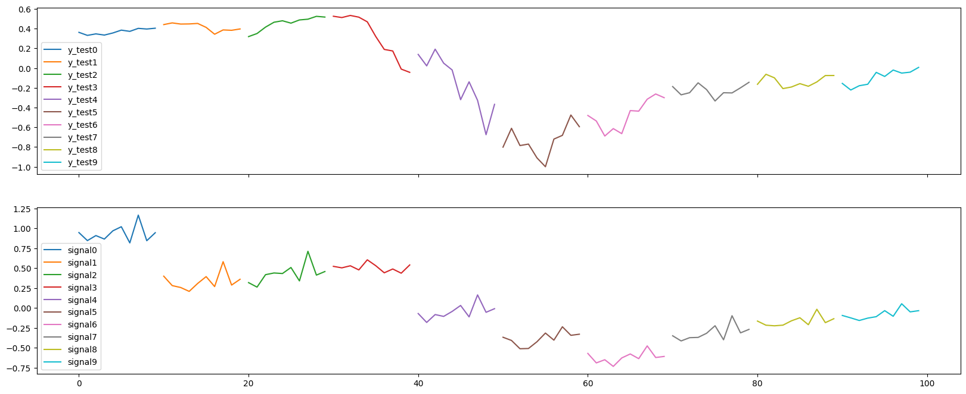
lookback = 1, horizon = y_length

Slide 15
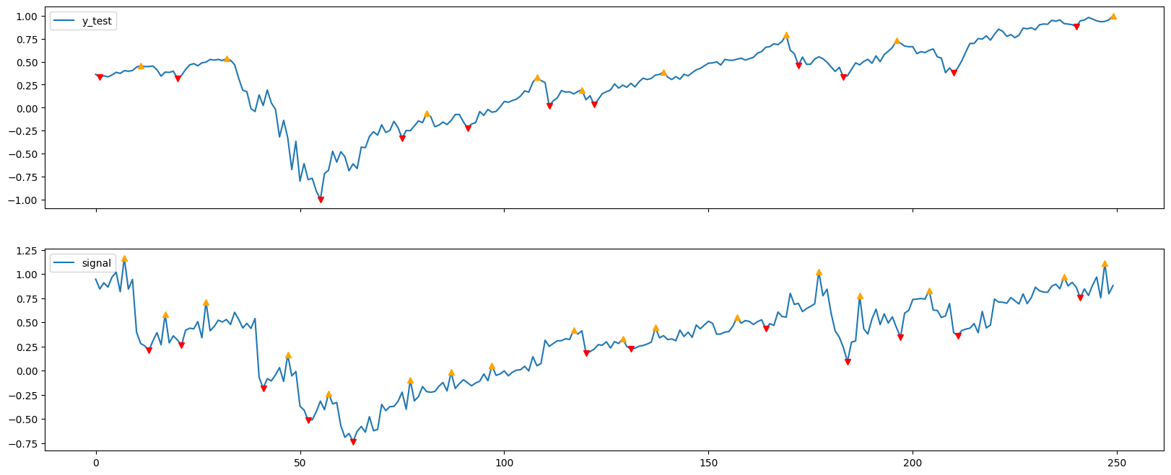
lookback = 1, horizon = y_length

Slide 16
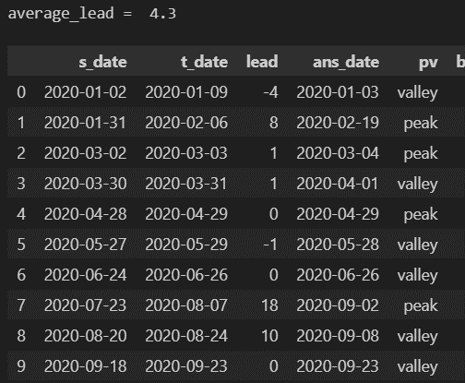
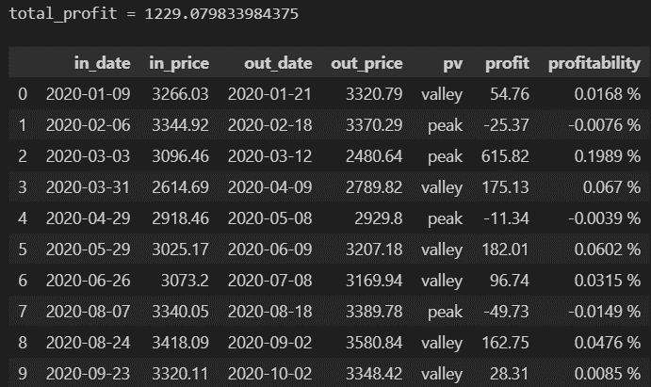
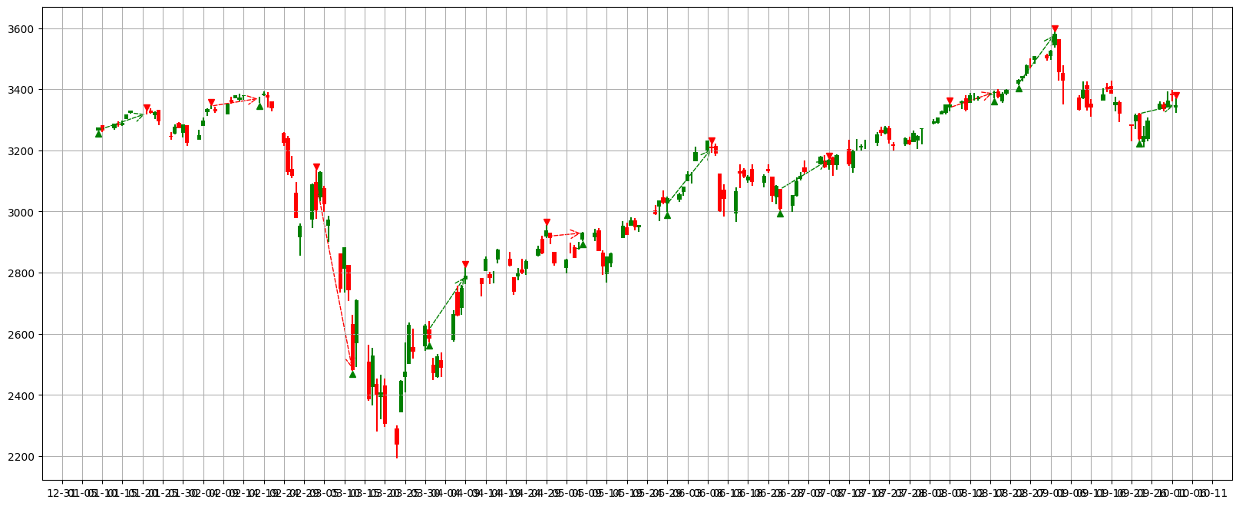
pv_range=7, data_range=500, Strategy 1
Valley:
buy→sell
Peak:
sell→buy
Stop profit line
Stop loss line
buy
sell
increasing
decreasing

Slide 17
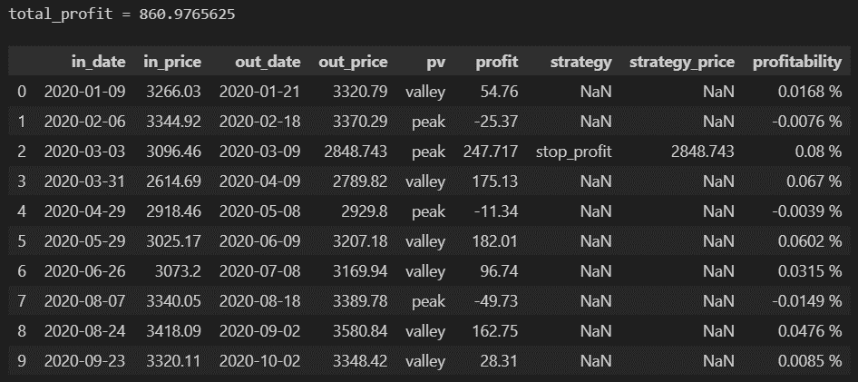

pv_range=7, data_range=500, Strategy 2
Valley:
buy→sell
Peak:
sell→buy
Stop profit line
Stop loss line
buy
sell
increasing
decreasing

Slide 18
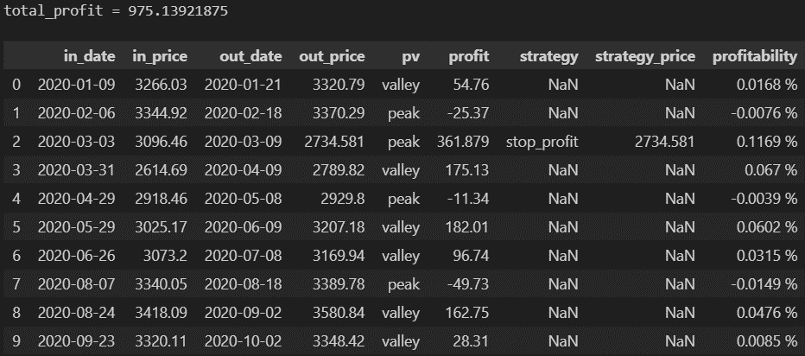
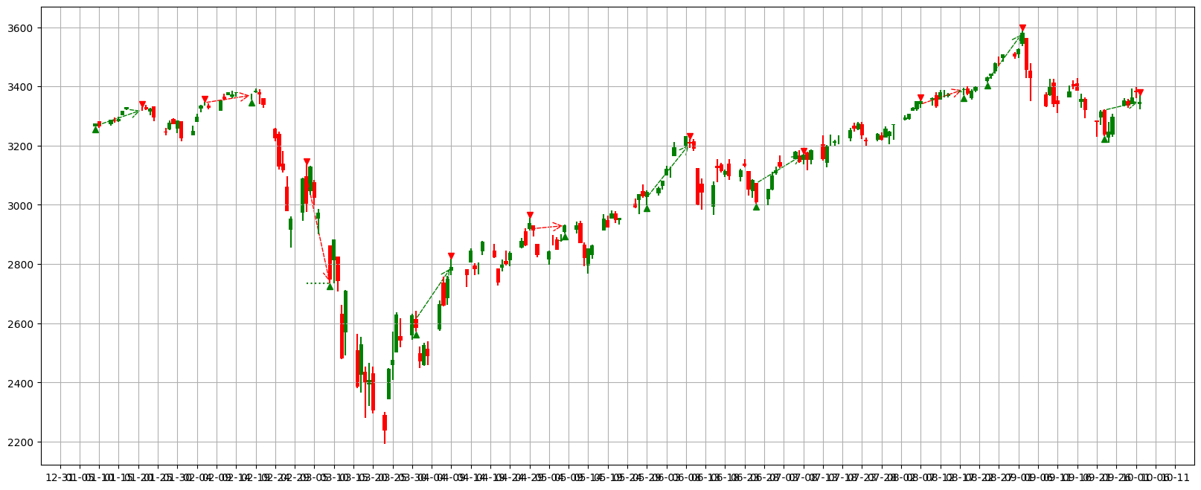
pv_range=7, data_range=500, Strategy 3
Valley:
buy→sell
Peak:
sell→buy
Stop profit line
Stop loss line
buy
sell
increasing
decreasing

Slide 19
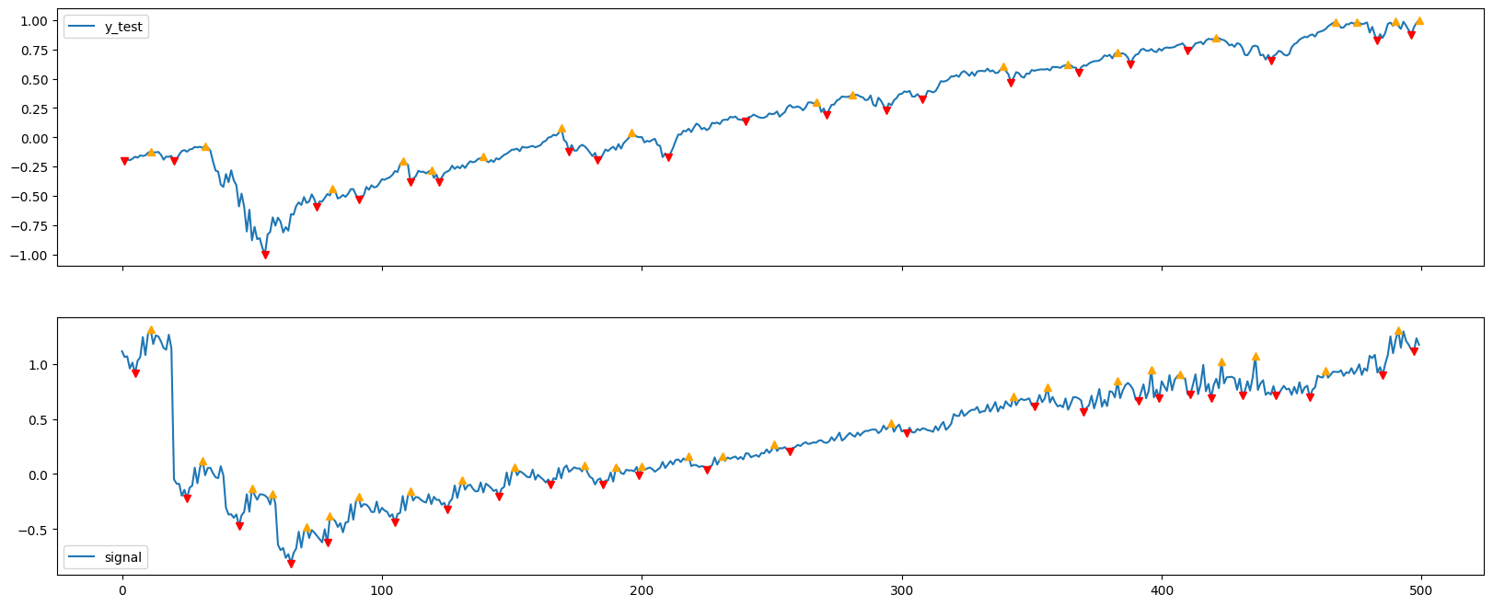
lookback = 1, horizon = y_length

Slide 20
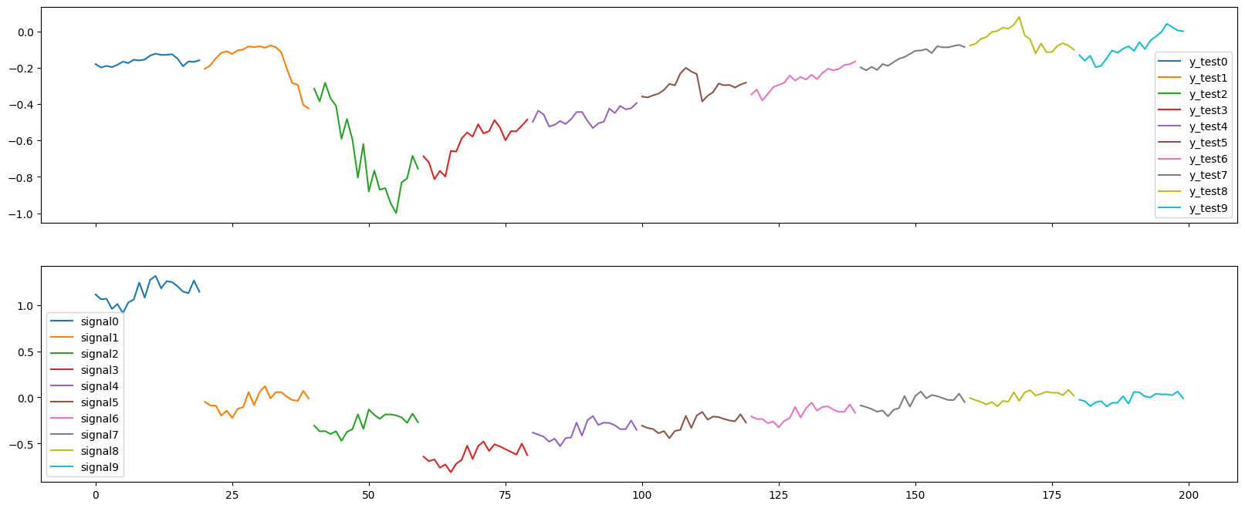
lookback = 1, horizon = y_length

