Slide 1
main.py Flow chart
LoadData
Preprocess
Model
Postprocess
Evaluate
fit_error
best_harmonics
peaks, valleys
lead, first lead

Slide 2
Organizational Chart
/stock_predict
├─data
│ │ dataBase.py
│ │ loadData.py
│ │ postprocess.py
│ │ preprocess.py
│ │ __init__.py
│ └─__pycache__
│
├─evaluate
│ │ evaluateBase.py
│ │ evaluateModel.py
│ │ evaluateProfit.py
│ │ __init__.py
│ └─__pycache__
│
├─model
│ │ fft.py
│ │ lstm.py
│ │ modelBase.py
│ │ sarima.py
│ │ __init__.py
│ └─__pycache__
|
│ main.py
│ requirements.txt
DataBase
LoadData
Preprocess
Postprocess
ModelBase
FFTModel
LstmModel
SarimaModel
EvaluateBase
EvaluateModel
EvaluatePorfit

Slide 3
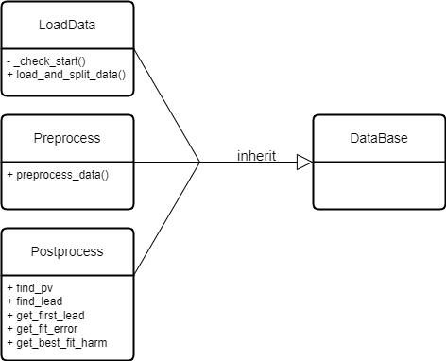
Data Class Diagram

Slide 4
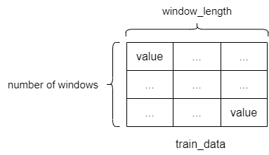
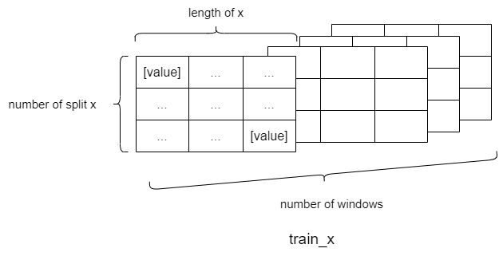

Data Preprocess Array Diagram
train_x, train_y
test_x, test_y
train_data, test_data
LoadData
Preprocess
Model
load_and_split_data()
preprocess_data()
shape: (number of windows, window_length)
x, y: numpy.ndarray
shape: (number of windows, number of split, length, 1)

Slide 5
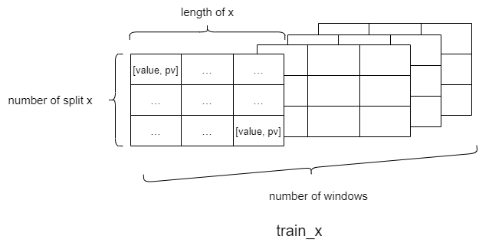
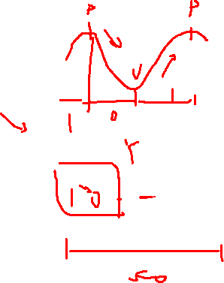

Data Preprocess Array Diagram
train_x, train_y
test_x, test_y
train_data, test_data
LoadData
Preprocess
Model
load_and_split_data()
preprocess_data()
shape: (number of windows, window_length)
x, y: numpy.ndarray
shape: (number of windows, number of split, length, 2)

Slide 6
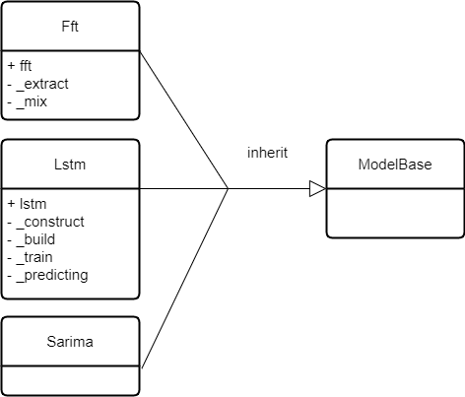
Model Class Diagram

Slide 7
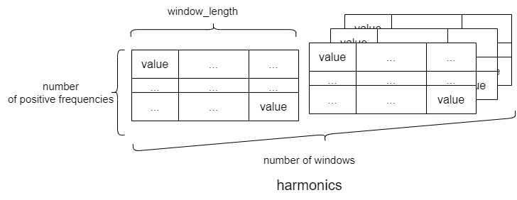
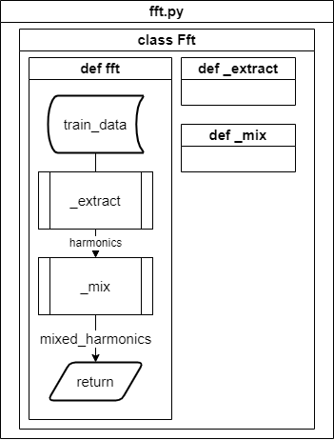
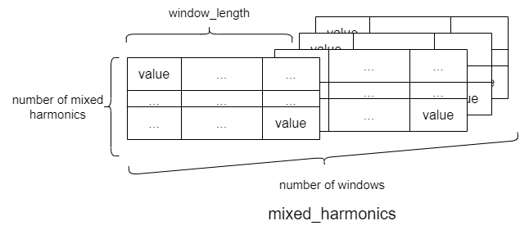
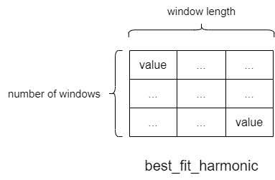
Fft
harmonics: numpy.ndarray
shape: (number of windows, number of positive frequencies, window_length)
n_harm_lower_limit = 1
n_harm_upper_limit = 5
number of positive frequence
= [0, 1, 2, 3, 4, ….]
number of mixed harmonics
= [0, 1, 2, 3, 4]
Compute error
Get best harmonic
mixed_harmonics: numpy.ndarray
shape: (number of windows, number of mixed harmonics, window_length)

Slide 8
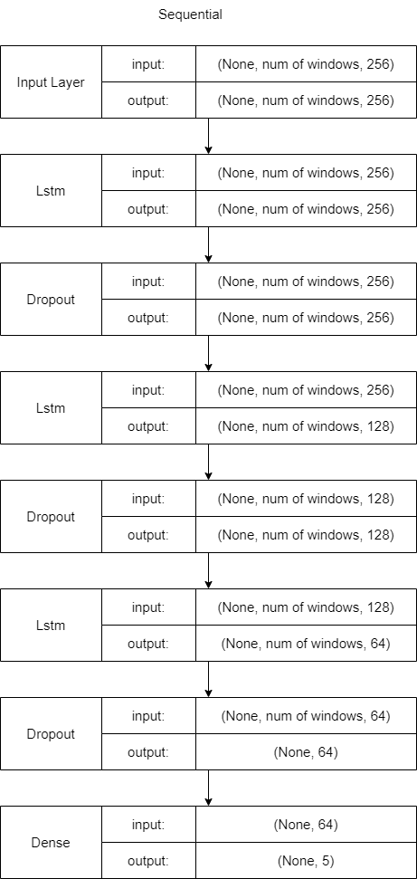
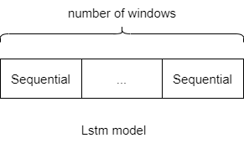
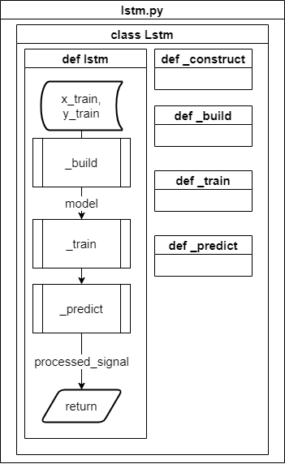
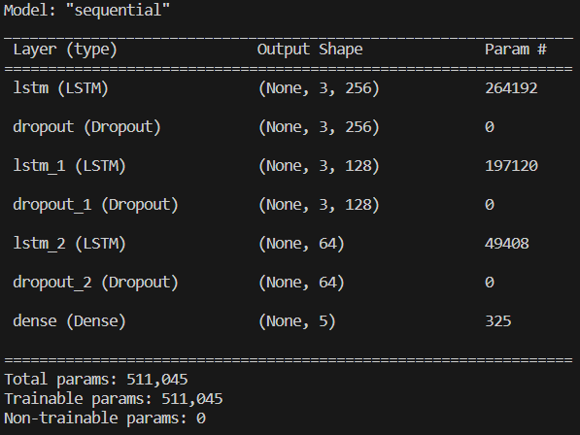
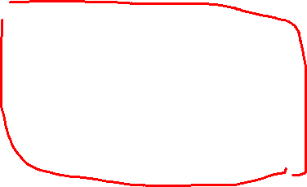
Lstm

Slide 9
Lstm

Slide 10

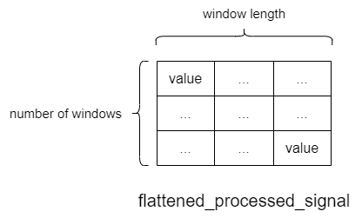
Lstm
processed_signal: numpy.ndarray
shape =
(number of windows, number of split y, length of y)
flatten_processed_signal: numpy.ndarray
shape =
(number of windows, window length)

Slide 11
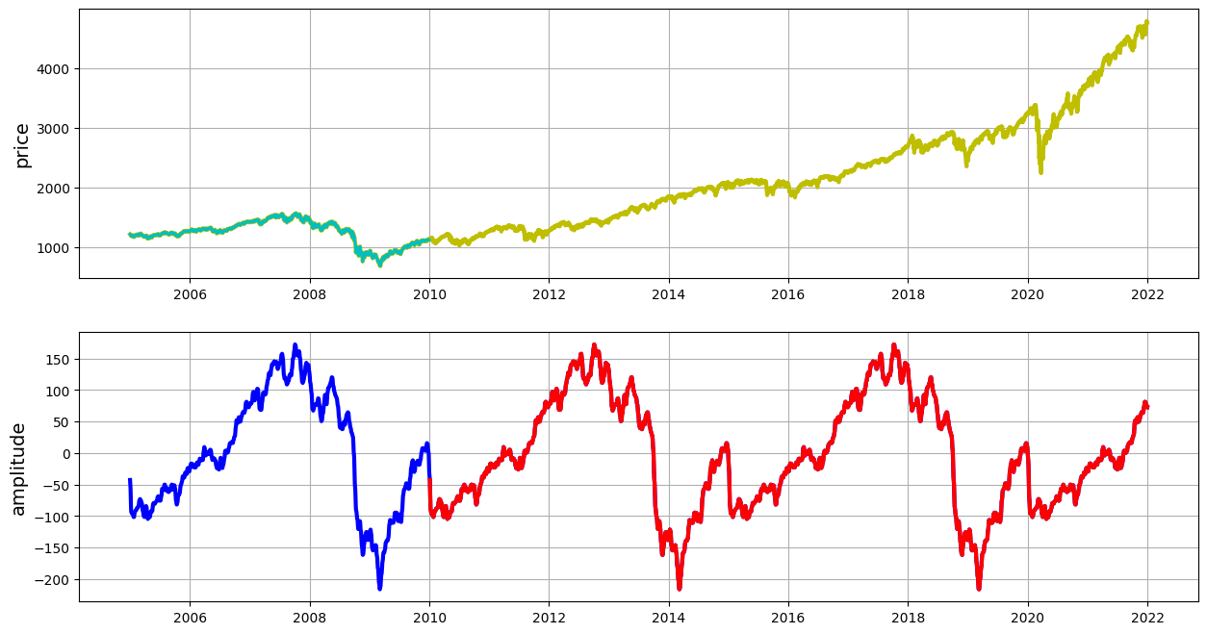
train_data
test_data
mixed_train_harm
mixed_test_harm

Slide 12
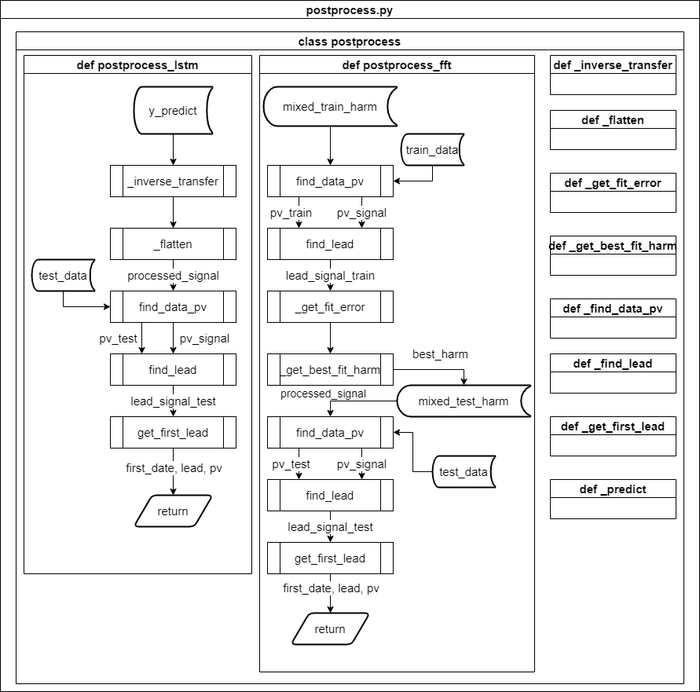
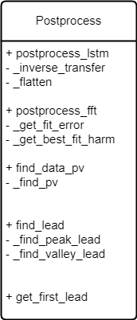
Postprocess

Slide 13
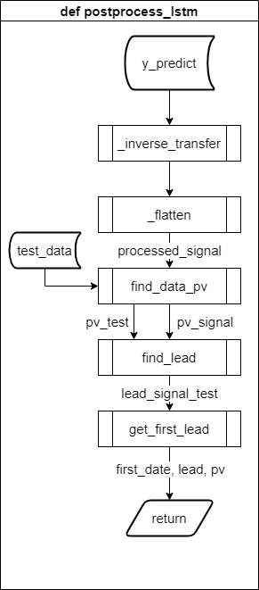
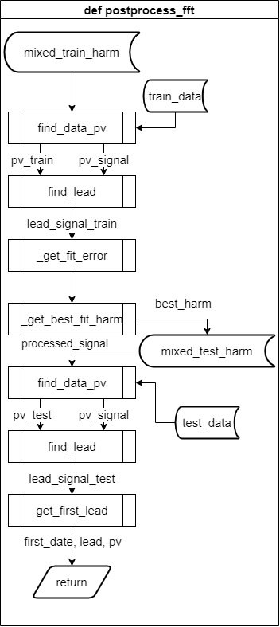

Slide 14

 | 0 | 1 | 2 | 3 | 4 | 5 | 6 | 7 | 8 | 9 | 0 | 1 | 2 | 3 | 4 | 5 | 6 | 7 | 8 | 9
0 | Train_data |  |  |  |  |  |  |  |  |  | Test_data
1 | X_train |  | Y_train
2 |  | X_train |  | Y_train
3 |  |  | X_train |  | Y_train
4 |  |  |  | X_train |  | Y_train
5 |  |  |  |  | X_train |  | Y_train
6 |  |  |  |  |  | X_train |  | Y_train
7 |  |  |  |  |  |  | X_train |  | Y_train
1 |  |  |  |  |  |  |  |  | X_test |  | Y_test
2 |  |  |  |  |  |  |  |  |  |  | X_test |  | Y_test
3 |  |  |  |  |  |  |  |  |  |  |  |  | X_test |  | Y_test
4 |  |  |  |  |  |  |  |  |  |  |  |  |  |  | X_test |  | Y_test
5 |  |  |  |  |  |  |  |  |  |  |  |  |  |  |  |  | X_test |  | Y_test
1 |  |  |  |  |  |  |  |  | X_test |  | y_predict
2 |  |  |  |  |  |  |  |  |  |  | X_test |  | y_predict
3 |  |  |  |  |  |  |  |  |  |  |  |  | X_test |  | y_predict
4 |  |  |  |  |  |  |  |  |  |  |  |  |  |  | X_test |  | y_predict
5 |  |  |  |  |  |  |  |  |  |  |  |  |  |  |  |  | X_test |  | y_predict
 |  |  |  |  |  |  |  |  |  |  | prediction
Step 1.
Split the row_data into train_data and test_data according to the window_length.
window_length = 10
x_length = y_length = slide = 2
Step 2.
Split train_data and test_data into x and y based on x_length and y_length.
Step 3.
Use x_test to predict y_predict.
Step 4.
Flatten multiple y_predict into prediction.

Slide 15
first_date, pv, lead
Peak = 1
Valley = -1
np.ndarray -> scipy.sparse.dok_matrix
index |  | 0 | 1 | 2 | 3 | 4 | 5 | 6 | 7 | 8 | 9
test_data | [ | 0 | 0 | 1(Peak) | 0 | 0 | 0 | 0 | -1(Valley) | 0 | 1(Peak) | ]
prediction | [ | 0 | 1(Peak) | 0 | 0 | 1(Peak) | 0 | 0 | -1(Valley) | 0 | -1(Valley) | ]
lead_signal_test | { | - | 1 | - | - | -2 | - | - | 0 | - | -2 | }
lead_signal_test | [ | 0 | 1 | 0 | 0 | -2 | 0 | 0 | 0 | 0 | -2 | ]
first_date | [1] | [1]
pv | [1(Peak)] | [Peak]
lead | [1] | [1]
np.ndarray -> scipy.sparse.dok_matrix
dict
np.ndarray
np.ndarray
np.ndarray

Slide 16
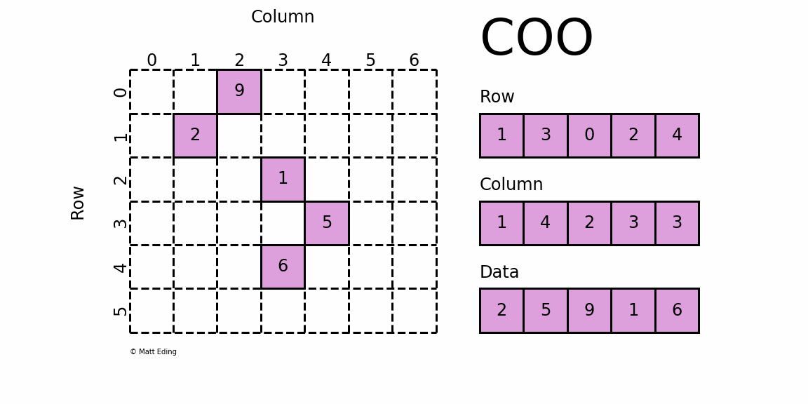
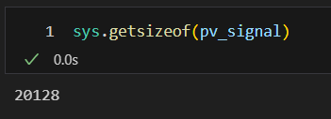
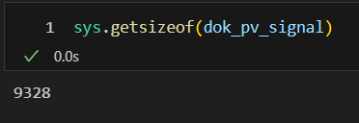
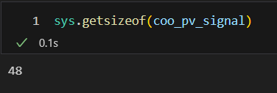
Sparse matrix
coo_matrix:
A sparse matrix in COOrdinate format.
Dense matrix
bytes
dok_matrix
bytes
dok_matrix:
Dictionary Of Keys based sparse matrix.
Allows for efficient O(1) access of individual elements.
coo_matrix
bytes

Slide 17
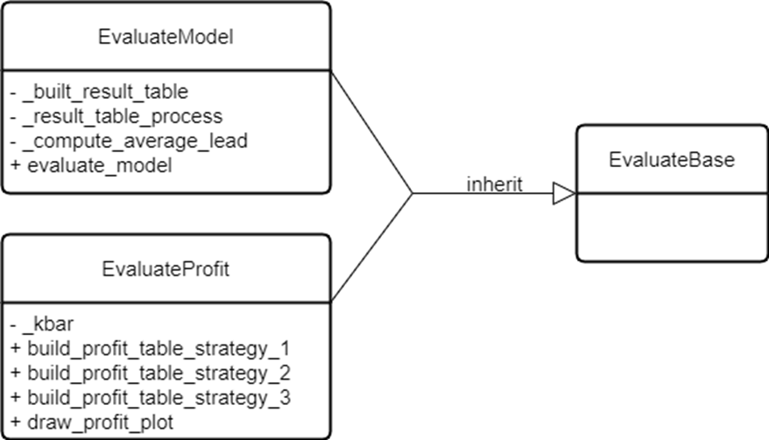
Evaluate Class Diagram

Slide 18
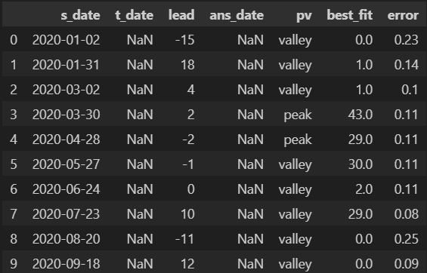
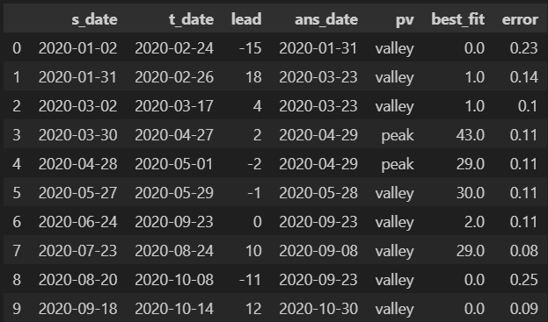
EvaluateModel
evaluate_model()
_built_result_table()
_result_table_process()
_compute_average_lead()

Slide 19
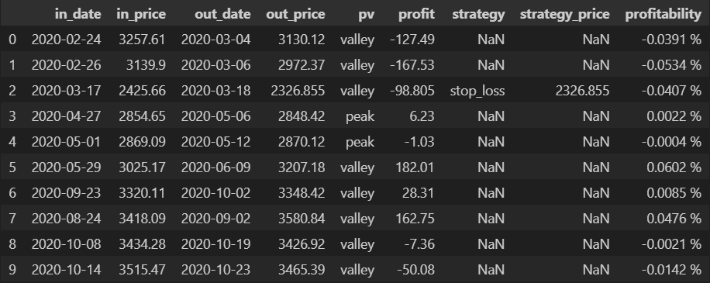
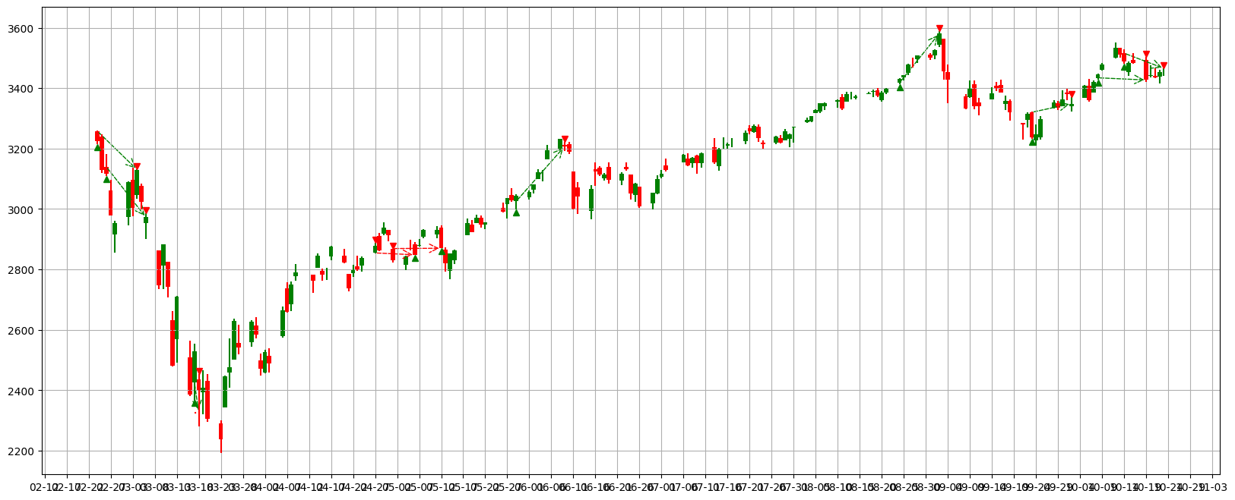
EvaluateProfit

Slide 20
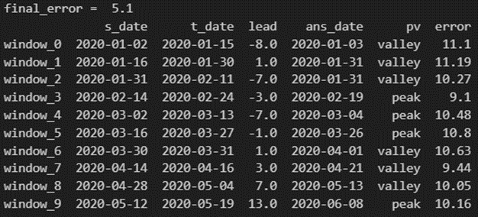
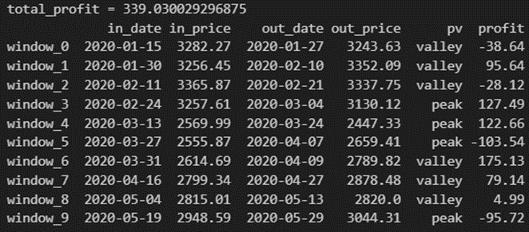
Strategy 1
valley
peak
Pv_range
Pv_range
t_date
s_date
s_date
t_date
Pv_range
Pv_range
Sell
out_price
in_date
in_price
Sell
out_date
Profit = out_price-in_price
Profit = in_price – out_price
out_date
Buy
Buy
in_price
out_price
in_date

Slide 21
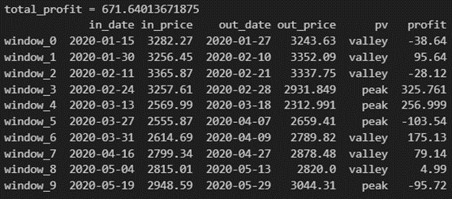
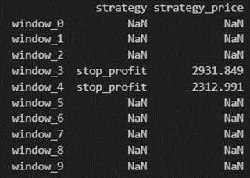
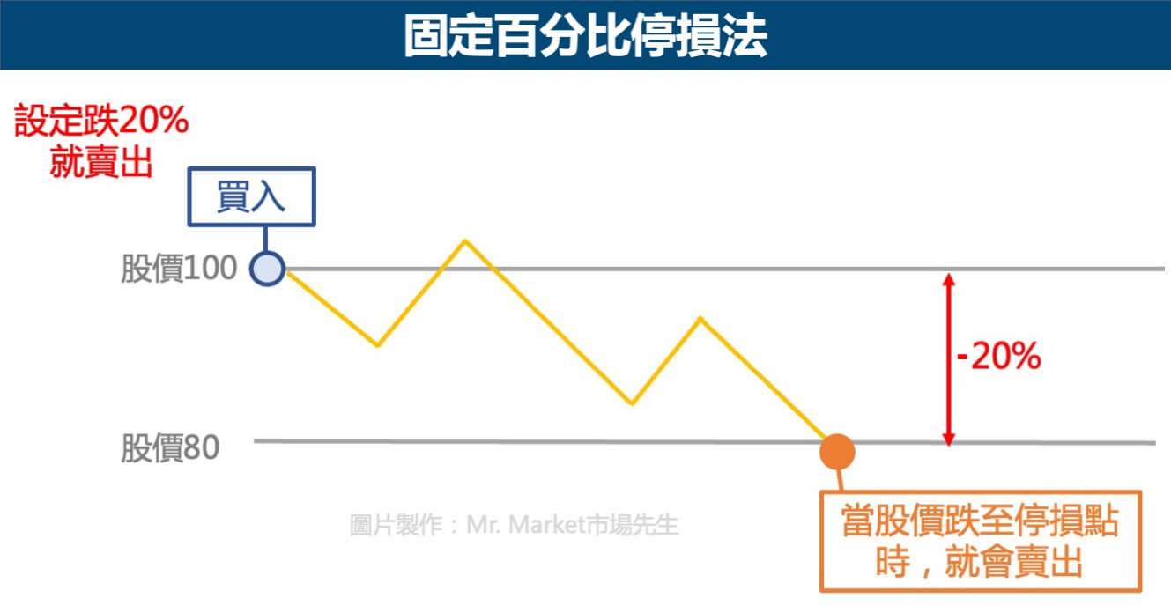
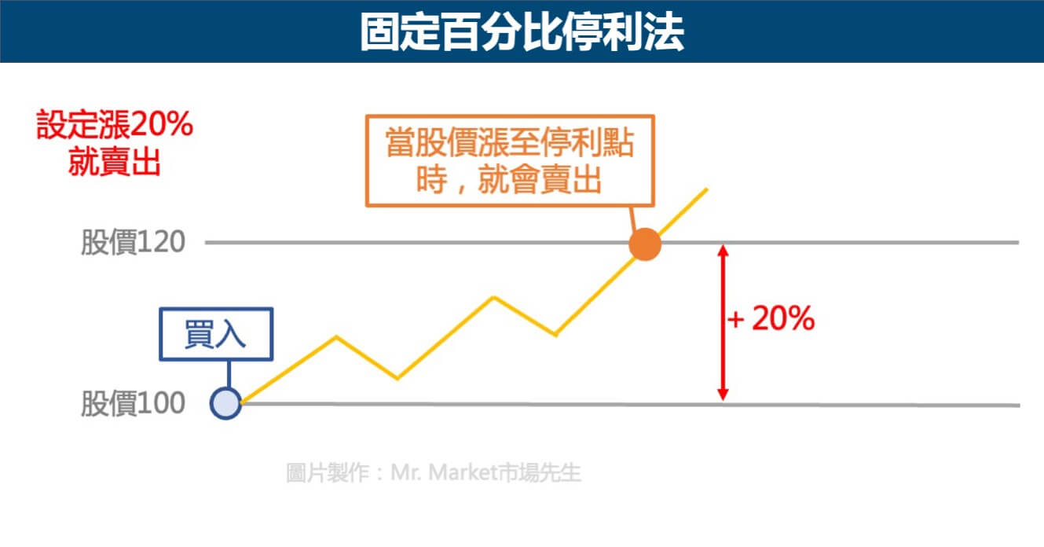
Strategy 2

Slide 22
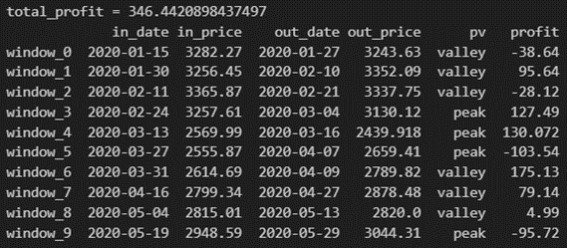
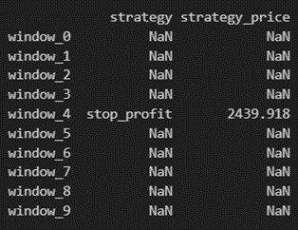
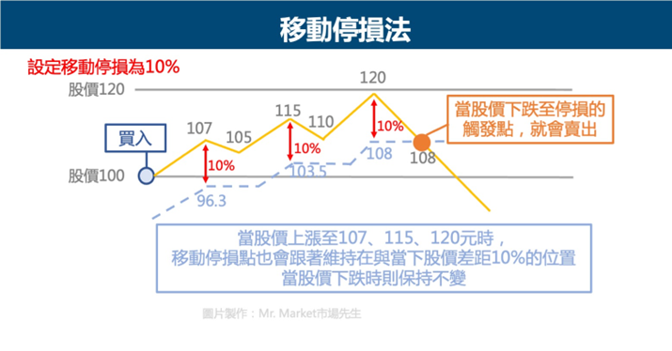
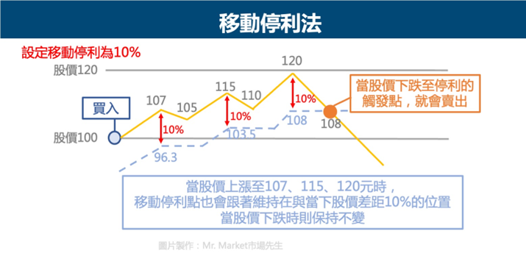
Strategy 3

Slide 23
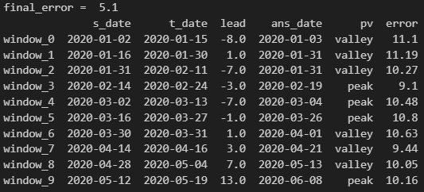
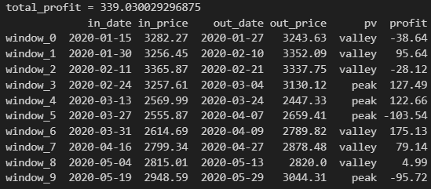
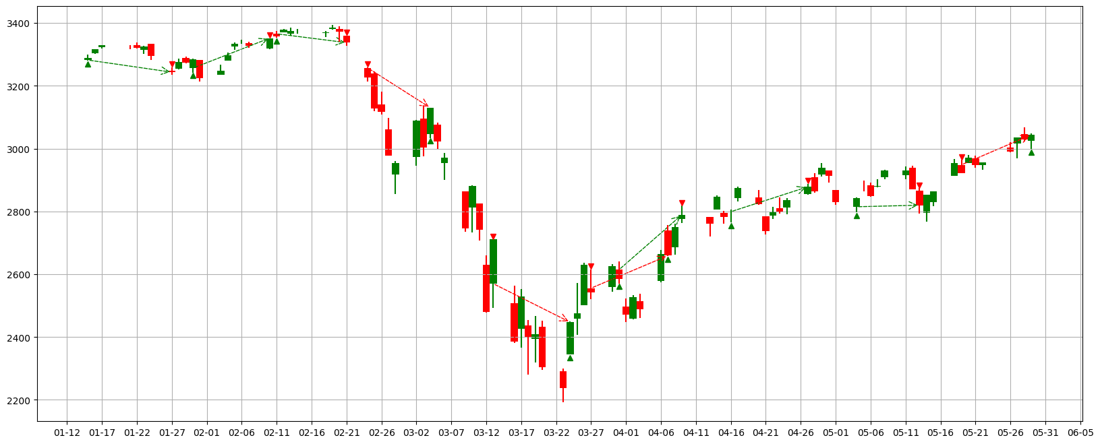
pv_range=7, x_length=10, try_1, Strategy A
Valley:
buy→sell
Peak:
sell→buy
Stop profit line
Stop loss line
buy
sell
increasing
decreasing

Slide 24
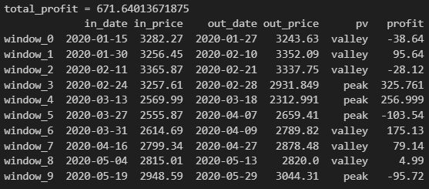
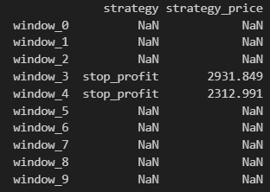

pv_range=7, x_length=10, try_1, Strategy B
Valley:
buy→sell
Peak:
sell→buy
Stop profit line
Stop loss line
buy
sell
increasing
decreasing

Slide 25
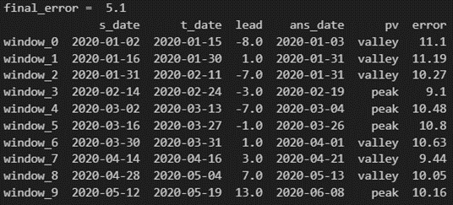
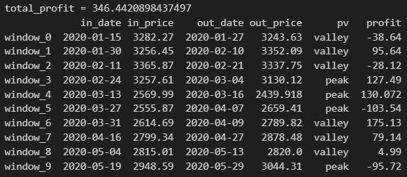
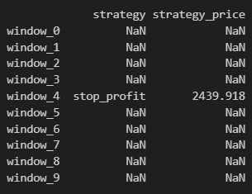

pv_range=7, x_length=10, try_1, Strategy C
Valley:
buy→sell
Peak:
sell→buy
Stop profit line
Stop loss line
buy
sell
increasing
decreasing

Slide 26

pv_range | Average_lead | Total_profit in stratage 1 | Total_profit in stratage 2 | Total_profit in stratage 3
7 (15days), data_range=250 x_length=25 y_length=25 epochs = 25 | 5.7 | 167.70 | 167.70 | 167.70
 | 5.0 | 88.75 | 88.75 | 88.75
 | 3.4 | -14.64 | -14.64 | -14.64
7 (15days), data_range=500 x_length=50 y_length=50 epochs = 50 | 5.3 | -12.35 | -12.35 | -12.35
 | 2.9 | 203.98 | 203.98 | 203.98
 | 4.6 | 165.60 | 165.60 | 165.60

Slide 27
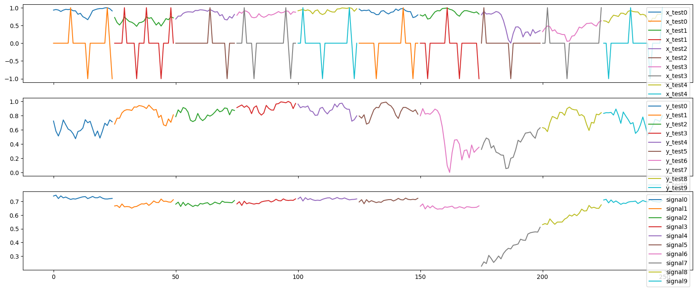
data_range=250, x_length=25, try_1 , window_0

Slide 28
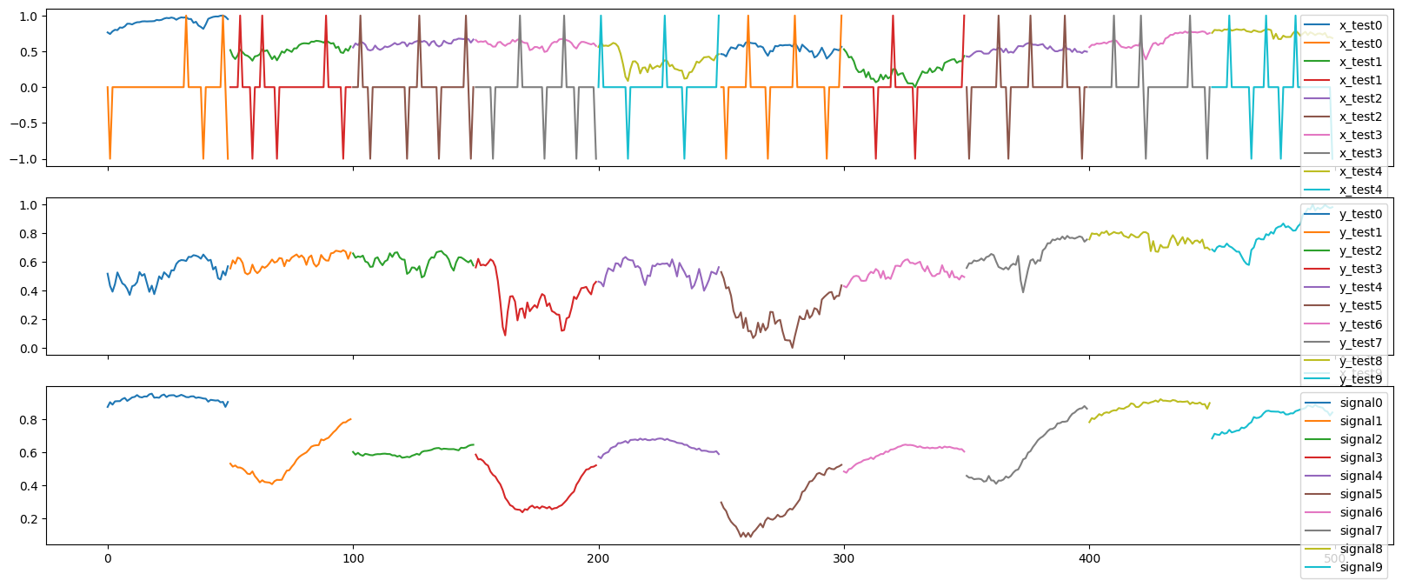
data_range=500, x_length=50, try_1 , window_0

Slide 29

data_range=1000, x_length=100, try_1 , window_0

