Slide 1
Fourier Analysis for Stock Price Forecasting: Assumption and Evidence & Predicting Stock Prices Using LSTM

Slide 2
Reference: Fourier Analysis for Stock Price Forecasting: Assumption and Evidence
Author: Bohumil Stádník, Jurgita Raudeliūnienė & Vida Davidavičienė , 2016
Faculty of Finance and Accounting, University of Economics, Czech Republic Summary:
The significant cycles were discovered using the Fourier analysis inside the price series of US stocks; then, the simulation of an agent buying and selling on minima and maxima of these cycles was made.
The results were then compared to those of an agent operating chaotically. Moreover, the existing significant cycles were found using more precise methods, suggested in the research, and based on the results of an agent buying and selling on all possible periods and phases.
It has been analysed whether these really existing cycles were in accordance with the significant cycles resulting from the Fourier analysis. It has been concluded that the Fourier analysis basically failed. Suchlike failures are expected on similar data series.

Slide 3
Methodology of the research
Data: daily closing prices of 2332 US stocks, up to 5 years back.
Analysis: Two methods – FFT and Complex Period Test were used to identify predominant cycles and to assess the benefit of the Fourier analysis.

Slide 4
FFT
To avoid poor functionality of the Fourier analyses, the transformed function must meet the following criteria: (1) Stationary function, meaning that the function repeats with the same periodicity to infinity; (2) The sample of the function, over which the Fourier transform is calculated, must be large enough to be representative. The sample must capture at least one period of all the components that make up the function.
The resulting significant cycles are called “best FFT cycles” in the following text. To practically quantify the benefit of this method, an agent opening and closing long positions on the best FFT cycles, minima and maxima are simulated.

Slide 5
Complex Period Test
This method was suggested in this research in order to find dominant periods and its phases for each stock utilizing an agent opening long positions successively in all possible phases of an assumed cycle and closing positions after a half period of the cycle. The time distance between the expected minima and maxima is one-half of the period.
Periods 2, 4, 6, 8, …, 160 days were checked in this way.
...
Then, for each period, the best WIN ratio of the phases is found, and these WIN ratios are compared together in order to select the most significant periods and their phases. The cycles providing the best WIN ratio results are denoted as the “best Complex Period Test cycles”.

Slide 6
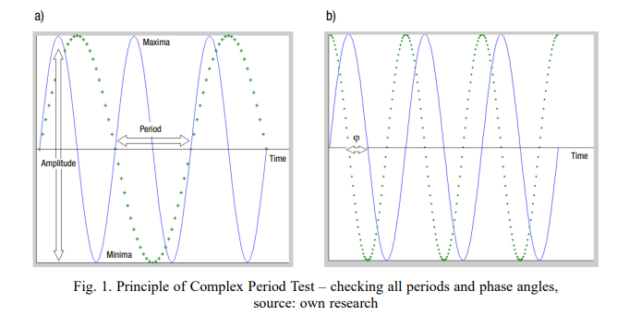
Complex Period Test

Slide 7
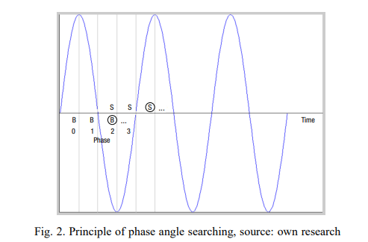
Complex Period Test

Slide 8
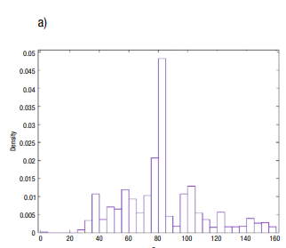
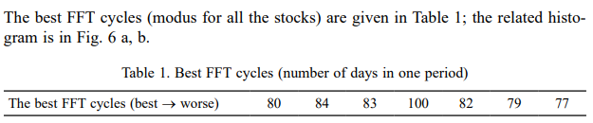

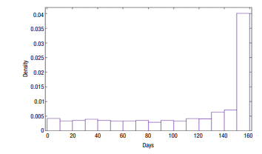
Findings of the research on the Fourier analysis

Slide 9
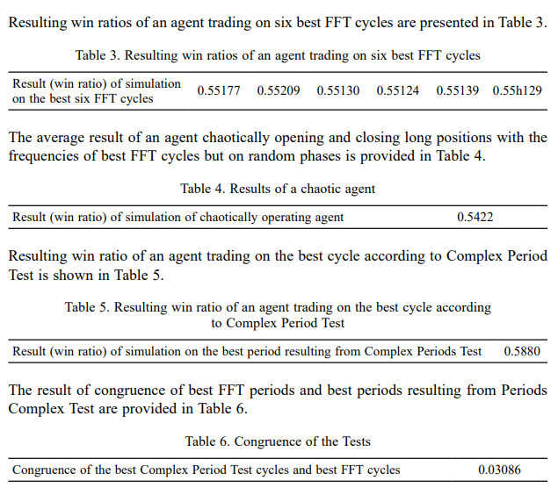

Findings of the research on the Fourier analysis
where, N success is a number of speculations with a financially positive result (the result is in plus), and
N all is the number of all the speculations.
Based on the test of congruence between significant cycles resulting from Complex Period Test and FFT methods, it can be stated that FFT basically fails to find the best cycles.

Slide 10
Why FFT basically fails?
The data series does not meet the criteria of stationarity which implies a possible poor functionality of FFT in general. (Stationary function, meaning that the function repeats with the same periodicity to infinity;)
Such problem could also be connected to a time series with noise. Saying that there is a noise inside the time series is very vague and does not contain any information at all. In the case of a technical approach, high or low-frequency noises are usually expected and a filter may be used to separate noise from a signal. In the case of a “financial” signal, the situation is different and basically, it cannot be recognised if there is a certain noise.

Slide 11
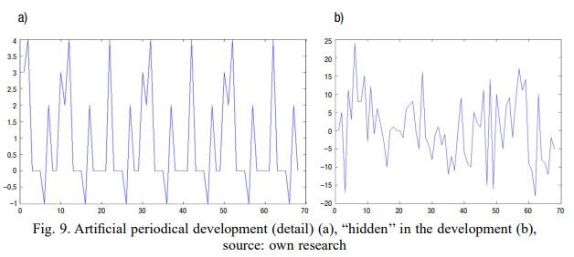
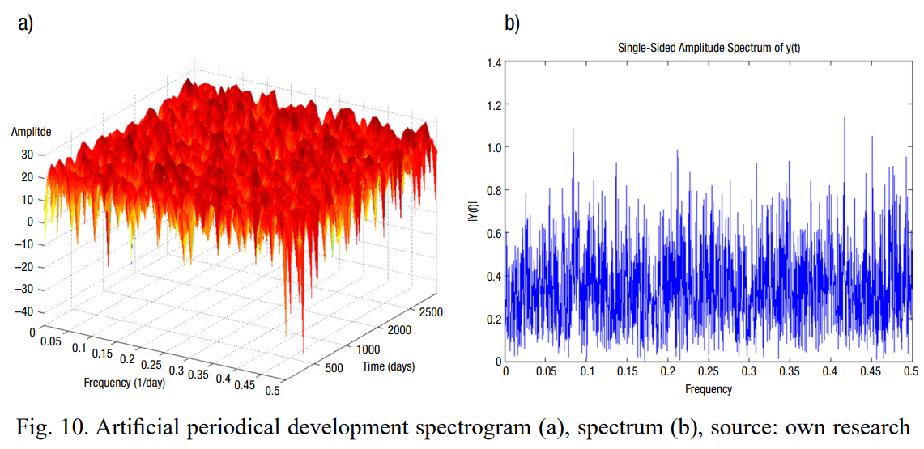
Why FFT basically fails?
By the way of example: in Figure 9 a, there is an example of a periodic artificial signal, which is hidden in the signal in Figure 9 b.
It is not possible to recognise the signal in the spectrum using FFT methods as it can be seen in Figure 10 a, b.

Slide 12
Reference: Predicting Stock Prices Using LSTM
Author: Murtaza Roondiwala, Harshal Patel, Shraddha Varma, 2015
Undergraduate Engineering Students, Department of Information Technology, Mumbai University Summary:
The paper that we have presented modeled and predicted the stock returns of NIFTY 50 using LSTM. We collected 5 years of historical data of NIFTY 50 and used it for the training and validation purposes for the model.

Slide 13
Methodology
Stage 1: Raw Data:
Stage 2: Data Preprocessing:
The pre-processing stage involves
Data discretization: Part of data reduction but with particular importance, especially for numerical data
Data transformation: Normalization.
Data cleaning: Fill in missing values.
Data integration: Integration of data files.

Slide 14
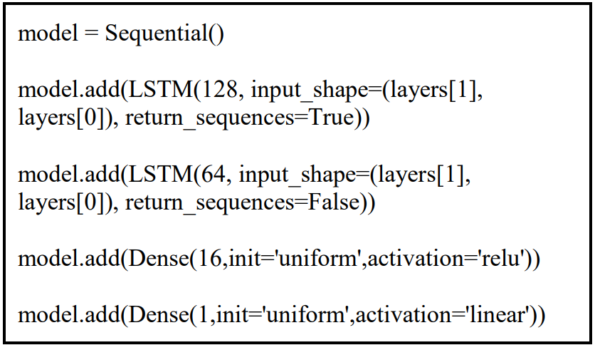
Methodology
Stage 3: Feature Extraction:
We will choose the feature from Date, open, high, low, close, and volume.
Stage 4: Training Neural Network:
Stage 5: Output Generation:

Slide 15
Experimental Work
Dataset description:
We have collected the historical stock data of NIFTY 50 from the National stock exchange. We have collected daily dataset and kept a window size of 22 days.
Sequence data:
From data set we used 1180 samples for training purpose and 132 samples for validation purpose.
Training Detail:
For training the model we used RMSprop as the optimizer and normalized each vector of the sequence.
For our experiment, we have used a various set of parameters with a different number of epochs to measure the RMSE of Training and Testing dataset.

Slide 16
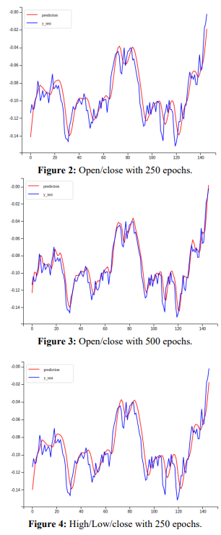
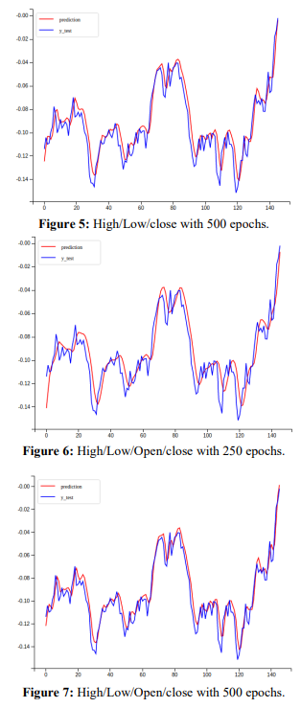
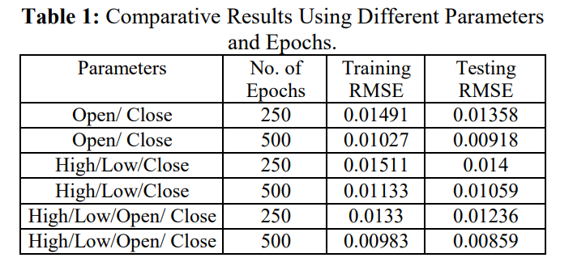
Experimental Results

Slide 17
Reference: Forecasting turning points in stock price by applying a novel hybrid CNN-LSTM-ResNet model fed by 2D segmented images
Author: Summary:
Analysis:
Conclusions:
1.

Slide 18
Reference:
Author: Summary:
Analysis:
Conclusions:
1.

