Slide 1
Definition of Reversal points

Slide 2
Definition of Reversal points
(1.)
Derivative Analysis
Moving Averages Analysis
Local Extrema (Peak, valley)
Piecewise linear representation (PLR)
The trend-based segmentation method (TBSM)
Fourier Transform
Wavelet Analysis
Other methods
(4.)
(5.)

Slide 3

Reference: A new LSTM based reversal point prediction method using upward/downward reversal point feature sets
Source:
Abstract: A novel Long-Short Term Memory (LSTM)-based prediction model of stock price reversal point was proposed by using upward/downward reversal point feature sets.
Based on the combinations of candlestick indicators and technical indicators, 27 sets of feature candidates were constructed, and then the feature sets suitable to each stock in terms of URP/DRP prediction were respectively extracted.
LSTMbased URP/DRP predictors were constructed, the results of which are combined to improve the prediction accuracy. Using this model, reversal point prediction has been conducted for 10 Chinese stocks and 10 American stocks. In results, the mean prediction accuracy (F1) was 68.6% and 55.2% for the Chinese and the American stock markets, respectively.

Slide 4
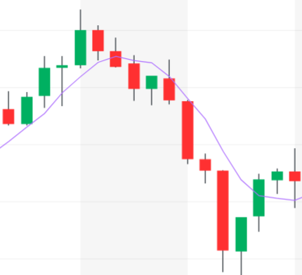
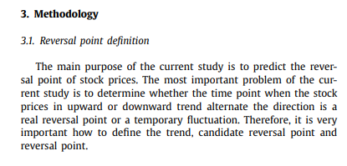
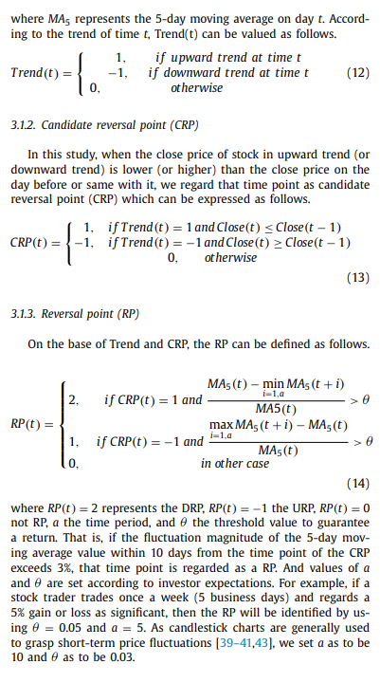
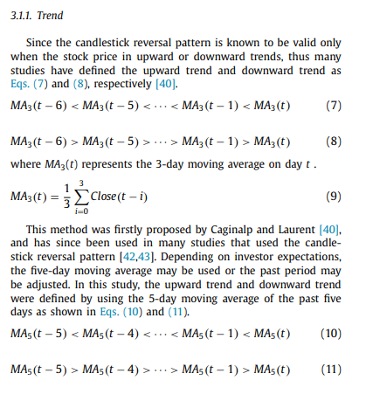
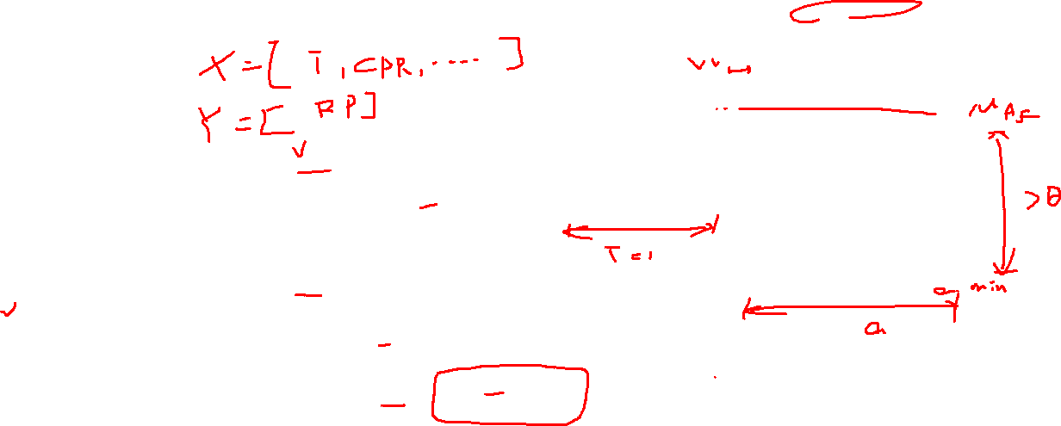
Past data
t
Future data
MA based on Close price

Slide 5
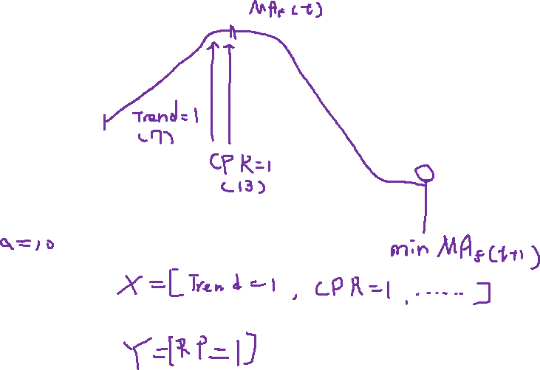

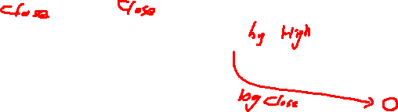
Past data
t
Future data
MA based on Close price

Slide 6

Reference: A Trend-Based Segmentation Method and the Support Vector Regression for Financial Time Series Forecasting
Source: Mathematical Problems in Engineering
Summary: This paper presents a novel trend-based segmentation method TBSM and the support vector
regression SVR for financial time series forecasting. The model is named as TBSM-SVR.
The basic idea of TBSM is to modify the PLR segmentation using the trend tendency in a specific time period. Three different trends such as uptrend, downtrend, and hold trend will be considered when making the segmentation.

Slide 7
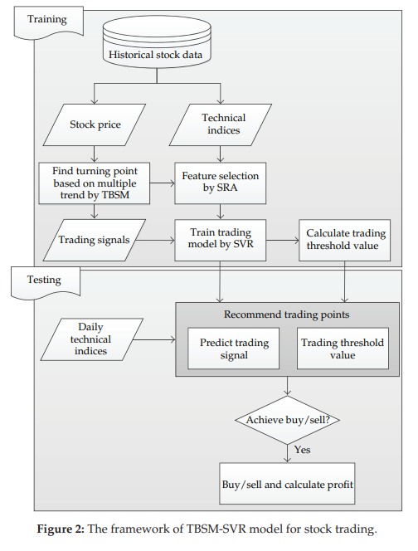
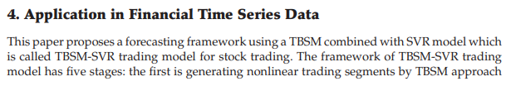

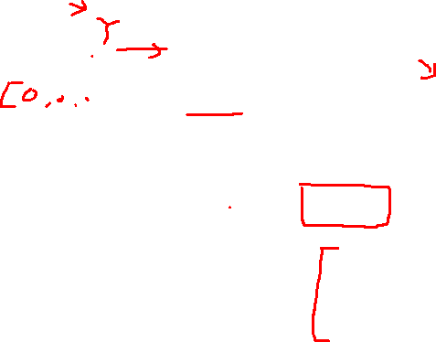
Application in Financial Time Series Data
X
Y
X
Y

Slide 8
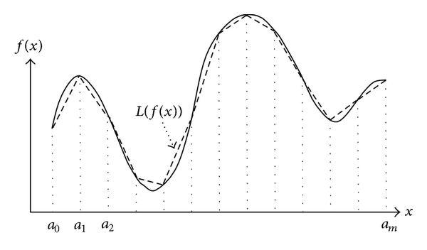
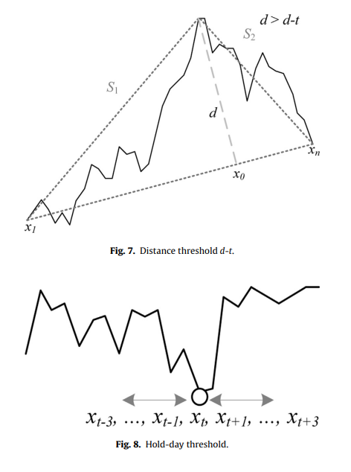
Piecewise linear representation (PLR)
The fundamental idea involves partitioning the nonlinear function into segments within different intervals, where a linear function is used to approximate the original function within each interval.

Slide 9
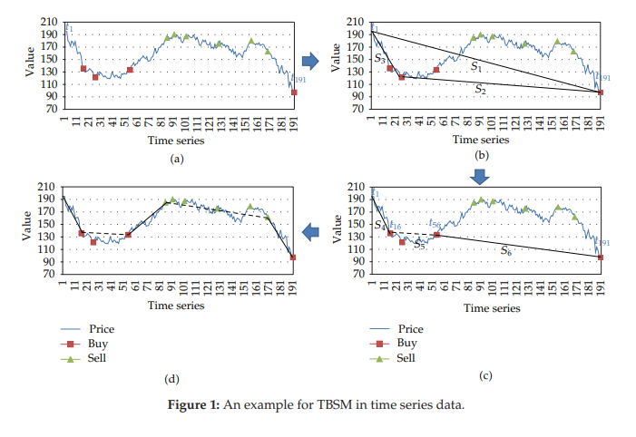
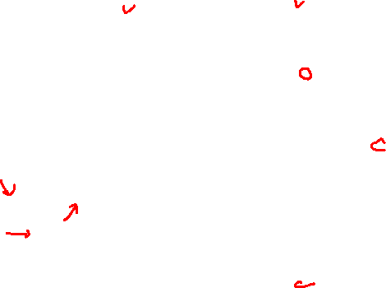
The trend-based segmentation method (TBSM)
The procedure of TBSM is as following:
PLR is applied to locate the turning points from the time series including uptrend or downtrend using the distance threshold (d-t);
The points around each turning point are checked to determine whether the variations ofthe points are within the hold-verticalthreshold (hv-t) and hold-day threshold (hd-t). When they are within the threshold,these points will have the same buy/sell trading in this period;
These points are set to be in the same trend.

Slide 10
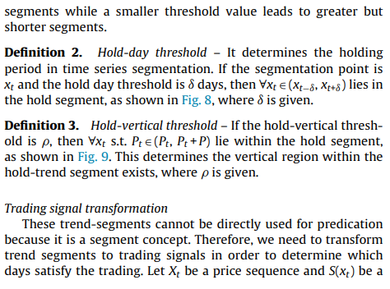
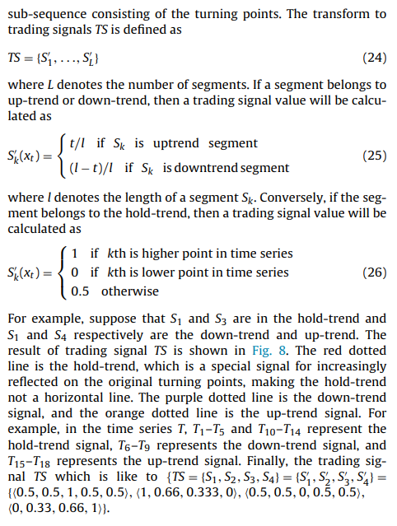
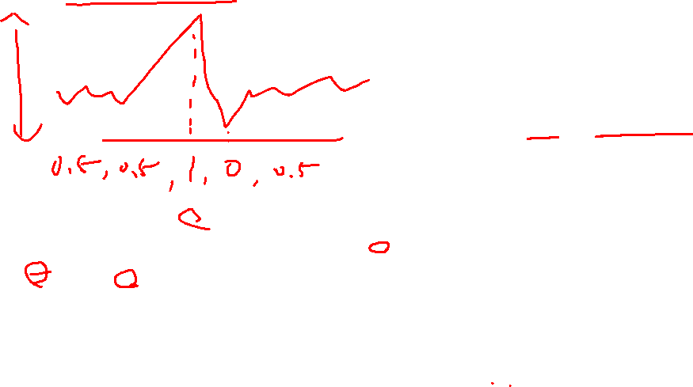
Trading Signal Transformation

Slide 11
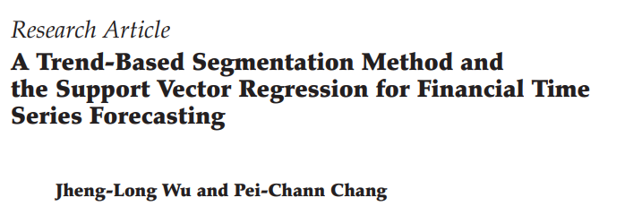
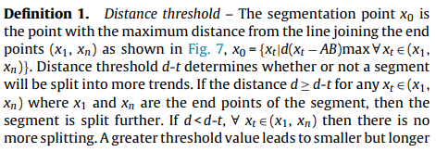
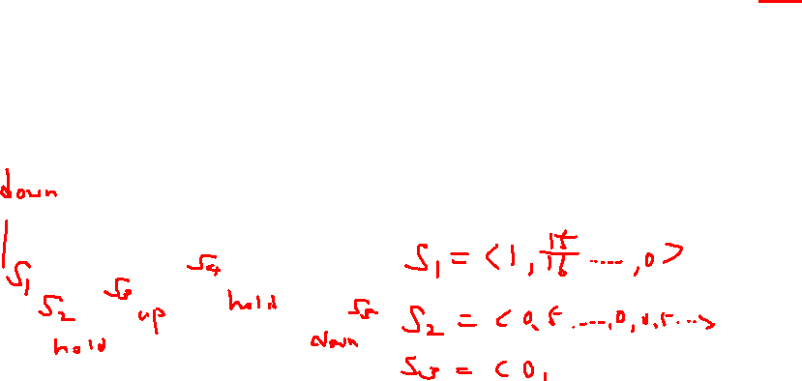
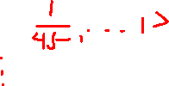

Slide 12
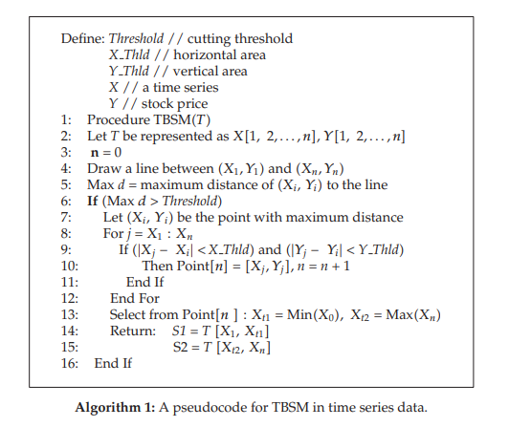
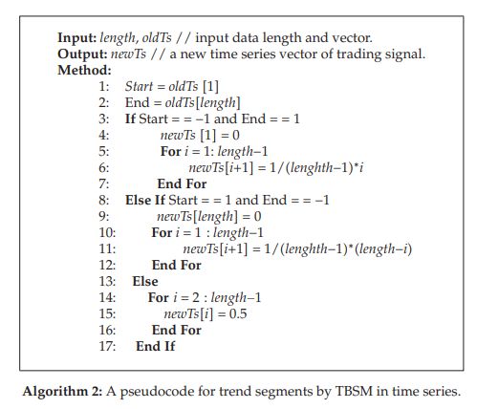

Slide 13
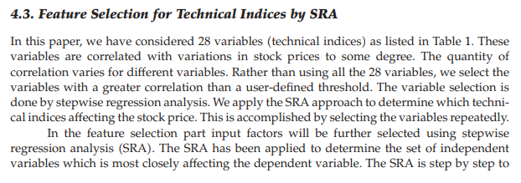
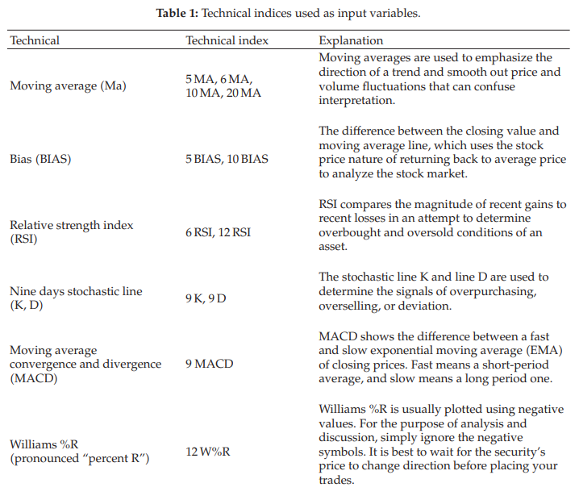
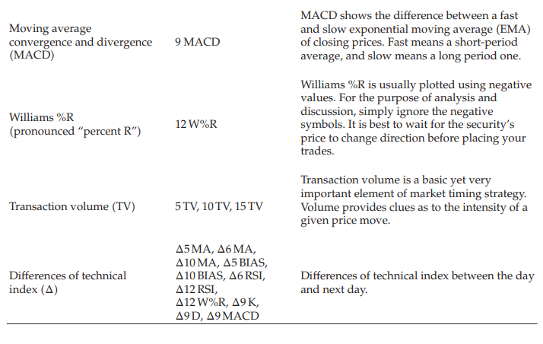


Slide 14
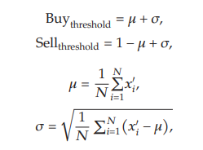
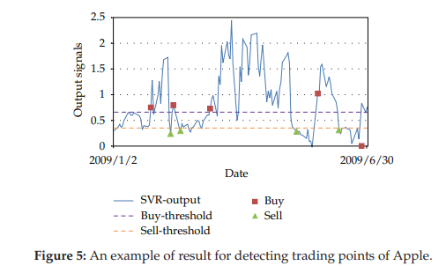
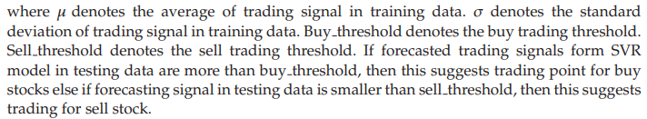
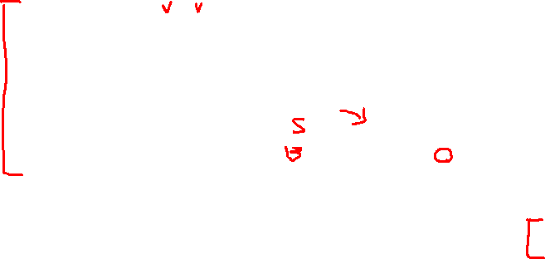
Trading Points Decision from Forecasted Trading Signal

Slide 15
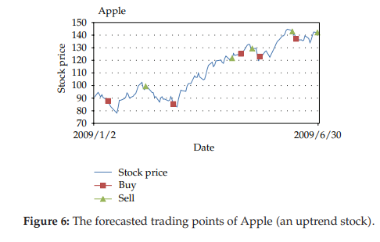
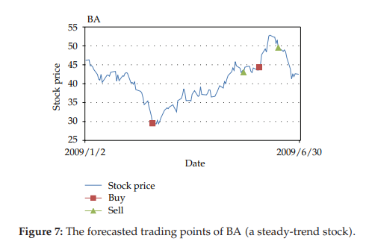
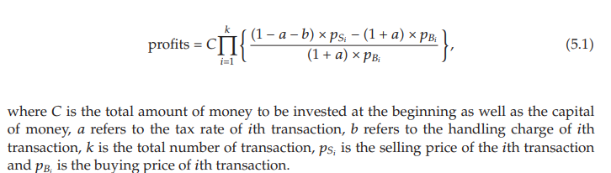
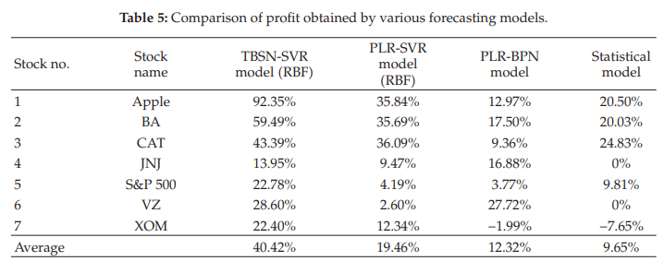
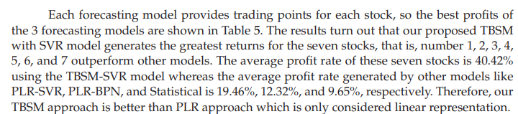
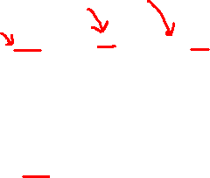
Experimental Results

Slide 16

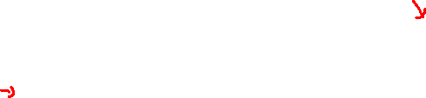
Reference: An intelligent stock trading system using comprehensive features
Source:
Author: Innovation Center of Big Data & Digital Convergence, Yuan Ze University, Taoyuan, Taiwan, 2013 Summary: The aim of this study is to predict automatic trading decisions in stock markets.
We present a framework of an intelligent stock trading system using comprehensive features (ISTSCF) to predict future stock trading decisions.
The ISTSCF consists of stock information extraction, prediction model learning and stock trading decision.
We apply three different methods to generate comprehensive features, including sentiment analysis (SA) that provides sensitive market events from stock news articles for sentiment indices (SI), technical analysis (TA) that yields effective trading rules based on trading information on the stock exchange for technical indices (TI), as well as the trend-based segmentation method (TBSM) that raises trading decisions from stock price for trading signals (TS).
This study focuses on mining useful features to classify sentiment in stock market news.

Slide 17
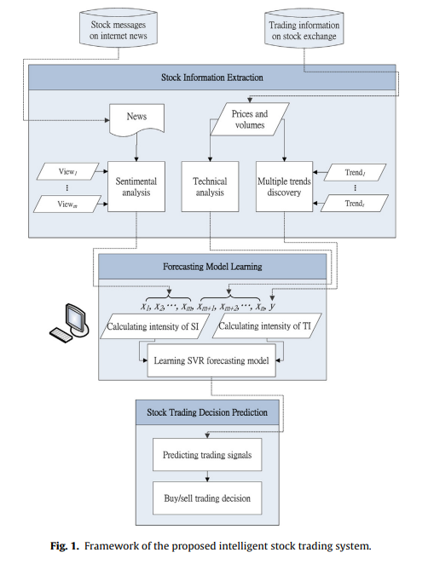
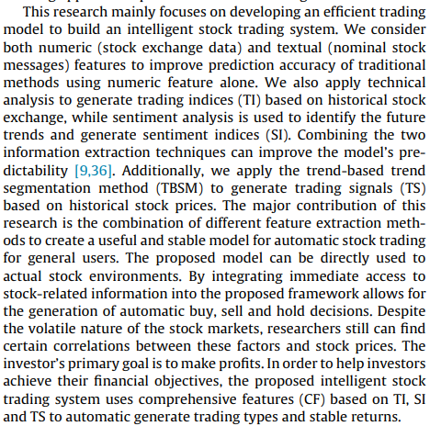


Slide 18
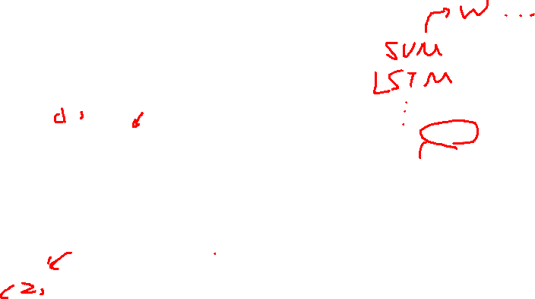
Structure flow chart
Data or Feature
X
Model
Feature Extraction
X
Stock data
Train
Predict
Y
Calculate reversal point
Y
Evaluate

Slide 19
Reference: Stock Market Trend Prediction and Investment Strategy by Deep Neural Networks
Source: 2020 11th International Conference on Awareness Science and Technology (iCAST)
Summary:
This research is mainly about the prediction of the price change in the stock market. Instead of daily change, this paper analyzes the trend of price change for weeks by judging
turning points. Deep neural networks will be used as the classifier of true and fake golden crosses to judge the growth trend of price change.

Slide 20
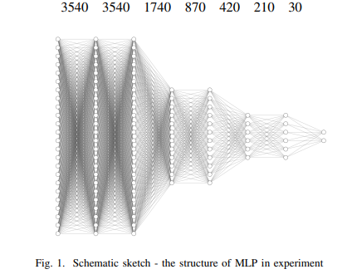

MLP (Multilayer Perceptron)

Slide 21
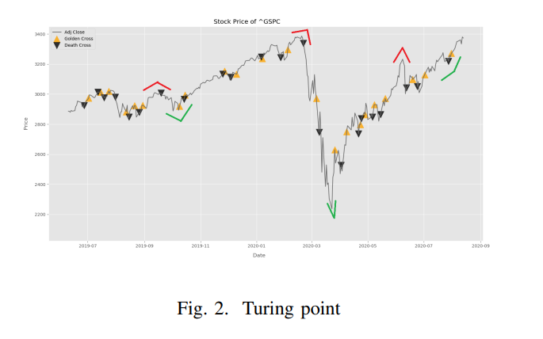
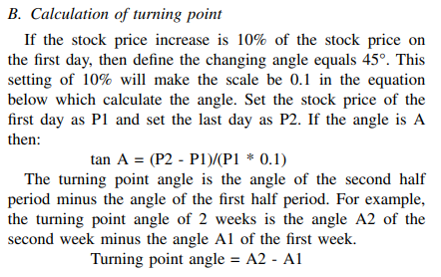
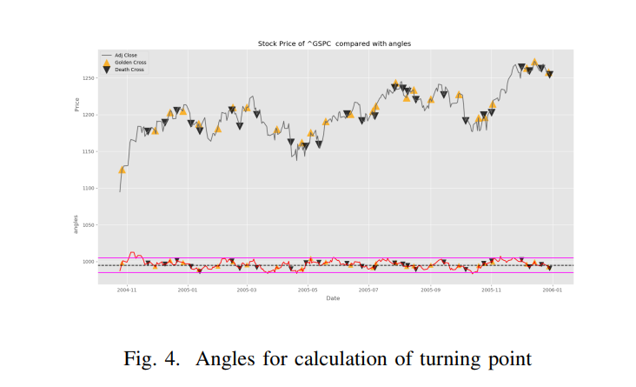
Turing point

Slide 22
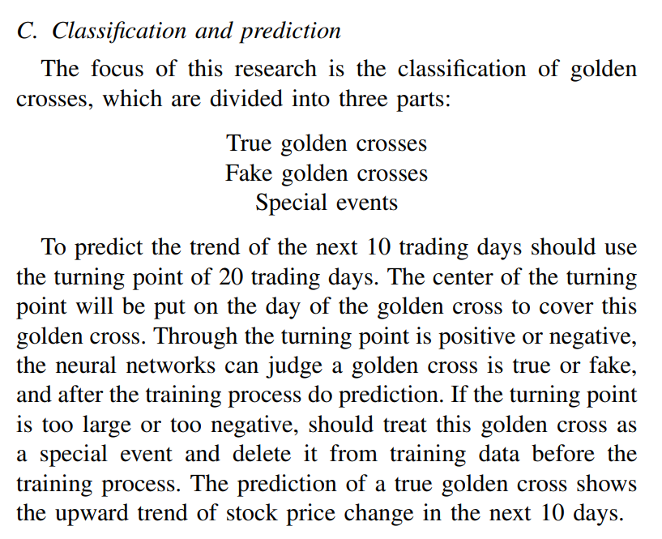
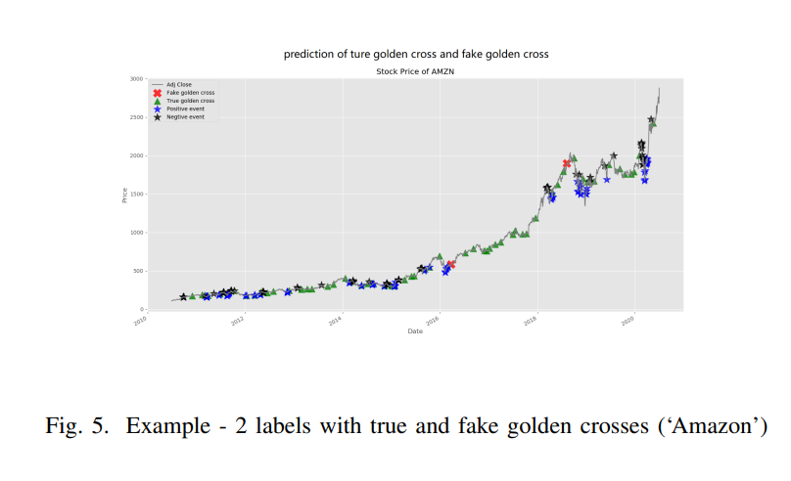
Classification and prediction

Slide 23
Reference: Identifying Financial Market Trend Reversal Behavior With Structures of Price Activities Based on Deep Learning Methods
Source:
Summary:

Slide 24

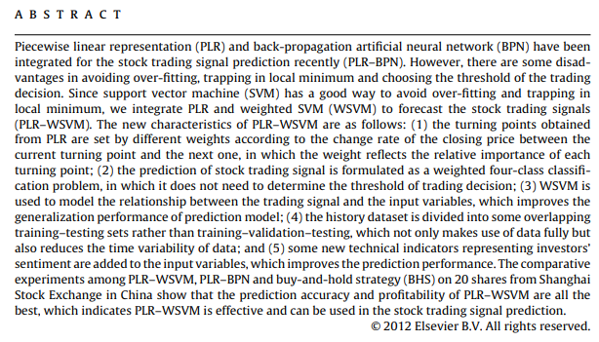

Reference: Integrating piecewise linear representation and weighted support vector machine for stock trading signal prediction

Slide 25

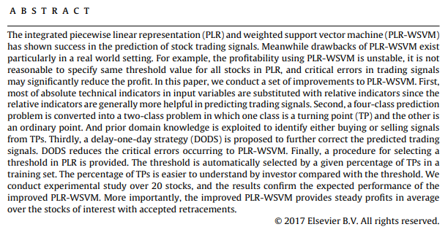
Reference: Improving the integration of piece wise linear representation and weighted support vector machine for stock trading signal prediction

Slide 26
Reference: Stock trend prediction based on a new status box method and AdaBoost probabilistic support vector machine
Source:
Summary:

Slide 27
Reference: An Analyze on Effectiveness of Candlestick Reversal Patterns for Vietnamese Stock Market
Source:
Summary:

Slide 28
Reference: Stock Price Reversal Point Prediction Based on ICA and SVM
Source:
Summary:

Slide 29
Reference:
Author: Summary:
Analysis:
Conclusions:
1.

