Slide 1
Flow chart
fetch_data
Feature Engineering
Standardizing
Data Processing
One hot encoding
Model Construction
Hyperparameter Tuning
Model Training
Prediction and Evaluation

Slide 2
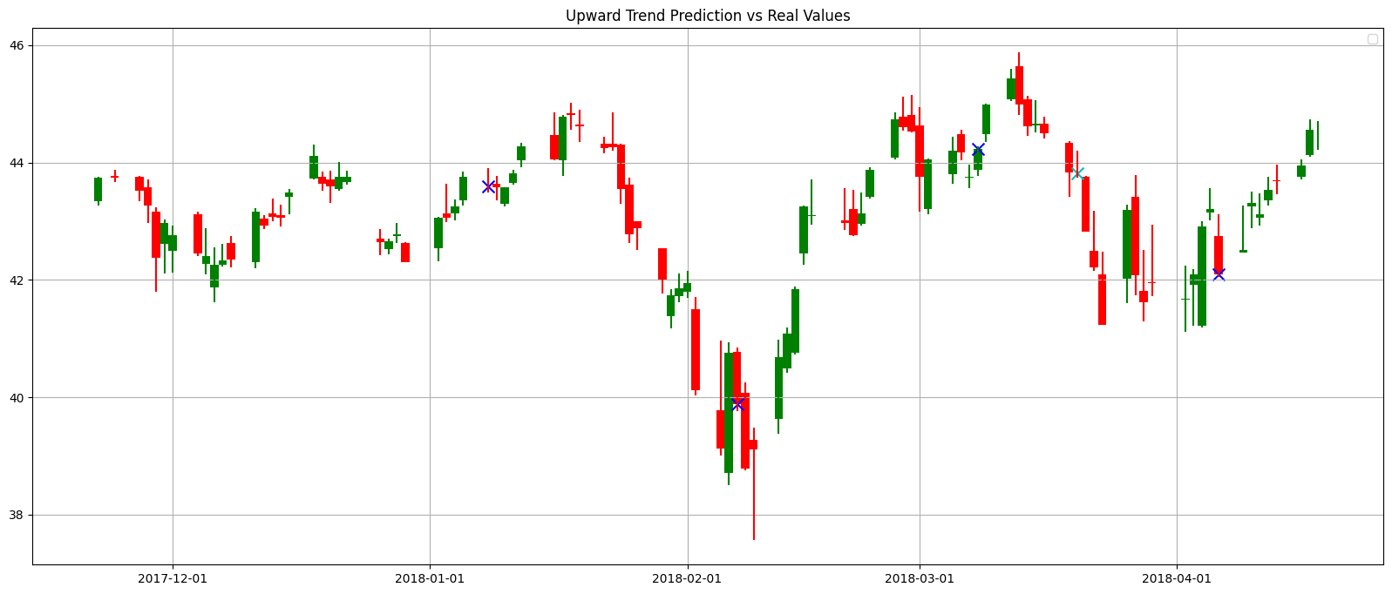
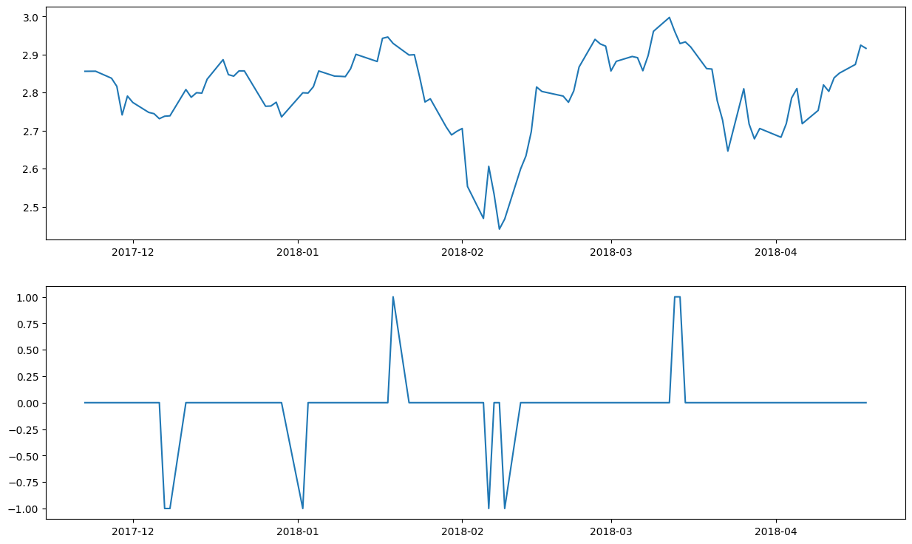
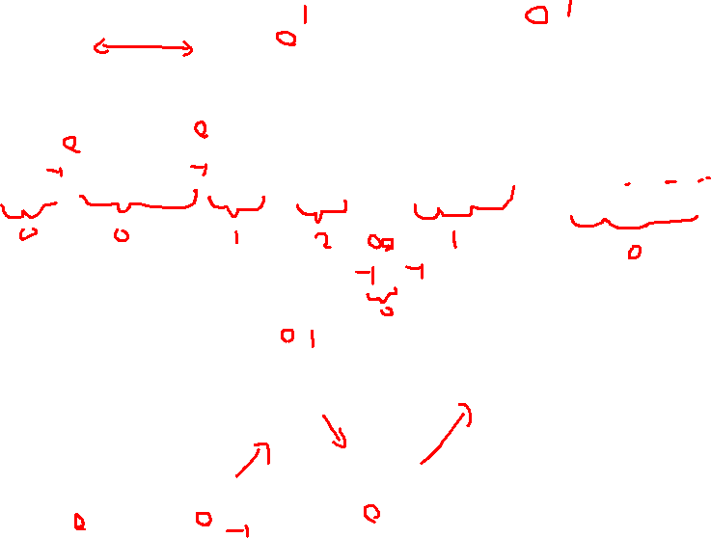
Feature Engineering--RP
array([ 0, 0, 0, 0, 0, 0, 0, 0, 0, 0, -1, -1, 0, 0, 0, 0, 0,
0, 0, 0, 0, 0, 0, 0, 0, 0, -1, 0, 0, 0, 0, 0, 0, 0,
0, 0, 0, 0, 1, 0, 0, 0, 0, 0, 0, 0, 0, 0, 0, 0, -1,
0, 0, -1, 0, 0, 0, 0, 0, 0, 0, 0, 0, 0, 0, 0, 0, 0,
0, 0, 0, 0, 0, 0, 1, 1, 0, 0, 0, 0, 0, 0, 0, 0, 0,
0, 0, 0, 0, 0, 0, 0, 0, 0, 0, 0, 0, 0, 0, 0],
dtype=int64)
1: downward point
RP
-1: upward point

Slide 3
Transformation Rule
Segment Transformation (1 to -1): For any contiguous sub-array ranging from the value 1 to -1, set all values in the sub-array starting from the second element to the last element to 2.
Segment Transformation (-1 to 1): For any contiguous sub-array ranging from the value -1 to 1, set all values in the sub-array starting from the second element to the last element to 1.
Uniform Value Segment Transformation: For any contiguous sub-array composed of identical values (either all 1s or all -1s), set all values in the sub-array starting from the second element to the last element to 0.
Default Values: For all other circumstances not covered above, retain all elements as 0.
Nearest Opposite Point Precedence: When processing contiguous sub-arrays, only consider the most recently encountered opposite value (either 1 or -1) for transformation. Once a transformation is complete, reset the starting point for identifying new nearest opposite values.

Slide 4
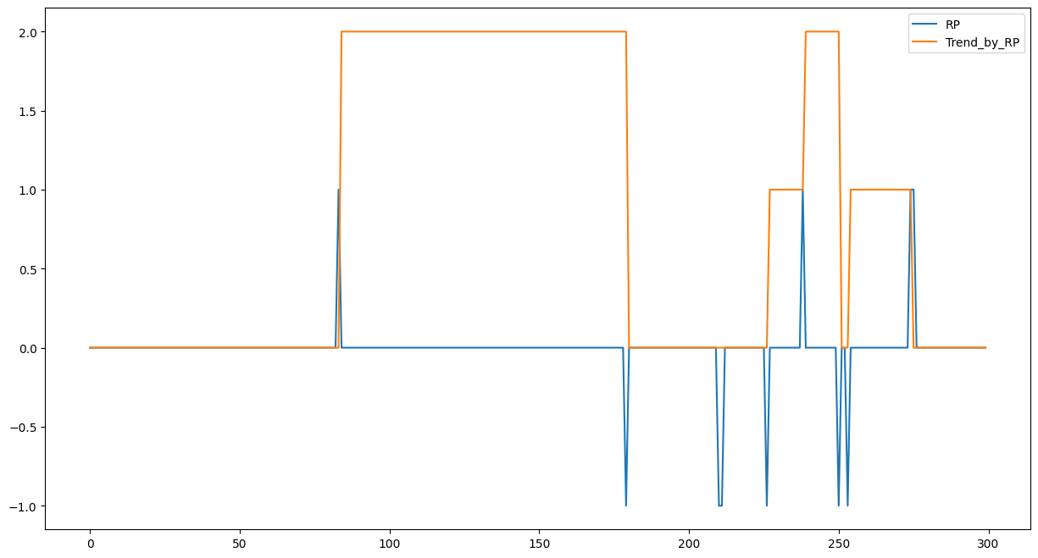

Feature Engineering—RP Transform to Trend

Slide 5
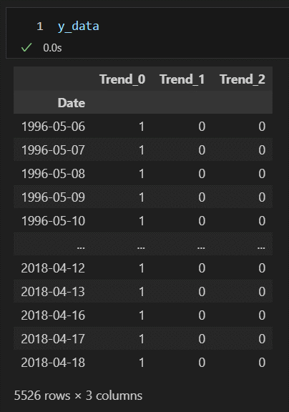
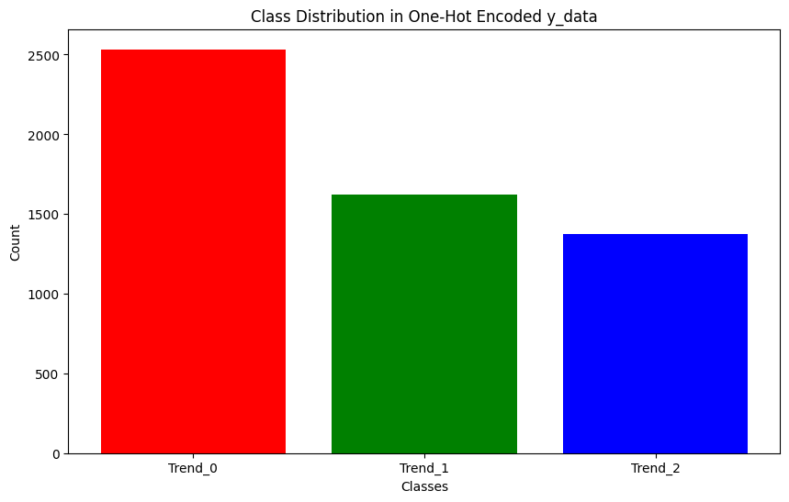

One hot encoding
No reversal trend
upward trend
downward trend

Slide 6
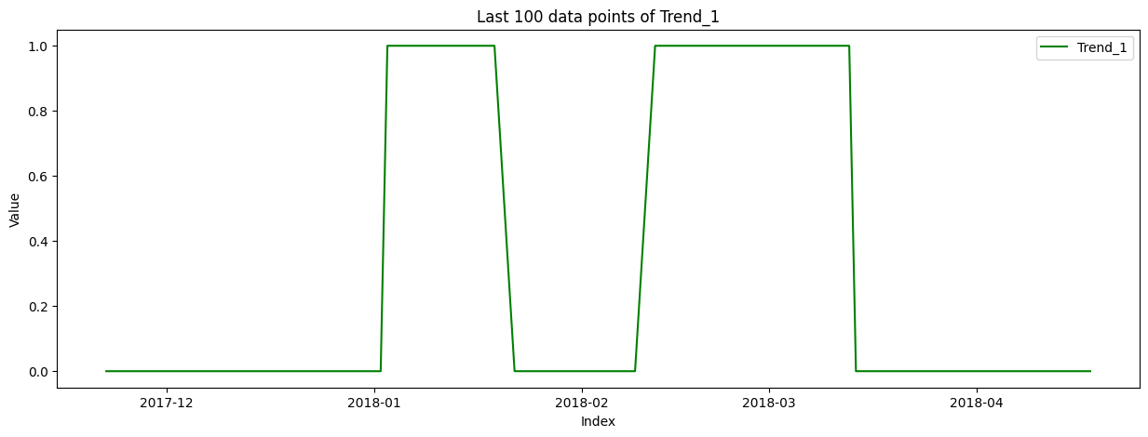
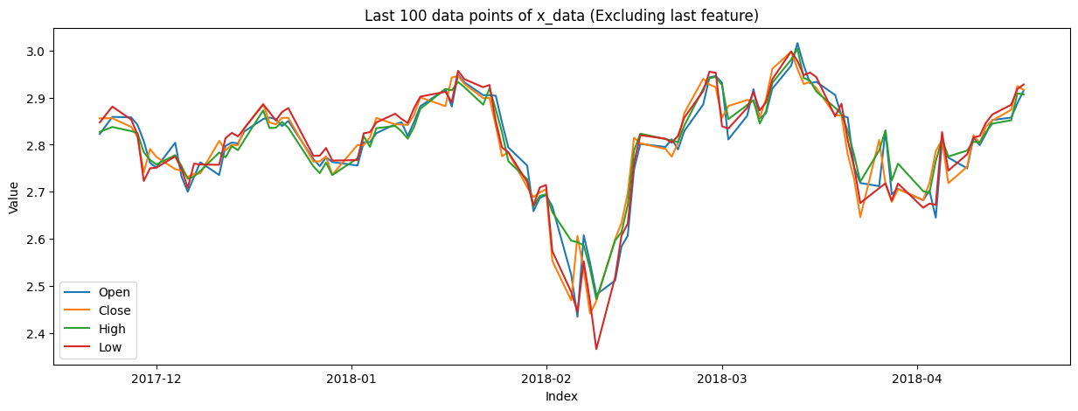
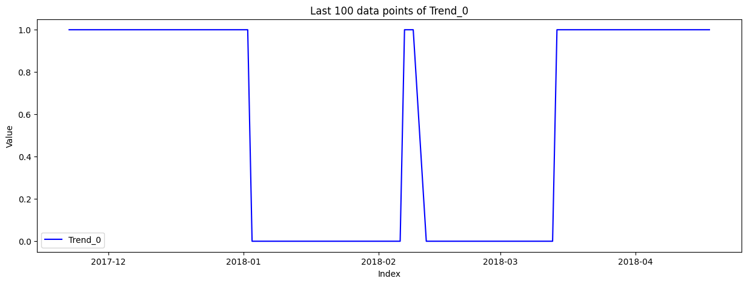
dataset

Slide 7
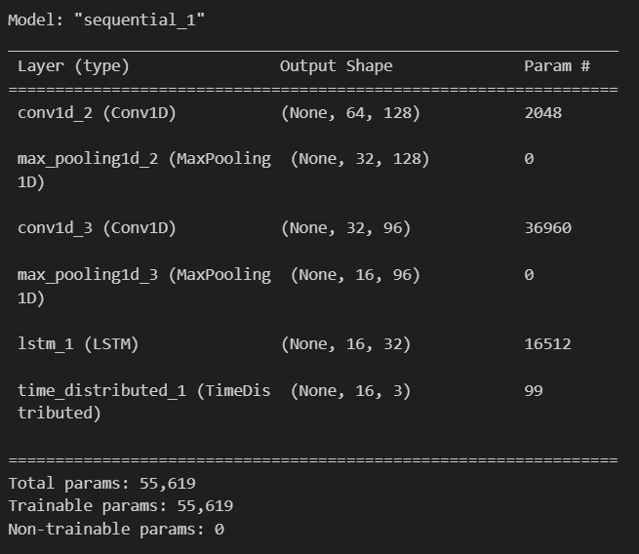
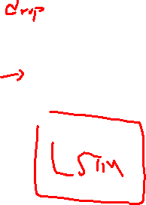
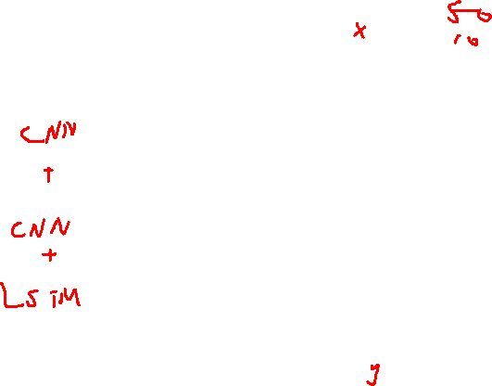
Model Construction and Hyperparameter Tuning
Uses Keras Tuner's RandomSearch to perform hyperparameter tuning for model.
Best model:
Number of Filters in the First Conv1D Layer:
Range: 32 to 128 (with a step of 32)
Kernel Size of the First Conv1D Layer:
Choices: 2 or 3
Number of Filters in the Second Conv1D Layer:
Range: 64 to 128 (with a step of 32)
Kernel Size of the Second Conv1D Layer:
Choices: 2 or 3
Number of Units in the LSTM Layer:
Range: 32 to 128 (with a step of 32)
Learning Rate: Choices: 1e-3, 1e-4, 1e-5

Slide 8
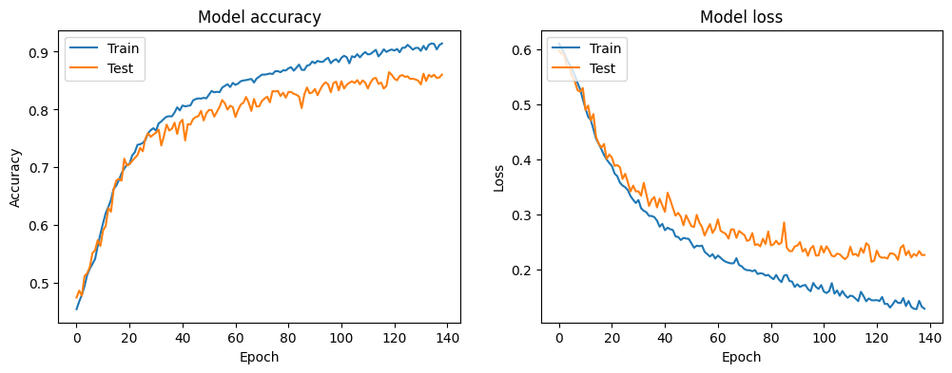
Training
50 Epochs for each dataset
Epoch 139

Slide 9
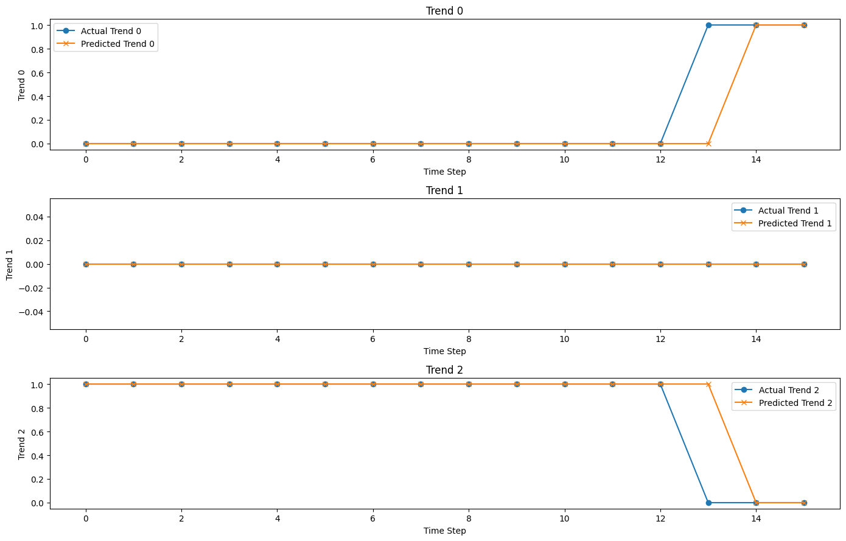

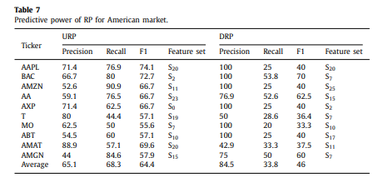
Evaluation
mean_change_index_diff = 4.199095022624435
actual change index = 13
predict change index = 14
diff = 1

Slide 10
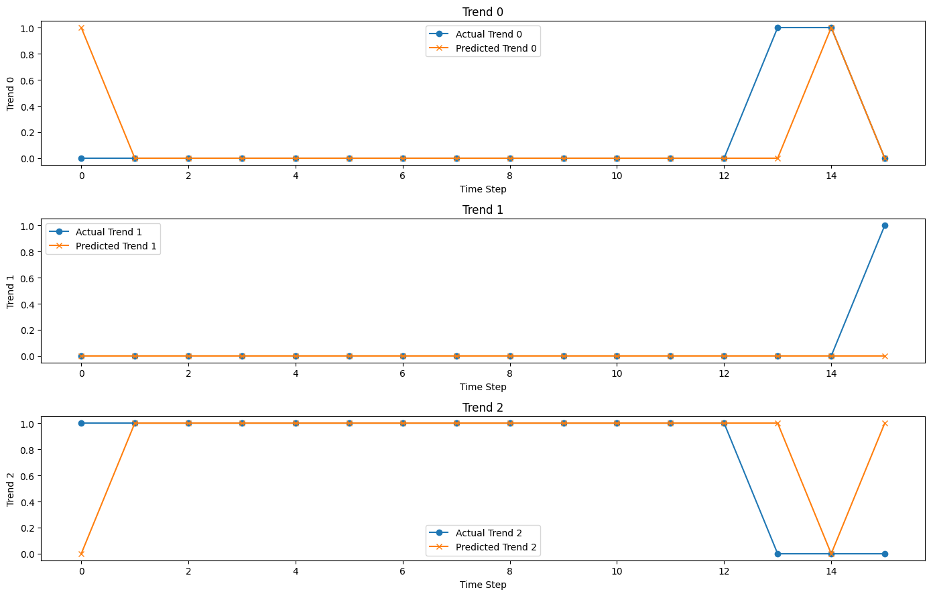

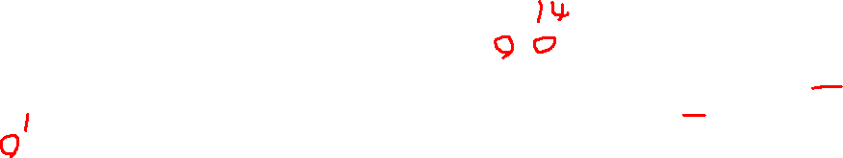
Evaluation
actual change index = 13
predict change index = 1
diff = 12

