Slide 1
Model_1

Slide 2
Flow chart
fetch_data
Feature Engineering
Standardizing
Data Processing
One hot encoding
Model Construction
Hyperparameter Tuning
Model Training
Prediction and Evaluation

Slide 3
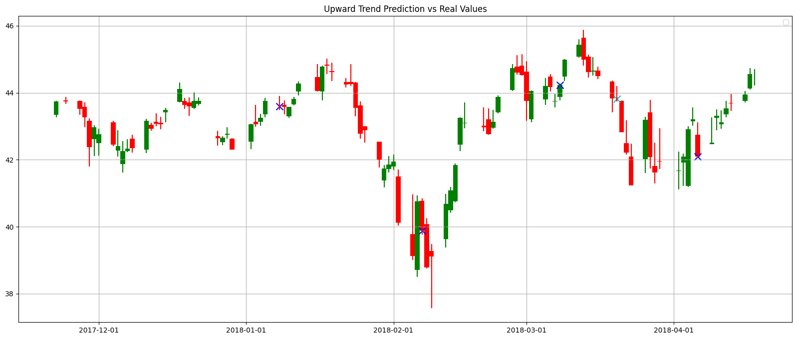
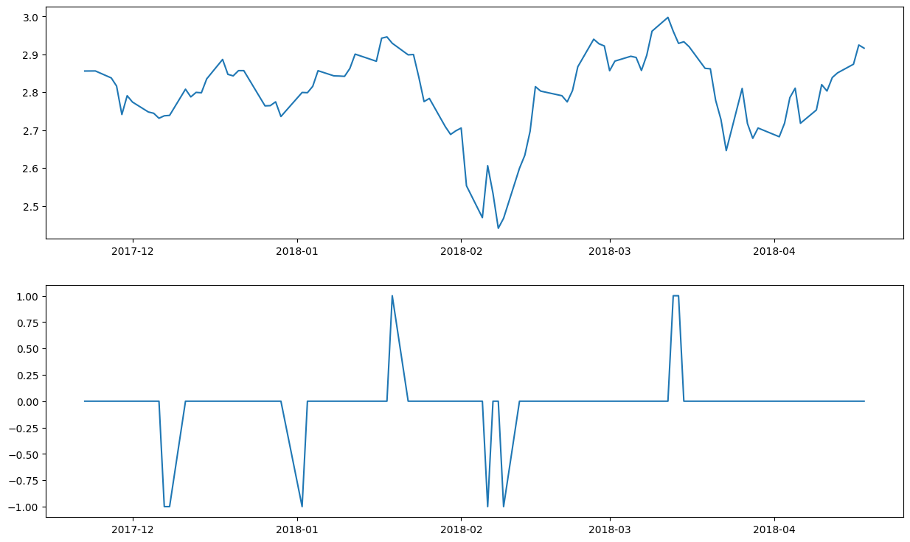
Feature Engineering--RP
array([ 0, 0, 0, 0, 0, 0, 0, 0, 0, 0, -1, -1, 0, 0, 0, 0, 0,
0, 0, 0, 0, 0, 0, 0, 0, 0, -1, 0, 0, 0, 0, 0, 0, 0,
0, 0, 0, 0, 1, 0, 0, 0, 0, 0, 0, 0, 0, 0, 0, 0, -1,
0, 0, -1, 0, 0, 0, 0, 0, 0, 0, 0, 0, 0, 0, 0, 0, 0,
0, 0, 0, 0, 0, 0, 1, 1, 0, 0, 0, 0, 0, 0, 0, 0, 0,
0, 0, 0, 0, 0, 0, 0, 0, 0, 0, 0, 0, 0, 0, 0],
dtype=int64)
1: downward point
RP
-1: upward point

Slide 4
Transformation Rule
Segment Transformation (1 to -1): For any contiguous sub-array ranging from the value 1 to -1, set all values in the sub-array starting from the second element to the last element to 2.
Segment Transformation (-1 to 1): For any contiguous sub-array ranging from the value -1 to 1, set all values in the sub-array starting from the second element to the last element to 1.
Uniform Value Segment Transformation: For any contiguous sub-array composed of identical values (either all 1s or all -1s), set all values in the sub-array starting from the second element to the last element to 0.
Default Values: For all other circumstances not covered above, retain all elements as 0.
Nearest Opposite Point Precedence: When processing contiguous sub-arrays, only consider the most recently encountered opposite value (either 1 or -1) for transformation. Once a transformation is complete, reset the starting point for identifying new nearest opposite values.

Slide 5
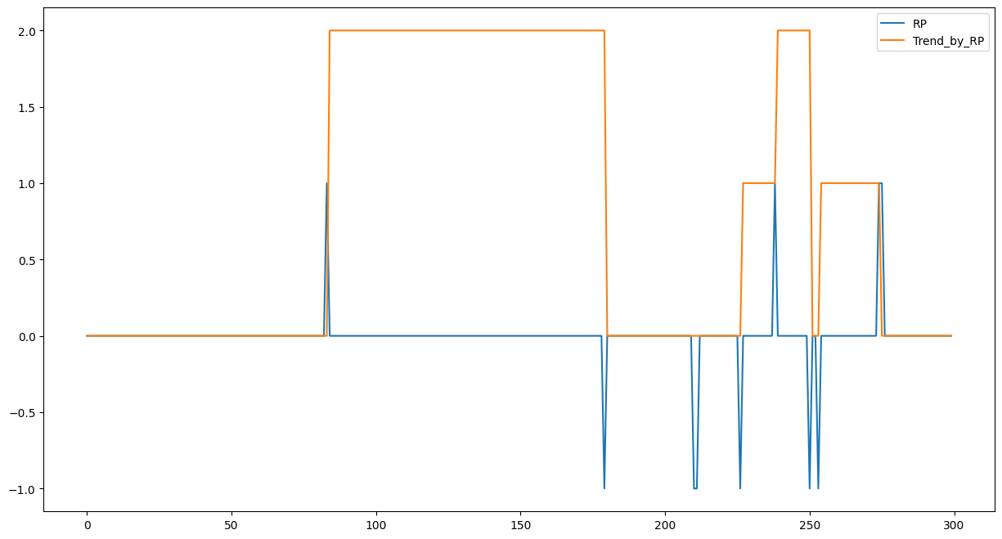

Feature Engineering—RP Transform to Trend

Slide 6
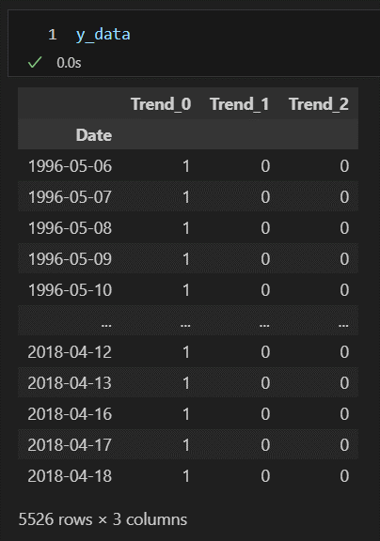
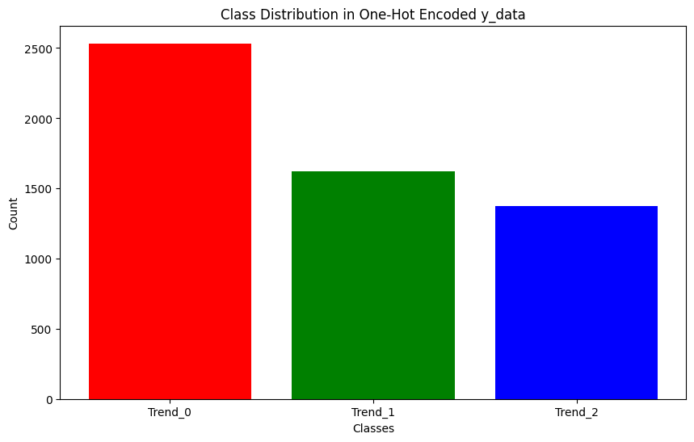
One hot encoding
No reversal trend
upward trend
downward trend

Slide 7
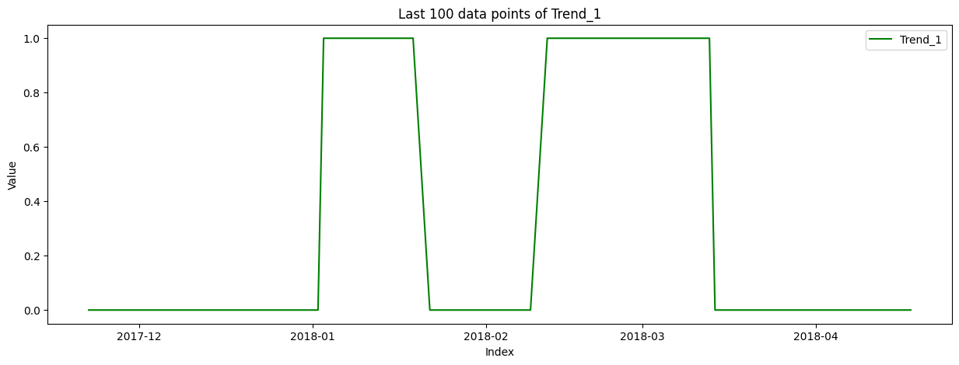
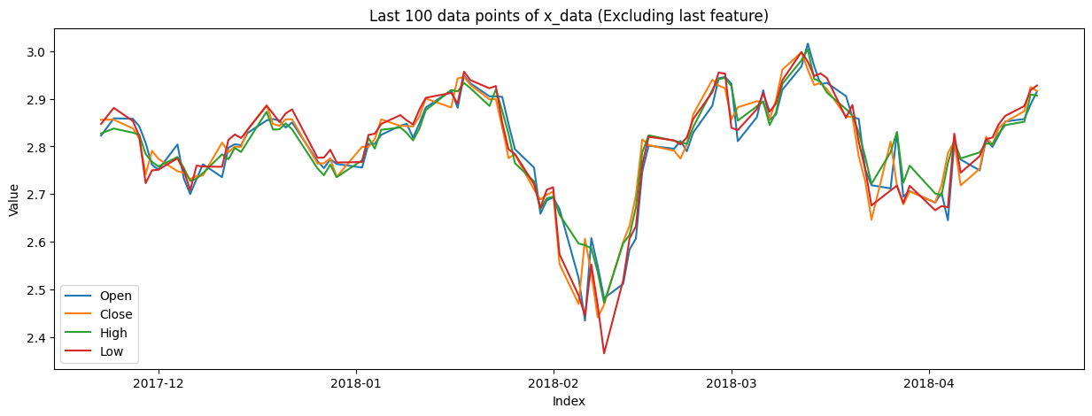
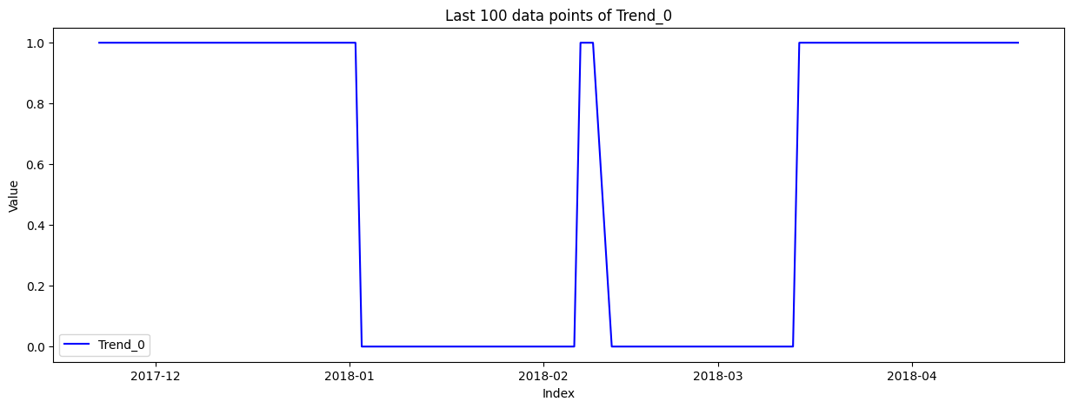
dataset

Slide 8
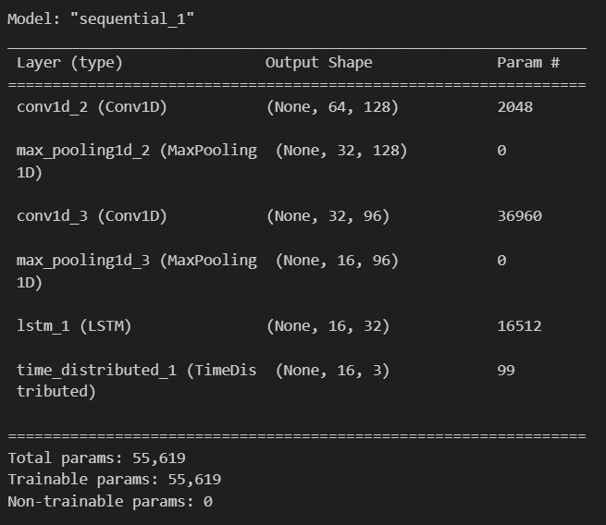
Model Construction and Hyperparameter Tuning
Uses Keras Tuner's RandomSearch to perform hyperparameter tuning for model.
Best model:
Number of Filters in the First Conv1D Layer:
Range: 32 to 128 (with a step of 32)
Kernel Size of the First Conv1D Layer:
Choices: 2 or 3
Number of Filters in the Second Conv1D Layer:
Range: 64 to 128 (with a step of 32)
Kernel Size of the Second Conv1D Layer:
Choices: 2 or 3
Number of Units in the LSTM Layer:
Range: 32 to 128 (with a step of 32)
Learning Rate: Choices: 1e-3, 1e-4, 1e-5

Slide 9
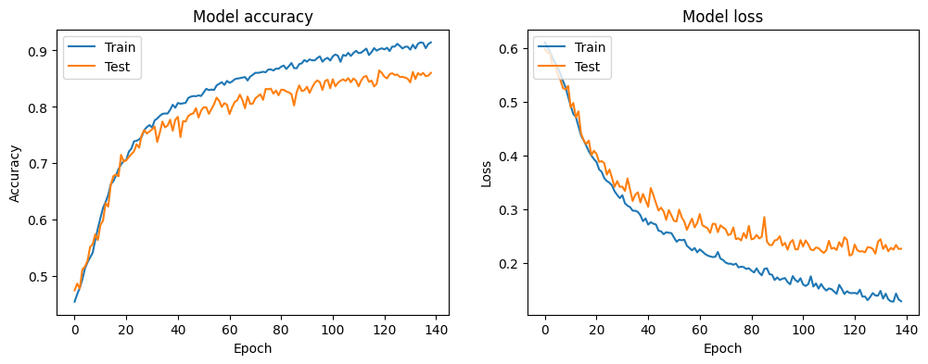
Training
50 Epochs for each dataset
Epoch 139

Slide 10
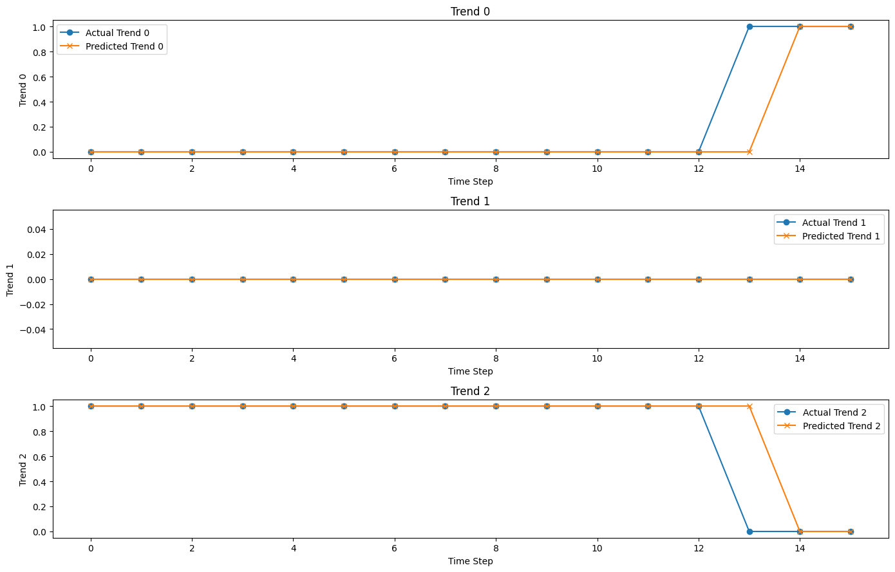

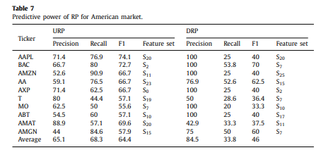
Evaluation
mean_change_index_diff = 4.199095022624435
actual change index = 13
predict change index = 14
diff = 1

Slide 11
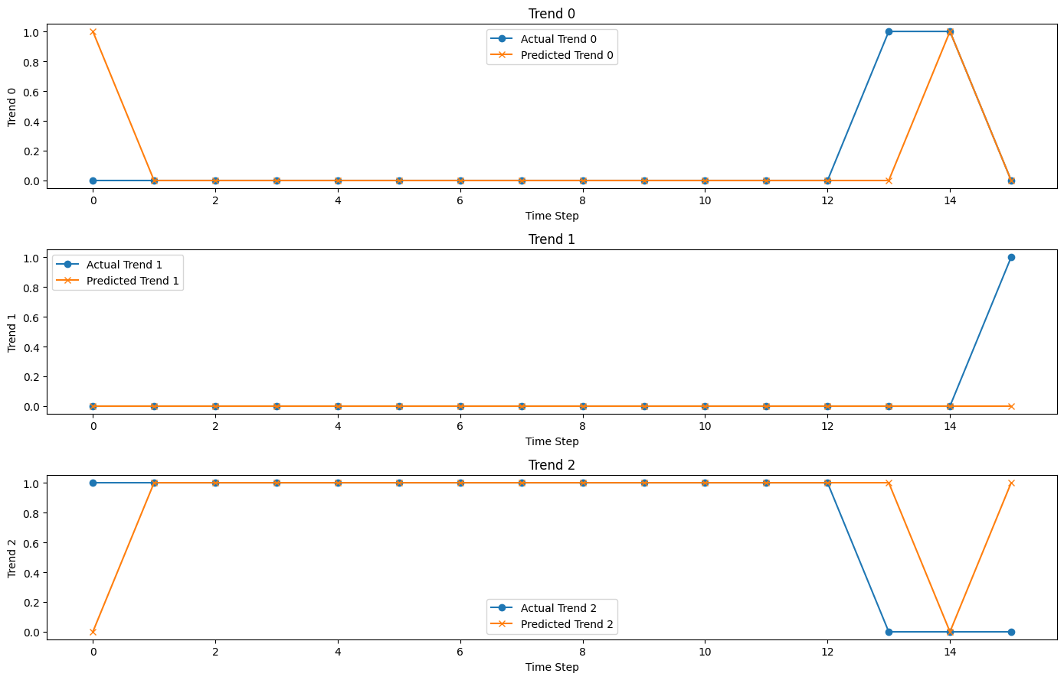
Evaluation
actual change index = 13
predict change index = 1
diff = 12

Slide 12
Model_1 in new test data

Slide 13
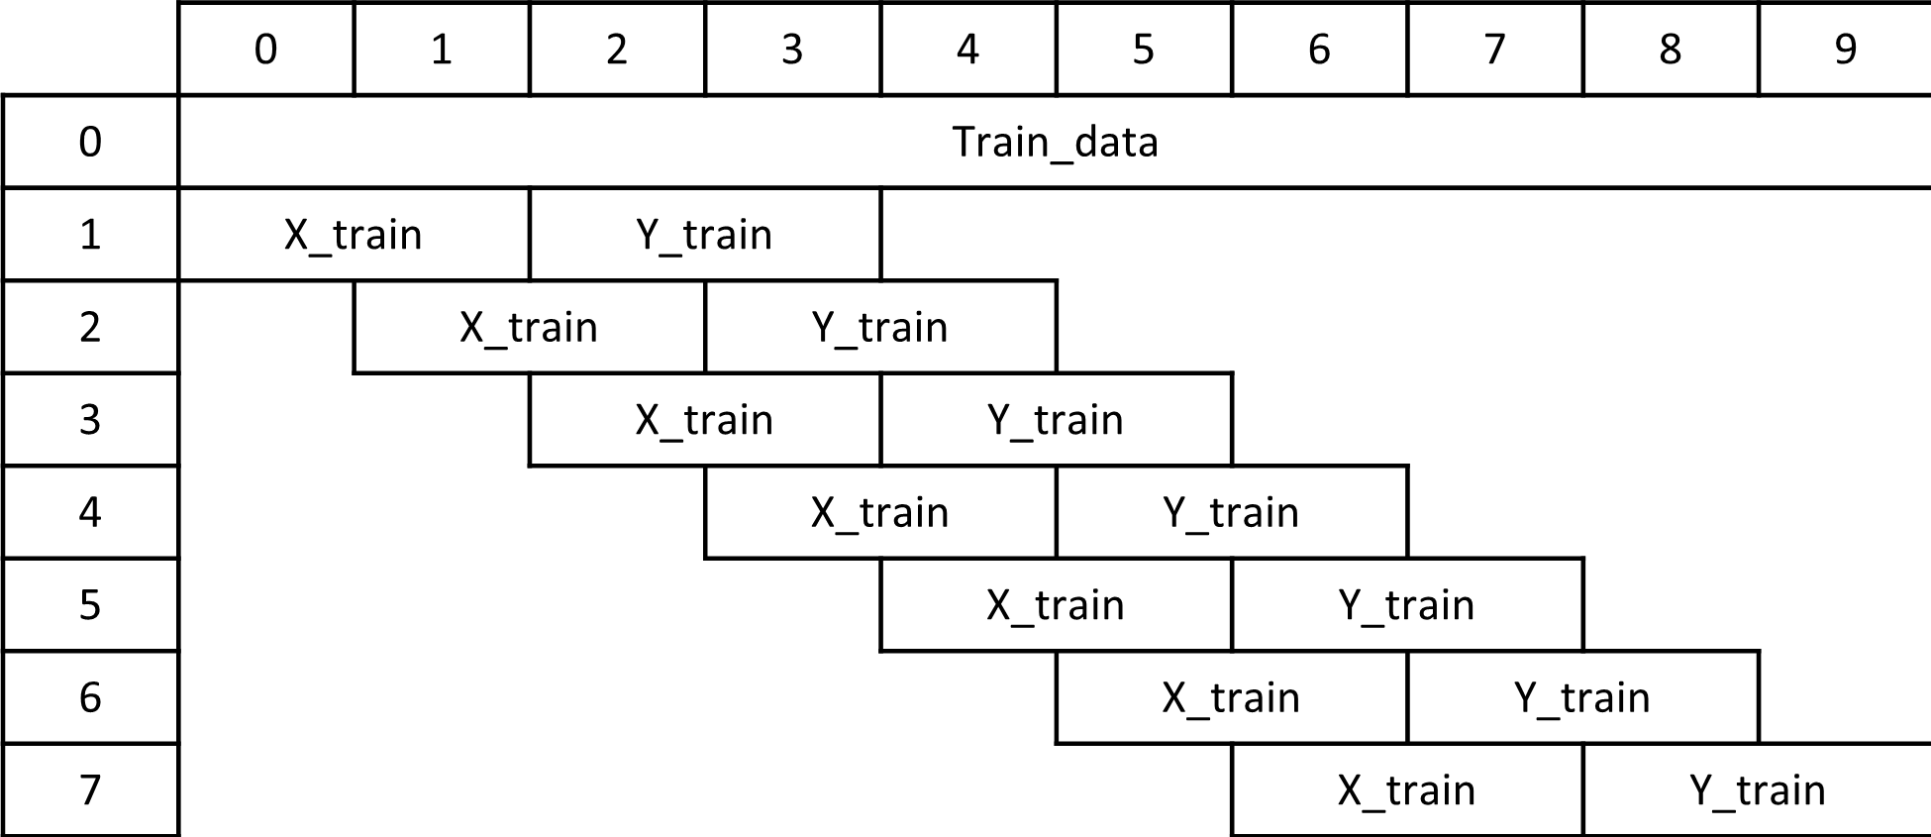

Training set , Validation set
similar
Validation set
randomly
Evaluation on validation
Slide=1

Slide 14
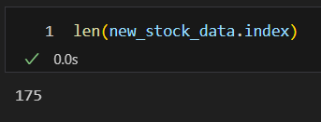
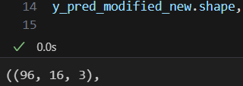
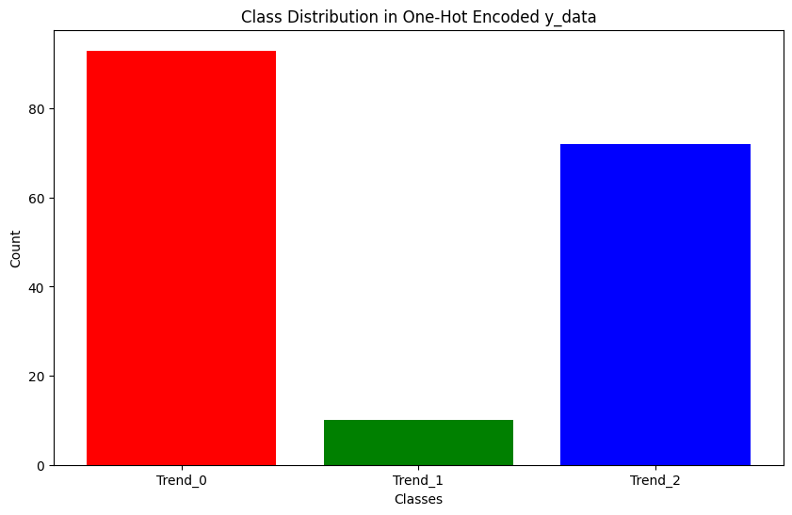

Evaluation on test data

Slide 15
Model_2

Slide 16
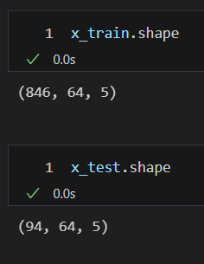
Training set , Validation set
 | 0 | 1 | 2 | 3 | 4 | 5 | 6 | 7 | 8 | 9 | 10
0 | Train_data | Train_data
1 | X_train | X_train |  | Y_train
2 |  |  | X_train | X_train |  | Y_train
3 |  |  |  |  | X_train | X_train |  | Y_train
4 |  |  |  |  |  |  | X_train | X_train |  | Y_train
less similar
Validation set
randomly
Slide=16
x_length=64
y_length=16
val

Slide 17
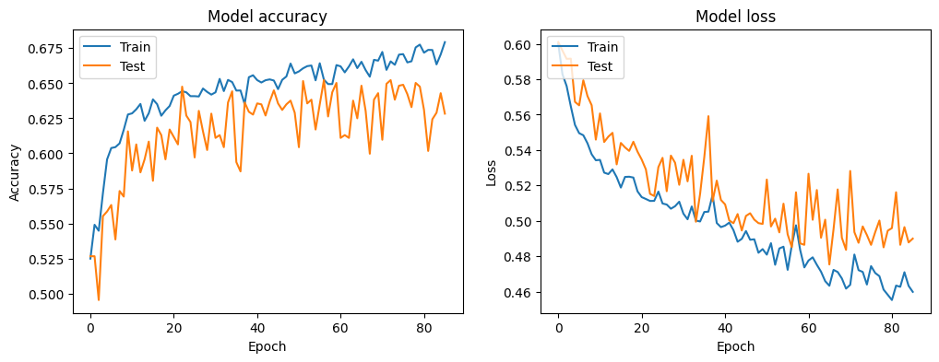
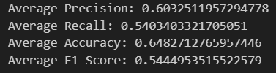
Evaluation on validation
val
val

Slide 18
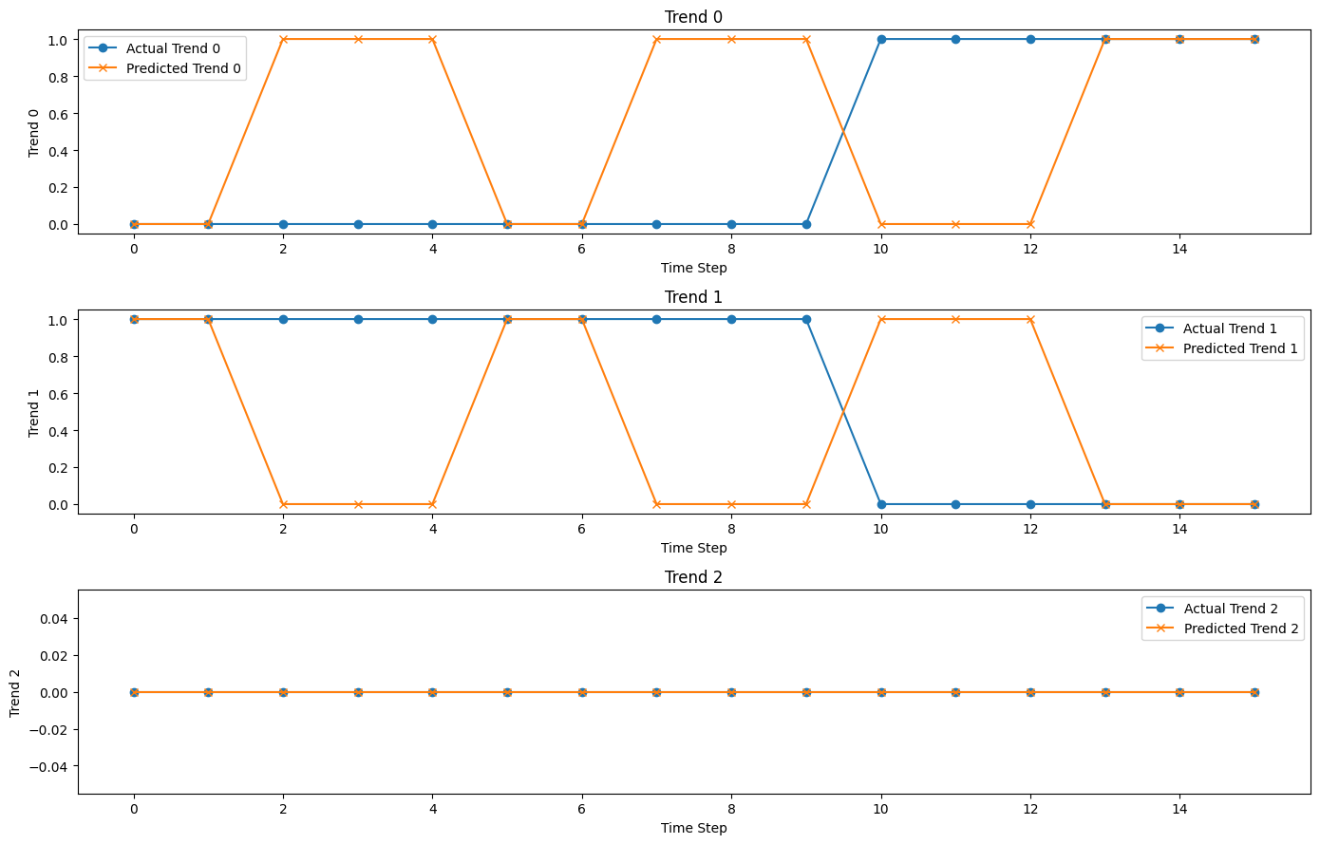
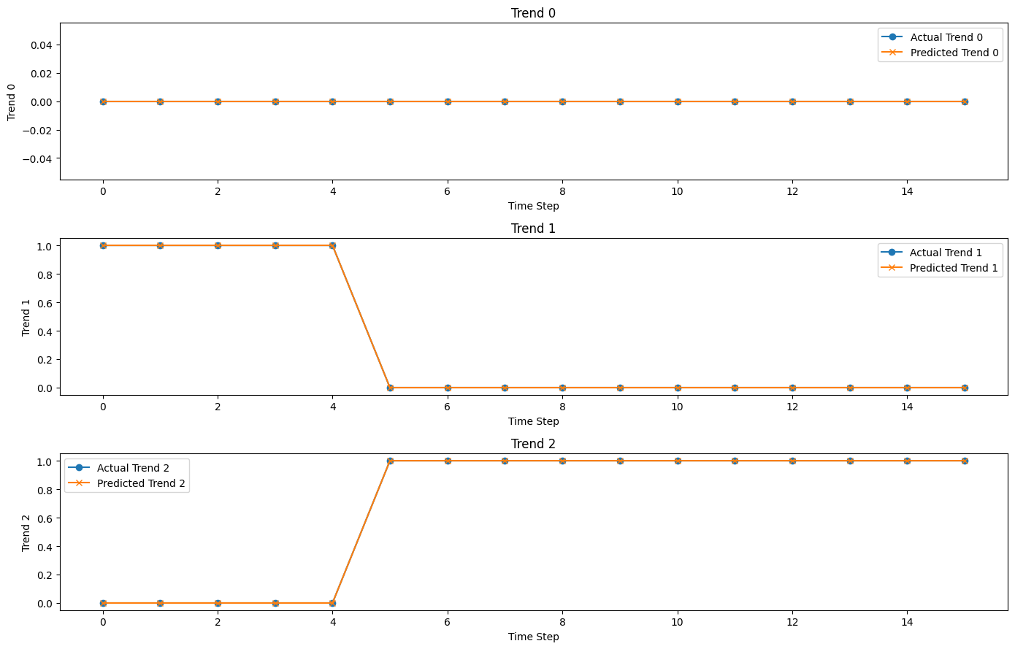
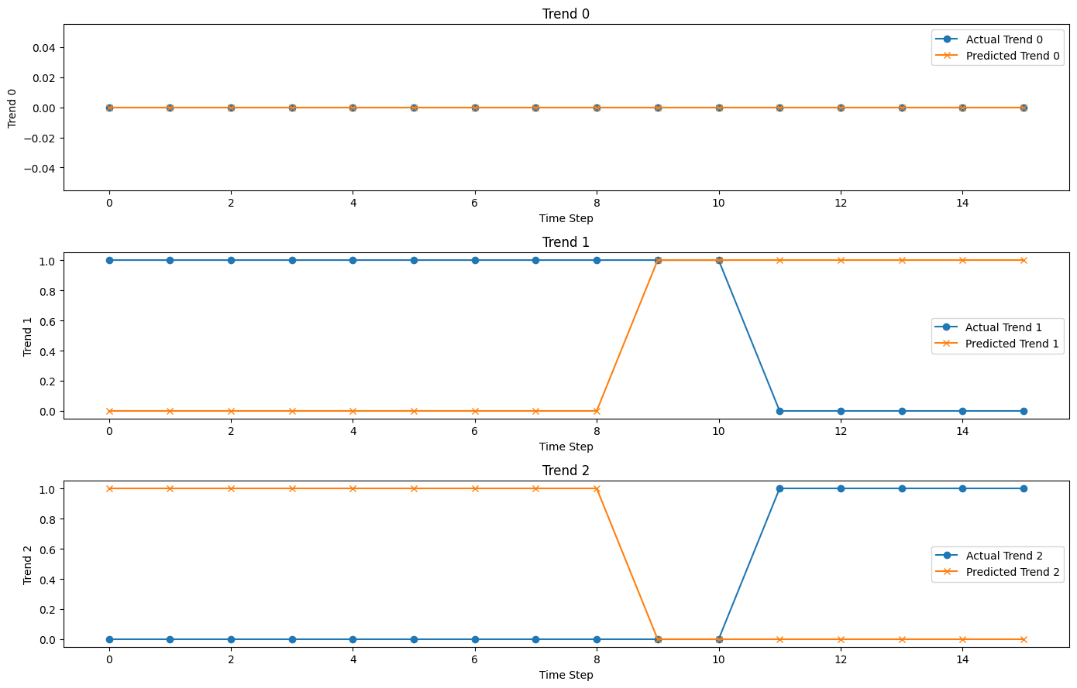
Evaluation on validation
mean_change_index_diff = 5.83

Slide 19
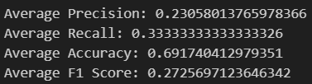
Evaluation on test data
Slide = 1
Slide = 16
(slide = y_length)

Slide 20
Model_3 - fetch 20 tech stock

Slide 21
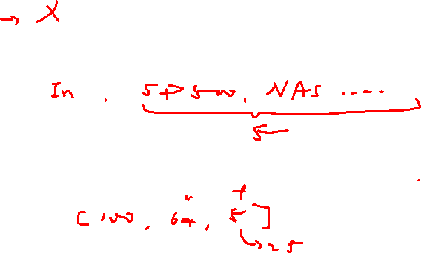
Flow chart
fetch_data
Feature Engineering
Standardizing
Data Processing
One hot encoding
Model Construction
Hyperparameter Tuning
Model Training
Prediction and Evaluation

Slide 22
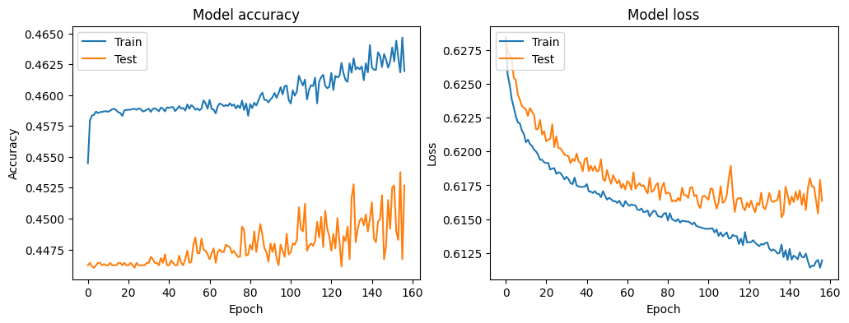

Evaluation on validation
val
val

Slide 23
Model_4

Slide 24
Flow chart
fetch_data
Feature Engineering
Standardizing
Data Processing
One hot encoding
train_data
test_data
Model Construction
Hyperparameter Tuning
Model Training
Prediction and Evaluation

Slide 25
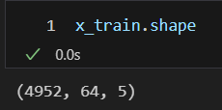
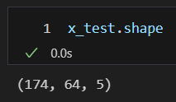
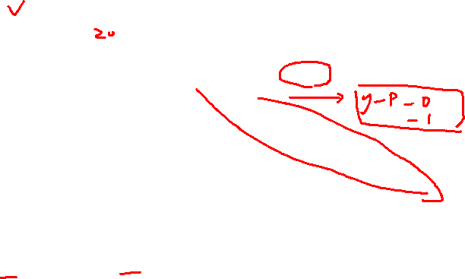
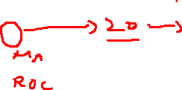
Training set , Validation set
 | 0 | 1 | 2 | 3 | 4 | 5 | 6 | 7 | 8 | 9 | 0 | 1 | 2 | 3 | 4 | 5 | 6 | 7 | 8 | 9
0 | Train_data |  |  |  |  |  |  |  |  |  | Test_data
1 | X_train |  | Y_train |  |  |  |  |  |  |  | X_test |  | Y_test
2 |  | X_train |  | Y_train |  |  |  |  |  |  |  | X_test |  | Y_test
3 |  |  | X_train |  | Y_train |  |  |  |  |  |  |  | X_test |  | Y_test
4 |  |  |  | X_train |  | Y_train |  |  |  |  |  |  |  | X_test |  | Y_test
5 |  |  |  |  | X_train |  | Y_train |  |  |  |  |  |  |  | X_test |  | Y_test
6 |  |  |  |  |  | X_train |  | Y_train |  |  |  |  |  |  |  | X_test |  | Y_test
7 |  |  |  |  |  |  | X_train |  | Y_train |  |  |  |  |  |  |  | X_test |  | Y_test
(validation)
not similar
Slide=1
x_length=64
y_length=16

Slide 26
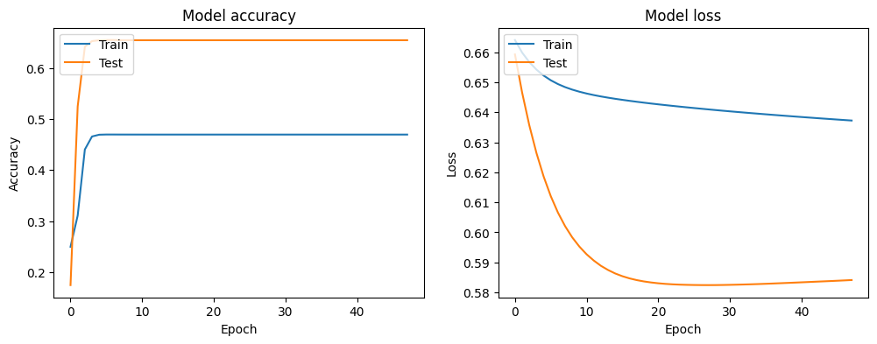
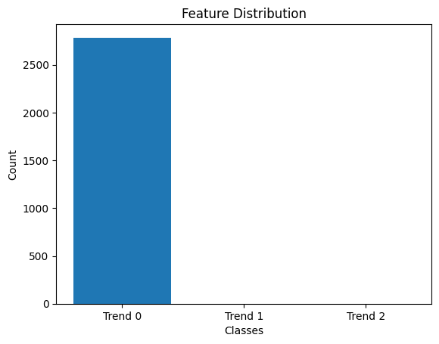

Evaluation on test data
val
val
y_pred

Slide 27

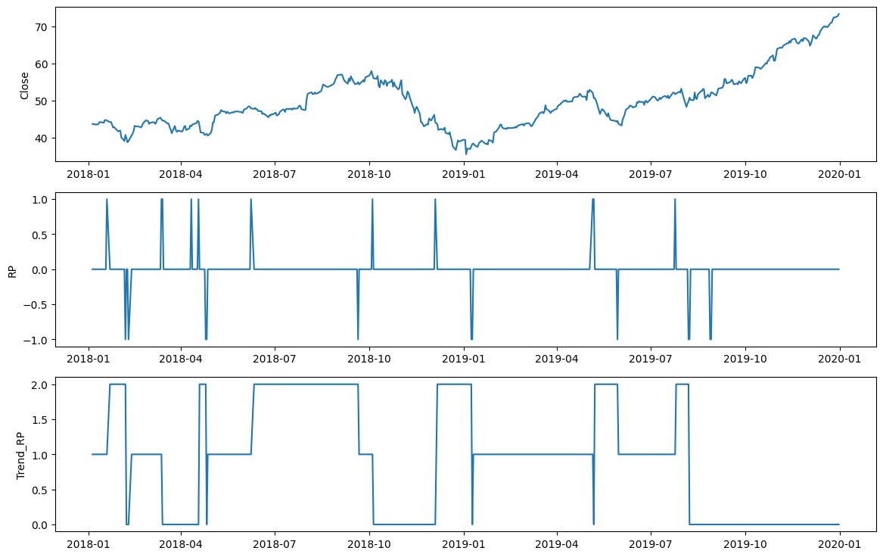
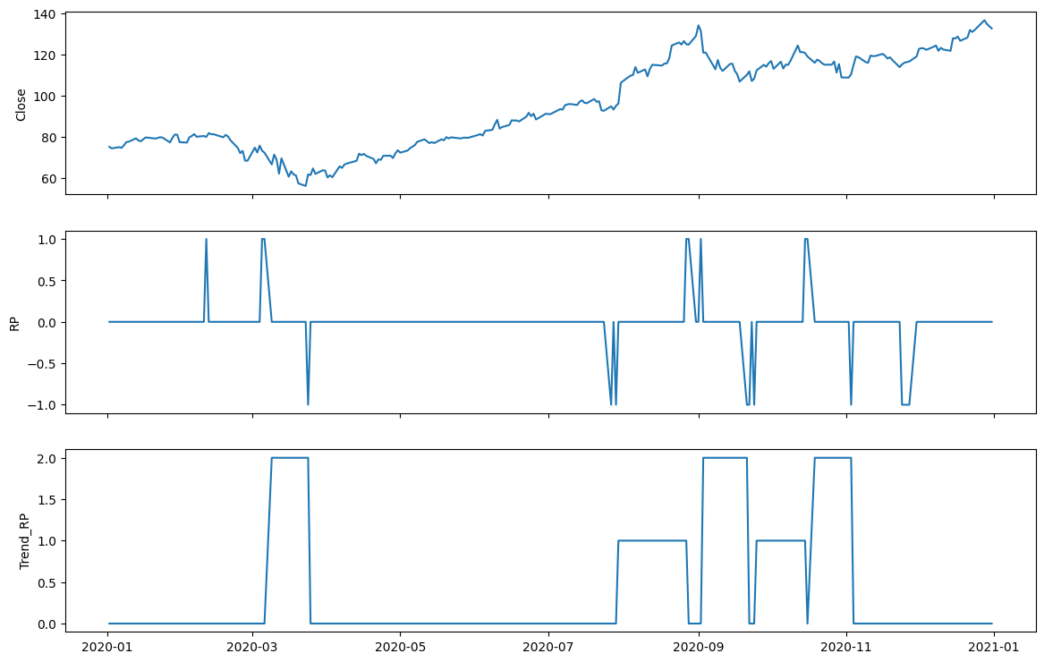
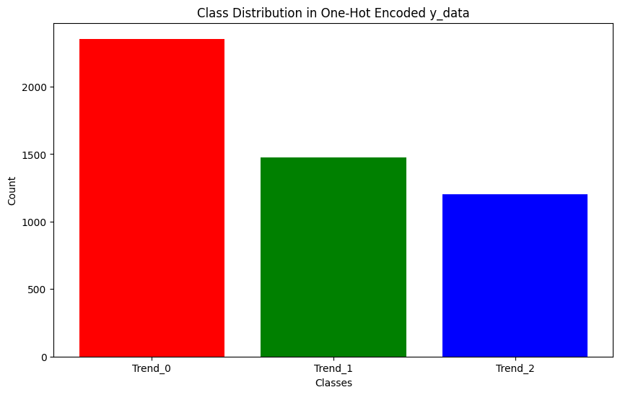
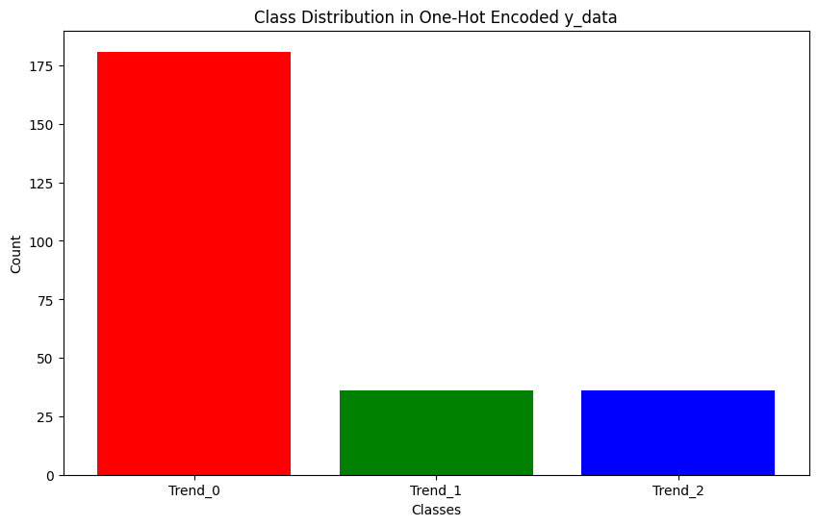

train_data
test_data

Slide 28
Model_4_2

Slide 29

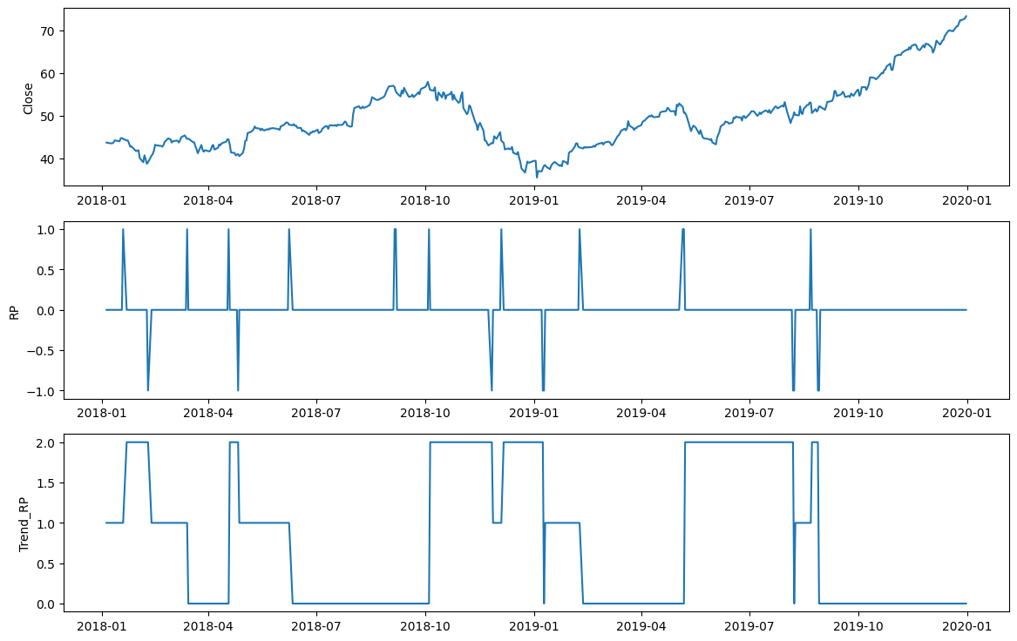
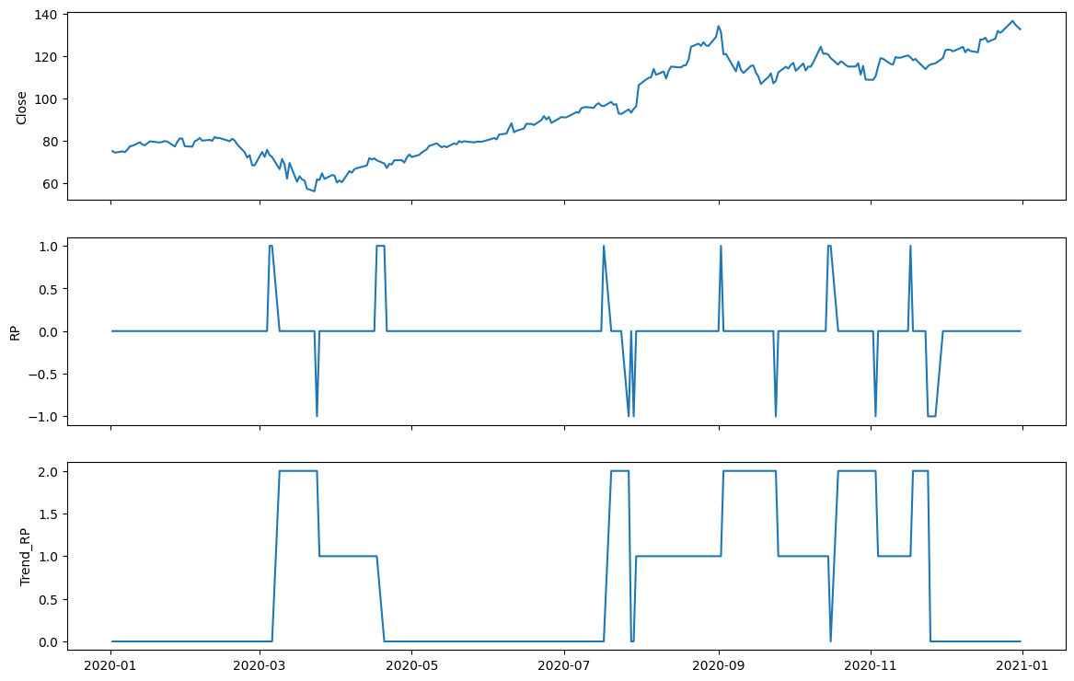
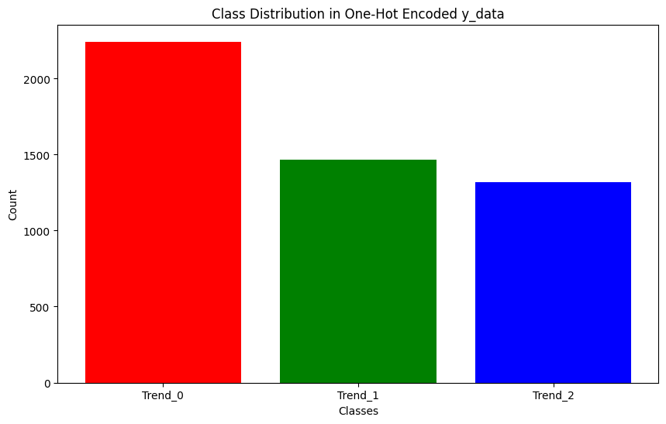
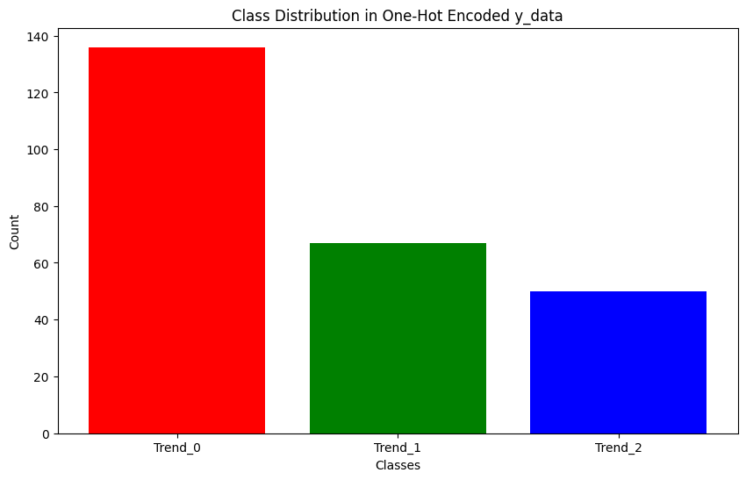
train_data
test_data

Slide 30
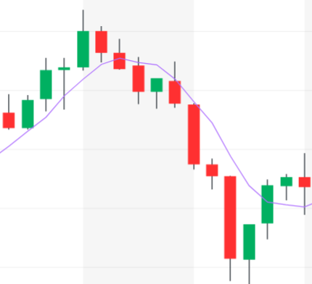
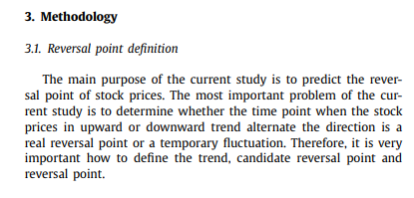
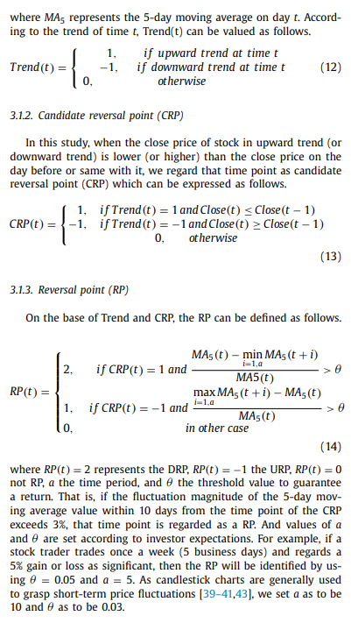
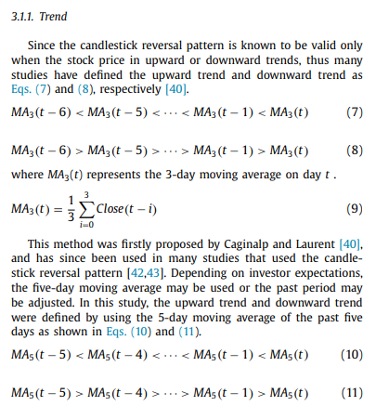
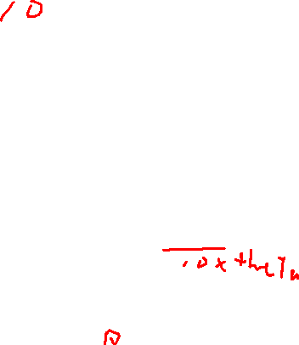
Past data
t
Future data
MA based on Close price
theta
min MA
a

Slide 31
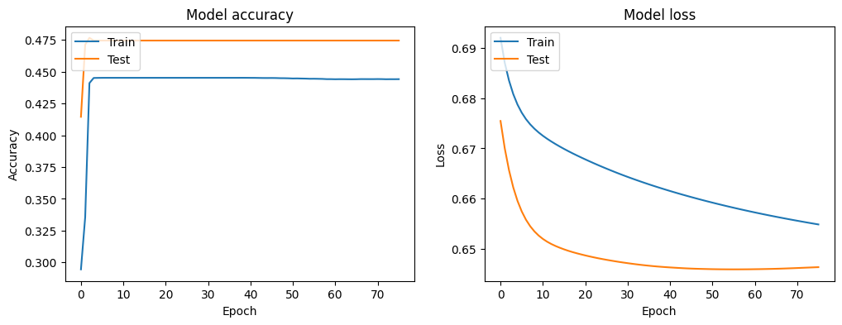


Evaluation on test data
val
val
y_pred

Slide 32
Model_seq2seq

Slide 33
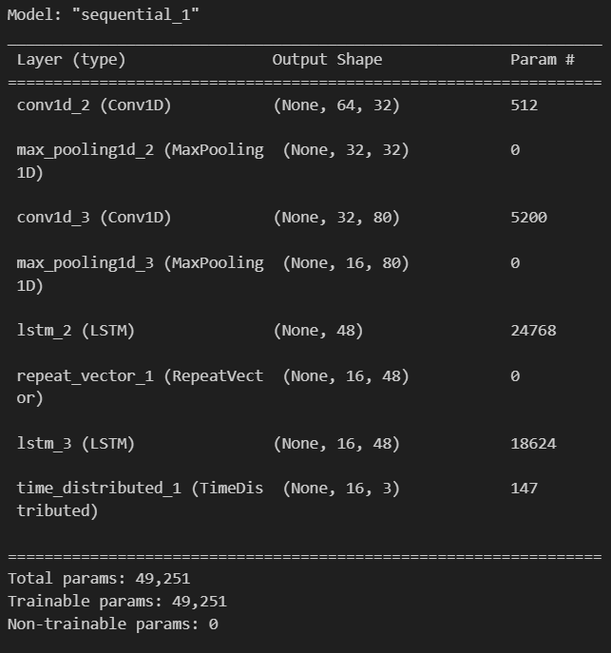
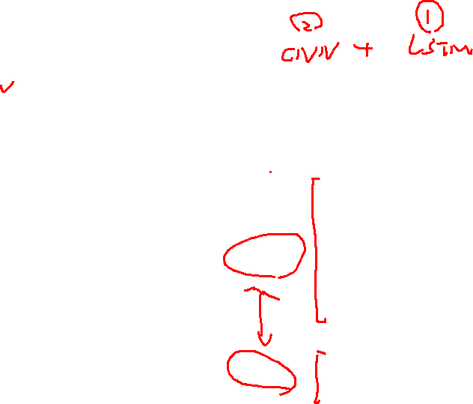
Seq2Seq
Developed by the Google Translate research team (first introduced in the 2014 paper 'Sequence to Sequence Learning with Neural Networks').
Basic Structure:
Encoder: The first part of the seq2seq model, which takes the input sequence and compresses the information into a context or a "thought" vector. This vector serves as a representation of the input sequence.
Decoder: The second part of the model, which takes the context vector from the encoder and produces the output sequence.
encoder
decoder

Slide 34
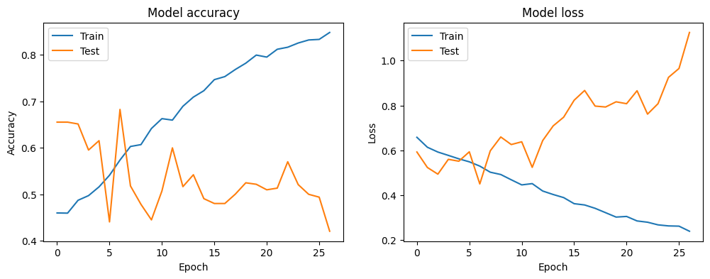
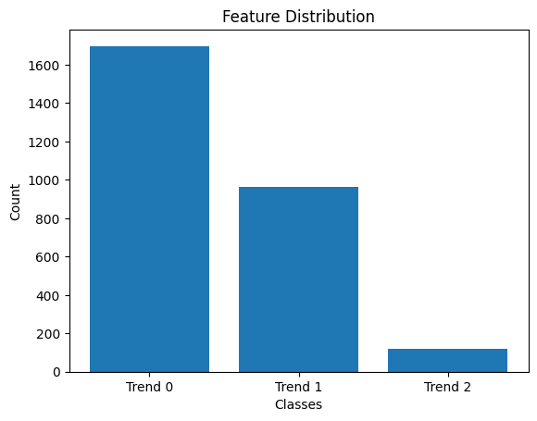


Evaluation on test data
val
val
y_pred

Slide 35
Model_seq2seq_add_dropout

Slide 36



Seq2Seq
Add dropout layers

Slide 37




Evaluation on test data
val
val
y_pred

Slide 38





Evaluation
mean_change_index_diff = 3

Slide 39
Model_seq2seq_add_dropout_2

Slide 40

train_data
test_data

Slide 41



Evaluation on validation
val
val
y_pred

Slide 42
Flow chart
Data Resample
fetch_data
Feature Engineering
Standardizing
Data Processing
One hot encoding
train_data
test_data
Model Construction
Hyperparameter Tuning
Model Training
Prediction and Evaluation
Models:
CNN+LSTM
LSTM
RNN
GRU
…
Model requirements:
Multi-layer feature extraction
Sequence data modeling
Multi-step input to multi-step output

Slide 43


Flow chart
Data Resample
fetch_data
Feature Engineering
Standardizing
Data Processing
One hot encoding
train_data
test_data
Model Construction
Hyperparameter Tuning
Model Training
Prediction and Evaluation
Models:
CNN+LSTM
LSTM
RNN
GRU
…
Model requirements:
Multi-layer feature extraction
Sequence data modeling
Multi-step input to multi-step output

