Slide 1
Model_1 in new test data

Slide 2
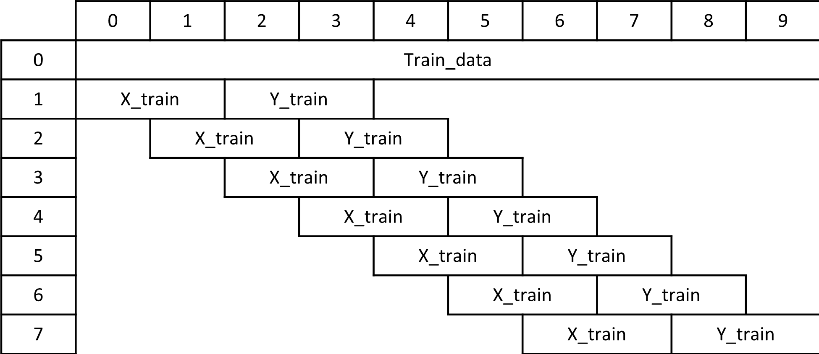


Training set , Validation set
similar
Validation set
randomly
Evaluation on validation
Slide=1

Slide 3
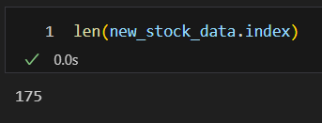
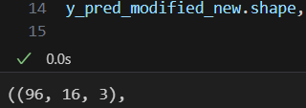
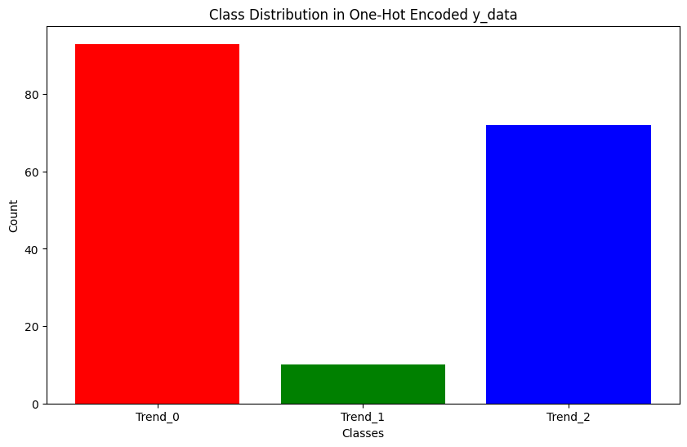

Evaluation on test data

Slide 4
Model_2

Slide 5
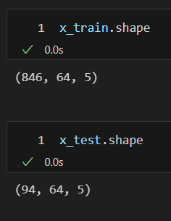
Training set , Validation set
 | 0 | 1 | 2 | 3 | 4 | 5 | 6 | 7 | 8 | 9 | 10
0 | Train_data | Train_data
1 | X_train | X_train |  | Y_train
2 |  |  | X_train | X_train |  | Y_train
3 |  |  |  |  | X_train | X_train |  | Y_train
4 |  |  |  |  |  |  | X_train | X_train |  | Y_train
less similar
Validation set
randomly
Slide=16
x_length=64
y_length=16
val

Slide 6
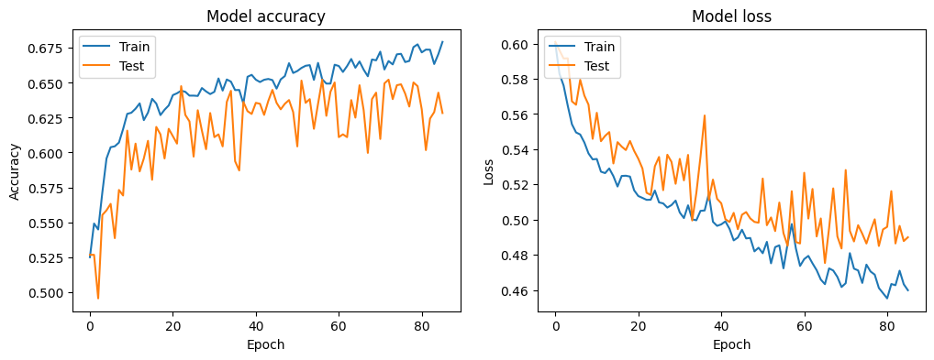
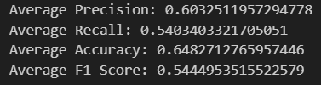
Evaluation on validation
val
val

Slide 7
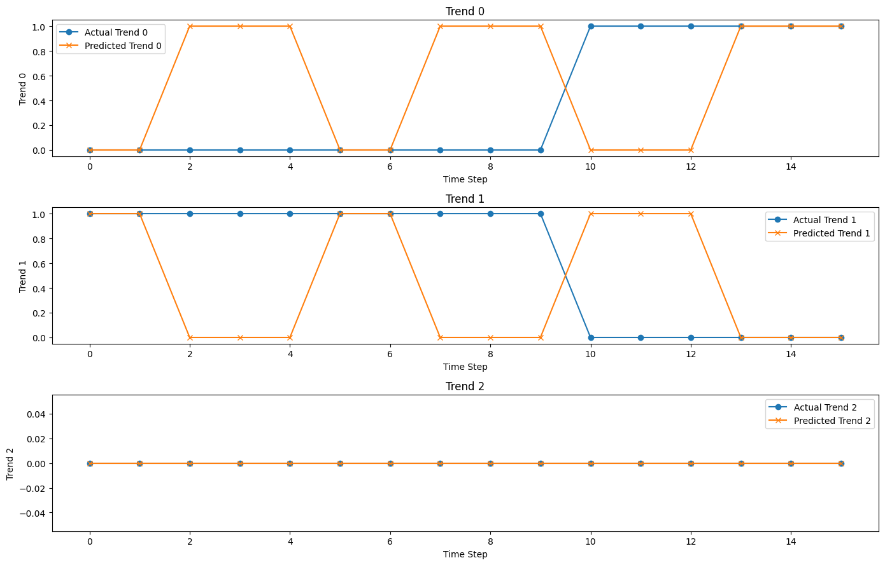
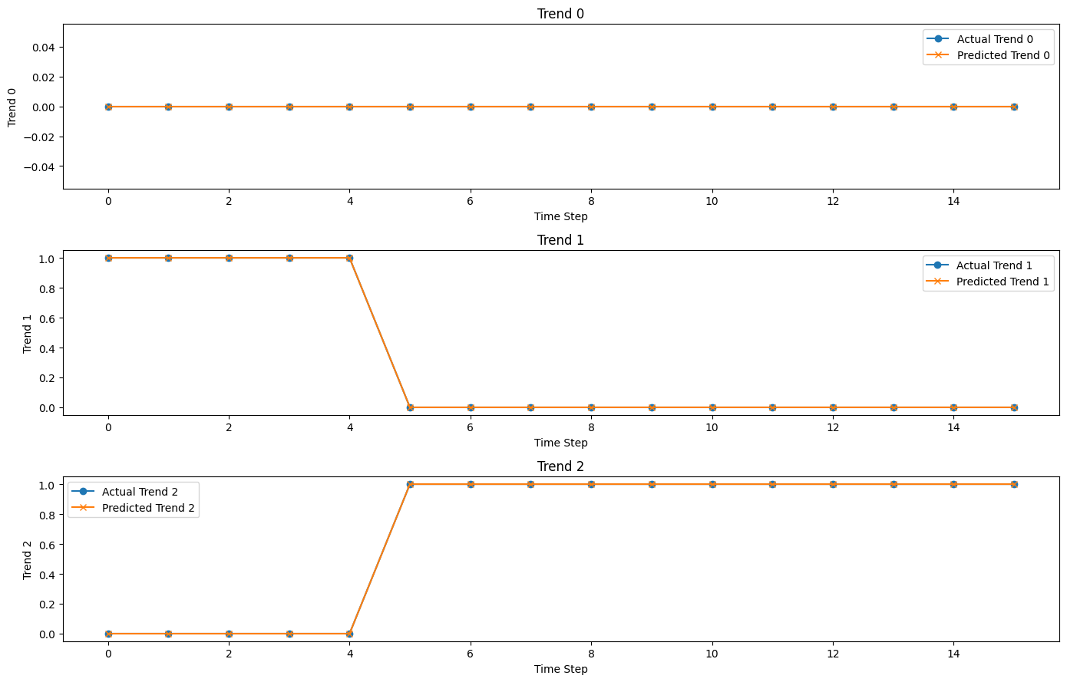
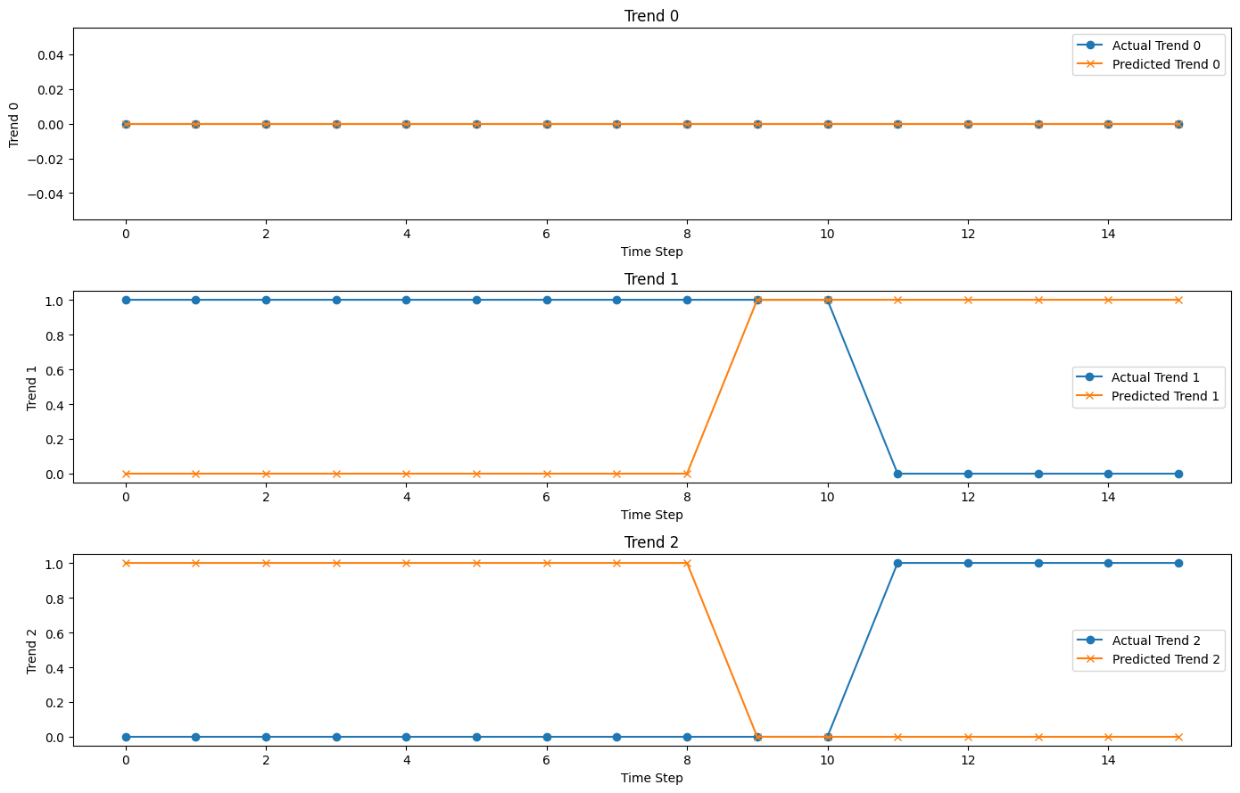
Evaluation on validation
mean_change_index_diff = 5.83

Slide 8
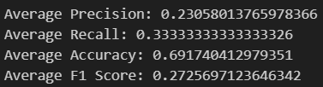
Evaluation on test data
Slide = 1
Slide = 16
(slide = y_length)

Slide 9
Model_3 - fetch 20 tech stock

Slide 10
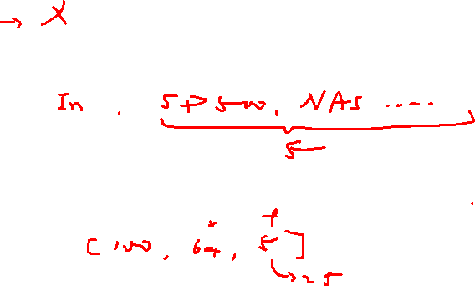
Flow chart
fetch_data
Feature Engineering
Standardizing
Data Processing
One hot encoding
Model Construction
Hyperparameter Tuning
Model Training
Prediction and Evaluation

Slide 11
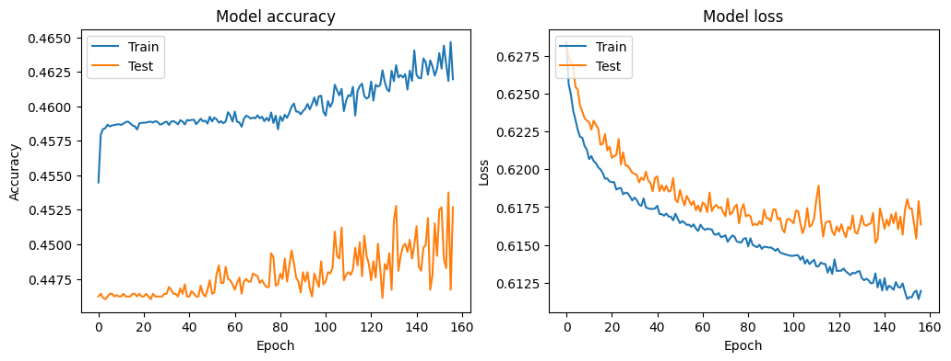

Evaluation on validation
val
val

Slide 12
Model_4

Slide 13
Flow chart
fetch_data
Feature Engineering
Standardizing
Data Processing
One hot encoding
train_data
test_data
Model Construction
Hyperparameter Tuning
Model Training
Prediction and Evaluation

Slide 14
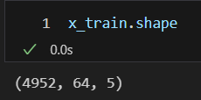
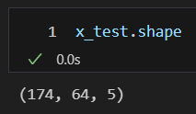
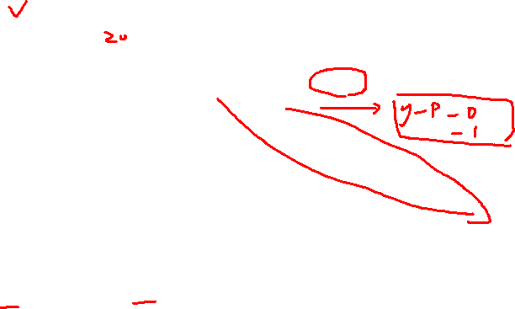
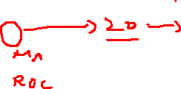
Training set , Validation set
 | 0 | 1 | 2 | 3 | 4 | 5 | 6 | 7 | 8 | 9 | 0 | 1 | 2 | 3 | 4 | 5 | 6 | 7 | 8 | 9
0 | Train_data |  |  |  |  |  |  |  |  |  | Test_data
1 | X_train |  | Y_train |  |  |  |  |  |  |  | X_test |  | Y_test
2 |  | X_train |  | Y_train |  |  |  |  |  |  |  | X_test |  | Y_test
3 |  |  | X_train |  | Y_train |  |  |  |  |  |  |  | X_test |  | Y_test
4 |  |  |  | X_train |  | Y_train |  |  |  |  |  |  |  | X_test |  | Y_test
5 |  |  |  |  | X_train |  | Y_train |  |  |  |  |  |  |  | X_test |  | Y_test
6 |  |  |  |  |  | X_train |  | Y_train |  |  |  |  |  |  |  | X_test |  | Y_test
7 |  |  |  |  |  |  | X_train |  | Y_train |  |  |  |  |  |  |  | X_test |  | Y_test
(validation)
not similar
Slide=1
x_length=64
y_length=16

Slide 15
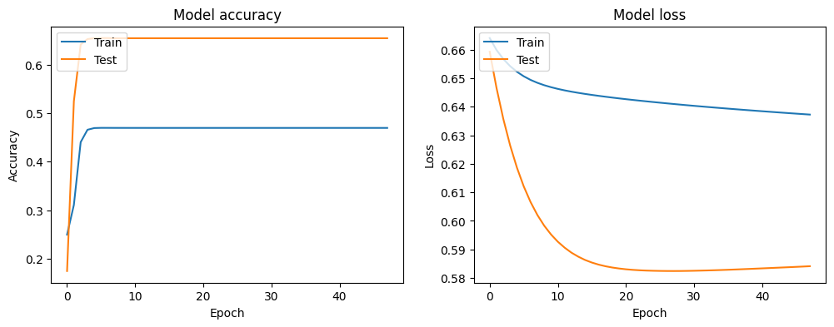
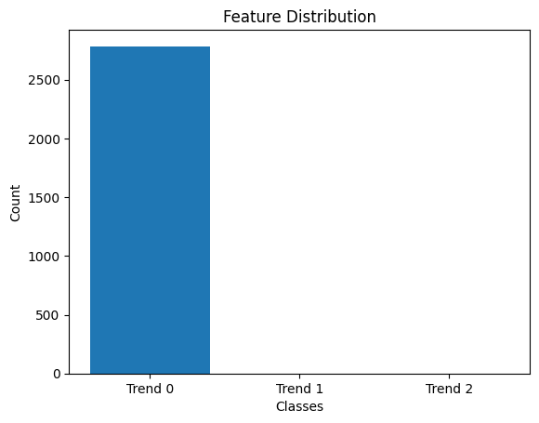

Evaluation on test data
val
val
y_pred

Slide 16

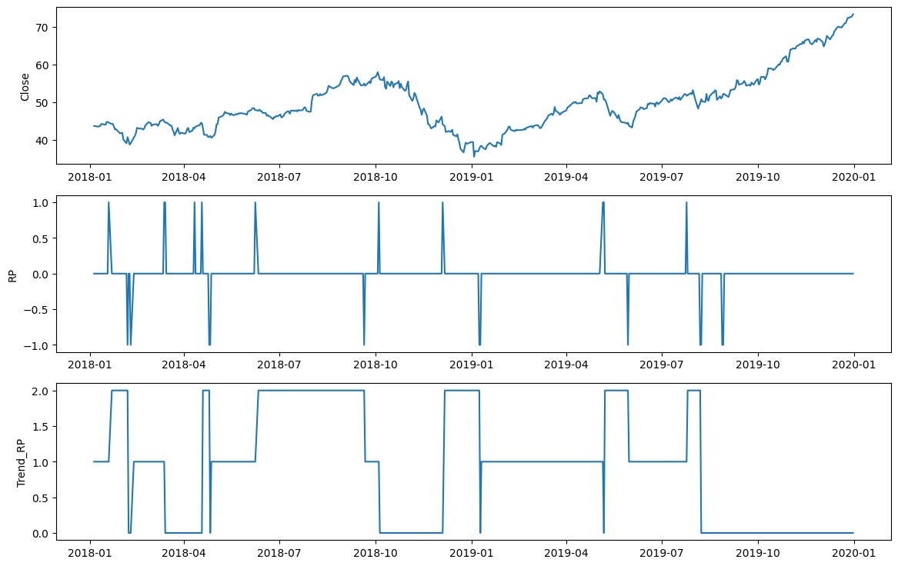
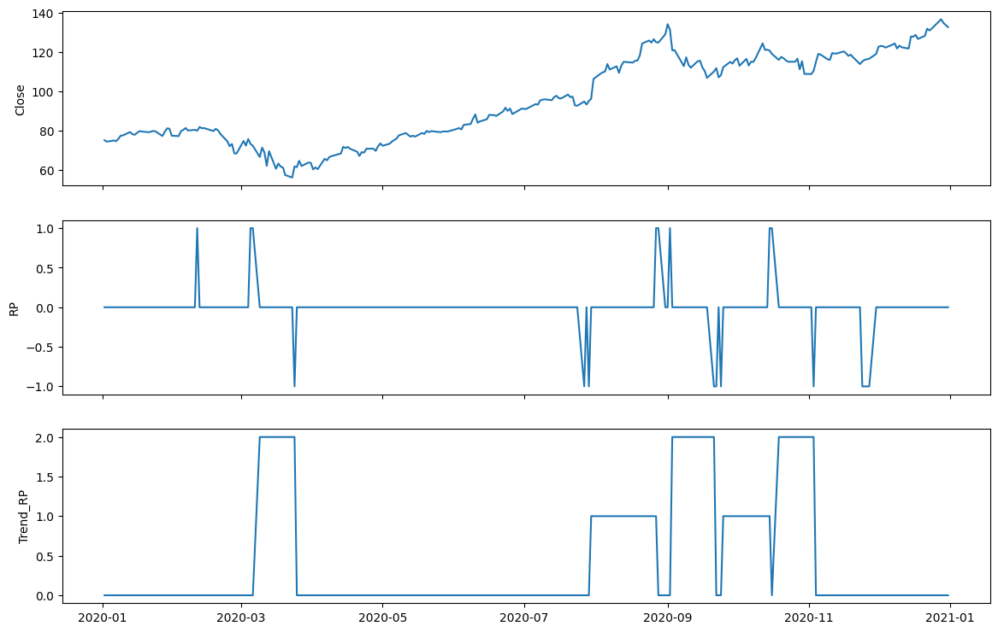
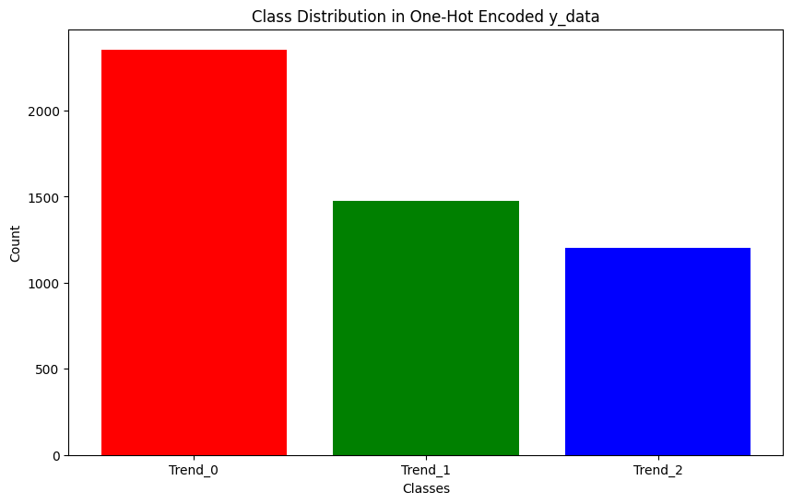
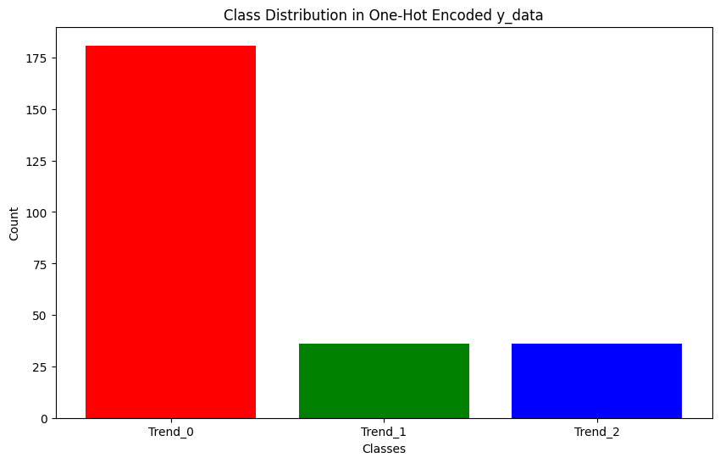
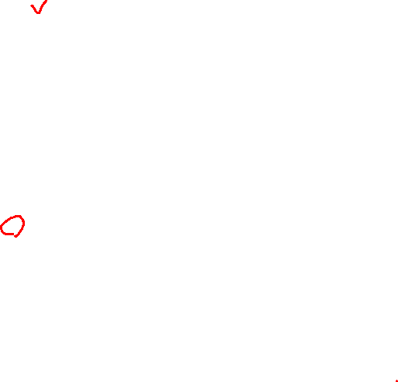
train_data
test_data

Slide 17
Model_4_2

Slide 18

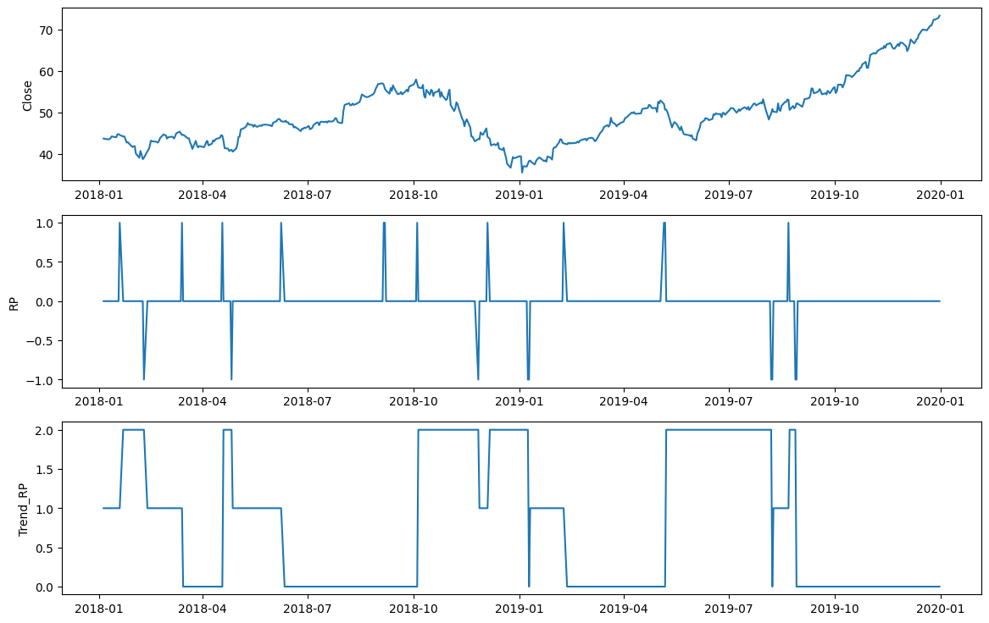
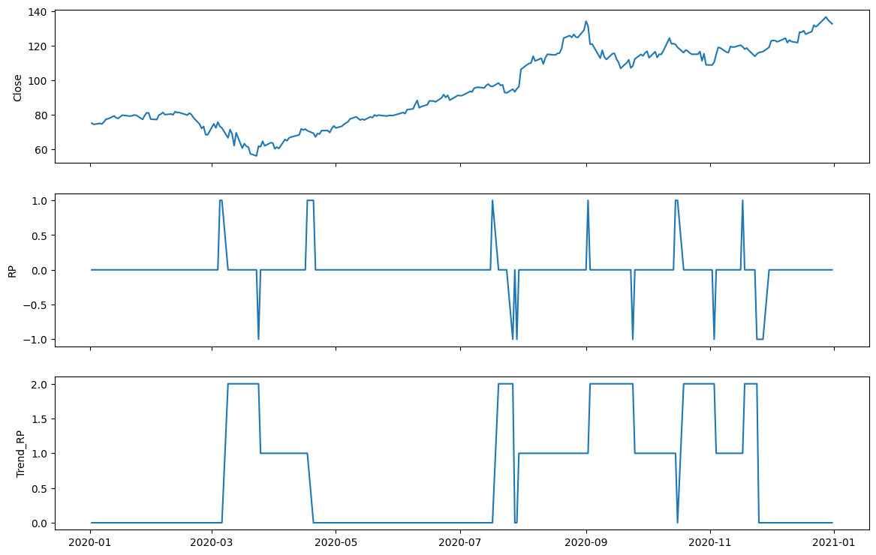
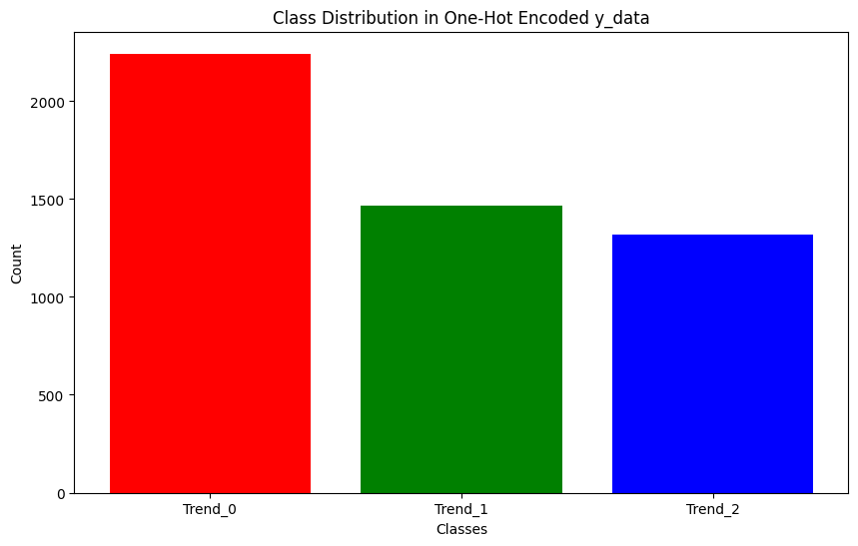
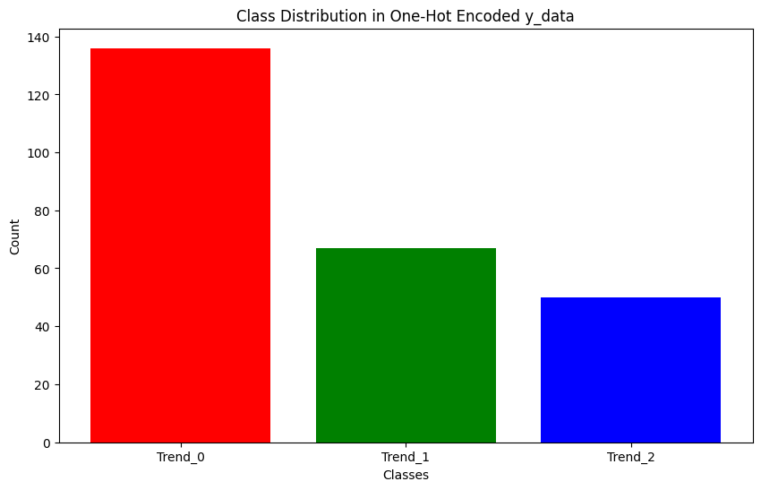
train_data
test_data

Slide 19
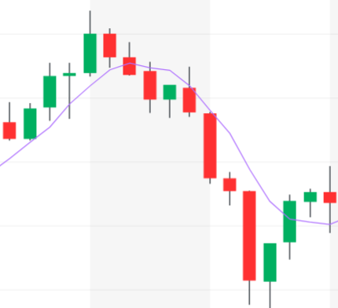
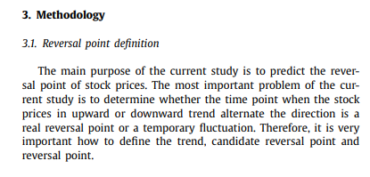
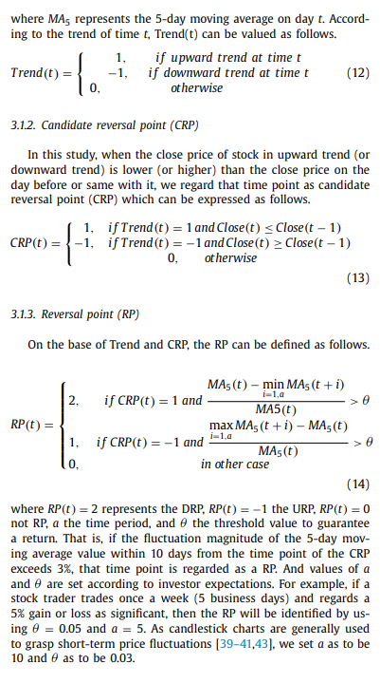
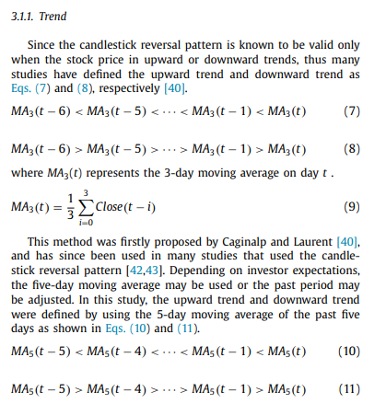
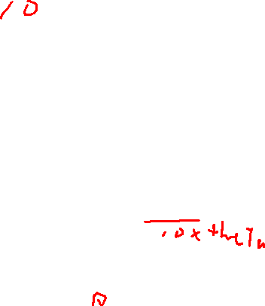
Past data
t
Future data
MA based on Close price
theta
min MA
a

Slide 20
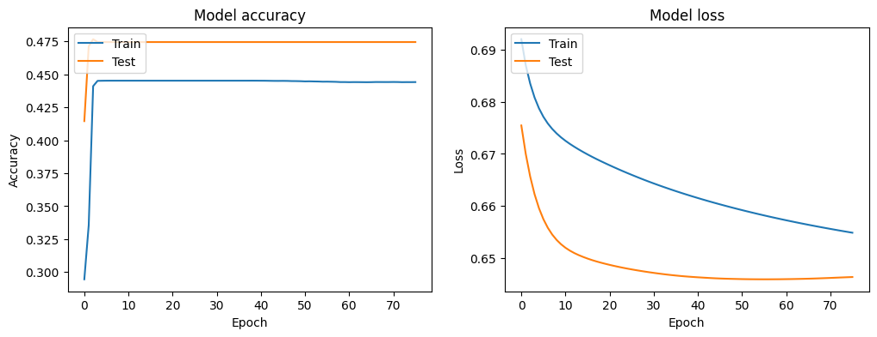


Evaluation on test data
val
val
y_pred

Slide 21
Model_seq2seq

Slide 22
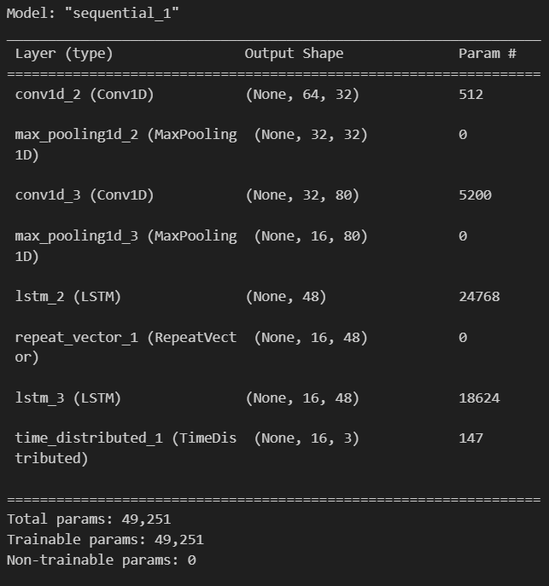
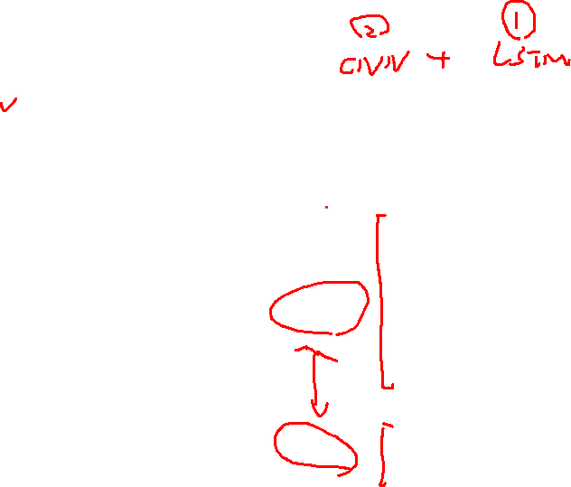
Seq2Seq
Developed by the Google Translate research team (first introduced in the 2014 paper 'Sequence to Sequence Learning with Neural Networks').
Basic Structure:
Encoder: The first part of the seq2seq model, which takes the input sequence and compresses the information into a context or a "thought" vector. This vector serves as a representation of the input sequence.
Decoder: The second part of the model, which takes the context vector from the encoder and produces the output sequence.
encoder
decoder

Slide 23
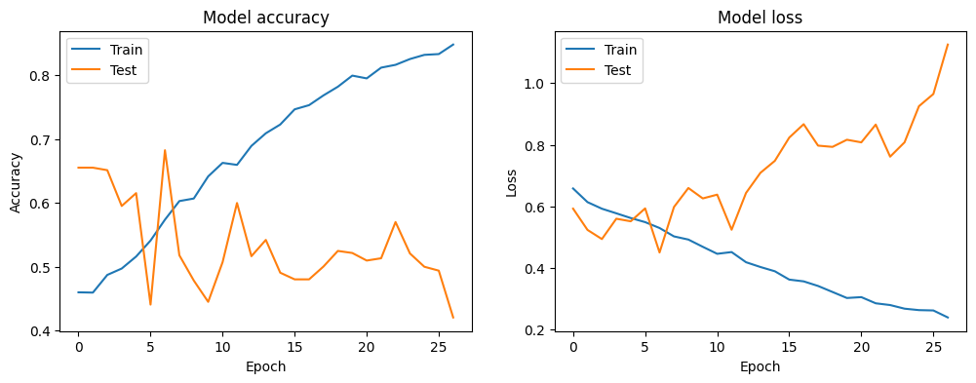
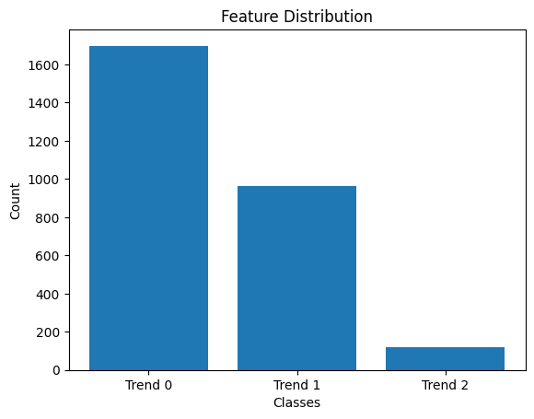

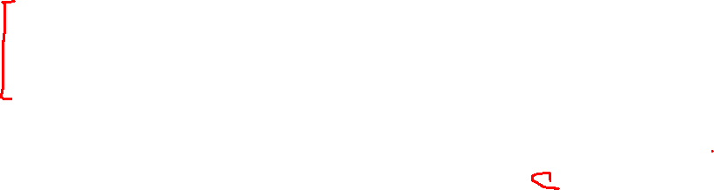
Evaluation on test data
val
val
y_pred

Slide 24
Model_seq2seq_add_dropout

Slide 25
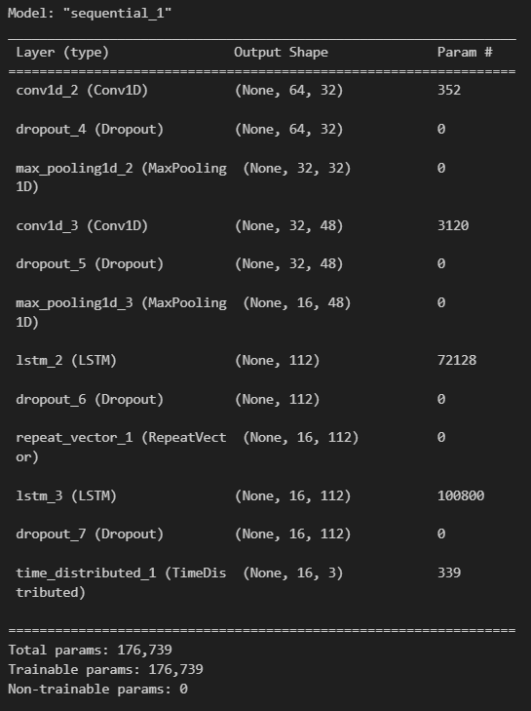
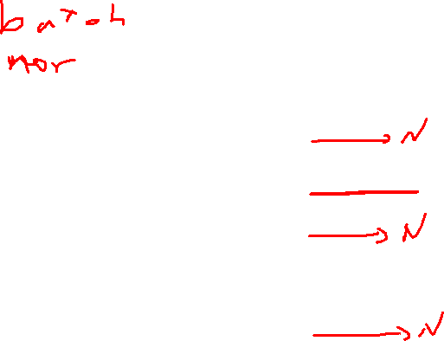

Seq2Seq
Add dropout layers

Slide 26
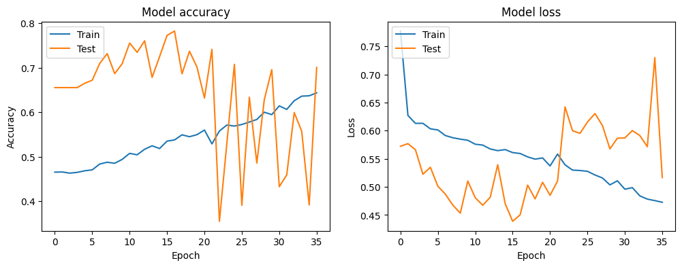
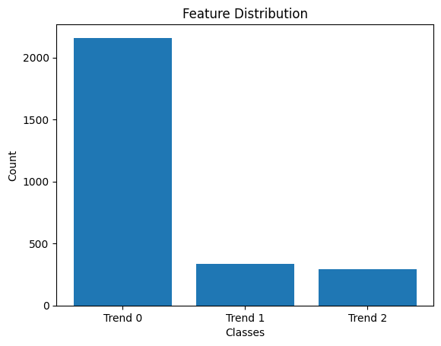

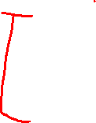
Evaluation on test data
val
val
y_pred

Slide 27
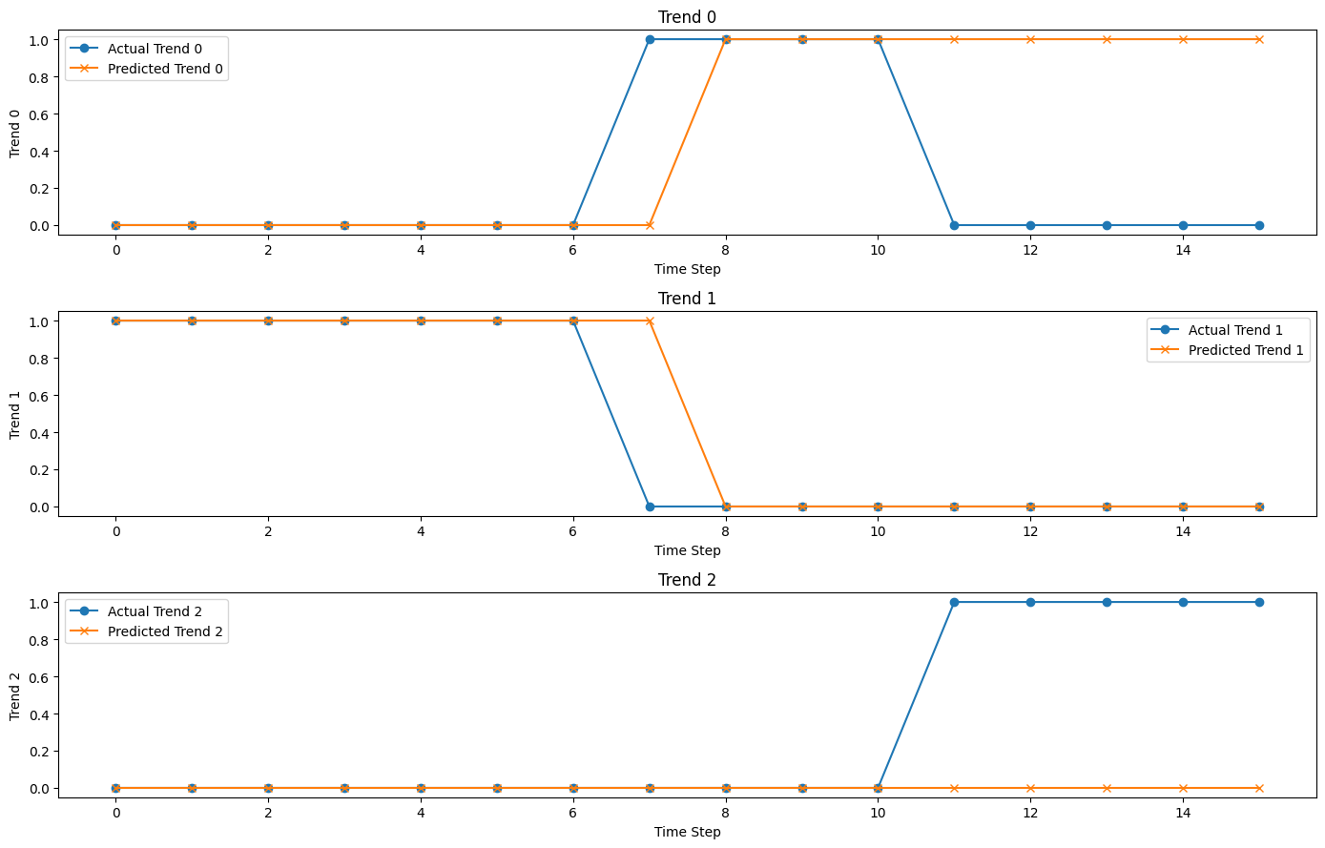
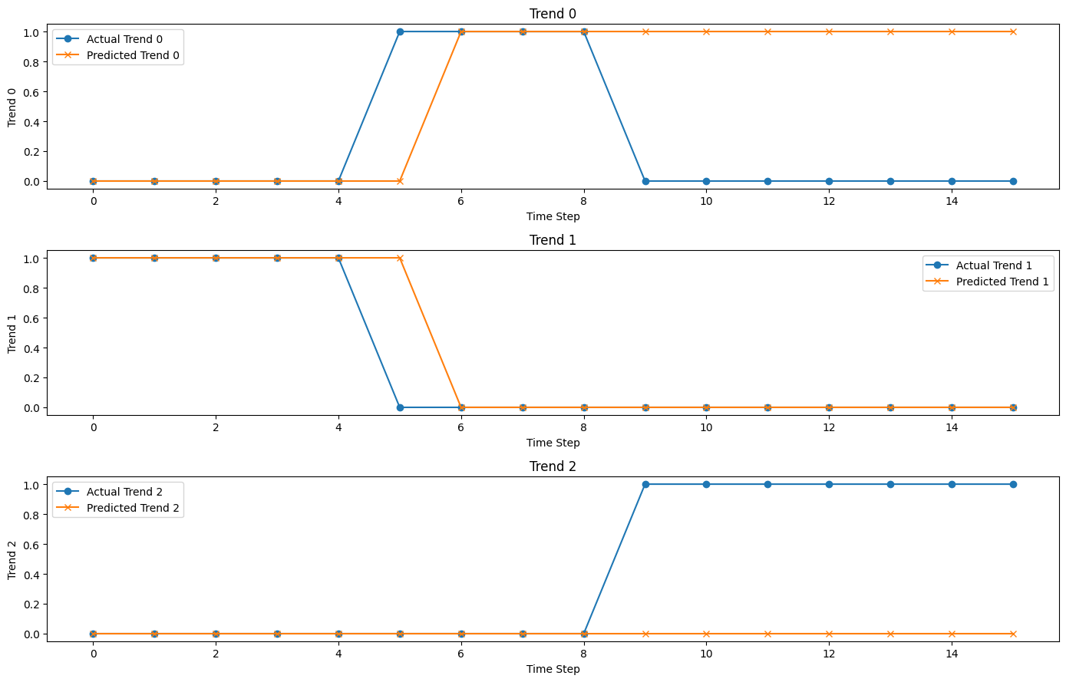
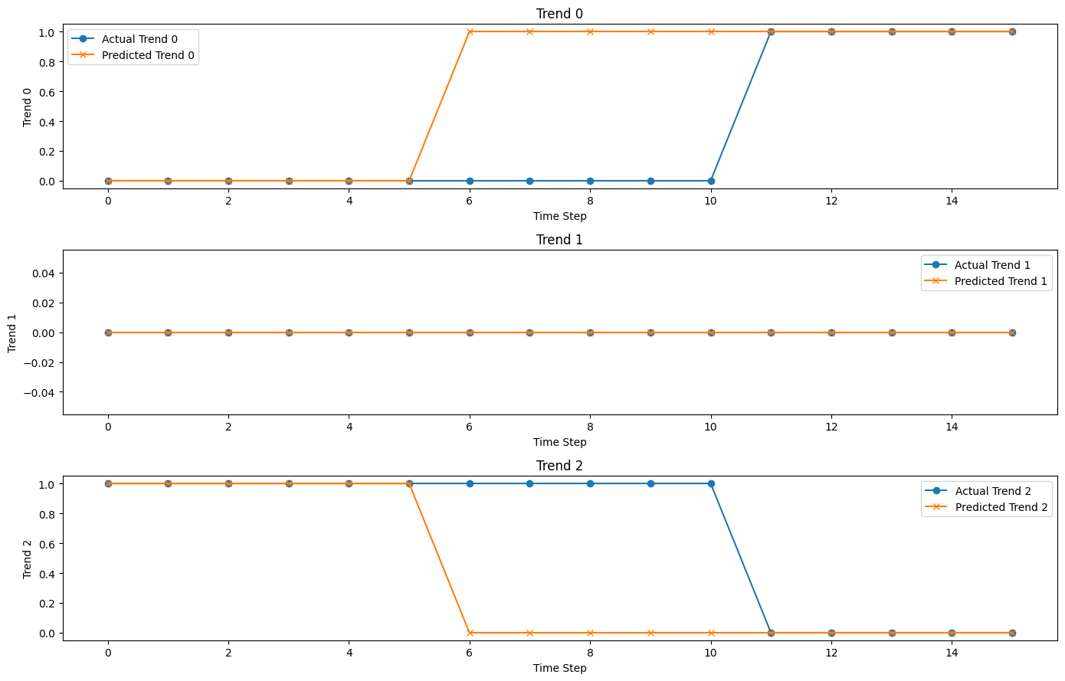
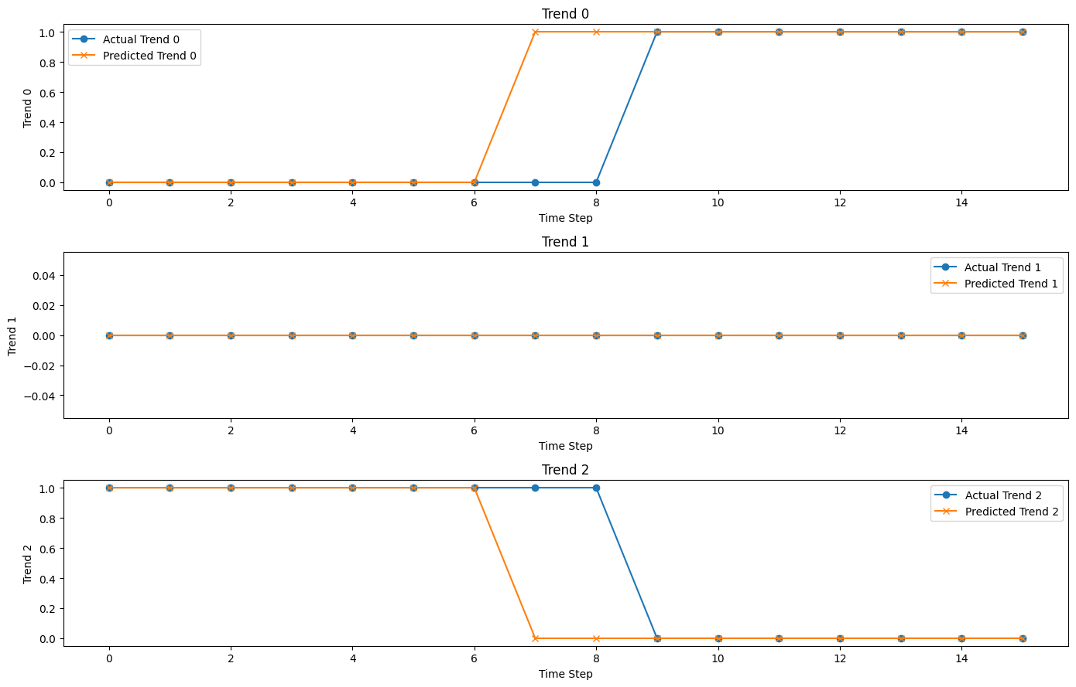
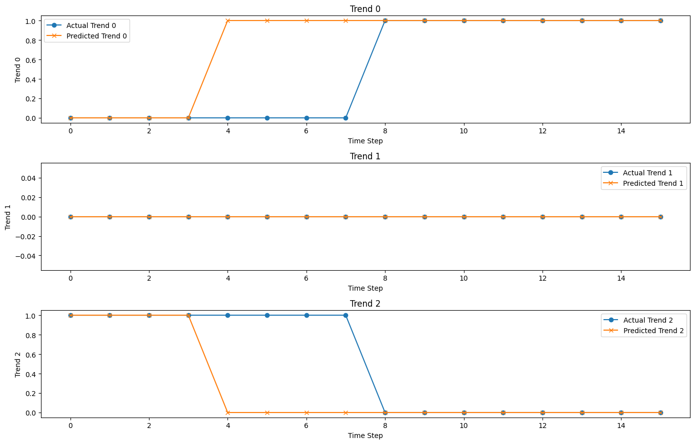
Evaluation
mean_change_index_diff = 3

Slide 28
Model_seq2seq_add_dropout_2

Slide 29
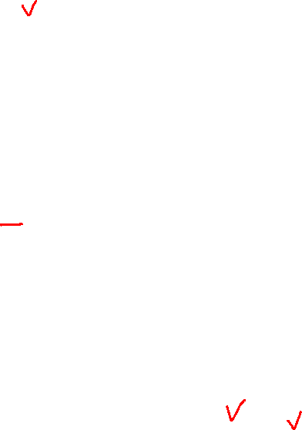
train_data
test_data

Slide 30



Evaluation on validation
val
val
y_pred

Slide 31
Flow chart
Data Resample
fetch_data
Feature Engineering
Standardizing
Data Processing
One hot encoding
train_data
test_data
Model Construction
Hyperparameter Tuning
Model Training
Prediction and Evaluation
Models:
CNN+LSTM
LSTM
RNN
GRU
…
Model requirements:
Multi-layer feature extraction
Sequence data modeling
Multi-step input to multi-step output

Slide 32


Flow chart
Data Resample
fetch_data
Feature Engineering
Standardizing
Data Processing
One hot encoding
train_data
test_data
Model Construction
Hyperparameter Tuning
Model Training
Prediction and Evaluation
Models:
CNN+LSTM
LSTM
RNN
GRU
…
Model requirements:
Multi-layer feature extraction
Sequence data modeling
Multi-step input to multi-step output

Slide 35
Reference: Predicting price trend reversals using machine learning techniques
Source: LUND UNIVERSITY, DEPARTMENT OF COMPUTER SCIENCE
Abstract:
In this thesis, we examined the performance of Logistic Regression (LR), k-Nearest Neighbor (kNN), Deep Neural Network (DNN), Convolutional Neural Network (CNN) and Long Short Term Memory (LSTM) in predicting past and future reversals.
The dataset used was all stocks listed in the S&P 500. Our experiments show that neural networks greatly outperformed LR and kNN, with our LSTM model "revLSTM" achieving the best performance in most cases.
We also evaluated the performance impact of adding additional features such as the distance to previous reversals.
By incorporating previous reversals, the Matthew Correlation Coecient (MCC) scores were shown to more than double. Using revLSTM, a MCC of 0.17 was achieved when predicting short term future reversals and 0.54 when confirming short term past reversals. A MCC score of 0.10 was achieved when predicting long term future reversals and 0.29 confirming long term past reversals.

Slide 36
Research question
The goal of this thesis is to investigate whether it is possible to accurately predict reversal events. Four research questions have been formulated:
• R1: Which methods are applicable for predicting reversals using the past m days?
• R2: To what accuracy can reversals p days in the future be predicted using the past m days?
• R3: To what accuracy can past reversals q days in the past be recognized using the past m days?
• R4: How will the performance of the predictions be affected by additional calculated features?

Slide 37

To-do list
Website frontend planning
Training with rolling window. (Online machine learning)
Batch normalization
Feather extension: (a. Technical indicators, b. economic indicators)
Backtesting result: (a. model evaluations, b. profit evaluations)
Integrate the FFT model
Website frontend implement
Add comparison models (SVM、LR…)

Slide 38
Website

Slide 39

Website structure
Fin Database
stock raw data
Backend computing
< 1m
sql query
Model 1:
Fast Fourier transform
User input stock、 parameters
Predict trading signals
Frontend present
Model 2:
ML base models
crontab
Fin Database
Backend computing:
Pretrained models are fitted to new data weekly.
stock raw data
Data injection
sql query
ML Database

Slide 40




Frontend present
today
Train data
val data
test data
1. Backtesting result (validation data)
FFT: 1y, ML: 10y
2 weeks
6 months
a. Trade signals in val data
b. Profit evaluation
c. Model evaluation

Slide 41


Frontend present
(Validation data will be input into the model at this stage.)
today
Train data
val data
test data
2. Forwardtesting result (test data)
FFT: 1y, ML: 10y
2 weeks
Frontend present
6 months
a. ML
test data
b. FFT
test data
2weeks
Sell signal
2weeks
Buy signal
Buy signal
Buy signal
today
today
Day 4
Day 10
Day 12
Day 12
Backend result
Upward trend

Slide 42
Model improvement

Slide 43
Training with rolling window. (Online machine learning)

Slide 44



Training with rolling window. (Online machine learning)
7:3
Train data: 3465 days
2013-11-07
Test data: 1486 days
2000-01-01
2019-12-31
Slide=1
Slide=16 (y_length)
 | 0 | 1 | 2 | 3 | 4 | 5 | 6 | 7 | 8 | 9 | 10
0 | Test_data | Train_data
1 | X_test | X_train |  | Y_test
2 |  |  | X_test | X_train |  | Y_test
3 |  |  |  |  | X_test | X_train |  | Y_test
4 |  |  |  |  |  |  | X_test | X_train |  | Y_test
x_train.shape: (3386, 64, 5)
y_train.shape: (3386, 16, 3)
x_test.shape: (88, 64, 5)
y_test.shape: (88, 16, 3)
Step 1: fit training data
Step 2: predict x_test[0], record y_pred[0], fit test_data[0]
Step 3: predict x_test[1], record y_pred[1], fit test_data[1]
…
Step n: predict x_test[n], record y_pred[n], fit test_data[n]
Evaluate y_pred with y_test

Slide 45
Batch normalization

Slide 46




Batch normalization
3. before activations
1. Between hidden layers
2. before dropout layers

Slide 47






Batch normalization
0. no batch normalization
Training curve
Rolling training curve

Slide 48





Batch normalization
1. Between hidden layers
Training curve
Rolling training curve

Slide 49






Batch normalization
2. before dropout layers
Training curve
Rolling training curve

Slide 50






Batch normalization
3. before activations
Training curve
Rolling training curve

Slide 51







Data Adjustment
theta = 0.03, a = 10
theta = 0.001, a = 5

Slide 52






Data Adjustment
3. before activations
Training curve
Rolling training curve

