Slide 1
B2B Solution for WLTP data
Schemas

Slide 2
Solutions
Solution en 2 parts :
Daily transfer of a file containing « precalculated data » with WLTP values for European countries
API for real time interrogations
Option to be confirmed :
Transfer of files containing vehicles Range (LCDV) by country / brand flagued as WLTP

Slide 3



Part 1 : Daily Send of a file containing Big Sales LCDV codes with WLTP values.
Part 1 : Daily transfer : file containing precalculated LCDV codes with WLTP values.
Cache WLTP
Objective: preload cache to be autonomous for this precalculated WLTP range
B2B Actor
B2B Actor gets the file by requesting it to our SFTP platform (mts2.mpsa.com) (Push)
LCDV + WLTP Values
SFTP
LCDV + WLTP values
WLTP Calculation LCDV
Pre-CALCULATED WLTP
Notes:
Ajouter anexe avec la liste de filiales qui ont MotCFG et back-office.
Ajouter interlocuteur IT.
Ajouter macro-planning Projet : sur tout partie de test.

Slide 4
Part 2 : API Real time Interrogation with LCDV Codes
Part 2 : API for real time consultation
Requests / Second :
(source B2B) : estimated values hits / second ??
B2B Actor
Cache WLTP
LCDV code must be used
Validation of LCDV code, retrieve WLTP values
MOTCONF

Slide 5
Part 3 : Sending vehicles Range by country / brand (with LCDV codification)
Part 3 : Sending LCDV vehicles Range by country / brand flagged WLTP mode
B2B Actor
To be confirmed
Range WLTP by NSC
B2B Actor gets the file by requesting it to our SFTP platform of n files containing vehicles Range WLTP by country (LCDV)
SFTP
Actual discussions with DJUR to validate transfers
Range WLTP by NSC (push)
PSA range SI
For subsidiaries : extraction from backoffices

Slide 6

Solution
B2B Actor :
Needed : range validation and returning WLTP values attached to specific title (flagged WLTP)
Points to be verified
B2B Actor is able to work with LCDV codes for versions, trims, colors and options (must have)
Evolution from Options codification is scheduled for moving length 4c (or 5c) → 7c
Codification Exemple :
version (16c) = 1PT9C5PMA1B0BUD0 ; trim (4c) = 8DFR ; color (4c) = M09V , Options List = LA05 QK02Z VD10 YD01E YR07 ZHJI ZV47
Perimeter of countries.
Feedback if possible : Hours of dense activity by day. Estimated hits/sec. Diversity of titles managed by B2B Actor
Need to put in place a cache system
PSA will provide precalculated data to load cache with WLTP datas. Push of information.
After real time consultation, B2B Actor needs to save WLTP datas in their cache system. /!\
Cached data will be valid for 15 days (under internal validation). See Details
B2B Actor is autonomous for range not flagged WLTP (as today)
Notes:
provide precalculated data to load cache for range dictionary for each NSC (National Sales Country) with WLTP flag

Slide 7
Cache Management
Cache Management (validity N days) How TO:
New values
Day 1 : PSA push a file with WLTP precalculated data to load in cache.
A parameter of data validity (number of days) must be set at this moment. Actually N = 15 (but it could be modified in the future)
Day 2 : New file will be pushed with WLTP values for titles (new ones or already calculated)
IF title exists from previous days → update values and set new validity with parameter N (actually 15 days)
IF title don’t exists → insert new value and set validity with parameter N (actually 15 days)
Day 3,4,… : New file will be pushed with WLTP values for new titles
Repeat process of day 2
For a value in the cache after the N days of validity and not arrived in new files or real time consultations
This value must be deleted or not take into account after this period of N days (actually N = 15)
Several reasons
Title is closed by marketing team, and it’s not possible to order vehicles with this title.
Title is not demanded by client, so it’s not worthy to recalculate.
Notes:
provide precalculated data to load cache for range dictionary for each NSC (National Sales Country) with WLTP flag

Slide 8
PROCESS (Engine Configurator)
Real Time API consultation :
Only open range will be present in engine configurator.
Unitary calls
Not massive mode implemented
Information exchange
Draft of API Rest defined.
File Format of precalculated data
Draft for file format

Slide 9
Macro - Planning
T1/2018
T2/2018
T3/2018
T4/2018
Part 1: Daily sending of precalculated WLTP values (LCDV codes. EU NSC)
Part 2 : API for real time interrogations
Part 3 : Sending vehicles Range (LCDV) by country / brand flagged WLTP (TBC!)
04
05
06
07
08
09
10
11
12
Part 1 WLTP B2B
Study Part 2
Part 3 WLTP B2B
TBC
PR Part 2 WLTP B2B

Slide 10
Planning : Testing
T3/2018
Part 1: Daily sending of precalculated WLTP values (LCDV codes. EU NSC)
Part 2 : API for real time interrogations
07
08
09
Cache load
API tests
Support PSA for WLTP projet : support_cfg@mpsa.com
For technical issues
IT Team :
PM : German Diaz
PM : César Augusto Murguía
Head Manager : Yago Castelao

Slide 11
ANNEXE : Country List
COUNTRY (in French) | CODE ISO | Cache file (part1) | API real time (part2) | Range file (part 3)
Allemagne | DE | 1 | 1
Autriche | AT | 1 | 1
Belgique | BE | 1 | 1
Bulgarie | BG | 1 | 0
Croatie | HR | 1 | 0
Espagne | ES | 1 | 1
Finlande | FI | 1 | 0
France | FR | 1 | 1
Grèce | GR | 1 | 0
Hongrie | HU | 1 | 0

Slide 12
ANNEXE : Country List
COUNTRY (in French) | CODE ISO | Cache file (part1) | API real time (part2) | Range file (part 3)
Irlande | IE | 1 | 0
Italie | IT | 1 | 1
Luxembourg | LU | 1 | 1
Norvège | NO | 1 | 0
Pays Bas | NL | 1 | 1
Pologne | PL | 1 | 0
Portugal | PT | 1 | 1

Slide 13
ANNEXE : Country List
COUNTRY (in French) | CODE ISO | Cache file (part1) | API real time (part2) | Range file (part 3)
République Tchèque | CZ | 1 | 0
Roumanie | RO | 1 | 0
Russie | RU | 1 | 1
Slovaquie | SK | 1 | 0
Slovenie | SI | 1 | 0
Suède | SE | 1 | 0
Suisse | CH | 1 | 1
Turquie | TR | 1 | 1
UK | GB | 1 | 1
Ukraine | UA | 1 | 0

Slide 14
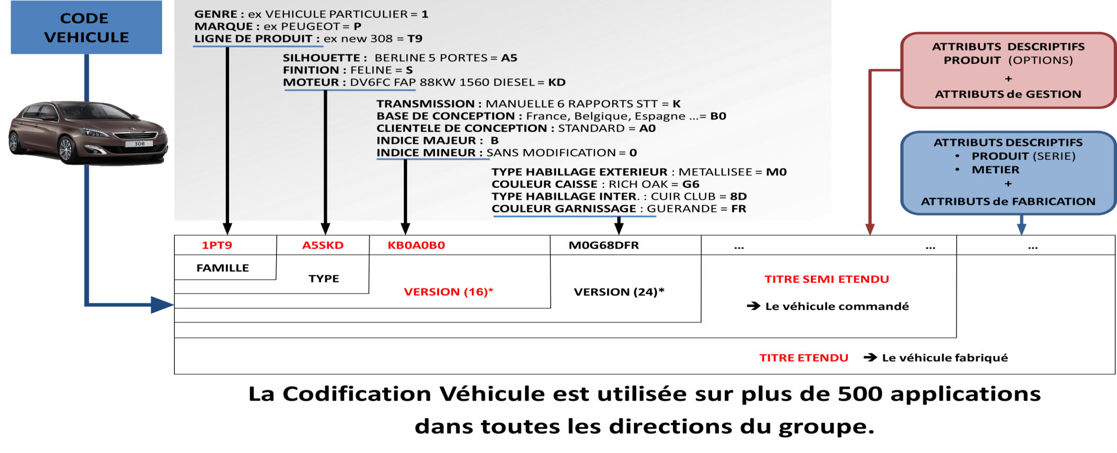
ANNEXE : Version 16c 24C et ….
Description d’un véhicule

