Slide 1
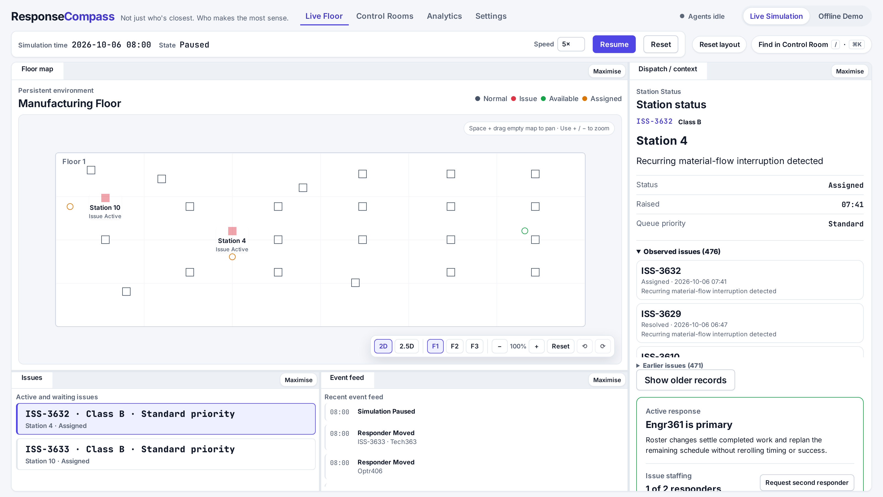
ResponseCompass
The right responder. The right fix.
Learned from every past repair.
Live Floor, simulated plant e8-aura-p1
An AI dispatch agent for operations control rooms, built on AMD Token Factory.
Notes:
ResponseCompass is a dispatch agent for operations control rooms, built on AMD Token Factory. The tagline is the product vision: responder ranking is built today; recommending the fix from past repairs is the next step (last slide). Say so when presenting this slide.

Slide 2
The problem
▸ When equipment fails, closest or free may be an incomplete answer.
▸ The nearest technician may never have fixed this kind of fault.
▸ A poor match can mean downtime, a reopened issue or another trip.
▸ Who fixes what, and how, lives in people's heads and old tickets.
2
Notes:
Proximity is easy to compute and easy to defend, but it ignores fit. What matters is who is likely to resolve this class of issue on the first attempt, given where everyone is and what they are already doing.

Slide 3
What ResponseCompass does
▸ For every new issue, Compass ranks the eligible responders and explains the tradeoffs.
▸ Offers go out automatically; responders accept or reject; complex work can get a second responder.
▸ Central command can override a pending dispatch; every step is audited.
▸ Each issue carries a response action; recommending fixes from past repairs is planned.
3
Notes:
Compass does not replace the operator. It proposes a ranked shortlist with reasons, and the system dispatches automatically with a human able to step in.

Slide 4
Code owns the facts. Models only rank.
Application code owns time, facts, eligibility, baselines and every mutation; models only propose.
Simulation clock
persistent, pausable
Event planner
AMD Token Factory
Validator
schema + facts
Central command
override pending dispatch
Scheduler
one-shot, restart-safe
Fallback planner
deterministic, API-free
Canonical state
persistent store, audit trail
Live Floor & Analytics
UI, fixed snapshots
Responders
accept or reject
Compass
AMD Token Factory: ranks
Context engine
eligibility, travel, history
Resolution engine
hidden skill → outcome
Dispatch
ranked offer queue
Baselines
nearest + naive score
Application code
AMD model
People
4
Notes:
The ranker receives application-owned evidence and ranks only the eligible candidates it is given. The planner proposes synthetic incidents; code validates every proposal and owns all mutations. If a model is slow, rate-limited or returns invalid output, the deterministic fallback takes over, so dispatch continues.

Slide 5
Honest by design
▸ Each responder's true skill is hidden simulation truth: no model, UI or analytics sees it.
▸ Outcomes are simulated from that hidden skill, independently of what the model claims.
▸ Two transparent baselines (nearest, naive score) run alongside; disagreements are flagged.
▸ Analytics show denominators, suppress thin samples and are not an employee leaderboard.
▸ Excluded from ranking: pay, seniority, demographics, fatigue, HR data.
5
Notes:
We wanted the demo to be able to show Compass being wrong as well as right. Hidden truth plus baselines make its choices inspectable. Disagreement alone does not prove better outcomes.

Slide 6
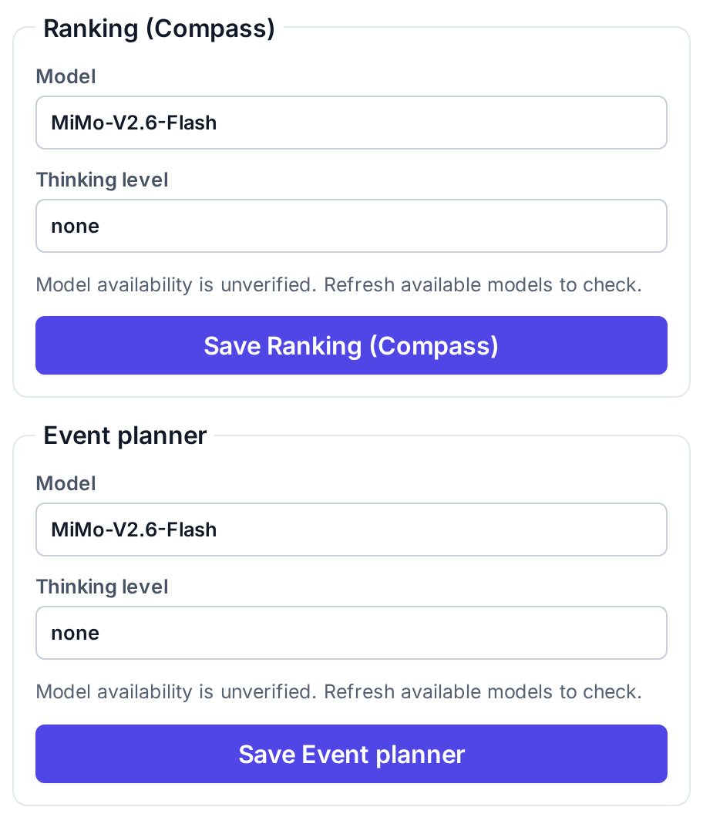
Built on AMD Token Factory
▸ OpenAI-compatible API, JSON output; our validators are the contract.
▸ Default model MiMo-V2.6-Flash; ranking and event planner can use different models.
▸ Local budget: 10 requests/min, 2 concurrent; bounded 429 retries; circuit breaker.
▸ Recorded MiMo check: 9/10 valid rankings, 10/10 valid event plans.
▸ Ranking deadline 90 s; model calls never hold the simulation clock.
6
Notes:
We measured several Token Factory models on the same scenario and chose the default per role from the data. These are small-sample validity results (10 samples, 60 s ranking / 30 s planner timeouts), not outcome accuracy or uptime guarantees; the ranking deadline was later raised to 90 s including one repair. Retries: at most two, only on HTTP 429. Five consecutive service failures open the breaker; one probe after 60 s. Rankings run in a background lane, so the clock keeps moving.

Slide 7
Live demo highlights
▸ Live Floor: three floors, 2D map and 2.5D overview, issues and responders in real time.
▸ Compass ranking with rationale; offer, accept, reject; help for complex work.
▸ Override and force-resolve; one-click audit trail per issue.
▸ Two independent control rooms (e8-aura-p1, e8-aura-p2).
7
Notes:
A disagreement marker in the event feed means Compass chose differently from either baseline. Open the recommendation record to see which baseline and to read the rationale.

Slide 8
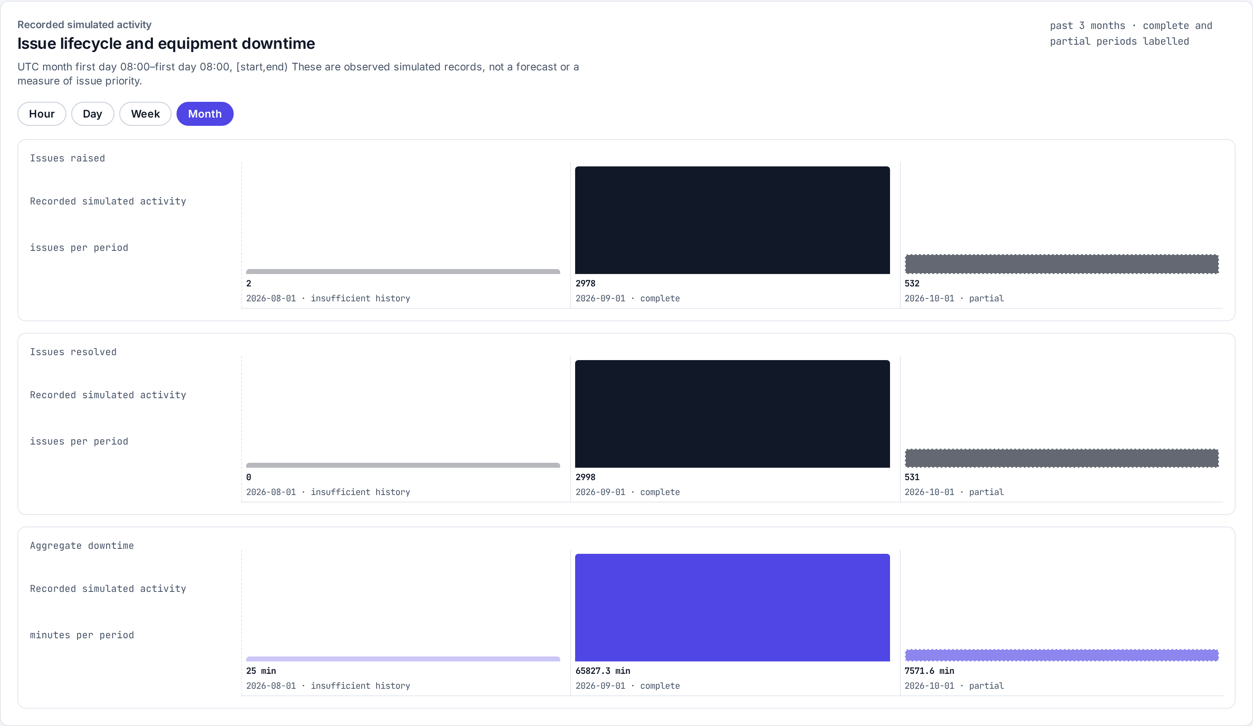
A month of operations
▸ e8-aura-p1: 3,531 issues, 1 September to 6 October (simulated).
▸ September: 2,978 raised / 2,998 resolved events.
▸ Day, week and month views; Compass-vs-baseline records.
▸ Seven-day detail retention: live state served in 56 ms in a local check.
8
Notes:
This history was generated with the app's own engine, offline and deterministically, so every record is one the app itself would produce. Retention archives older detail without changing any analytics number. The month extension used deterministic fallbacks; it is not an AMD-only benchmark or a controlled comparison of model and baseline outcomes. Latency is one local measurement, not a guarantee.

Slide 9
Engineering quality
▸ Live and Offline are one app; Offline makes no API calls and is fully reproducible.
▸ 277 hermetic unit and integration tests and 51 Chromium end-to-end tests.
▸ Deterministic seeded simulation; restart-safe scheduler; atomic, crash-safe persistence.
▸ Runs on Node.js 22 or Docker; no external services besides the model API.
9
Notes:
Everything that matters is tested without spending API credits; the browser tests force provider failures to prove the fallbacks.

Slide 10
What's next
▸ Recommended fixes: rank response actions retrieved from comparable past resolutions.
▸ Learn from outcomes: feed accepted and successful fixes back into the evidence.
▸ Connect to real maintenance and ticketing systems in place of the simulated floor.
▸ Long-run storage: compact the remaining growing history for year-long runs.
The right responder. The right fix.
10
Notes:
The dispatch half is built and measured. The next step uses the same boundary for actions: code retrieves comparable past resolutions, and the model ranks and explains the fix.

