Slide 1

AURA Health
A calm companion between doctor visits
Healthcare track
Notes:
Scene 1 · The challenge — 0:00–0:25 (live pitch)
[Slide: cover · "AURA Health — a calm companion between doctor visits" · Healthcare track badge.]
"We chose the Healthcare track's Challenge Statement 2, AI Healthier Every Day, Scenario 1: mental health maintenance for working adults on antidepressants. This is AURA Health."

Slide 2

AURA HEALTH
OUR CHOSEN CASE STUDY
Challenge Statement 2 · AI Healthier Every Day
Scenario 1 · Mental health maintenance for working adults on antidepressants
“How might we build an AI-powered health companion that helps people understand and manage their medications, stay on track with their care, and take greater ownership of their long-term health?”
Problem statement · Healthcare track, NTU Lee Kong Chian School of Medicine
Healthcare track · Challenge Statement 2 · Scenario 1
Synthetic demo data · aura-health.makodev58.com
Notes:
(Continues scene 1.)
Scene 1 · The challenge — 0:00–0:25 (live pitch)
[Slide: cover · "AURA Health — a calm companion between doctor visits" · Healthcare track badge.]
"We chose the Healthcare track's Challenge Statement 2, AI Healthier Every Day, Scenario 1: mental health maintenance for working adults on antidepressants. This is AURA Health."

Slide 3

AURA HEALTH
THE PROBLEM
Staying well happens between appointments
A dose gets missed, sleep drifts later, a flu knocks you out for a few days.
Most apps ask you to log your mood every evening, which is hard when you are tired or low.
When the appointment comes, it is all pieced together from memory.
Healthcare track · Challenge Statement 2 · Scenario 1
Synthetic demo data · aura-health.makodev58.com
Notes:
Scene 2 · The problem — 0:25–0:55 (live pitch)
[Slide: three short lines.]
"Staying well on an antidepressant happens mostly between appointments. A dose gets missed, sleep drifts later, a flu knocks you out for a few days. Most apps ask you to log your mood every evening, which is hard when you're tired or low. And when the appointment comes, it's all pieced together from memory."

Slide 4
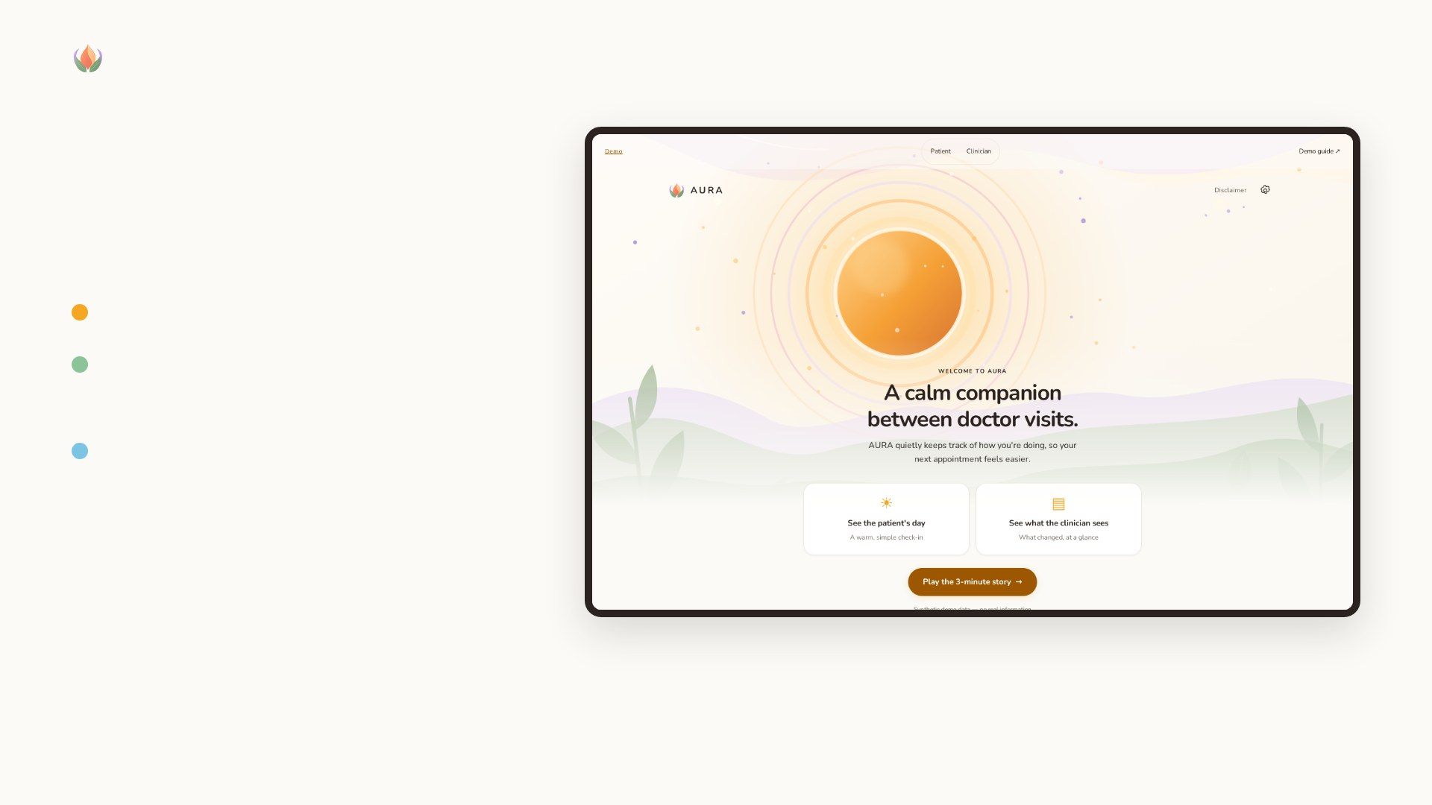
AURA HEALTH
WHAT AURA DOES
A calm companion between doctor visits
Reads everyday wearable data quietly
Compares it with this person's own usual, not a population average
A calm view for the patient; a clear “what changed and when” for the clinician they share with
Healthcare track · Challenge Statement 2 · Scenario 1
Synthetic demo data · aura-health.makodev58.com
Notes:
Scene 3 · A calm start — 0:55–1:35 (live pitch)
[Screen: landing → Play the 3-minute story → Start (the in-app guided story; each step highlights one thing and AURA does the tapping) → "Take a breath" → summary.]
"AURA starts with a breath, not a dashboard. Then one short summary, written by AI from facts the system has checked: sleep time later than usual since late February, and how the person has been checking in. It quietly reads everyday wearable data and compares it with this person's usual, not a population average."

Slide 5
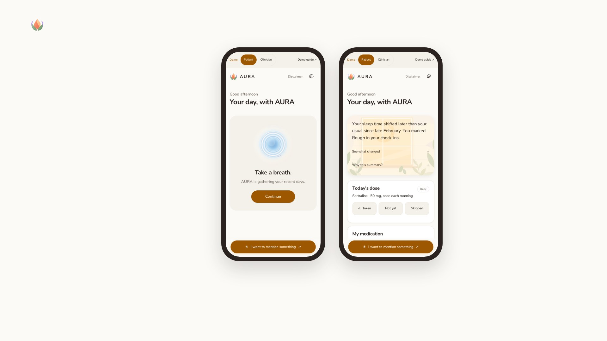
AURA HEALTH
A CALM START
A breath, not a dashboard
Then one short summary, written by AI from facts the system has checked: sleep time later than usual since late February, and how the person has been checking in.
Take a breath
One short summary
Healthcare track · Challenge Statement 2 · Scenario 1
Synthetic demo data · aura-health.makodev58.com
Notes:
(Continues scene 3.)
Scene 3 · A calm start — 0:55–1:35 (live pitch)
[Screen: landing → Play the 3-minute story → Start (the in-app guided story; each step highlights one thing and AURA does the tapping) → "Take a breath" → summary.]
"AURA starts with a breath, not a dashboard. Then one short summary, written by AI from facts the system has checked: sleep time later than usual since late February, and how the person has been checking in. It quietly reads everyday wearable data and compares it with this person's usual, not a population average."

Slide 6
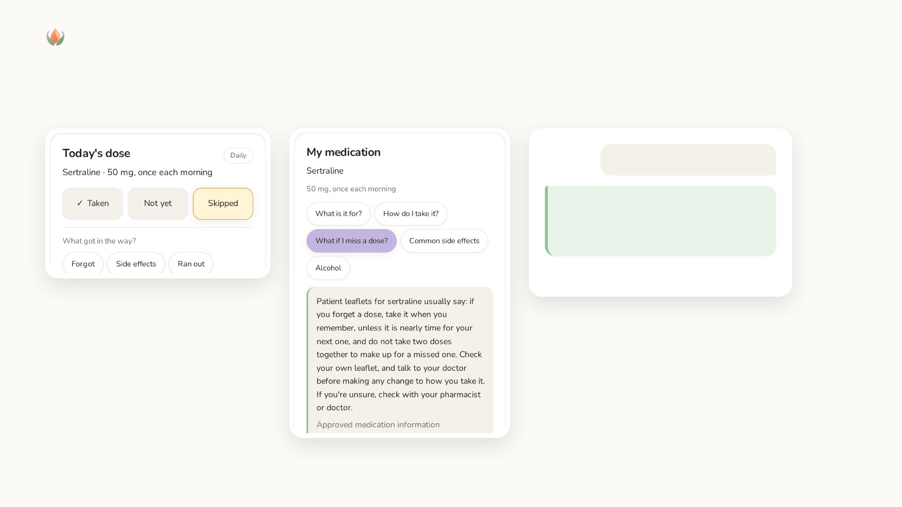
AURA HEALTH
MY MEDICATION, MY DAY
One tap a day, plain answers, honest limits
Can I take ibuprofen with it?
I'm not able to identify that medication, please check with your pharmacist.
AURA's exact reply in the live demo
Skipped? AURA asks what got in the way, because that is worth bringing to the doctor.
Answers come from approved information, not made up by AI. When it can't answer, it says so.
Healthcare track · Challenge Statement 2 · Scenario 1
Synthetic demo data · aura-health.makodev58.com
Notes:
Scene 4 · My medication, my day — 1:35–2:35 (live pitch)
[Screen: Today's dose → tap Skipped → "What got in the way?" → Side effects.]
"Every morning there's one tap: taken, not yet, or skipped. If it's skipped, AURA asks what got in the way, because that's what's worth bringing to a doctor. My medication explains the person's own prescription in plain words: what it's for, how it's usually taken, what patient leaflets say about a missed dose. These answers come from approved information, not made up by AI, and they always point back to the pharmacist."
[Then type in Ask a question: "Can I take ibuprofen with it?"]
"And when AURA can't answer, it says so: I'm not able to identify that medication, please check with your pharmacist. Exactly what the challenge asks for."

Slide 7
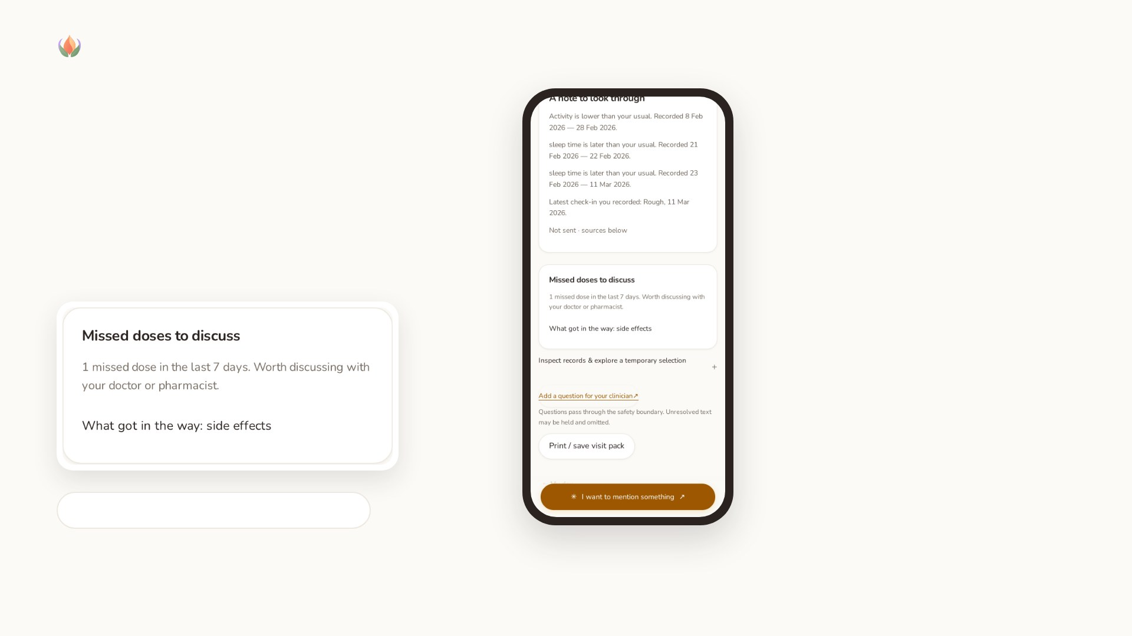
AURA HEALTH
READY FOR THE APPOINTMENT
Everything for the visit, in one place
What changed, when, and the missed dose with its reason, ready to discuss with the doctor or pharmacist.
Nothing is sent automatically · Not sent
Healthcare track · Challenge Statement 2 · Scenario 1
Synthetic demo data · aura-health.makodev58.com
Notes:
Scene 5 · Ready for the appointment — 2:35–3:05 (live pitch)
[Screen: Prepare for my appointment → missed doses → Not sent.]
"Before the visit, everything is in one place: what changed, when, and the missed dose with its reason, ready to discuss with the doctor or pharmacist. Nothing is sent automatically. It stays Not sent until the patient decides."

Slide 8
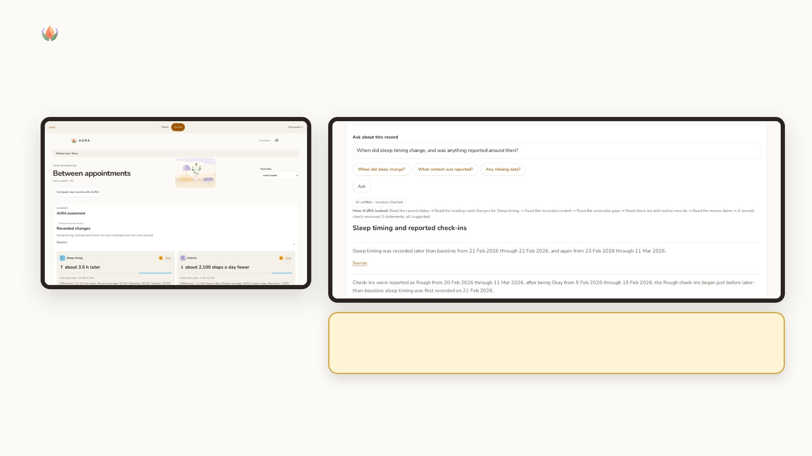
AURA HEALTH
WHAT THE CLINICIAN SEES · THE AGENT AT WORK
It decides what to look at, cites every statement, and is checked
What changed and when, with exact values and sources.
How AURA looked: which records it read, then “A second check reviewed 3 statements; all supported”. It can only read; it never changes the record or the treatment.
Healthcare track · Challenge Statement 2 · Scenario 1
Synthetic demo data · aura-health.makodev58.com
Notes:
Scene 6 · What the clinician sees — the agent at work — 3:05–4:10 (live pitch)
[Screen: Clinician → assessment cards → Ask about this record:]
"If the patient shares, their clinician sees what changed and when, with exact values and sources. And the clinician can ask. Here AURA works as an agent: it decides which signals, tools and dates to look at, reads the record, and drafts an answer where every statement cites its source. A second, independent check then reviews each statement and removes anything unsupported. How AURA looked shows exactly what it did. It can only read; it never changes the record or the treatment."
[If it falls back:]
"This time the draft didn't pass the checks, so AURA shows the related facts and says why."

Slide 9
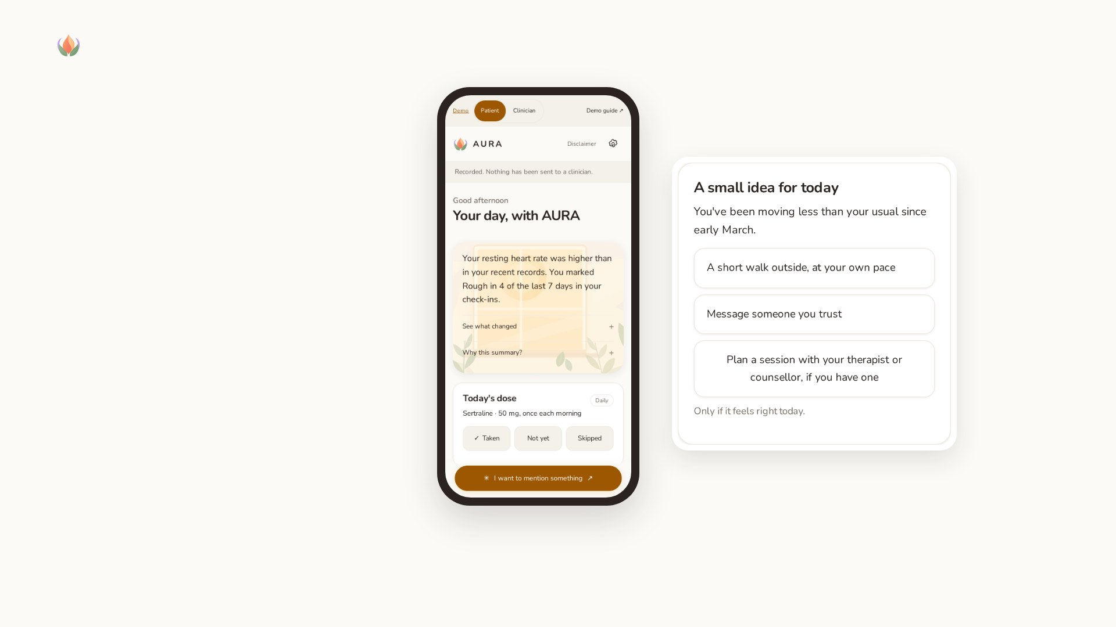
AURA HEALTH
SOMETHING CHANGES
A simulated three-day flu
AURA notices resting heart rate is higher than in the person's recent records, and says exactly that: a recent change, not a change from their usual.
When a change shows up, it offers a small idea for today. Optional, never about medication.
Healthcare track · Challenge Statement 2 · Scenario 1
Synthetic demo data · aura-health.makodev58.com
Notes:
Scene 7 · Something changes — 4:10–4:50 (live pitch)
[Screen: guided story step 9 → simulated flu → the patient home with the new summary and a small idea for today.]
"Now a flu, simulated over three days. AURA notices resting heart rate is higher than in the person's recent records, and says exactly that: a recent change, not a change from their usual. And when a change shows up, it offers a small idea for today: a short walk, a message to someone you trust, or planning a session. Optional, never about medication."

Slide 10
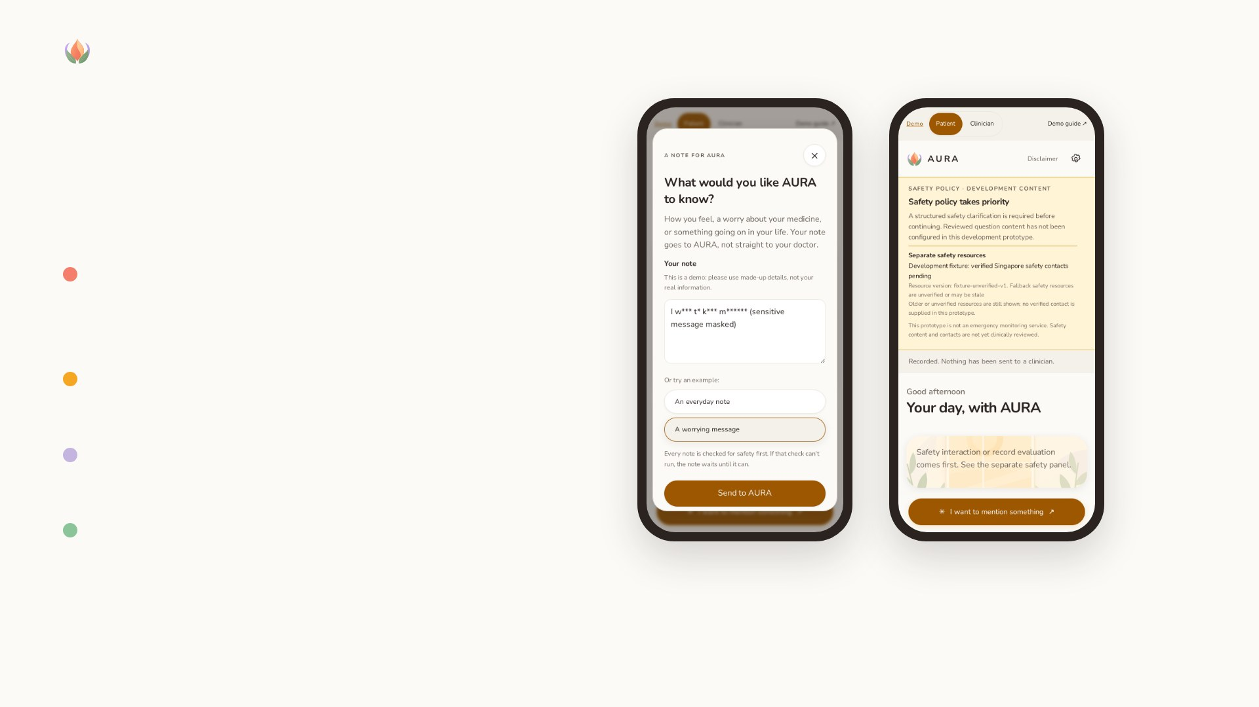
AURA HEALTH
SAFETY FIRST
Anything a patient types is safety-checked first
If there is a concern, fixed safety resources take over the screen and the AI steps back. They are never AI-written.
The patient can't dismiss them. The clinician sees the same safety state when they open the record.
No alerts are sent in this prototype: who is told, and how fast, is for the care team to decide.
Asking to double a dose goes to safety, not to an answer.
The example, masked
Safety takes over
Healthcare track · Challenge Statement 2 · Scenario 1
Synthetic demo data · aura-health.makodev58.com
Notes:
Scene 8 · Safety first — 4:50–5:15 (live pitch)
[Screen: finish card → Show the safety example → the note box opens with A worrying message (masked on screen) → Send to AURA → safety panel → the card explains, with Reset the demo.]
"Anything a patient types is safety-checked first. If there's a concern, fixed safety resources take over the screen and the AI steps back. Those messages are never AI-written, and the patient can't dismiss them. The clinician sees the same safety state when they open the record. This prototype doesn't send alerts: who is told, and how fast, is for the care team to decide. The same applies to medication questions: asking to double a dose goes to safety, not to an answer."

Slide 11
AURA Health · system architecture
Challenge 2 · Scenario 1: mental health maintenance for working adults on antidepressants
Web experience
Python app · owns the state
Bounded AI · read-only
Patient companion
Recap, dose + reasons
Replies, ideas, activities
Sharing choices
FastAPI application services
Atomic + idempotent events · SQLite + audit
Aura-Agent + patient-scoped tools
The model chooses tools, dates and comparisons
inputs
views
Curated medication content
Typed questions: safety first, fixed answers
request
result
Ground · verify · recheck
Cited answer, or a labelled fallback + trace
Clinician view
Findings, Ask the record
Only what is shared
Safety engine
T0–T4, fails closed
Longitudinal
Personal + recent baselines
Model gateway: provider configurable
Operator picks model + reasoning level
Synthetic data only
Presentation, not policy
Observable events
via app ingestion
limits what clinician
runs can read
Signals propose. Rules decide. AI words it.
Independent safety display
Pinned resources + fallback
Never AI-written
Separate simulation plane
Plans + seeded synthetic data
Only observable events enter
Patient-controlled sharing
Minimum always; notes, readings,
daily check-ins opt-in
One application · synthetic workspaces · development storage · demo roles, no clinical authentication · visit preview Not sent · institutional hosting is future work
Notes:
Scene 9 · How it's built — 5:15–6:00 (live pitch)
[Slides: architecture overview · agent loop · safety precedence (`diagrams/`).]
"Our rule: signals propose, rules decide, AI words it. Deterministic engines own the personal baselines and the safety state. Medication information is curated; AI only matches a question to an approved topic. The clinician agent investigates with read-only tools, and every answer passes number, date and citation checks plus an independent verifier. In this demo the model runs on synthetic data only; a hospital would run it on its own private infrastructure. And the patient decides what their clinician sees: an agreed minimum, plus anything they choose to share, enforced on the server, so the agent says 'not shared, ask the patient' instead of guessing."
Architecture audit 2026-10-14: implementation 90e31ea. See docs/submission/ARCHITECTURE_REVIEW.md. The 90-s budget is checked between calls; resource rendering has no model, but patient-input assessment may use one.

Slide 12
Aura-Agent · investigate, cite, check
Challenge 2 · Scenario 1: mental health maintenance for working adults on antidepressants
1 · Guard the request
Skill, selected patient, current safety
Read-only record + permitted window
2 · Model chooses a step
Which tool? Which dates? Which signal?
Read more, or draft a cited answer
tool calls,
facts back
3 · Execute scoped tools
Series, context, gaps, routine records
Return facts, sources and calculations
cited draft
when ready
“When did sleep timing change, and was anything reported around then?”
A clinician's question. Patient-typed text is safety-checked first.
4 · Ground and verify
Exact facts, citations, allowed claims
Live drafts: separate verification call
5 · Recheck current state
Record, safety + provider revision
Unsafe or stale results are withheld
Loop budgets: 8 model steps · 24 tool calls · 90 seconds
6 · Persist and display
Answer, sources, How AURA looked
No care-action or treatment-write tools
Time checked between calls; provider timeout 30 s. Verifier is separate.
Failed drafts use related facts when available; blocked/stale requests show no answer.
The trail shows actions, not hidden reasoning. Verification is not clinical validation.
Notes:
(Continues scene 9.)
Scene 9 · How it's built — 5:15–6:00 (live pitch)
[Slides: architecture overview · agent loop · safety precedence (`diagrams/`).]
"Our rule: signals propose, rules decide, AI words it. Deterministic engines own the personal baselines and the safety state. Medication information is curated; AI only matches a question to an approved topic. The clinician agent investigates with read-only tools, and every answer passes number, date and citation checks plus an independent verifier. In this demo the model runs on synthetic data only; a hospital would run it on its own private infrastructure. And the patient decides what their clinician sees: an agreed minimum, plus anything they choose to share, enforced on the server, so the agent says 'not shared, ask the patient' instead of guessing."
Architecture audit 2026-10-14: implementation 90e31ea. See docs/submission/ARCHITECTURE_REVIEW.md. The 90-s budget is checked between calls; resource rendering has no model, but patient-input assessment may use one.

Slide 13
Safety policy has the final say
Challenge 2 · Scenario 1: mental health maintenance for working adults on antidepressants
Patient input
Typed notes and medication questions
Safety-relevant path first
Safety gate + proposals
Demo fixtures or rules + model
Raise-only detector proposals
Deterministic safety controller
T0–T4 transitions and actions
Fail closed when degraded
Registry + built-in bundle
Lookup failure: built-in fallback
Stale/unverified: visible + notice
Longitudinal communication
Stay quiet / check in / clarify
Describes personal changes
Safety overrides ordinary messages
Applies the authoritative state
The app does not assign tiers
Pinned safety resources
Shown outside generated text
Resource rendering uses no model
The patient can't dismiss safety content. The clinician sees the same state when they open the record. No alerts are sent in this prototype.
Assessment may call a model; failure holds input and restricts ordinary output.
Resources need review · no emergency monitoring or suicide-risk determination
Render the allowed interaction
Approved wording + checks
T4 / offline / degraded:
fixed wording
Notes:
(Continues scene 9.)
Scene 9 · How it's built — 5:15–6:00 (live pitch)
[Slides: architecture overview · agent loop · safety precedence (`diagrams/`).]
"Our rule: signals propose, rules decide, AI words it. Deterministic engines own the personal baselines and the safety state. Medication information is curated; AI only matches a question to an approved topic. The clinician agent investigates with read-only tools, and every answer passes number, date and citation checks plus an independent verifier. In this demo the model runs on synthetic data only; a hospital would run it on its own private infrastructure. And the patient decides what their clinician sees: an agreed minimum, plus anything they choose to share, enforced on the server, so the agent says 'not shared, ask the patient' instead of guessing."
Architecture audit 2026-10-14: implementation 90e31ea. See docs/submission/ARCHITECTURE_REVIEW.md. The 90-s budget is checked between calls; resource rendering has no model, but patient-input assessment may use one.

Slide 14

AURA HEALTH
KEY DESIGN TRADE-OFFS
Signals propose, rules decide, AI words it
Deterministic state, flexible language — engines own personal baselines and safety; AI writes words and investigates.
Quiet patient surface, deep clinician inspection — one record, two views; the patient decides what the clinician sees.
Strict checks, honest fallback — numbers, dates and citations are checked plus an independent verifier; failures show related facts and say why.
Curated medication information — AI only matches a question to an approved topic.
Synthetic data now, private hosting later — a hospital would run the model on its own infrastructure.
Healthcare track · Challenge Statement 2 · Scenario 1
Synthetic demo data · aura-health.makodev58.com
Notes:
(Continues scene 9.)
Scene 9 · How it's built — 5:15–6:00 (live pitch)
[Slides: architecture overview · agent loop · safety precedence (`diagrams/`).]
"Our rule: signals propose, rules decide, AI words it. Deterministic engines own the personal baselines and the safety state. Medication information is curated; AI only matches a question to an approved topic. The clinician agent investigates with read-only tools, and every answer passes number, date and citation checks plus an independent verifier. In this demo the model runs on synthetic data only; a hospital would run it on its own private infrastructure. And the patient decides what their clinician sees: an agreed minimum, plus anything they choose to share, enforced on the server, so the agent says 'not shared, ask the patient' instead of guessing."

Slide 15
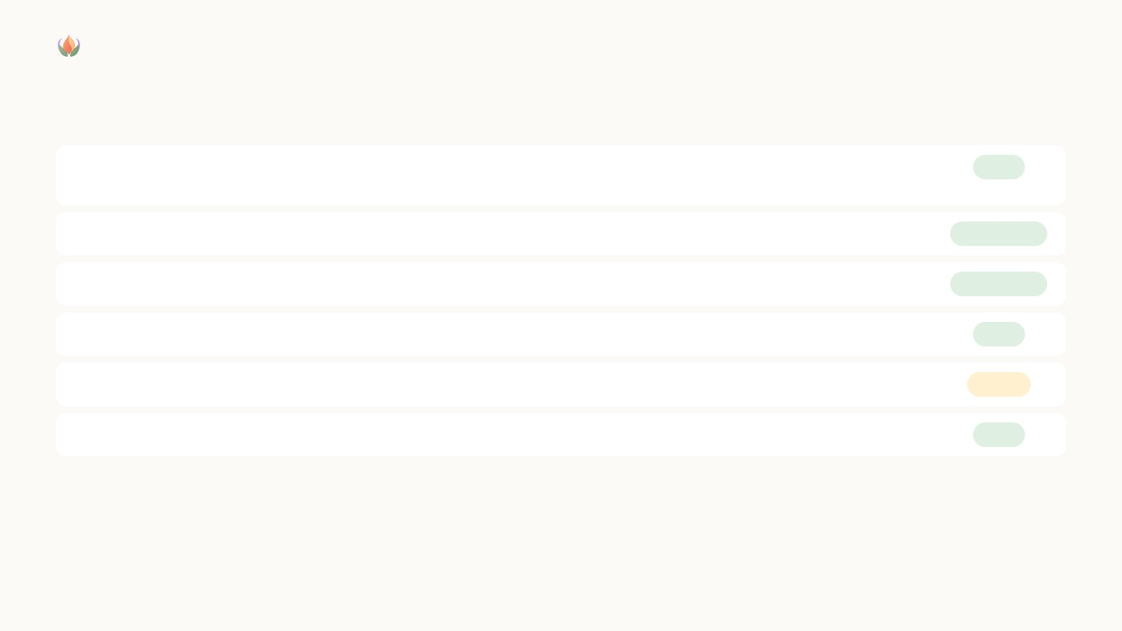
AURA HEALTH
FIT WITH THE CHALLENGE
Six features the challenge asks for
Medication understanding
Approved information about the person's own prescription; AI matches a question to an approved topic; honest “check with your pharmacist” when it can't answer
Built
Medication management
One tap a day: taken, not yet, skipped (no push reminders yet)
In the demo
Adherence support
“What got in the way?” reasons, carried to the visit note
In the demo
Health tracking
Wearable signals against the person's own usual and recent pattern
Built
Preventive health
Refill and medication-review dates; screenings and vaccinations not yet
Partial
Healthcare preparation
Visit note with changes and missed doses, Not sent until the patient decides
Built
Deliberately different: AURA describes changes; it does not predict relapse or give medication advice.
Healthcare track · Challenge Statement 2 · Scenario 1
Synthetic demo data · aura-health.makodev58.com
Notes:
Scene 10 · Fit with the challenge — 6:00–6:25 (live pitch)
[Slide: six features: built / partial / next (from `../submission/CHALLENGE_MAPPING.md`).]
"Against the challenge: medication understanding, adherence with barriers, health tracking, follow-up dates for refills and medication reviews, and appointment preparation are in the demo. Push reminders, screenings and pharmacist-reviewed content come next. One choice is deliberate: AURA describes changes; it doesn't predict relapse or give medication advice."

Slide 16

AURA HEALTH
HOW WE BUILT IT
Core first, then the agent, then the experience
Safety and personal-baseline engines first, then the read-only agent, then the patient experience
AI development tools, including Tencent CodeBuddy and Miora, working from written specs
Every change reviewed and tested before release
Our tip: write down what must never change before asking an AI to build anything.
Healthcare track · Challenge Statement 2 · Scenario 1
Synthetic demo data · aura-health.makodev58.com
Notes:
Scene 11 · How we built it — 6:25–6:45 (live pitch)
[Slide: how we built it (core first, AI development tools, reviews and tests).]
"We built the safety and personal-baseline core first, then the agent, then the experience, using AI development tools including Tencent's CodeBuddy and Miora, working from written specs, with every change reviewed and tested. Our tip: write down what must never change before asking an AI to build anything."

Slide 17

AURA HEALTH
IMPACT WE WOULD MEASURE IN A PILOT
NEXT
Targets to measure, not results
Push reminders, screenings and pharmacist-reviewed content; consented real wearables; private hosting.
Missed doses with a recorded reason
LIMITS
Preparation time before visits
No diagnosis, relapse prediction or medication advice. Synthetic data only. Not clinically validated.
How many appointments start with a prepared note
Healthcare track · Challenge Statement 2 · Scenario 1
Synthetic demo data · aura-health.makodev58.com
Notes:
Scene 12 · Impact and close — 6:45–7:05 (live pitch)
[Slide: pilot metrics (labelled as targets) · closing line.]
"In a pilot we'd measure missed doses with a recorded reason, preparation time before visits, and how many appointments start with a prepared note. AURA Health: a calm companion between doctor visits, so both sides start the conversation on the same page."

Slide 18

AURA Health
A calm companion between doctor visits, so both sides start the conversation on the same page.
aura-health.makodev58.com · github.com/e8aura-makodev58/aura-health
Notes:
(Continues scene 12.)
Scene 12 · Impact and close — 6:45–7:05 (live pitch)
[Slide: pilot metrics (labelled as targets) · closing line.]
"In a pilot we'd measure missed doses with a recorded reason, preparation time before visits, and how many appointments start with a prepared note. AURA Health: a calm companion between doctor visits, so both sides start the conversation on the same page."

