Slide 1
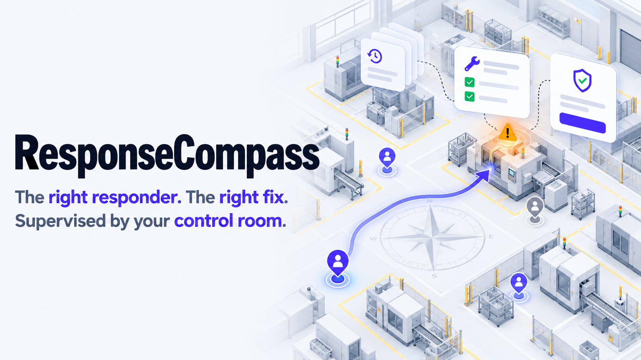
Nebius x NVIDIA Global AI Hackathon · Best Apps and Agents
Nemotron 3 Ultra, Nemotron 3 Super and Nemotron 3.5 Lightning on Nebius Token Factory
Notes:
ResponseCompass is a dispatch agent for operations control rooms, built for the Nebius x NVIDIA hackathon on Nemotron models through Nebius Token Factory. Technicians describe faults in their own words; code establishes the facts; Nemotron ranks and drafts; people approve the decisions that matter.

Slide 2
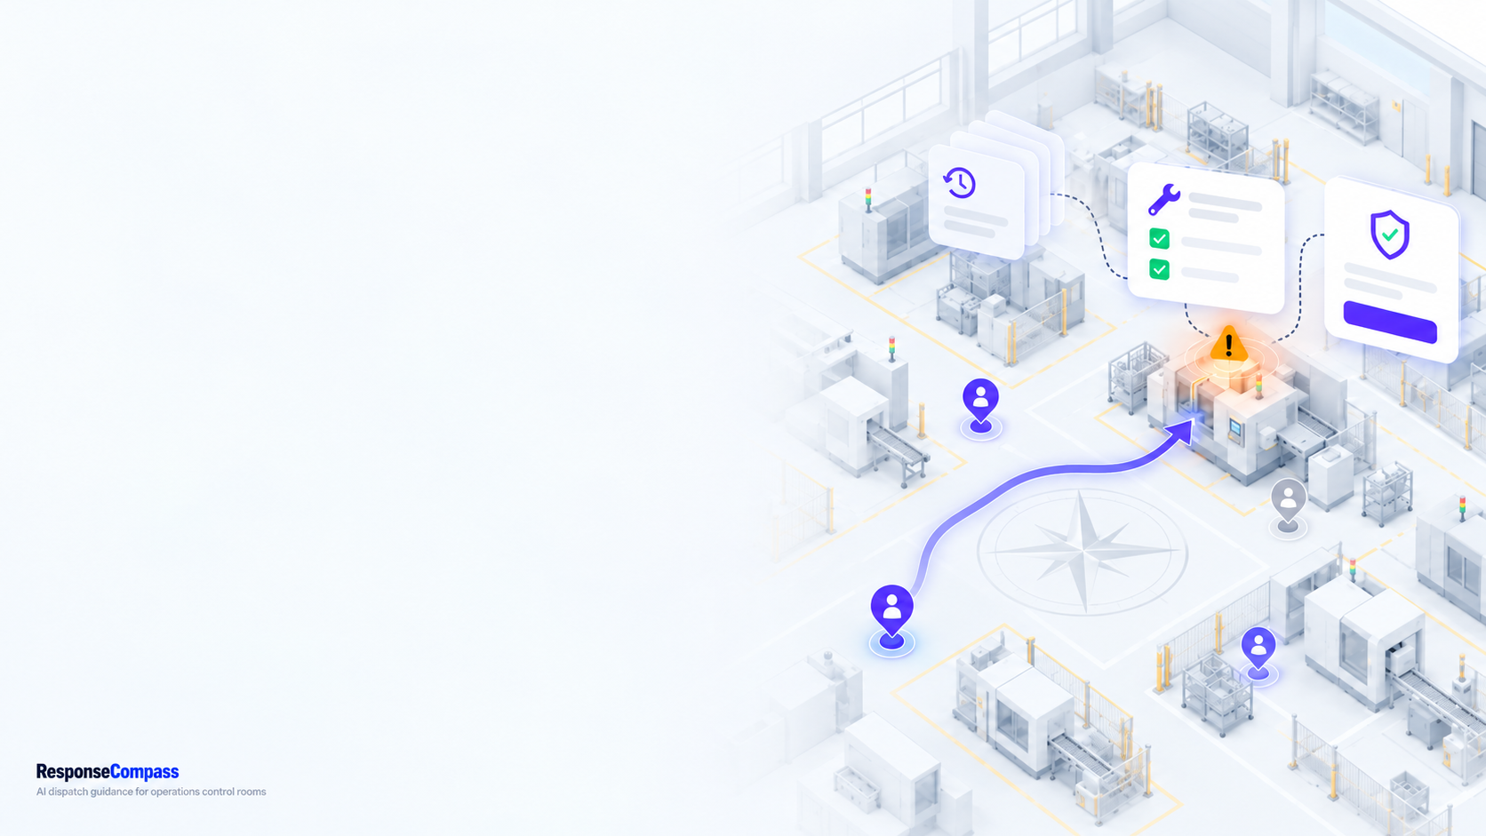
THE PROBLEM
Closest is not best
01
Nearest is not most experienced.
The closest technician may never have fixed this fault.
02
The first fix is often a guess.
A wrong guess means a reopened issue and another trip.
03
Reports arrive as free text.
"The transfer keeps stopping short" must become an equipment, a symptom and a set of past cases.
04
Backlogs force overtime calls.
Who may legally stay on, and who covers the most work?
2
Notes:
Proximity is easy to compute and easy to defend, but it ignores fit. What matters is who is likely to resolve this class of issue on the first attempt, with which procedure, and whether the shift can cover the backlog. Reports also arrive as free text, not clean tickets.

Slide 3
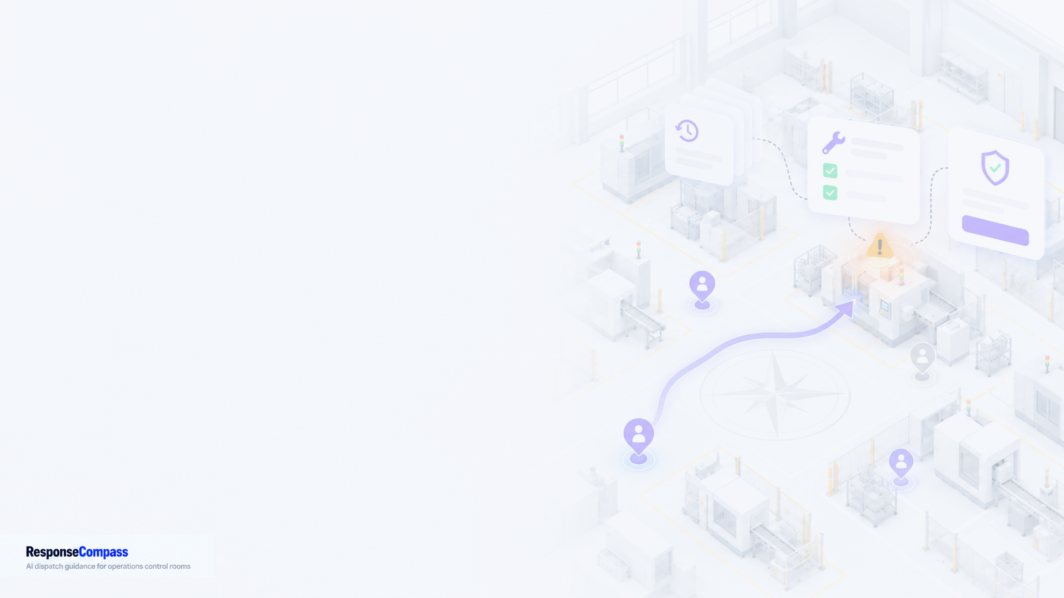
WHAT IS NEW FOR NEBIUS
Existing foundation, new Nebius work
The control-room product existed before this entry. The Nebius work is listed on the right.
Existing foundation (before baseline 1e1c69c)
Added for Nebius (after baseline 1e1c69c)
A persistent simulated control room with deterministic eligibility, metrics and outcomes.
Wall-display screens, operator console and Offline mode.
Hidden responder skill and hidden fault cause, never shown to a model or screen.
Analytics, Issue Pareto and baselines.
Built for an earlier AMD hackathon; that entry is disclosed in the repository.
Field reports and the Compass Investigator: Nemotron 3 Ultra in a bounded, read-only tool loop.
Citation, catalog and safety checks in code, and a single dispatch gate on every assignment.
Nebius Token Factory provider, with a Nemotron model chosen per role and per-model thinking control.
Paired evaluation harness, usage ledger and budget, and the Investigator checks on this deck.
Guest workplaces with a per-username workplace and a ten-username cap.
3
Notes:
The project existed before this hackathon: it was built for an earlier AMD hackathon. We claim only the work after baseline 1e1c69c. The full disclosure, with commit counts, is HACKATHON_CHANGES.md in the repository.

Slide 4
FIELD REPORTS
A report, not a ticket
Technicians describe faults in their own words. Code turns the words into facts; the model only ranks.
FIELD REPORT · UNTRUSTED TEXT
"Station 12: the transfer keeps stopping short of the end position every few cycles."
Technician report
free text, typed on the floor
Code resolves facts
equipment, history, hazard policy
Nemotron 3 Super
ranks up to 12 interpretations
Operator confirms
symptom and equipment, by a person
Interpretations come only from candidates code resolved from the report. A report whose equipment does not resolve is not investigated. Without enough history, the Investigator abstains rather than guesses.
4
Notes:
A field report is untrusted text. The hazard and input policy runs in code before any model call. Nemotron 3 Super ranks interpretations from candidates the code resolved; the operator confirms the symptom. Nothing is dispatched from this step.

Slide 5
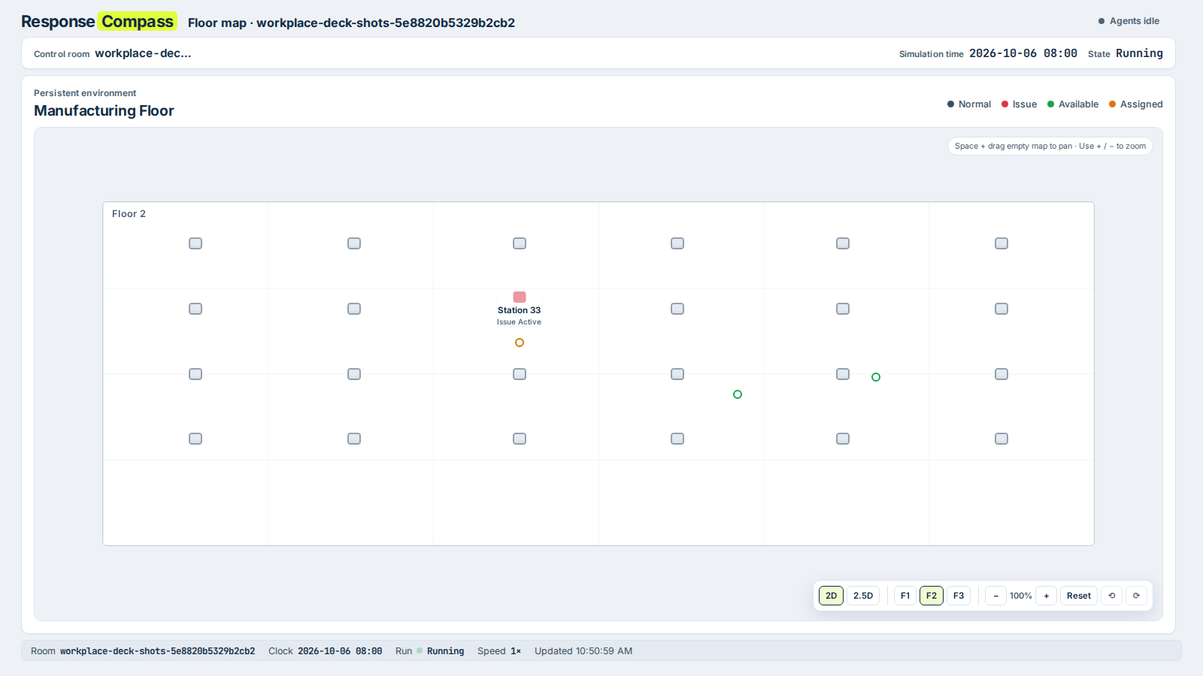
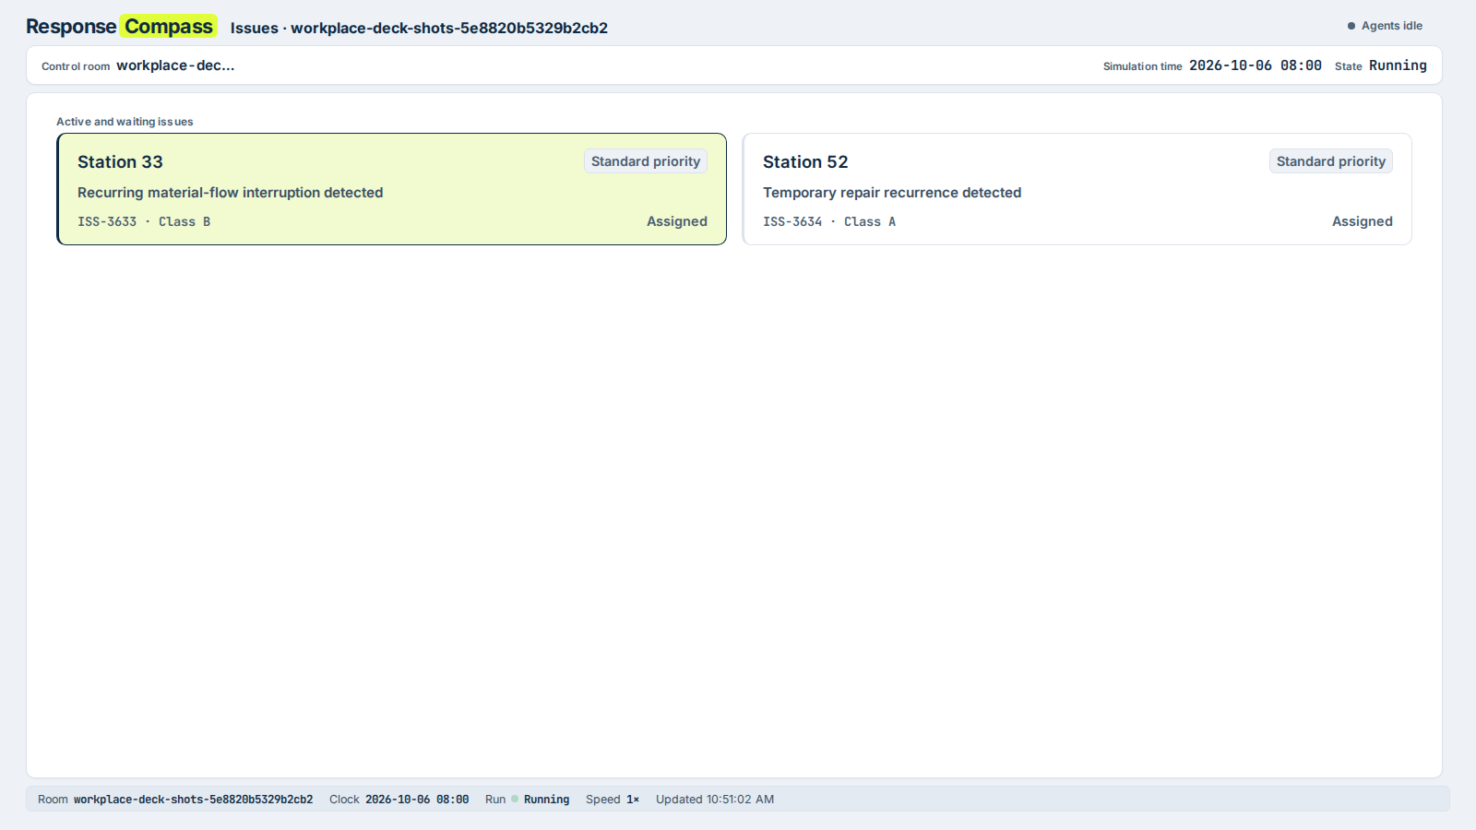
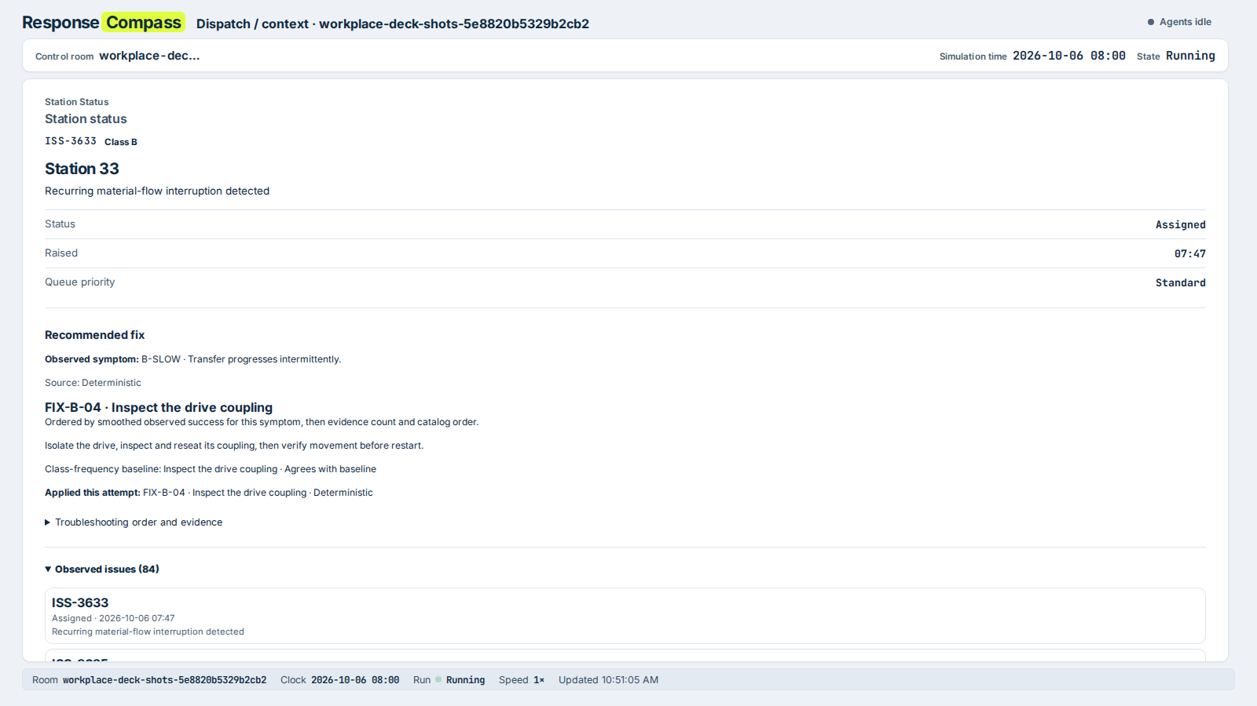
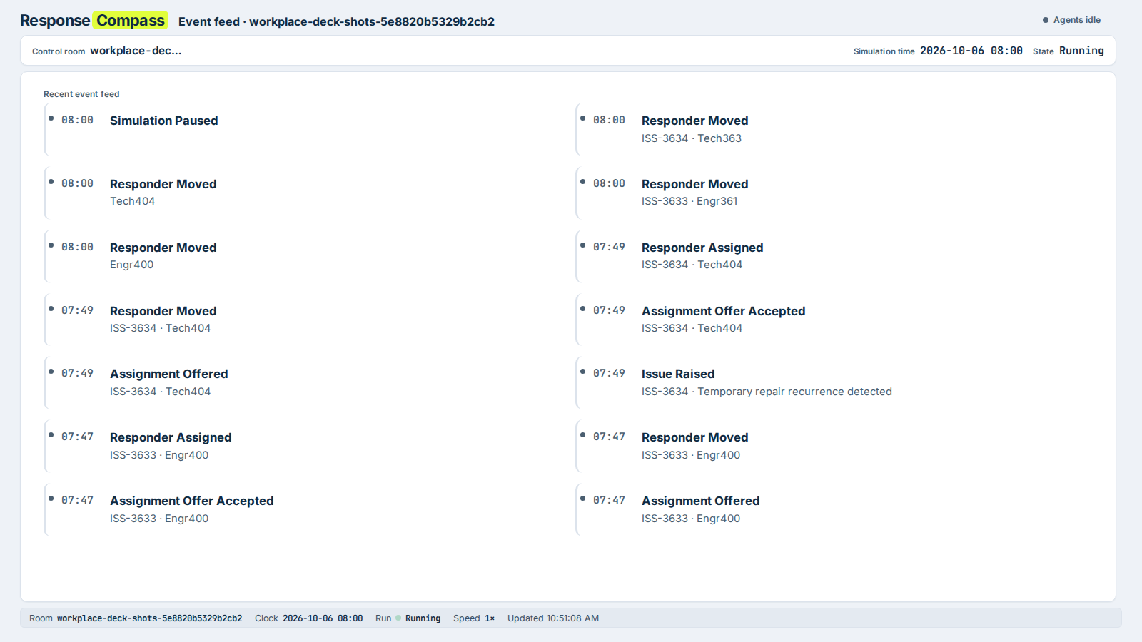
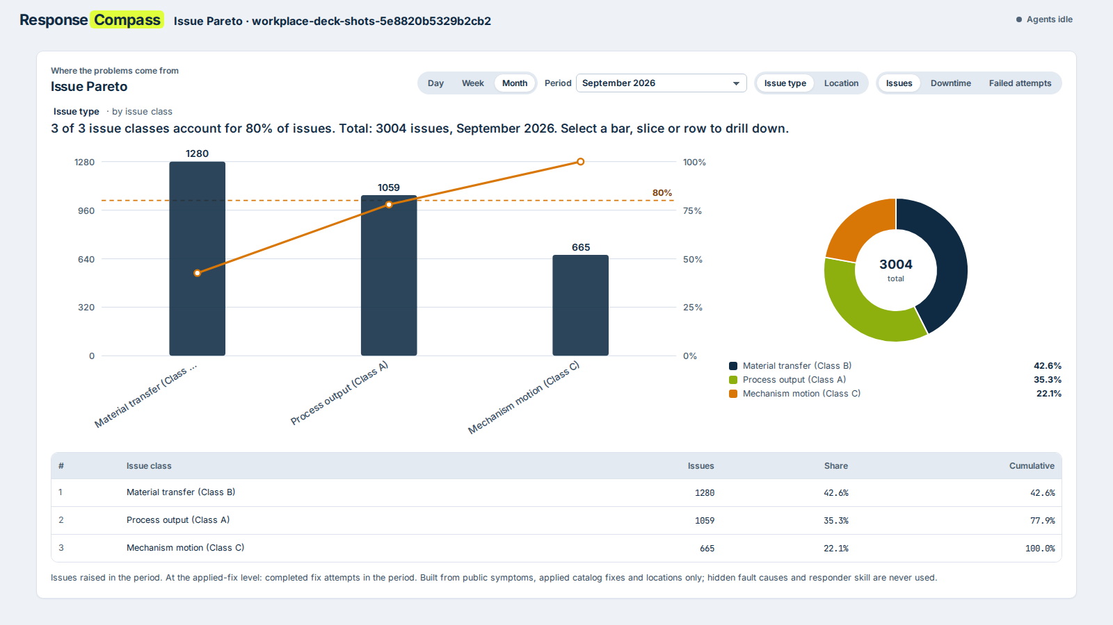
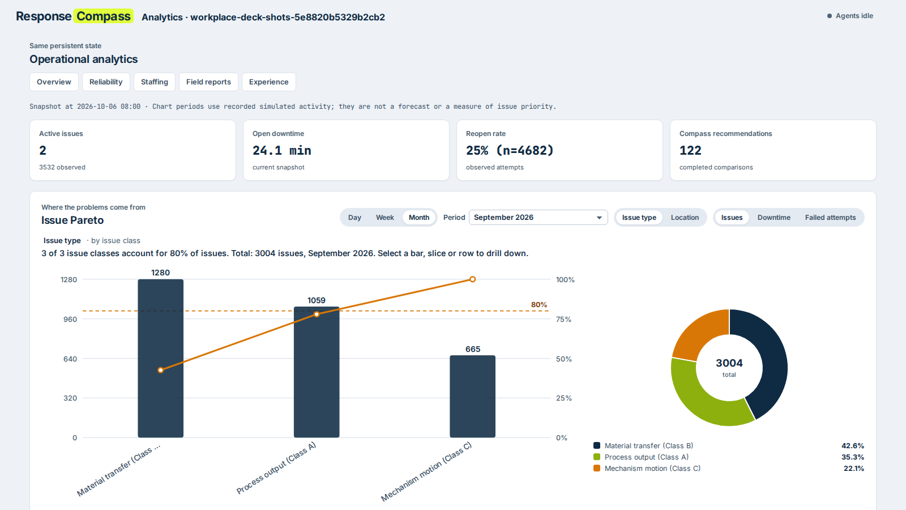
CONTROL ROOM
One agent, many screens
Each panel runs full screen on its own monitor; the operator console keeps the controls.
Floor map
Issues
Dispatch
Event feed
Issue Pareto
Analytics
5
Notes:
A control room puts the floor map, the issue queue, the dispatch context, the event feed, the Issue Pareto and analytics on separate monitors (/rooms/<room>/display/<screen>). Staffing, station KPIs, loadboards and field reports are panels too. The operator console, with override and approval controls, is the seventh screen. Captured live from a local build on the synthetic plant-1 month.

Slide 6
HOW IT RUNS
Two paths, one dispatch gate
Ordinary dispatch runs on its own. A field report waits for the operator and an approval before any assignment.
ORDINARY DISPATCH
Issue raised
equipment fault
Rank responders
Super, eligible only
Offer sent
automatic, ranked
Responder
accepts or rejects
Rank fixes
Super, catalog procedures
Repair attempt
outcome from hidden truth
FIELD REPORT · INVESTIGATION
Field report
technician text, untrusted
Super ranks
interpretations, up to 12
Operator confirms
symptom and equipment
Ultra investigates
six read-only tools
Operator approves
the gate opens here
Assign
responder and fix
OVERTIME
Backlog review
before each handover
Rank overtime
Super, legal options
Central command
approves or rejects
Observed history
evidence for every ranking
Central command can override, transfer or add support at any time.
6
Notes:
Two paths share one dispatch gate. Ordinary dispatch: an issue is raised, Super ranks eligible responders, an offer goes out, and the responder accepts or rejects. Field-report investigation: a technician's report is confirmed by the operator, Ultra runs the bounded investigation, and a person approves the recommended responder and fix before any assignment. The outcome feeds observed history. Overtime is a separate branch: Super ranks lawful options and central command decides.

Slide 7
ARCHITECTURE
Application code
Nemotron model
Store
People
Code owns the facts. Models only rank.
Code owns time, facts, eligibility, baselines, the dispatch gate and every mutation. Models rank or propose.
Simulation clock
persistent, pausable
Event planner
Nemotron 3.5 Lightning
Investigator
Nemotron 3 Ultra
Narrator
Nemotron 3.5 Lightning
Validator and gate
schema, facts, one dispatch gate
Central command
approves, overrides
Scheduler
one-shot, restart-safe
Fallback planner
deterministic, API-free
Canonical state
persistent store, audit trail
Live Floor & Analytics
UI, fixed snapshots
Responders
accept or reject
Compass
Nemotron 3 Super ranks
Context engine
eligibility, travel, history
Resolution engine
hidden skill, outcome
Dispatch
ranked offer queue
Baselines
nearest + naive score
7
Notes:
Code owns time, facts, eligibility, baselines, the dispatch gate and every mutation. Models rank or propose; they never act. The ranker receives application-owned evidence and ranks only the candidates it is given. The Investigator quotes only what its tools returned, and the validator checks every citation. The planner proposes synthetic incidents; the validator checks each proposal. If a model is slow, rate-limited or returns invalid output, the deterministic path takes over.

Slide 8
COMPASS INVESTIGATOR
Investigate before anyone is sent
Super ranks the interpretations; Ultra runs six bounded, read-only tools; the operator approves before any dispatch.
01 Read the report
02 Rank interpretations
03 Tool loop
04 Check citations
05 Operator approves
Hazard and input policy decided in code, before any model call.
Nemotron 3 Super ranks up to 12 candidates that code resolved.
Ultra reads past cases, catalog procedures and qualifications, read-only.
Every cited case or procedure must be one a tool returned.
A person approves before assignment. Policy may approve safe cases only if a room enables it.
Live capture pending
The Nebius key is not yet set on the deployment, and field reports are closed to guest workplaces (access decision pending). Replace this box with a live Nemotron capture before filing. Nothing here is a model output.
8
Notes:
The Investigator runs Nemotron 3 Ultra in a bounded tool loop. Nemotron 3 Super ranks the interpretations first. Ultra reads past cases, catalog procedures and responder qualifications through six read-only tools. Every citation must be a record a tool returned. A person confirms the symptom, and the single dispatch gate accepts the assignment only after approval.

Slide 9
COMPASS INVESTIGATOR
Untrusted text, checked in code
A field report is data, not instructions. Code decides what reaches the model and checks what comes back.
Hazard policy in code
Report text is data
Citations checked
A person approves
Safety-sensitive reports are classified before any model call. A bounded lexicon, not the model, makes this decision.
The report is quoted to the model as data. The model is not asked to follow instructions written inside it.
A cited case or procedure must come from a tool result. Anything else is repaired or replaced by the deterministic path.
By default an operator approves. An audited policy may approve eligible safe cases only where a room enables it.
Scenario checks, run 3: hazard and input policy decided with no model call in 6 of 6 scenarios. Finite test set, not a coverage guarantee.
9
Notes:
Field reports are data, not instructions. The policy in code decides what reaches the model, and the validators check what comes back. We do not claim that Nemotron verifies its own prose, and the controls are finite: a bounded lexicon and validators, not a proof of semantic correctness.

Slide 10
TRUST
Honest by design
Hidden truth
Outcomes from truth
True skill and true fault cause stay hidden from every model, screen and chart.
Repairs succeed or fail from that hidden truth, not from what a model claims.
Baselines alongside
Fair analytics
Nearest, naive score and most common fix run next to Compass; disagreements are recorded.
Denominators shown, thin samples suppressed, no leaderboard. Pay, seniority and HR data are never inputs.
10
Notes:
We wanted the system to show Compass being wrong as well as right. Hidden truth plus baselines make its choices inspectable. Disagreement alone does not prove better outcomes.

Slide 11
MEASURED ON NEBIUS
Valid rankings, thinking off where it helps
Dated 2026-10-19. Small samples: five runs or samples each. Validity only, not outcome accuracy.
Generic ranking probe, both supplied ids
Model | Thinking on (default) | Thinking off
Nemotron 3 Ultra | 5/5 · median 1.8 s | 5/5 · 0.8 s
Nemotron 3 Super | 5/5 · 3.1 s | 5/5 · 0.9 s
Nemotron 3.5 Lightning | 1/5 · truncated at 1,024 tokens | 5/5 · 0.7 s
Nemotron 3 Nano | 5/5 · 3.9 s | 2/5 · omitted a candidate
Thinking control
Each model maps to chat_template_kwargs.enable_thinking. Thinking is off for ranking by default; the Super packet with thinking on was slower and less consistent (4/5, 17.6 s).
Compass's own packets, thinking off
Ranking is validated in code. Output that fails validation falls back to the deterministic order, so dispatch never stops.
Role | Model | Valid, time
Responder, fix and staffing ranking | Nemotron 3 Super | 5/5 · 3.2 s
Event planner | Nemotron 3.5 Lightning | 5/5 · 1.3 s
11
Notes:
Two measurements, both dated 2026-10-19 and both small samples. The generic probe uses one ranking prompt, five runs each. The Compass packets are the app's own ranking and planner packets, five samples each. Lightning truncated its reasoning at 1,024 tokens with thinking on, so thinking is switched off for it. These are validity results, not outcome accuracy or uptime guarantees.

Slide 12
MEASURED ON NEBIUS
First-fix replay, two live runs
60 held-out issues, the same responders, state and draws in every arm. Run B and a repeat, run C, on the same code.
46 / 60
46 / 60
41 / 60
Investigator, run B (repeat run C: 45 / 60)
Deterministic order, same issues in both runs
Class-frequency baseline, same issues in both runs
Fallbacks, discordant pairs and limits
Run B: 7 of 60 first answers fell back; discordant pairs 7 Investigator-only vs 2 baseline-only, and 2 vs 2 against the deterministic order.
Run C, same code: 23 of 60 fell back; discordant pairs 6 vs 2 against the baseline, and 2 vs 3 against the deterministic order.
One window, 60 issues, one sample each. No significance claim, and no demonstrated gain over the deterministic order.
12
Notes:
Paired replay on 60 held-out issues: the same responders, state and random draws in every arm, only the first fix differs. Run B and a repeat on the same code, run C, are both shown. In run B the Investigator ties the deterministic order; in run C it fell back to the deterministic path 23 times, and it did not beat the deterministic order. This is not a significance claim and does not show a gain over the deterministic order.

Slide 13
MEASURED ON NEBIUS
Investigator checks, run 3
Scenario evaluation on Token Factory after the security fixes. 2026-10-19; a small, finite scenario set.
24 / 24
60 / 60
8 / 8
6 / 6
outcome class matches the expected class
accepted citations were tool-returned references
abstention precision; recall is also 8 / 8
hazard and input policy decided with no model call
What the counts mean
Outcomes by path, overlapping and not additive: accepted 12, repaired 2, deterministic 11, raw invalid 2. Fallbacks are counted, not hidden.
Investigation latency p50 10.5 s, p95 32.9 s (15 cases, including deterministic and injected-provider cases).
13
Notes:
Evaluation run 3 of the Investigator on Token Factory, after the security fixes. Citation validity counts only references the tools returned; it does not show that a rationale follows from a case. Accepted, repaired, deterministic and raw-invalid counts overlap and are not additive. Latency includes deterministic and injected-provider cases.

Slide 14
STAFFING
Overtime, decided by people
Operator approval by default. Unanswered recommendations expire.
Backlog review
Lawful options only
Nemotron 3 Super ranks
Command approves
01
Configured limits first
16 h duty and 12 h rest limits, and the staffing cap, checked in code before ranking.
Recommendation card
A ranked list of lawful overtime options, with the coverage each one adds.
Approve, reject or let it expire. Nothing changes on the simulated floor until it is approved, unless a room has enabled the audited auto-approve policy.
02
Ranked by coverage
Observed coverage of the backlog; first-eligible is the baseline.
03
Audited decisions
Every approval or rejection, and who made it, is recorded.
14
Notes:
Operator approval is the default. Legal limits are configured limits checked in code before the ranking sees an option. Rooms can opt into an audited auto-approve policy; the default is operator approval.

Slide 15
ISSUE PARETO
Where the downtime comes from
Issue class → observed symptom → applied fix, or floor → station
Three measures
Issues, downtime or failed attempts, by day, week or month.
The vital few
Sorted bars, cumulative line and an 80% marker.
Drill down
Class to symptom to the fix that was applied.
Public records only
Hidden causes are never used.
Issue Pareto
15
Notes:
The Pareto answers the supervisor's first question: which few problems cost us most of the time. The bars are September 2026 issues: 1,280, 1,059 and 665, out of 3,004. It describes recorded work; it does not rank people or claim causation.

Slide 16
RESULTS
A month of operations
Synthetic plant e8-aura-p1, simulated 1 September to 6 October 2026.
3,004
25%
78%
issues in September, the three Pareto classes combined
of 4,682 repair attempts reopened, full history on the Analytics screen
of September issues in the top two classes (2,339 of 3,004)
How it was made
Generated offline with the app's own engine, with deterministic fallbacks. Every record is one the app would produce.
A simulation, not a benchmark of Nemotron against a baseline. The 80% line is crossed on the third class. Weeks start Monday 08:00 UTC.
16
Notes:
The month is synthetic and was generated offline with the app's own engine and deterministic fallbacks, so it is not a benchmark of the models. The 25% is the full-history reopen rate on the Analytics screen, over 4,682 repair attempts; it is not a September figure. The 78% is September: the top two classes account for 2,339 of 3,004 issues.

Slide 17
INFERENCE
Built on Nebius Token Factory
NVIDIA Nemotron models, one per role. Each role picks its own model in Settings. Prices as of 2026-10-19.
Role | Model | $ in / out per 1M | Context
Investigator (tool loop) | Nemotron 3 Ultra 550B-A55B | 1.00 / 3.00 | 1,048,576
Ranking and Ask Compass | Nemotron 3 Super 120B-A12B | 0.30 / 0.90 | 262,144
Event planner and narrator | Nemotron 3.5 Lightning | 0.06 / 0.24 | 1,048,576
Fallback on every call
If a model is slow, rate-limited or invalid, a deterministic path answers. Dispatch never stops on a model call.
01
Validators are the contract
Structured JSON, checked by code before anything is used.
02
Bounded failure
Timeouts, bounded retries and a circuit breaker per provider.
03
Never holds the clock
Model calls run in a background lane, not the simulation clock.
17
Notes:
Each role picks its own model in Settings, and the model name appears next to the calls it makes. Prices are the Token Factory list prices as recorded on 2026-10-19, in US dollars per million tokens. Ask Compass uses the Super assistant role.

Slide 18
TRY IT
Guest workplaces
Sign in with a valid username and the shared guest password. Each username gets its own workplace.
Own workplace
Ten registered usernames
Idle workplaces are swept
Each username starts from a full copy of the plant-1 history. Changes stay in that workplace.
New usernames close after ten workplaces, to limit bot sign-ups. Registered users still sign in.
A workplace unused for seven days is removed and its slot is freed.
Access decision pending
Field reports and the Investigator are closed on guest workplaces. Judges cannot reach the Nemotron Investigator until the owner decides whether to open it, and the Nebius key is set on the server.
18
Notes:
Judges sign in with a valid username and the shared guest password. Each username gets its own workplace, copied from the full plant-1 history. New usernames close after ten registered workplaces, to limit bot sign-ups. Field reports and the Investigator are operator-only on guest workplaces until the access decision is made.

Slide 19
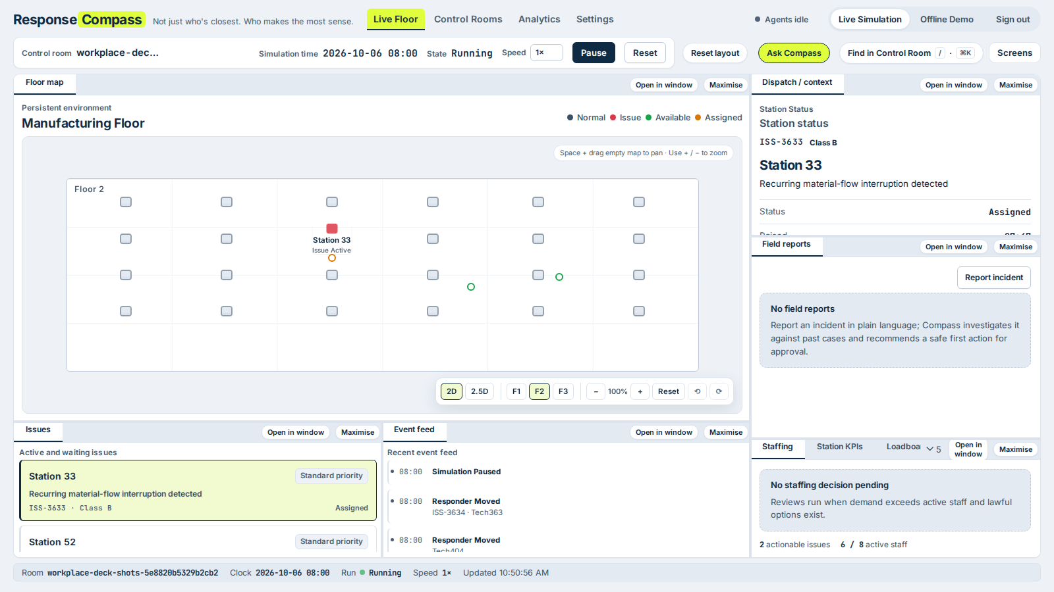
BUILT TO RUN
Engineering quality
635
208
hermetic unit and integration tests, all passing
Chromium end-to-end tests, last recorded run
01
One app, two modes
Offline makes no API calls and is fully reproducible.
02
Crash-safe state
Operator console
Checksummed journal and a restart-safe scheduler.
03
Spend only when watched
An unattended room pauses after 10 idle minutes by default; a usage ledger shows estimated spend.
19
Notes:
Everything that matters is tested without spending API credits. The browser tests force provider failures to prove the fallbacks. The hermetic suite passed 635 of 635 on 2026-10-26; the Chromium count is the last recorded run.

Slide 20
ROADMAP
What's next
01
Real systems
Maintenance, ticketing and rostering in place of the simulated floor.
Open before submission (remove before filing)
Nebius key set on the server, then a live Nemotron check and captures for the Investigator slides.
Owner decision: whether judges can use field reports and the Investigator, and for how long.
Demo video, under three minutes, uploaded to YouTube and linked on the form.
Public repository under Apache-2.0, with a sanitized history scan, and a working URL with test credentials.
02
Learn from approvals
Feed operator decisions and outcomes back into the evidence.
03
Longer live measurement
The Investigator against its baselines on live Nemotron runs.
20
Notes:
Review item: the amber card lists what must be finished before filing. Remove it from the final deck.

Slide 21
The right responder.
The right fix.
Runs autonomously. Supervised by your control room.
Built on Nebius Token Factory with NVIDIA Nemotron models.
Apache-2.0 · synthetic data only · repository and demo video links added at filing
Notes:
ResponseCompass: the right responder, the right fix, supervised by your control room. Built on Nemotron models through Nebius Token Factory. Repository and demo video links are added at filing.

