Slide 1

Context-aware responder dispatch for operations control rooms
An agent that recommends who to send and what to try first, cited from past repairs. People approve every dispatch.
Nebius x NVIDIA Global AI Hackathon · Best Apps and Agents

Slide 2
THE PROBLEM
The closest technician is not always the best one to send
Equipment faults arrive as technician reports in plain language, not clean tickets.
The nearest responder often has no record on this fault.
The first fix tried is often a guess, and each failed attempt costs downtime.
What works lives in old tickets and in people's heads, so it is hard to reuse.
ResponseCompass · draft for review

Slide 3
THE DEMO STORY
One report, from words to an approved dispatch
1 Free-text field report arrives
2 Wall screens show the room
3 Code resolves equipment and options
4 Nemotron investigates with cited cases
5 Operator confirms and approves
6 Outcome, history and analytics
Nothing is dispatched for a field report without an approval record.
ResponseCompass · draft for review

Slide 4
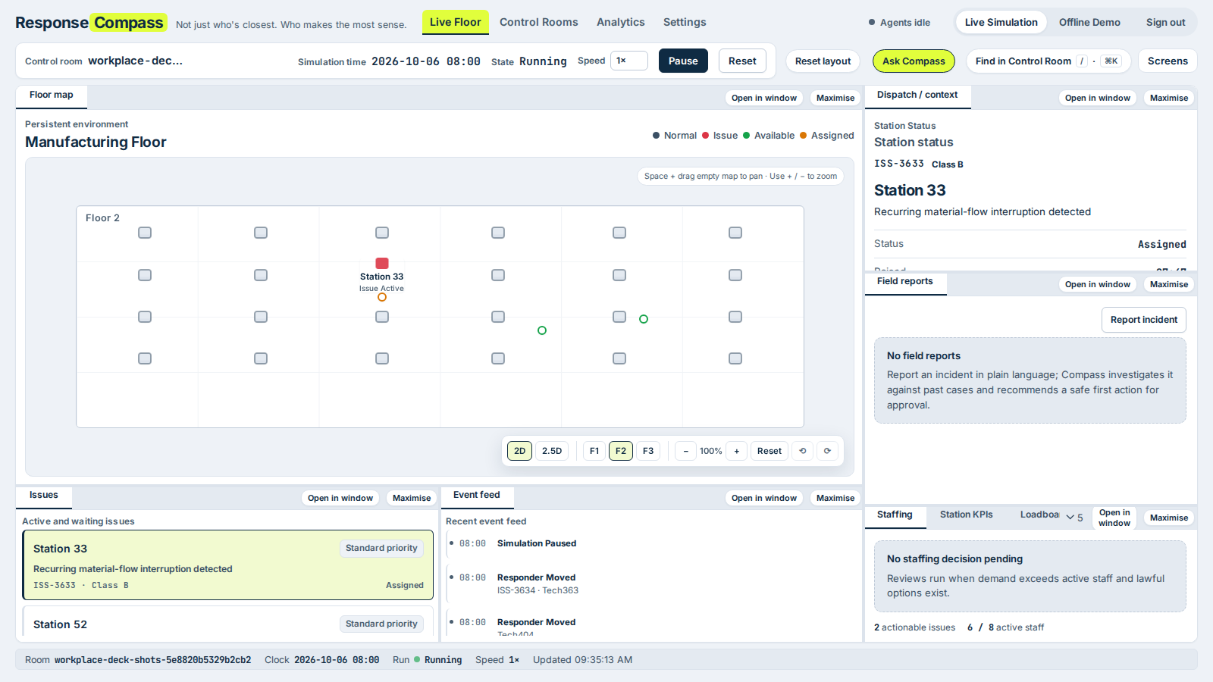
LIVE FLOOR
The control room watches the floor and keeps the controls
Six wall screens, one panel per monitor: floor map, issues, dispatch, event feed, Issue Pareto, analytics.
The operator console keeps override, pause and approval.
Live deployed app, synthetic plant data.
ResponseCompass · draft for review

Slide 5
COMPASS INVESTIGATOR
A field report becomes a cited, approved recommendation
1 Report
Operator types what happened. Text is untrusted data.
2 Options
Code lists possible equipment and symptom pairs (at most 12).
3 Investigate
Nemotron 3 Ultra reads past cases with read-only tools and cites them.
4 Confirm
Operator confirms the symptom and ticks safety prerequisites.
5 Approve
Central command approves responder and fix. Audit record written.
PLACEHOLDER: Investigator screenshots are not in this draft.
Guest workplaces currently block field reports ('This action is unavailable in demo workplaces'), and live Nemotron calls need the Nebius key on the server. Both are open decisions.
ResponseCompass · draft for review

Slide 6
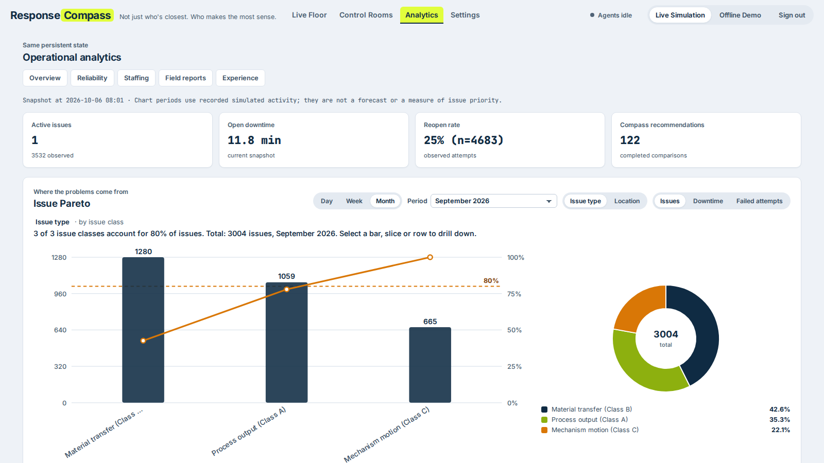
ANALYTICS
A month of recorded work shows where the time goes
September 2026: 3,004 issues in the synthetic plant.
Reopen rate 25% of 4,683 observed attempts.
The top two issue classes make 78% of September's issues; the 80% line is crossed on the third.
Compass recommendations are compared with their baselines; disagreements are recorded.
ResponseCompass · draft for review

Slide 7
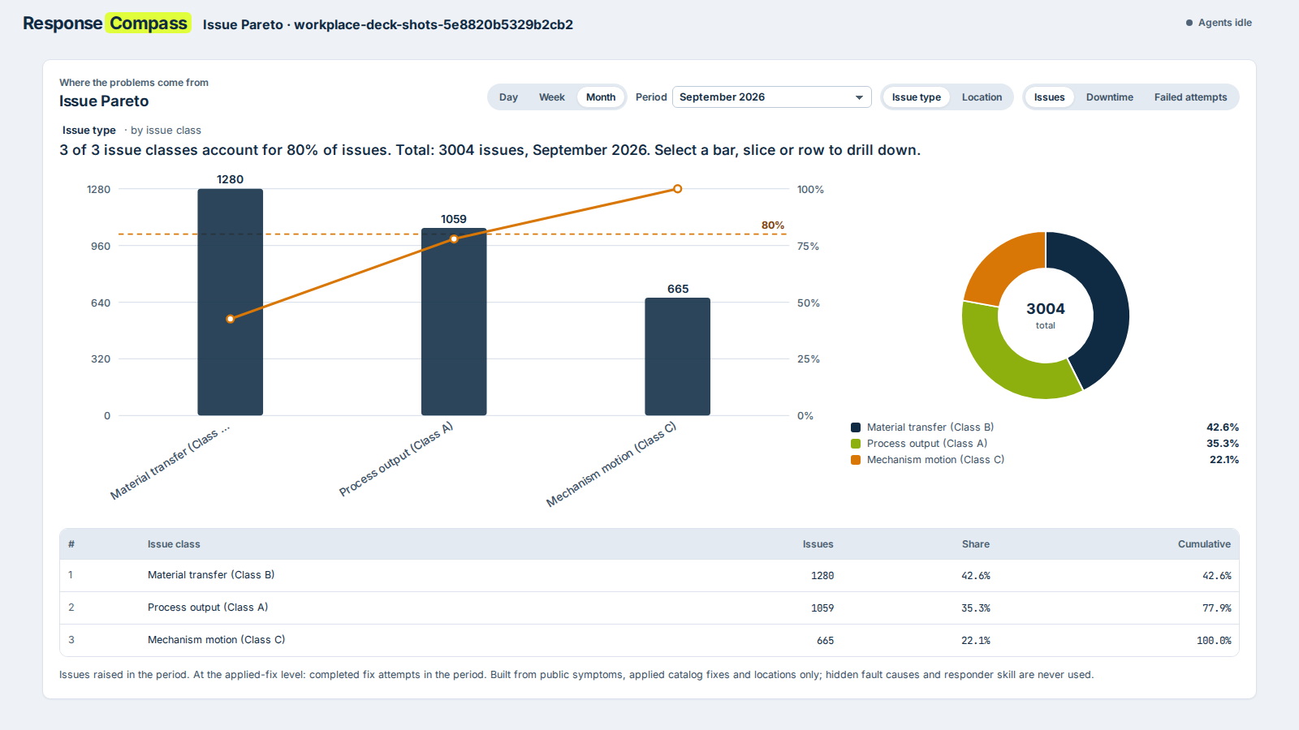
ISSUE PARETO
Where the downtime comes from
Bars, cumulative line and the 80% marker show which few classes cause most work.
Drill down from class to symptom to the fix that was applied.
The Pareto describes recorded work. It does not rank people or claim cause.
ResponseCompass · draft for review

Slide 8
HONEST BY DESIGN
Code owns the facts. Models only rank and explain.
CODE
Eligibility, travel time and observed history
CODE
Bounded list of options
MODEL
Ranks the options and explains each ranking
CODE
Validates output, citations and safety rules
OPERATOR
Approves; the dispatch gate opens only then
Never shown to any model or screen
Responder skill and the true fault cause are hidden simulation truth. Models see only public, observable records, and each citation is checked against what the tools actually returned.
ResponseCompass · draft for review

Slide 9
MODELS AND INFRASTRUCTURE
Built on NVIDIA Nemotron through Nebius Token Factory
Role | Model (code default) | What it does
Investigator | Nemotron 3 Ultra (550B-A55B) | Tool-using investigation of a field report, with cited cases
Responder, fix and overtime ranking | Nemotron 3 Super (120B-A12B) | Ranks code-supplied options with qualitative rationale
Event planner and narrator | Nemotron 3.5 Lightning | Plans simulated events and writes simulated narratives
Status: live Nebius calls are pending the Token Factory key on the deployed server. Until it is set, every ranking uses the deterministic fallback, and the screens say so. These slides will be re-shot after a live probe.
Provider controls: per-provider timeouts, bounded retries, rate limiting and a circuit breaker.
ResponseCompass · draft for review

Slide 10
STATUS
Status and what is left before submission
Built and tested
Open before submission
Control room wall screens and operator console
Guest workplaces with a shared password and a cap of 10 registered users
Dispatch gate, approval routes and audit trail
635 hermetic tests and 208 Chromium end-to-end tests on master
Nebius Token Factory key on the server, then a live Nemotron probe
Decide whether judges can use field reports (Investigator) on guest workplaces
Re-record the three-minute video with live Nemotron calls
Upload the video to YouTube and publish the Apache-2.0 repository
ResponseCompass · draft for review

