Slide 1
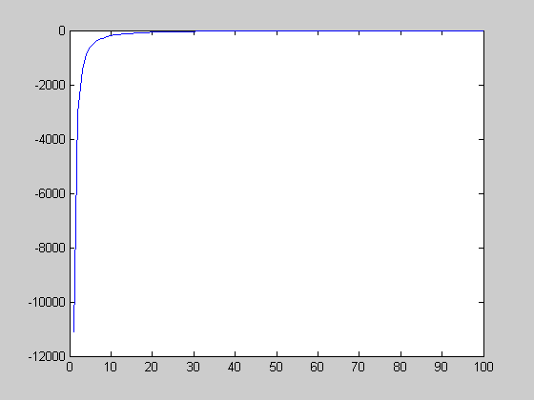
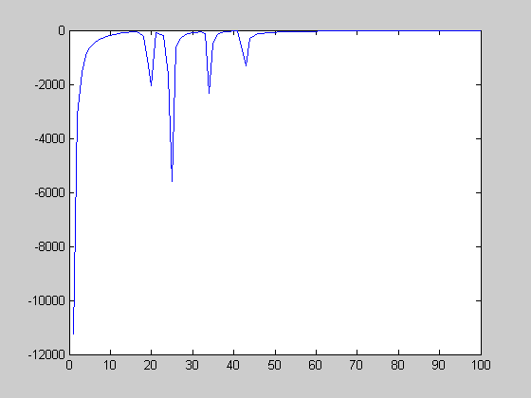
Problems on applying Runge-Kutta method
>> x=1:100;
>> k1=1e4 * 1./x .* (1/100 - 1./x) .* (1 + 12* x/100);
>> k2=1e4 * 1./(x+0.5*k1) .* (1/100 - 1./(x+0.5*k1)) .* (1 + 12* (x+0.5*k1)/100);
>> k3=1e4 * 1./(x+0.5*k2) .* (1/100 - 1./(x+0.5*k2)) .* (1 + 12* (x+0.5*k2)/100);
>> k4=1e4 * 1./(x+k3) .* (1/100 - 1./(x+k3)) .* (1 + 12* (x+k3)/100);
undesirable fluctuations at small size grains
(forward) Euler method
r* = 100
Runge-Kutta 4th order
r* = 100
Ver C; will adopt forward Euler method to the dissolving grains
NGG: The fluctuations did not observed at r > r*
2DNM: The The growth of 2DNM should be confirmed (not yet)
Screw:The fluctuations did not observed

Slide 2
A
B
l
a
O

