Slide 1
A Simple Uniprocessor Scheduling GUI Simulator for RMS and EDF
Presented By:
Zhanghao Wen

Slide 2

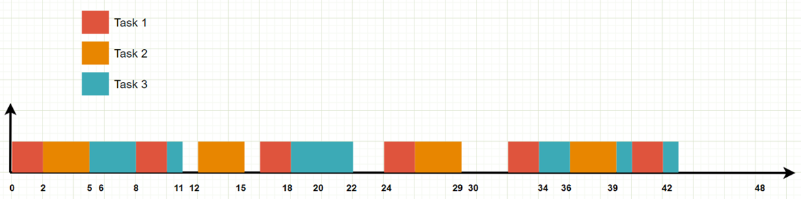
Problem Statement
In this project, an GUI Simulator for RMS and EDF algorithm in a simple uniprocessor scheduling is developed by Java in Eclipse IDE
RMS is an optimal preemptive scheduling algorithm with fixed priorities. EDF is an optimal preemptive scheduling algorithm with dynamic priorities
EDF offers higher schedulability than RMS, but it is more difficult to implement

Slide 3
Solution
First, the program asks user how many tasks in the task set.
Second, program asks user which algorithm that the user want to pick.
RMS
EDF
Third, program asks user to enter task set details in the format of computation time followed by ‘,’ and then followed by task period, then use semicolon to separate different tasks.

Slide 4
Solution
For example, to represent {(1, 8), (2, 6), (4, 24)}, user needs to enter
1,8;2,6;4,24
Then no more input will be required from user.
Program will check RMS utilization test or EDF schedubility check based on the algorithm option.

Slide 5
Solution
If schedubility check passed based on given algorithm and task set, the program will then display computation result and showing scheduler graph up to LCM time unit.
Different color represents different task in the graph
In case not schedulable, no graph will display and only test results will show in console

Slide 6
Implementation details
The program can be divided into three parts:
User interaction
Ask for input
Schedubility Check
RMS utilization test (easy)
RMS exact analysis (hard)
EDF schedubility check (easy)
Draw scheduler graph (if passed test)
JFrame setup: Canvas, paint rectangles, LCM, coordinates

Slide 7
Implementation details
Responsive design: graph size and task color is responsive to JFrame window size
Draw up to LCM time unit
RMS is relatively easy.
Find priority, draw from highest priority
Lower priority shift to the right if time slot is taken until all required time is consumed
EDF is very hard
Need to know and update current time, current period, current period remaining computation time, current period deadline, current period starting time
More details are in the code

Slide 8
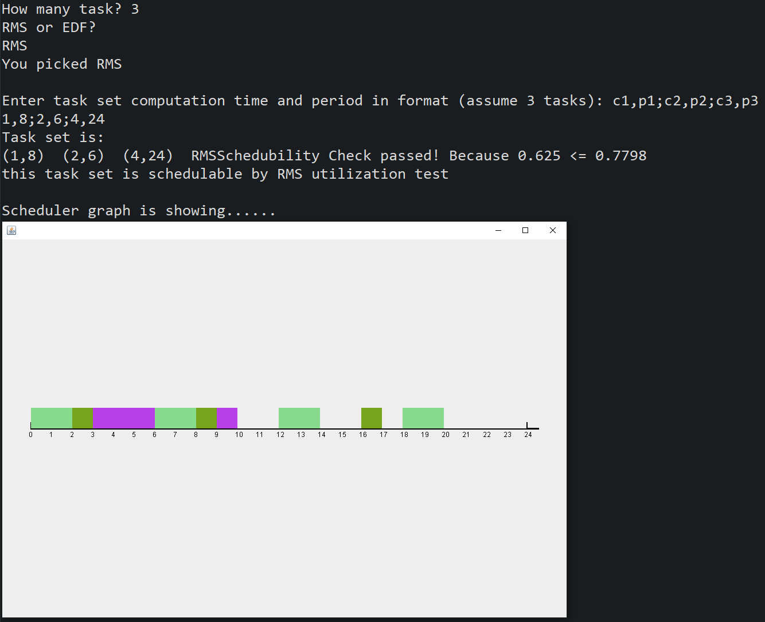
Evaluation -- RMS test
1. {T1,T2,T3} = {(1, 8), (2, 6), (4, 24)}.

Slide 9
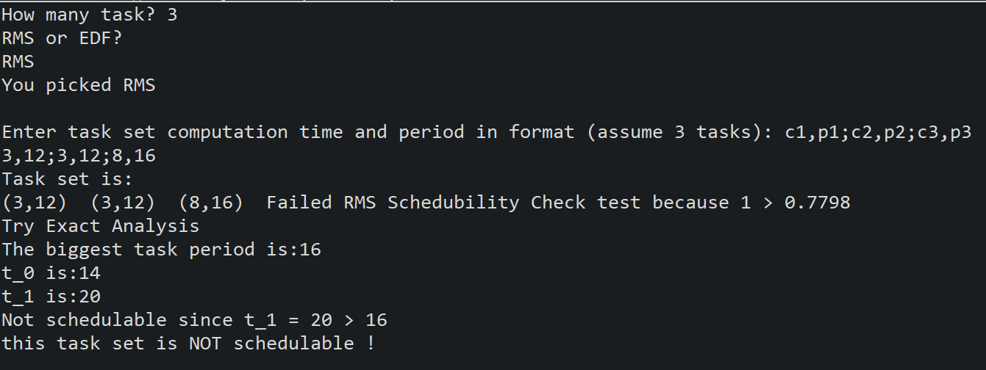
Evaluation -- RMS test
2. {T1,T2,T3} = {(3, 12), (3, 12), (8, 16)}.
In this case not schedulable, no graph will display and only test results will show in console.

Slide 10
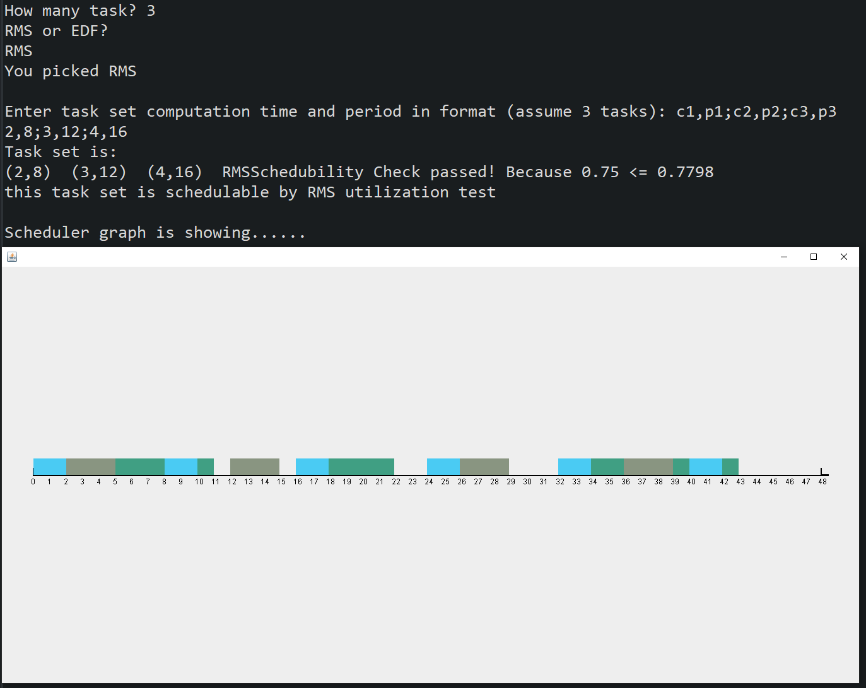
Evaluation -- RMS test
3. {T1,T2,T3} = {(2, 8), (3, 12), (4, 16)}.

Slide 11
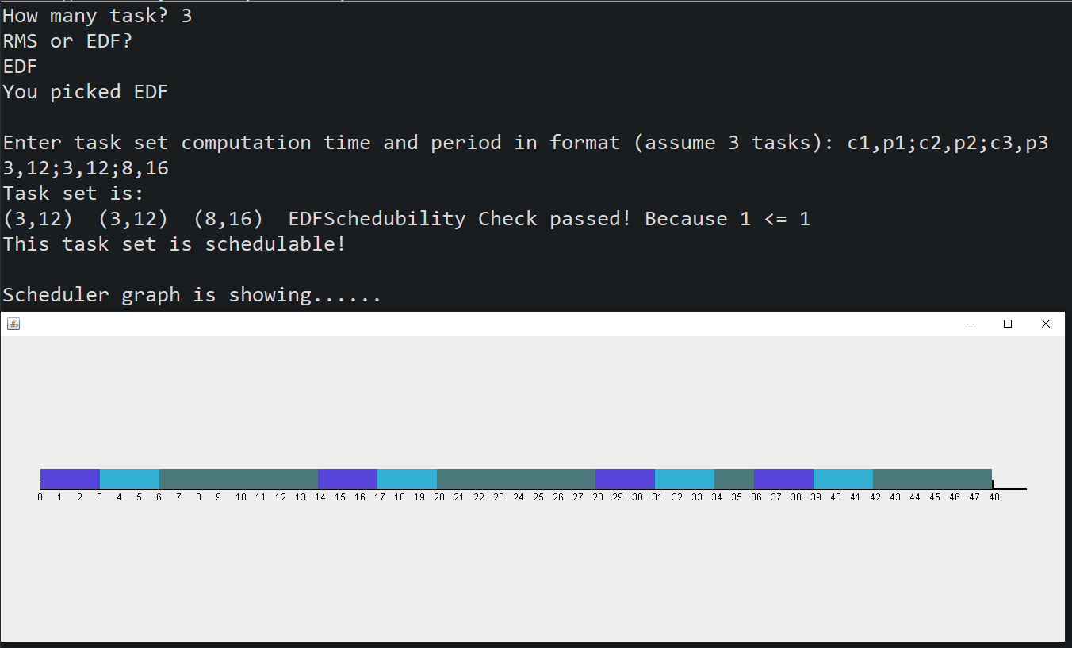
Evaluation -- EDF test
1. {T1,T2,T3} = {(3, 12), (3, 12), (8, 16)}.

Slide 12
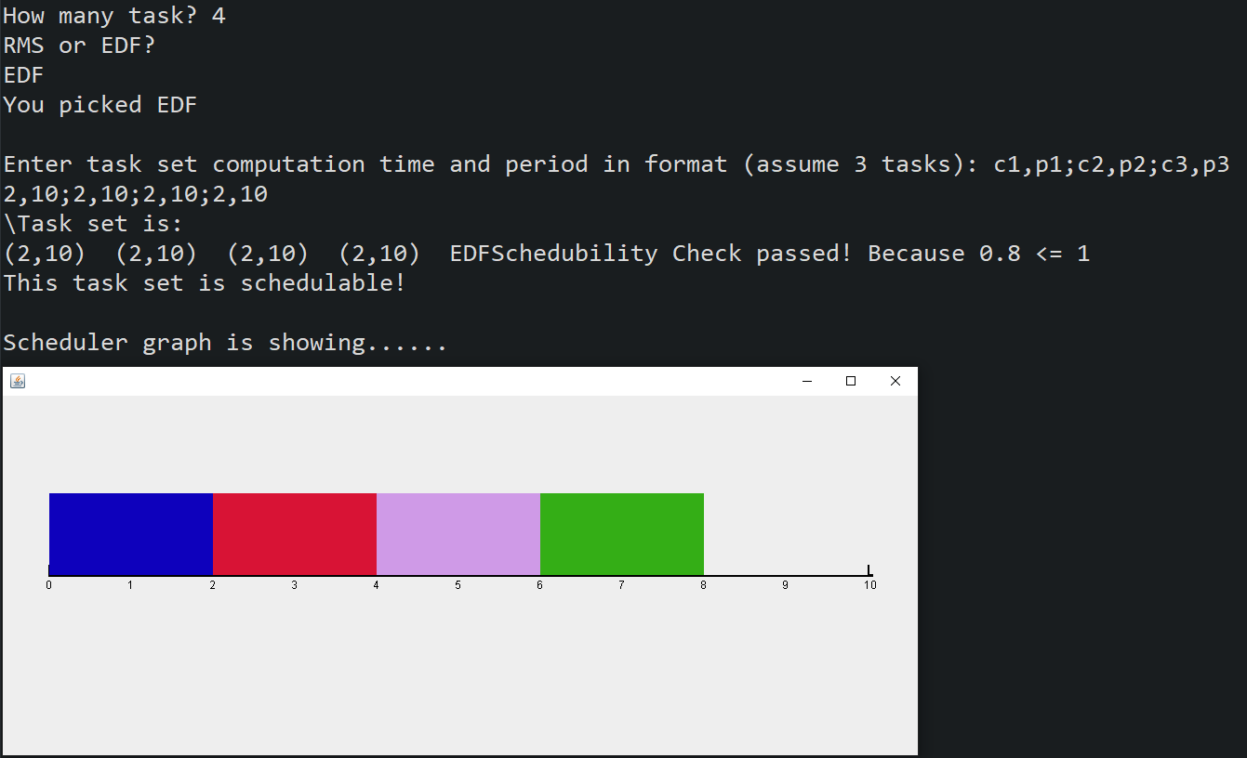
Evaluation -- EDF test
2. {T1,T2,T3,T4} = {(1, 5), (1, 5), (1, 5), (1, 5)}

Slide 13
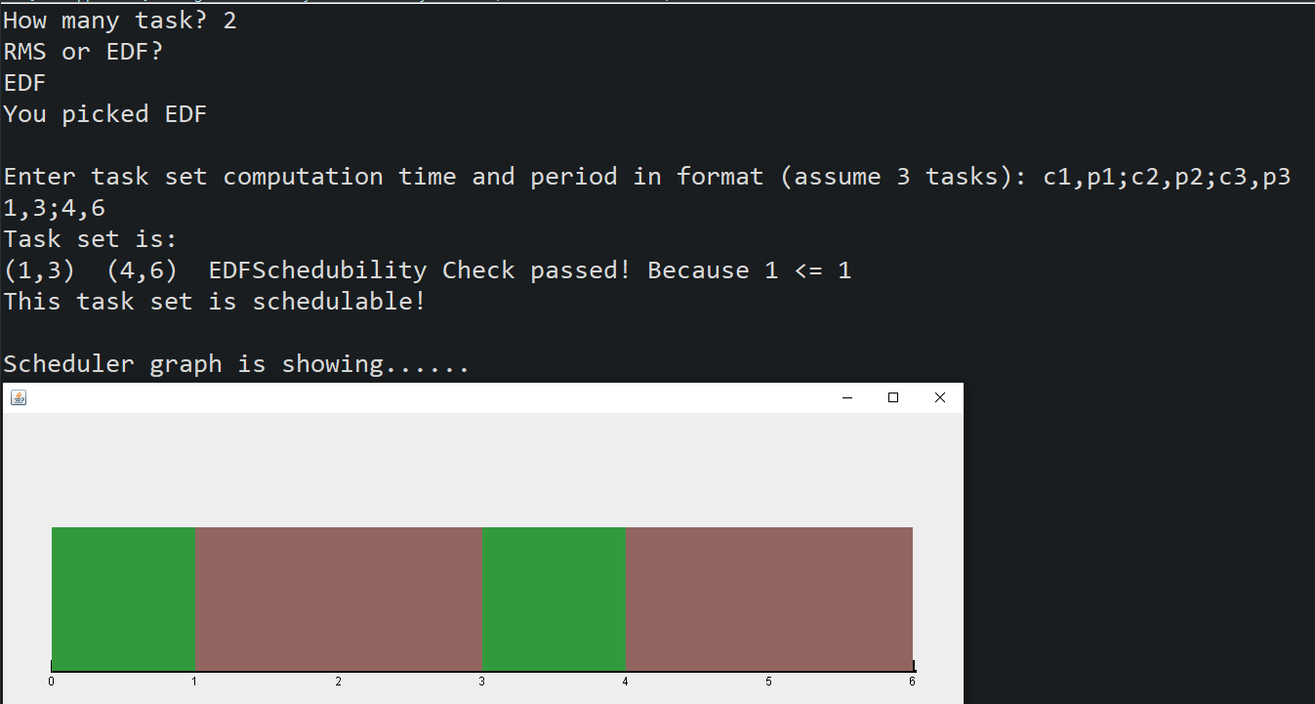
Evaluation -- EDF test
3. {(1,3),{4,6}}

Slide 14
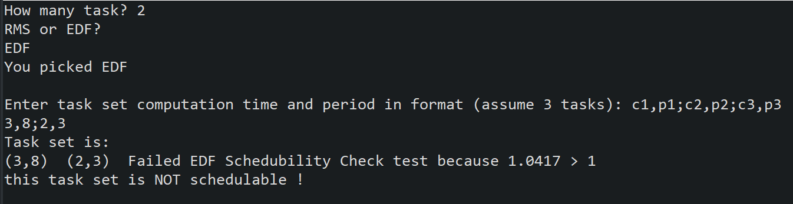
Schedubility Test
1. EDF test for {(3,8),(2,3)}. In this case, sums of Ci/Pi is bigger than 1, therefore not schedulable.

Slide 15
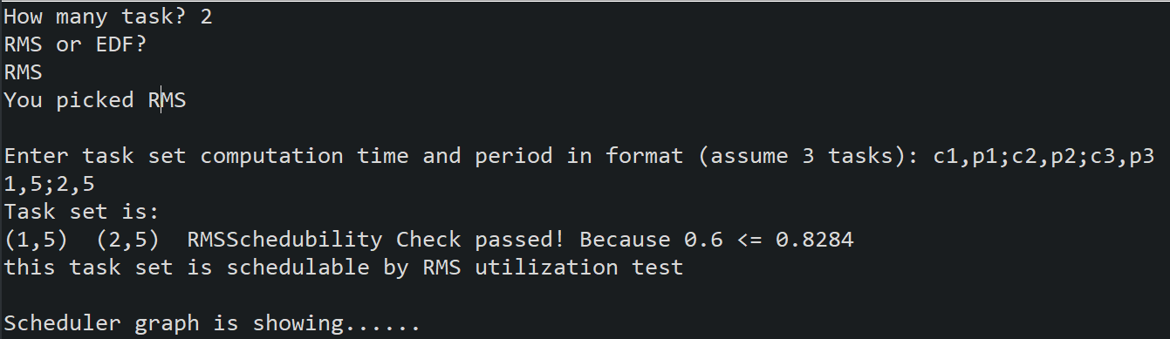
Schedubility Test
2. RMS test for {(1,5),(2,5)}. To reduce the computation time, RMS will first check utilization test before doing exact analysis as this is more time efficient.

Slide 16
Conclusions
Successfully use Eclipse IDE, Java, and Jpanel package to achieve scheduling analysis, scheduler construction, and provide text feedback through console.
Achieved standard RMS and EDF in format (task computation time, task period). Note: deadline is equals to task period and task is always ready at the beginning of each period.
User Input: workload parameters: number of tasks, “RMS” or “EDF” option, and task set details in form of (c, p).
Output: RMS; EDF; Include utility test and exact analysis. Use analysis to test whether the given workload is schedulable by “RMS” or “EDF”. If it can pass analysis test, then draw on canvas that can show scheduler details. If not pass test, then show the arithmetic reason on console.

Slide 17
Learning Achieved through the project
Learned more Java basics, components, packages, data structures
Thoroughly understand how RMS and EDF works
Software development methodology: Think and design clearly before writing any code!!
Work around: tried web stacked-bar-chart framework, Ng2-Charts, p5.js API before starting Java implementation

