Slide 1
Doyle-Fuller-Newman (DFN) Full Order Model (FOM) Tutorial
UC Berkeley
eCAL
Professor Scott Moura
May 12, 2016

Slide 2
Sample Output

Slide 3
Background
This code is Matlab implementation of electrochemical model equations found in
Doyle, Marc, Thomas F. Fuller, and John Newman. "Modeling of galvanostatic charge and discharge of the lithium/polymer/insertion cell." Journal of the Electrochemical Society 140.6 (1993): 1526-1533.
Fuller, Thomas F., Marc Doyle, and John Newman. "Simulation and optimization of the dual lithium ion insertion cell." Journal of the Electrochemical Society 141.1 (1994): 1-10.
Thomas, Karen E., John Newman, and Robert M. Darling. "Mathematical modeling of lithium batteries." Advances in lithium-ion batteries. Springer US, 2002. 345-392.
and more…

Slide 4
What it does
Simulates
Terminal voltage [V]
Solid & electrolyte concentrations [mol/m^3]
Solid & electrolyte potentials [V]
Internal temperature [K]
Generates
Various static plots and animations
Takes as input
An applied electric current time-series (time, current)
Requires
A parameter file, which defines electrochemical model parameters
OCP functions, electrolyte conductivity & diffusivity fcns
Assumes user is proficient with Matlab

Slide 5
What it does NOT do
Provide polished user-interface. This code is for developers, and is under development.
Simulate
Blended cathode materials
Different particle sizes
non Li-ion chemistries (e.g. NiMH)
Battery pack geometries
Mechanical stress
Aging
Include the model identification code (PSO)
Some of these features are under-development
Keep your expectations reasonable please ☺

Slide 6
Tutorial Outline
Parameter file
Material function files
Input current data
Main script to run DFN model
Generate plots and animations

Slide 7
Tutorial Outline
Parameter file
Material function files
Input current data
Main script to run DFN model
Generate plots and animations

Slide 8
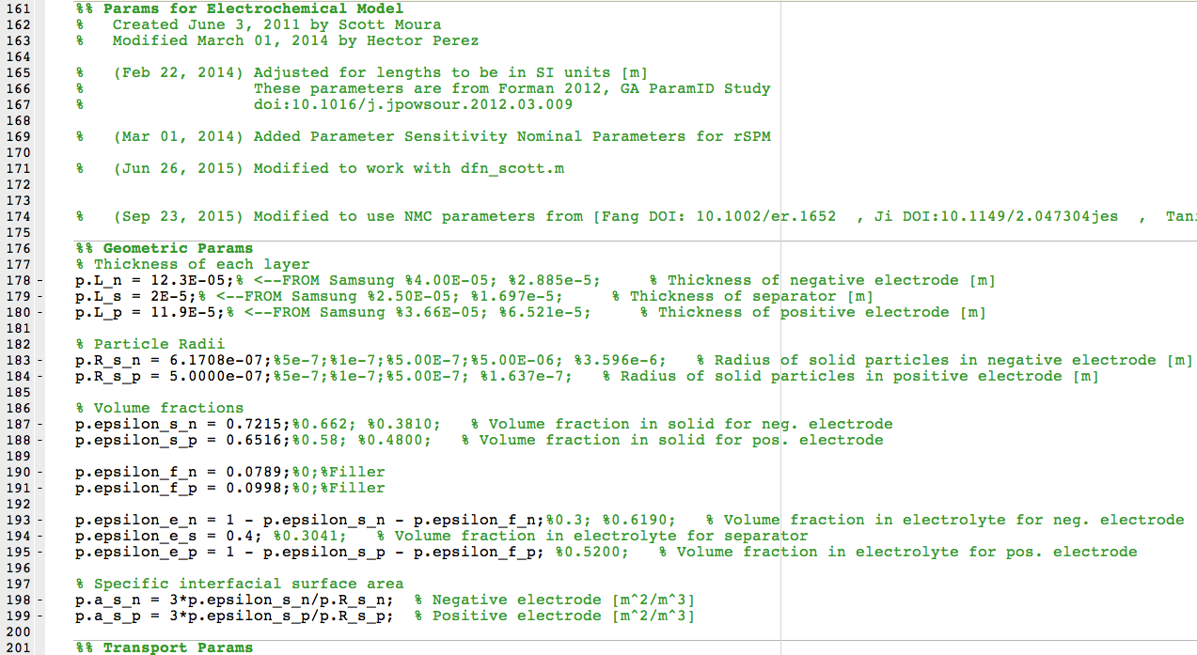
Parameter File
Open params_NMC_Samsung_new_iteration.m
Embeds scalar parameter values
Generates a struct object p, which is passed throughout the code

Slide 9
Tutorial Outline
Parameter file
Material function files
Input current data
Main script to run DFN model
Generate plots and animations

Slide 10
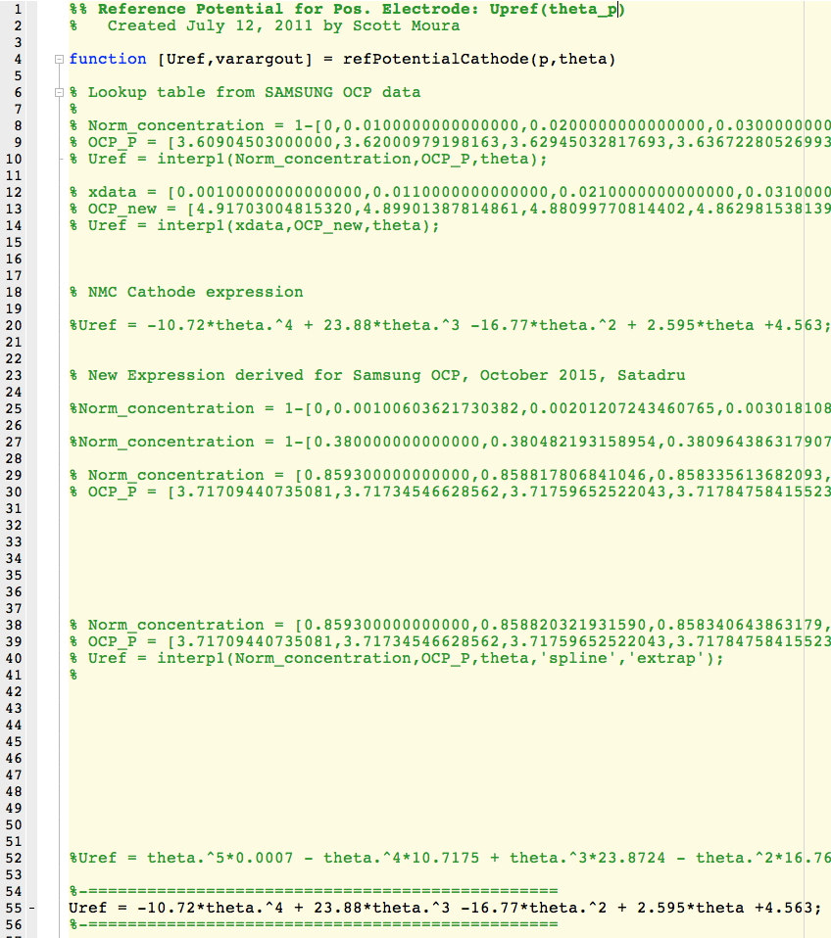
Open Circuit Potential Files
Open
refPotentialAnode.m
refPotentialCathode.m
Implements open circuit potentials for each electrode material
Computes OCP, and it’s derivative.

Slide 11
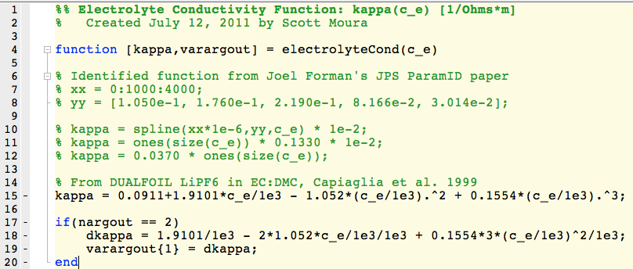
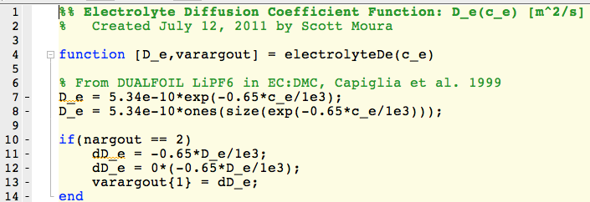
Electrolyte Conductivity & Diffusivity
Open
electrolyteCond.m
electrolyteDe.m
Electrolyte conductivity & diffusivity are functions of local concentration
Computes conductivity/diffusivity and it’s derivative

Slide 12
Tutorial Outline
Parameter file
Material function files
Input current data
Main script to run DFN model
Generate plots and animations

Slide 13
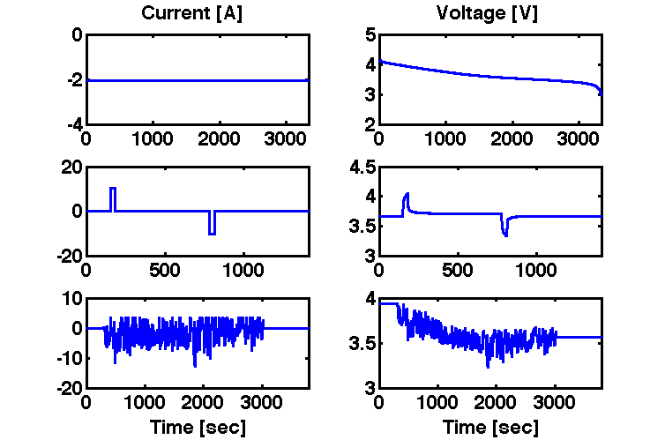
Input current files
All experimentally collected data is located in: data/Int_Obs/ directory
Samples:
1C Discharge
data/Int_Obs/1C_data_Oct_26_2015_05_sample.mat
5C Pulses
data/Int_Obs/dfn_5c.mat
UDDS drive cycle
data/Int_Obs/UDDS_data_Oct_26_2015_Sample_05sec.mat

Slide 14
Tutorial Outline
Parameter file
Material function files
Input current data
Main script to run DFN model
Generate plots and animations

Slide 15
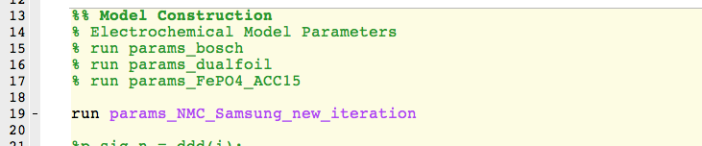
Main Script
Open dfn_scott_testing_Satadru.m
This is the main script that runs the DFN model
To input parameter file, go to line 19. Enter desired parameter file.

Slide 16

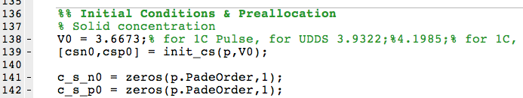
Main Script
To load input current, go to line 33. Enter desired input current file.
To set initial voltage, go to line 138.

Slide 17
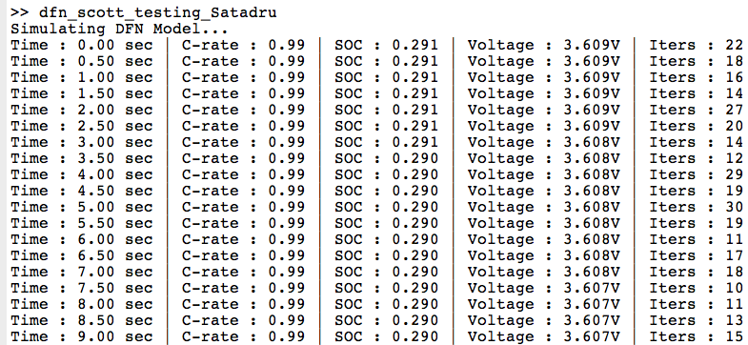
Main Script
You are ready! Run the m-file.
The command window output will look like…

Slide 18
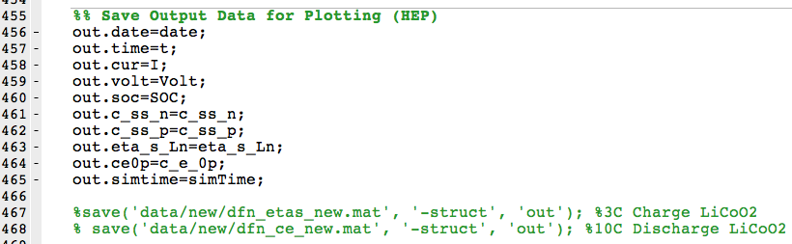
Main Script
After running, the simulation outputs of interest are saved to struct object out. Go to line 467, uncomment, and save to a user-specified filename.

Slide 19
Main Script – Ex: HEV Validation
To reproduce the model vs. experiment validation on the Samsung HEV cycle…
Use params_NMC_Samsung_new_iteration.m
Load data/Int_Obs/Samsung_HEV_data.mat cycle
Initialive model voltage to equal initial voltage from experimental data on line 138.
Run dfn_scott_testing_Satadru.m
The model will require 30min or so. After it’s finished, then the last code (line 507) will compute the RMS error between experiments and model

Slide 20
Tutorial Outline
Parameter file
Material function files
Input current data
Main script to run DFN model
Generate plots and animations

Slide 21
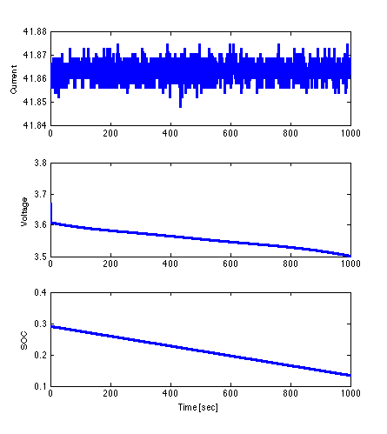
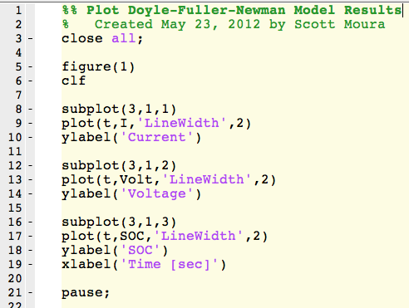
Generate Plots and Animations
Open plot_dfn.m
Plot basic outputs: current, SOC, and voltage
Example: 1C discharge for 1000 sec

Slide 22
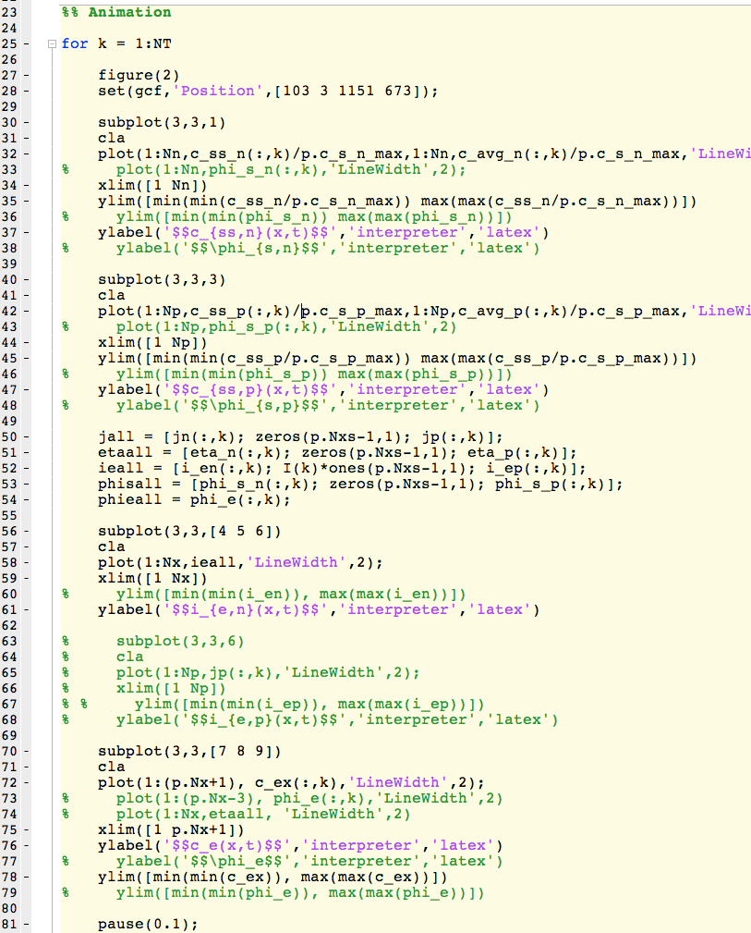
Generate Plots and Animations
Open plot_dfn.m
Animate electrochemical states, e.g. solid & electrolyte concentrations and ionic current. Please feel free to uncomment/comment parts of code to view different echem states.

Slide 23
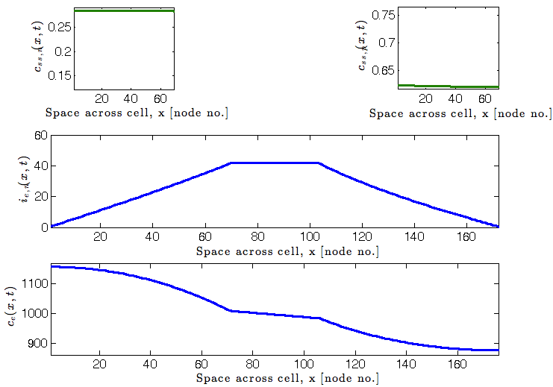
Generate Plots and Animations
Open plot_dfn.m
Animate electrochemical states, e.g. solid & electrolyte concentrations and ionic current.
Example: Snapshot of 1C discharge animation

Slide 24
Tutorial Outline
Parameter file
Material function files
Input current data
Main script to run DFN model
Generate plots and animations
Closing remarks: This code is under development. Future versions will have enhanced speed, accuracy, usability, etc. Enjoy!

