Slide 1



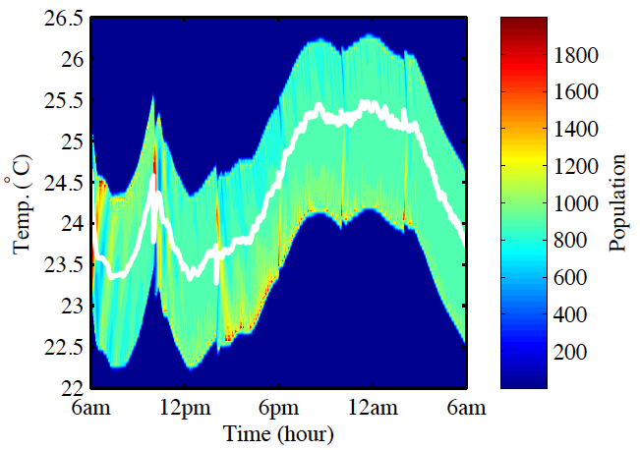



Flexible Load Aggregator

