Slide 1
LAND REGISTRATION DATABASE SYSTEM
Day 21 — Final Project Presentation
PostgreSQL • psql • Land Registration Database
Presented by: EDSON KAMUGISHA EDWIN. | Course: BCS
Day 21 • Slide 1

Slide 2
1. Problem Statement
Land registration involves multiple related records that must be managed consistently.
The system needs to organize landowners, parcels, districts, applications, payments, titles, transfers and disputes.
Manual or disconnected record keeping can make searching, reporting and relationship tracking difficult.
This project implements a relational PostgreSQL database to store and connect these records.
Day 21 • Slide 2

Slide 3
2. Project Objectives
Design and implement a Land Registration Database using PostgreSQL.
Register and manage landowners and land parcels.
Manage land registration applications and payments.
Create and manage land titles.
Track ownership transfers and land disputes.
Enforce data integrity using primary keys, foreign keys, UNIQUE and CHECK constraints.
Implement role-based database security.
Produce useful administrative reports.
Day 21 • Slide 3

Slide 4
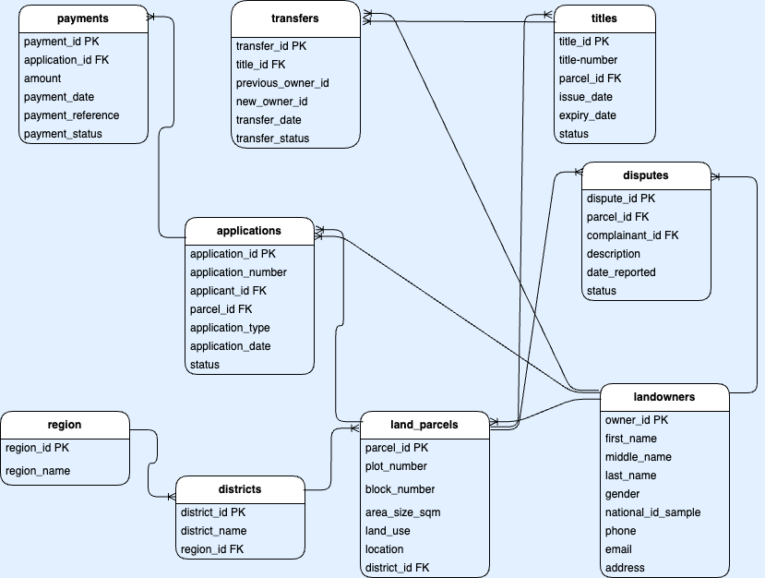
3. Entity Relationship Diagram (ERD)
Diagram supplied for the project
Day 21 • Slide 4

Slide 5
4. Database Schema
landowners — personal and contact details
regions — region information
districts — districts linked to regions
land_parcels — plot, block, area, use, location and owner
applications — registration and other land applications
payments — payments linked to applications
titles — titles linked to parcels
transfers — ownership transfer history
disputes — disputes linked to parcels and complainants
Indexes and constraints support integrity and efficient access
Day 21 • Slide 5

Slide 6
5. Key Relationships
regions → districts → land_parcels
landowners → land_parcels through current_owner_id
landowners → applications through applicant_id
land_parcels → applications through parcel_id
applications → payments through application_id
land_parcels → titles through parcel_id
titles → transfers through title_id
landowners → transfers as previous_owner and new_owner
land_parcels and landowners → disputes
Day 21 • Slide 6

Slide 7
6. Example SQL Queries
-- Search by name SELECT * FROM landowners WHERE first_name ILIKE '%John%'; -- Search by National ID SELECT * FROM landowners WHERE national_id_sample = 'TZ-100001'; -- Search by phone SELECT * FROM landowners WHERE phone = '+255712000001';
Day 21 • Slide 7

Slide 8
7. Security and Roles
land_admin — administrative access for managing the database.
land_officer — operational access for permitted data-entry and update tasks.
land_viewer — read-only access for viewing data and reports.
GRANT and REVOKE are used to control permissions.
The viewer role is verified as read-only.
-- Example read-only permission GRANT SELECT ON ALL TABLES IN SCHEMA public TO land_viewer; REVOKE INSERT, UPDATE, DELETE ON ALL TABLES IN SCHEMA public FROM land_viewer;
Day 21 • Slide 8

Slide 9
8. Final Reports
Landowners Report
Parcels by District Report
Active Titles Report
Pending Applications Report
Payments Report
Transfer History Report
Day 21 • Slide 9

Slide 10
9. Full System Test — Day 20
1. Register a fictional landowner
2. Register a parcel for the owner
3. Create a First Registration application
4. Record payment
5. Approve and complete the application
6. Create an ACTIVE land title
7. Register a second owner and complete a transfer
8. Create and verify a dispute
9. Test UNIQUE and FOREIGN KEY constraints
10. Produce a PASS/FAIL system test summary
Day 21 • Slide 10

Slide 11
10. Live Demonstration in psql
# Connect to PostgreSQL database psql -U georgemollel -d land_registration_db -- Inside psql \dt \d landowners SELECT * FROM landowners; -- Run final reports \i day19_final_reports.sql -- Run full system test \i day20_full_test.sql
Day 21 • Slide 11

Slide 12
11. Constraints and Data Integrity
Primary Keys uniquely identify records in each table.
Foreign Keys enforce valid relationships between related tables.
UNIQUE constraints protect values such as national ID, email, application number, payment reference and title number.
CHECK constraints restrict invalid values such as negative amounts or invalid statuses.
The Day 20 test verifies a duplicate National ID is rejected.
The Day 20 test verifies invalid foreign-key references are rejected.
Day 21 • Slide 12

Slide 13
12. Conclusion and Submission
The project demonstrates a complete relational database workflow for land registration.
It connects landowners, parcels, applications, payments, titles, transfers and disputes.
Relationships and constraints help maintain data integrity.
Role-based permissions support database security.
Reports and the full test demonstrate the database working end-to-end.
Submission folder should include: database dump, SQL scripts, ERD, presentation and final report.
Day 21 • Slide 13

