Slide 1
Docker

Slide 2
Containers
An isolated environment to run your applications
Can run anywhere
Roughly analogous to Virtual Machines
But cheaper, faster to start, less overhead
Have a dedicated portion of the OS

Slide 3
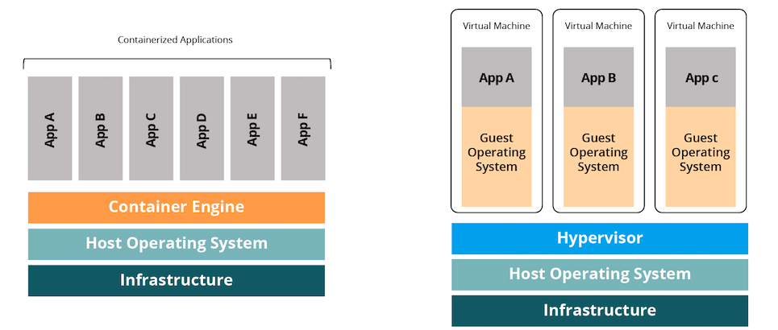
Containers

Slide 4
Docker
Docker is the software that creates, manages and orchestrates containers
Docker Engine is the core software running containers
Can either have Windows or Linux containers
Linux containers can run on Windows – but not the other way around
This is because for linux containers on windows, Docker daemon runs inside a lightweight Linux VM
You will probably always be working with Linux containers, as Window containers are too limiting and can’t run anywhere

Slide 5
Images
A blueprint from which containers are created
Describes the application
Application code
Libraries
Tools
Dependencies
Can have base images
Plenty of official images available at DockerHub
https://hub.docker.com/
Can create your own with a Dockerfile

Slide 6
Docker containers
Runtime instance of a docker image
Ability to start/stop/kill containers
Can run in background, or attach your terminal to interact directly inside the container

Slide 7
Docker CLI
Images
docker image ls
List images
docker image build –t <my-image>:<v1.0> ./
Create an image from a dockerfile in this working directory, and call it `my-image` and tag it version 1.
docker image history <my-image>
View instructions that were used to build the image
docker image inspect <my-image>
View instructions that were used to build the image

Slide 8
Docker CLI
Containers
docker ps
List running containers
-a to list all containers, including stopped
docker run <options> <image>:<tag> <app>
Run a container from an image
Options: common ones are -d to run in background, -it to attach the terminal
App: command to execute in the container
docker stop <container>
Shuts down the container for given name
docker start <container>
Restarts the container for given name
docker rm <container>
Remove the container for given name forever

Slide 9
Containerizing an application
aka : creating containers that run your application
Process:
Start with your application code
Create a Dockerfile that describes your app and its dependencies, and how to run it
Feed your Dockerfile into the docker image build command
Create and run a container using docker run command

Slide 10
Dockerfile
Instructions
Containerising a single application
FROM: Specifies the base image for your image
RUN: allows you to run commands inside your image which creates new layers
COPY: Adds files into your image
EXPOSE: documents the port your application uses
ENTRYPOINT: sets the default application to run when the container is ran
https://docs.docker.com/reference/dockerfile/

