Slide 1

INDIA ESG ALLIANCE
Building India's ESG Ecosystem for Sustainable and Responsible
Growth of MSMEs and Industries
CAPACITY BUILDING
ESG REPORTING
ASSESSMENT & ASSURANCE
BUSINESS INNOVATION
POLICY ADVOCACY

Slide 2





ABOUT IEA
Who We Are
IEA is a one-stop ESG market platform combining capacity building, advisory services, reporting support, assessments, research and partnerships — helping organisations move beyond compliance towards sustainable value creation.
VISION
MISSION
To build a trusted and inclusive ESG ecosystem that empowers MSMEs and industries to embrace sustainability, strengthen governance, and create positive social impact.
To enable a credible and inclusive ESG ecosystem through knowledge, partnerships, and sustainable action.
YEAR OF ESTABLISHMENT
GEOGRAPHICAL PRESENCE
2025
Pan India
INDIA ESG ALLIANCE
02

Slide 3




THE OPPORTUNITY
Why We Exist
Untapped Potential
Limited, Excluded Access
India's MSMEs and small industries hold immense potential waiting to be unlocked.
India-specific ESG solutions are limited — MSMEs and small industries remain excluded from the ESG ecosystem.
A Fast-Changing Landscape
High Compliance Cost
BRSR regulations, global supply-chain needs, investor expectations, export requirements and sustainable finance are reshaping business fast.
Compliance remains a high cost burden for MSMEs and small industries.
ESG is no longer only about compliance — it is becoming a key driver of market access, investment, brand reputation, and long-term sustainability.

Slide 4
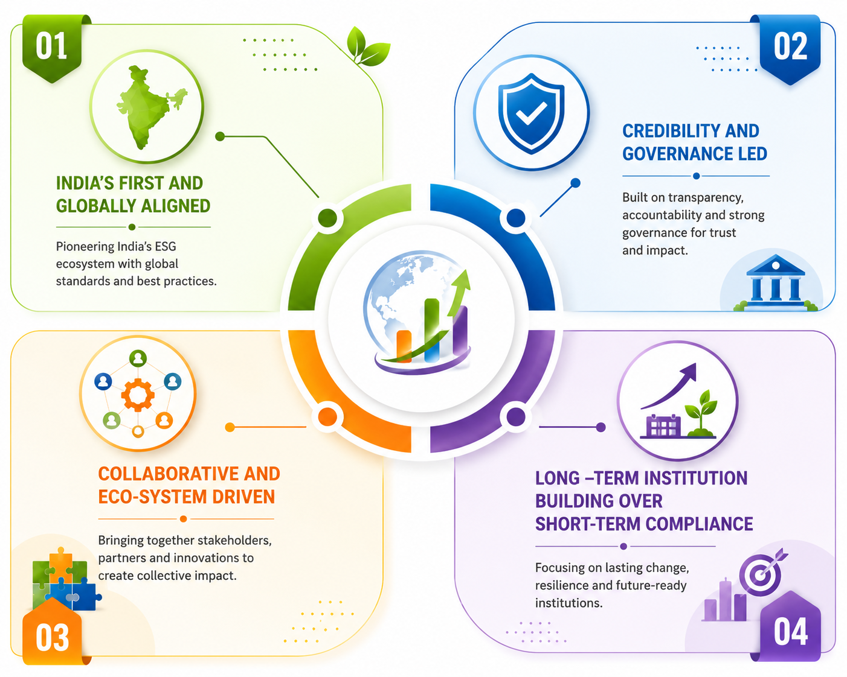
OUR DNA
Guiding Principles
INDIA ESG ALLIANCE
04

Slide 5
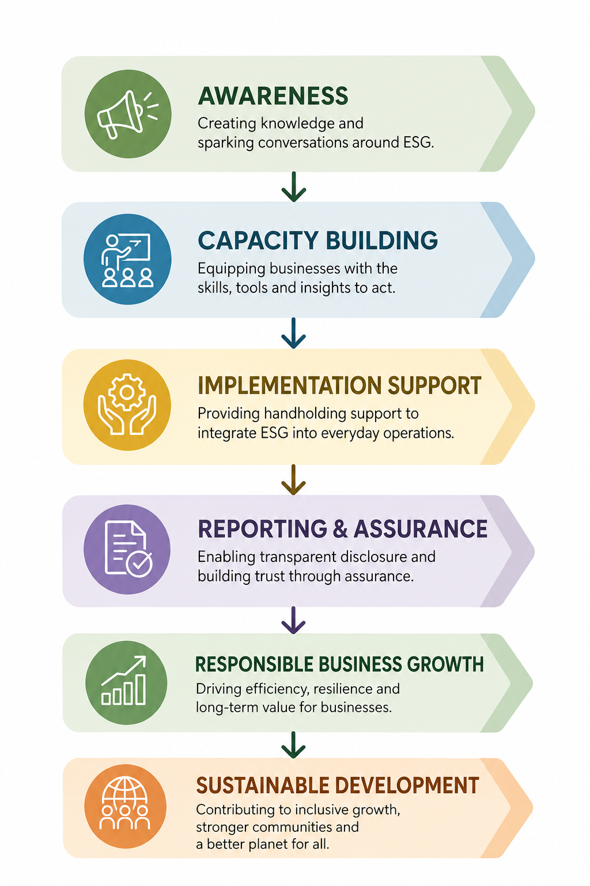

HOW WE WORK
Our Model & Theory of Change
OUR MODEL
THEORY OF CHANGE
INDIA ESG ALLIANCE
05

Slide 6
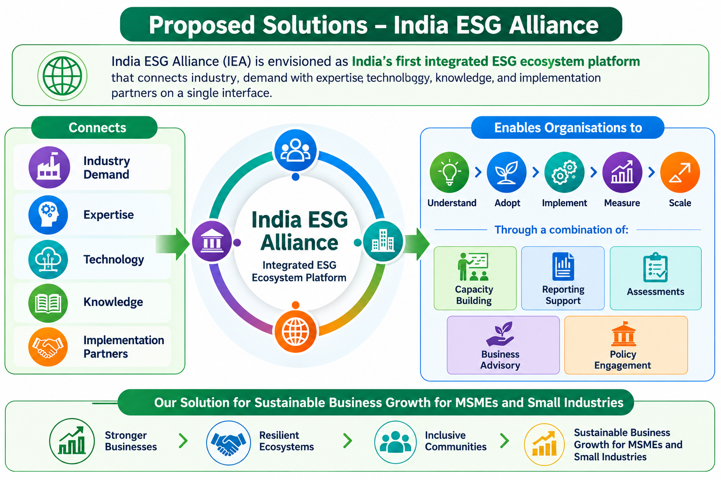
THE ECOSYSTEM PLATFORM
Proposed Solutions – India ESG Alliance
INDIA ESG ALLIANCE
06

Slide 7
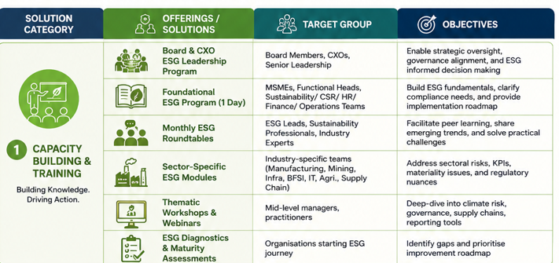

OUR SOLUTIONS FRAMEWORK — 1 OF 5
01
Capacity Building
& Trainings
Building knowledge. Driving action.
INDIA ESG ALLIANCE
07

Slide 8
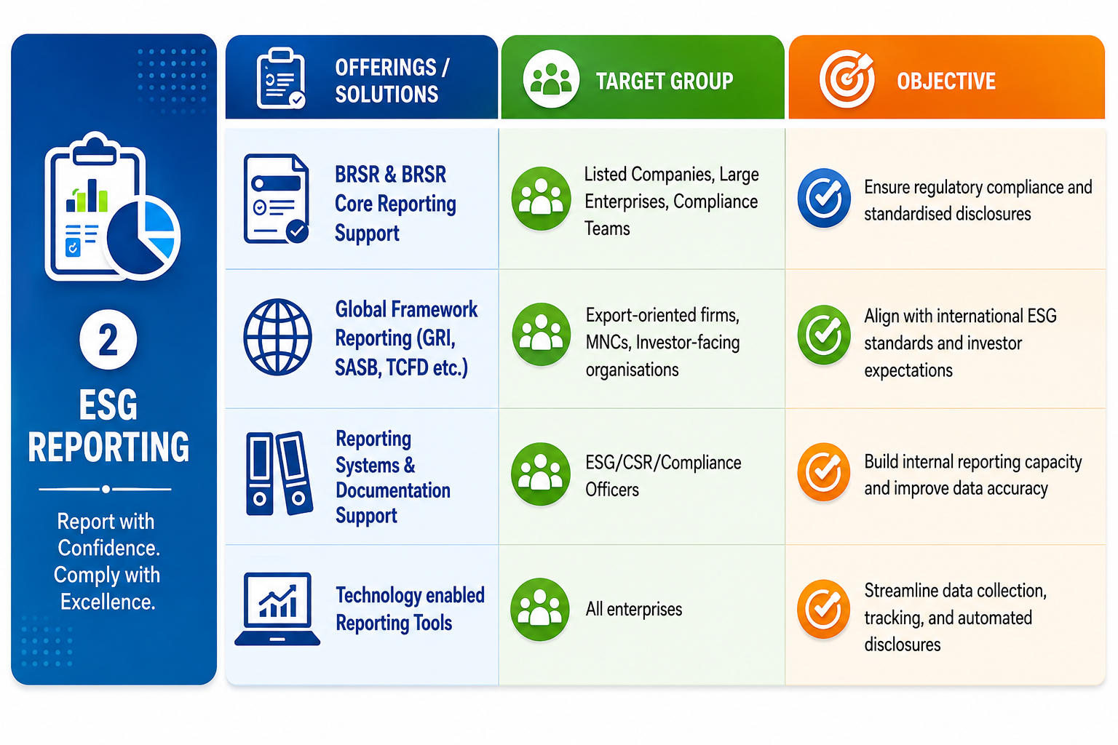

OUR SOLUTIONS FRAMEWORK — 2 OF 5
02
ESG Reporting
Report with confidence. Comply with excellence.
INDIA ESG ALLIANCE
08

Slide 9
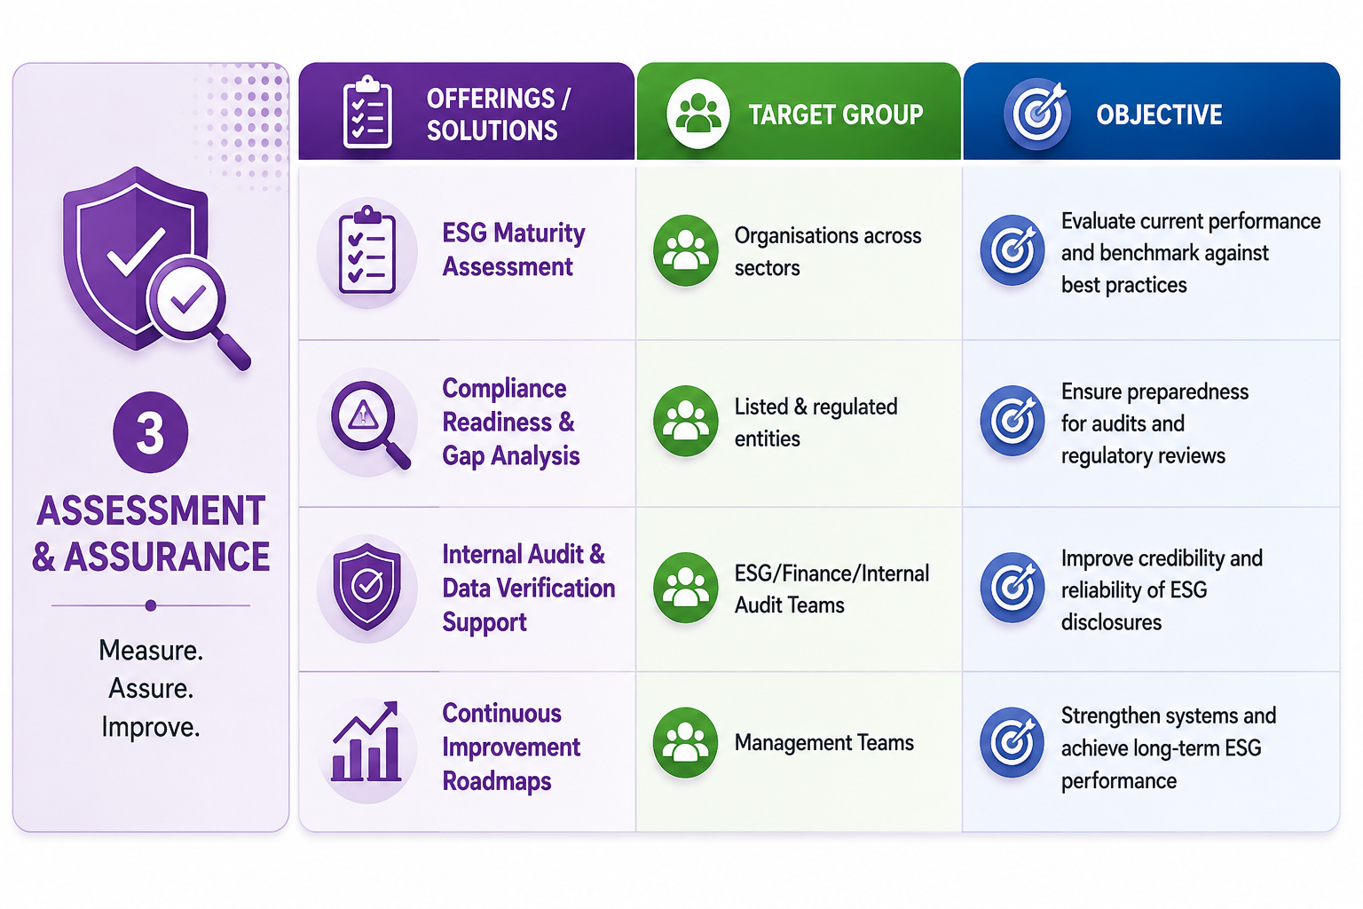

OUR SOLUTIONS FRAMEWORK — 3 OF 5
03
Assessment
& Assurance
Measure. Assure. Continuously improve.
INDIA ESG ALLIANCE
09

Slide 10
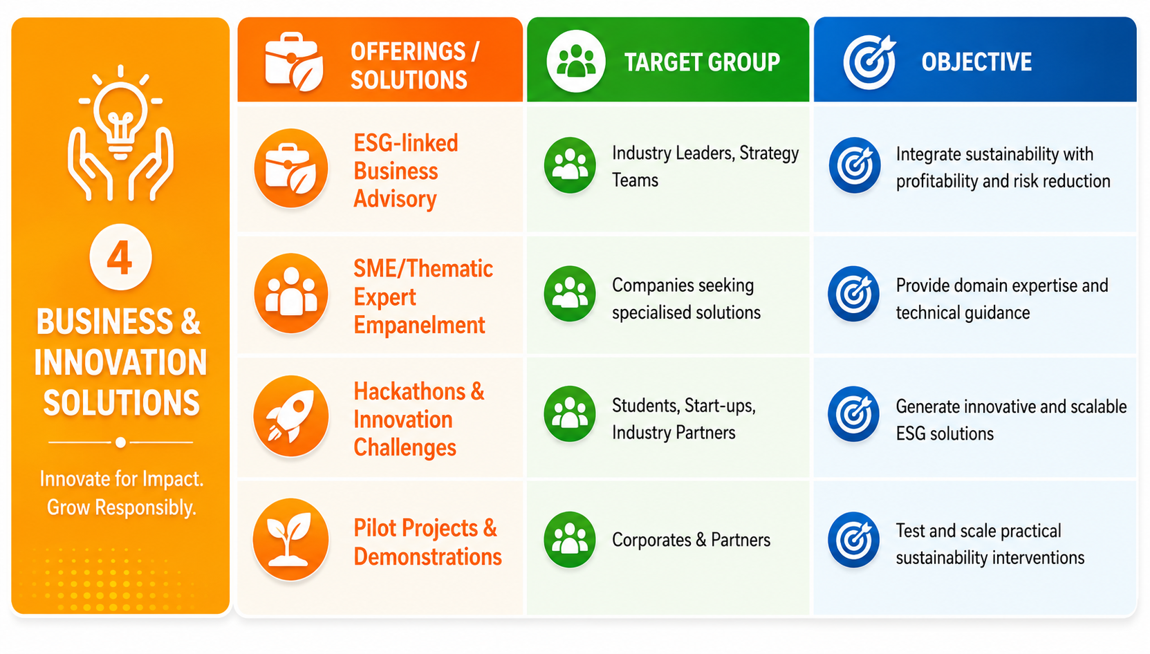

OUR SOLUTIONS FRAMEWORK — 4 OF 5
04
Business &
Innovation Solutions
Innovate for impact. Grow responsibly.
INDIA ESG ALLIANCE
10

Slide 11
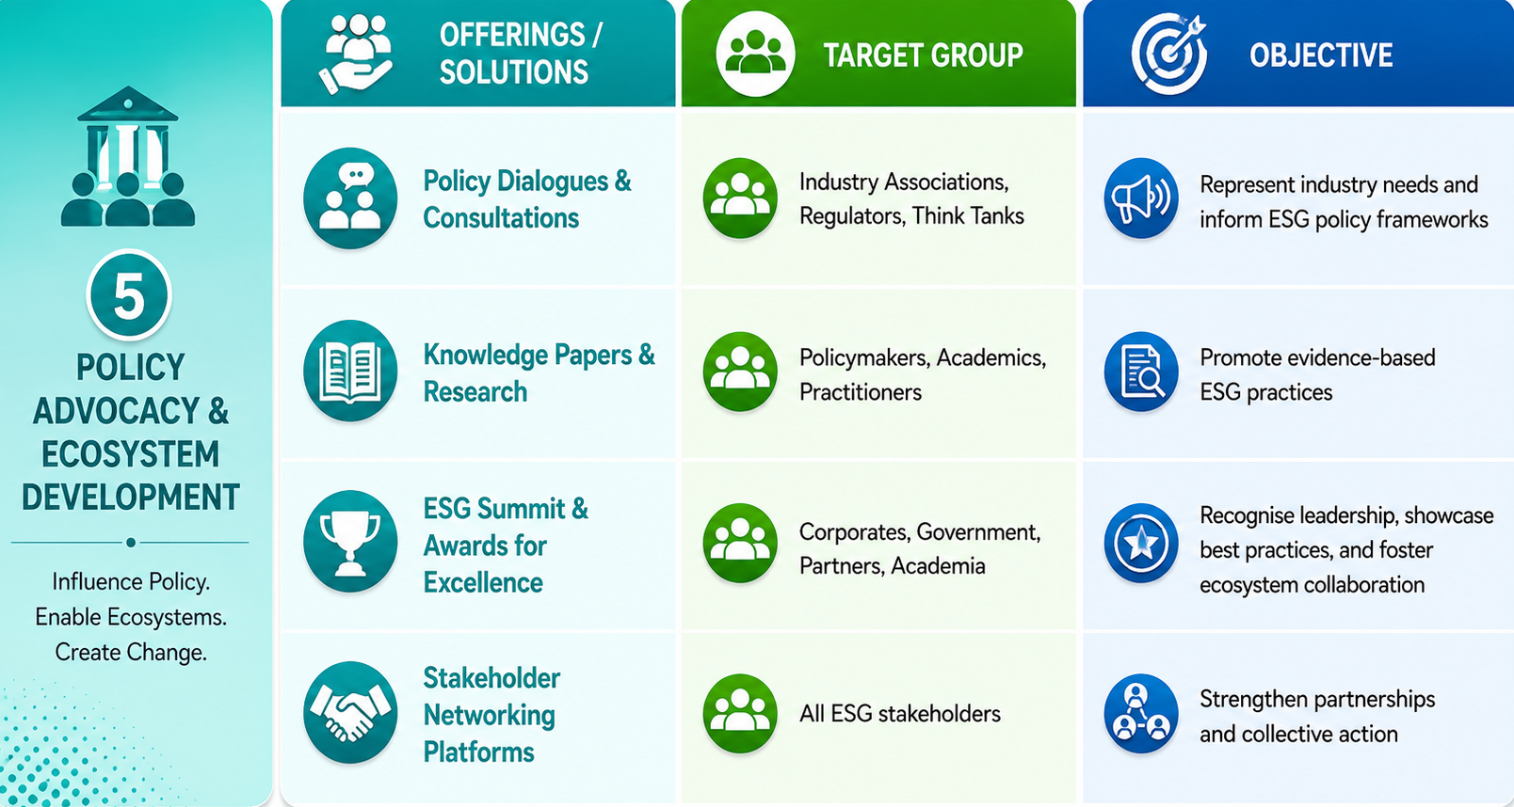

OUR SOLUTIONS FRAMEWORK — 5 OF 5
05
Policy Advocacy &
Ecosystem Development
Shape policy. Strengthen the ecosystem.
INDIA ESG ALLIANCE
11

Slide 12
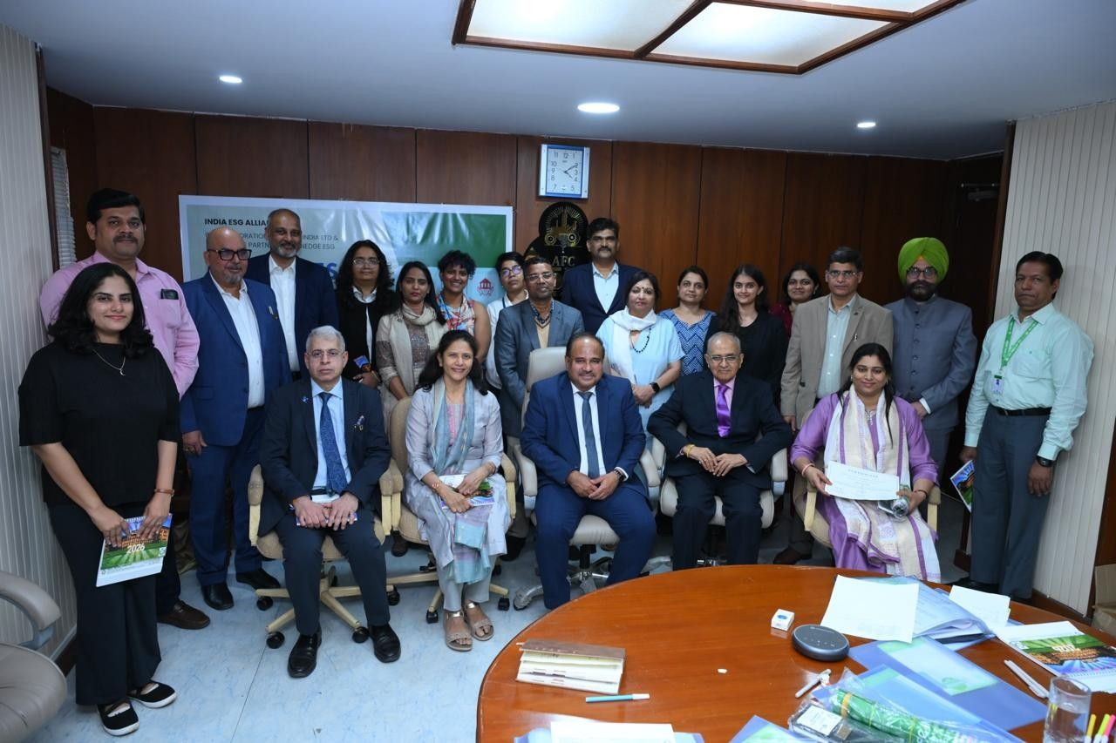
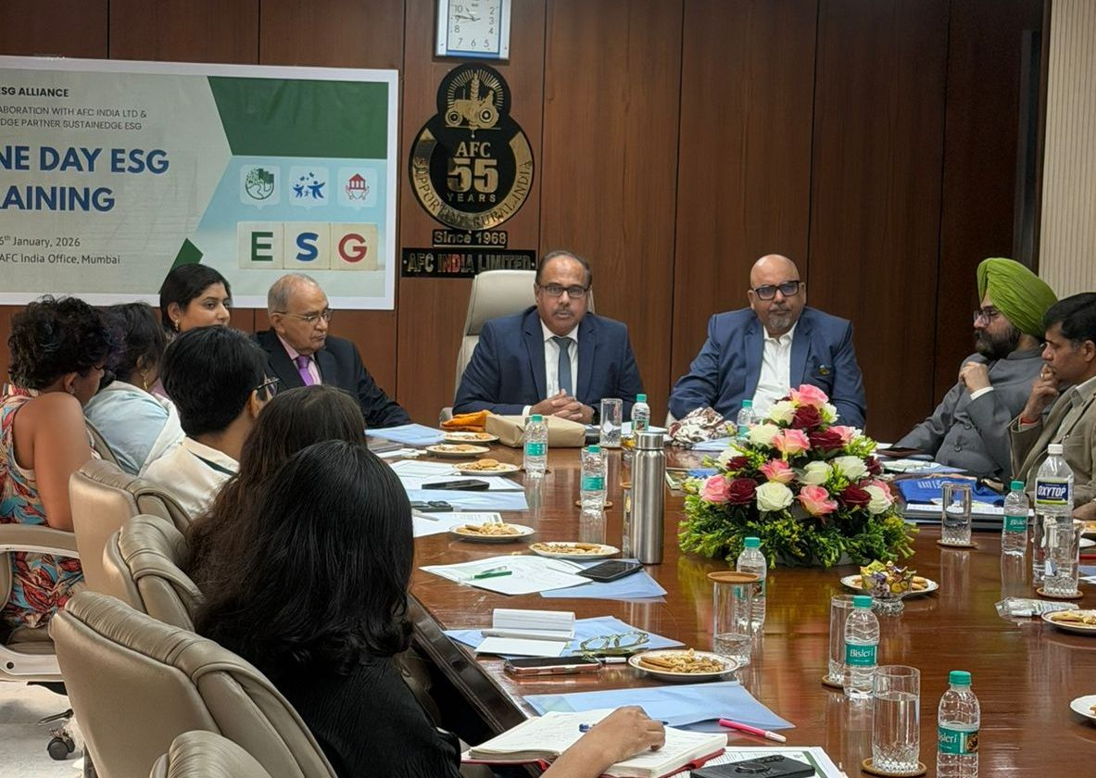
MAJOR INITIATIVES
One-Day Capacity Building Training on ESG Foundation
Foundational ESG Concepts
Practical Compliance Tools
Peer Learning & Discussion
INDIA ESG ALLIANCE
12

Slide 13
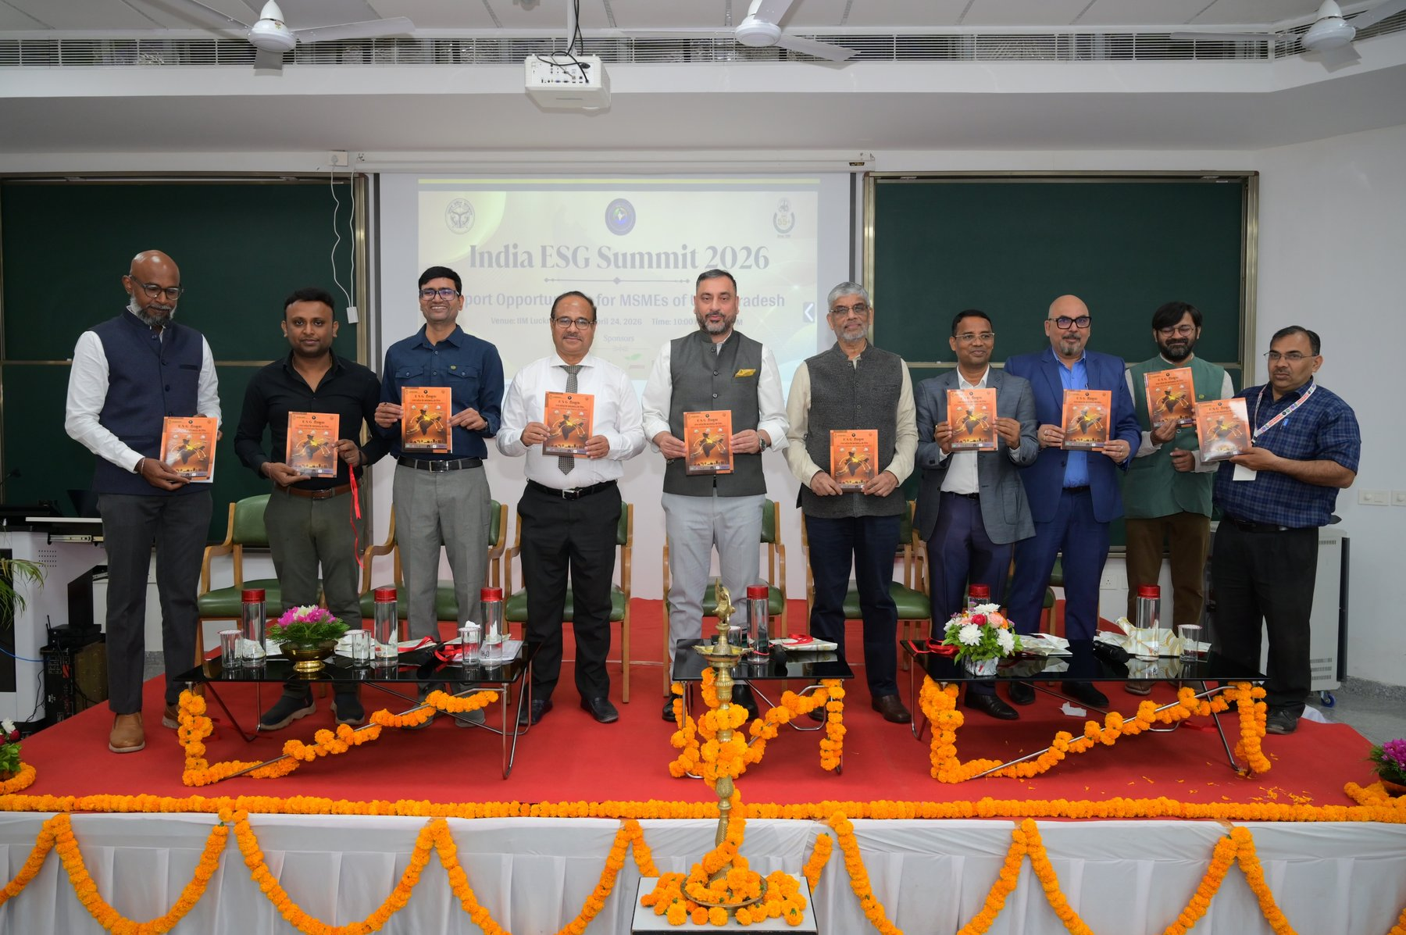
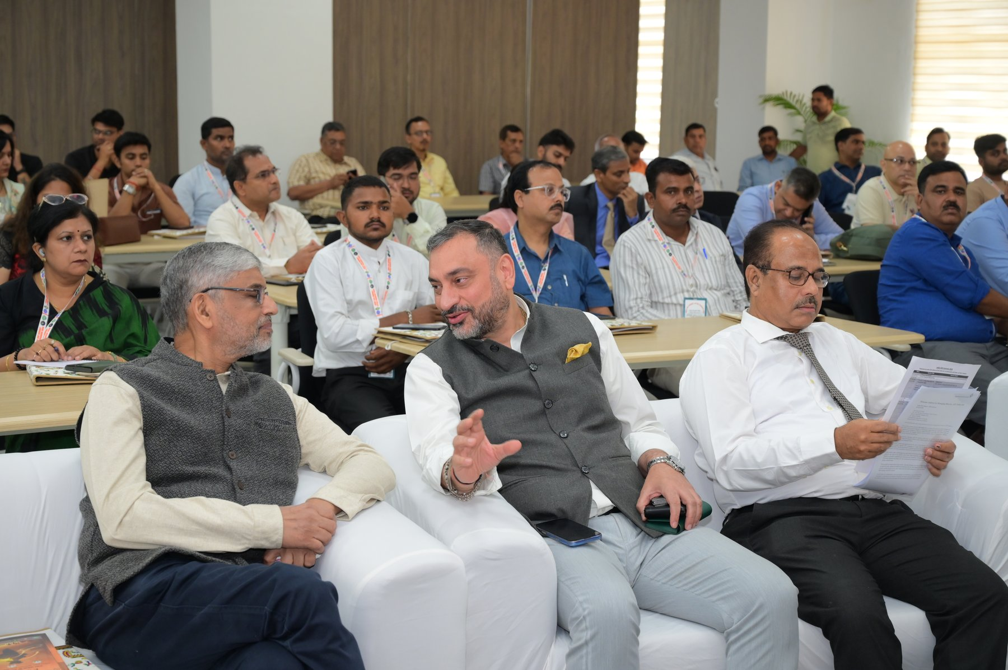
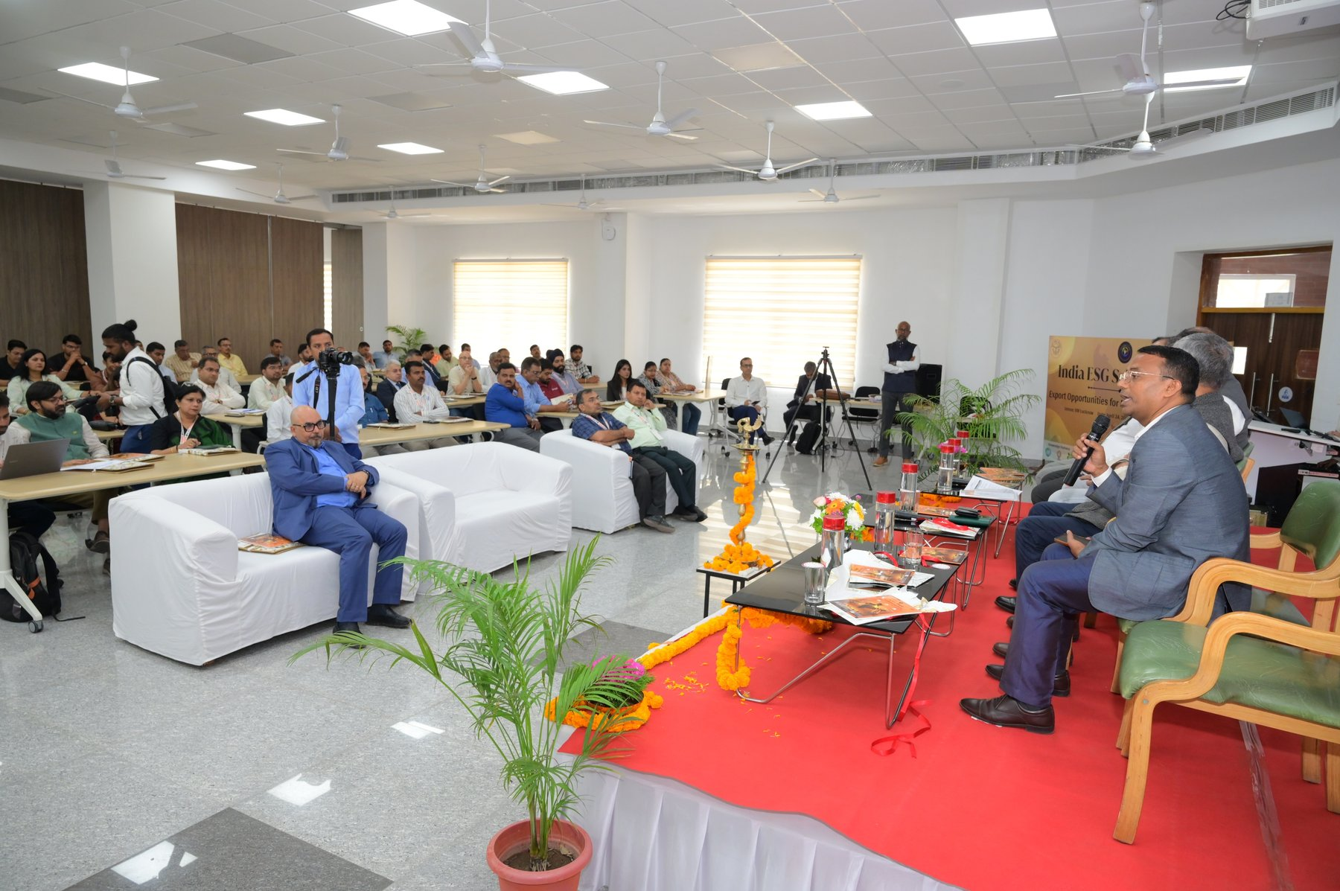
ON THE GROUND
National and State Level ESG Summits
INDIA ESG ALLIANCE
13

Slide 14






WHAT WE DELIVER
Programs & Initiatives
ESG Compliance Training
Board & CXO ESG Leadership Program
2-Day Capacity Building Trainings
For MSMEs
For MSMEs / Industries / Industry Associations
Business development planning & visioning for leaders
Sector-Specific ESG Modules
ESG Diagnostics & Strategy
Design Thinking Trainings
Developed for MSMEs and Industries
Development for organisations
To boost MSME revenue & sustainable growth
Research & Policy Advisory
MSME Exporters Program
India MSMEs Forum
M&E and program management support to governments
Export-readiness support for MSMEs
Supporting MSMEs/industries to export abroad
INDIA ESG ALLIANCE
14

Slide 15








TRUSTED BY
Clients and Partners
INDIA ESG ALLIANCE
15

Slide 16
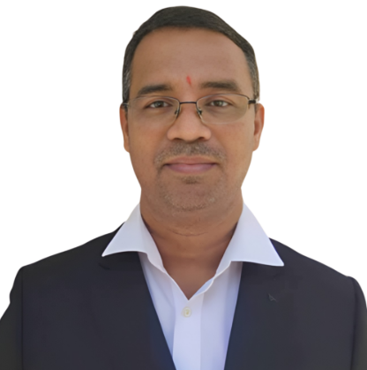
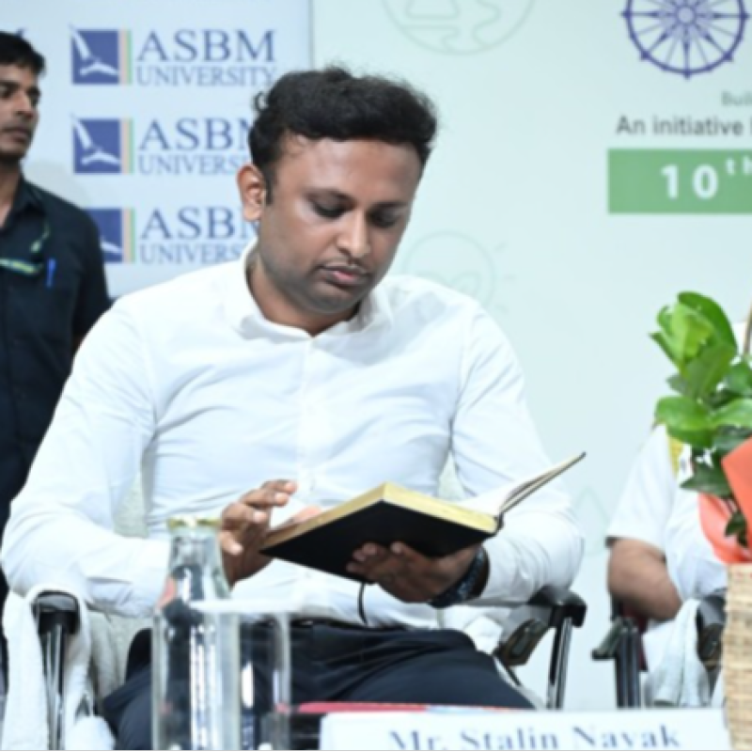


LEADERSHIP
Governance Philosophy & Board of Directors
BOARD OF DIRECTORS
GOVERNANCE PHILOSOPHY
IEA's governance is built on three principles:
Credibility & Independence
In ESG positioning
Strategic Oversight
By leaders from industry, policy, and academia
Operational Agility
Dr. Sanjaya Pradhan
Mr. Stalin Nayak
DIRECTOR
DIRECTOR
To respond to evolving ESG regulations and market needs
A serial social entrepreneur who has previously worked with NSDC, Tata Power and Mahindra Group.
A senior development professional and social entrepreneur; founder of the PANTISS group, known for his work on sustainability in mining areas.
IEA serves as a neutral and trusted ESG platform for corporates, investors, policymakers, and partners.
INDIA ESG ALLIANCE
16

Slide 17
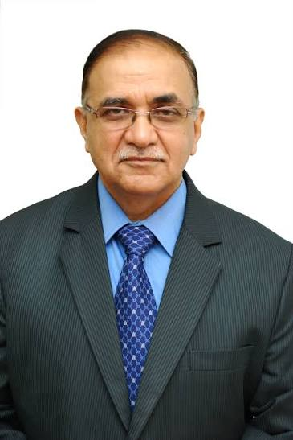
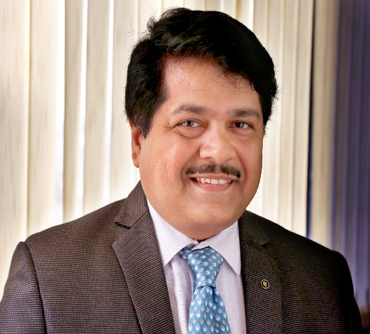
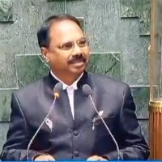
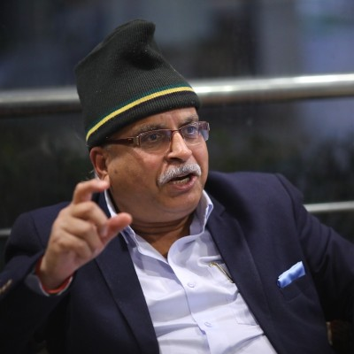
GUIDED BY
Advisory Council — 1 of 2
Shri Ashok Sethi
Dr. Subhransu Sekhar Acharya
Dr. Krishna Prasad
Colonel Prakash Tewari (Retd.)
SUSTAINABILITY & CORPORATE LEADERSHIP EXPERT
CHAIRMAN-CUM-MANAGING DIRECTOR, NSIC
MEMBER OF PARLIAMENT & FORMER IPS OFFICER
ENVIRONMENT, SUSTAINABILITY & SOCIAL IMPACT EXPERT
Partner, Sustain Edge ESG LLP; former Chairman of PXIL and of Tata Consulting Engineers.
Three decades across MSME credit, SME ratings and entrepreneurship development; former senior leader at SIDBI.
Brings public administration, governance and accountability perspective to the Alliance.
Career spanning the Armed Forces and sustainability leadership roles at Tata Power, Jindal Steel & Power and DLF.
INDIA ESG ALLIANCE
17

Slide 18
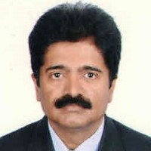

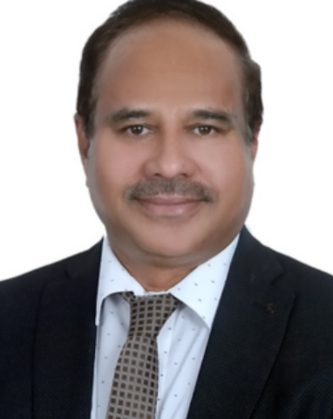
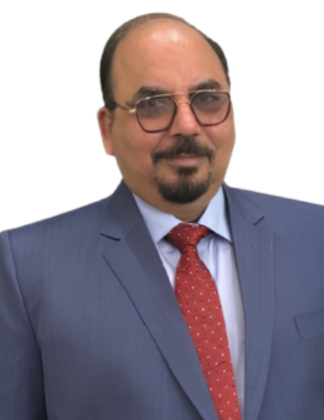
GUIDED BY
Advisory Council — 2 of 2
Prof. Shankar Murthy
Sobins Kuriakose
Shri Mashar Velapurath
Mr. Awanesh Kalik
PROFESSOR, ENVIRONMENTAL ENGINEERING & MANAGEMENT, IIM MUMBAI
INSTITUTION DEVELOPMENT & PUBLIC POLICY SPECIALIST
MANAGING DIRECTOR, AFC INDIA LIMITED
DGM & CEO, AFC FOUNDATION
Specialist in industrial sustainability, process safety and industrial wastewater management.
20+ years with NSDC, the World Bank and J-PAL in skilling, institution-building and monitoring & evaluation.
Former NABARD leader with deep expertise in climate finance and natural resource management.
25+ years in rural development; a recognised national expert on Panchayati Raj Institutions.
INDIA ESG ALLIANCE
18

Slide 19

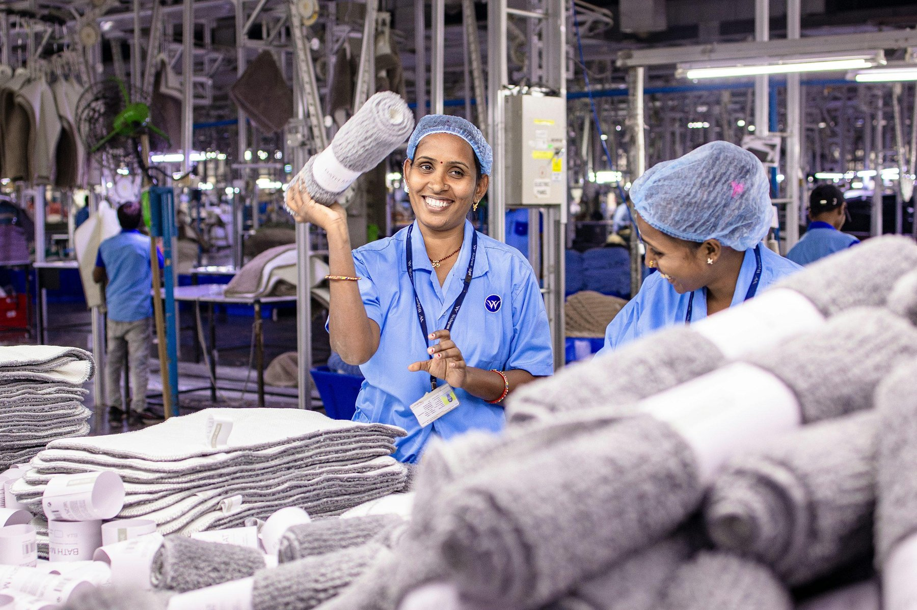
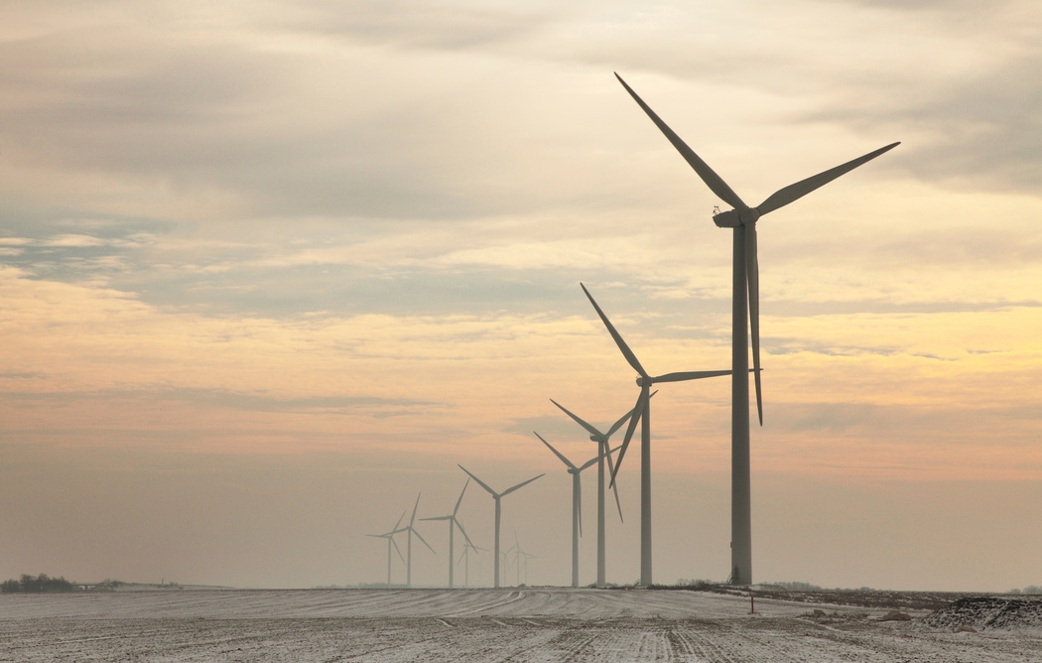
INDIA ESG ALLIANCE (IEA)
Better Future • Sustainability • Growth

Slide 20

Thank You
INDIA ESG ALLIANCE
Catalyzing ESG, Competitiveness
& Growth for a Developed India
Unit No. 8, P3, J Wing, Rustomjee Azziano Road,
Majhiwada, Thane West, Maharashtra – 400601, India

