Slide 1


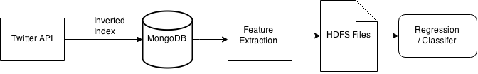
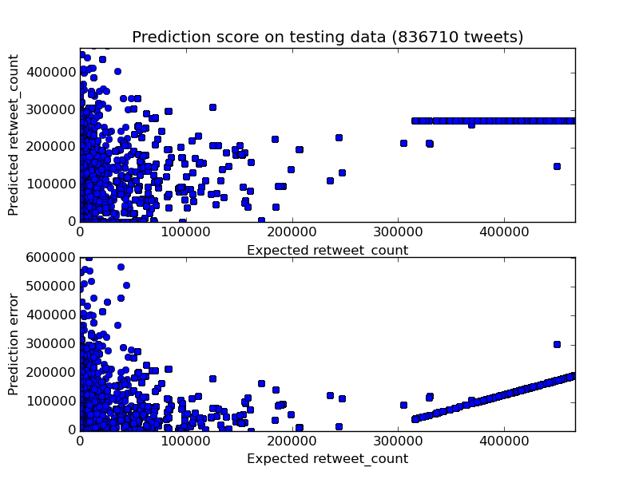
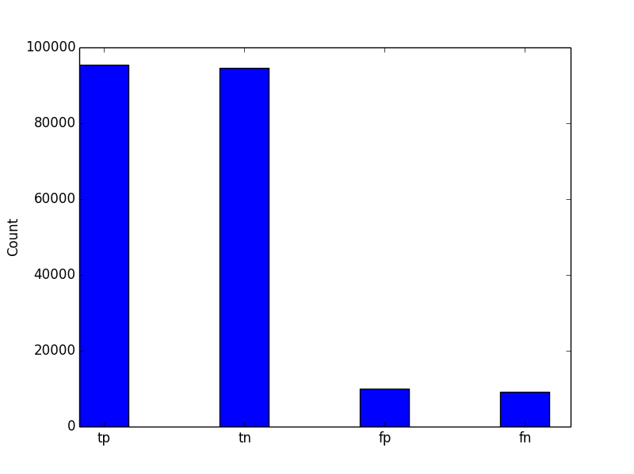
Twitter Virality Prediction
Benjamin Coors, Rémi Domingues, Håkan Eriksson, Paul Griffin, Akash Kumar Dhaka
1. Introduction
KTH Royal Institute Of Technology
4. Results
Twitter is a rich source of information. Mining it for data can be useful for a number of applications, for example in marketing. In our project we implemented a virality prediction of hashtags using machine learning and information retrieval techniques.
4.1 Virality predictions
2. Methodology
3. Model performance
Top-10 predictions for the first May week:
2.1 Data pipeline
3.1 Regression
BaltimoreRiots
BestFandomCA2015
FreddieGray
Baltimore
NepalEarthquake
SOL2015
LIAMISTHEPOOLCLEANER
HappyKyuziziDay
HowIBecameAFan
SaveMaryJaneVeloso
BaltimoreRiots
BestFandomCA2015
FreddieGray
Baltimore
MGWV
NepalEarthquake
FOLLOW
RT
FOLLOWTRICK
Nepal
2.2 Features
Followers
Friends
Listed
Status
Favourites
Account age
Verified
Hashtags
Media
User mentions
URLs
Tweet length
3.2 Classification
Regression
Classification
2.3 Prediction Model
5. Conclusion
Two approaches:
Regression:
Bayesian Ridge Regression
Classification:
Logistic Regression
The work done in this project shows the feasibility of predicting the virality of tweets using a feature-based approach. Future improvements could include further research into other fields such as social media analysis which will be needed to obtain even more accurate results.
Notes:
‹#›

