Slide 1








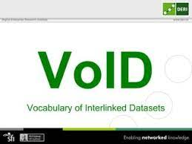
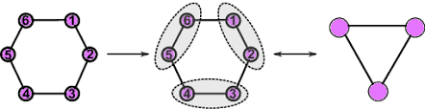



Metabolomic Semantic Datalake
Database Management System synoptic
Metabolomic Semantic Data Lake
Hadoop Distributed
File System
MSDDBM
Scala
Library
Loaded graphs
Online
RDF Metabolomic graphs
Metadata
Command line tool
+ MSDDBM
Python Library

