Slide 1

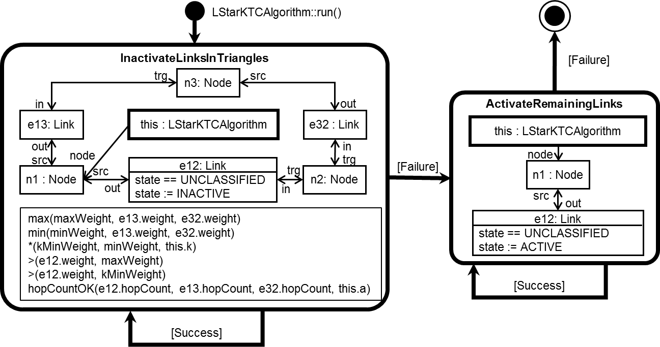

cMoflon: Model-Driven Generation of Embedded C Code for Wireless Sensor Networks
Conference Talk at ECMFA 2017
2017-07-19
Specification
Testbed
cMoflon

Slide 2
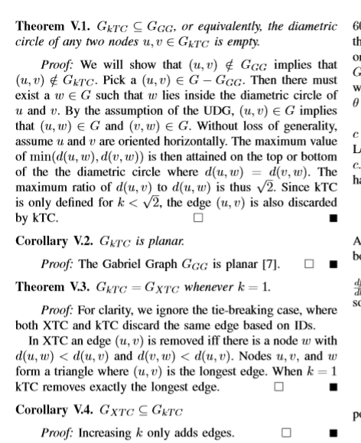
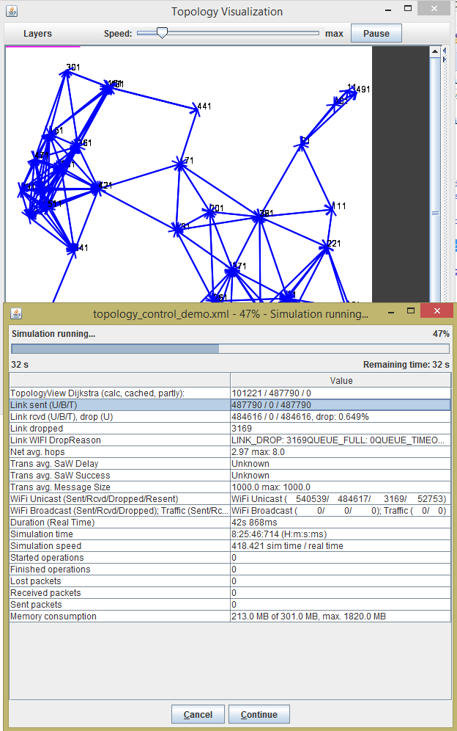
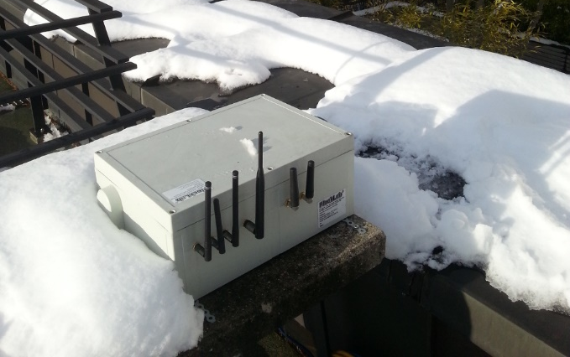


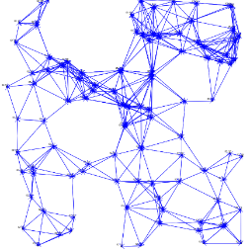
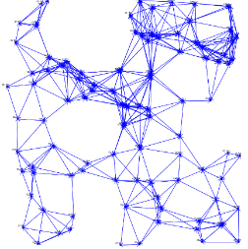


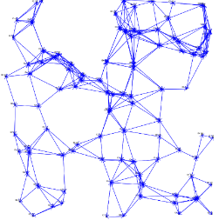


The curse of low abstraction in traditional communication system development
Model
Formalization, proofs,…
Constraints ✓
(i) Specification: Graph theory, …
(ii) Simulation:
C, Java, …
(iii) Testbed: C, C++,…
Limitations ✓
Feedback &
refinement
Code
Implementation
Porting
</>
Level of abstraction
https://www.flocklab.ethz.ch/wiki/chrome/site/wiki_public/observer/outdoor_1.jpg
Notes:
Level of abstraction drops early [Qadir15, Rexford13, Julien13]
Network protocols are usually analyzed after the fact [Zave12, Zave08]
Specification-to-implementation step is intransparent [Qadir15, Rexford13, Julien13]
[Quadir15] Qadir, Hasan: "Applying Formal Methods to Networking: Theory, Techniques, and Applications", IEEE Comm. Surveys & Tutorials, 2015
[Rexford15] Rexford, Zave: "Report of the DIMACS working group on abstr. for netw. services, arch., and impl.", ACM Comp. Comm. Review, 2013
[Julien13] Julien, Wehrle: Preface to SESENA'13 workshop on software engineering for sensor network applications (at ICSE'13)
[Zave12] Zave: "Using lightweight modeling to understand chord," SIGCOMM Comput. Commun. 2012
[Zave08] Zave: "Understanding SIP through Model-Checking," LNCS 5310, 2008

Slide 3



Leverage model-driven engineering principles!
Limitations ✓
Model
Formalization, proofs,…
Localization
Constraints ✓
(i) Specification: Graph theory, …
(ii) Simulation:
C, Java, …
(iii) Testbed: C, C++,…
Feedback &
refinement
Code
Extensible code gen.
Extensible code gen.
</>
Level of abstraction
Notes:
[Völter13, Kluge15]
[Völter13] Völter et al.: "Model-Driven Software Development: Technology, Engineering, Management," John Wiley & Sons, 2013
[Kluge15] Kluge et al.: "A Methodology for Designing Dynamic Topology Control Algorithms via Graph Transformation," in ICMT 2015
http://www.voelter.de/data/books/mdsd-en.pdf
(inspired by success stories of model-based approaches to WSN applications programming, e.g., Scatterclipse)

Slide 4


Contribution
Previous: Integration with wireless network simulator
(i) Specification: Story-driven modeling
(ii) Simulation:
Java
(iii) Testbed
eMoflon
</>
+
Extensible code. gen
This paper: Code generation for wireless sensor testbed
(i) Specification: Story-driven modeling
(ii) Simulation
(iii) Testbed: Embedded C
cMoflon
</>
+
Extensible code. gen

Slide 5
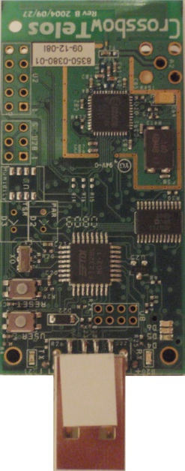
Wireless Sensor Networks
Wireless Sensor Network
Transmission range
n₁
0
2
Wireless node n₂ + hop count h₁(n₂) to n₁
n₂ 1
3
2
Wireless link e₃₄
+ link weight w(e₃₄) (e.g. distance approx. via RSSI)
TelosB sensor node [Polastre05] (48kB ROM, 10kB RAM)
2
n₃
1
n₄
2
y
[Polastre05] Polastre et al.: "Telos: enabling ultra-low power wireless research," IPSN 2005
x
Notes:
Wireless Sensor Network: resource-constrained devices, ad-hoc communication, e.g., for wildlife monitoring, wildfire detection
Topology: graph that represents devices and comm. links
Graph-based model of topologies:
nodes -> devices (with communication range and adjustable transmission power)
edges -> communication links
additional attributes: edge weight = link length, received signal strength indicator (RSSI), …
Paramount objective: save energy

Slide 6
Topology Control
High weight means high energy consumption
⇒
Inactivate high-weight links
Active
Inactive
n₁
0
n₁
0
2
2
n₂ 1
n₂ 1
3
Topology Control
3
2
2
2
n₃
1
2
n₃
2
n₄
2
n₄
3
y
y
Hop count increase
x
x
Notes:
Graph-based model of topologies:
nodes -> devices (with communication range and adjustable transmission power)
edges -> communication links
additional attributes: edge weight = link length, received signal strength indicator (RSSI), …
Paramount objective: save energy

Slide 7
Running examples: kTC, l*-kTC, and LMST
n₁
0
Legend
2
n_{a} h₁(n_{a})
w(e_{ab})
n₂ 1
n_{b} h₁(n_{b})
Input topology
6
3
2
Distance to node n₁
Unclassified
Active
Inactive
2
n₃
1
n₄
1
n₁
0
n₁
0
n₁
0
2
2
2
n₂ 1
n₂ 1
n₂ 1
Output topology
3
6
3
3
6
2
2
6
2
2
n₃
1
2
n₃
1
2
n₃
1
n₄
1
n₄
1
n₄
1
kTC[Schweizer16](k=2) Inactivate the weight-maximal link in each triangle
l*-kTC[Stein16] (k=2,a=1.5)
kTC + bound increase of routing path length
LMST[Li05] Activate links on local minimum spanning tree
[Schweizer16] Schweizer et al. "a-kTC: Integrating topology control into the stack," LCN'16
[Stein16] Stein et al. "Topology Control in WSNs: What Blocks the Breakthrough?," LCN'16
[Li05] Li et al. "Design and analysis of an MST-based topology control algorithm," IEEE Trans. Comm. 2005
Notes:
General motivation: These algorithms were implemented in a previous paper within the selected framework
Establishes comparability
kTC
Illustrates that cMoflon is suitable to implement weight-based Topology Control algorithms
l*-kTC[Stein16]
Illustrates how a developer may introduce custom attribute constraints
LMST[Li05]
Illustrates how a developer may introduce auxiliary classes into the metamodel

Slide 8


Challenges while building cMoflon
Ensure applicability
Problem: Unrealistic to build a "one-fits-all" solution
Approach: Representative algorithms and extensibility
Foster rapid prototyping
Problem: Porting to testbed incures high manual effort
Approach: Automation + extension points
Respect resource limitations
Problem: Resource constraints (e.g., Telos-B: 48kB ROM, 10kB RAM)
Approach: Use ToCoCo framework for Contiki OS
✓

Slide 9
Specification
(i) Specification
(ii) Simulation
(iii) Testbed

Slide 10
Topology Control metamodel
Spec.
n_{b}
Node
Link
state : LinkState
weight : EDouble
≪enumeration≫ LinkState
Active : LinkState
Inactive : LinkState
Unclassified : LinkState
w(e_{ab})
1
src
0..*
out
1
trg
0..*
in
≪derived≫ allLinks
0..*
node
1
≪abstract≫
TopologyControlAlgorithm
≪abstract≫ run() : void

Slide 11
Topology Control Metamodel
Spec.
User-defined attribute
Node
Link
state : LinkState
weight : EDouble
≪enumeration≫ LinkState
Active : LinkState
Inactive : LinkState
Unclassified : LinkState
hopCount : EInt
1
src
0..*
out
1
trg
0..*
in
≪derived≫ allLinks
0..*
node
1
1
node
parent
0..1
Auxiliary data structure
≪abstract≫
TopologyControlAlgorithm
≪abstract≫ run() : void
0..1
entry
0..1
entry
TreeEntry
entries
tree
Tree
0..*
1
tree
1
KTCAlgorithm
k : EDouble
run() : void
LStarKTCAlgorithm
k : EDouble
a : EDouble
run() : void
LMSTAlgorithm
run() : void
init() : void cleanup() : void
findShortestUnconnectedLink() : Link
Custom methods
Custom algorithm parameters

Slide 12
kTC story diagram
Spec.
while loops
KTCAlgorithm::run()
while loops
Stop
Start
InactivateLinksInTriangles
[Failure]
trg
n3: Node
src
Triangle pattern
in
out
ActivateRemainingLinks
e13: Link
this : LStarKTCAlgorithm
e32 : Link
this : LStarKTCAlgorithm
out
node
in
node
src
e12: Link
state == UNCLASSIFIED
state := INACTIVE
trg
trg
[Failure]
n1 : Node
src
n2: Node
n1 : Node
out
in
src
kTC: built-in constraints
out
max(maxWeight, e13.weight, e32.weight)
min(minWeight, e13.weight, e32.weight)
*(kMinWeight, minWeight, this.k)
>(e12.weight, maxWeight)
>(e12.weight, kMinWeight)
e12: Link
state == UNCLASSIFIED
state := ACTIVE
[Success]
[FNT+98] Fischer et al.: "Story Diagrams: A New Graph Rewrite Language Based on the UML and Java," 1998
[Success]

Slide 13
Executing the kTC story diagram
Spec.
LStarKTCAlgorithm::run()
k=2
n₁
0
n₁
0
InactivateLinksInTriangles
2
2
trg
n3: Node
src
n₂ 1
n₂ 1
in
out
6
3
6
3
e13: Link
e32 : Link
2
2
this : LStarKTCAlgorithm
2
n₃
1
2
n₃
1
out
in
n₄
1
n₄
1
src
node
trg
n1 : Node
e12: Link
state == UNCL.
state := INACTIVE
n2: Node
src
out
in
trg
Initial
After loop
"InactivateLinksInTriangle"
max(maxWeight, e13.weight, e32.weight)
min(minWeight, e13.weight, e32.weight)
*(kMinWeight, minWeight, this.k)
>(e12.weight, maxWeight)
>(e12.weight, kMinWeight)
✘
n₁
0
[Failure]
[Success]
2
n₂ 1
ActivateRemainingLinks
6
3
2
this : LStarKTCAlgorithm
Legend
2
n₃
1
node
n₄
1
n1 : Node
n2 : Node
src
out
trg
in
[Success]
match (only for type Node)
After loop
"ActivateLinksInTriangle"
[Failure]
e12: Link
state == UNCL.
state := ACTIVE

Slide 14
l*-kTC story diagram
Spec.
LStarKTCAlgorithm::run()
InactivateLinksInTriangles
[Failure]
trg
n3: Node
src
in
out
ActivateRemainingLinks
e13: Link
this : LStarKTCAlgorithm
e32 : Link
this : LStarKTCAlgorithm
out
node
in
node
src
e12: Link
state == UNCLASSIFIED
state := INACTIVE
trg
trg
[Failure]
n1 : Node
src
n2: Node
n1 : Node
out
in
src
out
max(maxWeight, e13.weight, e32.weight)
min(minWeight, e13.weight, e32.weight)
*(kMinWeight, minWeight, this.k)
>(e12.weight, maxWeight)
>(e12.weight, kMinWeight)
hopCountOK(n1.hopCount, n2.hopCount, n3.hopCount, this.a)
e12: Link
state == UNCLASSIFIED
state := ACTIVE
l*-kTC: Custom constraint
[Success]
[FNT+98] Fischer et al.: "Story Diagrams: A New Graph Rewrite Language Based on the UML and Java," 1998
[Success]

Slide 15
Code Generation for Testbed Evaluation
(i) Specification
(ii) Simulation
(iii) Testbed

Slide 16
Contiki and ToCoCo as target platform
Codegen.
Contiki OS: widely used in the WSN community
ToCoCo – Topology Control framework for Contiki: rapid prototyping and evaluation of Topology Control algorithms
cMoflon creates a per subclass of
≪abstract≫
TopologyControlAlgorithm
≪abstract≫ run() : void
TC
Contiki
Application
ToCoCo
Routing
TC
Neighbor discovery
Power control
Topology abstraction
Radio module
[Stein16] Stein et al.: "Control in Wireless Sensor Networks: What Blocks the Breakthrough?," In: LCN 2016
Source code on GitHub: https://github.com/steinmic/ToCoCo

Slide 17

A lean variant of eMoflon
Codegen.
Extensive reuse: Modeling frontend, preprocessing
Exchanged code generation phase (ca. 3400 LOC, 1% of eMoflon)
User-defined attribute constraints
User-defined code
Standalone
EMF code
Export of eMoflon
EA add-in
EA export file
Metamodel
with story diagrams
Metamodel with
control flow models
eMoflon
</>
Parser
M2M
.java
M2T
ToCoCo
TC components
.xmi
.ecore
1:1 relation
Story diagrams
Control flow models
TC
Attached to the corr. operations
.c,.h
cMoflon
I: Import
II: Validation
III: Code generation
Common to
eMoflon & cMoflon
eMoflon only
cMoflon
only
Notes:
The reused parts of eMoflon consist of ca. 358 000 lines of Java
and C# code. In contrast, cMoflon consists of 3 362 lines of Java code (ca. 1%
of eMoflon).

Slide 18
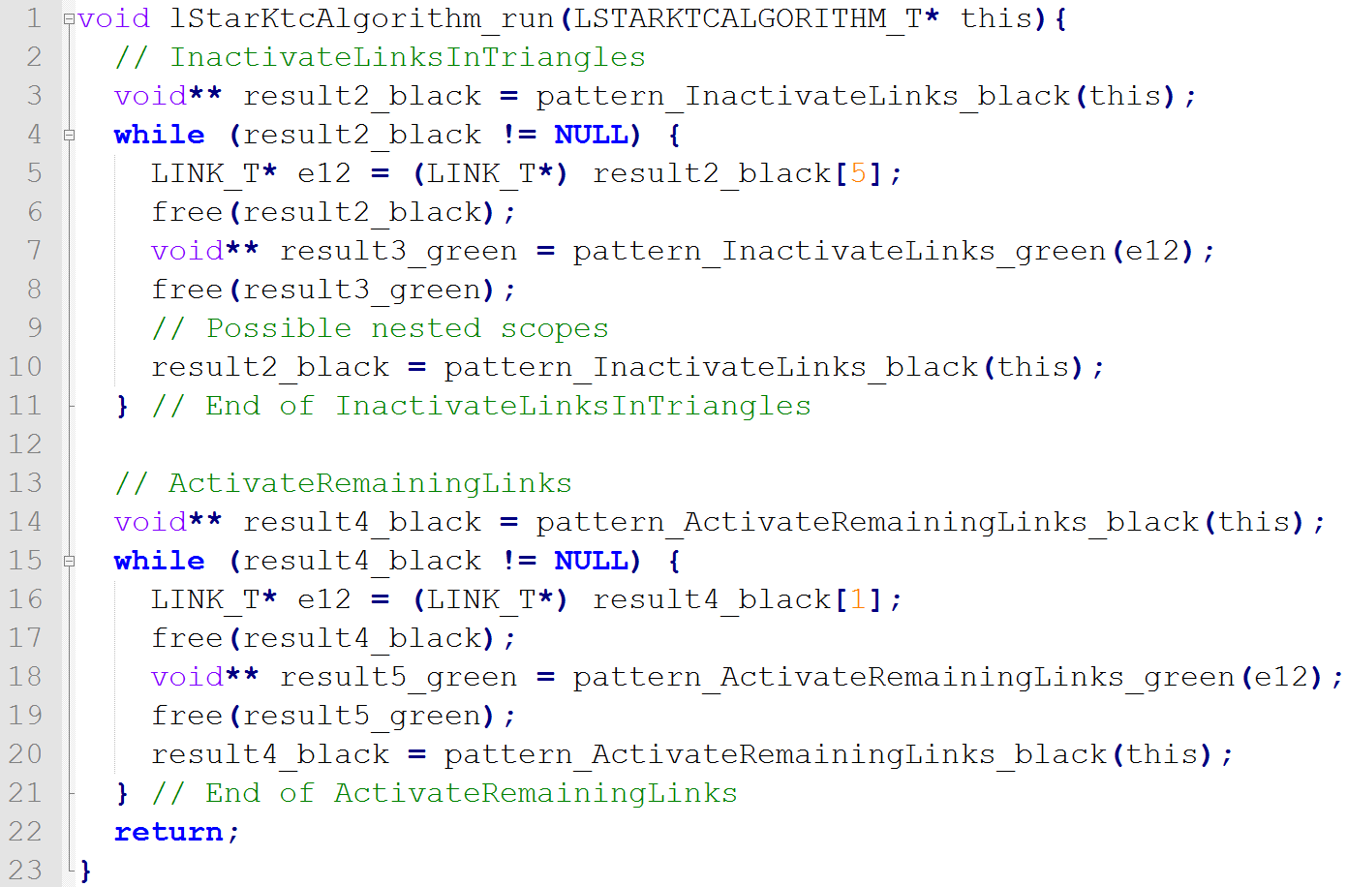
Example: Control flow code
Codegen.
Memory management (I):
free after use
Auxiliary type: Developer provides mapping (i.e., C struct)
LStarKTCAlgorithm::run()
LStarKTCAlgorithm::run()
InactivateLinksInTriangles
InactivateLinksInTriangles
…
trg
n3: Node
src
in
out
e13: Link
this : LStarKTCAlgorithm
e32 : Link
[Success]
out
node
in
src
src
e12: Link
state == UNCL.
state := INACTIVE
trg
trg
n1 : Node
out
in
n2: Node
max(maxWeight, e13.weight, e32.weight)
min(minWeight, e13.weight, e32.weight)
*(kMinWeight, minWeight, this.k)
>(e12.weight, maxWeight); >(e12.weight, kMinWeight)
hopCountOK(e12.hopCount, e13.hopCount, e32.hopCount, a)
Traceability via story node names
[Failure]
[Failure]
[Success]
ActivateRemainingLinks
…
ActivateRemainingLinks
this : LStarKTCAlgorithm
node
[Success]
n1 : Node
src
out
[Success]
e12: Link
state == UNCLASSIFIED
state := ACTIVE
[Failure]
Generic match representation: Array of void*
Story pattern decomposed into sub-patterns, e.g., for the LHS and RHS
[Failure]

Slide 19
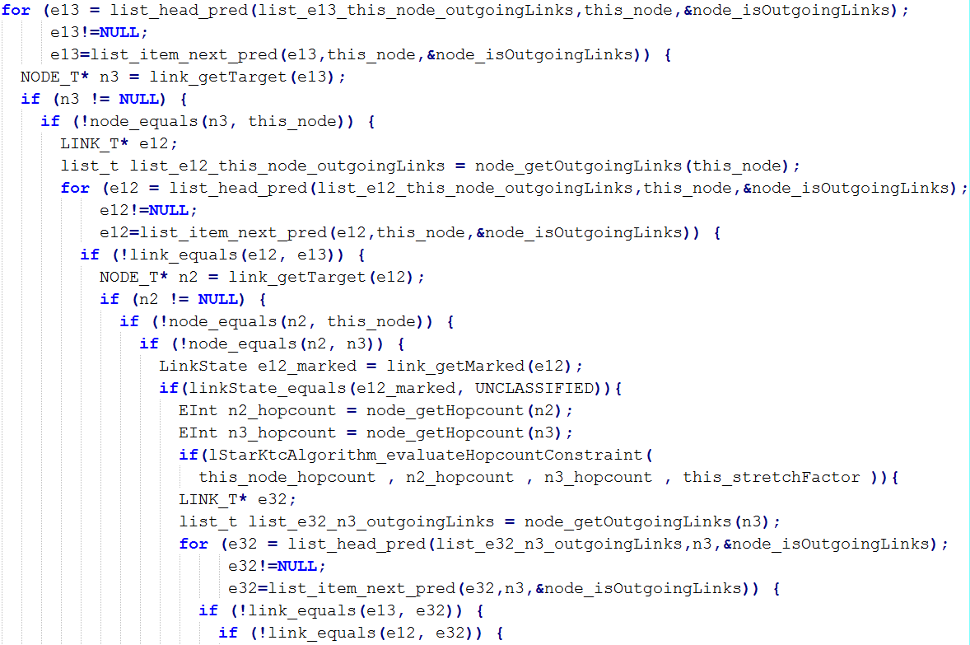
Example: Pattern matching code (I)
Codegen.
…
Proper NULL pointer handling
trg
n3: Node
src
n3: Node
in
out
e13: Link
this : LStarKTCAlgorithm
e13: Link
this : LStarKTCAlgorithm
e32 : Link
e32 : Link
out
node
in
src
e12: Link
state == UNCL.
state := INACTIVE
trg
n1 : Node
e12: Link
state == UNCL.
state := INACTIVE
n1 : Node
n2: Node
n2: Node
Mimic object orientation by conventional names
src
out
in
trg
max(maxWeight, e13.weight, e32.weight)
min(minWeight, e13.weight, e32.weight)
*(kMinWeight, minWeight, this.k)
>(e12.weight, maxWeight); >(e12.weight, kMinWeight)
hopCountOK(e12.hopCount, e13.hopCount, e32.hopCount, a)
User-defined l*-kTC
constraint
…

Slide 20
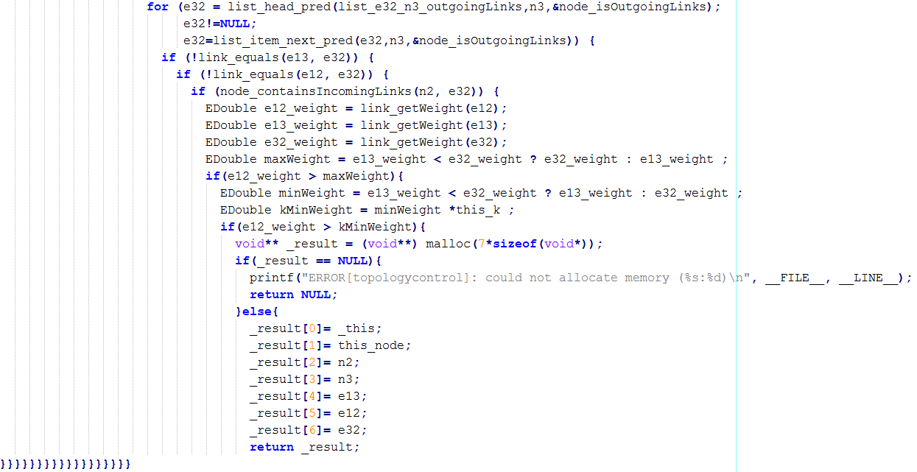
Example: Pattern matching code (II)
Codegen.
…
trg
n3: Node
src
in
out
e13: Link
this : LStarKTCAlgorithm
e32 : Link
out
node
in
src
e12: Link
state == UNCL.
state := INACTIVE
trg
n1 : Node
n2: Node
src
out
in
trg
max(maxWeight, e13.weight, e32.weight)
min(minWeight, e13.weight, e32.weight)
*(kMinWeight, minWeight, this.k)
>(e12.weight, maxWeight); >(e12.weight, kMinWeight)
hopCountOK(e12.hopCount, e13.hopCount, e32.hopCount, a)
max(maxWeight, e13.weight, e32.weight)
min(minWeight, e13.weight, e32.weight)
*(kMinWeight, minWeight, this.k)
>(e12.weight, maxWeight); >(e12.weight, kMinWeight)
hopCountOK(e12.hopCount, e13.hopCount, e32.hopCount, a)
Memory mgmt. (II)
malloc on match, notification on error

Slide 21
Evaluation for code size
Codegen.
… instead of runtime/scalability because (code) memory is scarcer (ca. 48kB)!
Algorithm | Image Size[B] | Δ rel. to NoTC | Δ rel. to Man.
No TC | 36 917
kTC Man Gen | 39 135 40 897 | +2 218 (+ 6.0 %) +3 980 (+10.8%) | +1 762 (+ 79.2%)
l*-kTC Man Gen | 40 293 42 247 | +3 376 (+ 9.1%) +5 330 (+14.4%) | +1 954 (+ 57.9%)
LMST Man Gen | 39 395 42 799 | +2 478 (+ 6.7%) +5 882 (+15.9%) | +3 404 (+137.4%)
"Boilerplate:" OS + sample application
Increase relative to image size: +4.8pp..+9.2pp
Size of compiled sensor images (Contiki 3.0), supp. resources available at https://github.com/eMoflon/cmoflon/releases/tag/cmoflon_1.0.0
Notes:
… instead of runtime/scalability because (code) memory is scarcer!
"Boilerplate" >37kB = 77% of 48kB
Size Increase:
Relative to TC: +80% to 140% (no sophisticated code minimization!)
Relative to whole image: +4.8% to 9.2%

Slide 22


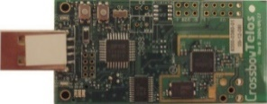
Summary and Outlook
Open source: eMoflon/cmoflon
Generate embedded C code of Topology Control algorithms
Extensible, dynamic memory & null-pointer handling
Compatible with previous simulation support
Outlook
More sensor platforms and algorithms
Improve memory allocation behavior
Reduce redundant null-pointer checks
(i) Specification: Story-driven modeling
(ii) Simulation:
Java
(iii) Testbed
eMoflon
</>
(i) Specification: Story-driven modeling
(ii) Simulation
(iii) Testbed: Embedded C
cMoflon
</>
+
Thank you!

Slide 23

Thank You for Your Attention
Department of Electrical Engineering
and Information Technology
Real-Time Systems Lab
Roland Kluge, M.Sc.
roland.kluge@es.tu-darmstadt.de Phone: +49(0)6151 16-22354
Merckstraße 25 Fax: +49(0)6151 16-22352
64282 Darmstadt www.es.tu-darmstadt.de
Germany

Slide 24
Icon sources
eMoflon/cMoflon logos: Work of the eMoflon developer team. Subject to Fair Use conditions.
TelosB Sensor node: Wiki Commons, CC-BY-3.0, by Jbasic, https://commons.wikimedia.org/wiki/File:TelosB.jpg
PowWow Sensor node: Wiki Commons, CC-BY-3.0, by Romain Fontaine, https://commons.wikimedia.org/wiki/File:PowWow.jpg
Writing Hand: CC-BY-3.0 US, Rediffusion, https://thenounproject.com/search/?q=hand%20drawing&i=29383
Gears: CC-BY-3.0 US, Pedro Santos https://thenounproject.com/search/?q=gear&i=1030299
Barrier: CC-BY-3.0 US, ProSymbols US, https://thenounproject.com/search/?q=barrier&i=792199
Lock: CC-BY-3.0 US, Aleksandr Vector, https://thenounproject.com/search/?q=lock&i=1009759
Light Bulb: CC-BY-3.0 US, ProSymbols, https://thenounproject.com/search/?q=idea%20bulb%20icon&i=799621
Target: CC-BY-3.0 US, Gregor Cresnar, https://thenounproject.com/search/?q=target&i=796213
GitHub Logo: CC-BY-3.0, Dave Gandy, http://www.flaticon.com/free-icon/github-logo_25231
These slides are provided under Creative Commons (BY-SA,

