Slide 1
Social Signal Interpretation XML Tutorial
Johannes Wagner <wagner@openssi.net>
(last update: 16.01.13)
http://openssi.net

Slide 2
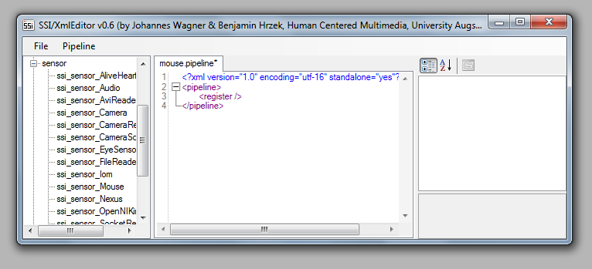
XML Editor
Start bin/<Win32|x64>/vc10/xmledit.exe
Create a new pipeline (File>New) and save it (File->Save), e.g. mouse.pipeline
components
editor
properties

Slide 3
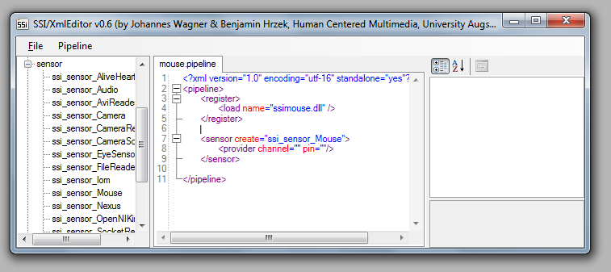
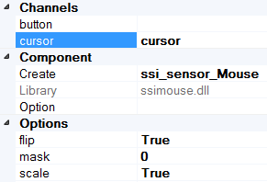

Provider
Within the component panel expand the sensor-tree and double click ssi_sensor_Mouse
Place cursor in line <sensor… to display the properties
Below Channels add a pin-name to cursor (e.g. also cursor)
Input components can now receive the cursor stream via the pin-name

Slide 4
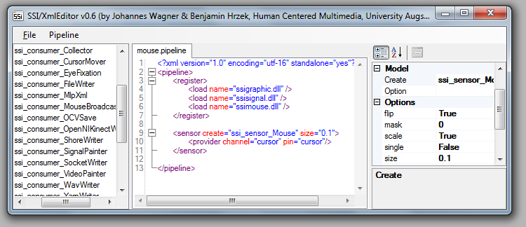
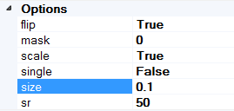
Optionen
Below the category Channels you find options specific to the component
Additional information to a selected option is displayed at the bottom of the panel
Change option size to 0.1

Slide 5
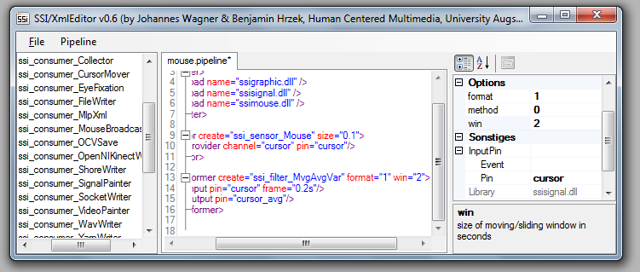
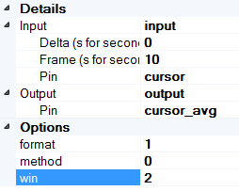
Transformer
Place cursor after </sensor> and insert a MvgAvgVar Filter (available from the transformer tree)
In the properties panel set the input pin to cursor and choose a name for the output pin (here cursor_avg)
Set frame size either by samples per second (e.g. "10") or in seconds (z.B. "0.2s“)
Set options format to 1 and win to 2

Slide 6
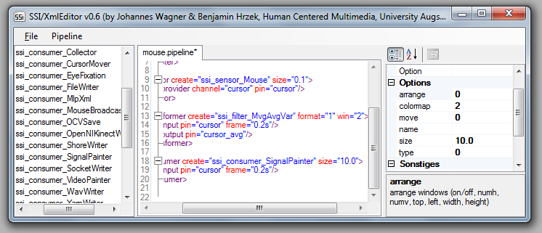
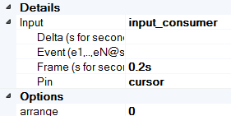
Consumer
Place cursor after </transformer> and add a SignalPainter consumer
Set input pin to cursor and choose a frame size (e.g. 0.2s)
Set option size to 10.0
Execute pipeline by pressing F5

Slide 7
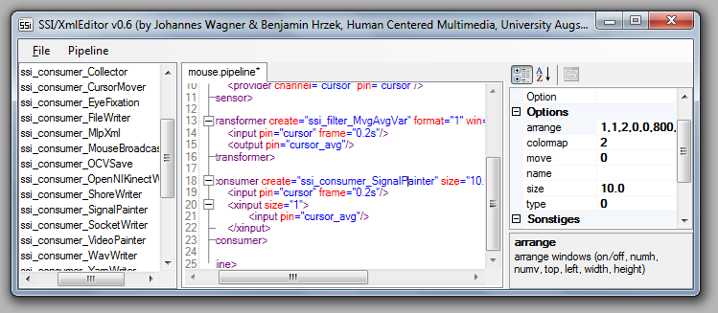
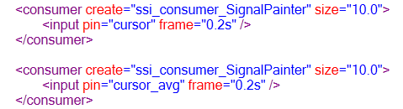
Consumer
To compare the raw cursor signal with its manipulated version either insert another SignalPainter consumer with input pin cursor_avg.
Set option arrange to 1,1,2,0,0,400,600

Slide 8
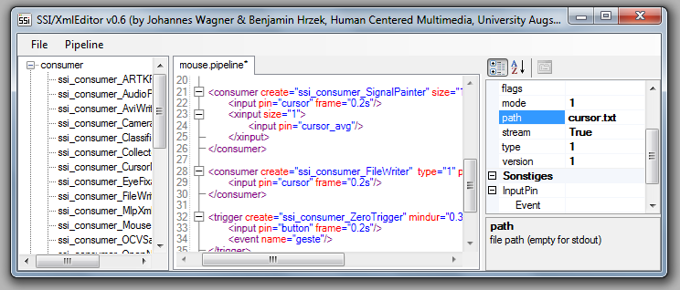

File
To store cursor signal to disk add a FileWriter consumer and set once more the pin and frame property
Use option path to set a file path and change mode to 1 (=ASCII)
When you run the pipeline again the cursor signal will be stored in files cursor.stream and cursor.stream~

Slide 9
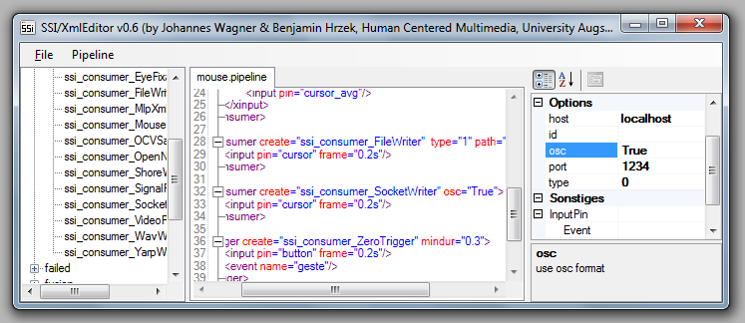

Socket
To stream the cursor signal through a socket insert a SocketWriter consumer and set option osc to True
Start pipeline and run the following command on the command line: <root>\[Win32|x64]\vc10\bin\sockspy.exe --osc -console 1234

Slide 10
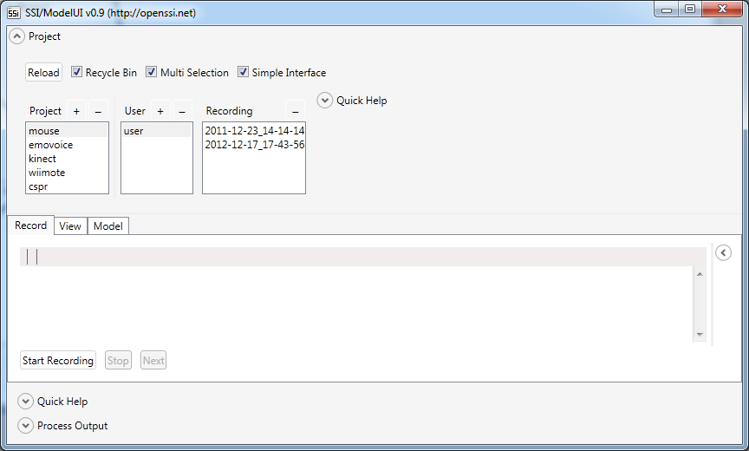
ModelUI
Start <root>\[Win32|x64]\vc10\bin\modelui.exe and select project mouse
User
Project
Recordings
Recording
Viewing
Model training & evaluation

Slide 11
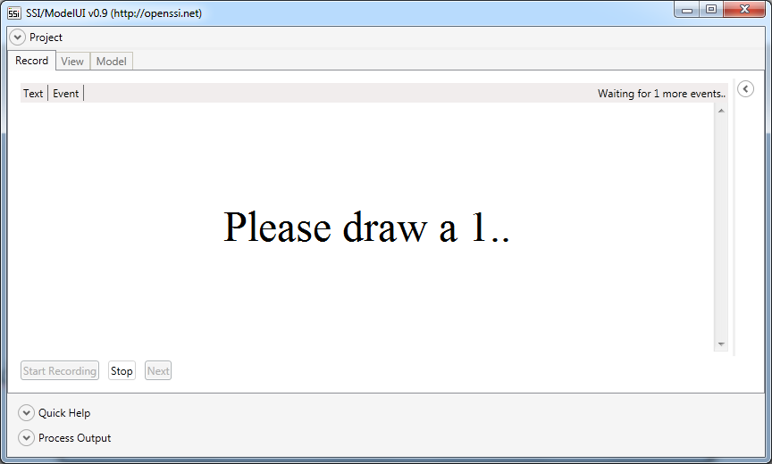

ModelUI
Select user and click Start Recording in record panel
Follow instructions on screen
Draw inside the GUI by holding the left mouse button pressed

Slide 12
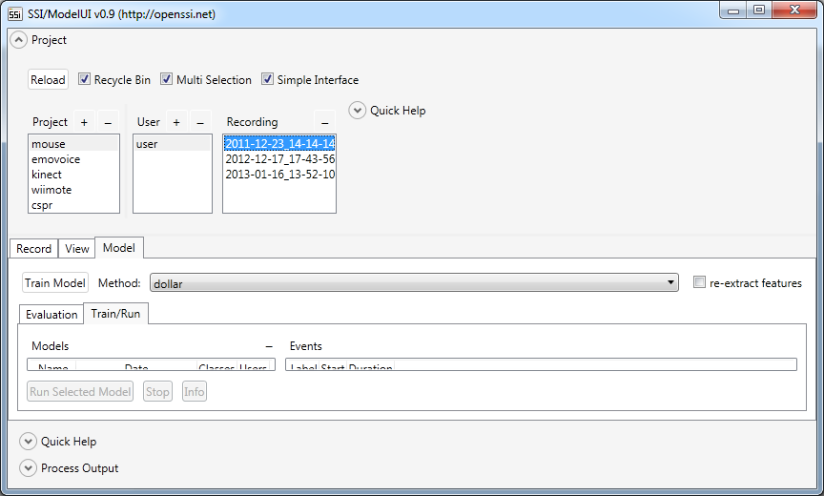
ModelUI
Switch to Model panel and switch to Train/Run
Select one or more recordings (by holding the ctrl key)
Select dollar as traning method panel
Press Train Model button
Choose Recording(s)
Switch to Model
Select Method
Train Model
Switch to Train/Run

Slide 13
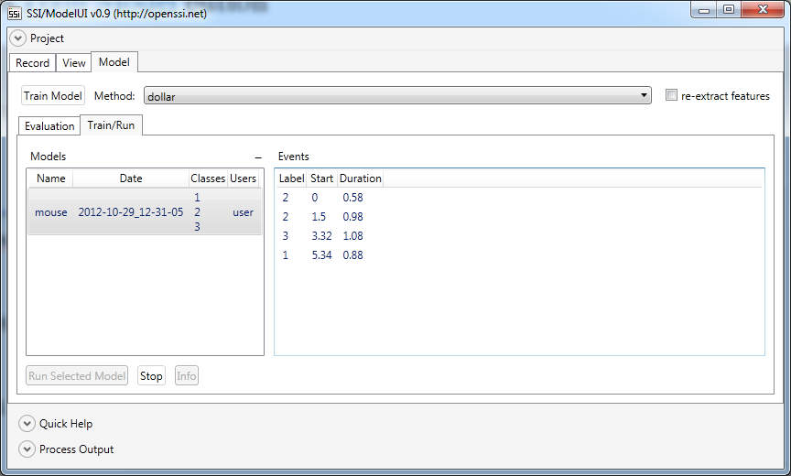
ModelUI
Select the trained model and click Run Selected Model
Draw inside the GUI by holding the left mouse button pressed
Choose Model
Run Model
Classification results

Slide 14
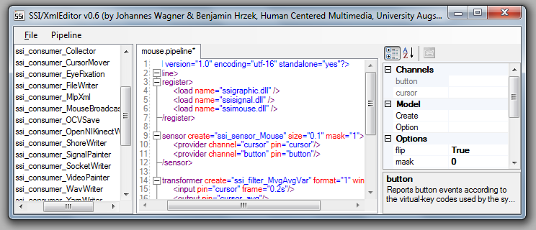

Provider
Switch back to the editor and place the cursor again in the <sensor… line
Set mask of mouse sensor to 1 and activate second provider by putting a name to the button channel name (e.g. button)

Slide 15
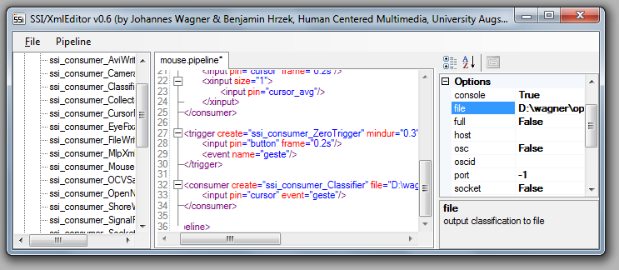
Trigger
Add a new consumer ZeroEventSender with input pin button and a frame size of 0.2s
Input an event name by setting option ename (e.g. gesture) and set option mindur to 0.3

Slide 16

Classifier
Insert a consumer of type Classifier and set input to cursor
Instead of a frame size set gesture@ as Event name
As option trainer set the path of the previously trained model (e.g.: <root>\model\mouse\train\2011-07-20_07-57-53\mouse) to complete your online classifier

