Slide 1
Ahihi
Discovery Social Network App
Class: SE357.M12.PMCL
Instructor: Nguyen Trinh Dong
Student: Nguyen Van Dat (19521347)

Slide 2

Business Requirement
01
Application Overview
02
Domain Diagram
03
Use Cases
04
SRS

Slide 3
Application Overview

Slide 4
Application Overview
01
Connect User to User
Chat, Friends, New Feeds and interact online
02
Connect User to Agency (Page)
Manage services, ADS, ranking
03
Connect User to Community (Group)
Manage members, Admin and News
04
Connect Agency to Agency
All Agencies will use the app as user role in the beginning
05
Area limiting
Vietnam

Slide 5



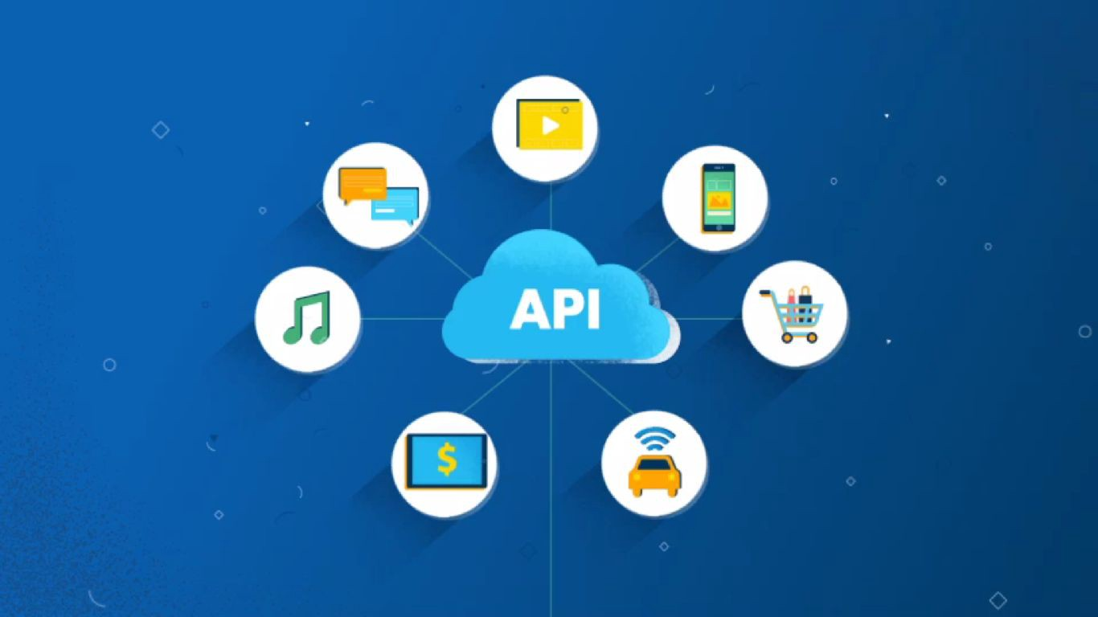
Application Overview
Problem | Solve
Media | Store on CDN
Notification, chat,… real time | WebSocket and Socket handler
Security | OAuth2
Payment | Use Agent’s APIs

Slide 6
Application Overview
User (role) | Page (role) | Group (role)
Chat | Manage Page information | Manage Page information
Write New Feeds | Manage New Feeds | Manage New Feeds
Watch News | Add/Register services | Add/Delete administrator
Like/Comment/Report a news | Add/Delete administrator | Block/Delete Group
Follow Page/Group/Account | Block/Delete Page
Add/Delete friends
Manage account information
Switch Account/Page/Group roles
CRUD Page
CRUD Group

Slide 7
Function List
Login | Login
 | Login by APIs
Manage Account | Forgot Password
 | Register
 | Change Password
 | Add Friend
 | Delete Friend
 | View Friend List
 | Lock Account
 | Change Account Information
 | Help
 | Create Page
 | Create Group
 | Switch Page/Group
News Feeds | Write Post
 | Write comment
 | Like
 | Disklike
 | Report
 | Search
 | Watch News
 | Block News
Services | Book Services
 | Edit Services
 | Add Services
Manage Page | Lock Page
 | Open Page
 | Delete Page
 | Edit Page
 | Ranking
 | Register ADS
 | View ADS
 | Cancel ADS
 | Add Admin
 | Delete Admin
 | Get Admin List
Manage Group | Lock Group
 | Open Group
 | Delete Group
 | Edit Group
 | Add Member
 | View Member
 | Delete Member
 | Add Admin
 | Delete Admin
 | Get Admin List
Notification | View Notification List
Chat | View Chat list
 | View Friend List

Slide 8
Domain Diagram

Slide 9
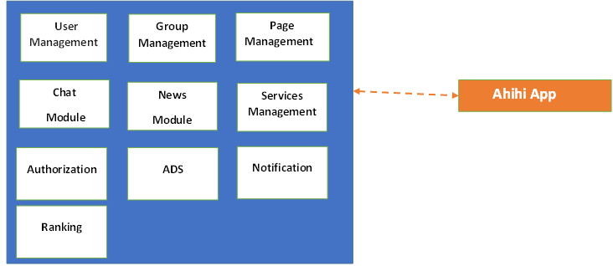
Domain Diagram

Slide 10
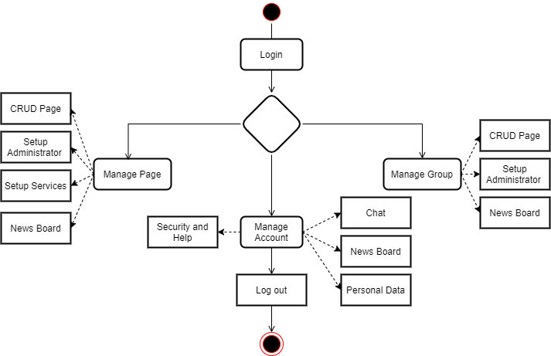
Workflow

Slide 11
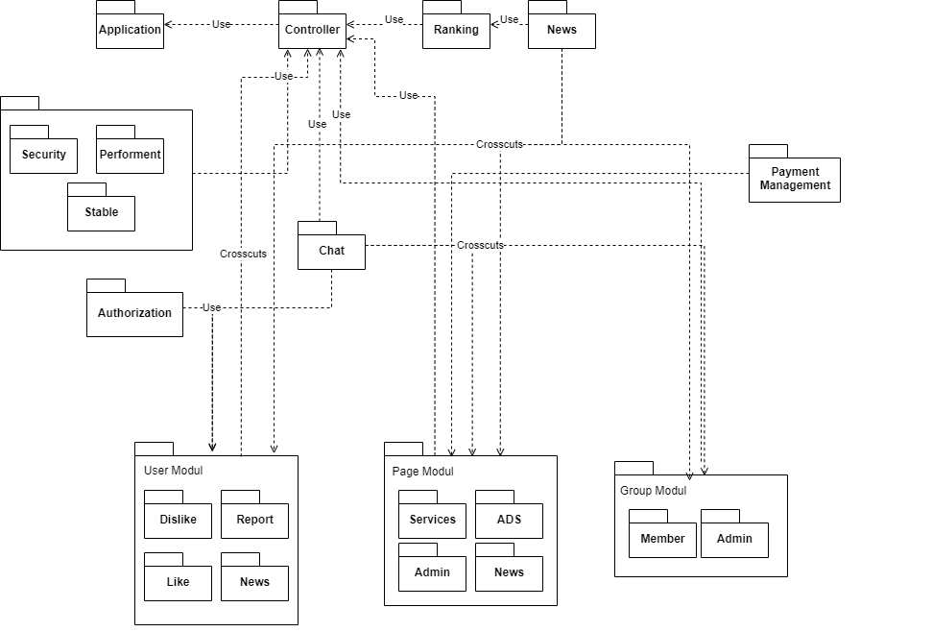
Module Diagram

Slide 12
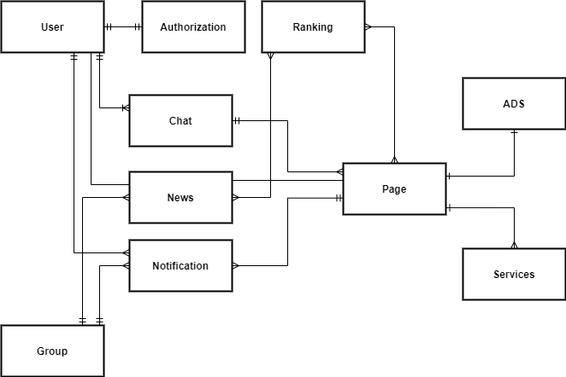
Module Diagram

Slide 13
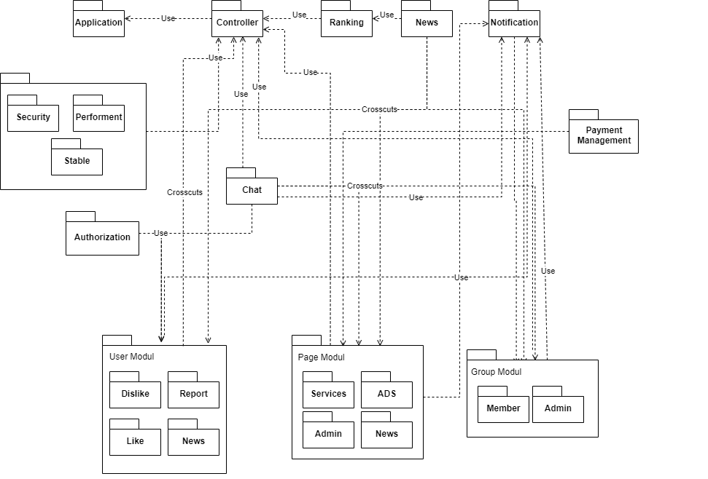
Module Diagram

Slide 14
Use Cases

Slide 15
Use Cases
Actor | Define
User | Anyone who want to travel or have traveled Travel Agent
System | System of Ahihi application
APIs Provider | Agent provide APIs like login API, Payment API,…

Slide 16
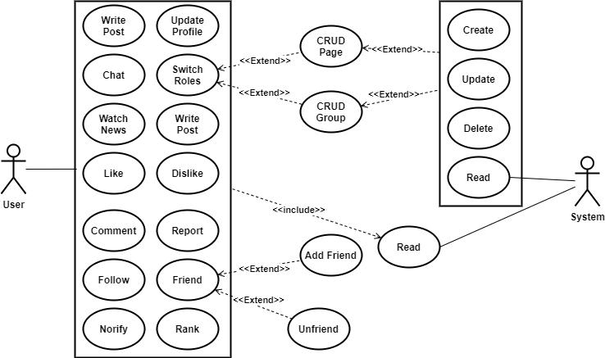
Use Cases (User role)

Slide 17
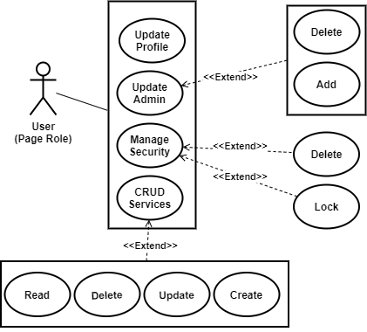
Use Cases (Page role)

Slide 18
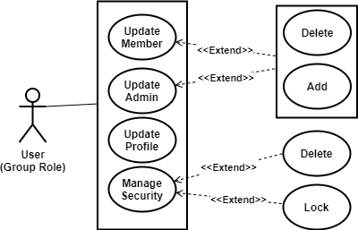
Use Cases (Group role)

Slide 19
SRS

Slide 20
Non-Functional Requirement
User Access and Security
Actor | User |  |  |  | Agency
Function | User Role | Page Role |  | Group Role
Login
Login | x^{(*)} |  |  |  | x^{(*)}
Login with APIs | x^{(*)}
Forgot Password | x^{(*)}
Register | x^{(*)}
Search | x^{(*)} |  | x^{(*)} | x^{(*)}
Write Post | x^{(*)} |  | x^{(*)} | x^{(*)}
Write Comment | x^{(*)} |  | x^{(*)} | x^{(*)}
Like | x^{(*)} |  | x^{(*)} | x^{(*)}
Dislike | x^{(*)} |  | x^{(*)} | x^{(*)}
Report | x^{(*)} |  | x^{(*)}
Chat | x^{(*)} |  | x^{(*)}
Book Services | x^{(*)}
Notify | x^{(*)} |  | x^{(*)} | x^{(*)} | x^{(*)}
News
Watch News | x^{(*)} |  | x^{(*)} | x^{(*)}
Block News | x^{(*)} |  | x^{(*)}
Friend
Add Friend | x^{(*)}
Delete Friend | x^{(*)}
View Friend | x^{(*)}
Actor | User |  |  | Agency
Function | User Role | Page Role | Group Role
Setting
Lock | x^{(*)} | x^{(*)} | x^{(*)}
Open | x^{(*)} | x^{(*)} | x^{(*)}
Add services |  | x^{(*)}
Delete services |  | x^{(*)}
Change Account | x^{(*)} | x^{(*)} | x^{(*)}
Help | x^{(*)} | x^{(*)} | x^{(*)}
Create Page | x^{(*)}
Create Group | x^{(*)}
Switch Group/Page | x^{(*)} | x^{(*)} | x^{(*)}
Add Admin |  | x^{(*)} | x^{(*)}
Add services |  | x^{(*)} | x^{(*)}
Delete Admin |  | x^{(*)}
Delete Page/Group | x^{(*)}
Edit | x^{(*)} | x^{(*)} | x^{(*)}
View Member | x^{(*)} | x^{(*)} | x^{(*)}
Delete Member |  | x^{(*)} | x^{(*)}
ADS
Register |  | x^{(*)} |  | x^{(*)}
View History |  | x^{(*)}
Cancel |  | x^{(*)}

Slide 21
Non-Functional Requirement
Performance Requirements
Cloud service: Google Cloud Platform
Location: Southeast Asia
Read-only Duration: 2 – 3 Hours
Read-only Timeframe: 3 AM
Availability: 24/7
Maintenance Window: Monthly
Number of users
Number of concurrent users: 4000
Number of business user: 15000
Architecture
Microservices

Slide 22
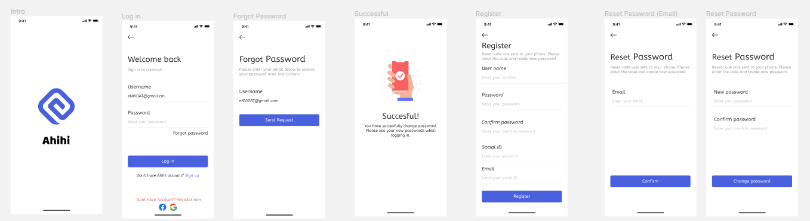
Non-Functional Requirement
Login - UI

Slide 23
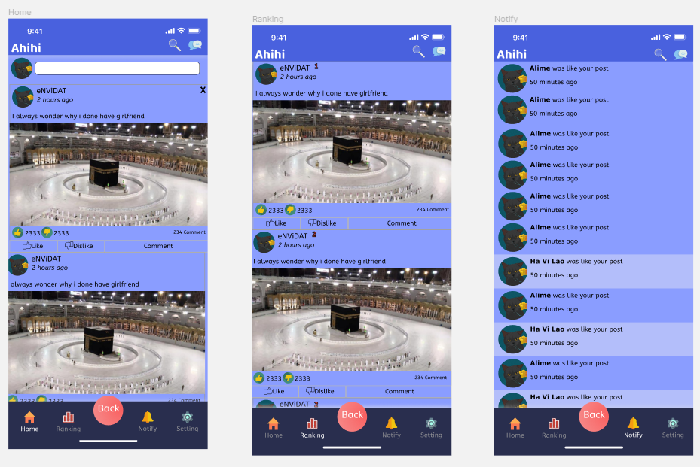
Non-Functional Requirement
Home - UI

Slide 24
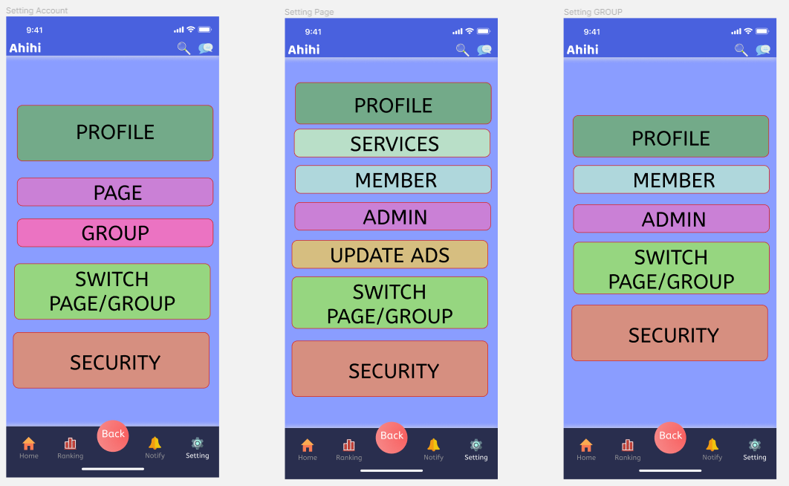
Non-Functional Requirement
Setting - UI

Slide 25
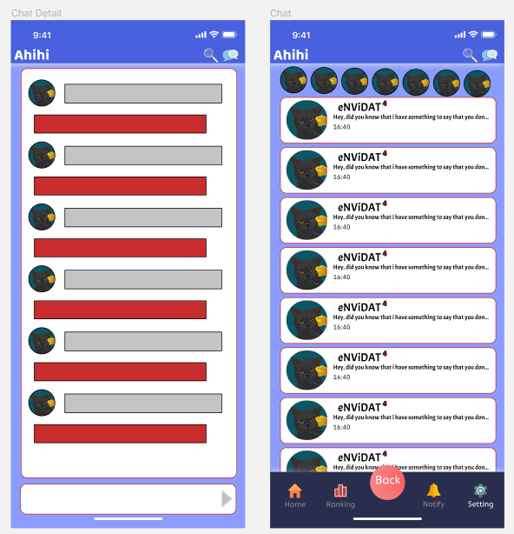
Non-Functional Requirement
Chat - UI

Slide 26
Thank you
FOR LISTENING

