Slide 1
Topics in Information Systems and Programming Languages
Yaniv Krol & Ron Rachev
Java and the Spring Boot framework

Slide 2

Java
Java is a high-level, statically-typed, class-based, object-oriented programming language
It is a general-purpose programming language intended to let programmers write once, run anywhere
Java is one of the most popular programming languages in use according to GitHub, particularly for client–server web applications, with a reported 9 million developers

Slide 3
Java - Pros
Java is easy to learn. Java was designed to be easy to use and is therefore easy to write, compile, debug, and learn than other programming languages.
Java is object-oriented. This allows you to create modular programs and reusable code.
Java is platform-independent. One of the most significant advantages of Java is its ability to move easily from one computer system to another. The ability to run the same program on many different systems is crucial to World Wide Web software, and Java succeeds at this by being platform-independent at both the source and binary levels.

Slide 4
Java - Cons
Java is slow and has a poor performance. Java is memory-consuming and significantly slower than native languages such as C or C++. This slow performance is due to the extra level of compilation and abstraction by the JVM and because the code must be interpreted to the machine level code . Moreover, sometimes the garbage collector leads in the poor performance of Java as it consumes more CPU time.
Verbose and Complex codes. Java codes are verbose, meaning that there are many words in it and there are many long and complex sentences that are difficult to read and understand. This can reduce the readability of the code. Java focuses on being more manageable but at the same time, it must compromise it with the overly complex codes and long explanations for each thing.

Slide 5

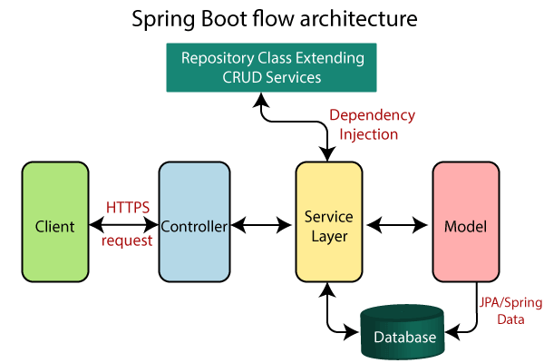
The Spring Framework (Spring)
The Spring Framework (Spring) is an open-source application framework that provides infrastructure support for developing Java applications.
Spring is a secure, low-cost and flexible framework. Spring improves coding efficiency and reduces overall application development time because it is lightweight -- efficient at utilizing system resources -- and has a lot of support.

Slide 6
The spring Framework - Pros
Open Source, Light weight, Flexible, Powerful Abstraction, Declarative Support, Highly Configurable, Lifecycle Management, Dependency Injection, Easy Testing, Secure, Supportive

Slide 7
The spring Framework - Cons
Complexity: Working with Spring is more complex. It requires a lot of expertise.
Parallel Mechanism: It provides multiple options to developers. These options create confusion to developers that must decide which feature to use and which not and wrong decisions may lead to significant delays.
High Learning Curve.

Slide 8
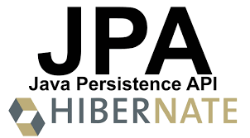
JPA (Java Persistence API) – SQL Database Abstraction
Separates SQL from other logic. This lets you work with a higher level of abstraction as you can navigate through related classes, “reduces” the amount of SQL you should write, simplifying those operations with some generic methods, and JPA makes the translation of the objects you send into SQL.
Integrates with Java Bean Validation.
Access is portable across databases by default. Useful when you have enterprise clients which can either be SQL Server, MySQL, DB2 or Oracle. So you can support more clients.

Slide 9
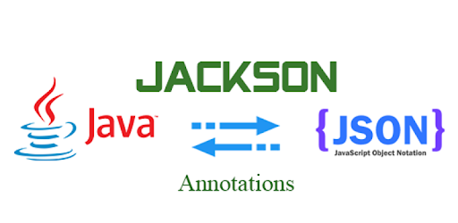
Serialization and Validation
Java provides an easy way to serialize and deserialize objects to and from JSON via Jackson .
We can easily validate object fields using Java’s validations library – built in or custom defined. This lets us have richer validation logic than what could be provided by database.
Both are used via annotations, which is decoupled from the business logic.

Slide 10
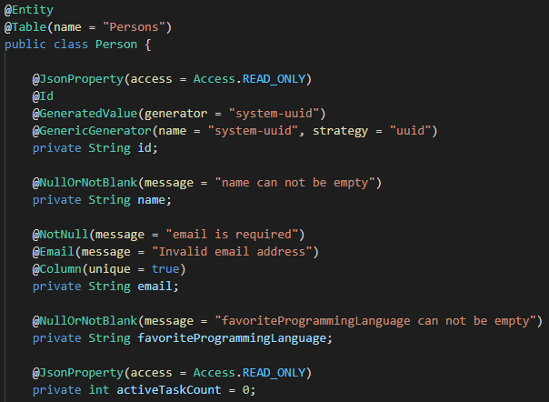
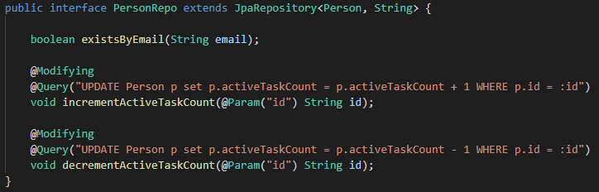
JPA, Validation and Serialization Example

Slide 11
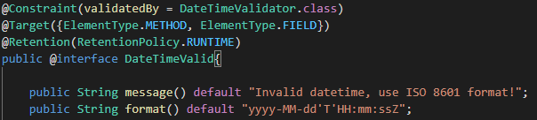
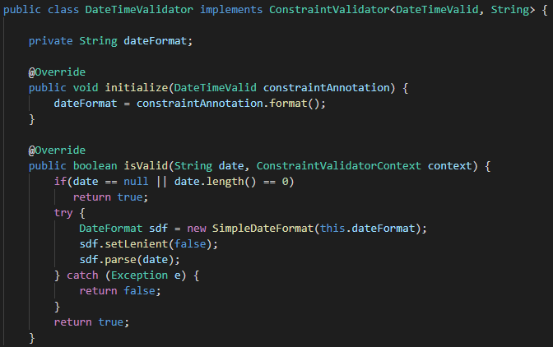
Custom Validator Example

Slide 12
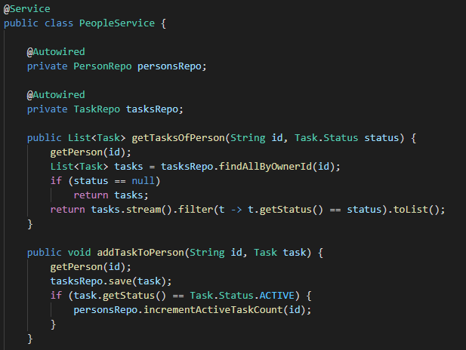
Service Layer Example

Slide 13
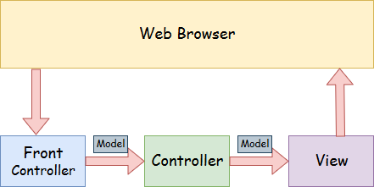
Spring MVC (Model View Controller)
Spring MVC is a Java framework which is used to build web applications. It follows the Model-View-Controller design pattern. It implements all the basic features of a core spring framework.
A Spring MVC provides an elegant solution to use MVC in spring framework by the help of DispatcherServlet. Here, DispatcherServlet is a class that receives the incoming request and maps it to the right resource such as controllers, models, and views.

Slide 14
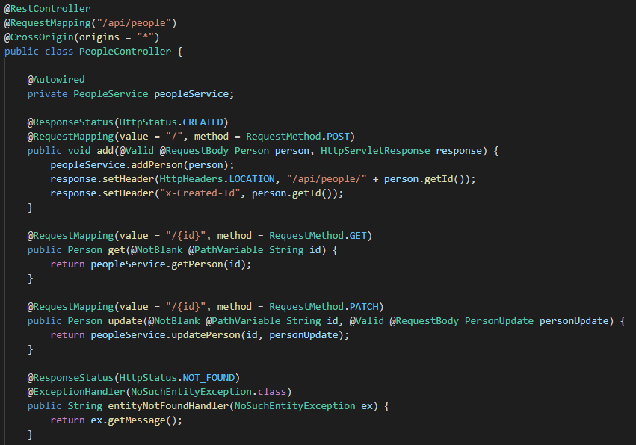
Controller Example

Slide 15
To summarize
Overall, Java, together with the Spring Framework provide a lot of tools that enable the programmer to focus on the application and business logic, and less on compatibility and infrastructure.
The downside however, just like with any Java application, is the robustness of the code, and the number of lines, compared to other languages, needed to perform simple tasks, although the Spring Framework makes this a bit easier.

