Slide 1
DYNAMIC FAST BUFFERS
eProsima
DYNAMIC FAST BUFFERS

Slide 2
Introduction
C++ library
Main objective: Serialize and deserialize data defined by user
Based on:
  Typecode description of data types
  Generation of Bytecode for a given Typecode
  Automatic serialization/deserialization of data
Three API's provided:
  Typecode creation. Creation of data structures (simple types, structures, arrays and sequences).
  Bytecode generation
  Data serialization/deserialization

Slide 3
Features
Simple Typecode structure (small amount of information)
No need for macros
Dynamic definition of data types
User doesn't need to know Bytecode structure
Dynamic data type independent serialization
Does not use C++ macros
Simple user API
Integrated with eProsima Fast Buffers
Doesn't use other external modules (except Fast Buffers library)

Slide 4
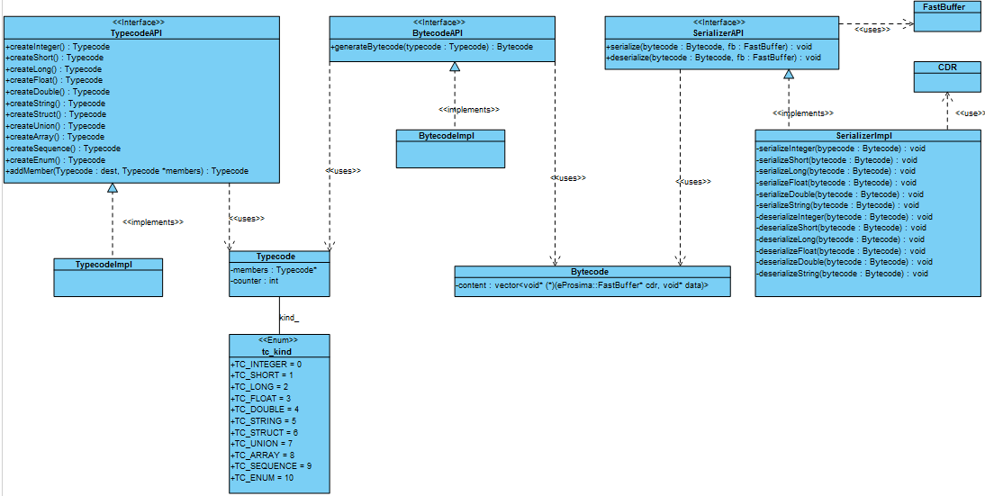
Conceptual Design

Slide 5
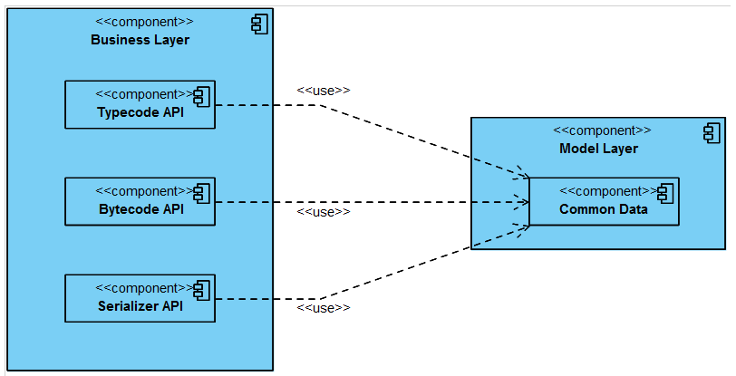
Detailed Design (I)
Architecture diagram

Slide 6
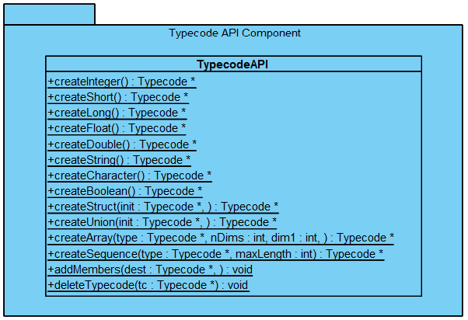
Detailed Design (II)
Typecode component diagram

Slide 7
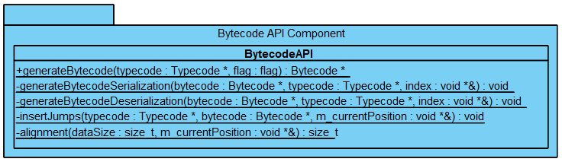
Detailed Design (III)
Bytecode component diagram

Slide 8
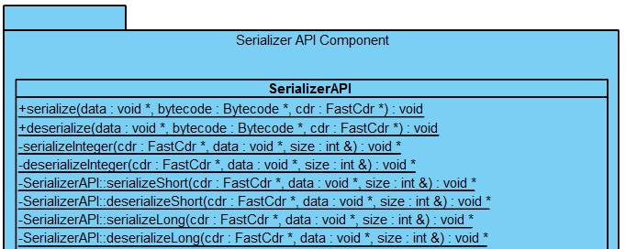
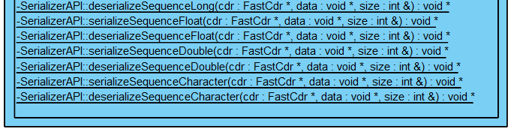
Detailed Design (II)
Serializer component diagram

Slide 9
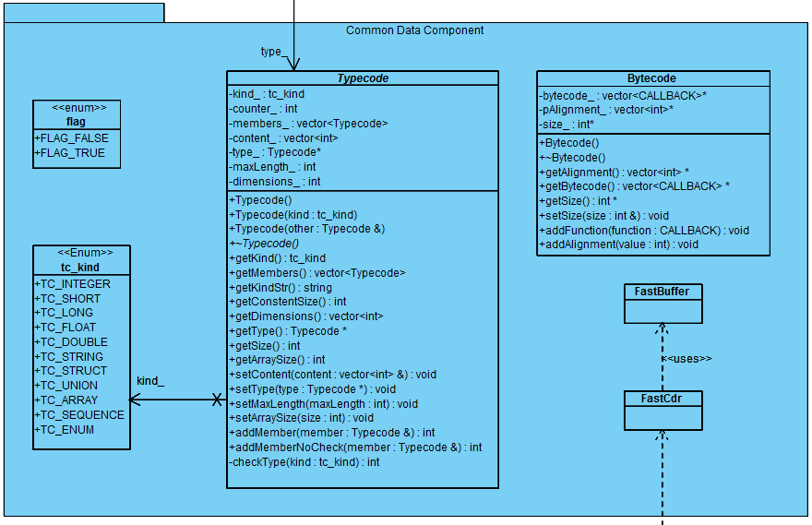
Detailed Design (V)
Common Data component diagram

Slide 10
User API (I)
Typecode API
static Typecode* createCharacter()
static Typecode* createShort()
static Typecode* createInteger()
static Typecode* createLong()
static Typecode* createFloat()
static Typecode* createDouble()
static Typecode* createString()
static Typecode* createBoolean()
static Typecode* createStruct(Typecode* init, …)
static Typecode* createArray(Typecode *type, int nDims, int dim1, …)
static Typecode* createSequence(Typecode *type, int maxLength)
static void addMembers(Typecode *dest, …)
static void deleteTypecode(Typecode *tc)

Slide 11
User API (II)
Bytecode API
Serializer API
static Bytecode* generateBytecode(Typecode *typecode, flag flag);
static void serialize(void *data, Bytecode *bytecode, eProsima::FastCdr *cdr)
static void deserialize(void *data, Bytecode *bytecode, eProsima::FastCdr *cdr)

Slide 12
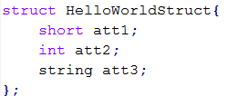


Overall Sample (I)
Previous data definition:
“FastCdr” object instantiation:

Slide 13
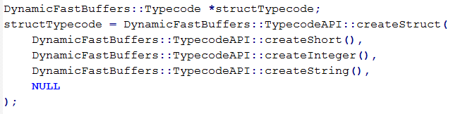
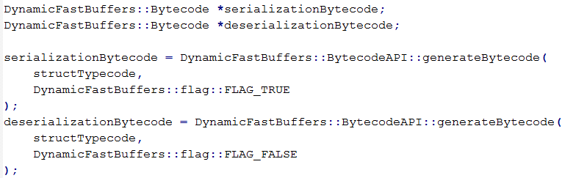
Overall Sample (II)
Typecode data description:
Bytecode generation:

Slide 14
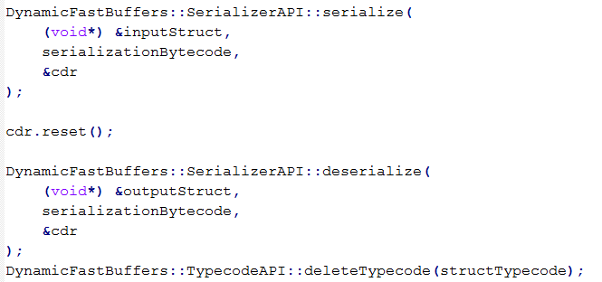
Overall Sample (III)
Data serialization and deserialization:

Slide 15
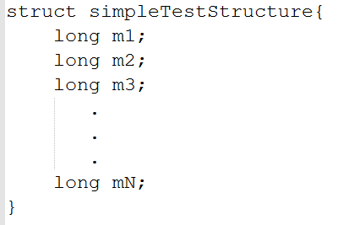
Performance Tests (II)
Simple structure:

Slide 16
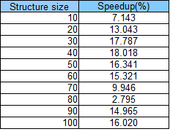
Performance Tests (III)

Slide 17
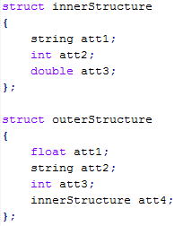
Performance Tests (III)
Complex structure:

Slide 18
Performance Tests (IV)

Slide 19
Thank you

