Slide 1
DYNAMIC FAST BUFFERS
eProsima
DYNAMIC FAST BUFFERS

Slide 2
Introduction
C++ library
Main objective: Serialize and deserialize data defined by user
Based on:
  Typecode description of data types
  Generation of Bytecode for a given Typecode
  Automatic serialization/deserialization of data
Three API's provided:
  Typecode creation. Creation of data structures (simple types, structures, arrays and sequences).
  Bytecode generation
  Data serialization/deserialization

Slide 3
Features
Simple Typecode structure (small amount of information)
No need for macros
Dynamic definition of data types
User doesn't need to know Bytecode structure
Dynamic data type independent serialization
Does not use C++ macros
Simple user API
Integrated with eProsima Fast Buffers
Doesn't use other external modules (except Fast Buffers library)

Slide 4
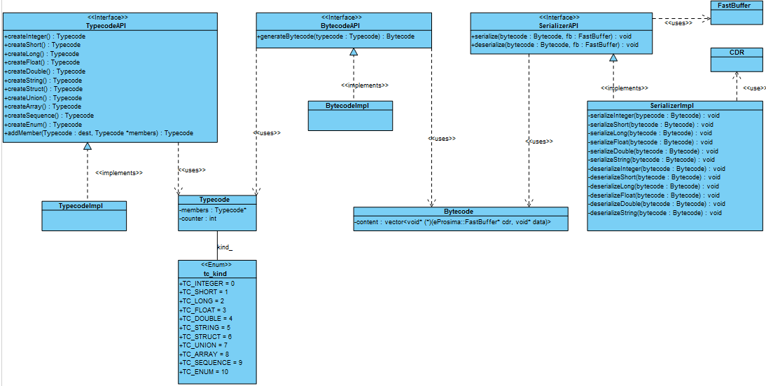
Conceptual Design

Slide 5
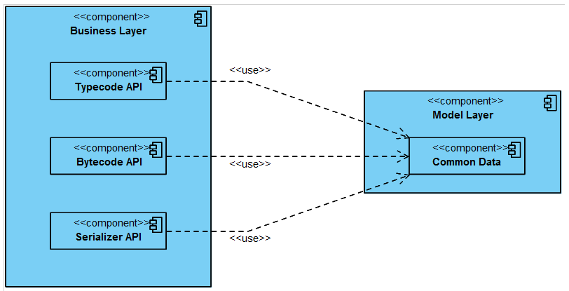
Detailed Design (I)
Architecture diagram

Slide 6
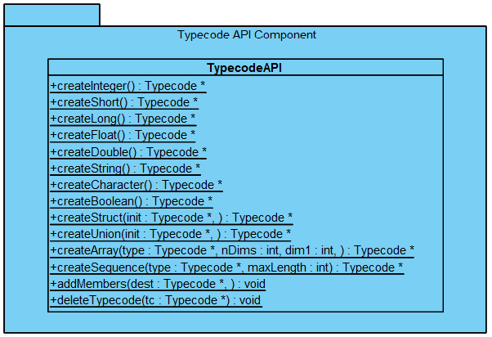
Detailed Design (II)
Typecode component diagram

Slide 7
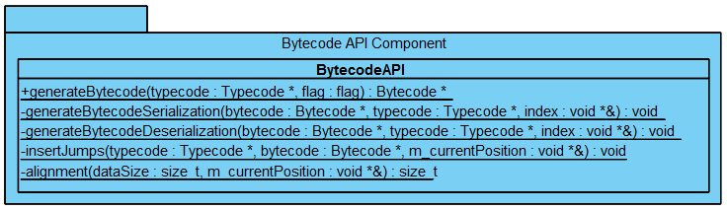
Detailed Design (III)
Bytecode component diagram

Slide 8
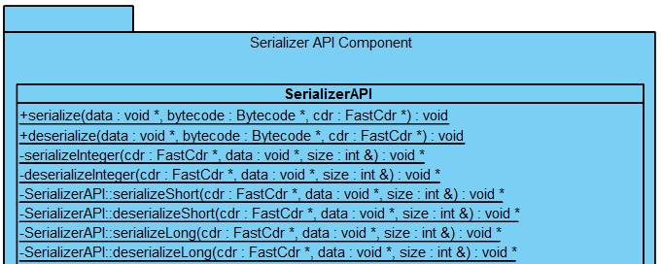
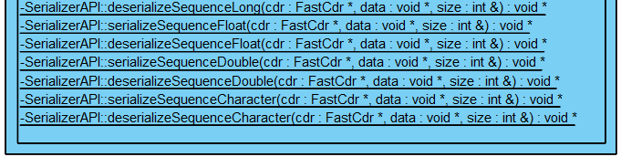
Detailed Design (II)
Serializer component diagram

Slide 9
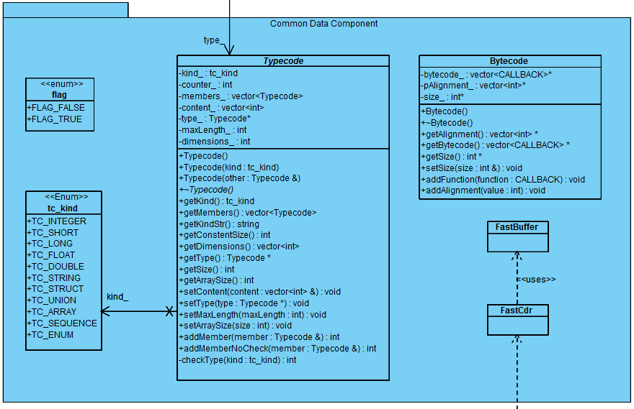
Detailed Design (V)
Common Data component diagram

Slide 10
User API (I)
Typecode API
static Typecode* createCharacter()
static Typecode* createShort()
static Typecode* createInteger()
static Typecode* createLong()
static Typecode* createFloat()
static Typecode* createDouble()
static Typecode* createString()
static Typecode* createBoolean()
static Typecode* createStruct(Typecode* init, …)
static Typecode* createArray(Typecode *type, int nDims, int dim1, …)
static Typecode* createSequence(Typecode *type, int maxLength)
static void addMembers(Typecode *dest, …)
static void deleteTypecode(Typecode *tc)

Slide 11
User API (II)
Bytecode API
Serializer API
static Bytecode* generateBytecode(Typecode *typecode, flag flag);
static void serialize(void *data, Bytecode *bytecode, eProsima::FastCdr *cdr)
static void deserialize(void *data, Bytecode *bytecode, eProsima::FastCdr *cdr)

Slide 12
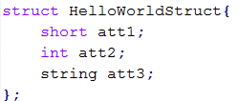


Overall Sample (I)
Previous data definition:
“FastCdr” object instantiation:

Slide 13
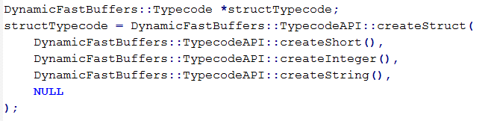
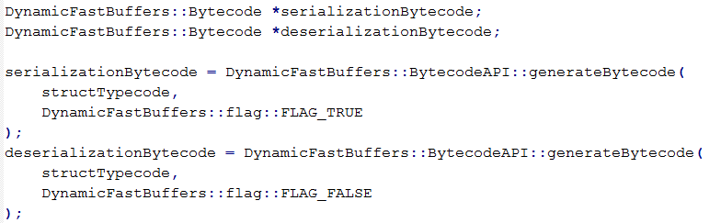
Overall Sample (II)
Typecode data description:
Bytecode generation:

Slide 14
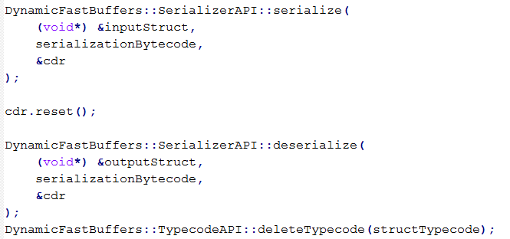
Overall Sample (III)
Data serialization and deserialization:

Slide 15
Serialization Technologies (I)
DDS: Common Data Representation (CDR)
  Represents structured or primitive data types
  Used in CORBA distributed objects
  Mapping from data types defined in OMG IDL
  Features:
    Variable byte ordering: Supports both little-endian and big-endian
    Aligned primitive types: Primitive OMG IDL data typed are aligned on their natural boundaries
    Complete OMG IDL Mapping: Describes representations for all OMG IDL data types

Slide 16
Serialization Technologies (II)
WS: XML (MSDN)
  Underlying transport mechanism used in the XML Web Services Architecture
  Converts public fields and properties of an object (or the parameters and return values of a method) into an XML stream
  XML serialization results in strongly typed classes
  Open standard
  XML serialization can also be used to serialize objects into XML streams that conform to the SOAP specification

Slide 17
Serialization Technologies (III)
WS: MTOM
  Method to efficiently send binary data through Web Services
  Usually used with XOP (XML-binary Optimized Packaging)
  Implementation dependent (no standard way to indicate whether data is in canonical lexical representation)
  Features:
    Abstract & HTTP SOAP Transmission Optimization
    Optimized MIME Multipart Serialization

Slide 18
Serialization Technologies (IV)
Google Protocol Buffers (I)
  Open sourced by Google
  Flexible, efficient and automated mechanism for serializing structured data
  Starts from data definition into a “.proto” file
  Multiple language support
  Features:
    Simpler & faster than XML
    Small data allocation
    Supports Binary serialization
    Automatically-generated serialization and deserialization code

Slide 19
Serialization Technologies (IV)
Google Protocol Buffers (II)
  Language support:
    C++
    Java
    Phyton

Slide 20
Serialization Technologies (V)
Apache Thrift (I)
  Open sourced by Facebook
  IDL language used to define and create services
  Multiple language support
  Complete stack for creating clients and servers
  Serialization through “protocols”
  Features:
    Cross-language serialization
    No XML configuration files
    Supports Binary & JSON serialization

Slide 21
Serialization Technologies (VI)
Apache Thrift (II)
  Language support:
    C++
    Java
    Phyton
    PHP
    Ruby
    Perl
    Erlang
    Haskell
    C#
    Cocoa
    SmallTalk
    OCaml

Slide 22
Performance Measurements
eProsima Dynamic Fast Buffers
  VS Google Protocol Buffers
    Simple structure
    Simple structure (different data types)
    Complex structure
  VS Boost XML Serializer
    Simple structure (different data types)
    Complex structure
  VS Apache Thrift
    Simple structure (different data types)
    Complex structure

Slide 23
Performance Measurements
eProsima Dynamic Fast Buffers
  VS Google Protocol Buffers
    Simple structure
    Simple structure (different data types)
    Complex structure
  VS Boost XML Serializer
    Simple structure (different data types)
    Complex structure
  VS Apache Thrift
    Simple structure (different data types)
    Complex structure

Slide 24
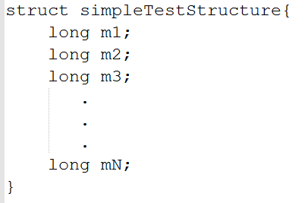
Performance Tests
DFB vs Protobuf (I)
Simple structure:

Slide 25
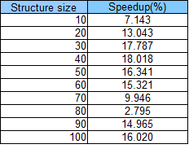
Performance Tests
DFB vs Protobuf (II)

Slide 26
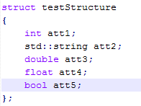
Performance Tests
DFB vs Protobuf (III)
Simple structure (different data types):

Slide 27
Performance Tests
DFB vs Protobuf (IV)

Slide 28
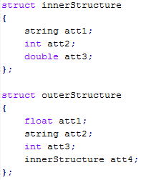
Performance Tests
DFB vs Protobuf (V)
Complex structure:

Slide 29
Performance Tests
DFB vs Protobuf (VI)

Slide 30
Performance Measurements
eProsima Dynamic Fast Buffers
  VS Google Protocol Buffers
    Simple structure
    Simple structure (different data types)
    Complex structure
  VS Boost XML Serializer
    Simple structure (different data types)
    Complex structure
  VS Apache Thrift
    Simple structure (different data types)
    Complex structure

Slide 31
Performance Tests
DFB vs Boost (I)
Simple structure (different data types):

Slide 32
Performance Tests
DFB vs Boost (II)

Slide 33
Performance Tests
DFB vs Boost (III)
Complex structure:

Slide 34
Performance Tests
DFB vs Boost (IV)

Slide 35
Performance Measurements
eProsima Dynamic Fast Buffers
  VS Google Protocol Buffers
    Simple structure
    Simple structure (different data types)
    Complex structure
  VS Boost XML Serializer
    Simple structure (different data types)
    Complex structure
  VS Apache Thrift
    Simple structure (different data types)
    Complex structure

Slide 36
Performance Tests
DFB vs Apache Thrift (I)
Simple structure (different data types):

Slide 37
Performance Tests
DFB vs Apache Thrift (II)

Slide 38
Performance Tests
DFB vs Apache Thrift (III)
Complex structure:

Slide 39
Performance Tests
DFB vs Apache Thrift (IV)

Slide 40
Thank you

