Slide 1
DYNAMIC FAST BUFFERS
eProsima
DYNAMIC FAST BUFFERS

Slide 2
Contents
Introduction
Features
Conceptual Design
Detailed Design
User API
Overall Sample
Serialization Technologies
Performance Measurements

Slide 3
Contents
  Introduction
Features
Conceptual Design
Detailed Design
User API
Overall Sample
Serialization Technologies
Performance Measurements

Slide 4
Introduction
C++ library
Main objective: Serialize and deserialize data defined by user
Based on:
  Typecode description of data types
  Generation of Bytecode for a given Typecode
  Automatic serialization/deserialization of data
Three API's provided:
  Typecode creation. Creation of data structures (simple types, structures, arrays and sequences).
  Bytecode generation
  Data serialization/deserialization

Slide 5
Contents
Introduction
  Features
Conceptual Design
Detailed Design
User API
Overall Sample
Serialization Technologies
Performance Measurements

Slide 6
Features
Simple Typecode structure (small amount of information)
Dynamic definition of data types
User doesn't need to know Bytecode structure
Dynamic data type independent serialization
Does not use C++ macros
Simple user API
Integrated with eProsima Fast Buffers
Doesn't use other external modules (except Fast Buffers library)

Slide 7
Contents
Introduction
Features
  Conceptual Design
Detailed Design
User API
Overall Sample
Serialization Technologies
Performance Measurements

Slide 8
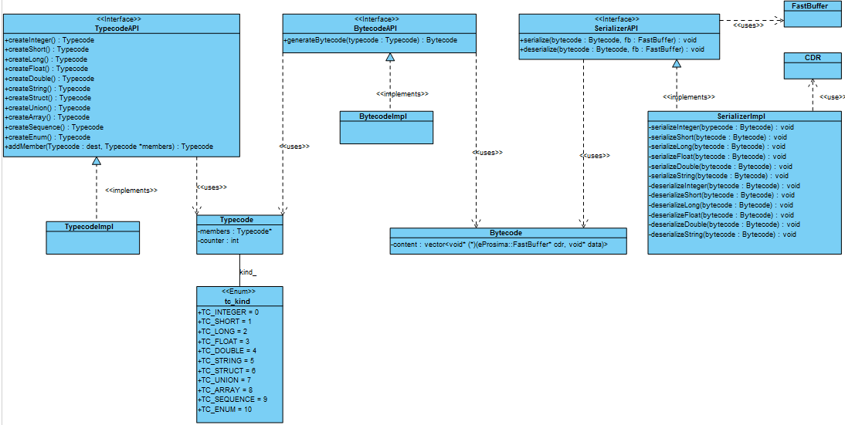
Conceptual Design

Slide 9
Contents
Introduction
Features
Conceptual Design
  Detailed Design
User API
Overall Sample
Serialization Technologies
Performance Measurements

Slide 10
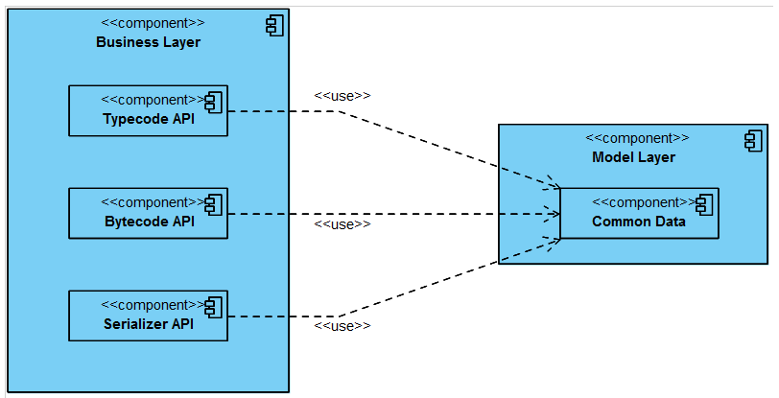
Detailed Design (I)
Architecture diagram

Slide 11
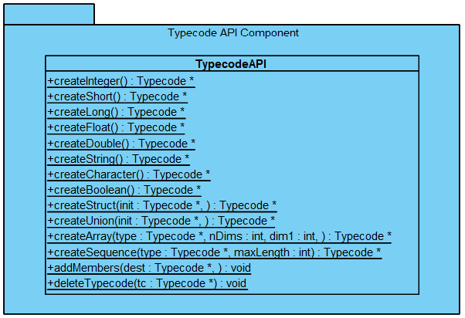
Detailed Design (II)
Typecode component diagram

Slide 12
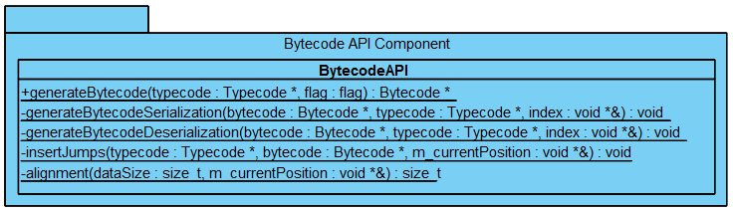
Detailed Design (III)
Bytecode component diagram

Slide 13
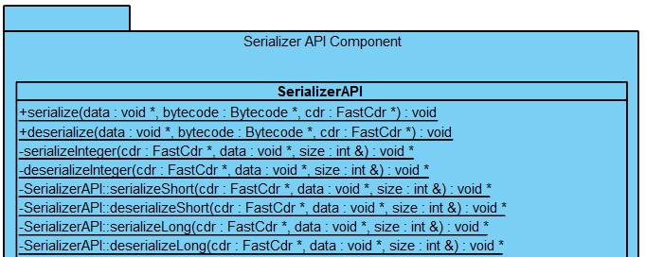
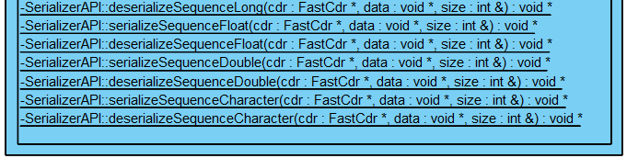
Detailed Design (II)
Serializer component diagram

Slide 14
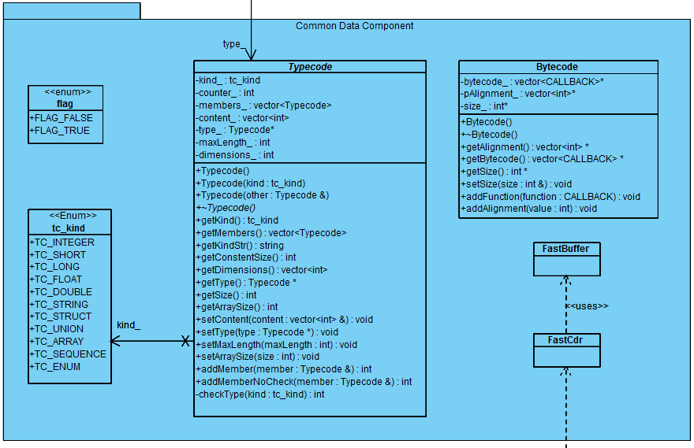
Detailed Design (V)
Common Data component diagram

Slide 15
Contents
Introduction
Features
Conceptual Design
Detailed Design
  User API
Overall Sample
Serialization Technologies
Performance Measurements

Slide 16
User API (I)
Typecode API
static Typecode* createCharacter()
static Typecode* createShort()
static Typecode* createInteger()
static Typecode* createLong()
static Typecode* createFloat()
static Typecode* createDouble()
static Typecode* createString()
static Typecode* createBoolean()
static Typecode* createStruct(Typecode* init, …)
static Typecode* createArray(Typecode *type, int nDims, int dim1, …)
static Typecode* createSequence(Typecode *type, int maxLength)
static void addMembers(Typecode *dest, …)
static void deleteTypecode(Typecode *tc)

Slide 17
User API (II)
Bytecode API
Serializer API
static Bytecode* generateBytecode(Typecode *typecode, flag flag);
static void serialize(void *data, Bytecode *bytecode, eProsima::FastCdr *cdr)
static void deserialize(void *data, Bytecode *bytecode, eProsima::FastCdr *cdr)

Slide 18
Contents
Introduction
Features
Conceptual Design
Detailed Design
User API
  Overall Sample
Serialization Technologies
Performance Measurements

Slide 19
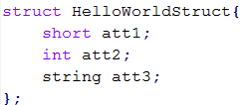


Overall Sample (I)
Previous data definition:
“FastCdr” object instantiation:

Slide 20
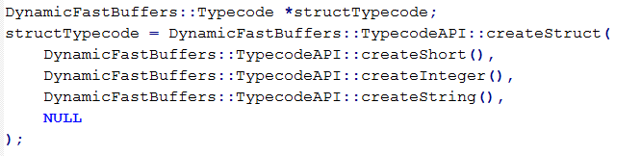
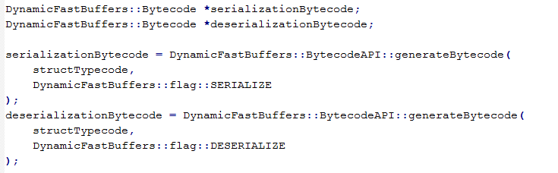
Overall Sample (II)
Typecode data description:
Bytecode generation:

Slide 21
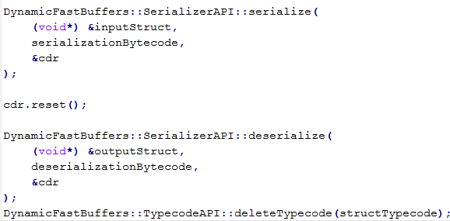
Overall Sample (III)
Data serialization and deserialization:

Slide 22
Contents
Introduction
Features
Conceptual Design
Detailed Design
User API
Overall Sample
  Serialization Technologies
Performance Measurements

Slide 23
Serialization Technologies (I)
DDS: Common Data Representation (CDR)
  Represents structured or primitive data types
  Used in CORBA distributed objects
  Mapping from data types defined in OMG IDL
  Features:
    Variable byte ordering: Supports both little-endian and big-endian
    Aligned primitive types: Primitive OMG IDL data typed are aligned on their natural boundaries
    Complete OMG IDL Mapping: Describes representations for all OMG IDL data types

Slide 24
Serialization Technologies (II)
WS: XML
  Underlying transport mechanism used in the XML Web Services Architecture
  Converts public fields and properties of an object (or the parameters and return values of a method) into an XML stream
  XML serialization results in strongly typed classes
  Open standard
  XML serialization can also be used to serialize objects into XML streams that conform to the SOAP specification

Slide 25
Serialization Technologies (III)
WS: MTOM
  Method to efficiently send binary data through Web Services
  Usually used with XOP (XML-binary Optimized Packaging)
  Implementation dependent (no standard way to indicate whether data is in canonical lexical representation)
  Features:
    Abstract & HTTP SOAP Transmission Optimization
    Optimized MIME Multipart Serialization

Slide 26
Serialization Technologies (IV)
Google Protocol Buffers (I)
  Open sourced by Google
  Flexible, efficient and automated mechanism for serializing structured data
  Starts from data definition into a “.proto” file
  Multiple language support
  Features:
    Simpler & faster than XML
    Small data allocation
    Supports Binary serialization
    Automatically-generated serialization and deserialization code

Slide 27
Serialization Technologies (IV)
Google Protocol Buffers (II)
  Language support:
    C++
    Java
    Phyton

Slide 28
Serialization Technologies (V)
Apache Thrift (I)
  Open sourced by Facebook
  IDL language used to define and create services
  Multiple language support
  Complete stack for creating clients and servers
  Serialization through “protocols”
  Features:
    Cross-language serialization
    No XML configuration files
    Supports Binary & JSON serialization

Slide 29
Serialization Technologies (VI)
Apache Thrift (II)
  Language support:
    C++
    Java
    Phyton
    PHP
    Ruby
    Perl
    Erlang
    Haskell
    C#
    Cocoa
    SmallTalk
    OCaml

Slide 30
Serialization Technologies (VII)
Binary XML: EXI
  Efficient XML Interchange
  Adopted as a recommendation by W3C
  Chosen over Fast Infoset after an evaluation including both
  Uses more constraints from XML schema (schema-informed)
  Disadvantage: Requires a schema for the document and a copy for the decoder
  Performance information: W3C

Slide 31
Serialization Technologies (VIII)
Binary XML: Fast Infoset
  Binary encoding format for XML Information Set (XML Infoset)
  Sort of a gzip XML
  Optimize both, document size and processing performance
  Not information lost
  Formal specification uses ASN.1 formalism
  Standardized by ITU-T (ITU-T Rec. X.891) and ISO (ISO/IEC 28424-1)
  Applications
    Portable devices, persisting large volumes of data, sending XML throughout the internet

Slide 32
Contents
Introduction
Features
Conceptual Design
Detailed Design
User API
Overall Sample
Serialization Technologies
  Performance Measurements

Slide 33
Performance Measurements
Measurements done by serializing and deserializing different data structures performing 10⁶ iterations.
Performance against:
  eProsima Fast CDR (Binary Common Data Representation)
  Google Protocol Buffers (Binary format in memory buffer)
  Apache Thrift (Binary data in memory buffer)
  Boost XML Serializer (XML)
  GSOAP XML Serializer (XML)
  Poco C++ Fast Infoset (Binary XML)
Performance with SESAR provided data

Slide 34
Performance Measurements
eProsima Dynamic Fast Buffers VS ...
  eProsima Fast CDR (Binary Common Data Representation)
  Google Protocol Buffers
  Apache Thrift
  Boost XML Serializer
  GSOAP XML Serializer
  Poco C++ Fast Infoset

Slide 35
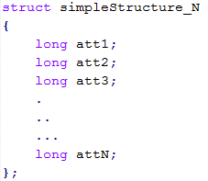
Performance Tests
DFB vs eProsima Fast CDR (I)
Simple structure:

Slide 36
Performance Tests
DFB vs eProsima Fast CDR (II)

Slide 37
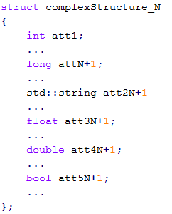
Performance Tests
DFB vs eProsima Fast CDR (III)
Complex structure:

Slide 38
Performance Tests
DFB vs eProsima Fast CDR (IV)

Slide 39
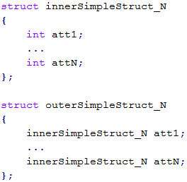
Performance Tests
DFB vs eProsima Fast CDR (V)
Simple nested structure:

Slide 40
Performance Tests
DFB vs eProsima Fast CDR (VI)

Slide 41
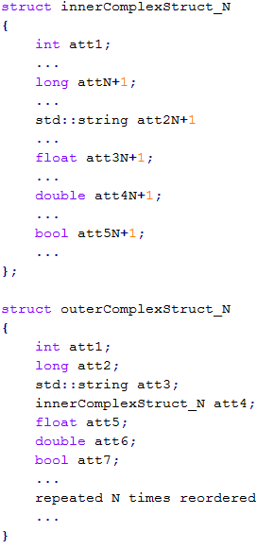
Performance Tests
DFB vs eProsima Fast CDR (VII)
Complex nested structure:

Slide 42
Performance Tests
DFB vs eProsima Fast CDR (VIII)

Slide 43
Performance Tests
DFB vs eProsima Fast CDR (IX)
Results analysis:
  Binary Serialization
  In memory buffer (with dynamic reallocation)
  Faster than DFB (DFB uses Fast CDR)
  Same temporal curves in graphs, but more exaggerated in DFB
    Because of the logic used for moving through structures

Slide 44
Performance Measurements
eProsima Dynamic Fast Buffers VS ...
  eProsima Fast CDR
  Google Protocol Buffers (Binary format)
  Apache Thrift
  Boost XML Serializer
  GSOAP XML Serializer
  Poco C++ Fast Infoset

Slide 45
Performance Tests
DFB vs Protobuf (I)
Simple structure:

Slide 46
Performance Tests
DFB vs Protobuf (II)

Slide 47
Performance Tests
DFB vs Protobuf (III)

Slide 48
Performance Tests
DFB vs Protobuf (IV)
Complex structure:

Slide 49
Performance Tests
DFB vs Protobuf (V)

Slide 50
Performance Tests
DFB vs Protobuf (VI)

Slide 51
Performance Tests
DFB vs Protobuf (VII)
Simple nested structure:

Slide 52
Performance Tests
DFB vs Protobuf (VIII)

Slide 53
Performance Tests
DFB vs Protobuf (IX)

Slide 54
Performance Tests
DFB vs Protobuf (X)
Complex nested structure:

Slide 55
Performance Tests
DFB vs Protobuf (XI)

Slide 56
Performance Tests
DFB vs Protobuf (XII)

Slide 57
Performance Tests
DFB vs Protobuf (XIII)
Results analysis:
  Binary Serialization
  Focused on performance and data compression
  Generates code from “.proto” file
  Good performance with slow simple data structures (uses Varint)
  With nested structures, performance grows as the structure size does
  Almost as good as DFB with big nested structures
    Google protobuf reads data from classes
    DFB decreases performance when moving through memory doing address jumps
      Protobuf strategy is more efficient, but cannot be performed dynamically

Slide 58
Performance Measurements
eProsima Dynamic Fast Buffers VS ...
  eProsima Fast CDR
  Google Protocol Buffers
  Apache Thrift (Binary data in memory buffer)
  Boost XML Serializer
  GSOAP XML Serializer
  Poco C++ Fast Infoset

Slide 59
Performance Tests
DFB vs Apache Thrift (I)
Simple structure:

Slide 60
Performance Tests
DFB vs Apache Thrift (II)

Slide 61
Performance Tests
DFB vs Apache Thrift (III)

Slide 62
Performance Tests
DFB vs Apache Thrift (IV)
Complex structure:

Slide 63
Performance Tests
DFB vs Apache Thrift (V)

Slide 64
Performance Tests
DFB vs Apache Thrift (VI)

Slide 65
Performance Tests
DFB vs Apache Thrift (VII)
Simple nested structure:

Slide 66
Performance Tests
DFB vs Apache Thrift (VIII)

Slide 67
Performance Tests
DFB vs Apache Thrift (IX)

Slide 68
Performance Tests
DFB vs Apache Thrift (X)
Complex nested structure:

Slide 69
Performance Tests
DFB vs Apache Thrift (XI)

Slide 70
Performance Tests
DFB vs Apache Thrift (XII)

Slide 71
Performance Tests
DFB vs Apache Thrift (XII)
Results analysis:
  Binary Serialization (same strategy than DFB and Protobuf)
  Serialization is way faster than deserialization
  Focused on data compression and sending through network
  Bad compression → Performance in serialization and deserialization decreases a lot
  Faster serializing small data and sending it through network
    Works over TCP
    Provides server and client classes already coded
  Originally thought as a fast serialization mechanism for small amounts of data (not doing it repeatedly) over the internet (Facebook)

Slide 72
Performance Measurements
eProsima Dynamic Fast Buffers VS ...
  eProsima Fast CDR
  Google Protocol Buffers
  Apache Thrift
  Boost XML Serializer (XML)
  GSOAP XML Serializer
  Poco C++ Fast Infoset

Slide 73
Performance Tests
DFB vs Boost XML Serializer (I)
Simple structure:

Slide 74
Performance Tests
DFB vs Boost XML Serializer (II)

Slide 75
Performance Tests
DFB vs Boost XML Serializer (III)

Slide 76
Performance Tests
DFB vs Boost XML Serializer (IV)
Complex structure:

Slide 77
Performance Tests
DFB vs Boost XML Serializer (V)

Slide 78
Performance Tests
DFB vs Boost XML Serializer (VI)

Slide 79
Performance Tests
DFB vs Boost XML Serializer (VII)
Simple nested structure:

Slide 80
Performance Tests
DFB vs Boost XML Serializer (VIII)

Slide 81
Performance Tests
DFB vs Boost XML Serializer (IX)

Slide 82
Performance Tests
DFB vs Boost XML Serializer (X)
Complex nested structure:

Slide 83
Performance Tests
DFB vs Boost XML Serializer (XI)

Slide 84
Performance Tests
DFB vs Boost XML Serializer (XII)

Slide 85
Performance Tests
DFB vs Boost XML Serializer (XIII)
Results analysis:
  Poor memory exploitation
  Huge data size (XML)
  Serializes directly into memory buffer (text mapping in memory is expensive in terms of CPU time)
  Parses all data to a intermediate structure which is then transformed to XML in each serialization call
  Wastes time in data conversion and serialization

Slide 86
Performance Measurements
eProsima Dynamic Fast Buffers VS ...
  eProsima Fast CDR
  Google Protocol Buffers
  Apache Thrift
  Boost XML Serializer
  GSOAP XML Serializer (XML)
  Poco C++ Fast Infoset

Slide 87
Performance Tests
DFB vs GSOAP XML Serializer (I)
Simple structure:

Slide 88
Performance Tests
DFB vs GSOAP XML Serializer (II)

Slide 89
Performance Tests
DFB vs GSOAP XML Serializer (III)

Slide 90
Performance Tests
DFB vs GSOAP XML Serializer (IV)
Complex structure:

Slide 91
Performance Tests
DFB vs GSOAP XML Serializer (V)

Slide 92
Performance Tests
DFB vs GSOAP XML Serializer (VI)

Slide 93
Performance Tests
DFB vs GSOAP XML Serializer (VII)
Simple nested structure:

Slide 94
Performance Tests
DFB vs GSOAP XML Serializer (VII)

Slide 95
Performance Tests
DFB vs GSOAP XML Serializer (IX)

Slide 96
Performance Tests
DFB vs GSOAP XML Serializer (X)
Complex nested structure:

Slide 97
Performance Tests
DFB vs GSOAP XML Serializer (XI)

Slide 98
Performance Tests
DFB vs GSOAP XML Serializer (XII)

Slide 99
Performance Tests
DFB vs GSOAP XML Serializer (XIII)
Results analysis:
  Shares characteristics with Boost (poor memory exploitation, huge data size, etc.)
  Between 5 and 10 times faster than Boost
    Serialized data size
      Bigger for small structures
      Smaller for big and complex structures (optimized)
    Parses data from XML into classes and generates functions for converting it
    Converts to XML Schema Definition Language (XSD) code before serializing data
  Wastes time only in data serialization (not in data conversion)

Slide 100
Performance Measurements
eProsima Dynamic Fast Buffers VS ...
  eProsima Fast CDR
  Google Protocol Buffers
  Apache Thrift
  Boost XML Serializer
  GSOAP XML Serializer
  Poco C++ Fast Infoset (Binary XML)

Slide 101
Performance Tests
DFB vs Poco C++ Fast Infoset (I)
Simple structure:

Slide 102
Performance Tests
DFB vs Poco C++ Fast Infoset (II)

Slide 103
Performance Tests
DFB vs Poco C++ Fast Infoset (III)

Slide 104
Performance Tests
DFB vs Poco C++ Fast Infoset (IV)
Complex structure:

Slide 105
Performance Tests
DFB vs Poco C++ Fast Infoset (V)

Slide 106
Performance Tests
DFB vs Poco C++ Fast Infoset (VI)

Slide 107
Performance Tests
DFB vs Poco C++ Fast Infoset (VII)
Simple nested structure:

Slide 108
Performance Tests
DFB vs Poco C++ Fast Infoset (VII)

Slide 109
Performance Tests
DFB vs Poco C++ Fast Infoset (IX)

Slide 110
Performance Tests
DFB vs Poco C++ Fast Infoset (X)
Complex nested structure:

Slide 111
Performance Tests
DFB vs Poco C++ Fast Infoset (XI)

Slide 112
Performance Tests
DFB vs Poco C++ Fast Infoset (XII)

Slide 113
Performance Tests
DFB vs Poco C++ Fast Infoset (VII)
Results analysis:
  Binary XML serialization
  Does not permit to separate data conversion (from XML to Fast Infoset and vice versa) from serialization
  Very poor performance serializing and deserializing because of data conversion
  Serialization is slower than deserialization
  Wastes time in data conversion and serialization
    It will have a better performance if these steps could be done separately

Slide 114
Performance Tests
Serialized data size comparison (I)
Simple structure:

Slide 115
Performance Tests
Serialized data size comparison (II)
Complex structure:

Slide 116
Performance Tests
Serialized data size comparison (III)
Simple nested structure:

Slide 117
Performance Tests
Serialized data size comparison (IV)
Complex nested structure:

Slide 118
Performance Tests
All frameworks (I)
Simple structure:

Slide 119
Performance Tests
All frameworks (II)

Slide 120
Performance Tests
All frameworks (III)
Complex structure:

Slide 121
Performance Tests
All frameworks (IV)

Slide 122
Performance Tests
All frameworks (V)
Simple nested structure:

Slide 123
Performance Tests
All frameworks (VI)

Slide 124
Performance Tests
All frameworks (VII)
Complex nested structure:

Slide 125
Performance Tests
All frameworks (VIII)

Slide 126
Performance Measurements
Measurements done by serializing and deserializing different data structures performing 10⁶ iterations.
Performance against:
  eProsima Fast CDR (Binary Common Data Representation)
  Google Protocol Buffers (Binary format in memory buffer)
  Apache Thrift (Binary data in memory buffer)
  Boost XML Serializer (XML)
  GSOAP XML Serializer (XML)
  Poco C++ Fast Infoset (Binary XML)
  Performance with SESAR provided data

Slide 127
Performance Tests
SESAR Data Structure (I)
Performance tests
  Performance in no XML serializers calculated from previously obtained results (they should be proportional)
  XML and no XML results will be shown in different tables because of the timing magnitude
  No XML serializers must result in better performance
  XML serializers
    Lower performance
    High serialized data size (except for Fast Infoset)
    GSOAP should beat Fast Infoset in execution time, but not in serialized data size
    Performance decrease is not lineal (but exponential)

Slide 128
Performance Tests
SESAR Data Structure (II)
Single Trajectory Point
Similar sized nested structure

Slide 129
Performance Tests
SESAR Data Structure (III)
Multiple Trajectory points

Slide 130
Performance Tests
SESAR Data Structure (IV)
Serialized data size comparison

Slide 131
Performance Tests
SESAR Data Structure (V)
Results analysis:
  Serialized size differences between similar structure sizes:
    Many boolean attributes inside structure will require:
      DFB: 8 bool → 8 Bytes
      GSOAP: 8 bool → 8*strlen(“true” | “false”) + name tags
    More nested levels means more tags
  Results with many Trajectory Points
    Execution time in proportion with simpler structures
    Time increase is not lineal
    Improvement in Dynamic Fast Buffers because of array serialization vs. simple data serialization

Slide 132
Thank you

